Slide 1
Management
Pharmacological Intervention
Antibiotics should be administered to those affected and to all family members.
A single antibiotic course is not always effective in eliminating infection in an individual and communities may need to receive annual treatment to suppress infection.
A single dose of azithromycin (20 mg/kg up to 1 g) is the treatment of choice.
Erythromycin 500 mg twice daily for 14 days
Doxycycline 100 mg twice daily for 10 days (tetracyclines are relatively contraindicated in pregnancy/breastfeeding and in children under 12).
Topical 1% tetracycline ointment is less effective than oral treatment.
HORIZONTAL INTEGRATION

Slide 2
Management
Preventive Medicine
Facial cleanliness is a critical preventative measure.
Environmental improvement, such as access to adequate water and sanitation, as well as control of flies, is important.
Surgery is aimed at relieving entropion and trichiasis and maintaining complete lid closure, principally with bilamellar tarsal rotation.
Horizontal integration

Slide 3
Neonatal conjunctivitis-(Core Subject)
Neonatal conjunctivitis (ophthalmia neonatorum) is defined as conjunctival inflammation developing within the first month of life.
C. trachomatis
N. gonorrhoeae
Herpes
Chemical

Slide 4
Diagnosis
Timing of onset
  Chemical irritation: first few days.
  Gonococcal: first week.
  Staphylococci and other bacteria: end of the first week.
  Herpes simplex virus (HSV): 1–2 weeks.
  Chlamydia: 1–3 weeks.

Slide 5
Diagnosis
History
Instillation of a prophylactic chemical preparation.
Parental symptoms of sexually transmitted infection (STI).
Recent conjunctivitis in close contacts.
Features of systemic illness in the child: pneumonitis, rhinitis and otitis in chlamydial infection, skin vesicles and features of encephalitis in HSV.
Disseminated gonococcal infection is relatively rare.
Prior persistent watering without inflammation may indicate a nasolacrimal duct that is not yet open.

Slide 6
Diagnosis
Signs
A mildly sticky eye may occur in staphylococcal infection, or with delayed nasolacrimal duct canalization (mucopurulent reflux on pressure over the lacrimal sac).
Discharge is characteristically watery in chemical and HSV infection, mucopurulent in chlamydial infection, purulent in bacterial infection and hyperpurulent in gonococcal conjunctivitis.

Slide 7
Severe eyelid oedema occurs in gonococcal infection. It may be difficult to distinguish severe conjunctivitis from preseptal or orbital infection.
Signs of dacryocystitis should be excluded.
Eyelid and periocular vesicles may occur in HSV infection and can critically aid early diagnosis and treatment.

Slide 8
Corneal examination is mandatory and is particularly important if gonococcal infection is suspected, as ulceration with rapid progression is common.
Pseudomembranes are not uncommon in chlamydial conjunctivitis.
Congenital glaucoma may masquerade as neonatal conjunctivitis and should always be considered, particularly in monocular cases.

Slide 9
Treatment
Pharmacological Intervention
Prophylaxis is routinely performed but there is no standard protocol.
A single instillation of povidone-iodine 2.5% solution is effective against common pathogens.
Erythromycin 0.5% or tetracycline 1% ointment.
Silver nitrate 1% solution agglutinates gonococci and is still utilized in areas where gonococcal infection is common.
It should be administered in conjunction with a single intramuscular dose of benzylpenicillin when maternal infection is present.
HORIZONTAL INTEGRATION

Slide 10
Treatment
Pharmacological Intervention
Mild conjunctivitis
A mildly sticky eye is extremely common in neonates.
Investigation is often unnecessary and a low intensity regimen with a broad-spectrum topical antibiotic such as chloramphenicol, erythromycin or fusidic acid ointment is adequate in most cases.
HORIZONTAL INTEGRATION

Slide 11
Treatment
Pharmacological Intervention
Moderate–severe cases should be investigated.
Microscopy with Gram staining alone is highly sensitive and will often provide a working diagnosis.
If the diagnosis is uncertain but chlamydial infection is a reasonable possibility, oral erythromycin can be commenced on an empirical basis after samples have been collected.
If bacteria are evident on Gram stain, a broad-spectrum topical antibiotic (e.g. chloramphenicol, erythromycin or bacitracin for Gram-positive organisms, neomycin, ofloxacin or gentamicin for Gram-negatives) should be used until sensitivities are available.
HORIZONTAL INTEGRATION

Slide 12
Treatment
Pharmacological Intervention
Severe conjunctivitis, or when systemic illness is suspected, requires hospital admission.
Samples should be taken for a range of investigations, including urgent microscopy and a broad-spectrum topical antibiotic, such as erythromycin, commenced.
The ocular risk is usually most acute from gonococcal infection, so empirical topical treatment should cover this and in most cases consideration given to systemic treatment such as parenteral ceftriaxone.
HORIZONTAL INTEGRATION

Slide 13
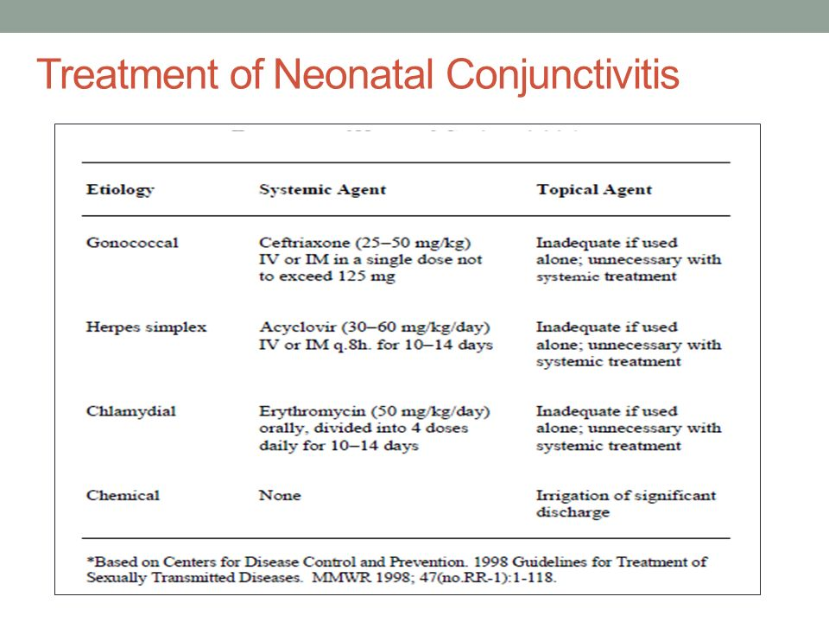
Pharmacological Intervention

Slide 14
Viral conjunctivitis-Core Subject
Viral conjunctivitis is a common external ocular infection, adenovirus (a non-enveloped double-stranded DNA virus) being the most frequent (90%) causative agent.
It may be sporadic, or occur in epidemics in environments such as workplaces (including hospitals), schools and swimming pools.
The spread of this highly contagious infection is facilitated by the ability of viral particles to survive on dry surfaces for weeks and by the fact that viral shedding may occur for many days before clinical features are apparent.
Transmission is generally by contact with respiratory or ocular secretions, including via fomites such as contaminated towels.

Slide 15
Presentation
The spectrum of viral conjunctivitis varies from mild subclinical disease to severe inflammation with significant morbidity. There will often be a history of a close contact with acute conjunctivitis.
Non-specific acute follicular conjunctivitis is the most common clinical form of viral conjunctivitis and is typically due to adenoviral infection by a range of serological variants.
Unilateral watering, redness, irritation and/or itching and mild photophobia occur, the contralateral eye generally being affected 1–2 days later, often less severely.
The condition is usually milder than the other clinical forms of adenoviral conjunctivitis. Patients may have accompanying (usually mild) systemic symptoms, such as a sore throat or common cold.

Slide 16
Presentation
Pharyngoconjunctival fever is caused mainly by adenovirus serovars 3, 4 and 7.
It is spread by droplets within families with upper respiratory tract infection.
Keratitis develops in about 30% of cases but is seldom severe.
Symptoms are essentially as above, though sore throat is typically prominent.

Slide 17
Presentation
Epidemic keratoconjunctivitis is caused mainly by adenovirus serovars 8, 19 and 37 and is the most severe ocular adenoviral infection.
Keratitis, which may be marked, develops in about 80%.
Photophobia may be correspondingly prominent.

Slide 18
Presentation
Acute haemorrhagic conjunctivitis usually occurs in tropical areas.
It is typically caused by enterovirus and coxsackievirus, though other microorganisms may present similarly.
It has a rapid onset and resolves within 1–2 weeks.
Conjunctival haemorrhage is generally marked.
Systemic viral infections such as those common in childhood, e.g. varicella, measles and mumps, can feature an associated follicular conjunctivitis.

Slide 19
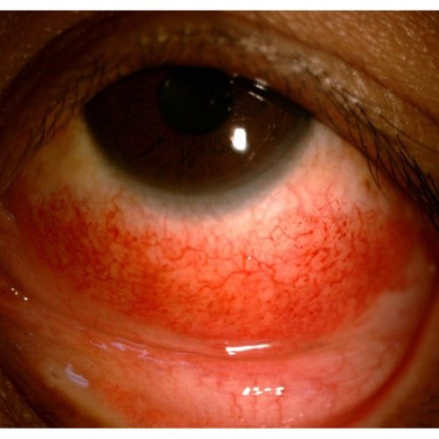
Signs
Eyelid oedema: ranges from negligible to severe.
Lymphadenopathy: preauricular
Conjunctival hyperaemia and follicles
Severe inflammation: may be associated with conjunctival haemorrhages (usually petechial in adenoviral infection), chemosis.

Slide 20
Signs
Keratitis (adenoviral):
Epithelial microcysts (non-staining) are common at an early stage.
Punctate epithelial keratitis (staining) may occur, usually within 7–10 days of the onset of symptoms, typically resolving within 2 weeks.
Focal white subepithelial/anterior stromal infiltrates often develop beneath the fading epithelial lesions, probably as an immune response to the virus.
They may persist or recur over months or years.

Slide 21
Treatment
Pharmacological Intervention
Spontaneous resolution of adenoviral infection usually occurs within 2–3 weeks, so specific treatment is typically unnecessary.
Discontinuation of contact lens wear until resolution of symptoms.
Artificial tears four times daily may be useful for symptomatic relief.
Cold compresses for symptomatic relief.
Topical antihistamines and vasoconstrictors may improve symptoms, particularly itching.
HORIZONTAL INTEGRATION

Slide 22
Prophylaxis
Preventive Medicine
Reduction of transmission risk by meticulous hand hygiene
Avoiding eye rubbing and towel sharing.
There should be scrupulous disinfection of instruments and clinical surfaces after examination of an infected patient
HORIZONTAL INTEGRATION

Slide 23
Research
Indication-prescription study for the management of conjunctivitis in a Colombian population
Luis Fernando Valladales-Restrepo et al. Int Ophthalmol.2023 Jan.

Slide 24
Bioethics
From a bioethical perspective, infective conjunctivitis raises several important issues. In the case of bacterial conjunctivitis, healthcare providers must take steps to prevent the spread of infection to other patients, as well as to prevent the development of complications such as corneal ulcers and vision loss.
Another important ethical consideration is the principle of autonomy, which recognizes the right of patients to make informed decisions about their healthcare. Patients with infective conjunctivitis should be fully informed about their condition and the risks and benefits of different treatment options. This may include the use of antibiotics, which can be effective in treating bacterial conjunctivitis but may also contribute to the development of antibiotic resistance.
.

Slide 25
Artificial Intelligence
Artificial intelligence (AI) has the potential to play a significant role in the diagnosis and management of bacterial conjunctivitis, a common eye infection caused by bacteria.
One way AI can assist in the diagnosis of bacterial conjunctivitis is through the analysis of medical images. Researchers have developed deep learning algorithms that can analyze images of the eye and identify signs of bacterial conjunctivitis, such as redness, discharge, and swelling. These algorithms can help healthcare providers make more accurate diagnoses and improve patient outcomes.
Another way AI can be used in the management of bacterial conjunctivitis is through predictive analytics. By analyzing patient data, including medical history and clinical symptoms, AI algorithms can predict the likelihood of a patient developing bacterial conjunctivitis. This can help healthcare providers take preventative measures and reduce the incidence of the infection.

Slide 26
ALLERGIC CONJUNCTIVITIS
Resources
Kanski’s clinical ophthalmology 9th edition

Slide 27
Acute Allergic Conjunctivitis
Acute allergic conjunctivitis is a common condition caused by an acute conjunctival reaction to an environmental allergen, usually pollen.
It is typically seen in younger children after playing outside in spring or summer.
Acute itching and watering are common, but the hallmark is chemosis.
Treatment is not usually required and the conjunctival swelling settles within hours as the acute increase in vascular permeability resolves.
Cool compresses can be used and a single drop of adrenaline 0.1% may reduce extreme chemosis.

Slide 28
Seasonal and Perennial Allergic Conjunctivitis
These common subacute conditions are distinguished from each other by the timing of exacerbations, thought to relate principally to differing stimulating allergens in each.
Seasonal allergic conjunctivitis, worse during the spring and summer, is the more common. The most frequent allergens are tree and grass pollens, although the specific allergen varies with geographic location.
Perennial allergic conjunctivitis causes symptoms throughout the year, generally worse in the autumn when exposure to house dust mites, animal dander and fungal allergens is greatest.
It is less common and tends to be milder than the seasonal form.

Slide 29
Treatment
Pharmacological Intervention
Artificial tears for mild symptoms.
Mast cell stabilizers (e.g. sodium cromoglicate, nedocromil sodium, lodoxamide) must be used for a few days before exerting maximal effect, but are suitable (except lodoxamide) for long-term use if required.
Antihistamines (e.g. emedastine, epinastine, levocabastine, bepotastine) can be used for symptomatic exacerbations and are as effective as mast cell stabilizers.
Dual action antihistamine and mast cell stabilizers (e.g.azelastine, ketotifen, olopatadine) act rapidly and are often very effective for exacerbations.
HORIZONTAL INTEGRATION

Slide 30
Treatment
Pharmacological Intervention
Combined preparation of an antihistamine and a vasoconstrictor (e.g. antazoline with xylometazoline).
Non-steroidal anti-inflammatory preparations (e.g. diclofenac) can provide symptomatic relief but are rarely used.
Topical steroids are effective but rarely necessary.
Oral antihistamines may be indicated for severe symptoms.
HORIZONTAL INTEGRATION

Slide 31
Vernal Keratoconjunctivitis
Vernal keratoconjunctivitis (VKC) is a recurrent bilateral disorder in which both IgE- and cell-mediated immune mechanisms play important roles.
It primarily affects boys and onset is generally from about the age of 5 years onwards.
There is remission by the late teens in 95% of cases, although many of the remainder develop atopic keratoconjunctivitis.

Slide 32
Vernal Keratoconjunctivitis
VKC is rare in temperate regions, but relatively common in warm dry climates such as the Mediterranean, sub-Saharan Africa and the Middle East.
In temperate regions over 90% of patients have other atopic conditions such as asthma and eczema and two-thirds have a family history of atopy.
VKC often occurs on a seasonal basis, with a peak incidence over late spring and summer, although there may be mild perennial symptoms.

Slide 33
Classification
Palpebral VKC
  It primarily involves the upper tarsal conjunctiva.
  It may be associated with significant corneal disease as a result of the close apposition between the inflamed conjunctiva and the corneal epithelium.
Limbal disease
  It typically affects black and Asian patients.
Mixed VKC
  It has features of both palpebral and limbal disease.

Slide 34
Diagnosis
Symptoms
  Intense itching
  Lacrimation
  Photophobia
  Foreign body sensation
  Burning
  Thick mucoid discharge
  Increased blinking is common.

Slide 35
Diagnosis
Palpebral Disease
  Early-mild disease is characterized by conjunctival hyperaemia and diffuse velvety papillary hypertrophy on the superior tarsal plate.
  Macropapillae (<1 mm) have a flat-topped polygonal appearance reminiscent of cobblestones.
  Progression to giant papillae (>1 mm) can occur, as adjacent smaller lesions amalgamate when dividing septa rupture.
  Mucus deposition between giant papillae.
  Decreased disease activity is characterized by milder conjunctival injection and decreased mucus production.

Slide 36
Diagnosis
Limbal disease
  Gelatinous limbal conjunctival papillae that may be associated with transient apically located white cellular collections (Horner–Trantas dots).
  In tropical regions, limbal disease may be severe.

Slide 37
Diagnosis
Keratopathy is more frequent in palpebral disease and may take the following forms:
Superior punctate epithelial erosions associated with layers of mucus on the superior cornea.
Epithelial macroerosions caused by a combination of epithelial toxicity from inflammatory mediators and a direct mechanical effect from papillae.
Plaques and ‘shield’ ulcers may develop in palpebral or mixed disease when the exposed Bowman membrane becomes coated with mucus and calcium phosphate, leading to inadequate wetting and delayed re-epithelialization.

Slide 38
Diagnosis
Pseudogerontoxon can develop in recurrent limbal disease.
It is characterized by a paralimbal band of superficial scarring resembling arcus senilis, adjacent to a previously inflamed segment of the limbus.
Vascularization does not tend to be prominent, though some peripheral superficial vessel ingrowth is common, especially superiorly.
Keratoconus and other forms of corneal ectasia are more common in VKC and are thought to be at least partly due to persistent eye rubbing.

Slide 39
Treatment
Preventive Medicine
General measures
  Allergen avoidance, if possible.
  Cool compresses may be helpful.
  Lid hygiene should be used for associated staphylococcal blepharitis.
  Moisturizing cream such as E45 can be applied to dry, fissured skin.
  Bandage contact lens wear to aid healing of persistent epithelial defects.
HORIZONTAL INTEGRATION

Slide 40
Treatment
Pharmacological Intervention
Mast cell stabilizers:
  e.g., sodium cromoglicate. reduce the frequency of acute exacerbations and the need for steroids and so form the basis of many regimens, but are seldom effective in isolation.
Topical antihistamines:
  e.g., emedastine, epinastine. when used in isolation are about as effective as mast cell stabilizers. They are suitable for acute exacerbations but generally not for continuous long-term use.
Combined action antihistamine/mast cell stabilizers:
  e.g., ketotifen, olopatadine.
HORIZONTAL INTEGRATION

Slide 41
Treatment
Pharmacological Intervention
Non-steroidal anti-inflammatory:
  e.g., Ketorolac, diclofenac. may improve comfort by blocking non-histamine mediators.
Topical steroids:
  e.g. fluorometholone 0.1%, prednisolone 0.5%, loteprednol etabonate 0.2% or 0.5%. are used for severe exacerbations of conjunctivitis and significant keratopathy. Reducing conjunctival activity generally leads to corneal improvement.
  They are usually prescribed in short but intensive courses.
HORIZONTAL INTEGRATION

Slide 42
Treatment
Pharmacological Intervention
Acetylcysteine:
  It is a mucolytic agent that is useful in VKC for dissolving mucus filaments and deposits and addressing early plaque formation.
Immunomodulators:
Ciclosporin (0.05–2%):
  If steroids are ineffective, inadequate or poorly tolerated, or as a steroid-sparing agent in patients with severe disease.
  The effects typically take some weeks to be exerted and relapses may occur if treatment is stopped suddenly. Irritation and blurred vision are common.
HORIZONTAL INTEGRATION

Slide 43
Treatment
Pharmacological Intervention
Calcineurin inhibitors:
Tacrolimus 0.03%
  It is an alternative to steroids in the treatment of allergic eye disease.
  Instillation into the fornix has been effective in modulating conjunctival inflammation in refractory cases.
  It is particularly useful when applied topically in patients with shield ulcers and corneal epitheliopathy and can be used without topical steroids.
  Factors associated with a poor response to tacrolimus include the presence of a giant papillae and palpebral abnormality.
HORIZONTAL INTEGRATION

Slide 44
Treatment
Pharmacological Intervention
Supratarsal steroid injection:
  It is considered in severe palpebral disease or for non-compliant patients.
  The injection is given into the conjunctival surface of the anaesthetized everted upper eyelid
  0.1 ml of betamethasone sodium phosphate 4 mg/ml, dexamethasone 4 mg/ml or triamcinolone 40 mg/ml.
HORIZONTAL INTEGRATION

Slide 45
Research
Efficacy of single dose dermatological 0.1 % Tacrolimus ointment in the treatment of vernal keratoconjunctivitis
Muhammad Sharjeel et al. J Pak Med Assoc.2022 Sep

Slide 46
Bioethics
In terms of bioethics, there are a few key considerations that come to mind when discussing VKC.. VKC is a chronic condition that requires ongoing treatment and management, which can be expensive and difficult to access for individuals without adequate healthcare coverage. Ensuring that individuals with VKC have access to the necessary medical resources is important from an ethical standpoint, as it can help to prevent unnecessary suffering and improve quality of life.
Another bioethical consideration related to VKC is the potential impact of the condition on an individual's ability to participate fully in society. For example, children with VKC may miss school or be unable to engage in sports or other physical activities due to the discomfort caused by the condition. Adults with VKC may experience similar limitations on their ability to work or participate in social activities. Ensuring that individuals with VKC have access to effective treatment and management options can help to mitigate these impacts, allowing individuals to participate more fully in society.
In summary, the bioethics of VKC involve considerations related to access to care, the impact of the condition on individuals' ability to participate fully in society, and the ethical dimensions of research and development of new treatments. By addressing these issues, we can help to ensure that individuals with VKC receive the care and support they need to live healthy, fulfilling lives.

Slide 47
Artificial intelligence
Artificial Intelligence could be useful in VKC is in the development of personalized treatment plans. By analyzing patient data such as medical history, genetics, and response to previous treatments, AI algorithms can help healthcare providers tailor treatment plans that are more likely to be effective for individual patients. Additionally, AI can assist in monitoring disease progression and adjusting treatment plans as needed.

Slide 48


