Slide 1


Slide 2
CONJUNCTIVITIS

Slide 3
Sequence of lecture
Core subject
Spiral integration
Vertical integration
EOLA end of lecture assessment
Digital library references
(Research , bioethics, artificial intelligence)

Slide 4

Lecture Objectives
At the end of this lecture you should be able to
  Describe etiology, pathophysiology, diagnosis, and treatment of conjunctival diseases
  Interpret common Eye clinical signs
  Advise correct diagnostics & management plan

Slide 5
Spiral Integration
Anatomy and Physiology of Conjunctiva

Slide 6
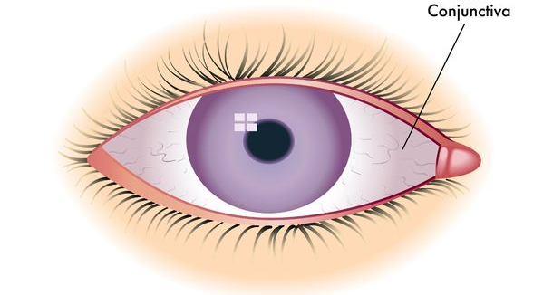
Anatomy
The conjunctiva is a transparent mucous membrane that lines the inner surface of the eyelids and the anterior surface of the globe, terminating at the corneoscleral limbus.

Slide 7
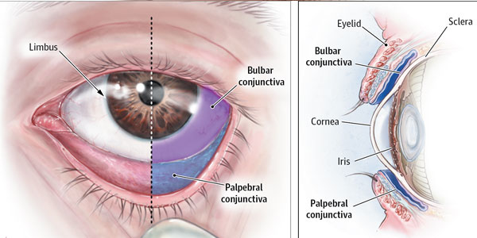
Parts of Conjunctiva
  Palpebral; covering the lids—firmly adherent.
Forniceal; covering the fornices—loose—thrown into folds.
Bulbar; covering the eyeball—loosely attached except at limbus.

Slide 8
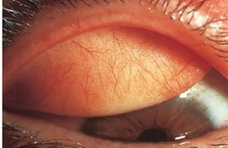
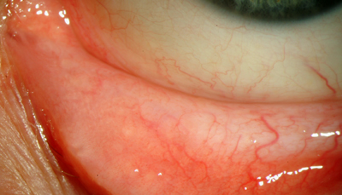
Palpebral conjunctiva
Subtarsal sulcus 2mm from posterior edge of the lid margin.
Richly vascular.
Extremely thin.
Strongly bound to the tarsal plate.

Slide 9
Bulbar conjunctiva
Lies in contact with eyeball.
Thin, translucent and loosely attached by connective tissue to tenon capsule, except at the limbus, where the two layers fuse.

Slide 10
Bulbar conjunctiva
Continuous with the corneal epithelium at the limbus.
Radial ridges at the limbus form the palisades of Vogt, the reservoir of corneal stem cells.
The plica semilunaris (semilunar fold) is present nasally, medial to which lies a fleshy nodule (caruncle) consisting of modified cutaneous tissue.

Slide 11
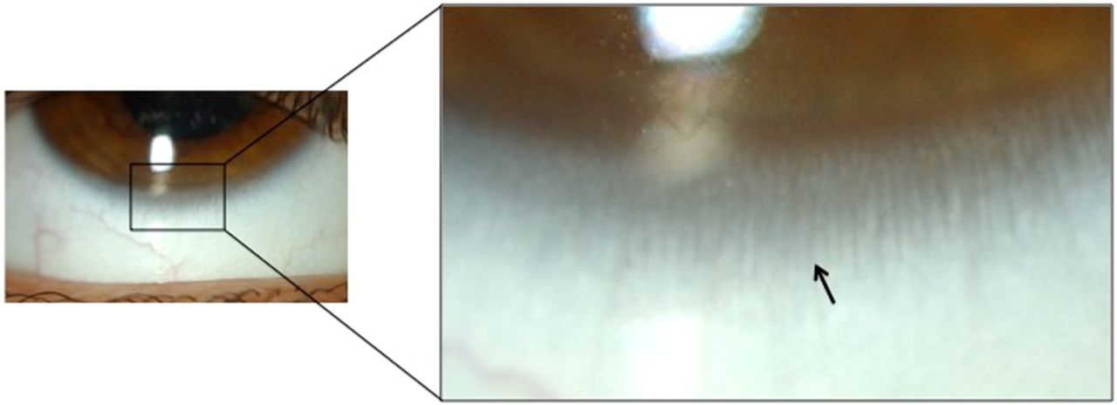
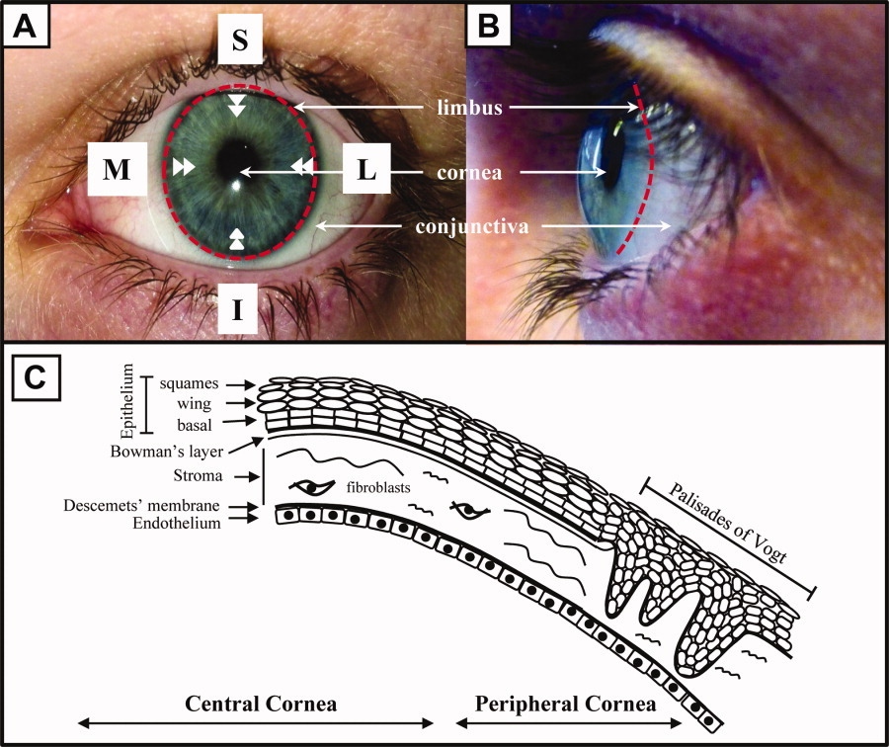
Palisades of Vogt

Slide 12
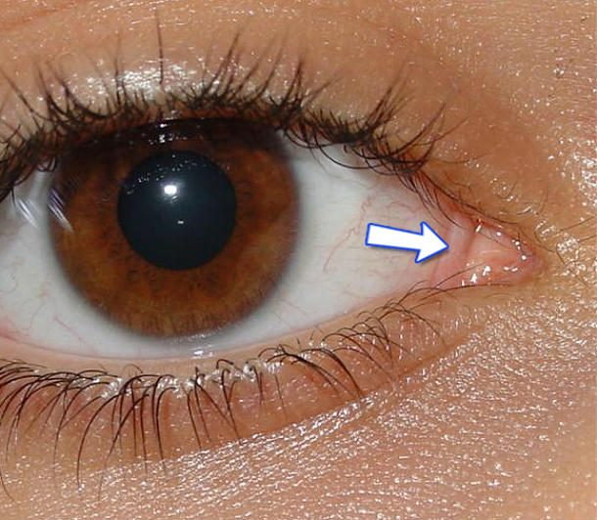
Plica Semilunaris

Slide 13
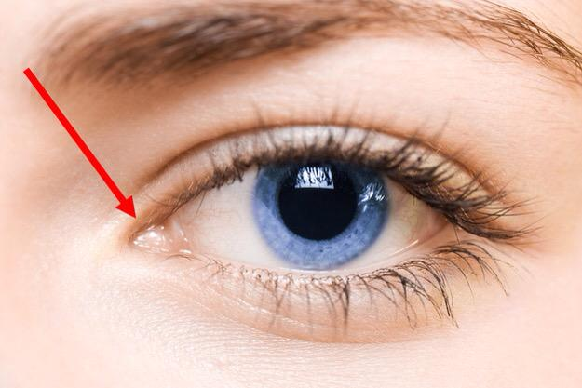
Caruncle

Slide 14
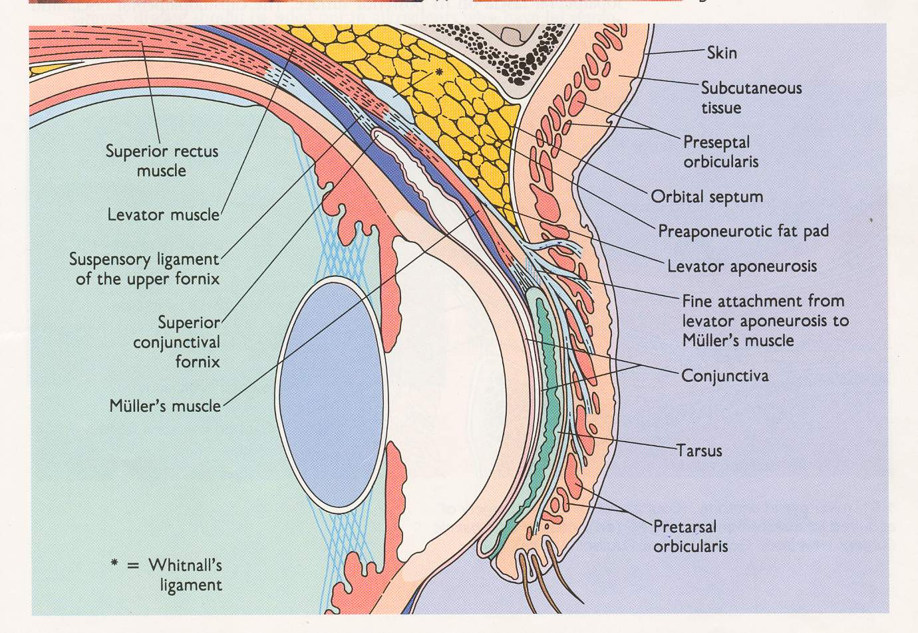
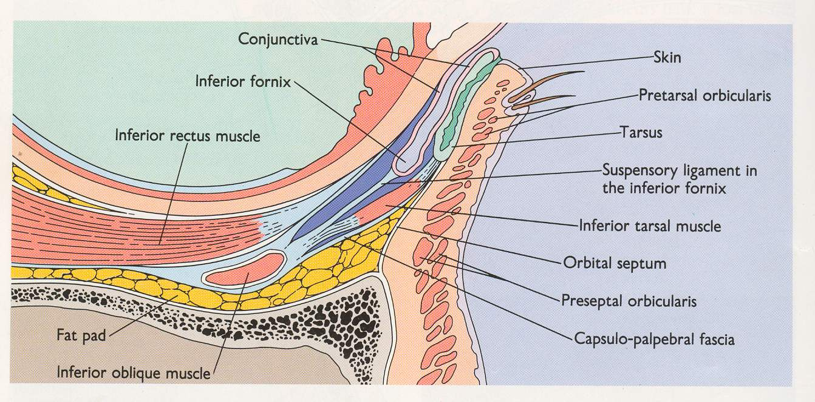
Conjunctival fornices
Transitional region between palpebral and bulbar conjunctivae.
Superior fornix 10 mm from limbus.
Inferior fornix 8 mm from limbus.
Lateral fornix 14mm from limbus.
Ducts of lacrimal glands open into lateral part of superior fornix.

Slide 15
Histology
The epithelium is non-keratinizing and around five cell layers deep.
Basal cuboidal cells evolve into flattened polyhedral cells, subsequently being shed from the surface.
Mucus-secreting goblet cells are located within the epithelium, being most dense inferonasally and in the fornices.

Slide 16
Histology
The stroma (substantia propria) consists of richly vascularized loose connective tissue.
The accessory lacrimal glands of Krause and Wolfring are located deep within the stroma.
Secretions from the accessory lacrimal glands are essential components of the tear film.

Slide 17
Histology
Conjunctiva-associated lymphoid tissue (CALT) is critical in the initiation and regulation of ocular surface immune responses.
It consists of lymphocytes within the epithelial layers, lymphatics and associated blood vessels, with a stromal component of lymphocytes and plasma cells, including follicular aggregates.

Slide 18
Nerve supply - Sensory
Bulbar conjunctiva
  Long ciliary nerves and Nasociliary Nerve - Ophthalmic division of trigeminal Nerve
Superior palpebral and forniceal conjunctiva
  Frontal and lacrimal branches of Ophthalmic division of trigeminal Nerve
Inferior palpebral and forniceal conjunctiva
  Laterally from lacrimal branches of Ophthalmic division of trigeminal Nerve
  Medially infraorbital Nerve – Maxillary division of trigeminal N.
Sympathetic;
Superior cervical sympathetics to blood vessels.

Slide 19
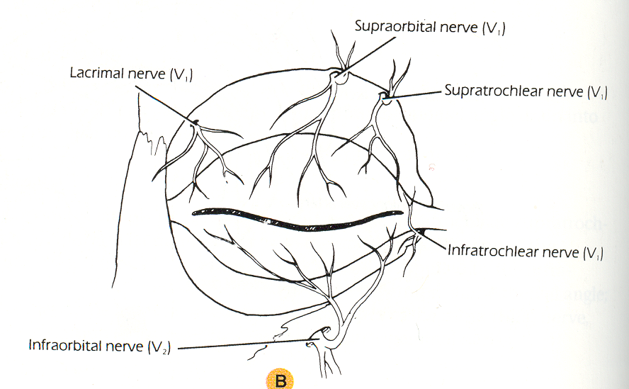

Slide 20
Blood supply
Arterial supply;
Posterior conjunctival arteries derived from arterial arcade of lids which is formed by palpebral branches of nasal and lacrimal arteries of the lids.
Anterior conjunctival arteries derived from the anterior ciliary arteries – muscular branch of ophthalmic artery to rectus muscles.
Venous drainage;
Palpebral and Ophthalmic veins.

Slide 21
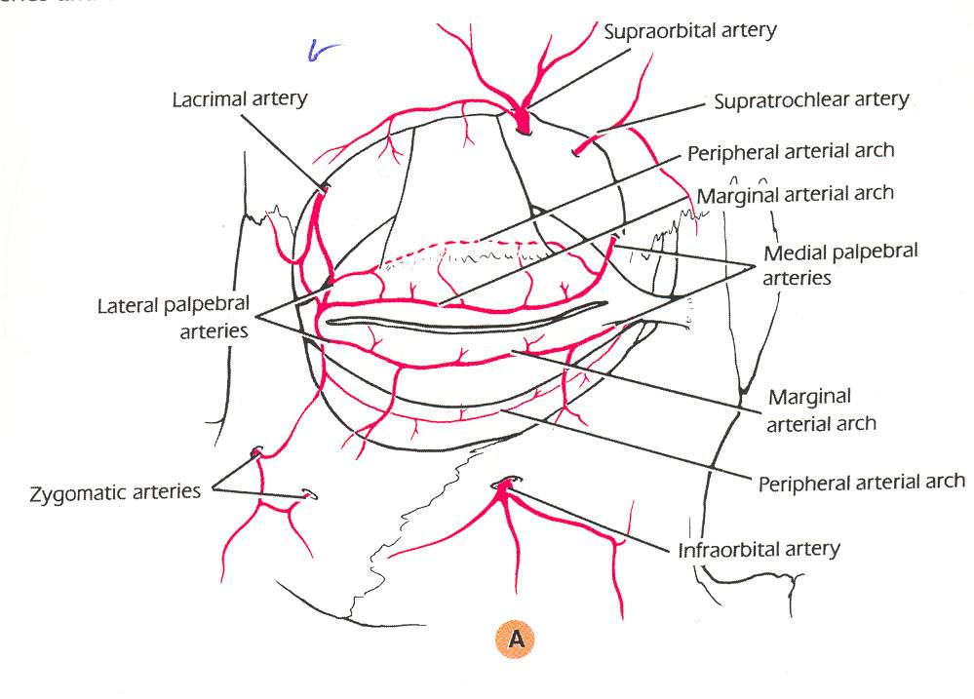

Slide 22
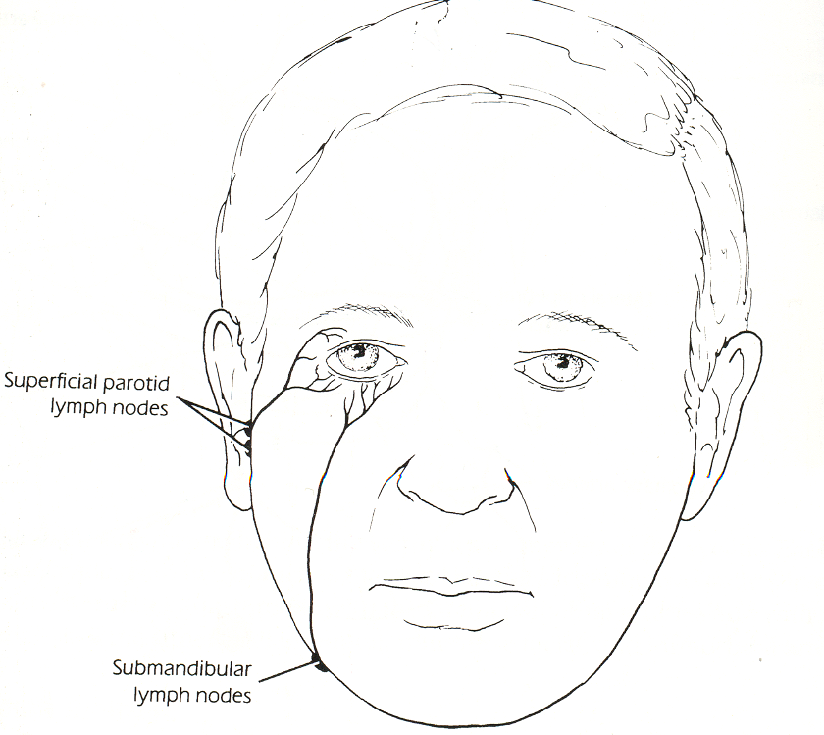
Lymphatic drainage
Lymph vessels are arranged as a superficial and a deep plexus in sub mucosa.
Ultimately as in the lids to the pre auricular and sub-mandibular lymph glands.

Slide 23
PHYSIOLOGY
Smooth surface.
Secretes mucin and aqueous component of tear film.
Highly vascular: supplies nutrition to the peripheral cornea.
Aqueous veins drains from anterior chamber maintenance of IOP.
Lymphoid tissue helps in combating infections.
Basic secretion—reflex secretion.

Slide 24
Core Subject

Slide 25
Symptoms of Conjunctival Conditions
Lacrimation.
Itching.
Irritation.
Stinging.
Burning.
Photophobia.
Redness.
Pain.
Foreign body sensation.

Slide 26
Conjunctival Discharge
Watery discharge is composed of a serous exudate and tears, and occurs in acute viral or acute allergic conjunctivitis.
Mucoid discharge is typical of chronic allergic conjunctivitis and dry eye.
Mucopurulent discharge typically occurs in chlamydial or acute bacterial infection.
Moderately purulent discharge occurs in acute bacterial conjunctivitis.
Severe purulent discharge is suggestive of gonococcal infection.

Slide 27
Conjunctival reactions
Hyperaemia

Slide 28
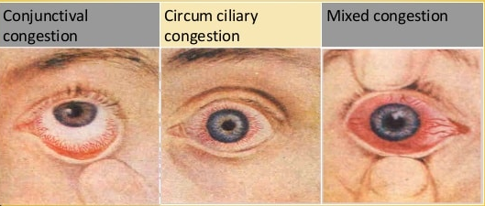
Hyperaemia
Diffuse, beefy-red and more intense away from the limbus is usual in bacterial infection.
This ‘conjunctival injection’ should be distinguished from the ciliary injection of iridocyclitis.

Slide 29
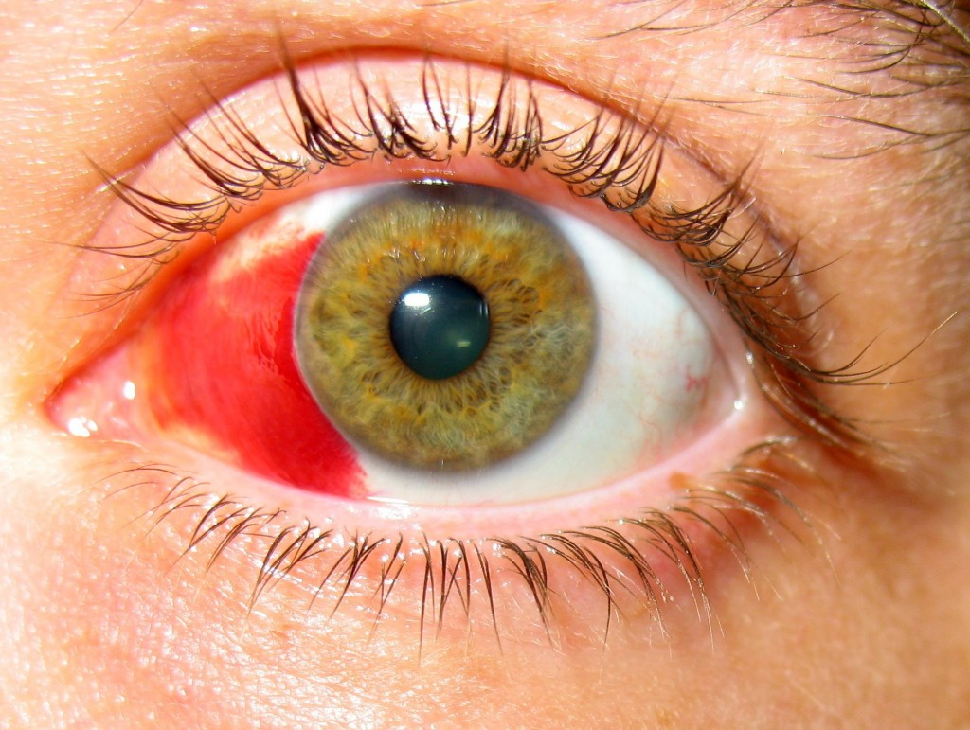
Conjunctival reactions
Haemorrhages
May occur in viral conjunctivitis, when they are often multiple, small and discrete (‘petechial’)
Severe bacterial conjunctivitis, when they are larger and diffuse

Slide 30
Conjunctival reactions
Chemosis

