Slide 1
COMPLICATIONS OF CSOM

Slide 2
University Motto, Vision, Values & Goals
Mission Statement To impart evidence-based research-oriented health professional education Best possible patient care Mutual respect, ethical practice of healthcare and social accountability. Vision and Values Highly recognized and accredited centre of excellence in Medical Education, using evidence-based training techniques for development of highly competent health professionals, who are lifelong experiential learner and are socially accountable. Goals The Undergraduate Integrated Learning Program is geared to provide you with quality medical education in an environment designed to:

Slide 3
Sequence of LGIS
Learning objectives
Development of cochlea (core concept = 60%)
Anatomy, physiology, biochemistry (spiral integration 8%)
Pathology and community medicine (horizontal integration 20%)
Related clinical medical surgical (vertical integration – 7%)
Research, family medicine, bioethics, artificial intelligence (5%)

Slide 4
Learning Objectives
At the end of this lecture students shall be able to learn:
Anatomy of Temporal bone
Extracranial CSOM Complications
Etiology and pathophysiology
Clinical Presentation
investigations
Management
Intracranial CSOM Complications
Etiology and pathophysiology
Clinical Presentation
investigations
Management

Slide 5
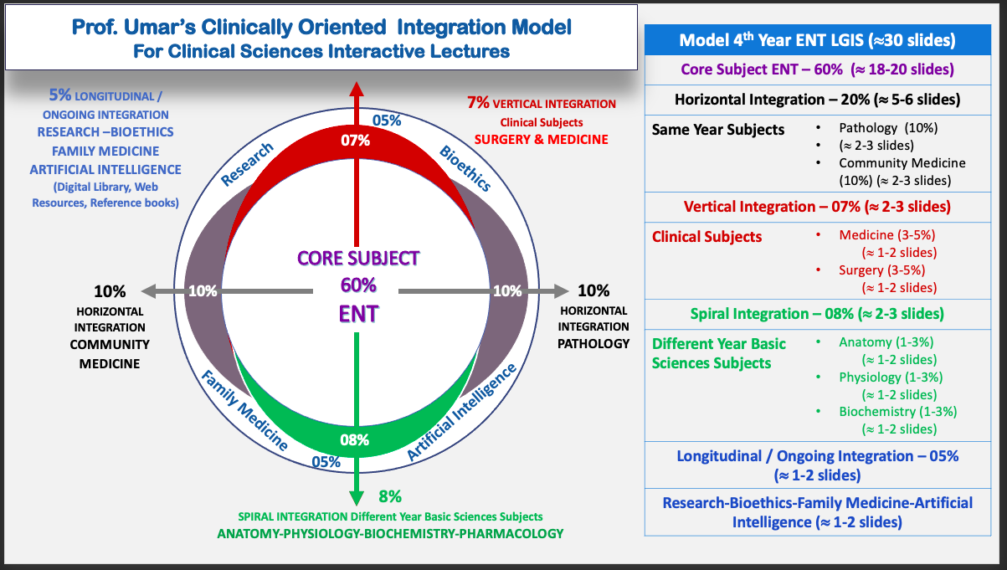
Prof Umer Model Of Integrated Lecture

Slide 6
SPIRAL INTEGRATION WITH ANATOMY

Slide 7
Overview of Temporal Bone

Slide 8
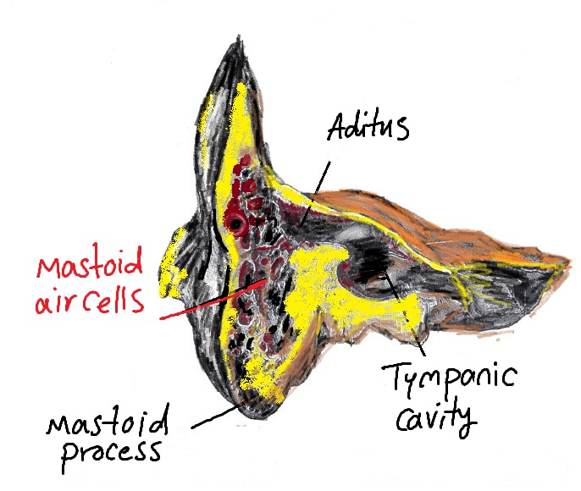

Slide 9
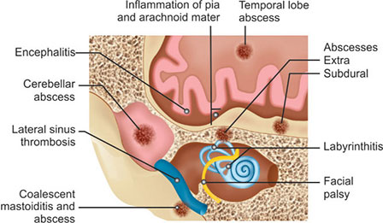

Slide 10
HORIZONTAL INTEGRATION WITH COMMUNITY MEDICINE

Slide 11
Epidemiology
Extracranial
Incidence: 32%
M/C: Postaural Abscess
Intracranial
Incidence 56%
M/C: Brain Abscess

Slide 12
Evaluation Of Patient with Suspicion Of CSOM Complication
History
H/O Chronic Otitis Media
Fever, Nausea ,Vomiting
Severe Headache
Vertigo
Otalgia
Retro-orbital Pain
Irritability Neck Rigidity
Diplopia
Facial Weakness

Slide 13
EXAMINATION
Vitals
High grade Fever
Neurological Examination
Mental status
Ear Examination
Comparison of color shape size and position of pinna
Sensory & motor function of extremities
Complete cranial nerve evaluation
Nystagmus
Cerebellar function test
Optic disc Evaluation
Nuchal Rigidity
Regions adjacent to auricles
EAC and TM EUM
Pneumatic otoscopy

Slide 14
Diagnosis
Imaging Techniques
CT Scan
MRI with Gadolinium Contrast
Lumbar Puncture
Contraindicated in raised CSF with brain abscess and subdural empyema

Slide 15
TREATMENT
Complications from COM and mastoiditis
Broad spectrum antibiotic therapy
Neurosurgical Evaluation
Mastoidectomy

Slide 16
Extracranial Complication
Mastoiditis
Postauricular abscess
Bezold Abscess
Temporal Abscess
Petrous apicitiis
Labyrinthine Fistula
Facial Nerve Paralysi
Acute Suppurative Labyrinthis

Slide 17
Acute Mastoiditis
Spread of infection from the mucosa of mastoid air cells to bony walls of the mastoid air cell system.
Mostly aﬀects children
S. pneumoniae the most common causative organism

Slide 18
HORIZONTAL INTEGRATION WITH PATHOLOGY

Slide 19
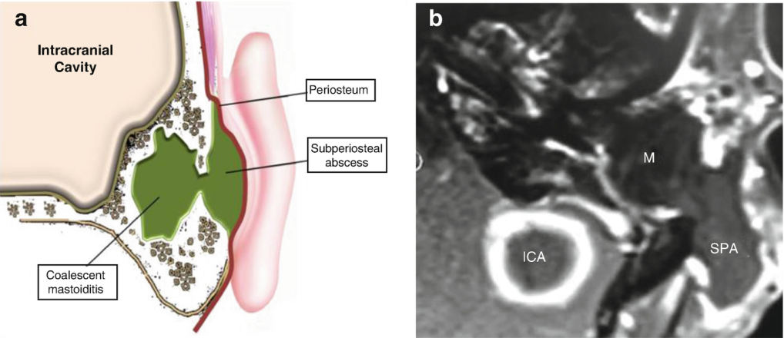
Pathophysiology
1. Production of pus under tension.
2. Hyperaemic decalcification and
osteoclastic resorption of bony walls.

Slide 20
Clinical Presentation
Symptoms
Retroauricular Pain
Signs
Mastoid Tenderness and erythema and swelling
Fever
Profuse Otorrhea > 2 weeks
Mastoid reservoir sign
Sagging of Posterosuperior meatal wall
CHL
Deafness

Slide 21
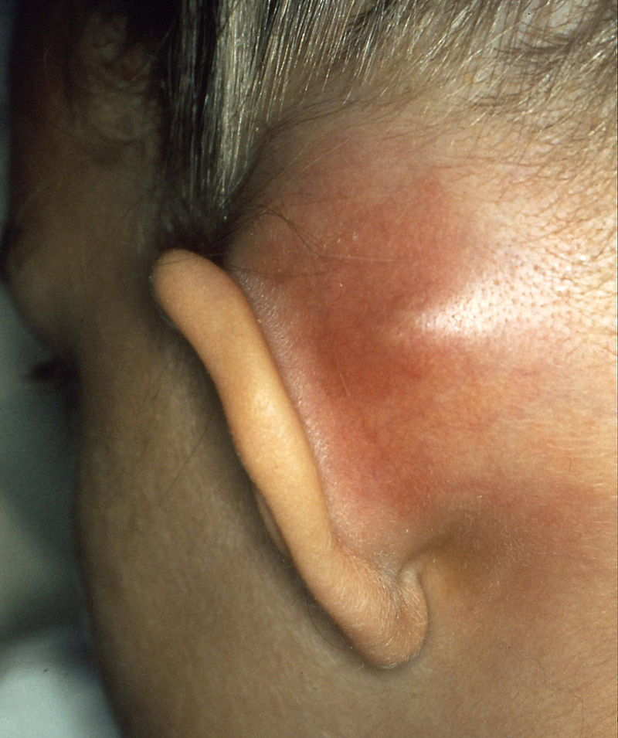
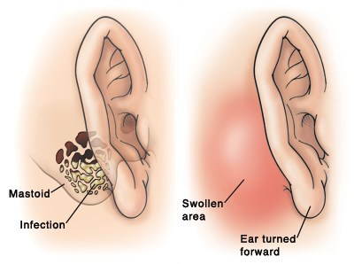
Sagging of posterosuperior meatal wall
Mastoid Swelling

Slide 22
Investigations
CBC
PMLs
ESR
Raised
CT Scan Temporal Bone
Clouding of air cells
Indistinct bony partitions
Ear Swab
Culture Sensitivity

Slide 23
Notes:
Soft tissue density material occupying partially the left mastoid air cells with cortical destruction of the posterior mastoid wall in continuity with a retroauricular fluid collection

Slide 24
TREATMENT
IV ANTIBIOTICS: Amoxicillin or Ampicilin with metronidazole until C/S for 3-6 weeks
MYRINGOTOMY
CORTICAL MASTOIDECTOMY

Slide 25
Chronic Mastoiditis
ETIOLOGY
Long-standing tympanic membrane perforation
Cholesteatoma
Infection after VT Insertion
Granulation tissue filled with inflammatory cells replaces the air spaces of the mastoid and middle ear

Slide 26
Clinical Presentation
Recurrent bouts of otalgia and retro- aural pain
Recurrent headaches & Fever
TM may appear retracted/ perforation
with pus

Slide 27
Treatment
Requires surgical intervention

Slide 28
MASKED MASTOIDITIS
Chronic otitis with granulation tissue formation and bone erosion without otorrhea.
Occurs in patients who have received numerous courses of antibiotics mostly oral penicillins

Slide 29
Clinical Features
History
Chronic auricular and post auricular pain
Examination
Tenderness of mastoid cortex
CHL on Audiometry
CT Scan
Localized area of opaciﬁcation in an otherwise normal mastoid.
Deafness

Slide 31
Treatment
Cortical Mastoidectomy
IV Antibiotics

Slide 32
Post Auricular Abscess
Most common complication of mastoiditis
Affecting mostly young children.
Spread:
Extension from mastoid
Direct extension
By mastoid veins.
Open Channels in Neonates

Slide 33
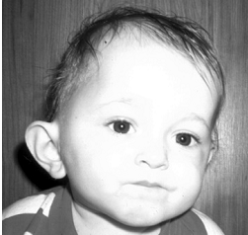
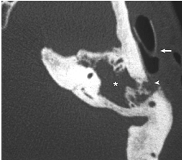
Examination
Erythema and post auricular swelling
Investigations (For Presence of air & Abscess)
CT scan
Pinna displaced downward and laterally
USG

Slide 35
Treatment
Incision and drainage of the abscess
Cortical mastoidectomy
Tympanostomy tube placement
Systemic antibiotics (Vancomycin/ Ceftriaxone)

Slide 36
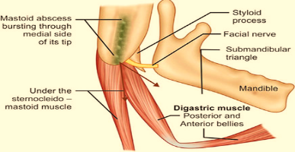
Bezold Abscess
Caused by a perforation in the bony plate of the inner surface of the tip of the mastoid
Commonly in older children or adults
Pus accumulates beneath the sternocleidomastoid, or in diagstric triangle

Slide 37
History
Sudden onset swelling in neck
H/O Purulent Otorrhea
Examination
Tender swelling
Torticollis
Investigation
CT mastoid and neck
Fever

Slide 38
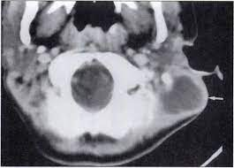

Slide 39
Treatment
Complete surgical excision of the mastoid pathology
Drainage of the abscess
Removal of any associated granulation tissue.
IV Antibiotics

Slide 40
Temporal Root Abscess
Abscess formation above auricle due to zygomatic root of mastoid involvement
Direct extension via bone erosion or via phlebitis
Presents as trismus
CT scanning is always recommended to rule out mastoiditis
Surgical drainage

Slide 41
Petrous Apicitis
Mastoiditis in the petrous part of temporal bone
Direct extension of a mastoid infection along posterosuperior and anteroinferior tracts.
Posterosuperior> from attic or antrum>SCC >petrous apex
Anteroinferior tract>Hypotympanum>Eustachian tube and cochlea>Petrous apex

Slide 42
SIGNS & SYMPTOMS
Deep or retro-orbital pain (trigeminal ganglion )
Cranial nerve VI Paralysis
Cranial nerves VII and VIII Dysfunction
Labyrinthitis
Triad of retro-orbital pain, sixth cranial nerve paralysis, and otorrhea,known as Gradenigo syndrome.

Slide 43
Investigations
CT scan
MRI

Slide 44
Treatment
Cannot be excised.
Establish drainage and prolonged antibiotics
Partial apicectomy ↓ bacterial load

Slide 45
Labyrinthine Fistula
Erosive loss of the endochondral bone overlying semicircular canals
Pressure induced motion of the underlying endolymphatic compartment > vestibular symptoms
Mostly lateral semicircular canal involved
Secondary to cholesteatoma
1-Cholesteatoma matrix.2-External Layer(periosteaum).3-Medial layer.4-Internal Layer.5-Perilymphatic space.6-Membranous Labyrinth

Slide 46
CT axial plane Right middle ear cholesteatoma responsible of lysis of the lateral SCC

Slide 47
Signs and symptoms
underlying cholesteatoma
Brief periods of imbalance, disequilibrium, or vertigo but have normal equilibrium most of the time (Tullio phenomenon).
Diagnosis
Fistula test
CT SCAN

Slide 48
Treatment
Treat underlying cholesteatoma
In cases with large ﬁstulae, perform a canal wall–down procedure and leave the ﬁstula covered by matrix

Slide 49
Identify the blue line of the ﬁstula
a ﬂat dissector used to peel the matrix from the underlying endosteum.
A ﬁne microsuction elevates the cholesteatoma and facilitates visualization and removal
a small piece of shaped cap of bone is placed over the site and secured with ﬁbrin glue or packing.

Slide 50
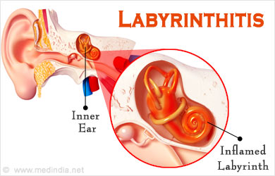
Acute Suppurative Labyrinthitis
Bacterial invasion of the labyrinth followed by total loss of auditory and vestibular function
Extension
Through weakened oval window
Enlarged vestibular aqueducts

Slide 51
Signs & Symptoms
Tinnitus and dizziness
Whirling vertigo
Pallor, diaphoresis
Nausea, and vomiting.
Brisk nystagmus toward the opposite ear
Within 2 to 3 weeks normal or near normal balance is restored.

Slide 52
Treatment
Aim of Treatment
Eradicate the labyrinthine infection
Prevent propagation to the meninges.
Treatment
Appropriate antibiotic treatment for 10 days

Slide 53
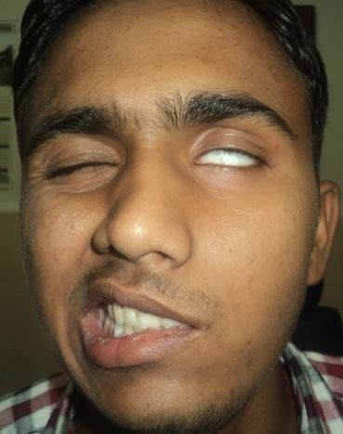
Facial Nerve Paralysis
Can result from COM without cholesteatoma,or cholesteatoma.
Congenital dehiscences of the bony fallopian canal or via erosion with granulation tissue or cholesteatoma

Slide 54
 | Facial Palsy Caused by COM without cholesteatoma | Facial Palsy caused by COM with cholesteatoma
Site | Horizontal portion of the facial nerve near the stapes affected | Erosion of the horizontal segment of the facial nerve canal
Progression | Progression from slight weakness to full | Slow progression
Duration | Prolonged Weakness | Persist after surgical treatment
Treatment | Surgical Decompression with Mastoidectomy | Surgical Decompression with Mastoidectomy

Slide 55
Outcomes
improved outcomes have if surgical decompression was performed within 1 week of the onset of facial paresis

Slide 56
INTRACRANIAL COMPLICATIONS

Slide 57
Meningitis
Inflammation of leptomeninges usually with bacterial invasion of CSF in subarachnoid space
MODE OF INFECTION:
Blood Borne
Bone erosion/ thrombophlebilitis

Slide 58
Clinical Features
Symptoms
Signs
High Grade Fever
Headache
Neck rigidity
Photophobia
Nausea, projectile vomiting
Drowsiness
Neck Rigidity
Kernig’s sign +
Brudzinski’s sign +
Papilledema on fundoscopy

Slide 59
Diagnosis
CT Scan
Lumbar Puncture
MRI

Slide 60
Management
Depends upon cause
Mastoid exploration (if caused by COM)

Slide 61
Brain Abscess
Mostly in the temporal lobe or cerebellum.
Bacteria involved are S.pneumoniae, S.haemolyticus, Proteus mirabilis, E.coli, and Pseudomonas aeruginosa

Slide 62
Pathology
Stage of Invasion (Initial Encephalitis)
Stage of Localization (Latent Abscess)
Stage of Enlargement (Manifest Abscess)
Stage of Termination (Rupture of Abscess)

Slide 63
Clinical Features
Due to raised ICP:
Headache, nausea, vomiting, lethargy, papilledema, drowsiness, coma.
Due to the area involved:
Temporal lobe involvement (Nominal aphasia, homonymous hemianopia, contralateral motor paralysis, fits, CNIII palsy).
Cerebellar involvement (Coarse horizontal nystagmus, ipsilateral ataxia, dysdiadochokinesia)

Slide 64
Diagnosis
Skull X-rays.
CT scan.
X-ray/CT scan mastoid.

Slide 67
Management
IV antibiotics
Dexamethasone in case of raised ICP.
Neurosurgical drainage or abscess excision within 24 hours followed by mastoidectomy.

Slide 68
Subdural Empyema
Fulminating purulent infection that develops between the dura and pia arachnoid membranes.
Neurosurgical emergency

Slide 69
Clinical Features
Headache.
High grade fever with chills.
Decline in the level of consciousness.
Aphasia.
Progressive contralateral hemiparesis.
Jacksonian seizures.
Neck stiffness and papilledema in case of posterior fossa collections

Slide 70
Diagnosis
CECT
CE-MRI
Lumbar puncture (Contraindicated can result in herniation)

Slide 73
Management
Appropriate antibiotic therapy.
Emergency neurosurgical drainage

Slide 74
Epidural Abscess
Collection of pus between bone and the dura.
A common complication of chronic mastoiditis.

Slide 75
Clinical Features
Deep mastoid pain.
Otalgia.
Persistent headache on the site of otitis media.
General malaise.
Pulsatile purulent discharge.

Slide 76
Diagnosis
CECT shows a fluid-filled cavity between the temporal bone and the enhanced dura.
MRI

Slide 78
Management
Antibiotic cover.
Evacuation of pus and mastoidectomy.

Slide 79
Lateral Sinus Thrombosis
Thrombosis of the lateral (sigmoid and/or transverse) sinus which usually forms from an adjacent abscess that develops after mastoid bone erosion
Bacteria involved are Bacillus proteus, Pseudomonas pyocyaneus, E.coli, and Staphylococci

Slide 80
Pathology
Formation of perisinus abscess.
Endophlebitis and mural thrombus formation.
Obliteration of sinus lumen and intrasinus abscess.
Extension of thrombus.

Slide 82
Clinical Features
‘Picket Fence’ fever pattern (diurnal temperature spikes that exceed 103 F/39.4 Celsius.
Neck pain
Diplopia
Griesingers’s Sign: Edema over posterior part of mastoid due to thrombosis of mastoid emissary vein.
Tenderness along the jugular vein and torticollis.

Slide 83
Clinical Tests
Tobey-Ayer Test: Compression of jugular vein on the healthy side causes rapid increase in ICP.
Crowe-Beck Test: Pressure on jugular vein of healthy side produces engorgement of retinal veins (seen by ophthalmoscopy) and supraorbital vein.

Slide 84
Diagnosis
Blood culture.
CECT (shows DELTA SIGN which is a triangular area due to the absence of contrast within the vessel lumen with enhancement of the wall of sigmoid sinus).
CE-MRI

Slide 87
Management
IV antibiotic therapy.
Neurosurgical drainage of abscess followed by mastoidectomy.
Anticoagulant therapy
Steroids.
Ligation of IJV.
Evacuation of the clot by giving an incision through the sinus wall.

Slide 88
Otitis Hydrocephalus
Raised ICP due to an otologic condition.
Normal CSF findings.
In most cases, it results from the initial occlusion of lateral sinus > diminished CSF Drainage> Raised ICP

Slide 89
Clinical Features
Severe headache.
Nausea & Vomiting.
Diplopia , blurring of vision
Nystagmus.
Raised CSF Pressure but sterile

Slide 90
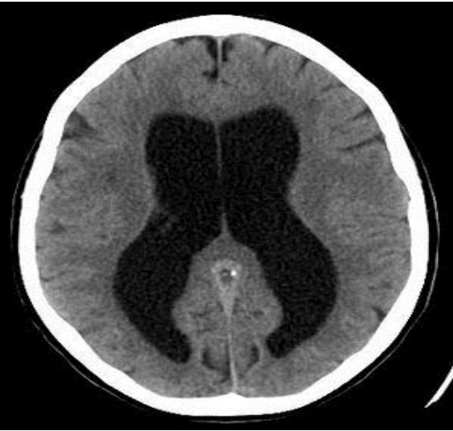
CT-Scan

Slide 91
Management
Steroids.
Antibiotics.
Hyperosmolar dehydrating agents.
Diuretics.
Ventriculoperitoneal shunt.
Mastoid exploration for ear disease.

Slide 92
BIOMEDICAL ETHICS
Longitudinal Integration
Before doing any medical and surgical treatment, informed consent must be taken
Prognosis should be explained to patients and attendants

Slide 93
Family Medicine
Longitudinal Integration
Any patient who presents with suspected complication of COM should have a complete otological and neurosurgical evaluation

