Slide 3
LADIES AND GENTLEMEN PLEASE RISE FOR THE NATIONAL ANTHEM

Slide 5
University Motto, Mission, Vision & Values
Mission Statement
To impart evidence-based research-oriented health
professional education, best possible patient care,
mutual respect, ethical practice of healthcare and social accountability.
Vision and Values
Highly recognized and accredited center of excellence in
Medical Education, using evidence-based training techniques for development of highly competent health professionals, who are lifelong experiential learner and are socially accountable.

Slide 6
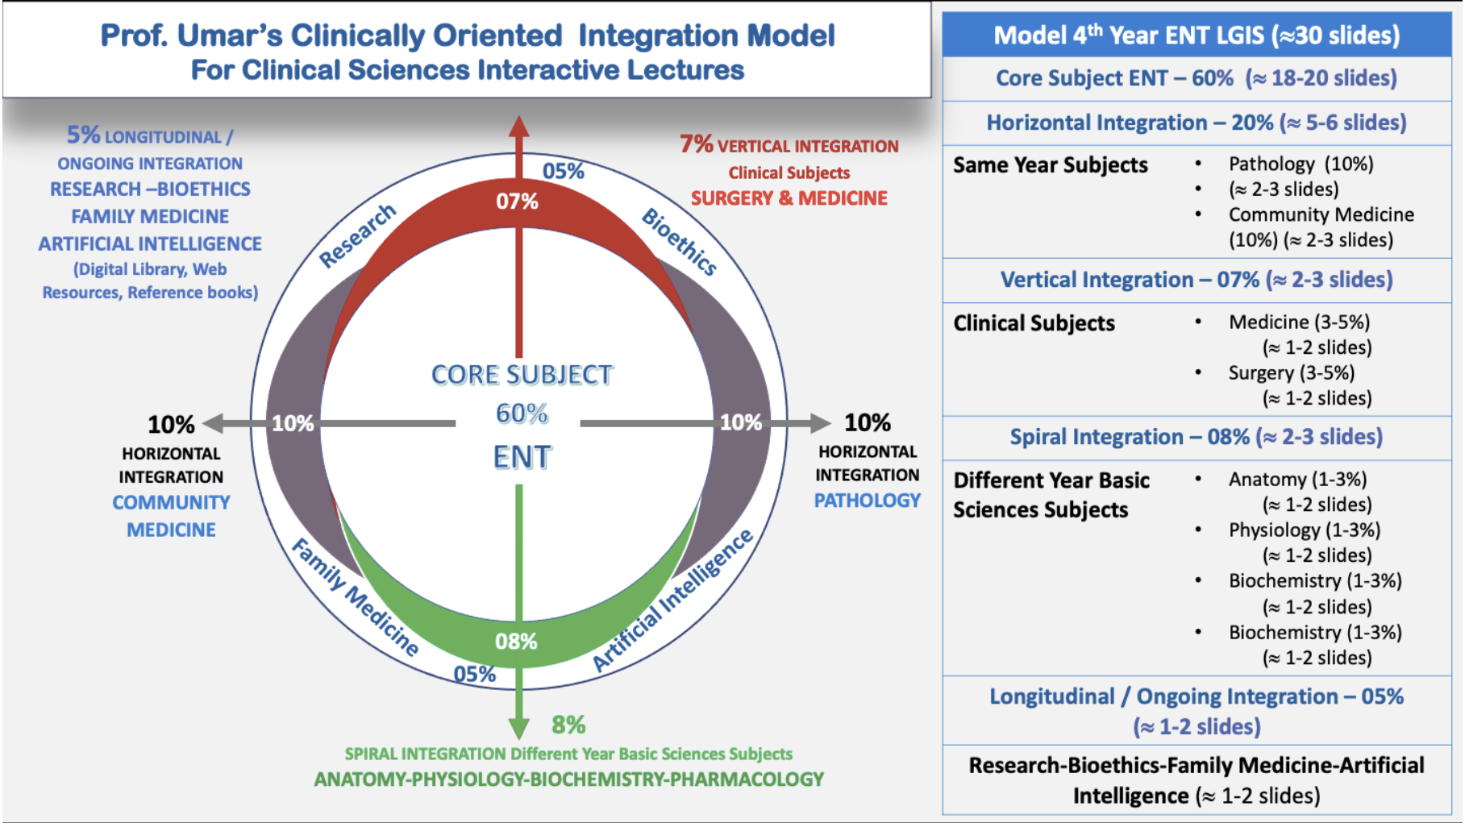
Prof Umar Model Of Integrated Lecture

Slide 7
Sequence Of LGIS
Learning objectives
Core concept of subject 60%
Anatomy, Biochemistry, Physiology (spiral integration 08%)
Surgery, Medicine (vertical integration – 07%)
Research article related to topic, Bioethics, A.I (05%)
Comm Med, Pathology (20%)

Slide 8
Complications of rhinosinusitis

Slide 9
Learning Objectives
At the end of 1 hour lecture students of 4th year will be able to:
Define the complications of rhinosinusitis
Enumerate the complications of rhinosinusitis
Explain pathological organisms involved
Identify the complications on the basis of clinical presentations of patients
Manage the patients of rhinosinusitis

Slide 10
Definition
1. Adverse progression of infection beyond muco-periosteal lining of para nasal sinuses to involve bone & neighboring structures (orbit, intra-cranial cavity, dentition)
2. Compromise in function of any part of body due to sinusitis

Slide 11
Etiology
1. Weak immune response of host: young children & immuno-compromised adults
2. Inadequate or inefficient treatment
3. Infection by high virulence organisms
4. Abnormalities of muco-cilliary clearance
5. Persistent allergy & blockade of sinus ostia

Slide 12
Routes of infection
1. Via thin bones: lamina papyracea
2. Through natural suture lines
3. Through natural canal: infra-orbital canal
4. Closely related roots of upper 2nd premolar &1st molar teeth

Slide 13
Common pathogens
Staphylococcus aureus
Streptococcus pnemoniae
Haemophilus influenzae
Moraxella catarrhalis
Anaerobes: Bacteroides
Aspergillus
Rhizopus

Slide 14
Orbital Complications
1. Pre-septal cellulitis
2. Orbital cellulitis without abscess
3. Orbital cellulitis with extra-periosteal abscess
4. Orbital cellulitis with intra-periosteal abscess
5. Cavernous sinus thrombosis ?: intracranial
6. Orbital apex syndrome

Slide 15
Intracranial Complications
1. Meningitis
2. Encephalitis
3. Extra-dural abscess
4. Sub-dural abscess
5. Intra-cerebral abscess
6. Cavernous sinus thrombosis
7. Sagittal sinus thrombosis

Slide 16
local complications
Bony
Osteitis
Osteomyelitis (Pott’s puffy tumour)
Dental
Dental abscess
Oro-antral fistula

Slide 17
Orbital complications

Slide 18
Introduction
Commonest complication of sinusitis
Young people at high risk: 85% < 20 yrs age
Ethmoid sinus most commonly implicated → → Frontal → Sphenoid → Maxillary
Left orbit more commonly involved

Slide 19
Pre-septal cellulitis

Slide 20
Pre-septal cellulitis
Infection external to peri-orbital septum
Edema of eyelid: upper lid = frontal sinusitis
lower lid = maxillary sinusitis
both lids = ethmoid sinusitis
No erythema / tenderness / proptosis / extra-ocular movement restriction / vision change

Slide 21
Pre-septal cellulitis

Slide 22
Pre-septal abscess

Slide 23
Pre-septal abscess

Slide 24
Orbital Cellulitis

Slide 25
Orbital Cellulitis
Infection inside peri-orbital septum
Diffuse peri-orbital edema
Mild proptosis present
Minimal or no restriction of extra-ocular movement
No change in vision

Slide 26
Orbital cellulitis

Slide 28
Extra-periosteal abscess

Slide 29
Extra-periosteal abscess
Localized extra-periosteal pus collection
Mild proptosis present
Mild restriction of extra-ocular movement
Mild vision loss
Color vision affected first: Red = brown
Blue = black

Slide 30
Extra-periosteal abscess

Slide 31
Intra-periosteal abscess

Slide 32
Intra-periosteal orbital abscess
Mild chemosis
Proptosis: severe, asymmetric, quadrantic
Concurrent, complete, ophthalmoplegia
Severe vision loss

Slide 33
Proptosis

Slide 34
Chemosis

Slide 35
Cavernous Sinus Thrombosis

Slide 36
Cavernous Sinus Thrombosis
Rapid onset, hectic fever
Bilateral orbital pain + severe chemosis
Bilateral absent pupillary reflex
Sequential ophthalmoplegia (VI → III → IV)
Papilloedema + loss of vision
Painful paraesthesia of V1, V2

Slide 37
Cavernous sinus thrombosis

Slide 38
C.T. with venogram
Absence of
contrast in
cavernous
sinuses

Slide 39
C.T. scan with contrast

Slide 40
Orbital apex syndrome
Frontal headache + deep orbital pain
Optic nerve involvement (vision loss)
Paralysis of abducens nerve….6
Paralysis of oculomotor nerve…..3
Paralysis of trochlear nerve….4
Painful paraesthesia of V1, V2….

Slide 41
Evaluation of orbital complication
1. Eye examination: Ophthalmology consultation
Edema of eyelids
Displacement of eyeball
Ocular movement
Visual acuity
Fundoscopy for papilledema
2. CT scan PNS (including orbit): coronal & axial

Slide 42
Medical Treatment
1. Broad spectrum, high dose IV antibiotics
(Ceftriaxone + Metronidazole)
2. NSAIDs
3. Topical / oral decongestants
4. Mucolytics: Bromhexine, Ambroxol
5. Nasal saline irrigation

Slide 43
Surgical Treatment
For sinusitis:
Frontal trephination
External fronto-ethmoidectomy (Lynch Howarth)
Functional Endoscopic Sinus Surgery
For orbital complication:
Sub-periosteal abscess drainage
Orbital decompression

Slide 44
Lynch – Howarth incision

Slide 45
Frontal sinus trephination

Slide 46
Indications for orbital decompression
No improvement in orbital symptoms in 24- 48 hours of treatment
CT scan evidence of orbital abscess
Visual acuity of 20 / 60 or worse

Slide 47
Intra-cranial complications

Slide 48
Introduction
2nd commonest complication of sinusitis
Most common in adolescents & young adults (diploic venous system at peak vascularity)
Frontal sinus most commonly implicated → Ethmoid → Sphenoid → Maxillary
Commonest route of spread = retrograde thrombophlibitis via Diploic veins

Slide 49
Intra-cranial complications

Slide 51
Clinical Features
Fever
Deep-seated headache
Nausea & projectile vomiting
Neck stiffness
Seizures
Altered sensorium & mood changes
Late: bradycardia / hypotension / stupor

Slide 52
C.T.: Frontal lobe abscess

Slide 53
Frontal lobe abscess

Slide 54
Investigations & Medical TREATMENT
Neurosurgery consultation
CT scan PNS + brain with contrast
MRI with contrast: investigation of choice
High dose IV broad spectrum antibiotics: Ceftriaxone & Metronidazole for 4-6 week
Steroids: controversial

Slide 55
Surgical Treatment
For sinusitis:
1. Frontal trephination
2. External fronto-ethmoidectomy (Lynch Howarth)
3. Functional Endoscopic Sinus Surgery
For intra-cranial complication: by Neurosurgeon
1. Burr hole drainage: for small abscess
2. Craniotomy: for large brain abscess

Slide 56
Sequelae
Seizures: 7.5%
Hemiparesis: 2 - 17 %
Hemiplegia
Death: 15 - 43 %

Slide 57
LOCAL complications

Slide 58
MUCOCELE
Definition: epithelium lined, mucus filled sac
completely filling paranasal sinus
& capable of expansion
Incidence:
Frontal = 65 % Ethmoid = 25 %
Maxillary = 10 % Sphenoid = rare

Slide 59
Etiology
1. Chronic obstruction of sinus ostium with retention of normal sinus mucus within sinus cavity
2. Mucous retention cyst: develops from obstruction of ducts of sero-mucinous glands within sinus mucosa

Slide 60
Clinical Features
Cystic, non-tender swelling above inner canthus with egg-shell crackling sensation on palpation
Proptosis: Frontal = down + forward + lateral
Ethmoid = forward + lateral
Maxillary = up + forward
Diplopia & restricted eyeball movement
Frontal headache, retro-orbital or facial pain

Slide 61
Differential diagnosis
Acute / chronic sinusitis
Retention cyst
Dermoid cyst
Paranasal sinus tumours
Antro-choanal polyp

Slide 62
Investigations
X-ray PNS: expanded frontal sinus, loss of scalloped margins, translucency, depression or erosion of supra-orbital ridge
CT scan: homogenous smooth walled mass expanding sinus, with thinning of bone
Ring enhancement on contrast = pyocoele

Slide 63
Frontal mucocoele

Slide 64
Fronto-ethmoid mucocele

Slide 65
Fronto-ethmoid mucocoele

Slide 66
Fronto-ethmoid mucocoele with proptosis

Slide 67
Maxillary mucocoele

Slide 68
Ethmoid + sphenoid mucocoele

Slide 69
Sphenoid mucocoele

Slide 70
Treatment
1. Antibiotics + nasal decongestants
2. External fronto-ethmoidectomy:
by Lynch – Howarth’s approach
3. Endoscopic fronto-ethmoidectomy
4. Endoscopic decompression (marsupialization)
5. Osteoplastic flap repair

Slide 71
Lt ethmoid mucocoele

Slide 72
Pre-op CT scan (axial)

Slide 73
Drainage + Marsupialization

Slide 74
Post-op CT scan (coronal)

Slide 75
Pott’s puffy tumour
Frontal sinus osteomyelitis (Percival Pott, 1760)
Fluctuant swelling over forehead anteriorly
May spread posteriorly → subdural abscess
Tx: 6 week antibiotics + drainage of pus & debridement of bone + obliteration of frontal sinus by osteoplastic flap technique

Slide 76
Pott’s puffy tumour

Slide 78
Oro-antral fistula
Communication b/w
oral cavity & maxillary
antrum
Tx: closure by
a. Buccal mucosal advancement flap
b. Palatal flap
c. Buccal fat pad flap

Slide 79
Maxillary sinusitis + fistula

Slide 80
Buccal mucosal advancement flap

Slide 81
Fistula closed

Slide 82
Toxic shock syndrome
Rare, potentially fatal complication
Septicaemia due to Staphylococcus aureus or Streptococcus infection
C/F: fever, hypotension, skin rashes with
desquamation, multi-system failure
Tx: 1. IV Ceftriaxone 1g Q8H
2. Drainage of sinus pus

Slide 83
family MEDICINE
Recognizing and managing complications of rhinosinusitis is crucial to preventing severe outcomes.
In primary care, early differentiation between viral and bacterial sinusitis is essential to avoid unnecessary antibiotic use while ensuring timely treatment for bacterial infections to prevent complications.
Patients should be educated on red flag symptoms such as high fever, periorbital swelling, and severe headache, which require urgent referral.
Preventative measures, including nasal saline irrigation and allergy management, are also emphasized in family medicine to reduce recurrence and complications

Slide 84
BIOMEDICAL ETHICS
Ethical challenges may arise when balancing antibiotic stewardship with the need to prevent life-threatening complications or when patients refuse necessary treatments, requiring careful navigation of medical and ethical responsibilities.

Slide 85
ARTIFICIAL INTELLIGENCE
AI-powered tools, such as machine learning algorithms and clinical decision support systems, can help differentiate bacterial from viral sinusitis, reducing unnecessary antibiotic prescriptions and preventing complications related to antibiotic resistance.

Slide 86
RESEARCH
https://pmc.ncbi.nlm.nih.gov/articles/PMC10477815/
https://www.kosinmedj.org/journal/view.php?number=1279

Slide 87
REFERENCES
https://www.mayoclinic.org/diseases-conditions/acute-sinusitis/symptoms-causes/syc-20351671
https://link.springer.com/chapter/10.1007/978-3-030-54088-3_23

