Slide 2
COMMON MEDICAL ISSUES
DR. Madiha Umair
MBBS, FCPS Medicine
Senior Registrar Medicine
Holy Family Hospital, Rawalpindi

Slide 4
LEARNING OUTCOMES
Describe patho-physiology of pain.
Describe evaluation of patient with pain.
Evaluate cause of chest discomfort
Describe approach to a patient with fever.

Slide 5
PAIN
CORE CONCEPT
Pain is an uncomfortable feeling that tells you something may be wrong. It can be steady, throbbing, stabbing, aching, pinching, or described in many other ways. Sometimes, it’s just a nuisance, like a mild headache. Other times it can be debilitating.
The International Association for the study of Pain (IASP) has defined pain as
‘’An unpleasant sensory and emotional experience associated with actual or potential tissue damage or described in terms of such damage.’’

Slide 6
PATHOPHYSIOLOGY
HORIZONTAL INTEGRATION
Acute pain, which usually occurs in response to tissue injury, results from activation of peripheral pain receptors and their specific A delta and C sensory nerve fibers (nociceptors).
Chronic pain related to ongoing tissue injury is presumably caused by persistent activation of these fibers.

Slide 7
PATHOPHYSIOLOGY
HORIZONTAL INTEGRATION

Slide 8
Pain classification and Mechanisms
CORE CONCEPT
NOCICEPTIVE
Due to direct stimulation of peripheral nerve endings by a noxious stimulus such as trauma, burns or ischemia
NEUROPATHIC
Due to dysfunction of the pain perception system within the PNS or CNS as a result of injury, disease or surgical damage such as continuing pain experienced from a limb which has been amputated.

Slide 9
Evaluation of patient with pain
VERTICAL INTEGRATION

Slide 10
CHEST PAIN
CORE CONCEPT
Chest pain is one of the frequent complaints in patients presenting to emergency rooms and ambulatory care clinics.
For the primary care physician evaluating these patients, there are three essential steps in the evaluation of chest pain.
The first step is to determine whether the chest pain is cardiac in origin or not.

Slide 11
CORE CONCEPT
If the pain is suspected to be cardiac, then the next step would be to determine if the chest pain is secondary to an acute coronary syndrome (acute myocardial infarction or unstable angina) that requires immediate referral to an emergency room to initiate therapy and admit to the hospital.

Slide 12
CORE CONCEPT
If the pain is not considered to be due to an acute coronary syndrome, then we proceed with a systematic approach to try to determine the likelihood that a particular patient has significant coronary artery disease (CAD).

Slide 13
CORE CONCEPT
This is determined based on the patient's history, risk factors and electrocardiogram.
Once the likelihood is assessed, this will determine what further invasive or non-invasive tests would be required to complete the patient's evaluation.

Slide 14
VERTICAL INTEGRATION

Slide 15
VERTICAL INTEGRATION

Slide 16
CARDIAC CHEST PAIN
VERTICAL INTEGRATION

Slide 17
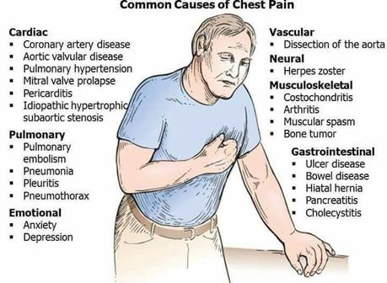
VERTICAL INTEGRATION

Slide 18
SELF DIRECTED LEARNING

Slide 19
FEVER
CORE CONCEPT
CDC considers a person to have a fever when he or she has a measured temperature of 100.4° F (38° C) or greater, or feels warm to the touch, or gives a history of feeling feverish.
The presence of fever suggests an infectious cause, but fever is not always present with an infection.
Having a fever is a sign that something out of the ordinary is going on in your body.

Slide 20
CORE CONCEPT
A careful travel history, exposure history (persons with fever, known infectious disease, animals, ticks, fresh or sea water, undercooked or unprocessed foods, toxins, etc.), history of localizing features, sexual history, and family history may provide vital clues.

Slide 21
CORE CONCEPT
There are four major patterns.
Intermittent
Remittent
Continuous
Relapsing

Slide 22
CORE CONCEPT
INTERMITTENT FEVER
the temperature is elevated but falls to normal (37.2°C or below) each day
REMITTENT FEVER
the temperature falls each day but not to normal.
In these two patterns the amplitude of temperature change is more than 0.3°C and less than 1.4°C.
Either of the two patterns can be called hectic when the difference between peak and trough temperature is great (1.4°C or more).

Slide 23
CORE CONCEPT
CONTINUOUS FEVER
is a pattern in which there is little change (0.3°C or less) in the elevated temperature during a 24-hour period.
RELAPSING FEVER
a variant of the intermittent pattern, fever spikes are separated by days or weeks of intervening normal temperature.

Slide 24
CORE CONCEPT
Hectic fevers, because of wide swings in temperature, are often associated with chills and sweats. This pattern is thought to be very suggestive of an abscess or pyogenic infection such as pyelonephritis and ascending cholangitis, but may also be seen with tuberculosis, hyper nephromas, lymphomas, and drug reactions.

Slide 25
CORE CONCEPT
Continuous or sustained fever is usually not associated with true chills or rigors. It is characteristic of typhoid fever or typhus, although commonly seen in bacterial endocarditis, tuberculosis, fungal disease, and bacterial pneumonia. Noninfectious etiologies include neoplasms, connective tissue disease, and drug fever.

Slide 26
CORE CONCEPT
Relapsing fevers may be seen in rat-bite fever, malaria, cholangitis, infections with Borrelia recurrentis, Hodgkin's disease (Pel-Ebstein fever), and other neoplasms.
Fever at 48-hour intervals suggests Plasmodium vivax or P. ovale; 72-hour intervals suggest P. malariae, while P. falciparum often has an unsynchronized intermittent fever.

Slide 27
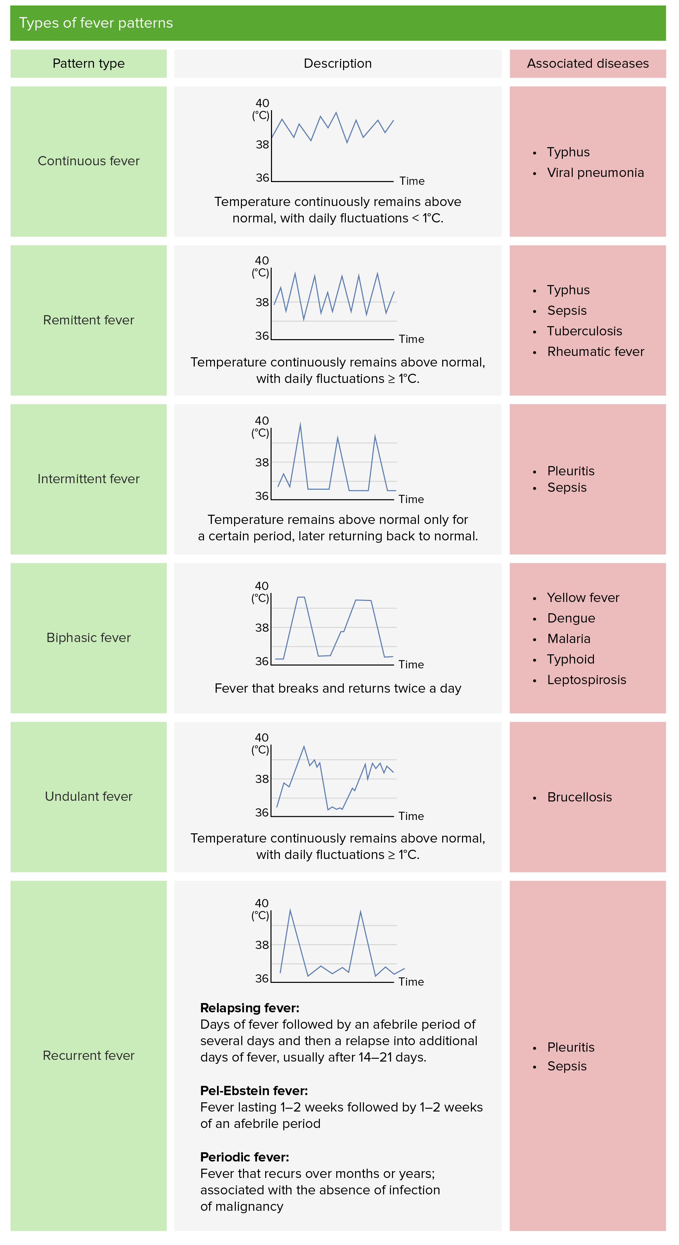

Slide 28
RELATIVE BRADYCARDIA
CORE CONCEPT
As a rule, the pulse rate rises about 15 beats/min for each degree centigrade of fever. When this expected rise is not seen, a relative bradycardia exists and, in the absence of beta-adrenergic blockers, suggests one of the diseases

Slide 29
Causes of relative Bradycardia
VERTICAL INTEGRATION
Factitious fever
Drug lever
Legionnaires" disease
Psittacosis
Typhoid fever
Mycoplasma pneumonia
Brucellosis
Dengue
Yellow fever
Tuberculous meningitis
Blackwater fever (Falciparum malaria with profound hemolysis)

Slide 30
SELF DIRECTED LEARNING

Slide 31
Approach to a patient with Fever
VERTICAL INTEGRATION

Slide 33
Routine Investigations in a febrile patient
VERTICAL INTEGRATION
CBC
ESR, CRP
Blood Cultures
Urine R/E and Culture
CXR
LFTs
RFTS
MP smear
Ultrasound Abdomen
ECHO

Slide 34
SELF DIRECTED LEARNING

Slide 35
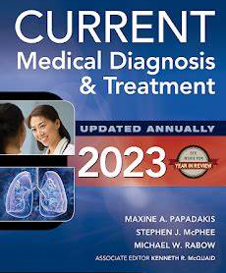
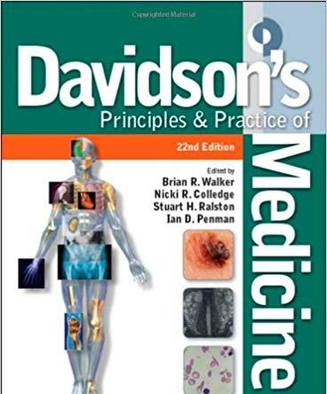
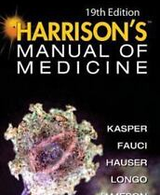
STUDY RESOURCES

Slide 36
MCQS
Pain sensation from the peripheral nerve fibres is carried to thalamus by
Dorsal column
Spinothalamic tract
Spinocerebellar tract
Corticospinal tract
Reticulospinal tract

Slide 37
Answer B

Slide 38
2. Nociceptive pain is present in
Diabetes
Herpes zoster
Ischemia
Nerve compression
Trigeminal neuralgia

Slide 39
Answer C

Slide 40
3. A 45-year-old diabetic male with history of cough and fever for last 3 days developed sudden onset left sided intense, sharp chest pain which increases in intensity on inspiration. Most likely cause of his chest pain is
Angina
Myocardial infarction
Pleuritic chest pain
Dyspepsia
Muscular pain

Slide 41
Answer C

Slide 42
4. Stepladder pattern of fever is seen in
Lymphoma
Typhoid
Tuberculosis
Infective Endocarditis
UTI

Slide 43
Answer B

Slide 44
5. Type of fever in which temperature falls each day but not touches the baseline is
Remittent fever
Intermittent fever
Relapsing fever
Continuous fever
Pel Ebstein fever

Slide 45
Answer A

