Slide 2
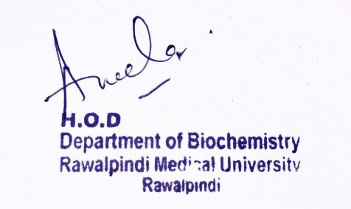
Foundation Module 1st Year MBBS (LGIS) Introduction & Classification of Enzymes
Presenter: Dr Raja Khalid Yaqub Date: 27-01-25

Slide 3
Motto, Vision, Dream
To impart evidence based research oriented medical education
To provide best possible patient care
To inculcate the values of mutual respect and ethical practice of medicine
Wisdom
Truth
Service

Slide 4
Professor Umar Model of Integrated Lecture

Slide 5
Learning Objectives
At the end of this lecture students should be able to
Understand classification and functions of enzymes.
Differentiate between coenzyme, cofactor and holoenzyme .
Discuss isoenzymes with suitable examples.

Slide 6
Introduction to Enzymes
Core Knowledge
Enzymes may be defined as biocatalysts synthesized by living cells.
They are protein in nature (exception – RNA acting as ribozyme), colloidal and thermolabile in character, and specific in their action.

Slide 7
Functions of Enzymes
Core Knowledge
Enzymes provide support for many important processes within the body. Some examples include:
The digestive system: Enzymes help the body break down larger complex molecules into smaller molecules, such as glucose, so that the body can use them as fuel.
DNA replication: Each cell in the body contains DNA. Each time a cell divides, the cell needs to copy its DNA. Enzymes help in this process by unwinding the DNA coils.
7

Slide 8
Functions of Enzymes
Core Knowledge
Liver enzymes: The liver breaks down toxins in the body. To do this, it uses a range of enzymes the facilitate the process of destroying the toxins.
Other activities enzymes help with include the hormone production, cell regulation, creating movement to make the muscle contract, transporting materials around a cell and respiration.
8

Slide 9
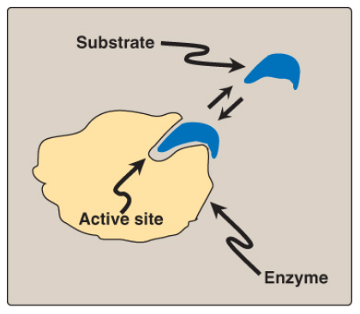
Core Knowledge
Enzymes
Enzymes are proteins that act as biological catalysts by accelerating chemical reactions, without being changed in the overall process.
An enzyme combines with the substrate at its active site and converts the substrate into product.
9

Slide 10
Core Knowledge
Coenzyme, Cofactor and Holoenzyme
An apoenzyme is an inactive enzyme, activation of the enzyme occurs upon binding of an organic or inorganic cofactor.
If the nonprotein component is a metal ion, such as zinc (Zn²⁺) or iron (Fe²⁺), it is called a cofactor. If it is a small organic molecule, it is termed a coenzyme (NAD⁺, NADP⁺, FAD derived from vitamins)
The term holoenzyme refers to the protein component of the enzyme along with its nonprotein component. It is the enzyme's catalytically active form.
Holoenzyme = Apoenzyme + Cofactor

Slide 11
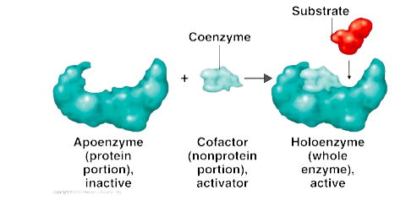
Coenzyme, Cofactor and Holoenzyme
Core Knowledge

Slide 12
Core Knowledge
Isoenzymes
Isoenzymes are variant forms of the same enzyme that catalyze the same reaction but have slightly different physical properties because of genetically determined differences in amino acid sequence.

Slide 13
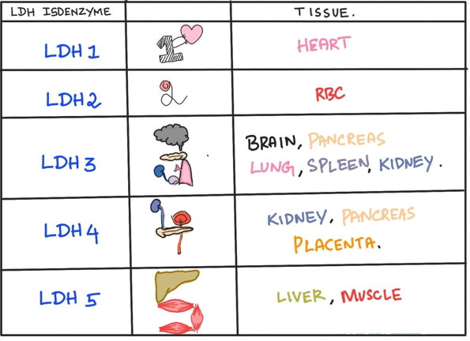
Five isoenzyme forms of LDH exist in various body tissues.
Core Knowledge
Lactate Dehydrogenase (LDH) Isoenzyme

Slide 14
Creatine Kinase (CK) Isoenzymes
Core Knowledge
CK occurs as three isoenzymes.
Each CK isoenzyme is a dimer composed of two polypeptide subunits (called B and M subunits for brain and skeletal muscle) associated in one of three combinations:
CK1 = BB (Brain)
CK2 = MB (Myocardium)
CK3 = MM (Skeletal muscle, cardiac muscle)
Each CK isoenzyme shows a characteristic electrophoretic mobility.

Slide 15
Core Knowledge
Clinical Importance of Isoenzymes
Different organs commonly contain particular proportions of different isoenzymes.
The pattern of isoenzymes found in the blood plasma can serve as a means of identifying the site of tissue damage.
The plasma levels of various isoenzyme forms of LDH and of creatine kinase (CK) vary under different disease states.

Slide 16
Classification of Enzymes
Core Knowledge
Enzymes involved in oxidation-reduction reactions.

Slide 17
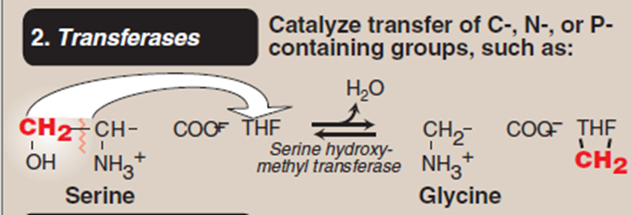
Core Knowledge
Enzymes that catalyze the transfer of functional groups.

Slide 18
Core Knowledge
Enzymes that bring about hydrolysis of various compounds.

Slide 19
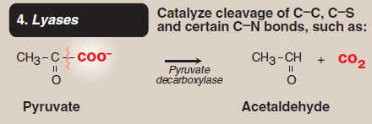
Core Knowledge
Enzymes specialized in the addition or removal of water, ammonia, CO2 etc.
Enzymes specialized in the addition or removal of water, ammonia, CO2 etc.

Slide 20
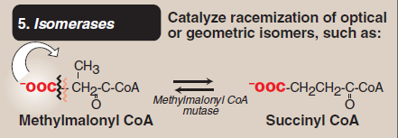
Core Knowledge
Enzymes involved in all the isomerization reactions.

Slide 21
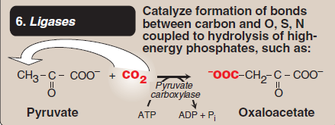
Core Knowledge
Enzymes catalyzing the synthetic reactions (Greek : ligate—to bind) where two molecules are joined together, and ATP is used

Slide 22
Core Knowledge

Slide 23
Functions of Enzymes
Horizontal Integration
The digestive system: Enzymes help the body break down larger complex molecules into smaller molecules, such as glucose, so that the body can use them as fuel.
DNA replication: Each cell in the body contains DNA. Each time a cell divides, the cell needs to copy its DNA. Enzymes help in this process by unwinding the DNA coils.
Liver enzymes: The liver breaks down toxins in the body. To do this, it uses a range of enzymes the facilitate the process of destroying the toxins.

Slide 24
Vertical Integration
Albinism:
Albinism refers to a group of conditions in which a defect in tyrosine metabolism results in a deficiency in the production of melanin.
It may be inherited by one of several modes: autosomal recessive (primary mode), autosomal dominant, or X linked.
Total absence of pigment from the hair, eyes, and skin, tyrosinase-negative oculocutaneous albinism (type 1 albinism), results from an absent or defective copper-requiring tyrosinase.

Slide 25
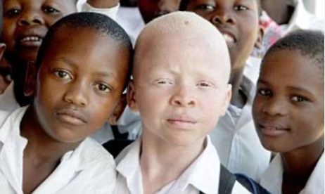
Albinism

Slide 26
Family Medicine
Spiral Integration
Family Medicine plays important role in following manner:
Early Diagnosis
Education
Dietary Guidance
Monitoring
Refer to Specialists

Slide 27
Artificial Intelligence
Spiral Integration
AI can assist in several ways to support individuals with albinism.
Diagnostic assistance: AI-powered image recognition and analysis tools can aid in the early detection of skin conditions such as skin cancer, which individuals with albinism are at higher risk for.
Vision Assistance: AI-powered vision enhancement technologies can help individuals with albinism compensate for vision impairments.
Personalized Healthcare: AI algorithms can analyze genetic data to provide personalized healthcare recommendations based on an individual's genetic predispositions and medical history

Slide 28
Suggested Research Article
Spiral Integration
Link: https://pubmed.ncbi.nlm.nih.gov/31213387/
Journal Name : Trends Genet
Title: Transcriptional Control by Premature Termination: A Forgotten Mechanism
Author Name: Kinga Kamieniarz-Gdula, Nick J Proudfoot
Abstract
The concept of early termination as an important means of transcriptional control has long been established. Even so, its role in metazoan gene expression is underappreciated. Recent technological advances provide novel insights into premature transcription termination (PTT). This process is frequent, widespread, and can occur close to the transcription start site (TSS), or within the gene body. Stable prematurely terminated transcripts contribute to the transcriptome as instances of alternative polyadenylation (APA). Independently of transcript stability and function, premature termination opposes the formation of full-length transcripts, thereby negatively regulating gene expression, especially of transcriptional regulators. Premature termination can be beneficial or harmful, depending on its context. As a result, multiple factors have evolved to control this process

Slide 29
Bioethics
Spiral Integration
Appropriate information
Explain to patient or his family the genetic aspects of the condition
Counselling

Slide 30
How To Access Digital Library
Steps to Access HEC Digital Library
Go to the website of HEC National Digital Library
On Home Page, click on the INSTITUTES
A page will appear showing the universities from Public and Private Sector and other Institutes which have access to HEC National Digital Library HNDL
Select your desired Institute
A page will appear showing the resources of the institution
Journals and Researches will appear
You can find a Journal by clicking on JOURNALS AND DATABASE and enter a keyword to search for your desired journal

Slide 31
Learning Resources
Textbook of Biochemistry, Lippincott Illustrated Reviews 8th edition, chapter no
Google scholar
Google images

