Slide 1
CHRONIC OSTEOMYELITIS
DEPARTMENT Of ORTHOPaedics
HOLY FAMILY HOSPITAL,RWP

Slide 3
Lay Out
Definition
Classification
Pathophysiology
Clinical features
Differential diagnosis
Investigations
Management (Treatment)
Complications
Biomedical Ethics
Recent Advances

Slide 4
LEARNING OBJECTIVES
At the end of this lecture students shall be able to learn:
Explain pathophysiology in chronic osteomyelitis .
Identify clinical features and use diagnostics (imaging, labs) for diagnosis.
Describe medical (antibiotics) and surgical (debridement) management.
Recognize complications
Apply knowledge to diagnose, manage, and educate patients clinically.

Slide 13
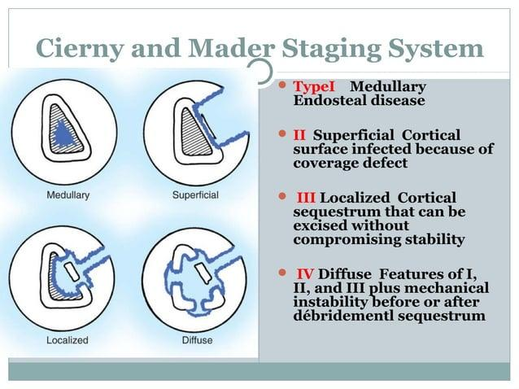

Slide 19
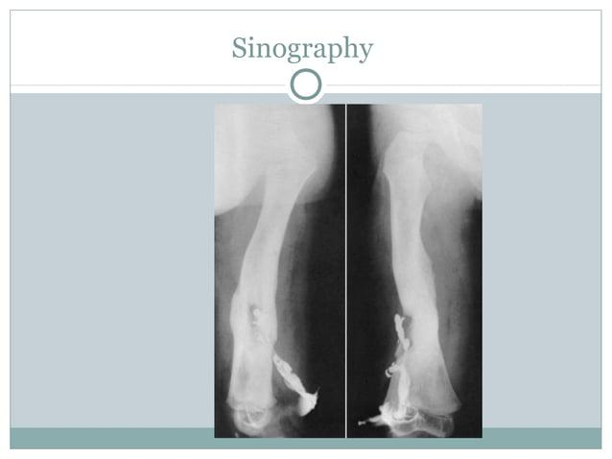

Slide 32
Bioethics in Chronic Osteomyelitis
1. Patient Autonomy & Informed Consent
2. Beneficence & Non-Maleficence
3. Justice & Resource Allocation
4. Pain Management & Quality of Life
5. End-of-Life & Disability Considerations

Slide 33
Recent Advances
1. Multifunctional Hydrogels for Localized Therapy
2. Advancements in Local Antibiotic Delivery Systems
3. Antimicrobial Biodegradable Bone Substitutes:
4.Development of New Antibiotics

Slide 34
Research
Here are some recent research articles focusing on advancements in the treatment of chronic osteomyelitis:
1. "Osteomyelitis: Recent Advances in Pathophysiology and Therapeutic Strategies"Authors: J. Wang et al.Published in: Journal of Orthopaedic Translation, 2017.Summary: This review discusses the latest insights into the pathophysiology of osteomyelitis and highlights novel therapeutic approaches, including local antibiotic delivery systems and biofilm disruptors.
2. "Current Application and Future Perspectives of Antimicrobial Degradable Bone Substitutes for Chronic Osteomyelitis"Authors: C. Jiang et al.Published in: Frontiers in Bioengineering and Biotechnology, 2024.Summary: This paper reviews clinical evidence on antimicrobial biodegradable bone substitutes, emphasizing their dual role in eradicating infections and facilitating bone regeneration.
3. "Single vs. Two-Stage Management of Long-Bone Chronic Osteomyelitis:A Meta-Analysis"Authors: Y. Li et al.Published in: Journal of Orthopaedic Surgery and Research, 2024.Summary: This meta-analysis compares the efficacy of single-stage versus two-stage surgical treatments for chronic osteomyelitis in long bones, finding no significant difference in cure rates between the two approaches.

Slide 35
THANK YOU

