Slide 1
CKD
DR ASMARA ASRAR
ASSISSTANT PROFESSOR NEPRHOLOGY
HOLY FAMILY HOSPITAL

Slide 2
MOTTO AND VISION
Mission Statement
      To impart evidence-based research-oriented health professional education Best possible patient careMutual respect, ethical practice of healthcare and social accountability.
Vision and Values
      Highly recognized and accredited centre of excellence in Medical Education, using evidence-based training techniques for development of highly competent health professionals, who are lifelong experiential learner and are socially accountable.
Goals
      The Undergraduate Integrated Learning Program is geared to provide you with quality medical education in an environment designed to:

Slide 3
Learning Objectives
AT THE END OF THIS LECTURE STUDENTS SHALL BE ABLE TO LEARN:
  ETIOLOGY OF CKD
  STAGES OF CKD
  SIGNS AND SYMPTOMS
  EXAMINATION
  INVESTIGATIONS
  MEDICAL MANAGEMENT
  RECENT ADVANCES

Slide 4
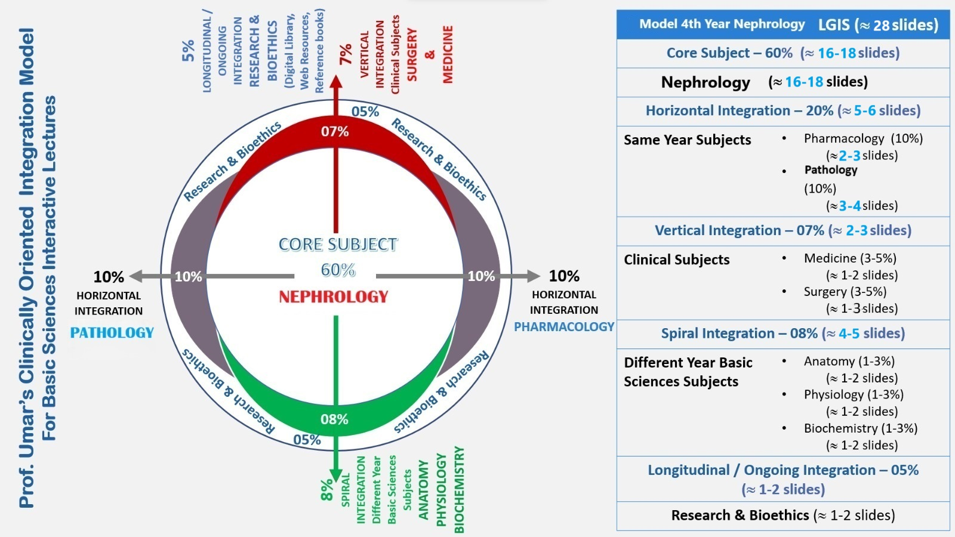

Slide 5
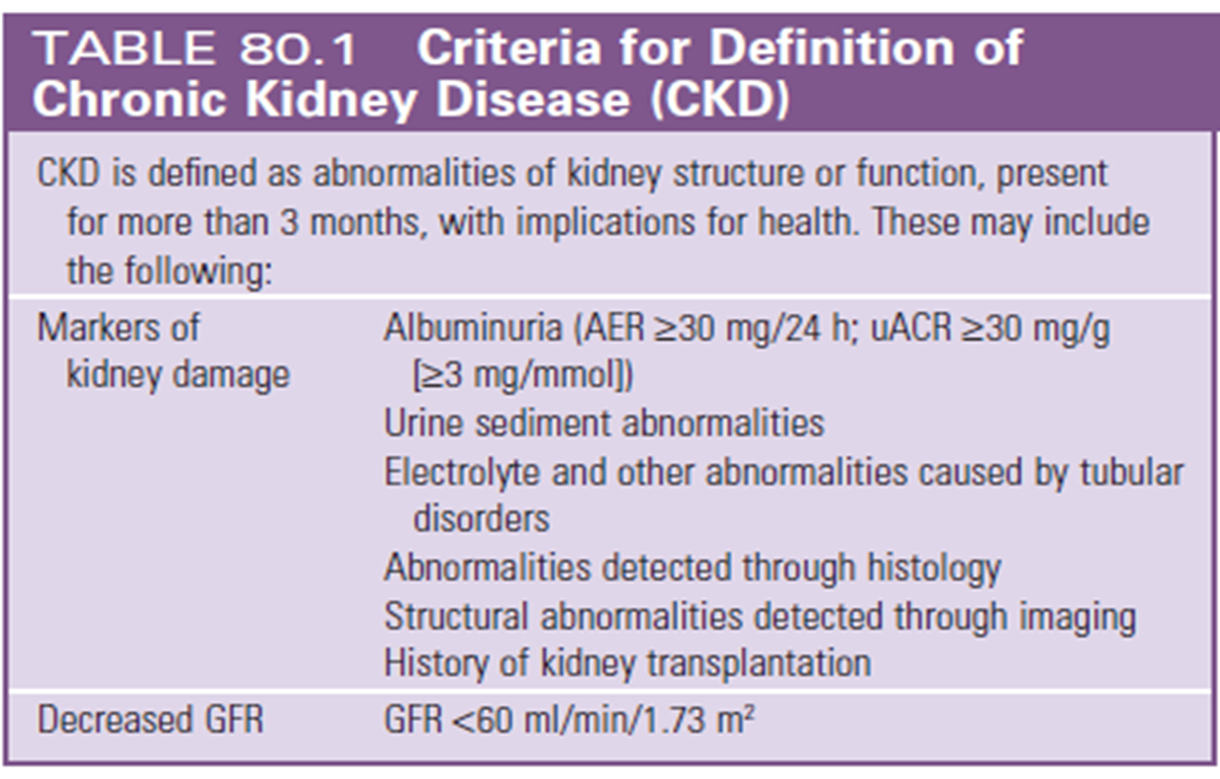

Slide 6
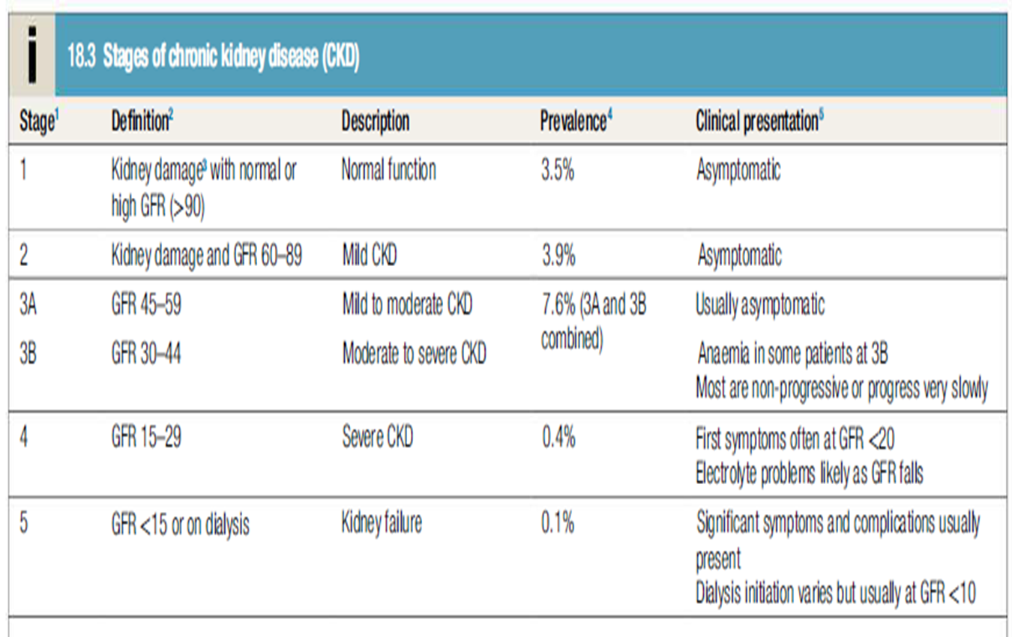

Slide 7
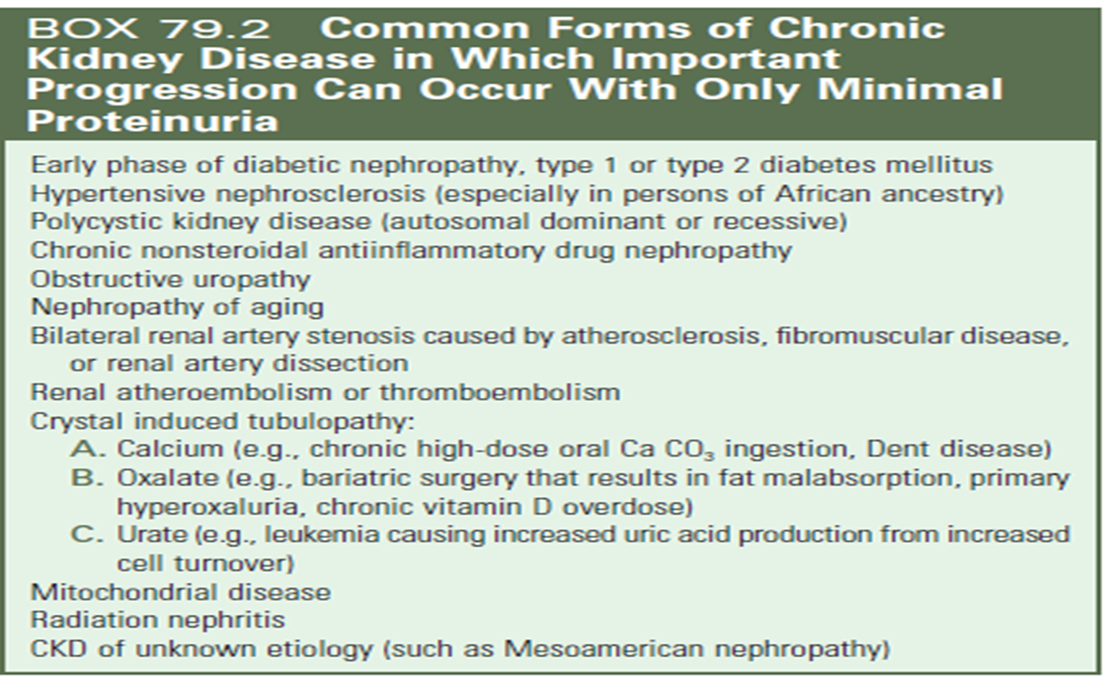

Slide 8
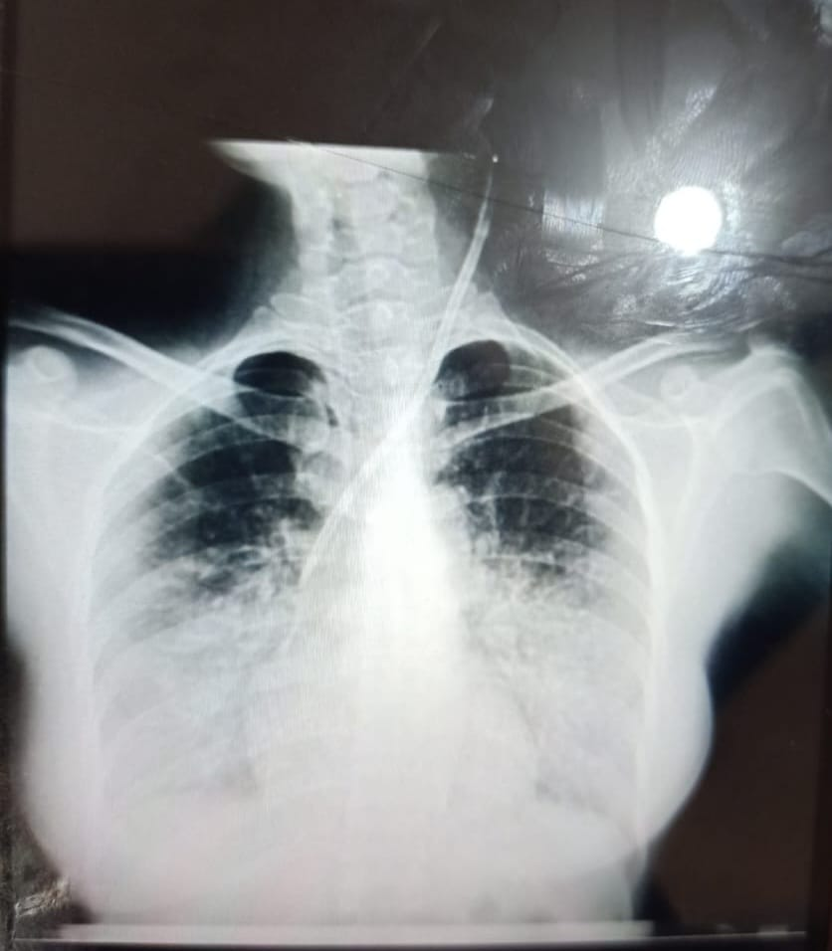

Slide 9
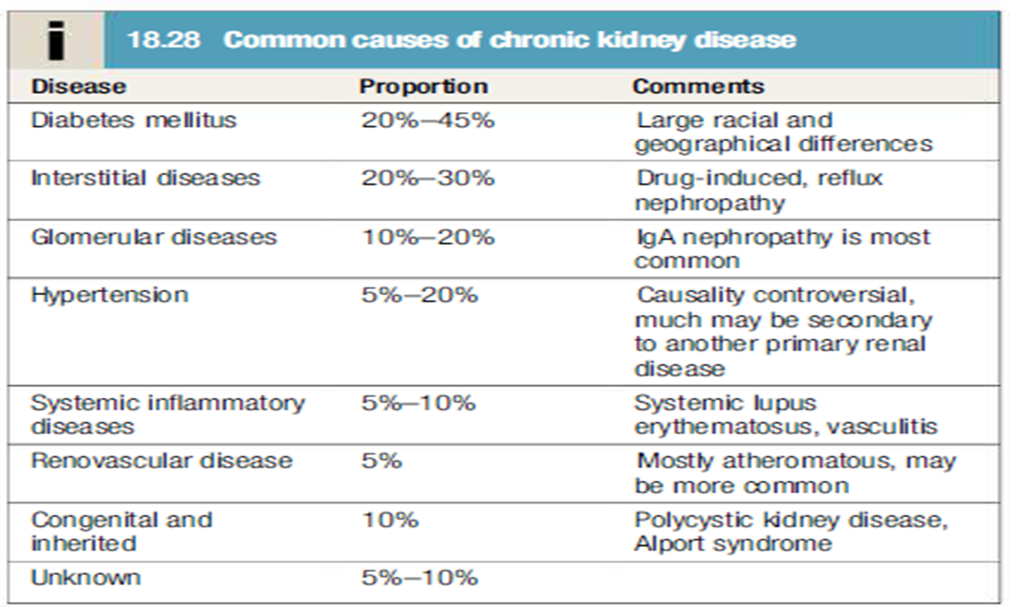

Slide 10
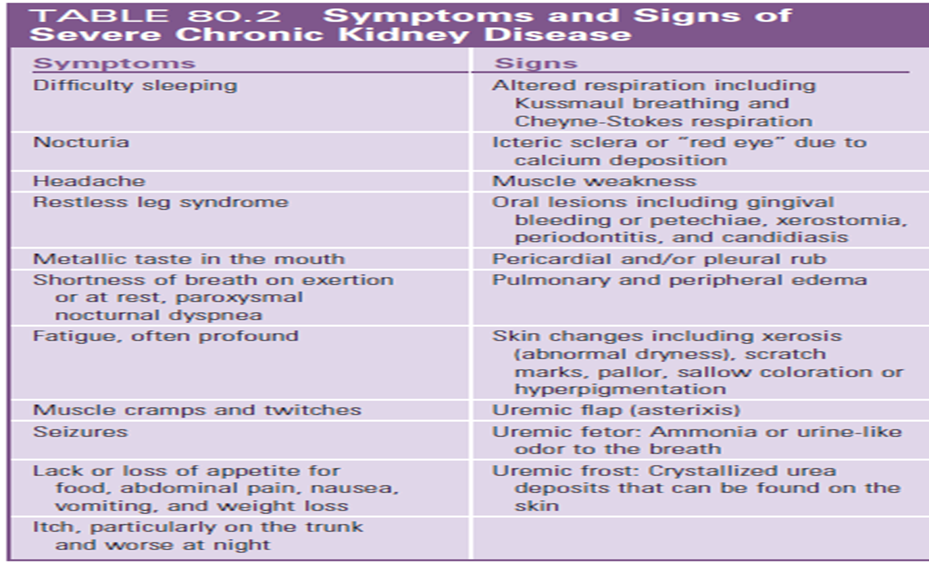

Slide 11
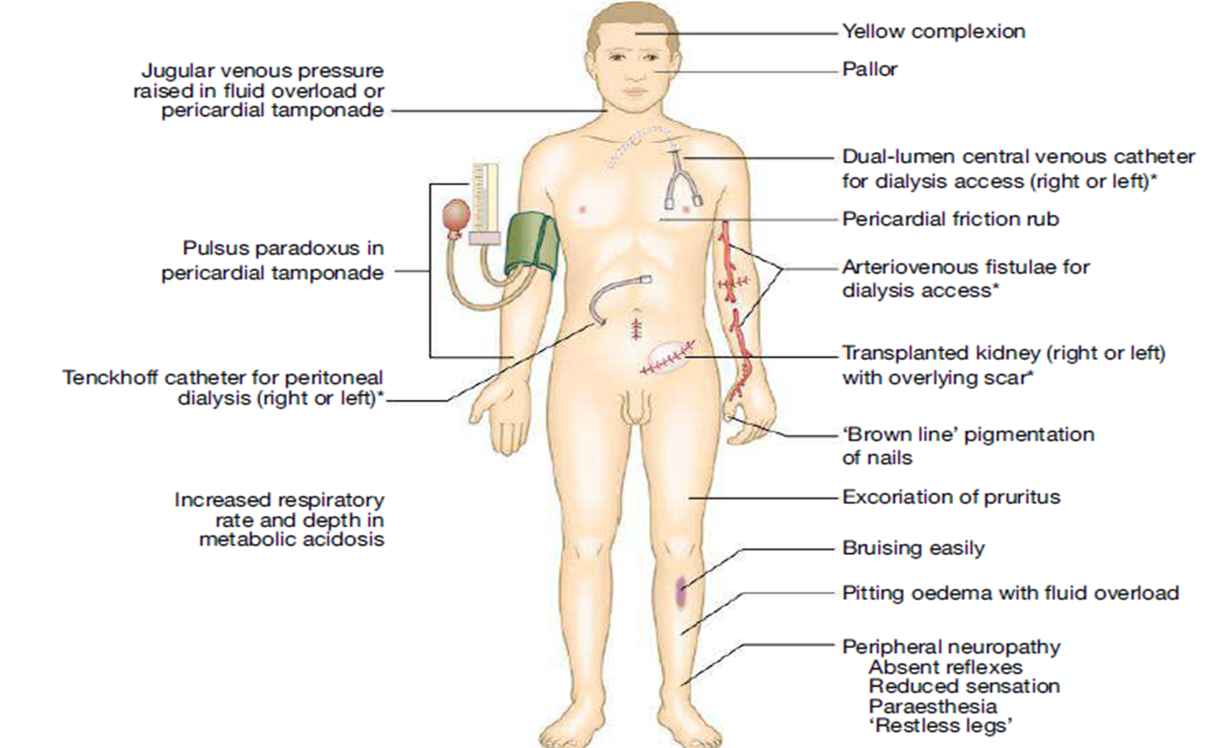

Slide 12
CKD
Uremia(gastritis,pericarditis,encephalopathy,pruritis)
Metabolic acidosis and hyperkalemia
Anemia
Uremic bleed
Fluid overload
CKD-MBD

Slide 13
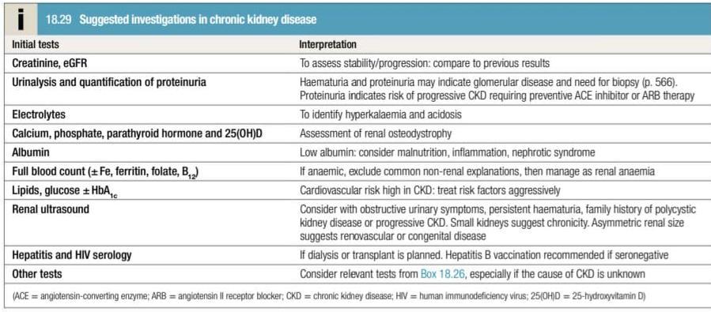
INVESTIGATIONS

Slide 14
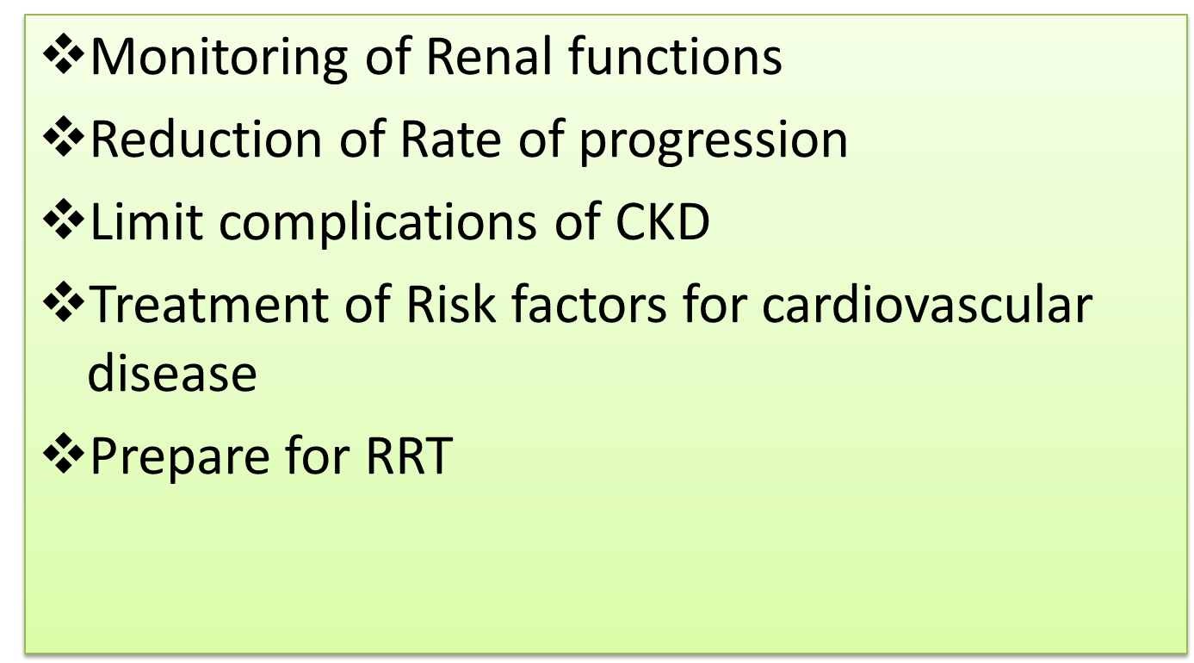
MANAGEMENT PLAN FOR CKD

Slide 15
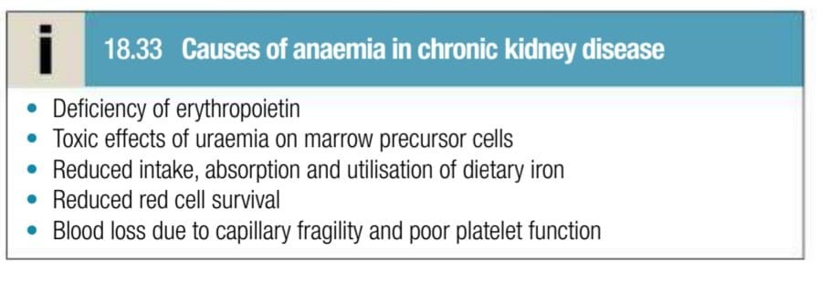

Slide 16
CONSERVATIVE MANAGEMENT
BP AND BSR CONTROL
DIETARY SALT AND WATER RESTRICTION
POTASSIUM RESTRICTION
PROTEIN RESTRICTION
AV FISTULA FORMATION
PRE-EMPTIVE TRANSPLANT

Slide 17
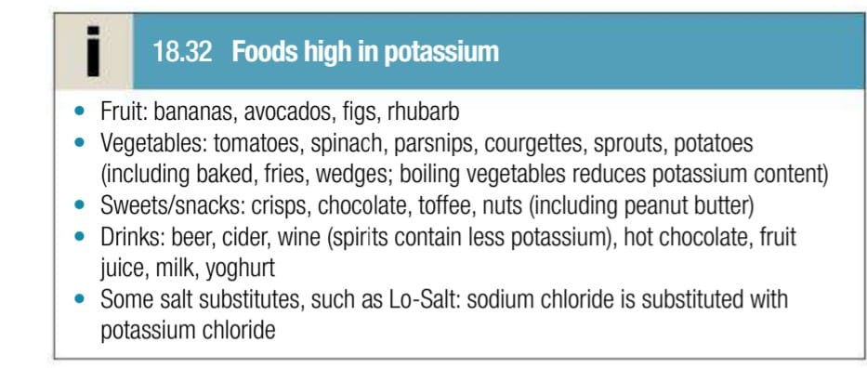

Slide 18
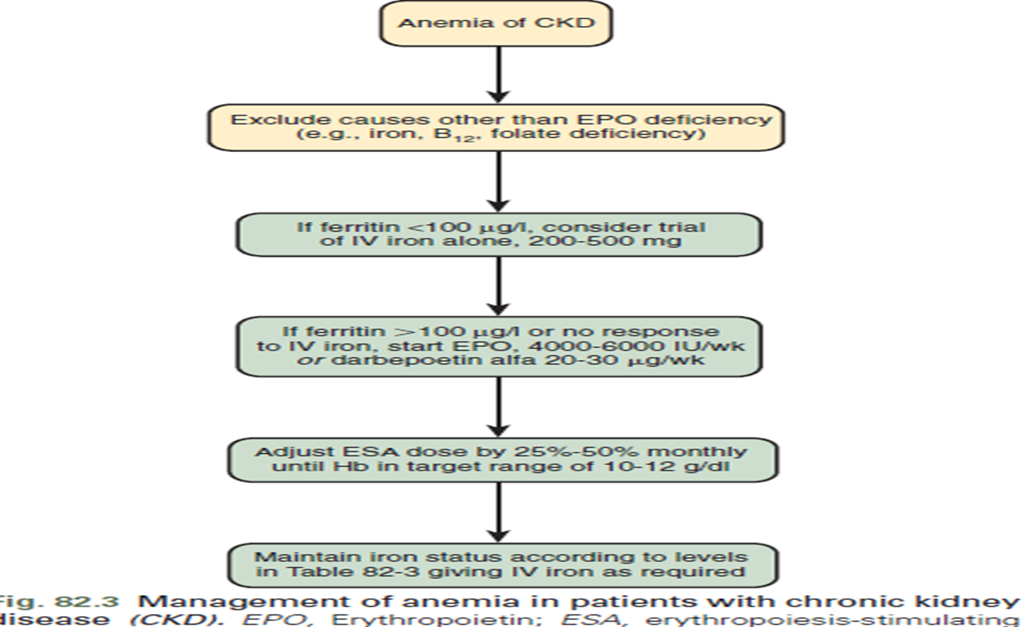

Slide 19
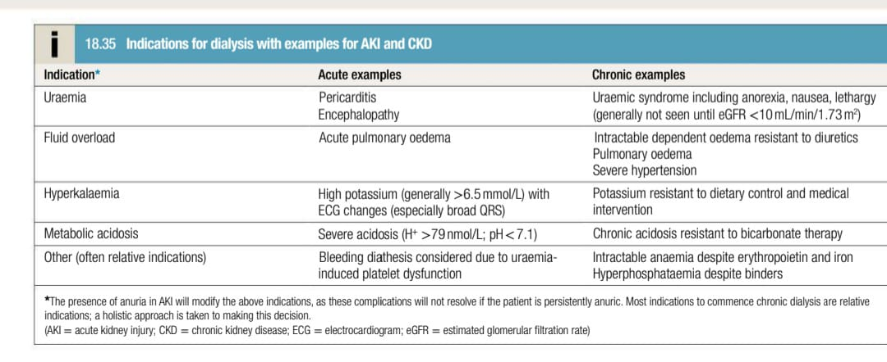

Slide 20
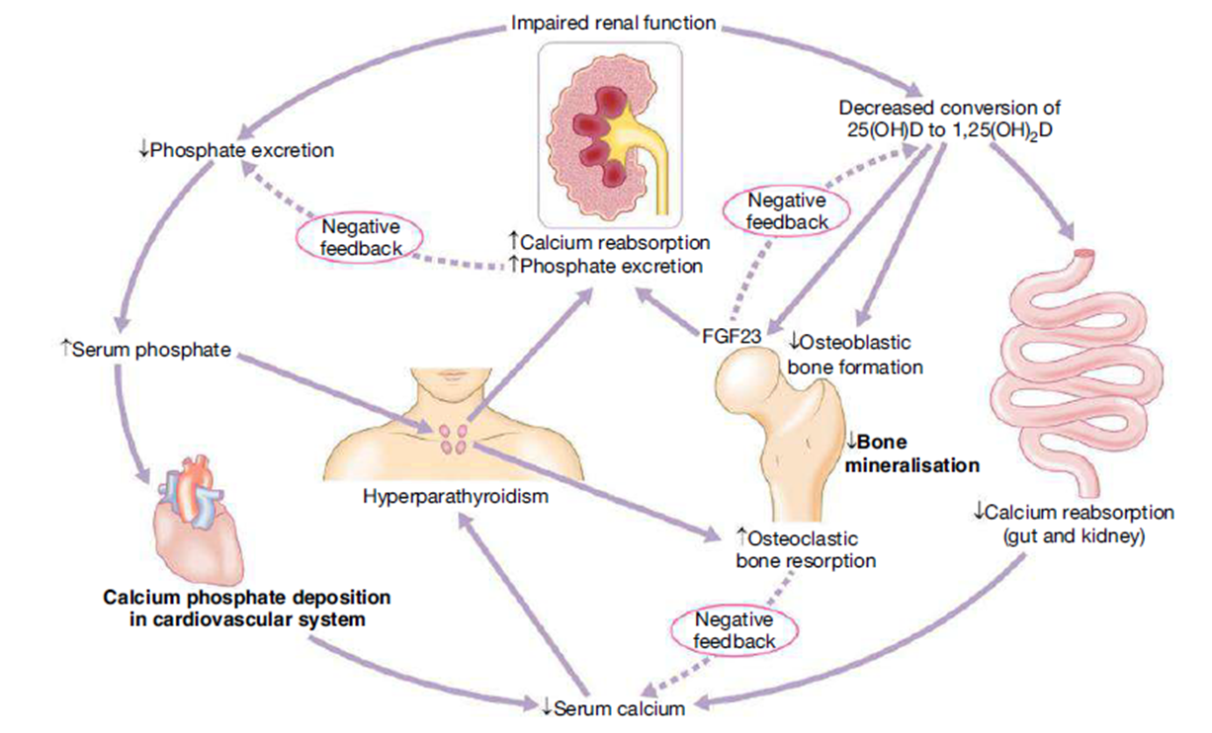

Slide 21
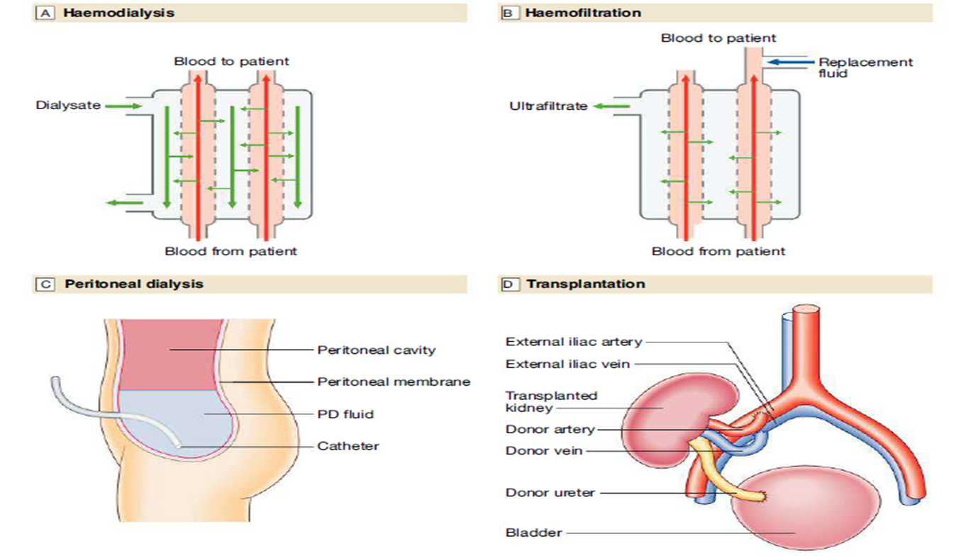

Slide 22
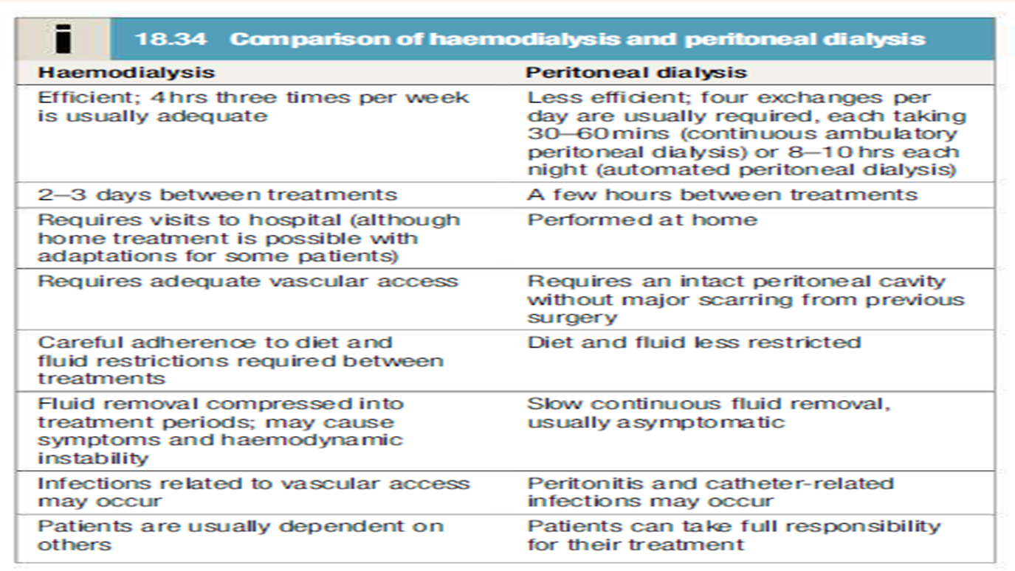

Slide 23
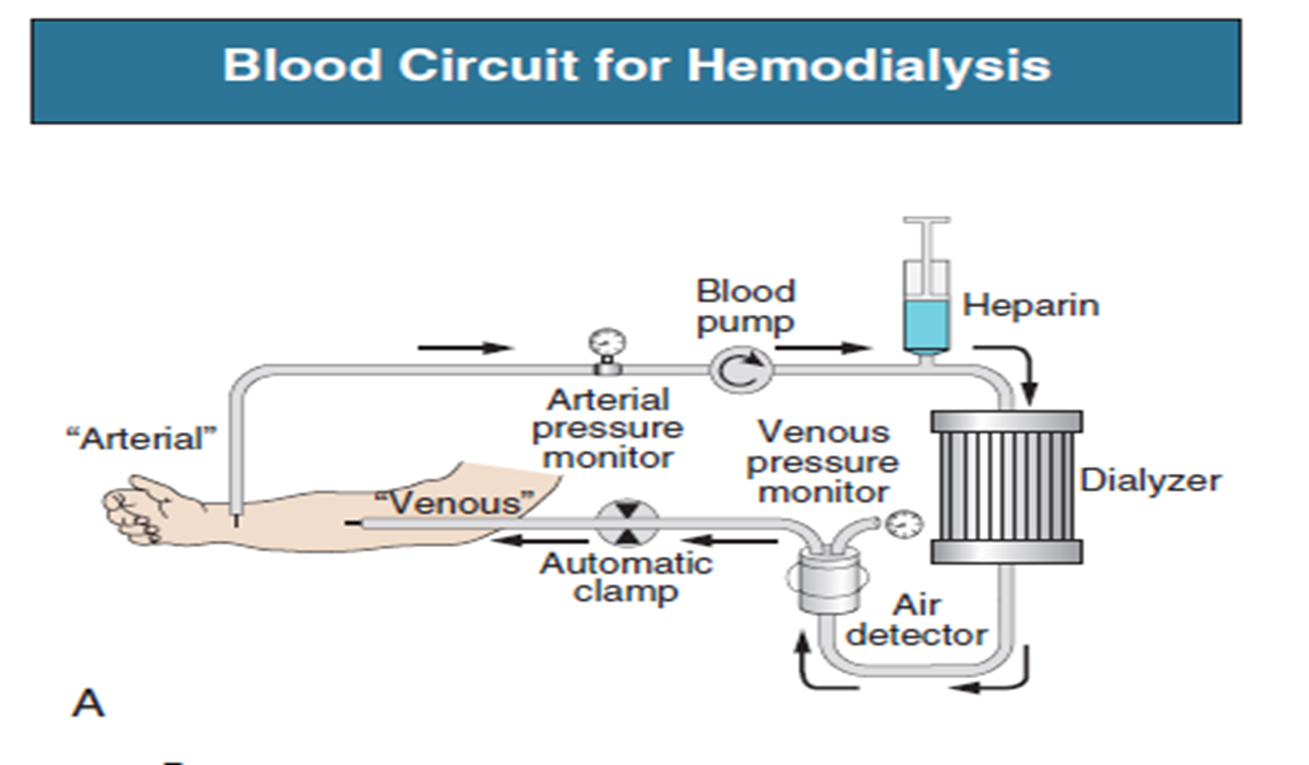

Slide 24
QUESTION 1
What is the primary method for staging Chronic Kidney Disease (CKD) according to the KDIGO guidelines?
A) Serum creatinine level
B) Urine protein-to-creatinine ratio
C) Estimated Glomerular Filtration Rate (eGFR)
D) Presence of kidney damage

Slide 25
QUESTION 2
A 50-year-old patient with hypertension and diabetes is diagnosed with stage 3 Chronic Kidney Disease (CKD). Which of the following is the most appropriate management strategy for slowing the progression of CKD?
A) Tight blood pressure control with ACE inhibitors or ARBs
B) Intensive glycemic control with insulin therapy
C) Restriction of protein intake to 0.5 g/kg/day
D) All of the above

Slide 26
ANSWERS
ANSWER 1 :C) Estimated Glomerular Filtration Rate (eGFR)
ANSWER 2: D) All of the above

Slide 27
REFRENCES
1. Levey AS, Eckardt KU, Dorman NM, et al. Nomenclature for kidney function and disease: executive summary and glossary from a Kidney
Disease: Improving Global Outcomes (KDIGO) consensus conference. Am J Kidney Dis. 2020;76(2):157–160.
2. National Kidney Foundation. K/DOQI clinical practice guidelines for
chronic kidney disease: evaluation, classication, and stratication. Am J Kidney Dis. 2002;39(2 suppl 1):S1–S266.
3.Stevens PE, Levin A. Kidney disease: improving global outcomes chronic
kidney disease guideline development work group members. Evaluation
and management of chronic kidney disease: synopsis of the kidney disease: improving global outcomes. Ann Intern Med. 2013;158(11):825–830.
4. Levey AS, Inker LA, Coresh J. GFR estimation: from physiology to public
health. Am J Kidney Dis. 2014;63(5):820–834.

Slide 28
THANKYOU

