Slide 1
Chlamydia and
Rickettsiae
Microbe Module 3rd Year MBBS
By: Dr.Kiran Fatima
Pathology Department
Rawalpindi Medical University

Slide 5
Learning outcomes
Define Chlamydia and Rickettsia, highlighting their unique characteristics as obligate intracellular bacteria.
Identify the major diseases caused by Chlamydia and Rickettsia.
Explain the modes of transmission for both Chlamydia and Rickettsia infections.
Describe the symptoms, complications, and diagnostic methods for these infections.
Outline the treatment and prevention strategies for Chlamydia and Rickettsia diseases.

Slide 6
Learning resources
Levinson, W. Review of Medical Microbiology and Immunology. 15th ed. McGraw-Hill Education / Medical; 2020

Slide 7
Chlamydia
Pathology
Core
1. Ocular Infections:
Chlamydia trachomatis causes:
Trachoma and inclusion conjunctivitis.
Genital Infections:
Respiratory Infections:

Slide 8
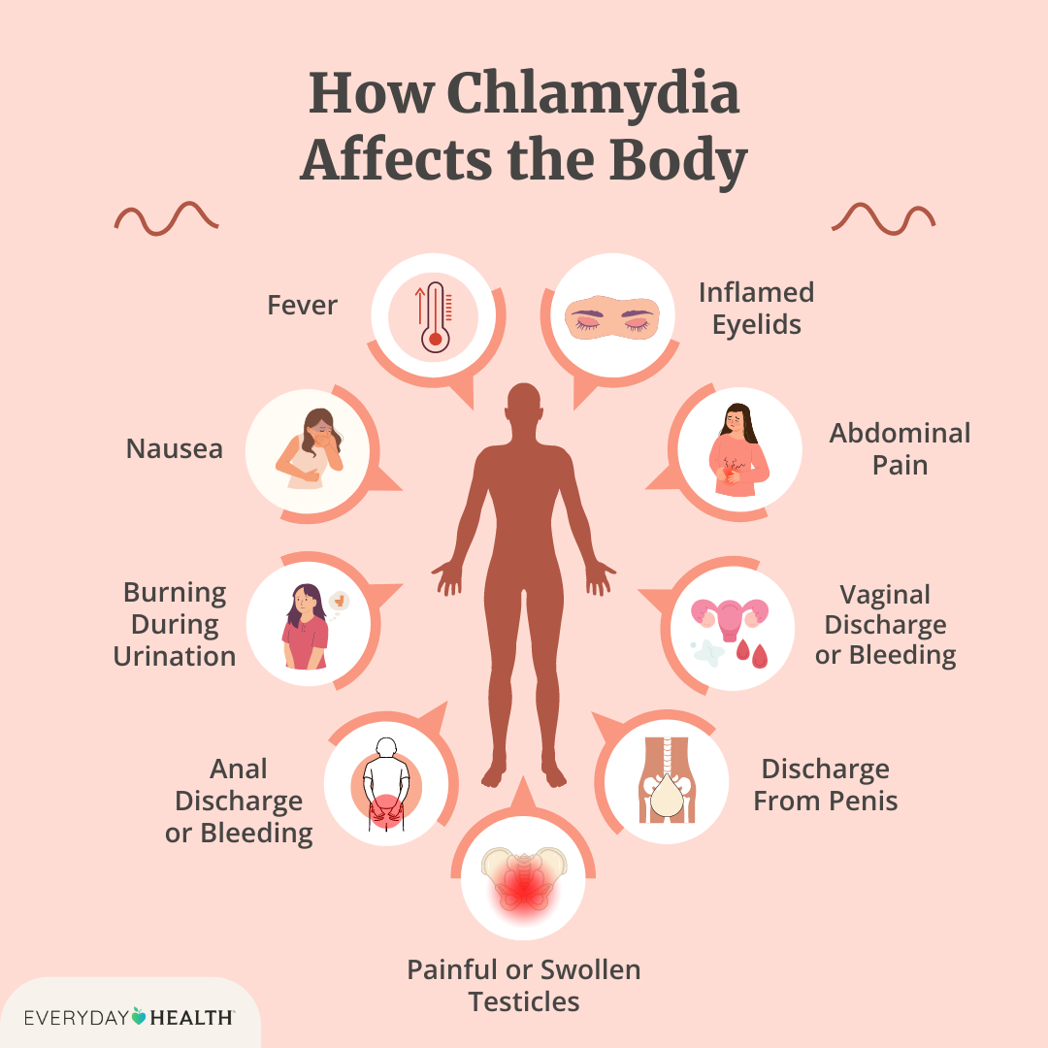
spiral

Slide 9
Pathology
Core

Slide 10
Pathology
Core

Slide 11
Trachoma and conjunctivitis.
Core
Trachoma is characterized by development of follicles and inflammed conjunctivae. Cornea may become cloudy and vascularized; repeated infections are a common cause of blindness. Inclusion conjunctivitis is a milder inflammatory conjuctival infection with purulent discharge.

Slide 12
Genital infections :
Core
Some C trachomatis strains cause genital infections, including non gonococcal uretheritis (NGU) in men and acute salpingitis and cervicitis in women.
Other strains cause
Lymphogranuloma venereum, a venereal disease with genital lesions and regional lymph node involvement (buboes).

Slide 13
Core
Respiratory Infections: Chlamydia psittaci usually causes an influenza like illness called psittacosis.
Chlamydia pneumoniae
TWAR organism causes atypical pneumonitis in humans.

Slide 14
Taxonomy
Pathology
Core
C.Trachomatis
Sexually transmited disease
Human to human
C.Pneumoniae
Human to human
C.Psittasi
Bird to human

Slide 15
Virulence factor
Pathology
Core

Slide 16
Pathology
Core

Slide 17
Pathology
Core

Slide 18
Pathology
Core

Slide 20
Pathology
Core

Slide 21
Treatment
Pathology
Horizontal
Tetracycline and erythromycin are the drugs of choice.
Penicillin is not effective.

Slide 22
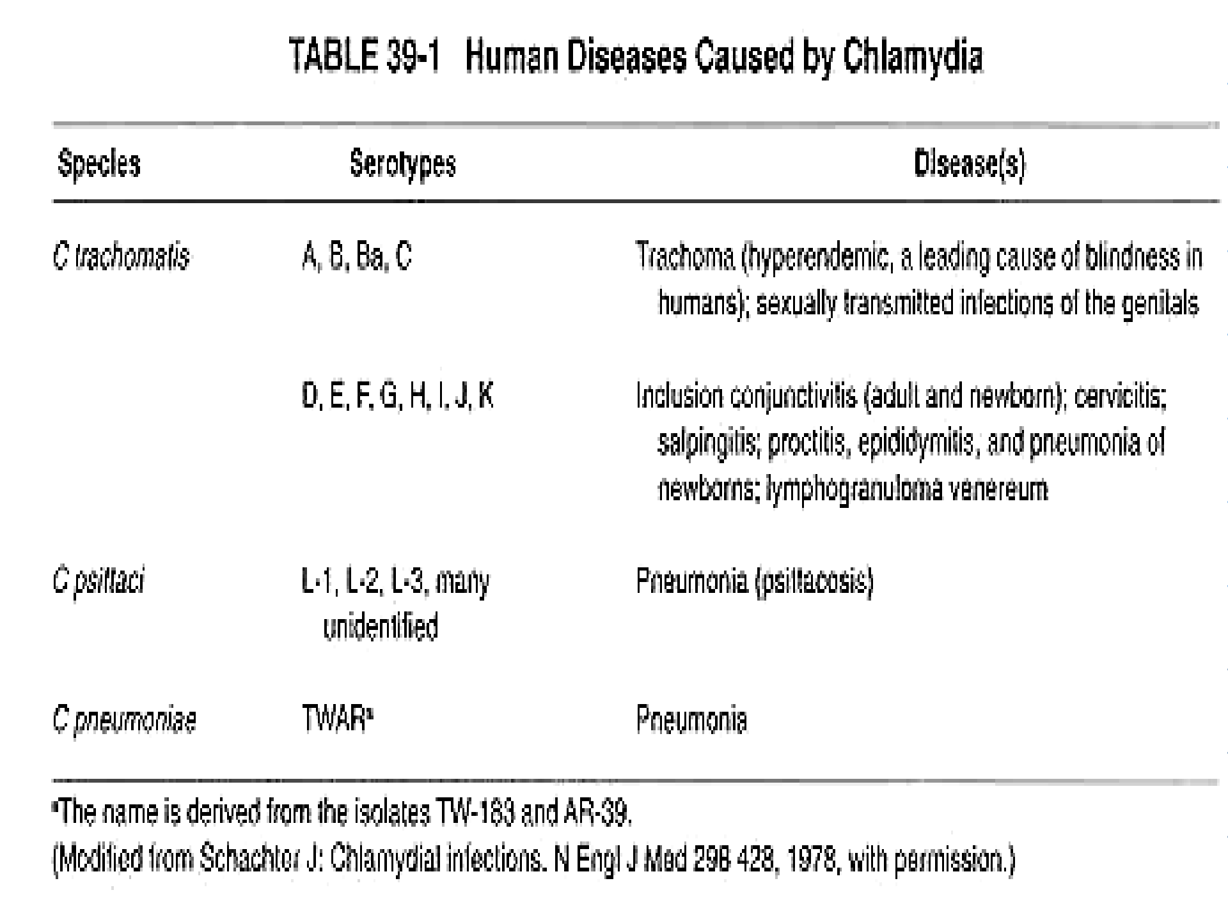
Pathology
Core

Slide 23
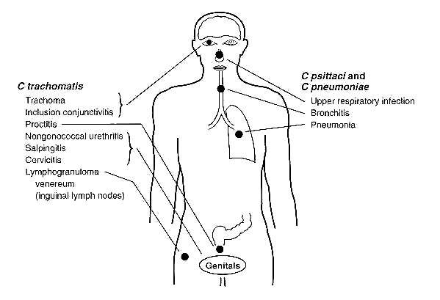
Clinical manifastations of
Vertical
chlamydial infections

Slide 24
Rickettsiae
Pathology
Spiral
Introduction
Rickettsiae are small, Gram-negative bacilli that have evolved in such close association with arthropod hosts that they to are adapted survive within the host cells.

Slide 25
Summary of selected Rickettssial
Pathology
Core
diseases.
 | Disease | Organism | Arthropod Vector | Mammalian reservoir | Imp. in the USA
 | Rocky | R. | Ticks | Dogs, | Yes
 | mountain spotted | rickettssii |  | Rodents | (East coast)
 | fever

Slide 26
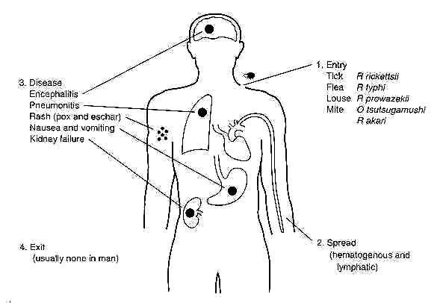
Common clinical manifestations of rickettsial diseases.
Pathology Vertical

Slide 27
Diagnosis
Pathology
core
The clinical signs and symptoms (e.g., fever, headache, nausea, vomiting, and muscle aches) resemble many other diseases during the early stages when antibiotic treatment is most effective
A history of exposure to the appropriate vector .
Detection rickettsial antigens themselves (e.g., the indirect fluorescence antibody test or latex agglutination)

Slide 28
Weil-Felix test that is based
Pathology
Core
on the cross-reactive antigens of OX-19 and OX-2 strains of Proteus negative only in Q fever

Slide 29
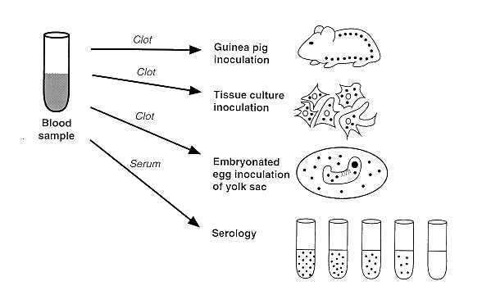
Laboratory methods used in confirming a
Pathology Core
diagnosis of rickettsial infection.

Slide 30
Treatment
Pathology
Horizontal
Doxycycline, tetracycline, or chloramphenicol is effective in controlling the infection

Slide 31
Longitudinal

Slide 32
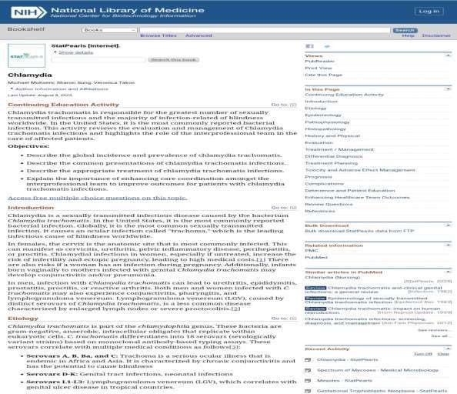
Research
Longitudinal

Slide 33
Longitudinal

Slide 34
A remote village in a developing country experiences an unusual outbreak characterized by
Longitudinal
fever, headache, muscle pain, and a rash. Laboratory tests reveal the presence of an obligate intracellular organism.
The most likely causative agent of this outbreak is:
Streptococcus pneumoniae
Rickettsia rickettsii
Staphylococcus aureus
Escherichia coli

Slide 35
Take home massage
Rickettsiae are tiny, obligate intracellular bacteria that cause a variety of diseases in humans and animals. These bacteria are transmitted by arthropod vectors such as ticks, fleas, and lice. They are responsible for a range of illnesses, including typhus, Rocky Mountain spotted fever, and other serious infections. Prompt diagnosis and treatment with antibiotics are crucial for recovery.

