Slide 2
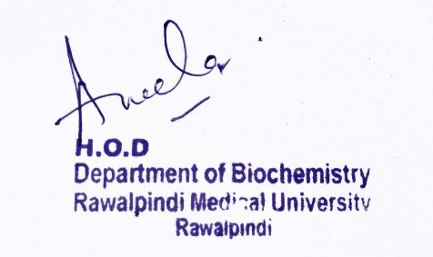
CVS Module 1st Year MBBS (LGIS) Simple and Compound Lipids
Presenter: Dr. Aneela Jamil Date: 24-02-25
(Assistant Professor)

Slide 3
Motto, Vision, Dream
To impart evidence based research oriented medical education
To provide best possible patient care
To inculcate the values of mutual respect and ethical practice of medicine
Wisdom
Truth
Service

Slide 4
Professor Umar Model of Integrated Lecture

Slide 5
Learning Objectives
At the end of this lecture students should be able to
Classify simple and compound lipids
Describe structure and functions of simple and compound lipids
Vertically integrate related disorder

Slide 6
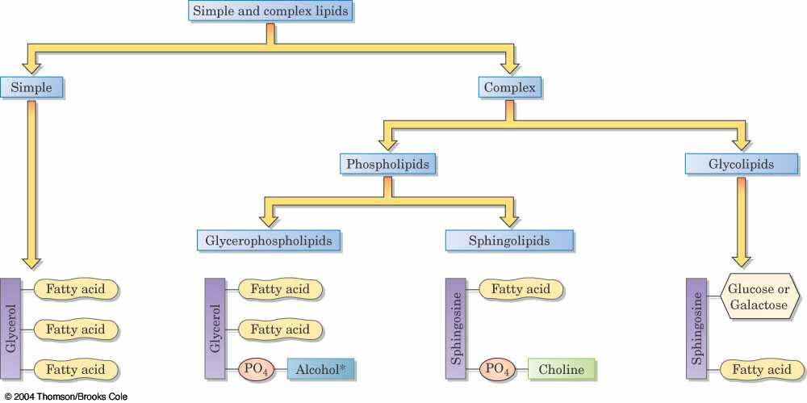
Core Knowledge

Slide 7
Core Knowledge
Simple lipids
Esters of fatty acids with alcohols
Neutral lipids
Waxes

Slide 8
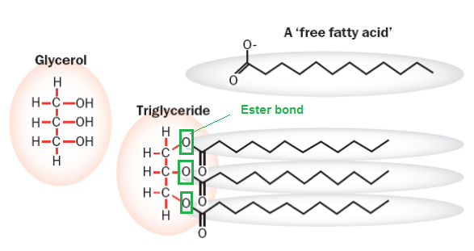
Core Knowledge
Structure of Triglycerides
Functions of Triglycerides
Stored energy
Insulation

Slide 9
Core Knowledge
Physical properties of Triglycerides
Melting point (chain length and degree of unsaturation)
Oils (rich in unsaturated fatty acids)
Fat (rich in saturated fatty acids)
Chemical properties of Triglycerides
Hydrolysis
Saponification
Rancidity
Oxygenation
Hydrogenation
Halogenation
Notes:
8
8

Slide 10
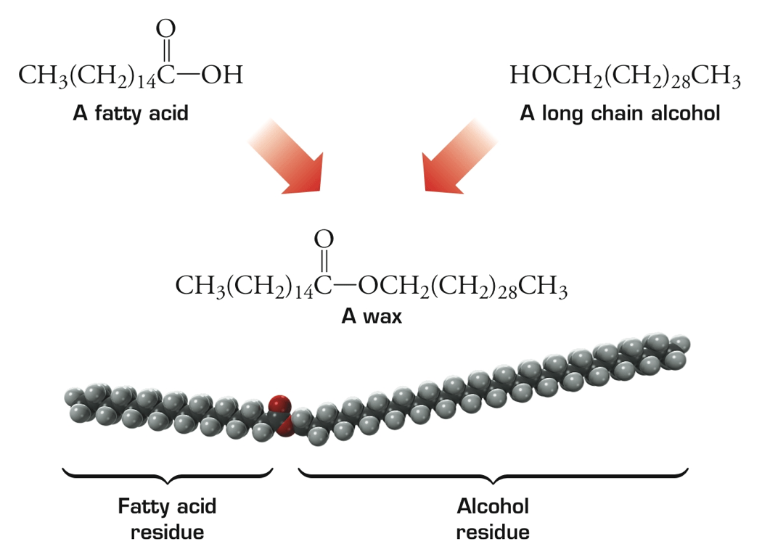
Core Knowledge
Structure of Wax
Functions of Waxes
Waxes are very hydrophobic and are used by plants and animals for protective, water-proof coatings

Slide 11
Core Knowledge
Compound lipids
Phospholipids
Glycerophospholipids
Sphingophospholipids
Glycolipids
Neutral glycolipids
Acidic glycolipids
Lipoproteins

Slide 12
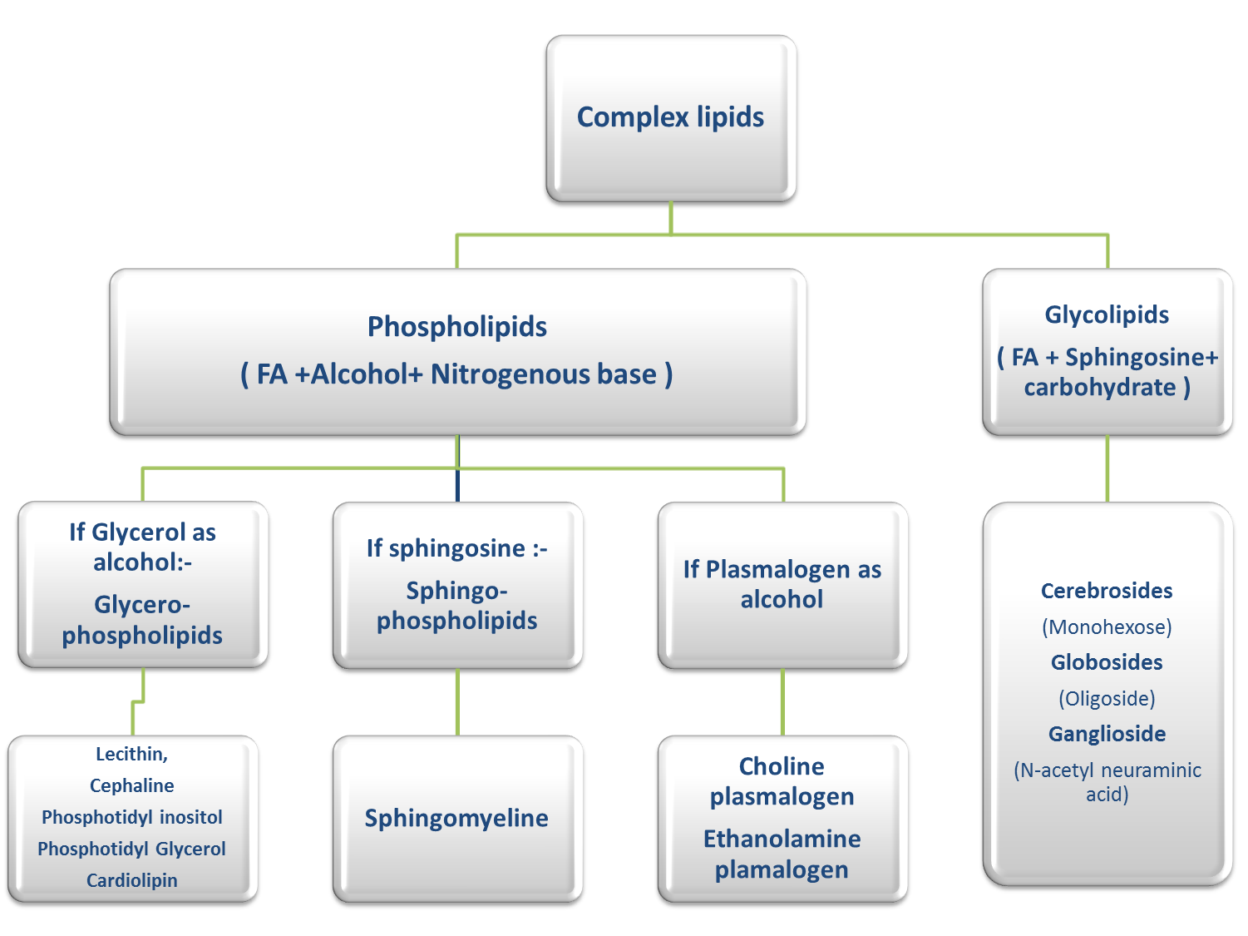
Core Knowledge
Notes:
12

Slide 13
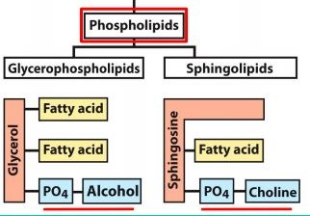
Core Knowledge
Structure of Phospholipids

Slide 14
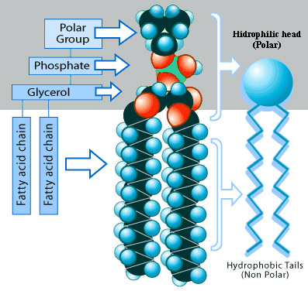
Core Knowledge
Structure of Glycerophospholipids

Slide 15
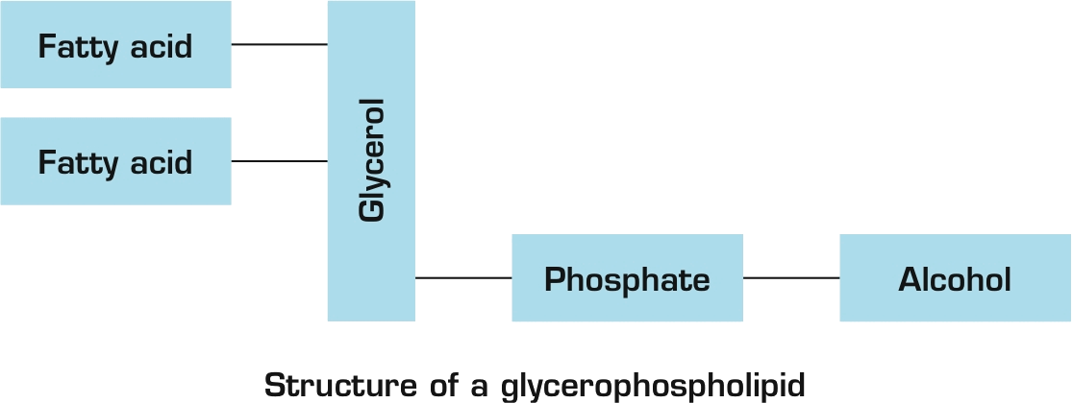
Core Knowledge
Structure of Glycerophospholipids

Slide 16
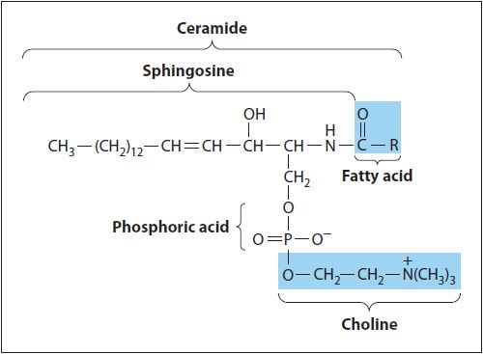
Core Knowledge
Structure of Sphingophospholipids

Slide 17
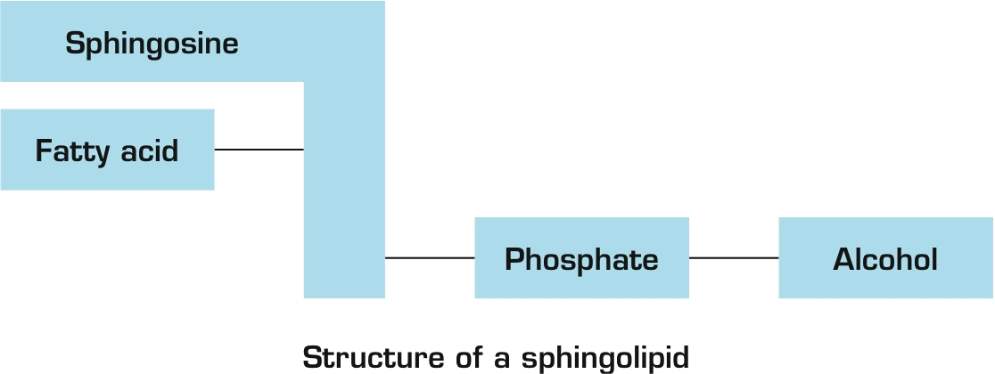
Core Knowledge
Structure of Sphingophospholipids

Slide 18
Core Knowledge
Functions of Phospholipids
Component of membranes
Constituent of lung surfactant
Present in bile
Second messenger
Present in myelin sheaths

Slide 19
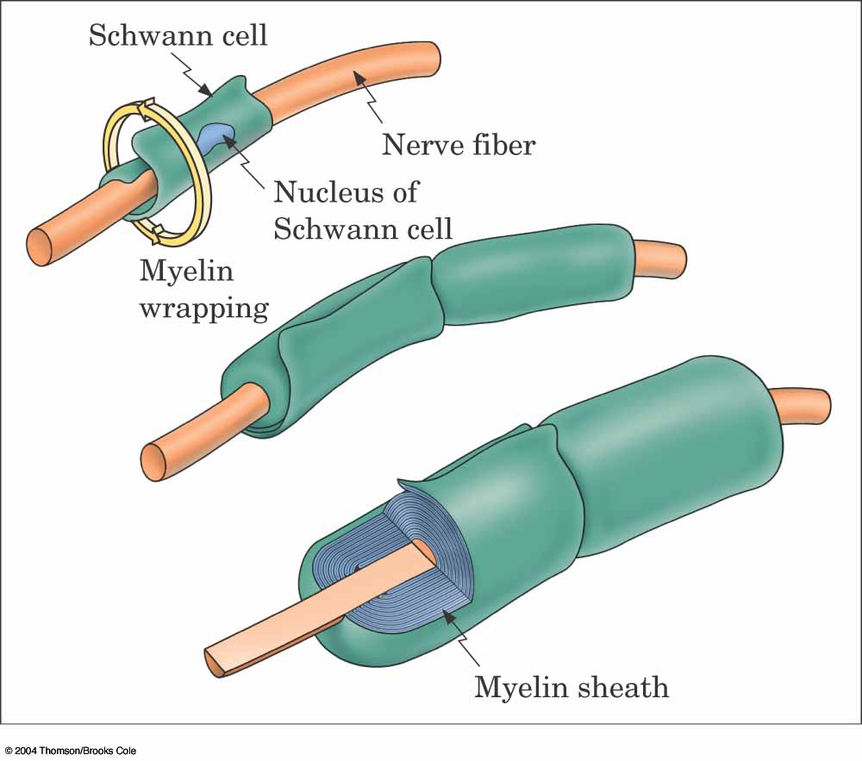
Core Knowledge

Slide 20
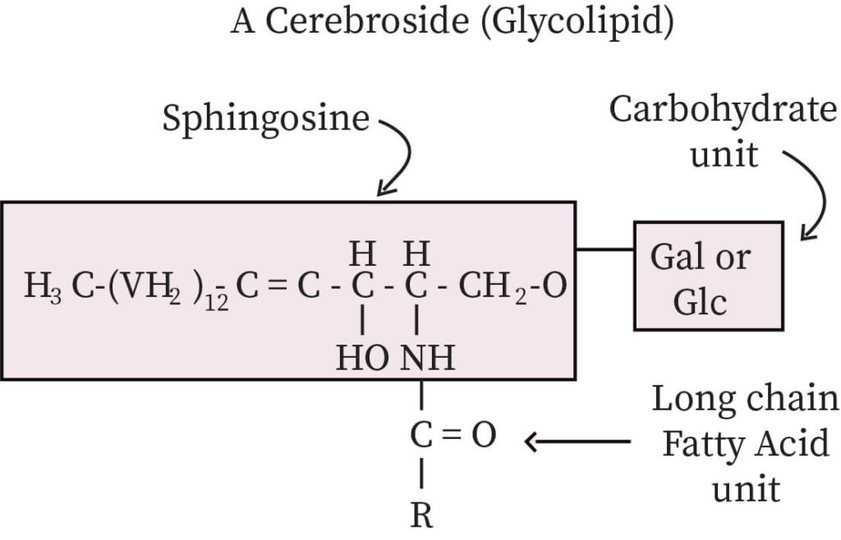
Core Knowledge
Structure of Glycolipids

Slide 21
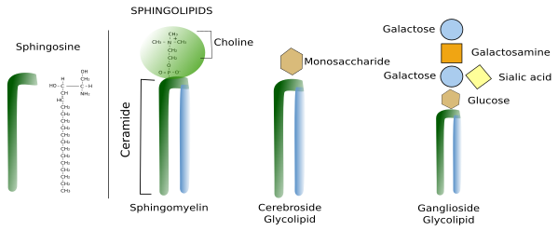
Core Knowledge

Slide 22
Core Knowledge
Functions of Glycolipids
Component of glycocalyx
Blood group antigens
Cell-cell recognition
Cell-cell adhesion
Cell surface receptors

Slide 23
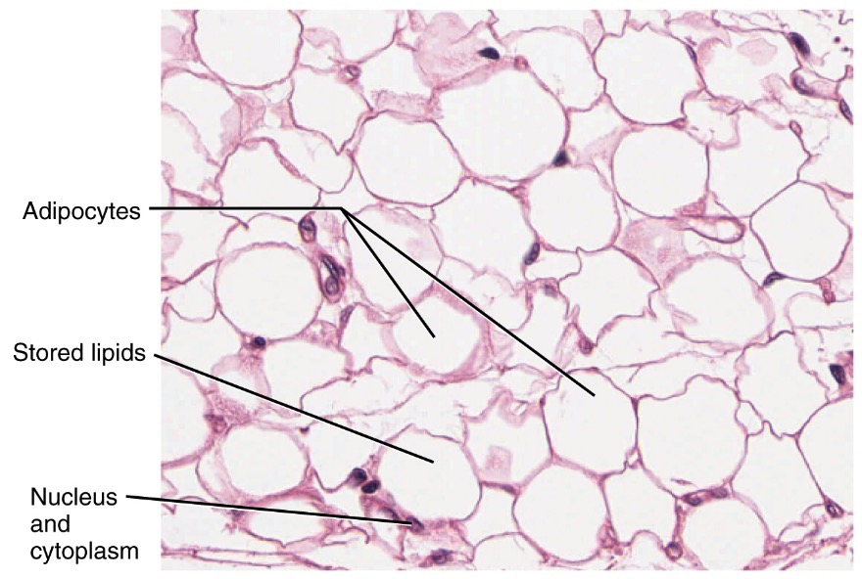
Anatomical Aspects
Horizontal Integration

Slide 24
Horizontal Integration
Physiological Aspects
Energy reserve of the body (triglycerides)
Structural component of membranes
Constituent of lung surfactant and bile
Transport of lipids in plasma
Cell surface receptors

Slide 25
Vertical Integration

Slide 26
Vertical Integration
Respiratory Distress Syndrome

Slide 27
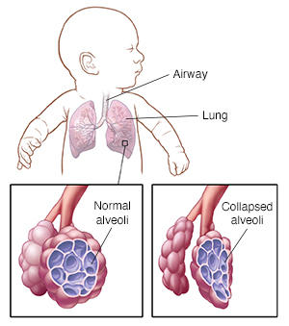
Vertical Integration

Slide 28
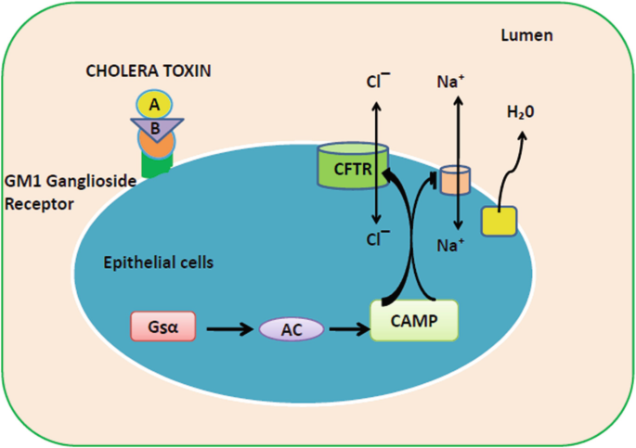
Vertical Integration

Slide 29
Family Medicine
Spiral Integration
Family Medicine plays important role in following manner:
Early Diagnosis
Education
Dietary Guidance
Monitoring
Refer to Specialists

Slide 30
Artificial Intelligence
Spiral Integration
Artificial Intelligence plays role in following aspects:
Decoding DNA sequences to
pinpoint genetic variations
identify genetic abnormalities
Utilizes extensive data from patient thereby enhancing prevention, diagnosis & treatment based on individual genetic profiles
Food Recommendations

Slide 31
Suggested Research Article
Spiral Integration
Abstract
Prolonged or excessive exposure to oxidized phospholipids (OxPLs) generates chronic inflammation. OxPLs are present in atherosclerotic lesions and can be detected in plasma on apolipoprotein B (apoB)-containing lipoproteins. Indeed, experimental and clinical studies show that Lp(a) particles carry the largest fraction of OxPLs among apoB-containing lipoproteins. Plasma OxPL–apoB levels provide diagnostic information on the presence and extent of atherosclerosis and improve the prognostication of peripheral artery disease and first and recurrent myocardial infarction and stroke. The addition of OxPL–apoB measurements to traditional cardiovascular risk factors improves risk reclassification, particularly in patients in intermediate risk categories, for whom improving decision-making is most impactful. Moreover, plasma OxPL–apoB levels predict cardiovascular events with similar or greater accuracy than plasma Lp(a) levels, probably because this measurement reflects both the genetics of elevated Lp(a) levels and the generalized or localized oxidation that modifies apoB-containing lipoproteins and leads to inflammation.
Link: https://www.nature.com/articles/s41569-023-00937-4
Journal Name : Nature Reviews Cardiology
Title: Oxidized phospholipids in cardiovascular disease
Author Name: Sotirios Tsimikas

Slide 32
Bioethics
Spiral Integration
Appropriate information
Explain to patient or his family the genetic aspects of the condition
Counselling

Slide 33
How To Access Digital Library
Steps to Access HEC Digital Library
Go to the website of HEC National Digital Library
On Home Page, click on the INSTITUTES
A page will appear showing the universities from Public and Private Sector and other Institutes which have access to HEC National Digital Library HNDL
Select your desired Institute
A page will appear showing the resources of the institution
Journals and Researches will appear
You can find a Journal by clicking on JOURNALS AND DATABASE and enter a keyword to search for your desired journal

Slide 34
Learning Resources
Mushtaq Essentials of Medical Biochemistry (chapter 5, pages 127-134)
Lippincott Illustrated Review, Biochemistry (Eighth edition, chapter 17, Pages 410-13, 422)
Google scholar
Google images

