Slide 2
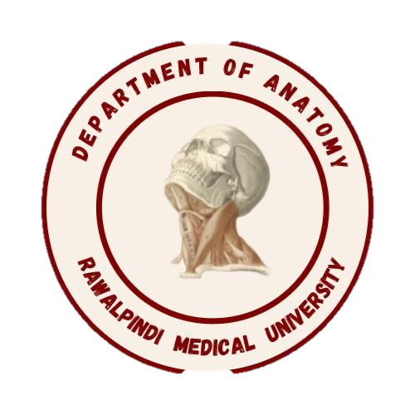
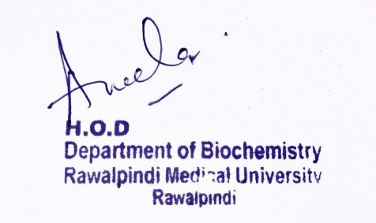
CVS Module 1st Year MBBS (LGIS) Prostaglandins
Presenter: Dr. Aneela Jamil Date: 24-02-25
(Assistant Professor)

Slide 3
Motto, Vision, Dream
To impart evidence based research oriented medical education
To provide best possible patient care
To inculcate the values of mutual respect and ethical practice of medicine
Wisdom
Truth
Service

Slide 4
Professor Umar Model of Integrated Lecture

Slide 5
Learning Objectives
At the end of this lecture students should be able to
Explain synthesis of prostaglandins
Describe the role of prostaglandins in our body
Discuss effect of various drugs on prostaglandins synthesis

Slide 6
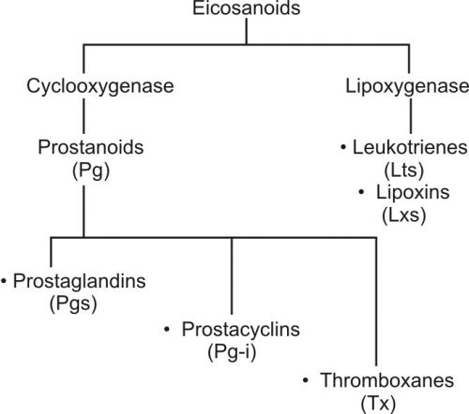
Core Knowledge

Slide 7
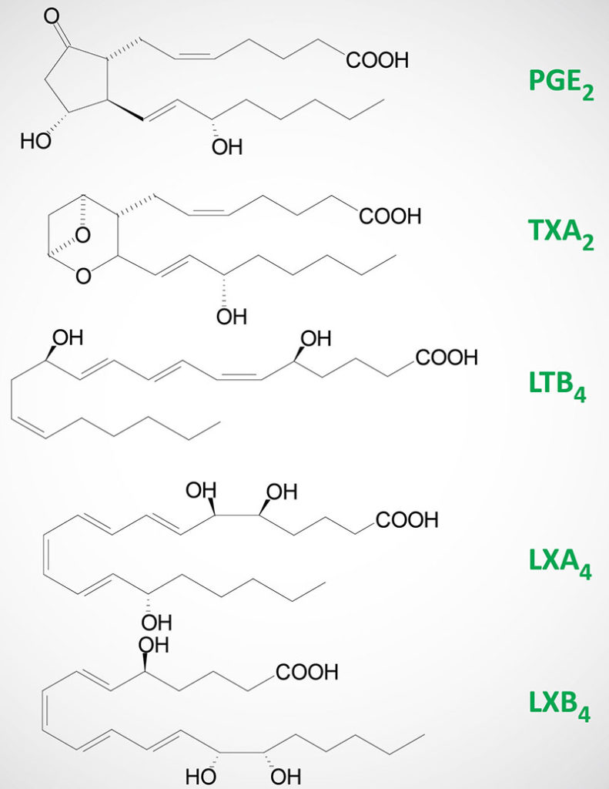
Core Knowledge

Slide 8
Core Knowledge

Slide 9
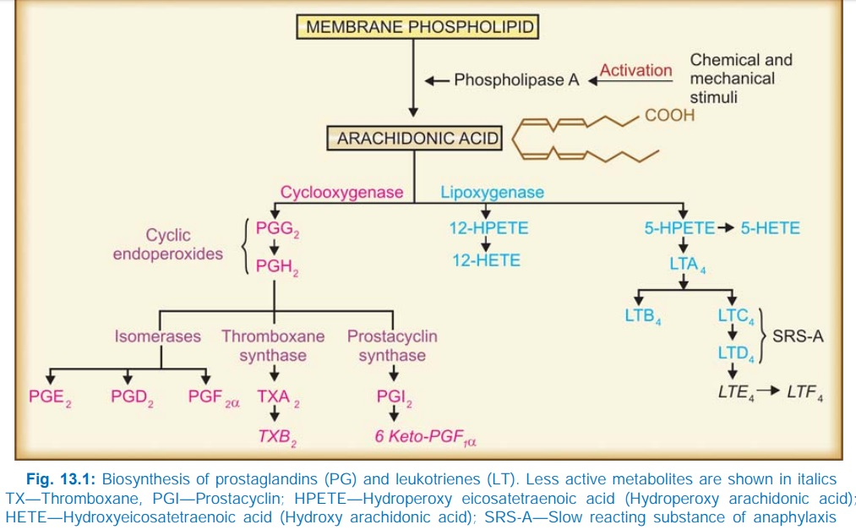
Core Knowledge

Slide 10
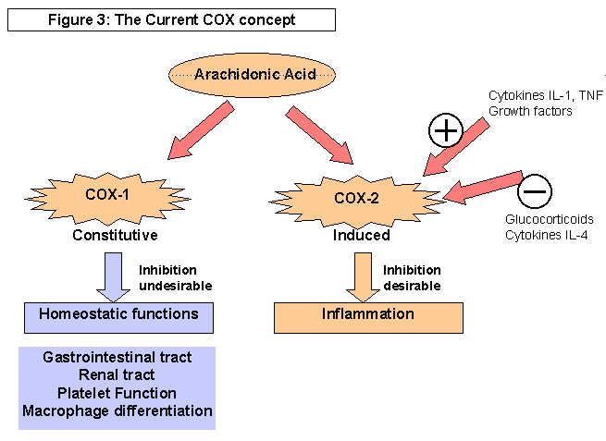
Core Knowledge

Slide 11
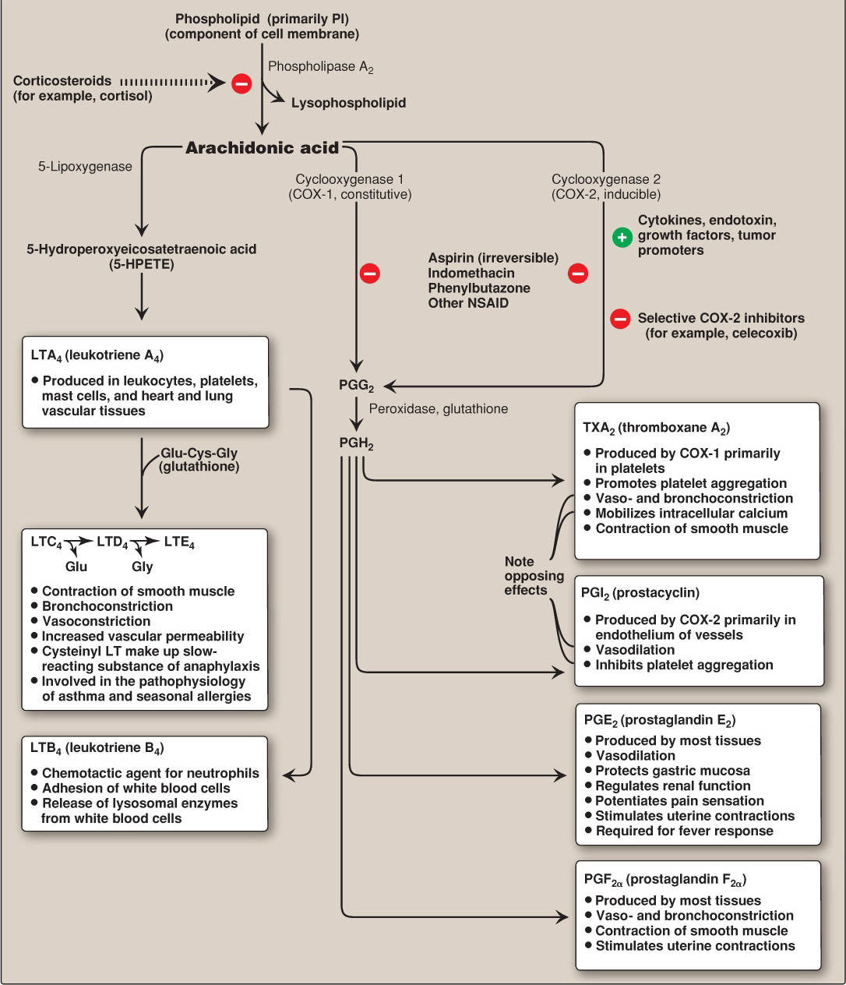

Slide 12
Anatomical Aspects
Horizontal Integration

Slide 13
Horizontal Integration
Physiological Aspects
Functions of Prostaglandins
Regulate blood flow and blood pressure
Effect on platelet aggregation
Effect on vascular and uterine smooth muscle
Effect on bronchial smooth muscle

Slide 14
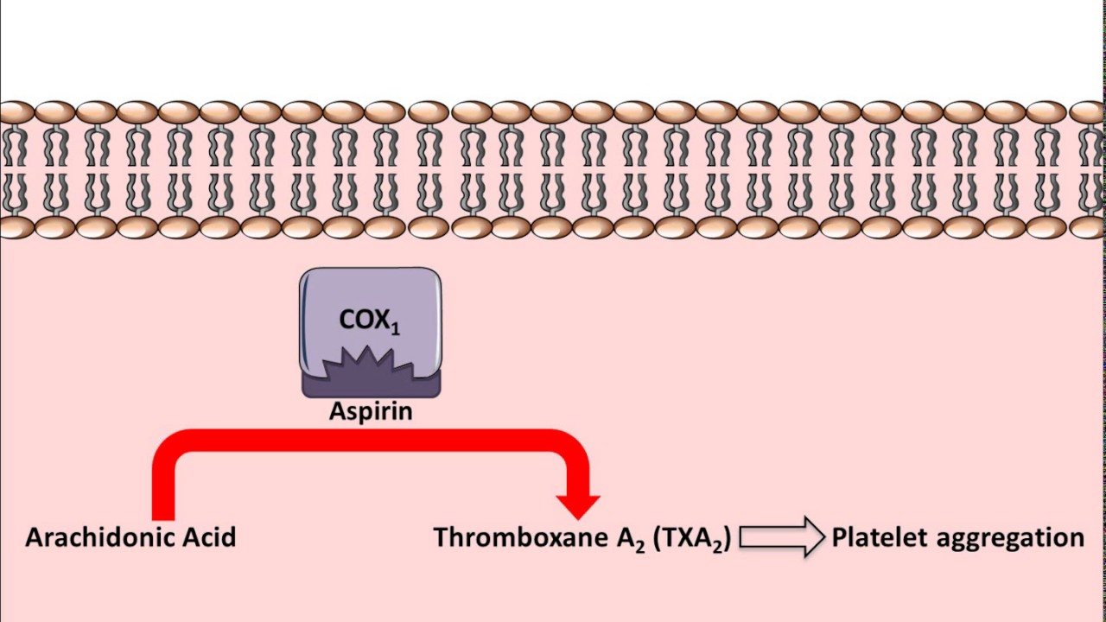
Vertical Integration

Slide 15
Vertical Integration

Slide 16
Family Medicine
Spiral Integration
Family Medicine plays important role in following manner:
Early Diagnosis
Education
Dietary Guidance
Monitoring
Refer to Specialists

Slide 17
Artificial Intelligence
Spiral Integration
Artificial Intelligence plays role in following aspects:
Decoding DNA sequences to
pinpoint genetic variations
identify genetic abnormalities
Utilizes extensive data from patient thereby enhancing prevention, diagnosis & treatment based on individual genetic profiles
Food Recommendations

Slide 18
Suggested Research Article
Spiral Integration
Link: https://www.mdpi.com/2073-4409/10/6/1487
Journal Name : Cells
Title: The Role of Prostaglandins in Different Types of Cancer
Author Name: Álvaro Jara-Gutiérrez
Abstract
The prostaglandins constitute a family of lipids of 20 carbon atoms that derive from polyunsaturated fatty acids such as arachidonic acid. Traditionally, prostaglandins have been linked to inflammation, female reproductive cycle, vasodilation, or bronchodilator/bronchoconstriction. Recent studies have highlighted the involvement of these lipids in cancer. In this review, existing information on the prostaglandins associated with different types of cancer and the advances related to the potential use of them in neoplasm therapies have been analyzed. We can conclude that the effect of prostaglandins depends on multiple factors, such as the target tissue, their plasma concentration, and the prostaglandin subtype, among others. Prostaglandin D2 (PGD₂) seems to hinder tumor progression, while prostaglandin E2 (PGE₂) and prostaglandin F2 alpha (PGF_{2α}) seem to provide greater tumor progression and aggressiveness.

Slide 19
Bioethics
Spiral Integration
Appropriate information
Explain to patient or his family the genetic aspects of the condition
Counselling

Slide 20
How To Access Digital Library
Steps to Access HEC Digital Library
Go to the website of HEC National Digital Library
On Home Page, click on the INSTITUTES
A page will appear showing the universities from Public and Private Sector and other Institutes which have access to HEC National Digital Library HNDL
Select your desired Institute
A page will appear showing the resources of the institution
Journals and Researches will appear
You can find a Journal by clicking on JOURNALS AND DATABASE and enter a keyword to search for your desired journal

Slide 21
Learning Resources
Lippincott Illustrated Review, Biochemistry (Eighth edition, chapter 17, Pages 432-438)
Google scholar
Google images

