Slide 2
CVS MODULE CHEST RADIOGRAPH WITH PERSPECTIVE OF CARDIOVASCULAR SYSTEM
By:
Dr. Aniqua Saleem
Senior Registrar Radiology
Holy Family Hospital Rawalpindi Medical University

Slide 3
 | Mission Statement To impart evidence-based research-oriented health professional education in order to provide best possible patient care and inculcate the values of mutual respect, ethical practice of healthcare and social accountability. Vision and Values Highly recognized and accredited center of excellence in Medical Education, using evidence-based training techniques for development of highly competent health professionals, who are lifelong experiential learner and are socially accountable. Goals of the Undergraduate Integrated Modular Curriculum To provide you with quality medical education in environment designed to: Provide thorough grounding in the basic theoretical concepts underpinning the practice of medicine. Develop and polish the skills required for providing medical services at all levels of the Health care delivery system. Help you attain and maintain the highest possible levels of ethical and professional conduct in your future life.
TRUTH, WISDOM & SERVICE
“OUT MOTTO”

Slide 4
NUMBER OF SLIDES ACCORDING TO DR UMAR LGIS MODEL
Introductory slides
Bismillah 1
Introduction 1
Mission vision 1
Dr. Umar model of LGIS 1
Gain attention slides 1
Learning objectives 1
Core Concept 8
Horizontal Integration 8
Vertical integration 20
Assessment 4
Recommended Books/References 1
Take home message 1

Slide 5
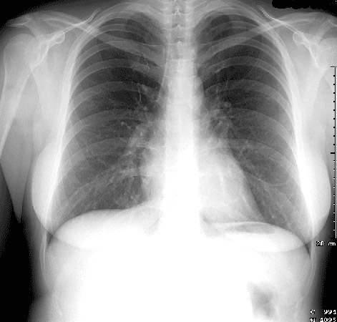
What can you see???
Respiratory system
Cardiovascular system
Gastrointestinal system
Musculoskeletal system

Slide 6
Learning OBJECTIVES & lecture Outline
To describe the origin, production and utilization of X ray radiation
To recognize basic densities on an chest radiograph
Gas, Fat,Soft tissue, Fluid, Bone/calcification, Metal
To be aware of importance of technical parameters of chest xray, patient’s identity, sex and date.
To understand the cardio mediastinal borders on radiographs
To identify valvular positions on chest radiograph
To analyze basic cardiac pathologies

Slide 7
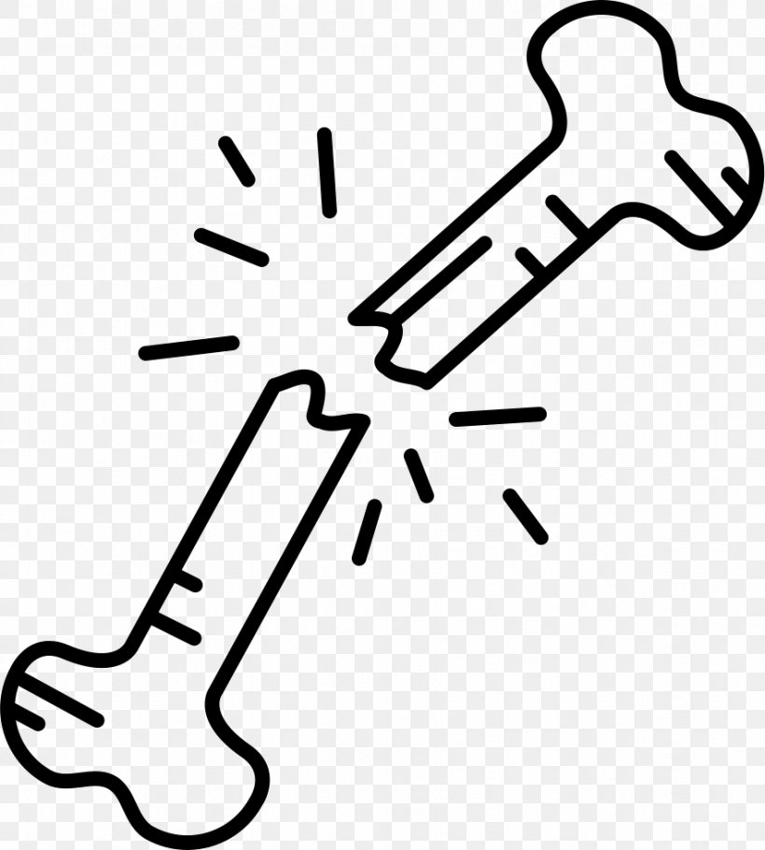
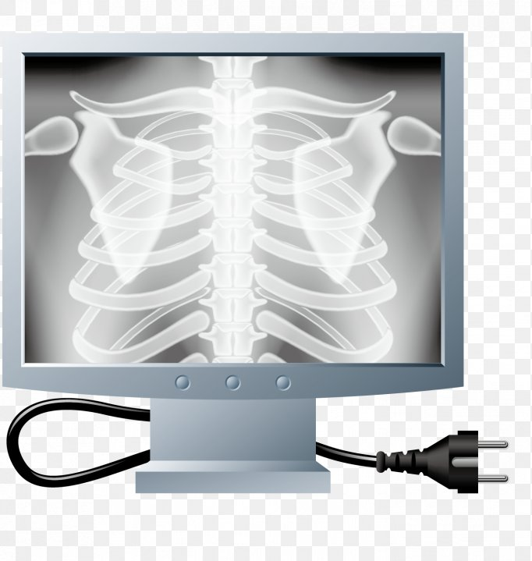
What are X-rays?
Electromagnetic radiation
Generated in X-ray tube
High energy
Travel in straight lines
Core Concept

Slide 8
Core Concept

Slide 9
‘5’ densities seen on X-Ray
Core Concept

Slide 10
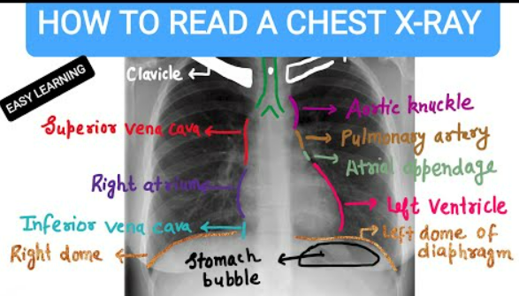
Cardiomedial borders on chest radiography
Understanding of the structures that make up the normal contours of the heart and mediastinum (cardiomediastinal contour) on chest radiography is essential if abnormalities are to be detected
Horizontal Integration

Slide 11
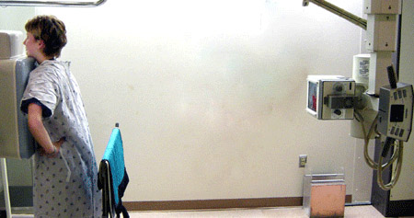
There are 2 basic view
Frontal
Lateral
Core Concept

Slide 12
RIGHT CARDIOMEDIASTINAL CONTOUR on frontal view
From superior to inferior:
1. Right paratracheal stripe
seen in two thirds of normal films
made up of right brachiocephalic vein and SVC
2. Arch of the azygous vein
ascending aorta in older individuals often projects to the right of the SVC
superior vena cava (SVC)
3. Right atrium
4. Inferior vena cava (IVC)
Horizontal Integration

Slide 13
LEFT CARDIOMEDIASTINAL CONTOUR on frontal view
From superior to inferior:
1. Left paratracheal stripe
made up of left common carotid artery, left subclavian artery and the left jugular vein
2. Aortic arch +/- aortic nipple (left superior intercostal vein)
3. Pulmonary artery
4. Auricle of left atrium
5. Left ventricle
Horizontal Integration

Slide 14
LATERAL VIEW
ANTERIOR CARDIOMEDIASTINAL CONTOUR From superior to inferior:
1. superior mediastinum
great vessels
thymus
2. ascending aorta
3. right ventricular outflow track
4. right ventricle
POSTERIOR CARDIOMEDIASTINAL CONTOUR
From superior to inferior:
1. left atrium and pulmonary veins
2. right atrium
3. inferior vena cava
Horizontal Integration

Slide 15
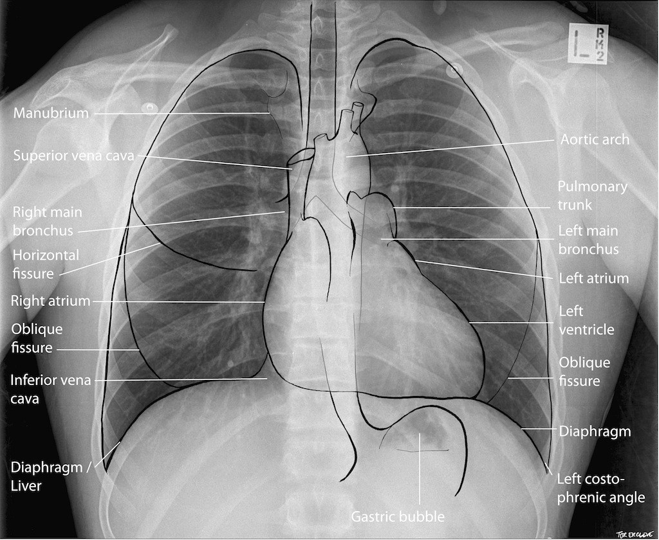
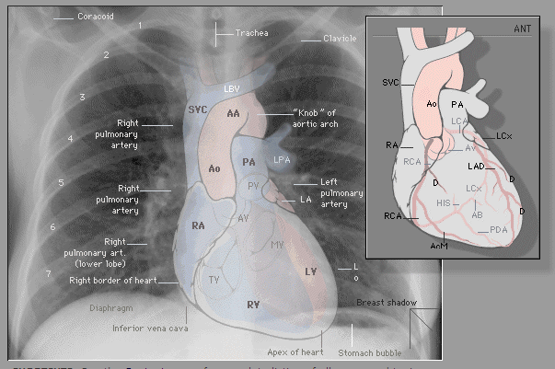
Horizontal Integration

Slide 16
Horizontal Integration

Slide 17
CARDIAC VALVULAR ANATOMY
Heart valves are located in the cardiac fibrous skeleton
Two are atrioventricular (AV) valves: the right-sided tricuspid valve and left-sided mitral (bicuspid) valve
Two are semilunar valves: the right-sided pulmonary valve and left-sided aortic valve
On the lateral chest film the aortic and pulmonary valves are located above the line from base of the heart to the apex and tricuspid and mitral valves are below this line.
Horizontal Integration

Slide 18
Horizontal Integration

Slide 19
CARDIAC PATHOLOGY ON CHEST XRAYS
Cardiac Chamber enlargement
Pulmonary vasculature
Effusions (pericardial/ pleural effusion)
Vertical Integration

Slide 20
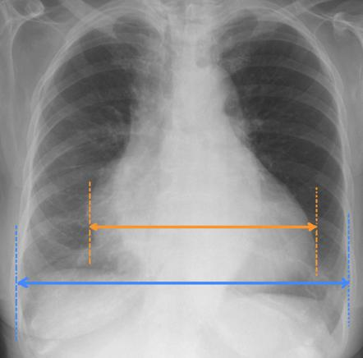
CARDIOTHORCIC RATIO (CTR)
Vertical Integration

Slide 21
CARDIAC CHAMBER ENLARGEMENT
Cardiac chamber enlargement can be recognised by cardiac contour changes, new or different interfaces with adjacent lung, and/or displacement of adjacent mediastinal structures.
Right atrial enlargement
Right ventricular enlargement
Left atrial enlargement
Left ventricular enlargement
Vertical Integration

Slide 22
RIGHT ATRIAL ENLARGEMENT
enlarged, globular heart
narrow vascular pedicle
gross enlargement of the right atrial shadow, i.e. increased convexity in the lower half of the right cardiac border
right atrial convexity is more than 50% of the cardiovascular height
right atrial margin is more than 5.5 cm from the midline
Vertical Integration

Slide 23
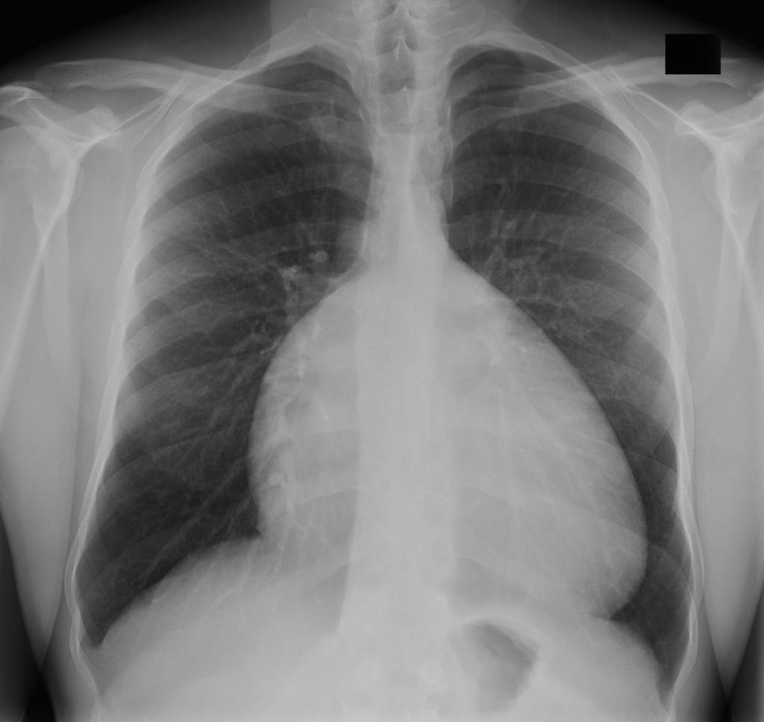
Vertical Integration

Slide 24
LEFT ATRIAL ENLARGEMENT
Double density sign
right side of the left atrium pushes into the adjacent lung, and becomes visible superimposed or even beyond the normal right heart border (known as atrial escape)
a similar appearance can be caused by the right superior pulmonary vein in patients without atrial enlargement
oblique measurement of greater than 7cm
measured from midpoint of left main bronchus to the right border of the left atrium (this requires a double density sign of course)
thought to be the most reliable sign on chest radiography
convex left atrial appendage (third mogul sign): normally the left heart border just below the pulmonary outflow track should be flat or slightly concave
Vertical Integration

Slide 25
Double density sign
Vertical Integration

Slide 26
midpoint of left main bronchus to the right border of the left atrium
Vertical Integration

Slide 27
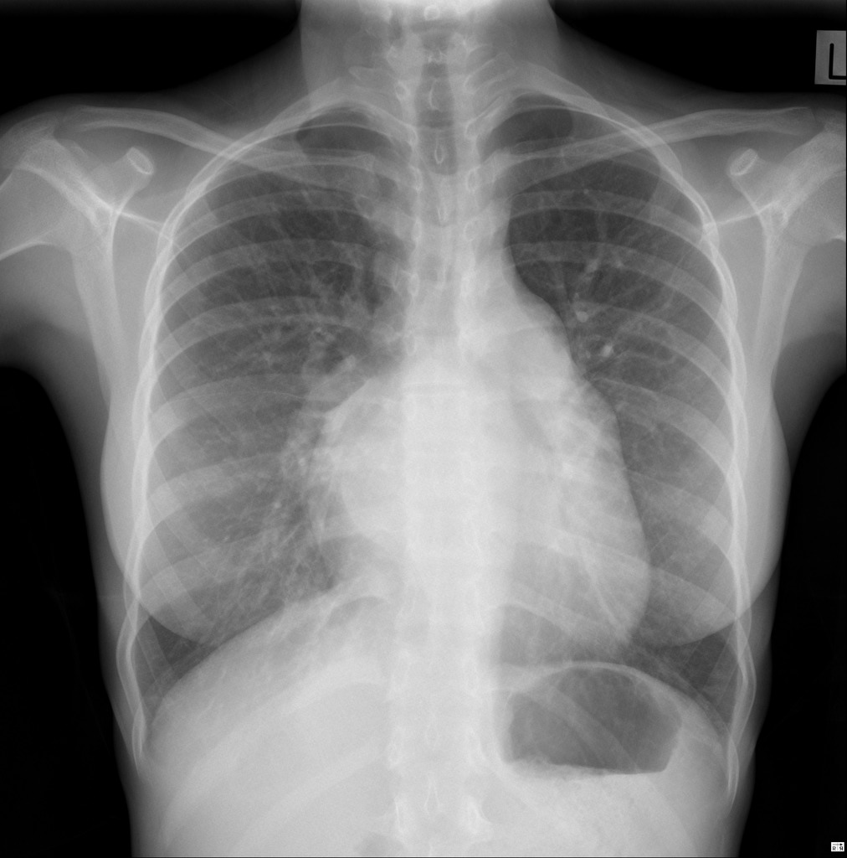
ATRIAL ESCAPE
Vertical Integration

Slide 28
RIGHT VENTRICULAR ENLARGEMENT
Frontal view demonstrates:
rounded left heart border
uplifted cardiac apex
Lateral view demonstrates:
filling of the retrosternal space
rotation of the heart posteriorly
Vertical Integration

Slide 29
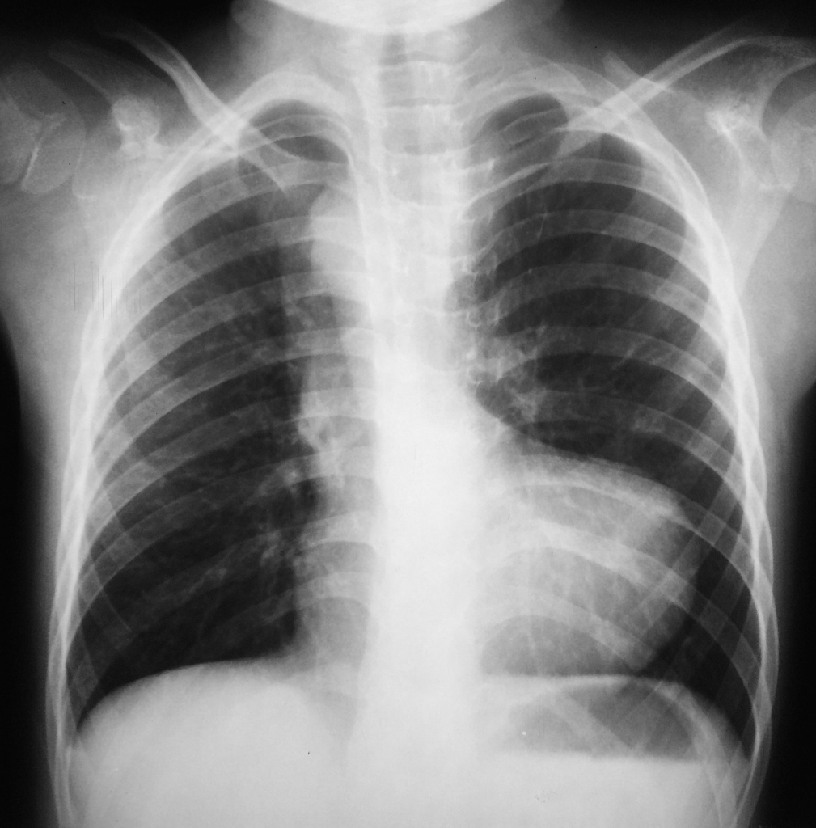
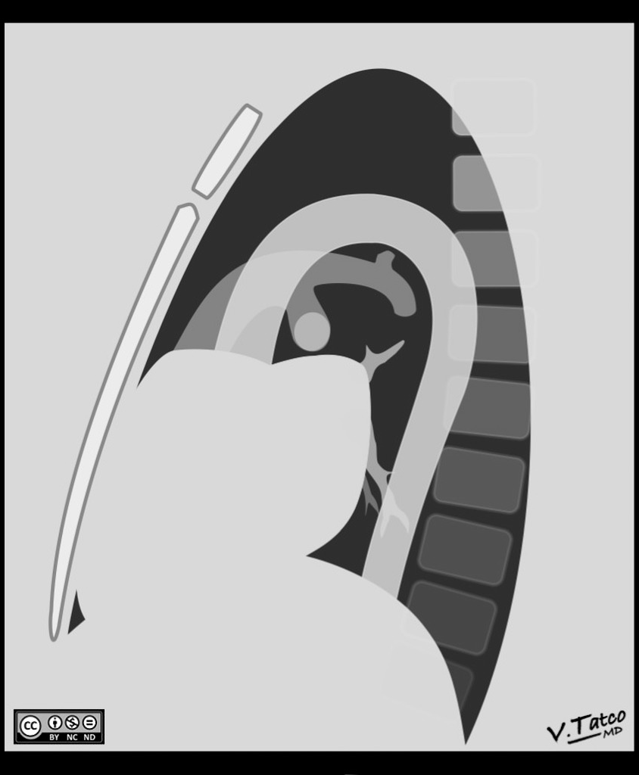
RIGHT VENTRICULAR ENLARGEMENT
Vertical Integration

Slide 30
LEFT VENTRICULAR ENLARGEMENT
Left heart border is displaced leftward, inferiorly, or posteriorly
rounding of the cardiac apex
Hoffman-Rigler sign
Shmoo sign
Vertical Integration

Slide 31
Shamoo sign
Vertical Integration

Slide 32
PULMONARY EDEMA
Cardiogenic
Left ventricular failure
Mitral regurgitation
Noncardiogenic
WIDE RANGE OF CAUSES
Vertical Integration

Slide 33
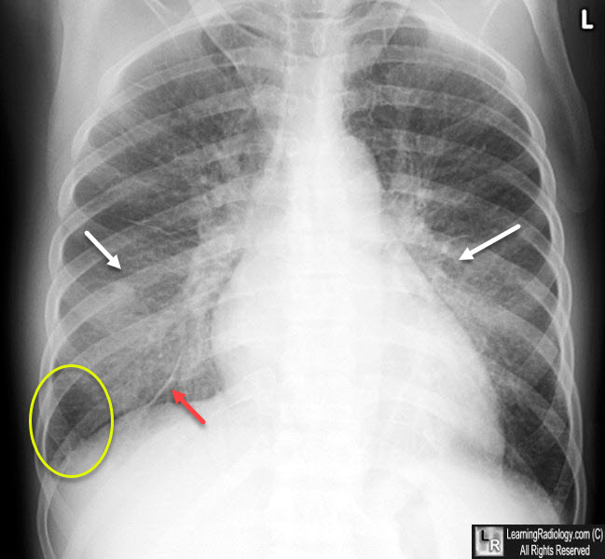
RADIOGRAPHIC FEATURES OF PULMONARY EDEMA
upper lobe pulmonary venous diversion / pulmonary venous engorgement/ stag's antler sign
increased CTR size
features of pulmonary interstitial oedema:
peri-bronchial cuffing and perihilar haze
septal lines / Kerley lines
thickening of interlobar fissures
features of pulmonary alveolar oedema:
air space opacification classically in a batwing distribution
may have air bronchograms
pleural effusions and fluid in interlobar fissures (including 'vanishing' pulmonary pseudotumour)
Vertical Integration

Slide 34
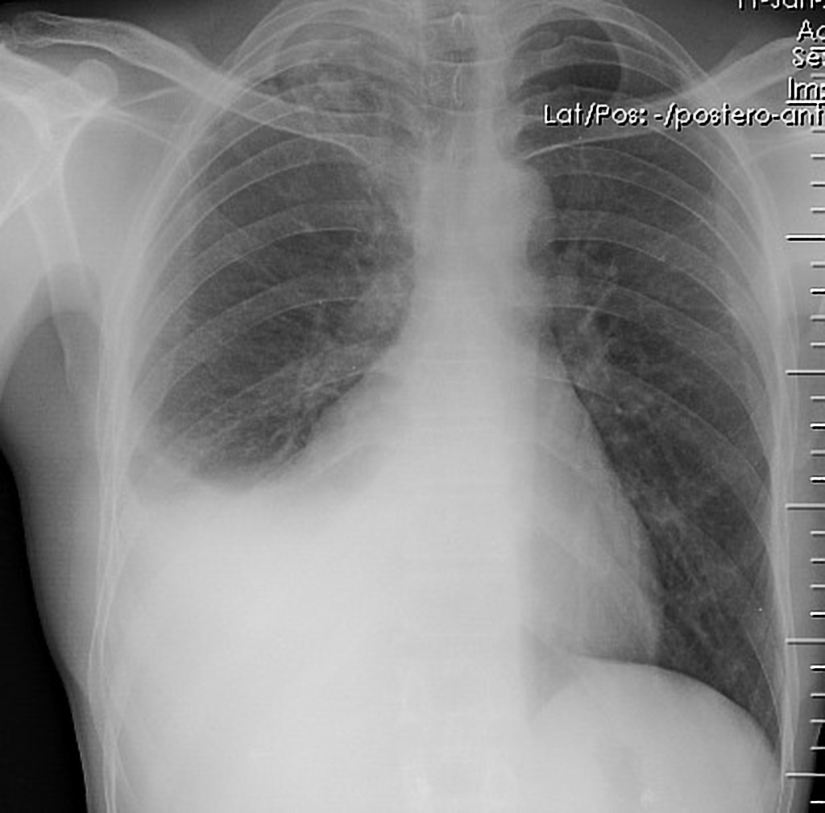
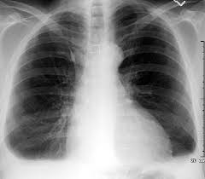
PLEURAL EFFUSION
25 to 50 ml effusion is not seen on radiograph…can b detected by USG
>50 ml of pleural effusion could be detected on radiograph
Mild effusion is seen as blunting of costophrenic angles
Vertical Integration

Slide 35
Vanishing tumor
Vertical Integration

Slide 36
PERICARDIAL EFFUSION
Very small effusion can be occult on plain film
Globular enlargement of the cardiac shadow giving a water bottle configuration
Lateral CXR may show a vertical opaque line (pericardial fluid) separating a vertical lucent line directly behind sternum (epicardial fat) anteriorly from a similar lucent vertical lucent line (pericardial fat) posteriorly; this is known as the Oreo cookie sign
Widening of the subcarinal angle without other evidence of left atrial enlargement may be an indirect clue
usually requires greater than 200 ml of pericardial fluid to become radiographically visible
Vertical Integration

Slide 37
Vertical Integration

Slide 39
ARTIFICIAL INTELLIGENCE
Core Concept

Slide 40
In 1959, Arthur Samuel defined artificial intelligence (AI) as a field of study that gives a computer the ability to learn without needing to be reprogrammed.
In layman’s terms, AI algorithms are developed to derive rules and patterns from large amounts of data to calculate the probabilities of various outcomes with new sets of similar data.
For instance, Netflix uses AI algorithms to analyze the viewing preferences of millions of people and determine what a viewer is likely to enjoy based on prior viewing behavior. Computers are programmed to continuously update probabilities of a person liking a given television show based on a combination of new all-user data and individual viewing choices.
Core Concept AI

Slide 41
ROLE OF AI IN DETECTING CARDIAC ABNORMALITIES
Cardiomegaly Detection
Congestive Heart Failure
Calcifications in coronaries and valves
Aortic Abnormalities: aneurysms and dissections
Electrocardiogram (ECG) Integration: While not specific to chest X-rays, AI can also integrate ECG data with imaging findings to provide a more comprehensive assessment of cardiac health. Combining information from both sources can aid in diagnosing arrhythmias, ischemic events, or other electrical abnormalities.
Risk Assessment: AI can help assess the risk of cardiac events by analyzing a combination of chest X-ray findings, clinical data, and patient history. It can provide risk scores or flags for further evaluation.
Core Concept AI

Slide 42
Core Concept AI

Slide 43
Assessment

Slide 44
Assessment

Slide 45
A 30 years old male presented in emergency department with night fever for 20 days, chest pain and severe shortness of breath for 03 days. His x ray was done.
Identify the view?
Describe the findings?
Further imaging if required?
Assessment

Slide 46
ANSWER KEY
IDENTIFY THE VIEWS?
Chest xray PA view
DESCRIBE THE FINDINGS?
Heart size is massively enlarged giving a water bottle appearance suggesting pericardial effusion. Ill defined haze noted in right lower zone suggesting right lower zone consolidation.
FURTHER IMAGING IF REQUIRED?
Echocardigraphy, fluid aspiration RE
Assessment

Slide 47
REFERENCES
https://radiologyassistant.nl/cardiovascular/anatomy/cardiac-anatomy
https://radiopaedia.org/articles/cardiac-silhouette
https://www.wikidoc.org/index.php/The_chest_x-ray_in_cardiovascular_disease
Manheimer E. Chest roentgenography for cardiovascular evaluation. Clinical Methods: The History, Physical, and Laboratory Examinations. 3rd edition. 1990.
https://www.nature.com/articles/s41746-020-0273-z

Slide 48
Knowing anatomy is most important to make diagnosis
Cardiac pathologies can be detected by simple chest radiograph and this may reduce morbidity and mortality

