Slide 1
1

Slide 2
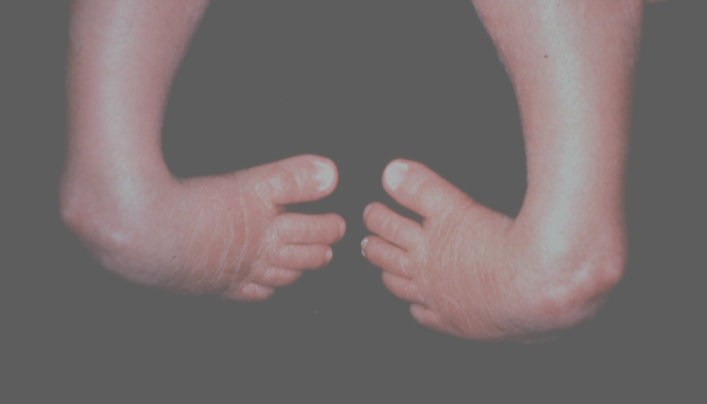
CONGENITAL TALIPES
EQUINOVARUS DEFORMITY
Department Of Orthopedics
Holy Family Hospital
2

Slide 4
Lay Out
Definition
Incidence
Classification
Radiology
Managment (Treatment)
Biomedical Ethics
Recent Advances

Slide 5
Learning Objective
By the end of the lecture, students should be able to:
Define congenital talipes equinovarus (CTEV).
Describe its characteristic deformities.
Explain the etiology and pathophysiology of CTEV.
Recognize the clinical features of CTEV and diagnose it using physical examination and imaging.
5

Slide 6
DEFINITION
Congenital foot deformity characterized by four distinct components:
Plantar flexion (equinus) of the ankle,
adduction (varus) of the heel (hind foot), high arch (cavus) at the midfoot, adduction of the forefoot.
6

Slide 7
CLUBFOOT - CTEV
Incidence: 1 in 1000
Male to Female ratio of approximately 2:1
Bilateral in one third of cases
7

Slide 8
CLASSIFICATION
GRADE I (MILD)
The foot can be corrected to neutral position by gentle manipulation and slight over correction is also possible.
GRADE II (MODERATE)
The foot can be corrected just to neutral position by gentle manipulation and over correction is not possible.
GRADE III (SEVERE)
The foot can not be corrected to neutral position by manipulation.
8

Slide 9
9

Slide 10
10

Slide 11
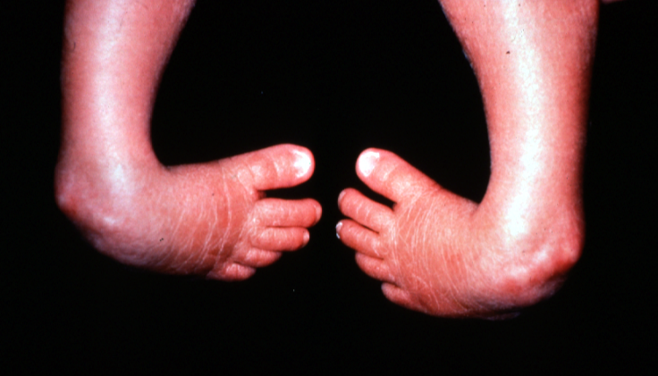
C.T.E.V
11

Slide 12
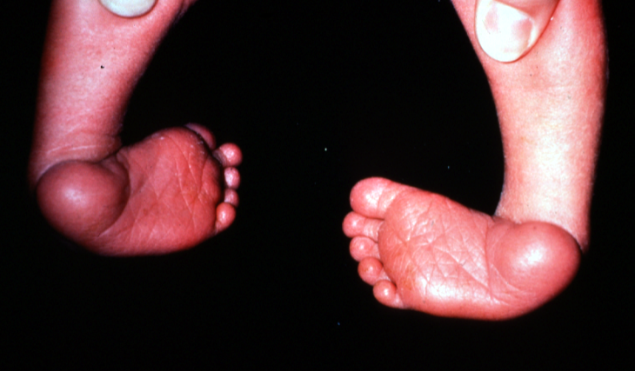
C.T.E.V
12

Slide 13
Integration with RADIOLOGY
13

Slide 14
CTEV - MANAGEMENT
Corrective manipulation and strapping or casting
Surgical release for resistant feet
14

Slide 15
THE TREATMENT OF CLUBFOOT SHOULD START AS SOON AS THE FOOT IS OUT, IN BREECH PRESENTATION.
15

Slide 16
TREATMENT
Aims
Plantigrade
Painless mobile foot
Normal muscle balance
Reasonably straight outer and inner border of foot
16

Slide 17
NON OPERATIVE MANAGEMENT
Infants with clubfeet should be seen with in first 24 hours after the birth
Beginning the treatment of clubfoot, as soon after birth as possible.
METHODS OF NON OPERATIVE TREATMENT
 Manipulation and serial casting
 Stretching and strapping
 Manipulation and Denis Brown Splinting
17

Slide 18
NON OPERATIVE TREATMENT
MANIPULATION AND PLASTER CASTING
Correction is done in following order
 Adduction of fore-foot
 Varus of heel
 Equinus at ankle
Manipulations are performed at least once a week initially (in newborn) for at least 1 – 3 months.
Then the frequency is decreased to every 10-14 days.
After correction has achieved Denis Brown splint is given.
18

Slide 19
OPERATIVE TREATMENT
INDICATIONS
 The patients of Grade III deformity .
Grade II deformity who had been on conservative treatment for variable time and radiological evidence of failure .
 Recurrent deformity
 Residual deformity
19

Slide 20
OPERATIVE MANAGEMENT
Surgical soft tissue release should be considered an extension of stretching and manipulation of clubfoot deformity. The rationale of surgical release should be parallel to those of the non-operative treatment, namely to attempt to restore the bones and joints to as near an anatomic normality as possible through elongation of periarticular soft tissue contractures.
The decision,about the choice of operative procedure, depends upon;
 The age of patient.
 The degree of rigidity.
 The extent of deformity.
 The extent of correction obtained.
20

Slide 21
PROCEDURES THAT INVOLVE SOFT TISSUE
Attenborough Posterior Release
Complete posterior release
Turco’s One Stage Posteromedial Release
Posterior, medial and subtalar soft tissue contractures release to permit realignment of bones. Corrected alignment is secured with K-wires.
McKay’s One Stage Circumferential Release
Soft tissue release (circumferential release) involving the medial, posterior, lateral and plantar aspect of the foot.
21

Slide 22
CTEV : CAUSES OF RECURRENCE
Improper timing of therapy
Improper procedure
Improper maintainence therapy
22

Slide 23
MAINTAINENCE CHART: After Turco’s CPMR at 4 months
2 wks: Change POP & remove sutures
6 wks: Remove pins & Change POP
12 wks: Remove POP
3-10 months: Dennis-Browne Splint
10-24 months: Pre-walking shoes
>2 years: Polypropylene night splint if needed
23

Slide 24
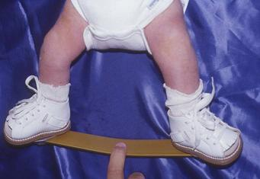
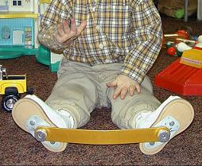
24

Slide 25
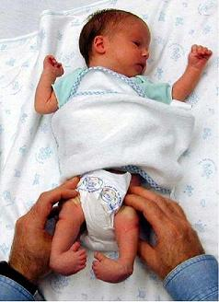
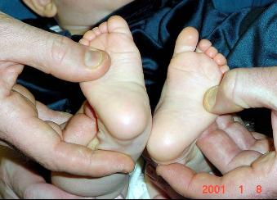
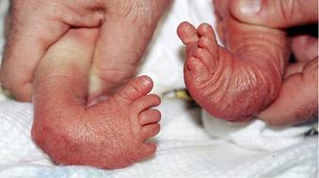
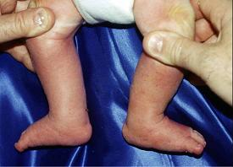
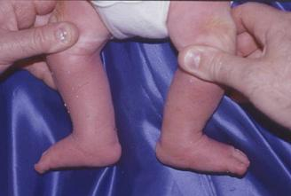
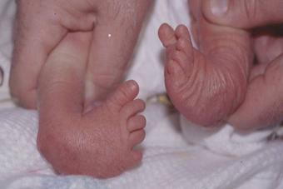
25

Slide 26
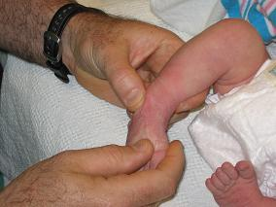
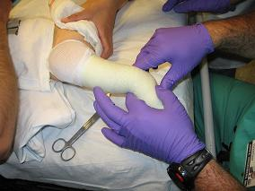
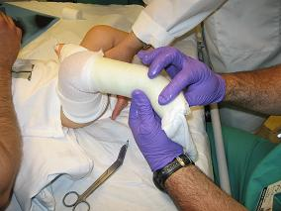
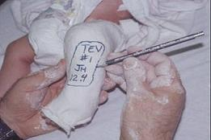
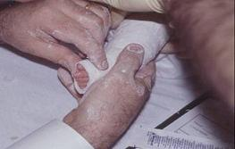
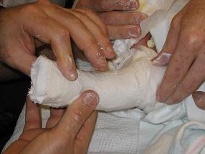
26

Slide 27
Dennis Browne shoes
27

Slide 28
BIOETHICS
1. Informed Consent and Parental Autonomy
2. Equity and Access to Care
3. Best Interests of the Child
4. Cultural Sensitivity and Respect
5. Long-Term Quality of Life
6. Research and Innovation

Slide 29
Recent Advances
1.Enhanced Ponseti Method with Accelerated Casting:
- Modifications to the traditional Ponseti method, such as using shorter intervals between cast changes (e.g., 4-5 days instead of 7 days), have shown to reduce the overall treatment duration while maintaining effectiveness.

Slide 30
Recent Advances
2.Use of Minimally Invasive Surgical Techniques:
- Advances in arthroscopic and percutaneous surgical techniques for resistant or recurrent cases have improved outcomes with reduced tissue damage, faster recovery, and fewer complications compared to open surgeries.

Slide 31
"The Ponseti Method of Clubfoot Treatment: Principles and Techniques” by Ignacio V. Ponseti. 3rd edition
Campbell's Operative Orthopaedics - 14th Edition

Slide 32
Research
Rastogi A, Agarwal A. Long-term outcomes of the Ponseti method for treatment of clubfoot: a systematic review. Int Orthop. 2021 Oct;45(10):2599-2608. doi: 10.1007/s00264-021-05189-w. Epub 2021 Aug 20. PMID: 34415418.

Slide 33
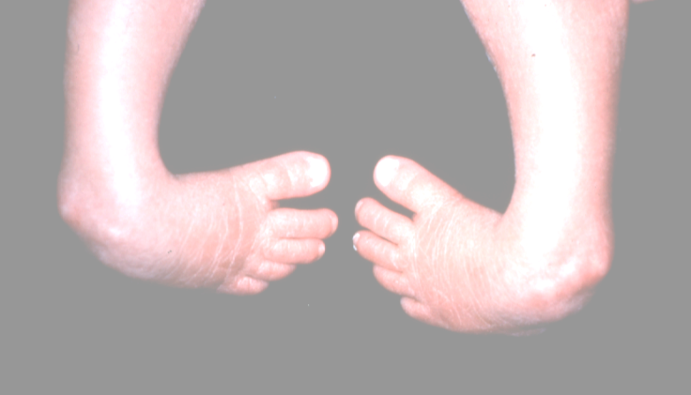
Thank You
THANK YOU
33

