Slide 1
CHRONIC OTITIS MEDIA

Slide 3
Sequence Of LGIS
Learning objectives
Structure of Middle Ear and CSOM(Core concept(60%)
Anatomy and physiology-spiral integration(8%)
Pathology and community medicine-Horizontal integration(20%)
Related clinical medical and surgical-Vertical integration(7%)
Research,family medicine and artificial intelligence(5%)

Slide 4
Learning Objectives
At the end of this lecture,students should shall be able to:
Understand the anatomy of middle ear cleft
Know the physiology of middle ear
Chronic suppurative otitis media
Types of CSOM
Etiology of CSOM
Diagnosis
Treatment

Slide 6
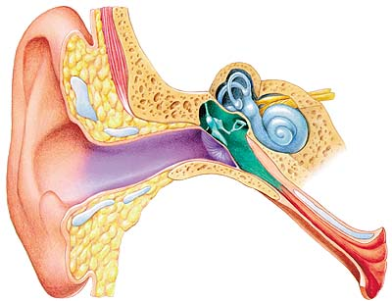
The Middle Ear Cleft (Anatomy)
Middle Ear
Structure:
All the walls are bony except the lateral wall (Tympanic membrane)
Lining Epithelium;
Antro-inferiorly, ciliated columnar epithelium
Middle part: cuboidal epithelium
Attic: pavement like epithelium

Slide 7
DEFINITION OF C.S.O.M
A long standing Infection of middle ear or mastoid air cells characterized by ear discharge in the presence of perforated tympanic membrane.
It is characterized by:
Deafness
Otalgia
Ear discharge
T.M. perforation (permanent defect)

Slide 8
TYPES OF C.S.O.M.
Chronic Suppurative otitis Media
Tubo-Tympanic C.S.O.M
Atticoantral C.S.O.M

Slide 9
TYPES OF C.S.O.M.
Tubo-Tympanic | Atticoantral
Safe Disease | Unsafe Disease
Intermittent | Continuous
Mucoid , Purulent | Blood Stained
Odorless | Foul smell
No | Cholesteatoma
Rare | Granulation tissue
Central Perforation | Marginal Perforation
Less Complication | More Complication

Slide 10
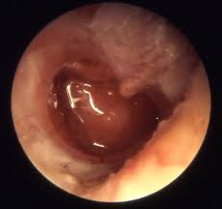
Pictorial presentation of C.O.M

Slide 11
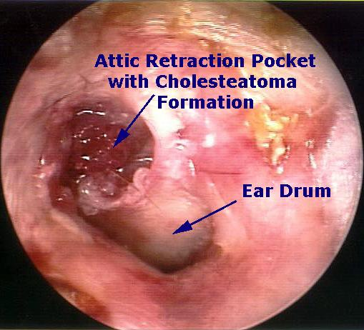
Pictorial presentation of Cholesteatoma Formation

Slide 12
TYPES OF CSOM
CLASSIFICATION
INACTIVE MUCOSAL COM.
INACTIVE SQUAMOUS COM.
ACTIVE MUCOSAL COM.
ACTIVE SQUAMOUS COM.
SYNONYMS
DRY CENTRAL PERFORATION.
RETRACTION.
CENTRAL PERFORATION WITH DISCHARGE.
CHOLESTEATOMA.

Slide 13
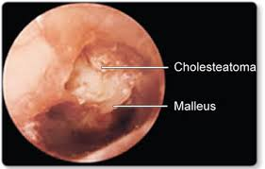
ATTICO ANTRAL C.S.O.M.
Chronic otitis media (Atticoantral disease) is an inflammatory disease of the middle ear cleft characterized by the formation of a cholesteatoma inside the ear with potentially fatal complications.

Slide 14
CHOLESTEATOMA
Cholesteatoma is an abnormal collection of skin cells lined by squamous epithelium present deep inside the ear.

Slide 15
TUBO TYMPANIC C.O.M
Chronic suppurative otitis media is usually of safe/tubotympanic type in developing countries. Safe ear disease also known as tubotympanic disease is characterized by a central perforation of the pars tensa with the inflammatory process affecting the mucosa of the middle ear cleft.
It is Characterized by:
Deafness
Discharge
Central perforation

Slide 16
Pictorial Presentation of tubotympanic type

Slide 17
Causes of tubotympanic csom
CSOM
Patency of Eustachian tube
Nidus of infection in URTI
Immune suppression
Aerobic/Anaerobic bacterial Infection

Slide 18
TYPES OF TUBO TYMPANIC CSOM
Active Tubo Tympanic C.O.M.
Ear Discharge
T.M. Perforation
Inactive Tubo Tympanic C.O.M.
Dry Perforation
No Ear Discharge

Slide 19
BACTERIOLOGY (integration with microbiology)
Both aerobes and anaerobes are involved
Common organisms include pseudomonas,proteus,E.coli and staph aureus

Slide 20
EPIDEMIOLOGY (Integration with community medicine)
Affects all age groups and both sexes
Incidence is higher in developing countries with poor socioeconomic standards and poor nutrition
Higher incidence in rural population

Slide 21
DIAGNOSIS OF TUBO TYMPANIC CSOM
History
Long standing, unilateral, bilateral, painless otorrhea, deafness
Discharge intermittent, mucoid, mucopurulent,
Non odorous
Follow U.R.T.I. and entry of water.

Slide 22
Examination
Inspection , otoscopy, e.u.m.
Mucoid
Perforation , central
Pale mucosa
Rarely polyp
Pus for c/s

Slide 23
Examination Under Microscope (EUM)
Identify Perforation
Site , Size , Edges of Perforation
Middle Ear Mucosa
Normal , Congested , Polypoidal
Ossicular Chain
Normal , Necrosed
Medial Wall of Middle Ear Cavity
Promontory, Round & Oval Window, 7th Nerve Canal

Slide 24
Audiological assessment
Voice test
No Response to Whisper
Response to Loud Sound
Tuning fork test
Rennie's , Negative may be positive
Weber’s Lateralized to diseased ear
A.B.C. Normal
Pure tone audiogram
Conductive/mixed Hearing Loss

Slide 25
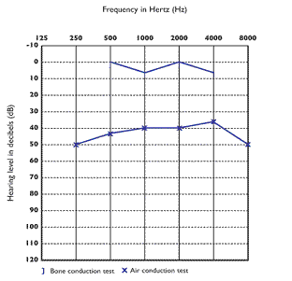

Slide 26
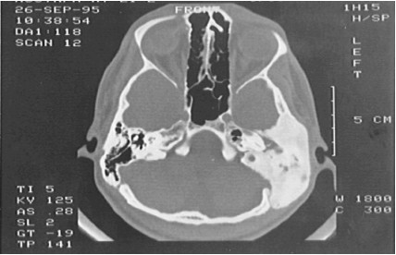
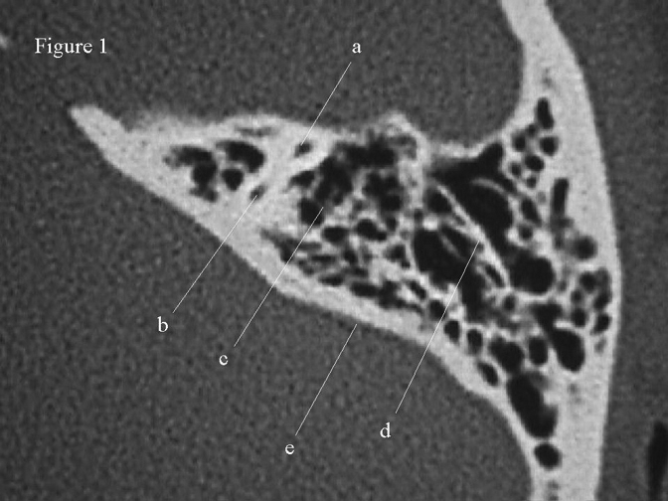
RADIOLOGICAL ASSESSMENT
CT-scan temporal bone

Slide 27
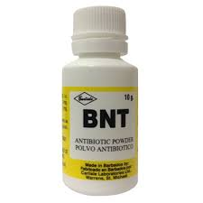
Treatment
Aural toilet
Suction and cleaning
Antibiotics
Topical antibiotics
Systemic antibiotics

Slide 28
Surgical treatment
Mainstay of the treatment
Canal wall up procedure
Canal wall down procedure
Reconstructive surgery

Slide 29
References: Scott Brown 8th Edition Disease Of ENT PL Dhingra, 7th Edition

Slide 30
THANK YOU

