Slide 1
COPD
Professor Muhammad Khurram
Head of Department, Medical Unit-2, HFH

Slide 2
University Motto, Vision, Values & Goals
Mission Statement
To impart evidence-based research oriented health professional education.
Best possible patient care
Mutual respect, ethical practice of healthcare and social accountability.
Vision and Values
Highly recognized and accredited centre of excellence in medical Education, using evidence-based training techniques for development of highly competent health professionals, who are lifelong experiential learner and are socially accountable.
Goals
The Undergraduate Integrated Learning Program is geared to provide you with quality medical education in an environment designed to.

Slide 3
Sequence OF LGIs
Learning objectives
What is COPD? (core concept= 70%)
Related pathology and pharmacology (horizontal integration 15%)
Related recent advances (vertical integration – 10%)
Research article related to topic (3%) and Ethics (3%)

Slide 4
Learning Objectives
Establish diagnosis of COPD through focused history , physical examination, and work up
Grading and severity
Treatment modalities
Proposing management plan
Multidisciplinary management
MDM/Future perspective.-Research
AI/Family Medicine
Resources/Articles to go through-MCQs

Slide 5
PROF UMER MODEL OF INTEGRATED LECTURE

Slide 6
Horizontal Integration
with Clinical Disciplines
- Community Medicine: Prevalence and risk factors in different populations.
- Pathology: Chronic bronchitis vs. emphysema, airway inflammation.
- Family Medicine: Long-term COPD management, smoking cessation strategies.

Slide 7
Vertical Integration with Basic Sciences
- Anatomy/Physiology: Airflow limitation, destruction of alveolar walls.
- Immunology: Neutrophil-mediated inflammation, role of proteases.
- Pharmacology: Mechanisms of bronchodilators, corticosteroids, and biologics.

Slide 8
Pathophysiology of COPD
- Chronic Inflammation: Neutrophils, macrophages, proteases breaking down lung tissue.
- Airway Remodeling: Increased mucus production, fibrosis, and airway narrowing.
- Emphysema Development: Alveolar destruction leads to decreased gas exchange efficiency.

Slide 9
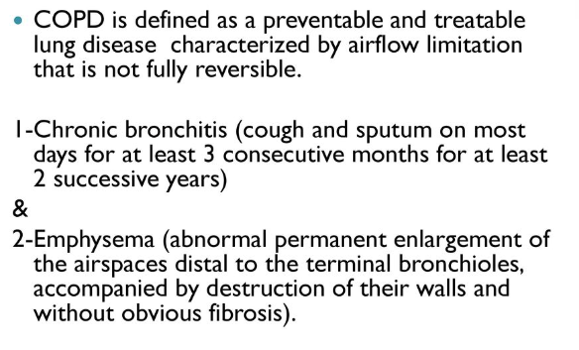
Definition
GOLD, and WHO, definition- A "heterogeneous lung condition characterized by chronic respiratory symptoms (dyspnea, cough, expectoration, exacerbations) due to abnormalities of the airway (bronchitis, bronchiolitis) and/or alveoli (emphysema) that cause persistent, often progressive, airflow obstruction"
In practice, the diagnosis of COPD requires all of the following; 1) presence of pulmonary symptoms (dyspnea, cough, or sputum production), 2) appropriate clinical context (most notably but not exclusively tobacco exposure), and 3) evidence of airflow limitation

Slide 10
Aetiology Pathophysiology
Tobacco smoking
Exposure to noxious gases & particles
Genetic factors such as severe deficiency of alpha-1 antitrypsin
Aging
Poor lung growth during gestation & childhood
Poor socioeconomic status
Characterized by the accumulation of inflammatory mucous exudates in the lumens of small airways & the thickening of their walls. These walls become infiltrated by adaptive and innate inflammatory immune cells. This chronic inflammatory process is associated with tissue repair & remodeling.
The defining feature of COPD is irreversible airflow limitation during forced expiration.

Slide 11
History
Dyspnea
Ask about the amount of effort required to induce uncomfortable breathing. Many individuals will deny symptoms of dyspnea, but will have reduced their activity levels substantially.
Cough
Cough with or without sputum production should be an indication for spirometric testing. The presence of chronic cough and sputum has been used to define chronic bronchitis.
Wheezing
Wheezing or squeaky noises occurring during breathing indicate the presence of airflow obstruction
Acute chest illnesses
Inquire about occurrence and frequency of episodes of increased cough and sputum with wheezing, dyspnea, or fever

Slide 12
Examination
Chest
Emphysema (only when severe): overdistention of the lungs in the stable state (chest held near full inspiratory position at end of normal expiration, low diaphragmatic position), decreased intensity of breath and heart sounds, and prolonged expiratory phase
Evidence of AFL/O: wheezes during auscultation on slow or forced breathing and prolongation of forced expiratory time
With severe disease: pursed-lip breathing, use of accessory respiratory muscles, retraction of lower interspaces
Other
Unusual positions to relieve dyspnea at rest
Digital clubbing suggests other diagnoses (lung cancer, bronchiectasis, fibrosis)
Mild dependent edema may be seen in the absence of right heart failure

Slide 13
Work Up
Spirometry
A postbronchodilator ratio of FEV1/FVC <0.7 or <LLN of FEV1/FVC is used to establish the presence of airflow limitation.
Chest radiography
Evidence of hyperinflation (eg, enlarged lungs, flattened diaphragm, increased AP diameter) and loss of parenchyma (decreased lung markings, large bullae) are present and diagnostic in severe emphysema. Radiography is frequently obtained to exclude other lung disease.
CBC
ABGs
Lung volumes
Body plethysmography to assess lung volumes is not necessary except in patients with a low FVC on spirometry (<80% predicted) or when concomitant interstitial lung disease is suspected.
Diffusing capacity for carbon monoxide
Echo

Slide 14
Spirometry
Spirometry to confirm diagnosis and establish the staging. If values are abnormal, a post-bronchodilator test may be indicated. Airflow limitation that is irreversible or only partially reversible with bronchodilator is suggestive of COPD rather than asthma.
A postbronchodilator ratio of FEV1/FVC <0.7 or <LLN of FEV1/FVC is used to establish the presence of airflow limitation.

Slide 15
Severity- Grade & Severity PBD-FEV1

Slide 16
Available Interventions

Slide 34
Complications

Slide 35
MDM
Future perspective – Research
Pulmonology
Rehabilitation
Nursing and Home Care.
Social Work and Palliative Care:
Clinical Trials: Ongoing research into new treatments, including pharmacological interventions, non-pharmacological therapies, and surgical options, requires clinical trials to assess efficacy and safety.
Epidemiological Studies: These studies help understand the disease's prevalence, risk factors, and impact on various populations, guiding public health strategies and policies.
Outcomes Research: Focuses on understanding the results of various therapeutic approaches on patient outcomes, quality of life, and healthcare utilization.
Notes:
Research in COPD
Clinical Trials: Ongoing research into new treatments, including pharmacological interventions, non-pharmacological therapies, and surgical options, requires clinical trials to assess efficacy and safety.
Epidemiological Studies: These studies help understand the disease's prevalence, risk factors, and impact on various populations, guiding public health strategies and policies.
Outcomes Research: Focuses on understanding the results of various therapeutic approaches on patient outcomes, quality of life, and healthcare utilization.
Multidisciplinary Management Components
Pulmonology: Specialists provide advanced care, manage complex cases, and perform procedures like bronchoscopy.
Rehabilitation: Pulmonary rehabilitation programs, involving physical therapists, nutritionists, and psychologists, offer comprehensive care to improve functional status and quality of life.
Nursing and Home Care: Nurses and home health aides support medication compliance, oxygen therapy, and daily living activities.
Social Work and Palliative Care: Addressing social determinants of health, providing support for end-of-life care decisions, and managing comorbid conditions like depression and anxiety.
Integrating these components provides a holistic approach to COPD management, improving patient outcomes through advanced diagnostics, personalized care, ongoing research, and comprehensive support across healthcare disciplines.

Slide 36
AI
Family Medicine
Diagnosis and Monitoring
Predictive Modeling.
Personalized Treatment
Early Detection and Management
Ongoing Care
Patient Education
Notes:
Artificial Intelligence (AI) in COPD Management
Diagnosis and Monitoring: AI algorithms can analyze data from spirometry, imaging (e.g., chest X-rays and CT scans), and patient-reported symptoms to assist in diagnosing COPD and assessing its severity.
Predictive Modeling: AI models can predict exacerbations, hospital readmission risks, and long-term outcomes by analyzing patient data, environmental factors, and treatment responses.
Personalized Treatment: AI can help tailor treatment plans to individual patients based on their disease patterns, genetic information, and response to previous treatments, optimizing efficacy and minimizing side effects.
Family Medicine's Role in COPD
Early Detection and Management: Primary care physicians play a crucial role in the early detection of COPD through screening and spirometry, especially in smokers and those with chronic respiratory symptoms.
Ongoing Care: Family practitioners manage stable COPD patients, prescribe maintenance medications, and adjust treatments based on disease progression and exacerbations.
Patient Education: They are pivotal in educating patients and caregivers about COPD, smoking cessation, pulmonary rehabilitation, and lifestyle modifications.

Slide 37
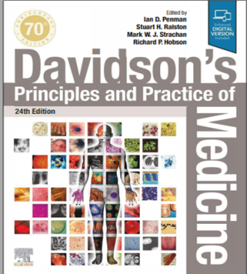
Resources/References
Article to go though/MCQs
GOLD Guidelines
RMU Portal

Slide 38
Recent Advances in COPD Management
- Biologic Therapies: Anti-IL-33 and other novel biologics for COPD exacerbation control.
- AI Applications: Predictive analytics for early exacerbation detection.
- Pulmonary Rehabilitation: New techniques for improving lung function and quality of life.

Slide 39
