Slide 2
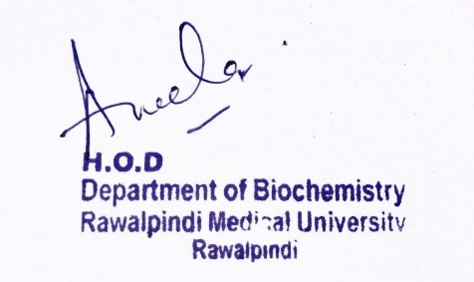
CNS Module 2nd Year MBBS (LGIS) Triglyceride Metabolism
Presenter: Dr. Aneela Jamil Date: 24-02-25
(Assistant Professor)

Slide 3
Motto, Vision, Dream
To impart evidence based research oriented medical education
To provide best possible patient care
To inculcate the values of mutual respect and ethical practice of medicine
Wisdom
Truth
Service

Slide 4
Professor Umar Model of Integrated Lecture

Slide 5
Learning Objectives
At the end of this lecture students should be able to
Explain synthesis and degradation of triglycerides
Discuss different enzymes involved in triglyceride metabolism
Describe regulation of triglyceride metabolism

Slide 6
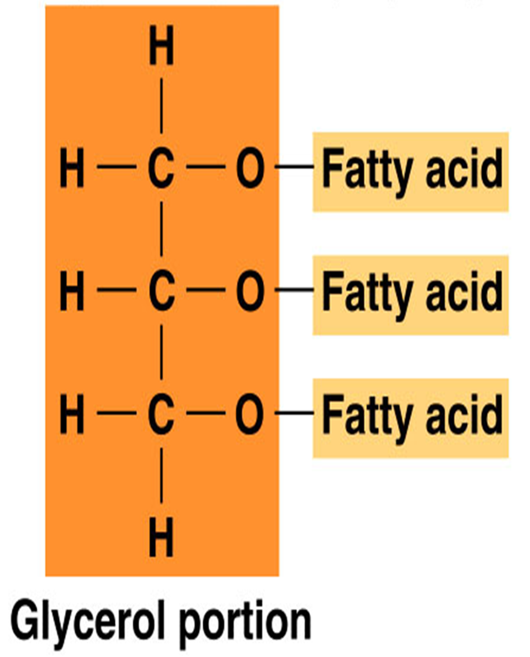
Core Knowledge
Structure of Triglyceride
Fatty acids and glycerol
Ester linkage

Slide 7
Core Knowledge
LIPOGENESIS

Slide 8
Core Knowledge
Synthesis of Triacylglycerol from
Fatty acyl CoA
Glycerol 3-phosphate

Slide 9
Core Knowledge
Synthesis of Glycerol 3-phosphate

Slide 10
Core Knowledge
Synthesis of Fatty acyl CoA

Slide 11
Core Knowledge
Synthesis of Triacylglycerol

Slide 12
Core Knowledge
Fate of Triglyceride
In Liver
Most is released as very-low-density lipoproteins (VLDLs)
In Adipose tissue
Stored as fat droplets “depot fat”

Slide 13
Core Knowledge
LIPOLYSIS

Slide 14
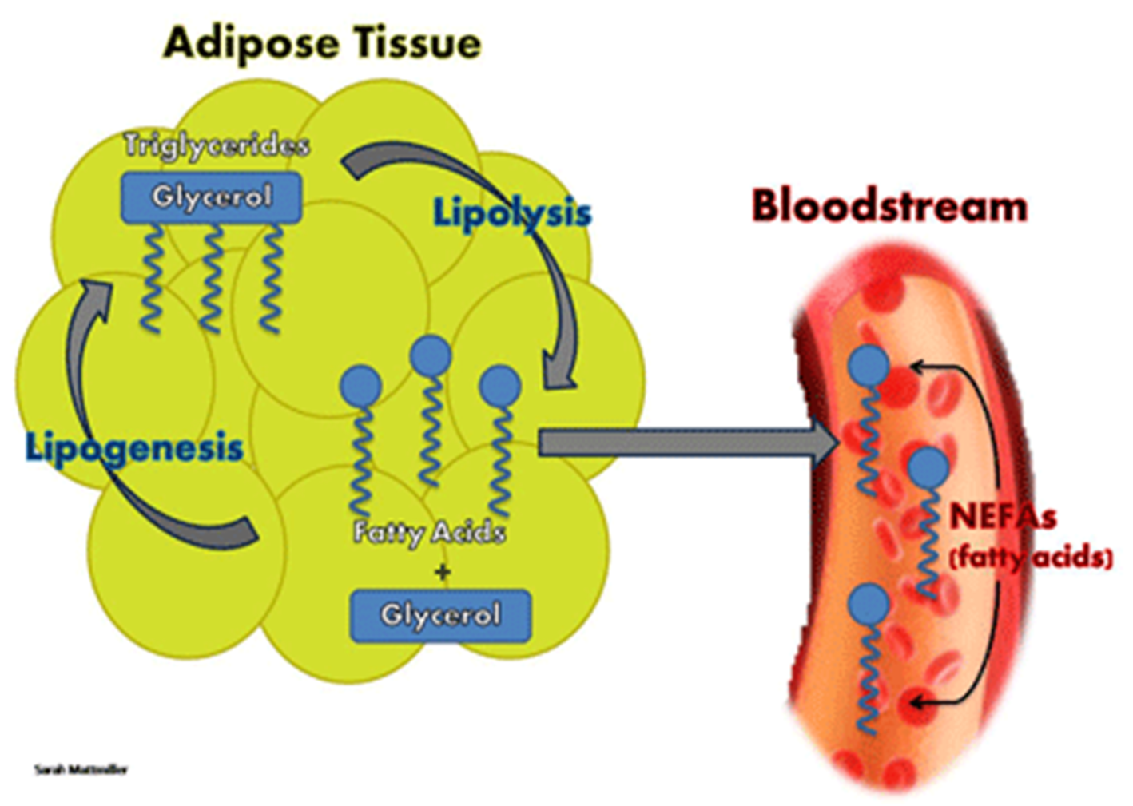
Core Knowledge
TAGs are degraded to fatty acids and glycerol in the adipose tissue by the action of Lipases

Slide 15
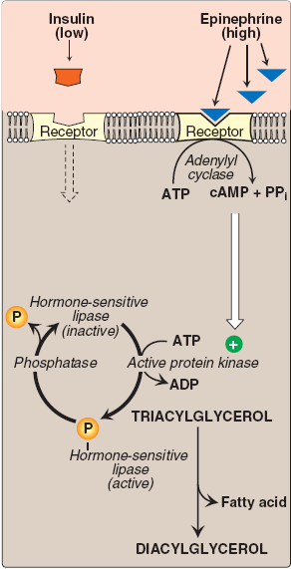
Core Knowledge

Slide 16
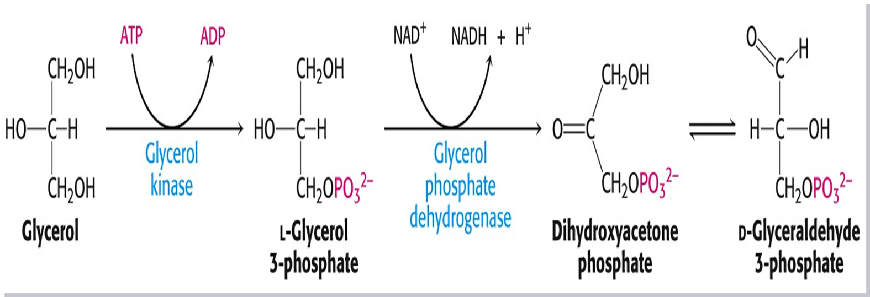
Core Knowledge

Slide 17
Core Knowledge

Slide 18
Core Knowledge
Regulation of Triglyceride metabolism
Regulated by hormones
Insulin promotes the conversion of carbohydrate to triacylglycerols
Glucagon & epinephrine promote mobilization of fatty acids from adipose tissue

Slide 19
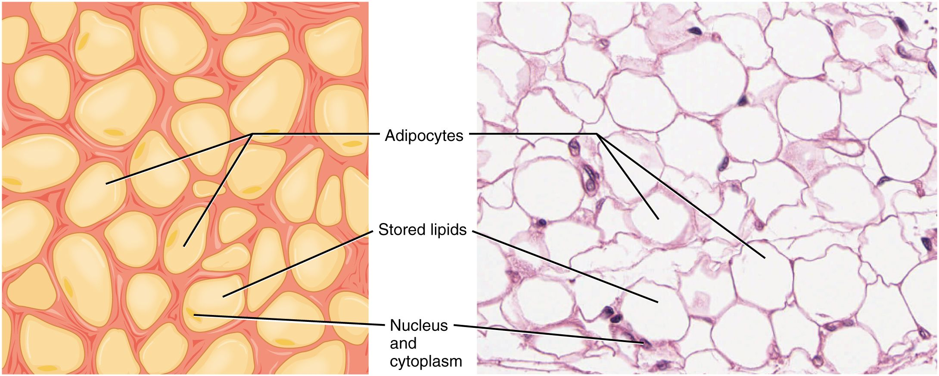
Anatomical & Physiological Aspects
Horizontal Integration

Slide 20
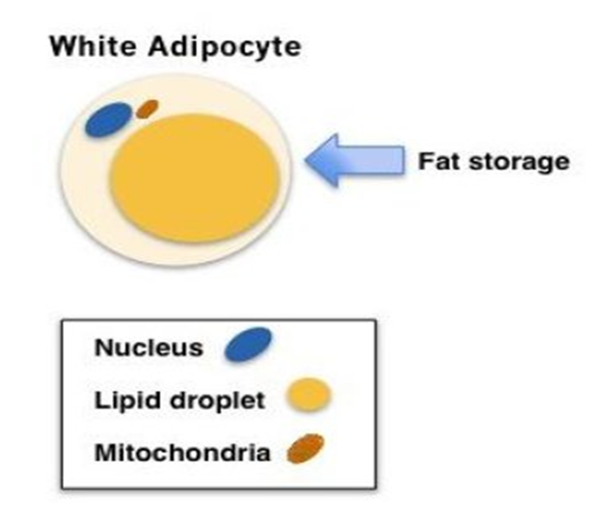
Horizontal Integration
Physiological Aspects
Functions of Adipose tissue
Fat reservoir
Synthesis of triglycerides
Provision of fatty acids to other tissues

Slide 21
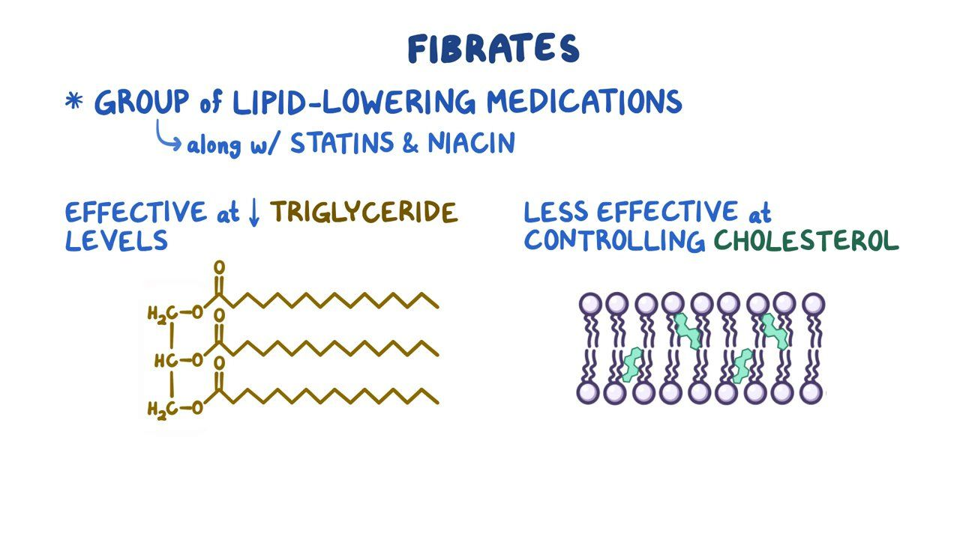
Vertical Integration

Slide 22
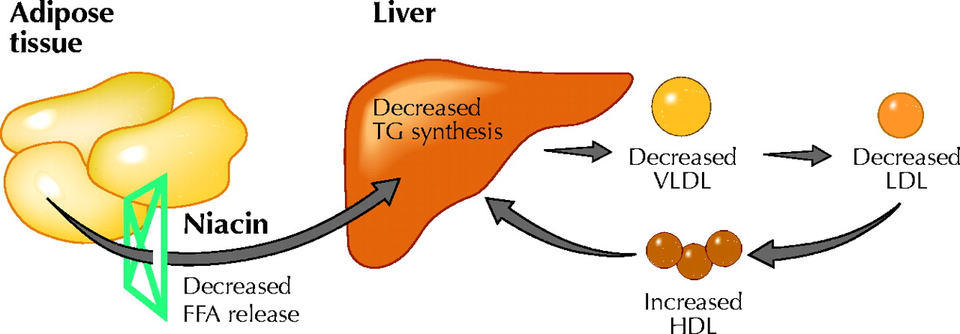
Vertical Integration

Slide 23
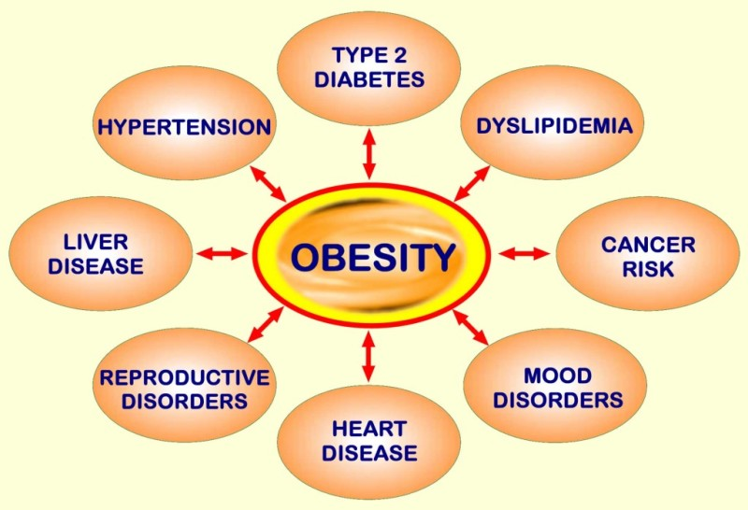
Vertical Integration

Slide 24
Family Medicine
Spiral Integration
Family Medicine plays important role in following manner:
Early Diagnosis
Education
Dietary Guidance
Monitoring
Refer to Specialists

Slide 25
Artificial Intelligence
Spiral Integration
Artificial Intelligence plays role in following aspects:
Utilizes extensive data from patient thereby enhancing prevention, diagnosis & treatment based on individual genetic profile

Slide 26
Suggested Research Article
Spiral Integration
Link: https://journals.plos.org/plosone/article?id=10.1371/journal.pone.0243068
Journal Name : PLOS One
Title: The association between triglycerides and ectopic fat obesity: An inverted U-shaped curve
Author Name: Yang Zou
Introduction
Ectopic fat obesity and triglycerides are risk factors for diabetes and multiple cardiovascular diseases. However, there have been limited studies on the association between triglycerides and ectopic fat obesity. The purpose of this study was to explore the association between triglycerides and ectopic fat obesity.

Slide 27
Bioethics
Spiral Integration
Appropriate information
Explain to patient or his family the genetic aspects of the condition
Counselling

Slide 28
How To Access Digital Library
Steps to Access HEC Digital Library
Go to the website of HEC National Digital Library
On Home Page, click on the INSTITUTES
A page will appear showing the universities from Public and Private Sector and other Institutes which have access to HEC National Digital Library HNDL
Select your desired Institute
A page will appear showing the resources of the institution
Journals and Researches will appear
You can find a Journal by clicking on JOURNALS AND DATABASE and enter a keyword to search for your desired journal

Slide 29
Learning Resources
Lippincott Illustrated Reviews Biochemistry, 8th Edition, Chapter 16, page no. 208-10
Google scholar
Google images

