Slide 2
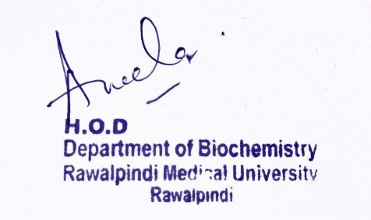
CNS Module 2nd Year MBBS (LGIS) Ketone Body Metabolism
Presenter: Dr. Aneela Jamil Date: 24-02-25
(Assistant Professor)

Slide 3
Motto, Vision, Dream
To impart evidence based research oriented medical education
To provide best possible patient care
To inculcate the values of mutual respect and ethical practice of medicine
Wisdom
Truth
Service

Slide 4
Professor Umar Model of Integrated Lecture

Slide 5
Learning Objectives
At the end of this lecture students should be able to
Explain steps of synthesis and degradation of ketone bodies
Describe regulation of ketone body metabolism
Discuss related clinical disorders

Slide 6
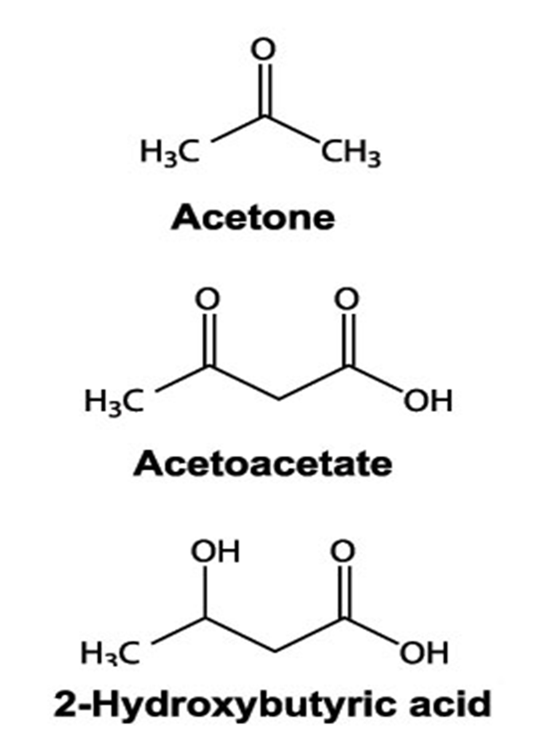
Core Knowledge
Ketone bodies
Acetoacetate
β-hydroxybutyrate
Acetone

Slide 7
Core Knowledge
Ketogenesis
In liver mitochondria
Substrate - Acetyl CoA derived from fatty acid oxidation
Formation and utilization is enhanced in fasting/ starvation

Slide 8
Core Knowledge
Steps
Synthesis of acetoacetyl CoA
Synthesis of HMG CoA
Cleavage of HMG CoA to acetoacetate
Reduction of acetoacetate to β-hydroxybutyrate
Decarboxylation of acetoacetate to acetone

Slide 9
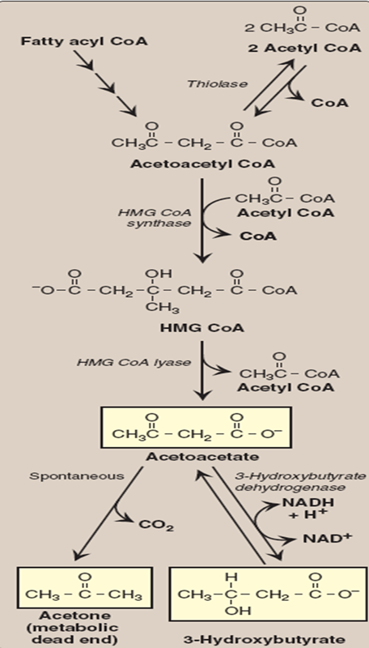
Core Knowledge

Slide 10
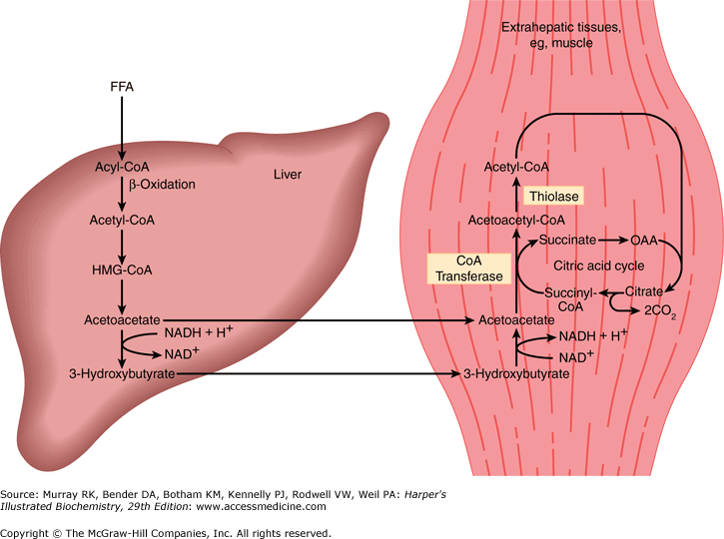
Core Knowledge

Slide 11
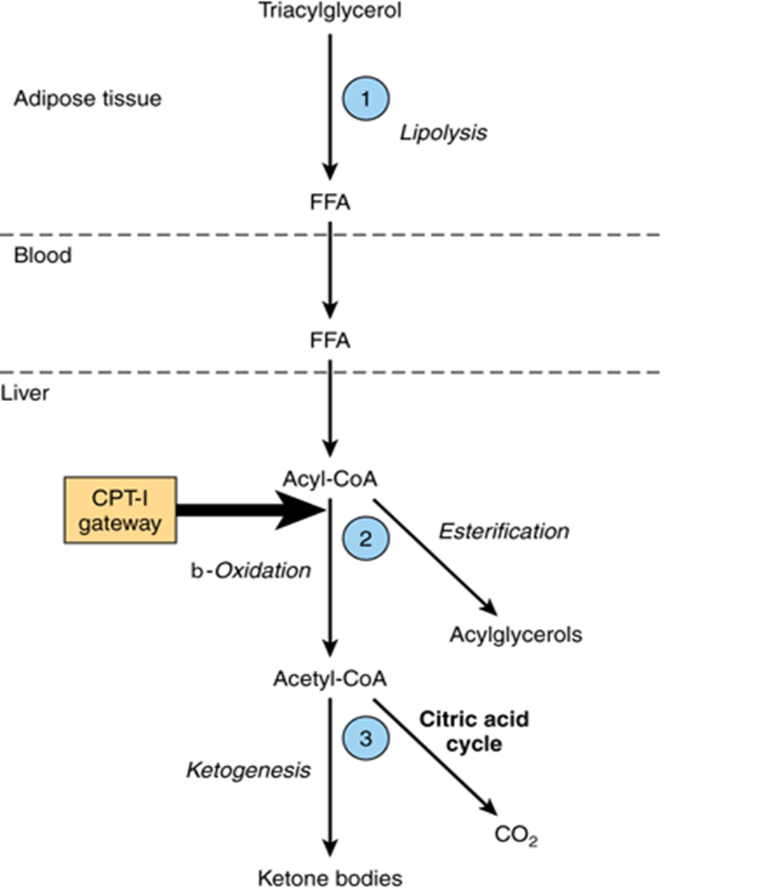
Core Knowledge
Regulation of Ketogenesis

Slide 12
Core Knowledge
Steps of Ketolysis
β-hydroxybutyrate is oxidized to acetoacetate by β-hydroxy butyrate dehydrogenase, producing NADH
Acetoacetate is then provided with a CoA molecule taken from succinyl CoA by Thiophorase
Acetoacetyl-CoA is then cleaved by thiolase to yield two acetyl-CoA which enter the citric acid cycle

Slide 13
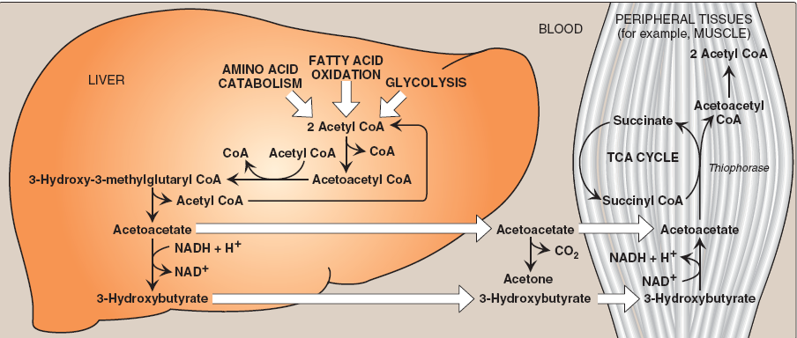
Core Knowledge

Slide 14
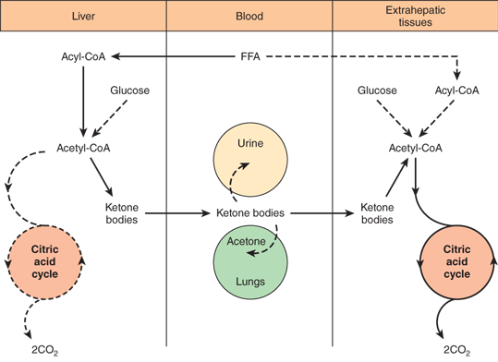

Slide 15
Core Knowledge

Slide 16
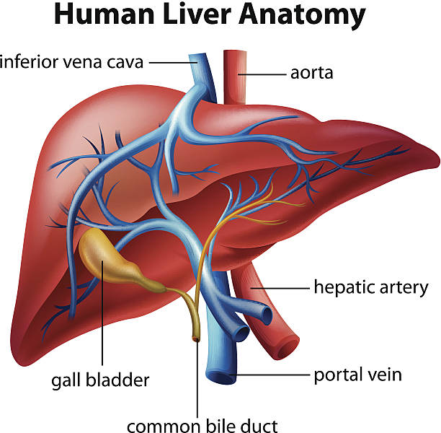
Anatomical & Physiological Aspects
Horizontal Integration

Slide 17
Horizontal Integration
Physiological Aspects
Functions of Liver
Metabolic functions
Synthesis of ketone bodies
Production of bile
Synthesis of plasma proteins

Slide 18
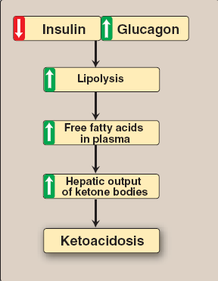
Vertical Integration

Slide 19
Vertical Integration

Slide 20
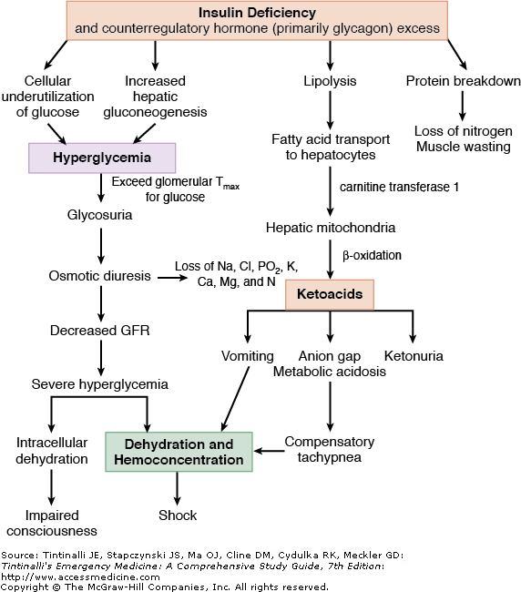
Vertical Integration

Slide 21
Family Medicine
Spiral Integration
Family Medicine plays important role in following manner:
Early Diagnosis
Education
Dietary Guidance
Monitoring
Refer to Specialists

Slide 22
Artificial Intelligence
Spiral Integration
Artificial Intelligence plays role in following aspects:
Utilizes extensive data from patient thereby enhancing prevention, diagnosis & treatment based on individual genetic profile

Slide 23
Suggested Research Article
Spiral Integration
Introduction
The most frequent hyperglycemic emergency and the leading cause of death in people with diabetes mellitus is diabetic ketoacidosis (DKA). DKA is common in people with type 1 diabetes, while type 2 diabetes accounts for roughly one-third of occurrences. Although DKA mortality rates have generally decreased to low levels, they are still significant in many underdeveloped nations. In industrialized countries, its mortality rate ranges from 2 to 5%, but in underdeveloped nations, it ranges from 6 to 24%. Therefore, it is always lethal if misdiagnosed or improperly treated.
Link: https://pmc.ncbi.nlm.nih.gov/articles/PMC10289692/
Journal Name : PMC
Title: Comprehensive review of diabetic ketoacidosis: an update
Author Name: Lara Console

Slide 24
Bioethics
Spiral Integration
Appropriate information
Explain to patient or his family the genetic aspects of the condition
Counselling

Slide 25
How To Access Digital Library
Steps to Access HEC Digital Library
Go to the website of HEC National Digital Library
On Home Page, click on the INSTITUTES
A page will appear showing the universities from Public and Private Sector and other Institutes which have access to HEC National Digital Library HNDL
Select your desired Institute
A page will appear showing the resources of the institution
Journals and Researches will appear
You can find a Journal by clicking on JOURNALS AND DATABASE and enter a keyword to search for your desired journal

Slide 26
Learning Resources
Lippincott Illustrated Reviews Biochemistry, 8th Edition, Chapter 16, page no. 218-220
Google scholar
Google images

