Slide 2
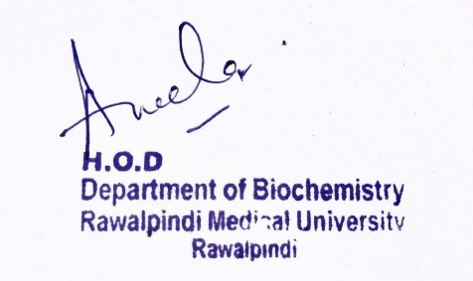
CNS Module 2nd Year MBBS (LGIS) Fatty Acid Synthesis
Presenter: Dr. Aneela Jamil Date: 24-02-25
(Assistant Professor)

Slide 3
Motto, Vision, Dream
To impart evidence based research oriented medical education
To provide best possible patient care
To inculcate the values of mutual respect and ethical practice of medicine
Wisdom
Truth
Service

Slide 4
Professor Umar Model of Integrated Lecture

Slide 5
Learning Objectives
At the end of this lecture students should be able to
Explain steps of synthesis of fatty acids
Describe regulation of fatty acid synthesis

Slide 6
Core Knowledge
Fatty acid synthesis
Location → cytosol of many tissues
Substrate → acetyl CoA (derived from glucose)
End product → palmitate
Requires ATP
Coenzymes are NADPH & Biotin

Slide 7
Core Knowledge
Steps of fatty acid synthesis
Production of cytosolic acetyl CoA
Carboxylation of acetyl CoA to form malonyl CoA
Synthesis of palmitate by fatty acid synthase complex

Slide 8
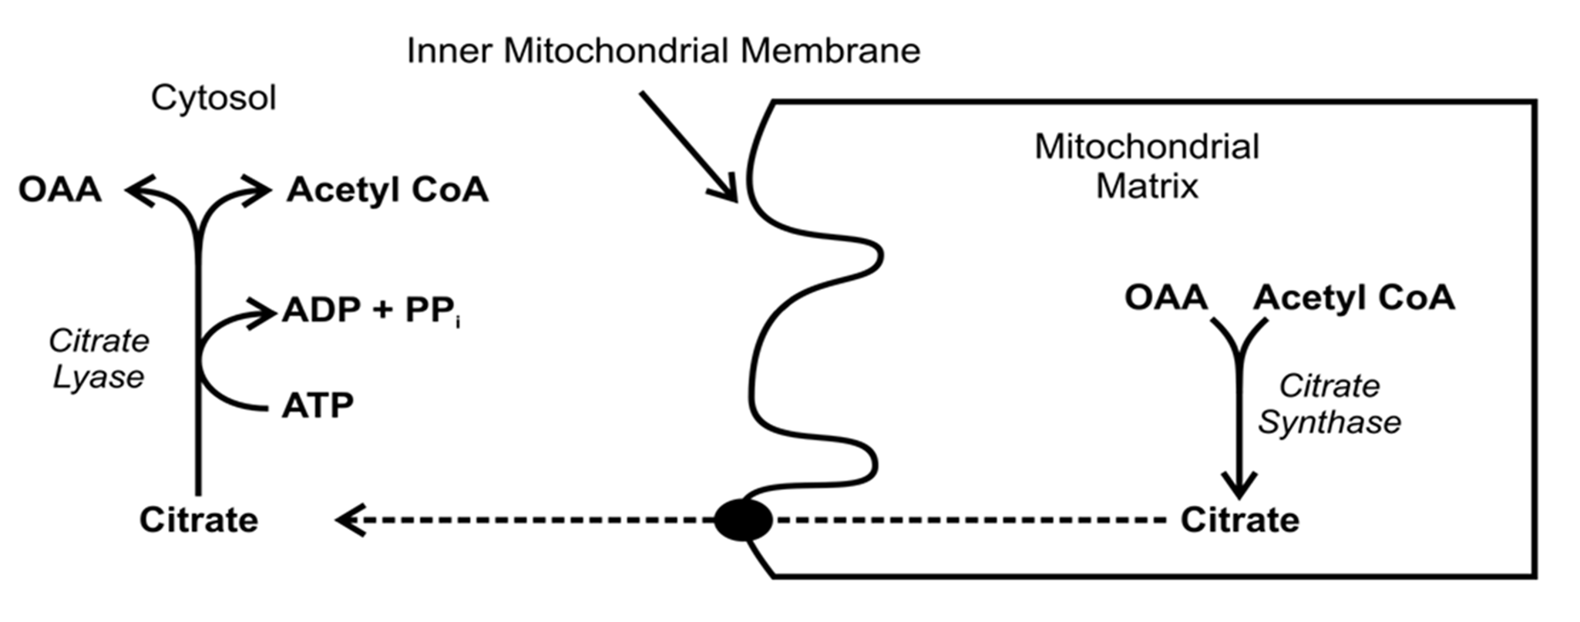
Core Knowledge
1. Production of cytosolic acetyl CoA

Slide 9
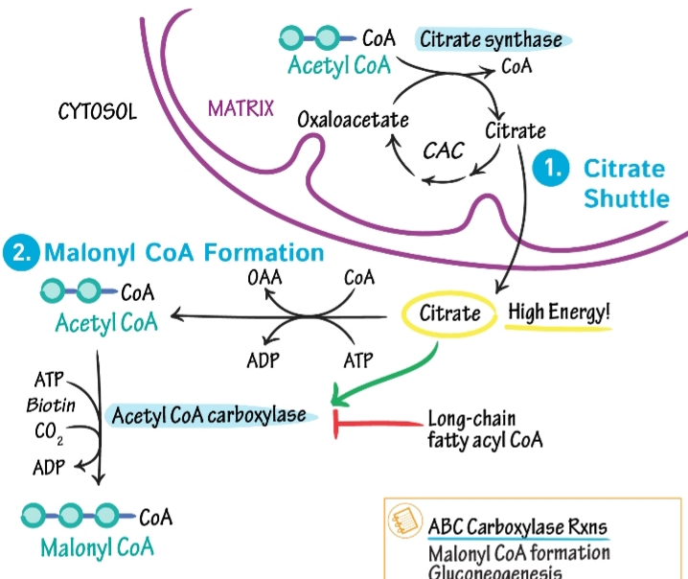
Core Knowledge

Slide 10
Core Knowledge
2. Carboxylation of acetyl CoA to malonyl CoA
Acetyl CoA + CO₂ Malonyl CoA
acetyl CoA carboxylase (biotin)

Slide 11
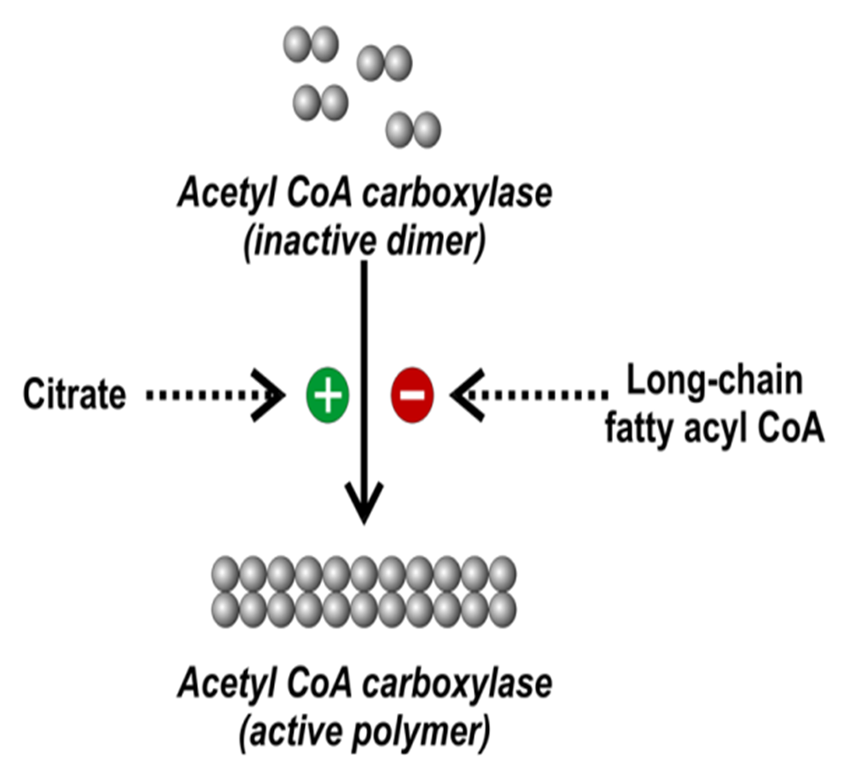
Core Knowledge
Regulation of acetyl CoA carboxylase

Slide 12
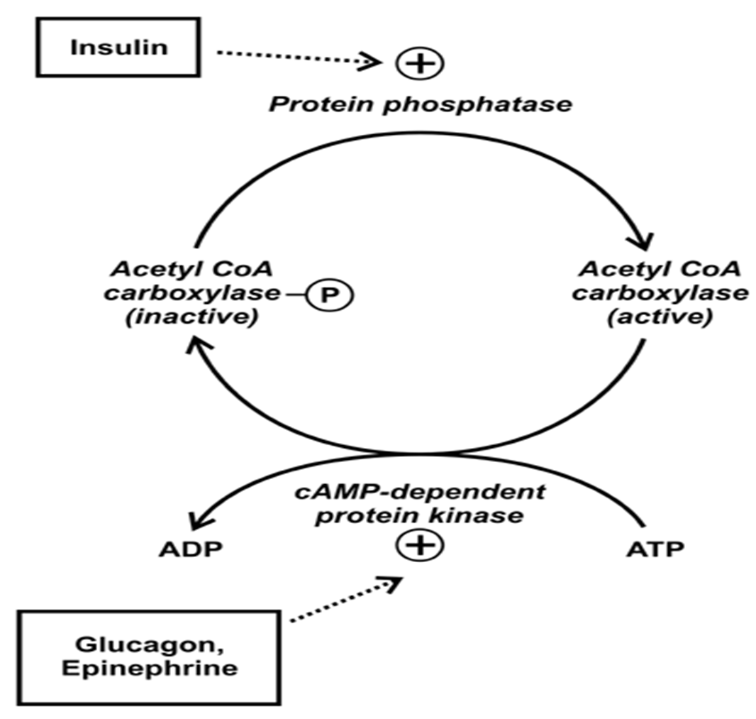
Core Knowledge

Slide 13
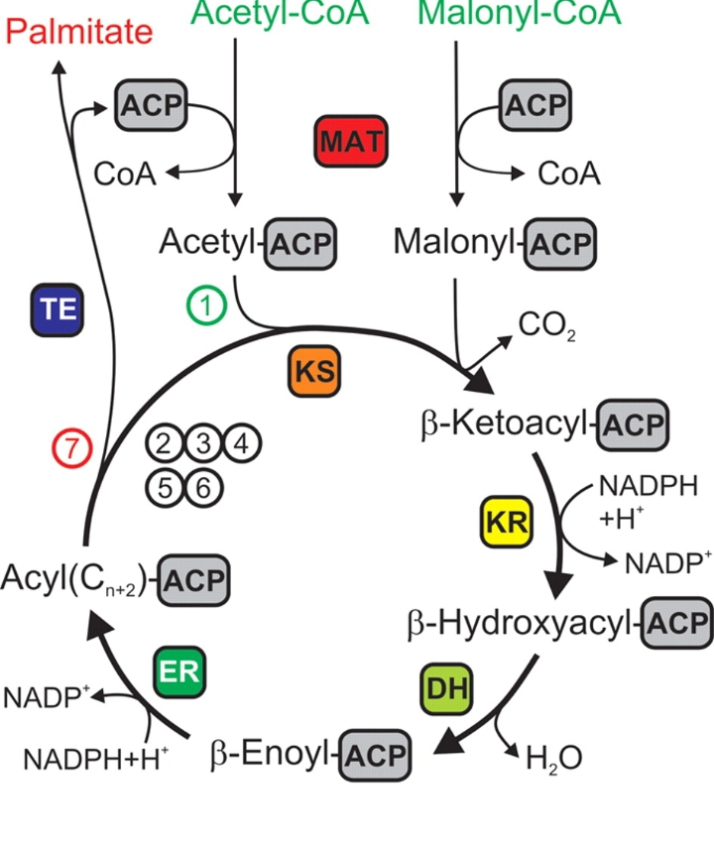
Core Knowledge
3. Synthesis of palmitate by fatty acid synthase

Slide 14
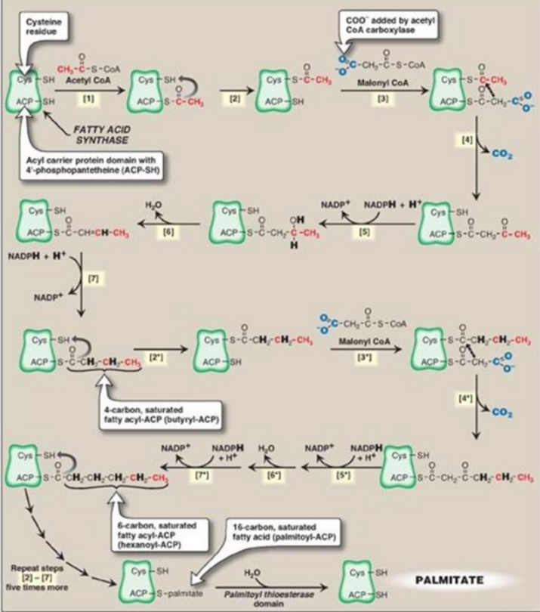
Core Knowledge

Slide 15
Core Knowledge
Steps
Condensation
Reduction
Dehydration
Reduction

Slide 16
Core Knowledge
Sources of NADPH
Pentose phosphate pathway
Malic enzyme (NADP dependent malate dehydrogenase)

Slide 17
Core Knowledge
Fatty acid elongation
In the smooth endoplasmic reticulum
Fatty acid elongation system of enzymes
Malonyl CoA is the two-carbon donor, and NADPH supplies the electrons

Slide 18
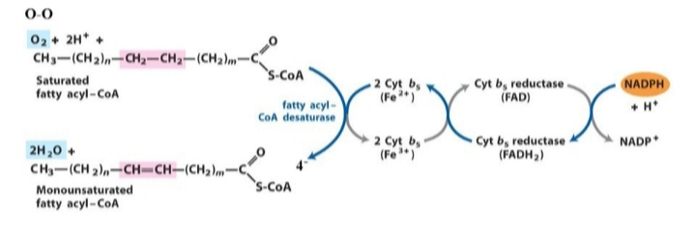
Core Knowledge
Fatty acid Desaturation

Slide 19
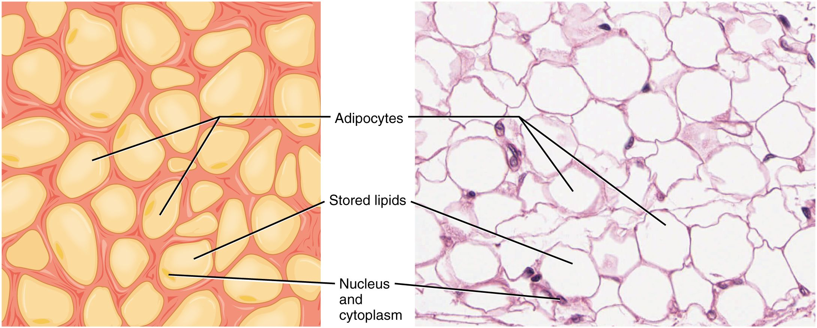
Anatomical & Physiological Aspects
Horizontal Integration

Slide 20
Horizontal Integration
Physiological Aspects
Functions of Adipose tissue
Fat reservoir
Synthesis of triglycerides
Provision of fatty acids to other tissues

Slide 21
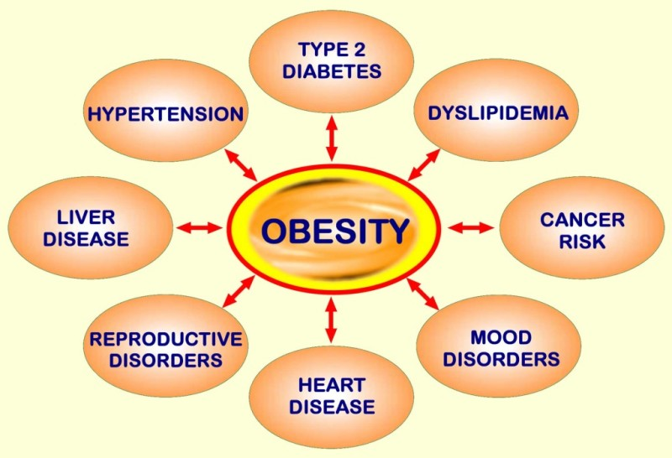
Vertical Integration

Slide 22
Family Medicine
Spiral Integration
Family Medicine plays important role in following manner:
Early Diagnosis
Education
Dietary Guidance
Monitoring
Refer to Specialists

Slide 23
Artificial Intelligence
Spiral Integration
Artificial Intelligence plays role in following aspects:
Utilizes extensive data from patient thereby enhancing prevention, diagnosis & treatment based on individual genetic profile

Slide 24
Suggested Research Article
Spiral Integration
Link: htthttps://www.frontiersin.org/articles/10.3389/fphys.2020.00794/full
Journal Name : Front. Physiol.
Title: The Link Between the Mitochondrial Fatty Acid Oxidation Derangement and Kidney Injury
Author Name: Lara Console
Introduction
Renal proximal tubular cells are high energy-demanding cells mainly relying on fatty acid oxidation. In stress conditions, such as transient hypoxia, fatty acid oxidation (FAO) decreases and carbohydrate catabolism fails to compensate for the energy demand. In this scenario, the surviving tubular cells exhibit the peculiar phenotype associated with fibrosis that is the histological manifestation of a process culminating in chronic and end-stage kidney disease. Genome-wide transcriptome analysis revealed that, together with inflammation, FAO is the top dysregulated pathway in kidney diseases with a decreased expression of key FAO enzymes and regulators. Another evidence that links the derangement of FAO to fibrosis is the progressive decrease of the expression of peroxisome proliferator-activated receptor α (PPARα) in aged people, that triggers the age-associated renal fibrosis.

Slide 25
Bioethics
Spiral Integration
Appropriate information
Explain to patient or his family the genetic aspects of the condition
Counselling

Slide 26
How To Access Digital Library
Steps to Access HEC Digital Library
Go to the website of HEC National Digital Library
On Home Page, click on the INSTITUTES
A page will appear showing the universities from Public and Private Sector and other Institutes which have access to HEC National Digital Library HNDL
Select your desired Institute
A page will appear showing the resources of the institution
Journals and Researches will appear
You can find a Journal by clicking on JOURNALS AND DATABASE and enter a keyword to search for your desired journal

Slide 27
Learning Resources
Lippincott Illustrated Reviews Biochemistry, 8th Edition, Chapter 16, page no. 203-07
Google scholar
Google images

