Slide 2
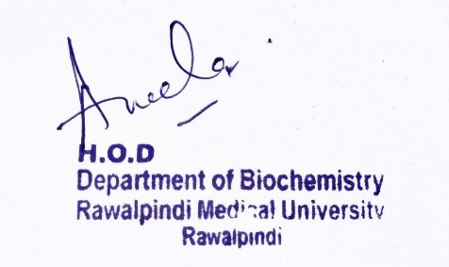
CNS Module 2nd Year MBBS (LGIS) Fatty Acid Oxidation II
Presenter: Dr. Aneela Jamil Date: 24-02-25
(Assistant Professor)

Slide 3
Motto, Vision, Dream
To impart evidence based research oriented medical education
To provide best possible patient care
To inculcate the values of mutual respect and ethical practice of medicine
Wisdom
Truth
Service

Slide 4
Professor Umar Model of Integrated Lecture

Slide 5
Learning Objectives
At the end of this lecture students should be able to
Explain different types of fatty acid oxidation
Discuss different enzymes involved fatty acid oxidation

Slide 6
Core Knowledge
Oxidation of monounsaturated fatty acids
All the steps are same except, one additional enzyme called enoyl-CoA isomerase is required (converts cis-double bond to trans double bond)

Slide 7
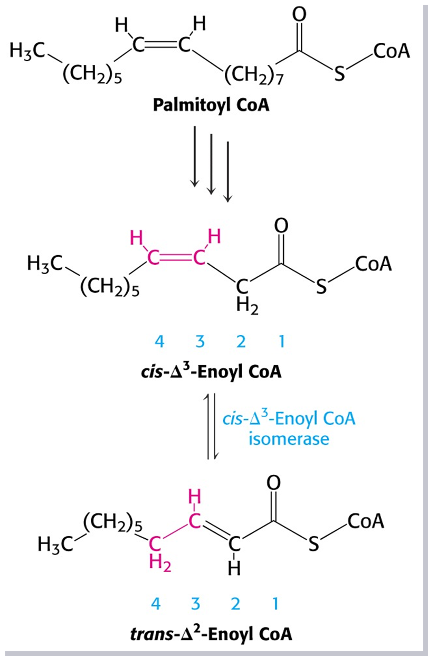
Core Knowledge

Slide 8
Core Knowledge
Oxidation of polyunsaturated fatty acids
Enoyl-CoA isomerase
NADPH-dependent 2,4 dienoyl CoA reductase

Slide 9
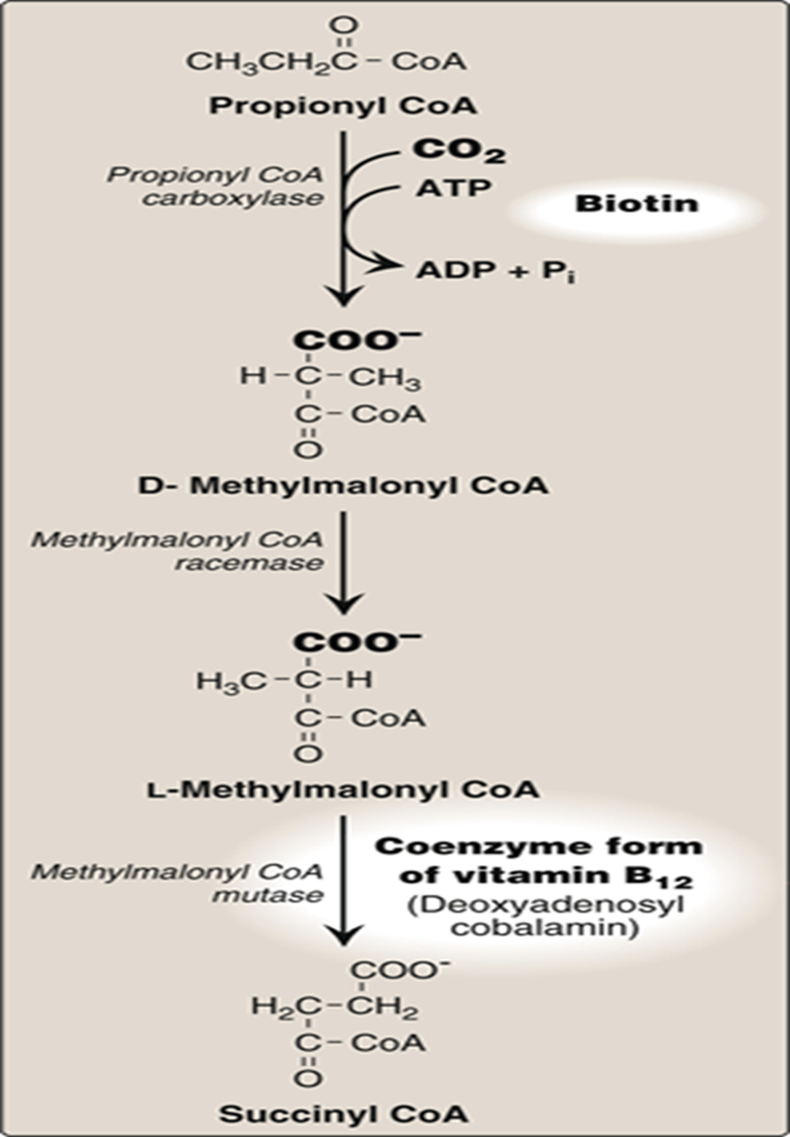
Core Knowledge
Oxidation of odd carbon fatty acids

Slide 10
Core Knowledge
Peroxisomal oxidation
Modified form of β-oxidation
Consists of four steps, as in mitochondrial β-oxidation
Mainly used as a chain shortening pathway
Peroxisomal oxidation is induced by high fat diet

Slide 11
Core Knowledge
Alpha oxidation
Branched fatty acids are catabolized in peroxisomes of animal cells by α oxidation
Branched chain phytanic acid is not a substrate for acyl CoA dehydrogenase because of the methyl group on its β carbon
It is hydroxylated at the α-carbon by phytanoyl CoA α-hydroxylase
Carbon 1 is released as CO₂, and the product, 19 carbon pristanic acid, is activated and undergoes β-oxidation

Slide 12
Core Knowledge
Omega oxidation
Alternative pathway to beta oxidation
Involves oxidation of the omega carbon
In the ER of liver & kidneys
Preferred substrates are fatty acids of 10 or 12 carbon atoms
Generates dicarboxylic acids

Slide 13
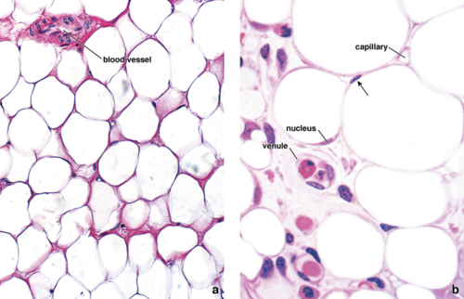
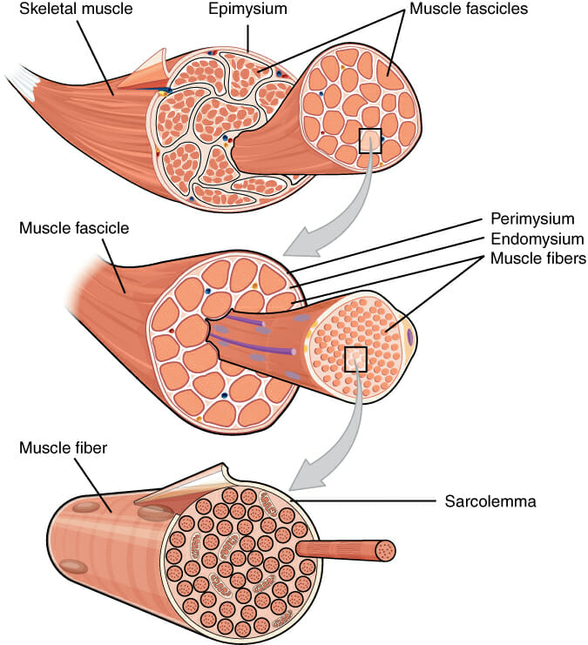
Anatomical & Physiological Aspects
Horizontal Integration

Slide 14
Horizontal Integration
Physiological Aspects
Functions of Muscle
Movement
Posture & stability
Utilization of glucose and fatty acids for energy
Functions of Adipose tissue
Fat storage
Utilization of glucose and fatty acids for energy

Slide 15
Vertical Integration
Methylmalonic aciduria
Inherited
Deficiency of mutase enzyme
Inability to convert vitamin B12 to its coenzyme
Acquired
Vitamin B12 deficiency

Slide 16
Vertical Integration
Zellweger syndrome
Genetic defects in the ability to make peroxisomes and therefore lack all the metabolism unique to that organelle
X-linked adrenoleukodystrophy
Peroxisomes fail to oxidize very-long-chain fatty acids, due to lack of a functional transporter for these fatty acids in the peroxisomal membrane
Both lead to accumulation of VLCFA in the blood and tissues

Slide 17
Vertical Integration
Refsum disease
Rare, autosomal recessive disorder
Caused by deficiency of peroxisomal phytanoyl hydroxylase
This results in the accumulation of phytanic acid in the plasma and tissues
Symptoms are primarily neurologic including blindness & deafness
Treatment involves dietary restriction

Slide 18
Vertical Integration
Dicarboxylic aciduria
Decreased mitochondrial medium chain acyl-CoA dehydrogenase
Increased ω-oxidation of long chain FA and decreased oxidation of medium chain FA, long chain shortened by beta oxidation to dicarboxylic acid
C6-C10 ω-dicarboxylic acids in urine
Nonketotic hypoglycemia

Slide 19
Family Medicine
Spiral Integration
Family Medicine plays important role in following manner:
Early Diagnosis
Education
Dietary Guidance
Monitoring
Refer to Specialists

Slide 20
Artificial Intelligence
Spiral Integration
Artificial Intelligence plays role in following aspects:
Utilizes extensive data from patient thereby enhancing prevention, diagnosis & treatment based on individual genetic profile

Slide 21
Suggested Research Article
Spiral Integration
Link: htthttps://www.frontiersin.org/articles/10.3389/fphys.2020.00794/full
Journal Name : Front. Physiol.
Title: The Link Between the Mitochondrial Fatty Acid Oxidation Derangement and Kidney Injury
Author Name: Lara Console
Introduction
Renal proximal tubular cells are high energy-demanding cells mainly relying on fatty acid oxidation. In stress conditions, such as transient hypoxia, fatty acid oxidation (FAO) decreases and carbohydrate catabolism fails to compensate for the energy demand. In this scenario, the surviving tubular cells exhibit the peculiar phenotype associated with fibrosis that is the histological manifestation of a process culminating in chronic and end-stage kidney disease. Genome-wide transcriptome analysis revealed that, together with inflammation, FAO is the top dysregulated pathway in kidney diseases with a decreased expression of key FAO enzymes and regulators. Another evidence that links the derangement of FAO to fibrosis is the progressive decrease of the expression of peroxisome proliferator-activated receptor α (PPARα) in aged people, that triggers the age-associated renal fibrosis.

Slide 22
Bioethics
Spiral Integration
Appropriate information
Explain to patient or his family the genetic aspects of the condition
Counselling

Slide 23
How To Access Digital Library
Steps to Access HEC Digital Library
Go to the website of HEC National Digital Library
On Home Page, click on the INSTITUTES
A page will appear showing the universities from Public and Private Sector and other Institutes which have access to HEC National Digital Library HNDL
Select your desired Institute
A page will appear showing the resources of the institution
Journals and Researches will appear
You can find a Journal by clicking on JOURNALS AND DATABASE and enter a keyword to search for your desired journal

Slide 24
Learning Resources
Lippincott Illustrated Reviews Biochemistry, 8th Edition, Chapter 16 , page no. 214-16
Google scholar
Google images

