Slide 2
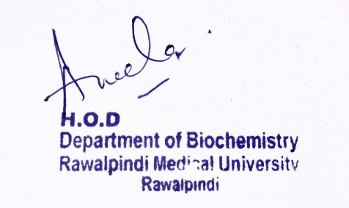
CNS Module 2nd Year MBBS (LGIS) Fatty Acid Oxidation I
Presenter: Dr. Aneela Jamil Date: 24-02-25
(Assistant Professor)

Slide 3
Motto, Vision, Dream
To impart evidence based research oriented medical education
To provide best possible patient care
To inculcate the values of mutual respect and ethical practice of medicine
Wisdom
Truth
Service

Slide 4
Professor Umar Model of Integrated Lecture

Slide 5
Learning Objectives
At the end of this lecture students should be able to
Describe the steps of beta oxidation of fatty acids
Discuss different enzymes/coenzymes involved in oxidation
Explain carnitine shuttle
Understand energy yield

Slide 6
Core Knowledge
Fatty acid oxidation
It is an aerobic process
Occurs in the mitochondria
Requires NAD & FAD as coenzymes
Generates ATP

Slide 7
Core Knowledge
Steps of fatty acid oxidation
Activation of fatty acid to its CoA from
Transport of fatty acyl CoA into mitochondria
Reactions of β-oxidation

Slide 8
Core Knowledge
I. Activation of Long chain fatty acids

Slide 9
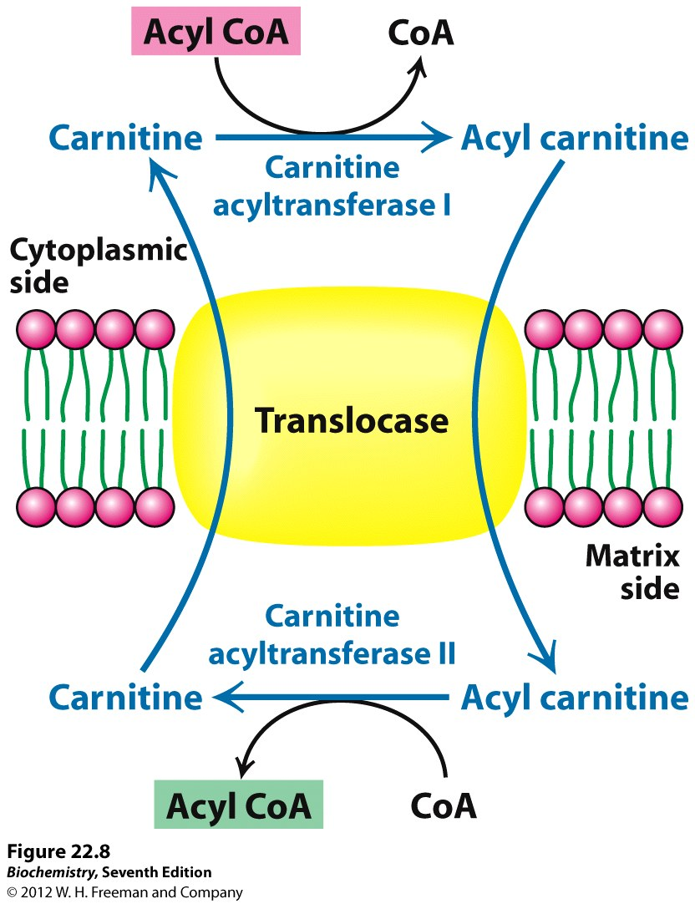
Core Knowledge
II. Transport into mitochondria
Carrier is carnitine, and transport process is called the carnitine shuttle

Slide 10
Core Knowledge
Components of carnitine shuttle
Carnitine palmitoyl transferase I (CPT-I or CAT-I),
Carnitine-acyl carnitine translocase
Carnitine palmitoyl transferase II (CPT-II or CAT-II),

Slide 11
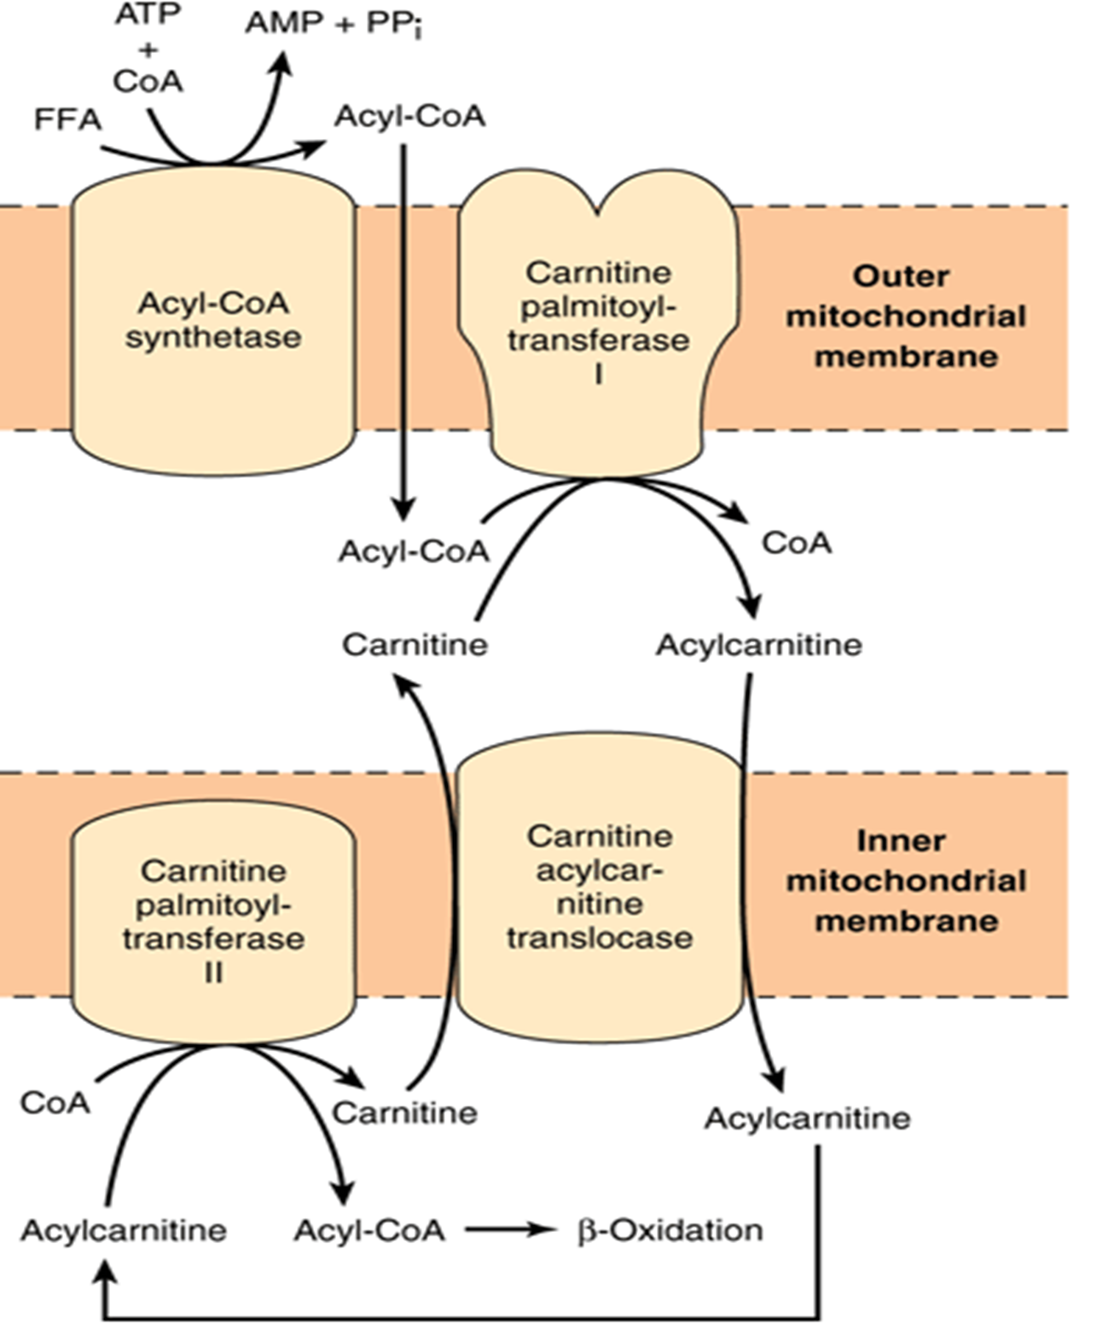
Core Knowledge

Slide 12
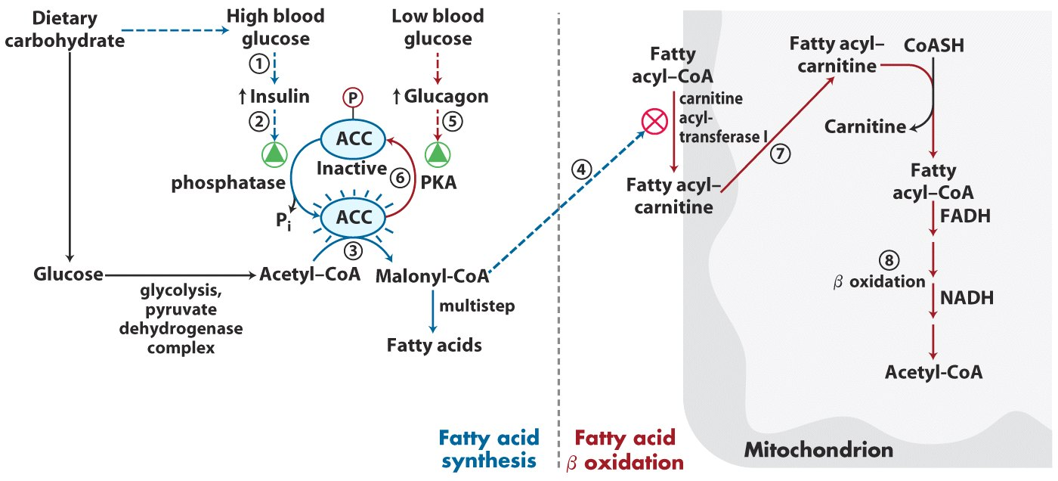
Core Knowledge

Slide 13
Core Knowledge
NOTE:
Fatty acids with chain lengths of 12 carbons or less can cross the inner mitochondrial membrane without the aid of carnitine
Inside mitochondria they are activated and are oxidized

Slide 14
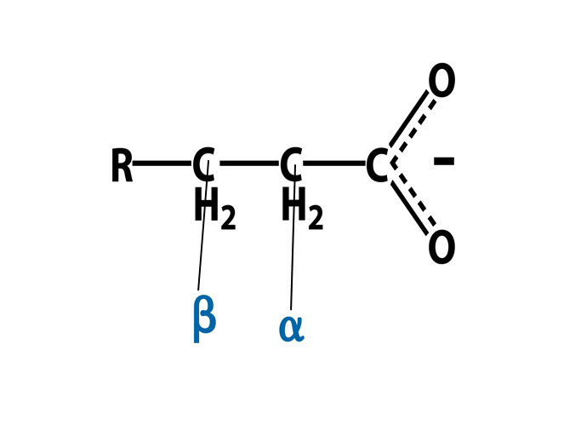
Core Knowledge
III. Reactions of β-oxidation
Oxidation
Hydration
Oxidation
Thiolytic cleavage

Slide 15
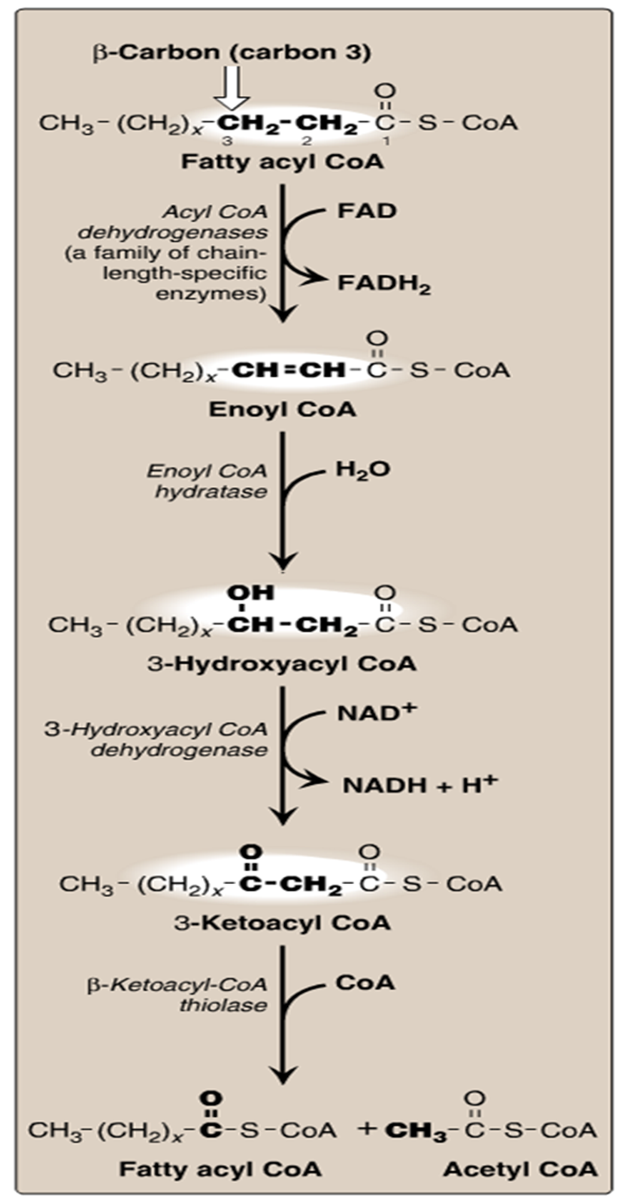
Core Knowledge

Slide 16
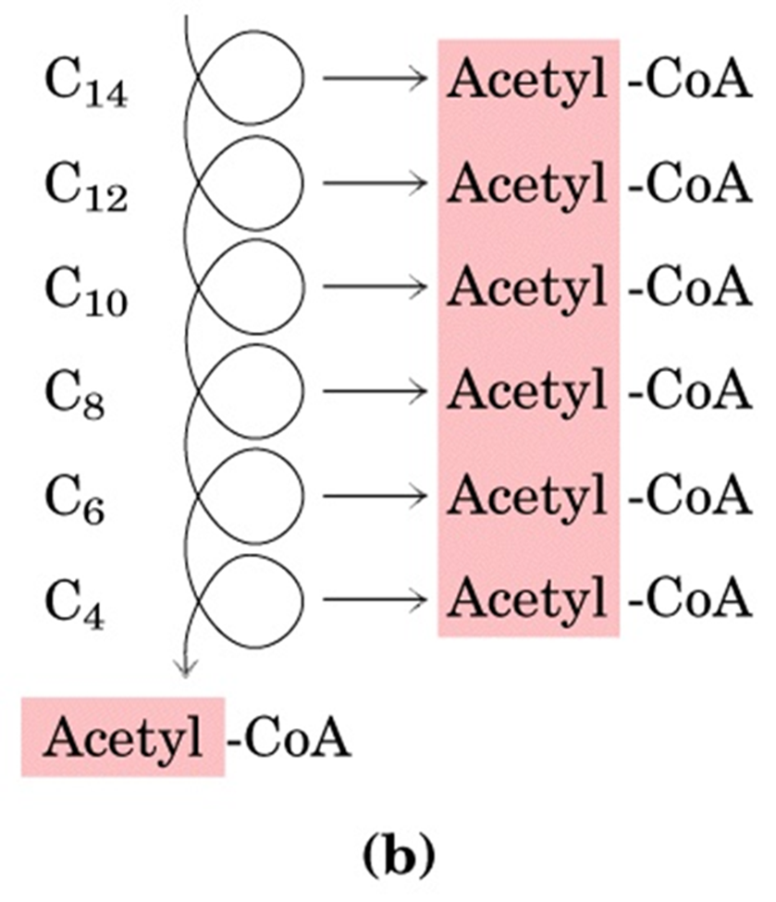
Core Knowledge
Process repeats itself

Slide 17
Core Knowledge
Each cycle produces
one acetyl CoA
one NADH and
one FADH₂
The final thiolytic cleavage produces two acetyl groups
Acetyl CoA is oxidized in TCA cycle

Slide 18
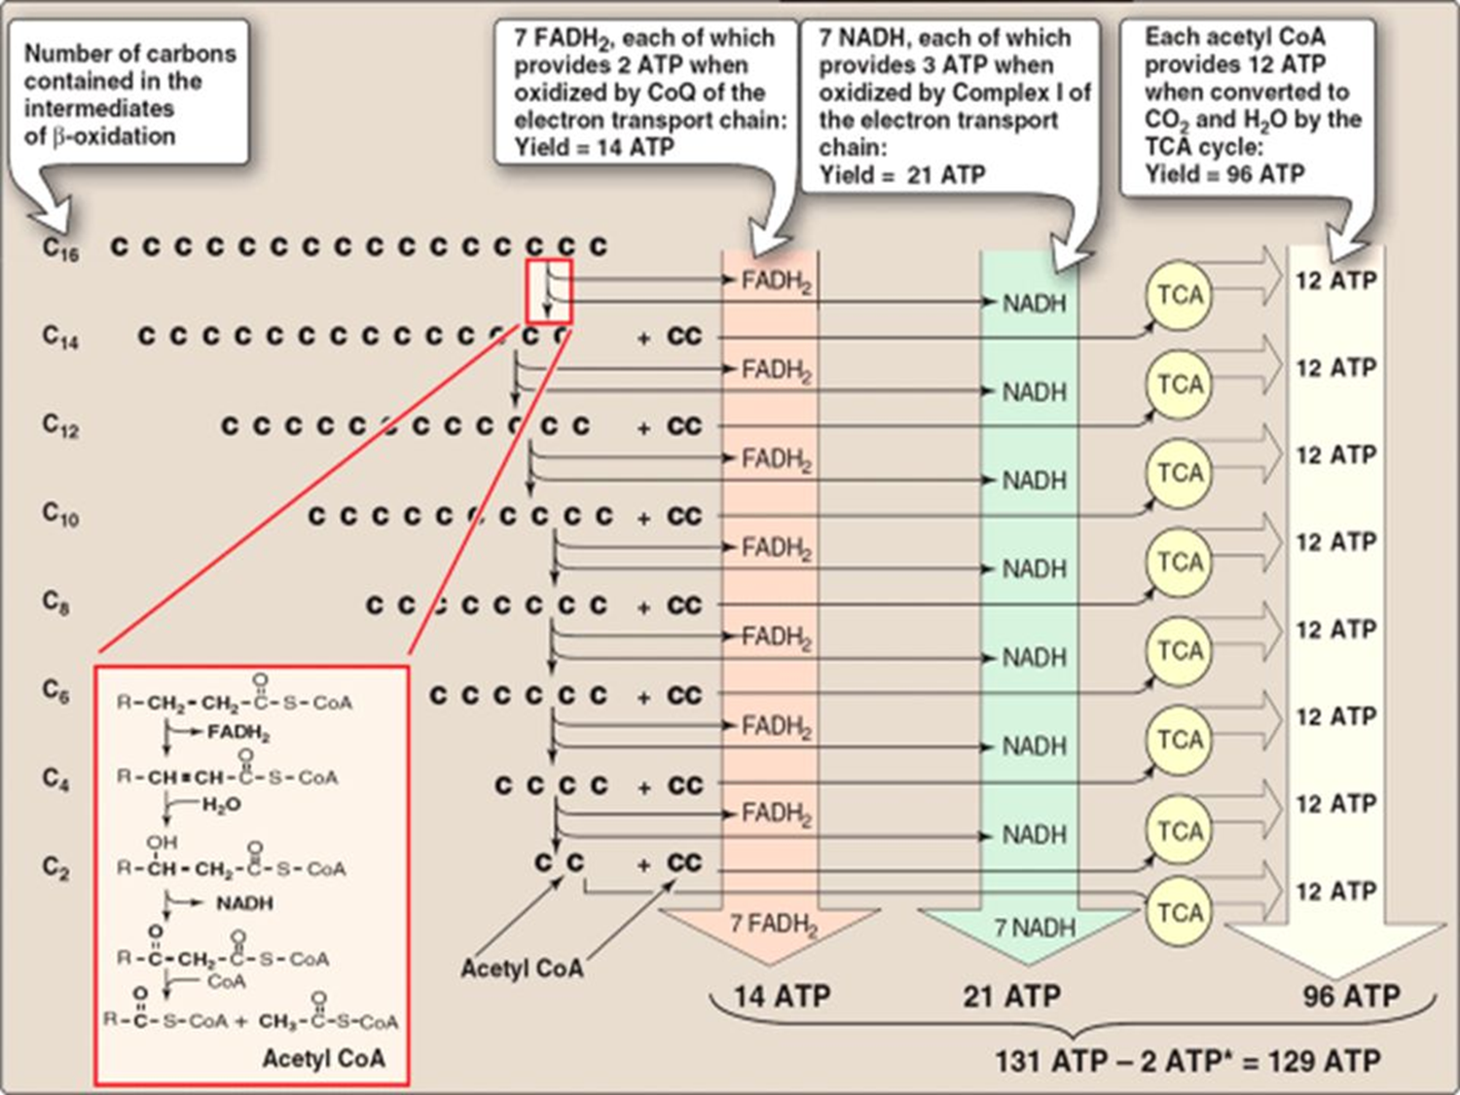
Core Knowledge
ATP Yield

Slide 19
Core Knowledge
Regulation of β-oxidation
Availability of free fatty acid
Entry of fatty acid into mitochondria
Acetyl CoA to CoA ratio

Slide 20
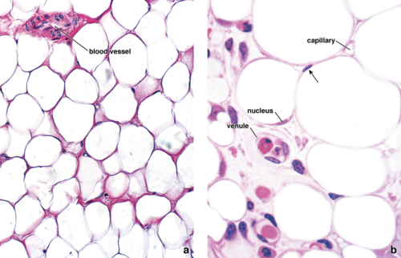
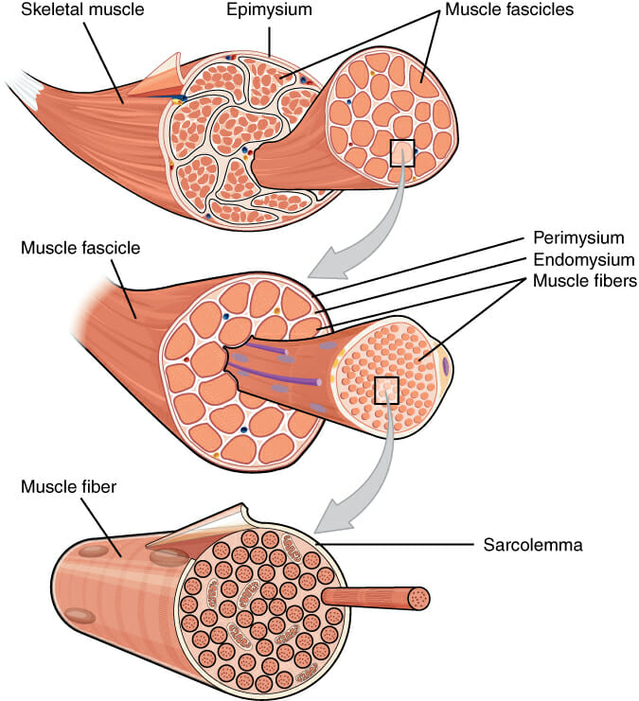
Anatomical & Physiological Aspects
Horizontal Integration

Slide 21
Horizontal Integration
Physiological Aspects
Functions of Muscle
Movement
Posture & stability
Utilization of glucose and fatty acids for energy
Functions of Adipose tissue
Fat storage
Utilization of glucose and fatty acids for energy

Slide 22
Vertical Integration
Deficiency of Carnitine
CPT-I deficiency
CPT-I deficiency

Slide 23
Vertical Integration
Medium chain acyl CoA dehydrogenase deficiency
Decreased ability to oxidize medium chain fatty acids and severe hypoglycemia
Cause of some cases of sudden infant death syndrome

Slide 24
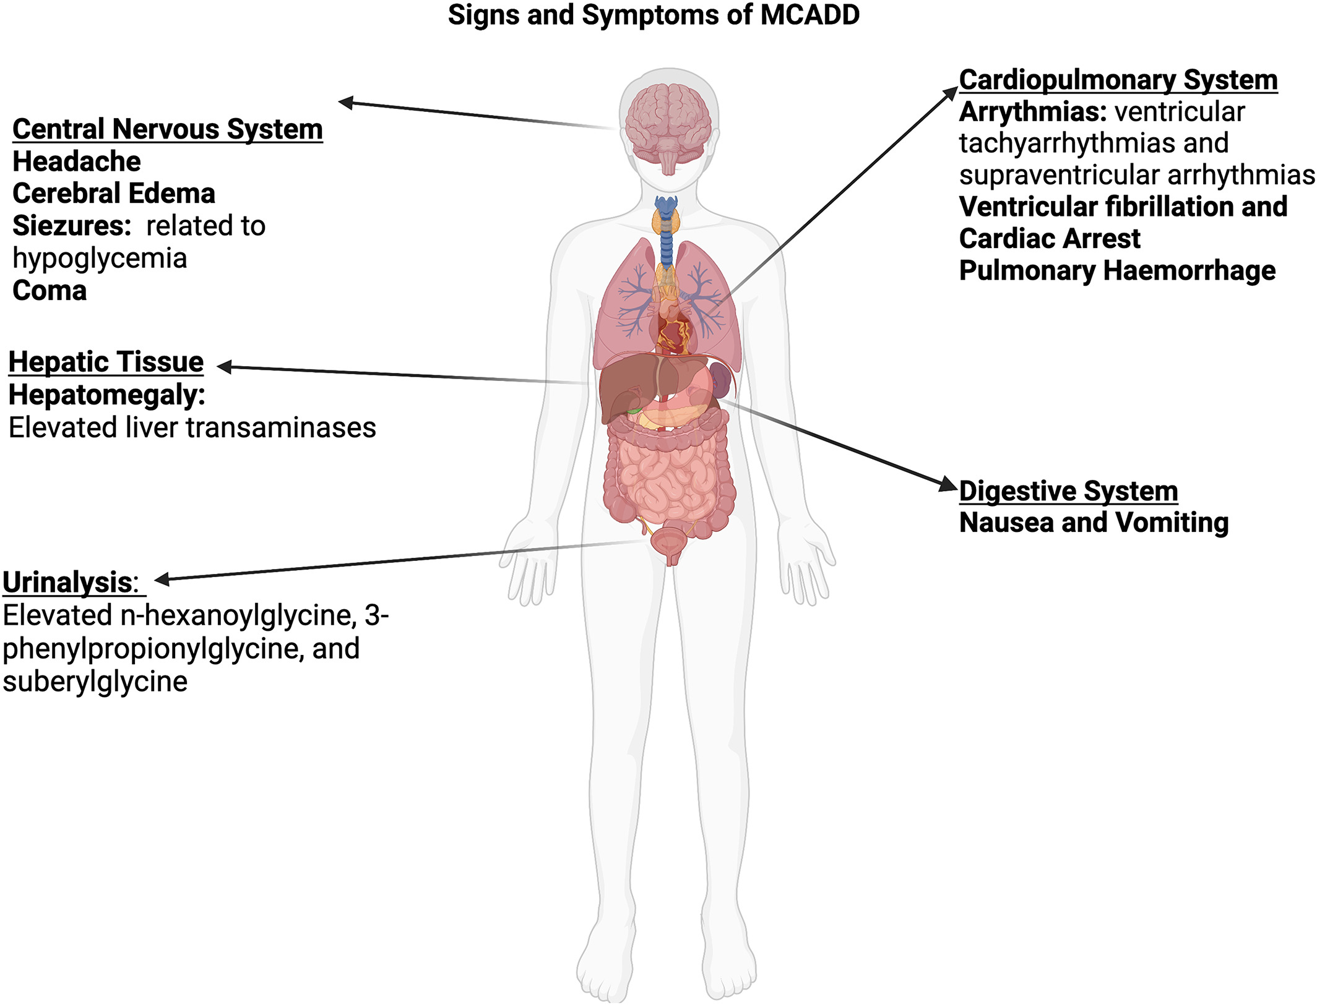
Vertical Integration

Slide 25
Vertical Integration
Jamaican Vomiting Sickness
Eating of unripe fruit of ackee tree that contains hypoglycin A which inactivates acyl-CoA dehydrogenase and causes hypoglycemia

Slide 26
Family Medicine
Spiral Integration
Family Medicine plays important role in following manner:
Early Diagnosis
Education
Dietary Guidance
Monitoring
Refer to Specialists

Slide 27
Artificial Intelligence
Spiral Integration
Artificial Intelligence plays role in following aspects:
Utilizes extensive data from patient thereby enhancing prevention, diagnosis & treatment based on individual genetic profile

Slide 28
Suggested Research Article
Spiral Integration
Link: htthttps://www.frontiersin.org/articles/10.3389/fphys.2020.00794/full
Journal Name : Front. Physiol.
Title: The Link Between the Mitochondrial Fatty Acid Oxidation Derangement and Kidney Injury
Author Name: Lara Console
Introduction
Renal proximal tubular cells are high energy-demanding cells mainly relying on fatty acid oxidation. In stress conditions, such as transient hypoxia, fatty acid oxidation (FAO) decreases and carbohydrate catabolism fails to compensate for the energy demand. In this scenario, the surviving tubular cells exhibit the peculiar phenotype associated with fibrosis that is the histological manifestation of a process culminating in chronic and end-stage kidney disease. Genome-wide transcriptome analysis revealed that, together with inflammation, FAO is the top dysregulated pathway in kidney diseases with a decreased expression of key FAO enzymes and regulators. Another evidence that links the derangement of FAO to fibrosis is the progressive decrease of the expression of peroxisome proliferator-activated receptor α (PPARα) in aged people, that triggers the age-associated renal fibrosis.

Slide 29
Bioethics
Spiral Integration
Appropriate information
Explain to patient or his family the genetic aspects of the condition
Counselling

Slide 30
How To Access Digital Library
Steps to Access HEC Digital Library
Go to the website of HEC National Digital Library
On Home Page, click on the INSTITUTES
A page will appear showing the universities from Public and Private Sector and other Institutes which have access to HEC National Digital Library HNDL
Select your desired Institute
A page will appear showing the resources of the institution
Journals and Researches will appear
You can find a Journal by clicking on JOURNALS AND DATABASE and enter a keyword to search for your desired journal

Slide 31
Learning Resources
Lippincott Illustrated Reviews Biochemistry, 8th Edition, Chapter 16 , page no. 210-14
Google scholar
Google images

