Slide 1
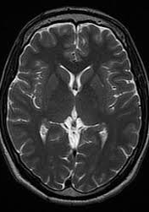
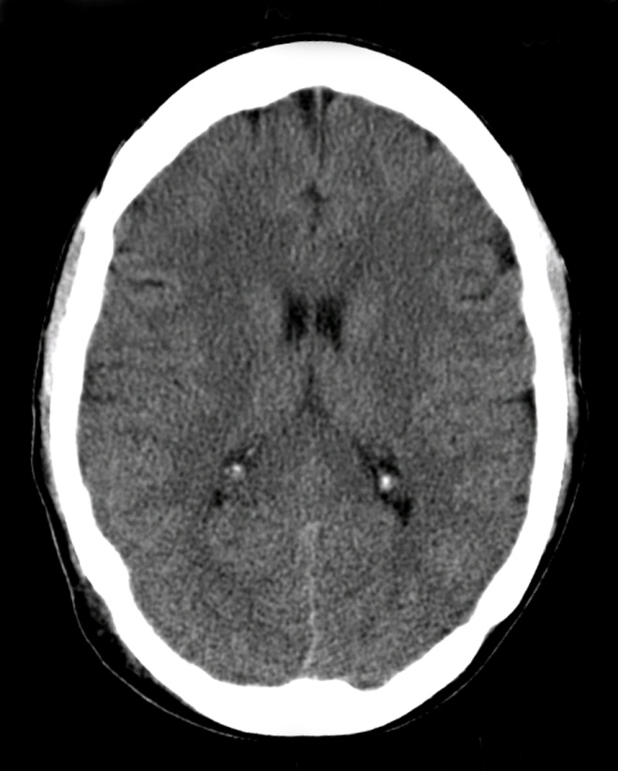
CNS MODULE (RADIOLOGY)
By:
Dr. Anam Zahoor
Assistant Professor Radiology
Holy Family Hospital

Slide 2
University Motto, Vision and Values
Mission Statement
To impart evidence-based research-oriented health professional education Best possible patient care Mutual respect, ethical practice of healthcare and social accountability.
Vision and Values
Highly recognized and accredited centre of excellence in Medical Education, using evidence-based training techniques for development of highly competent health professionals, who are lifelong experiential learner and are socially accountable.

Slide 5
LEARNING OBJECTIVES
At the end of the LGIS. Students should be able to:
Identify and Describe …. Radiological techniques i.e CT and MRI
Differentiate between CT and MRI images
Learn basic anatomy on CT and MRI images and associated pathologies
Classify…Cerebrovascular disease and hemorrhages
Explain…CNS trauma and clinical implications and management

Slide 6
Sequence of LGIS
Introduction To CT
Radiological anatomy on CT brain
Introduction To MRI
Radiological anatomy on MRI brain and spine
Common Radiological pathology on CT and MRI of brain and spine
Clinical scenario and management
Research article
Biomedical ethics

Slide 7
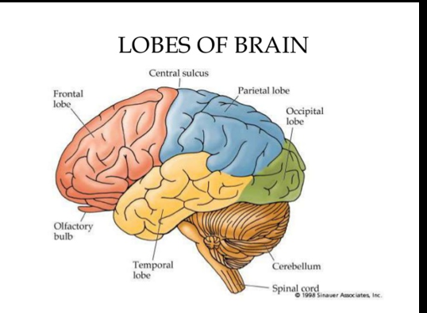

Slide 8
INTRODUCTION TO COMPUTED TOMOGRAPHY
CT (computed tomography)
Or CAT (computer assissted tomography)
Tomography refers to a process for generating 2D image slice of an examined organ
Based on differential absorption of x ray by various tissues

Slide 10
TECHNIQUE

Slide 12
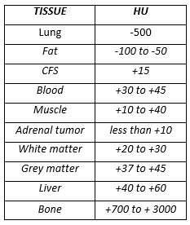
In CT, shades of gray correspond to a number on an arbitrary linear scale, expressed as HOUNSEFIELD UNITS (HU). (-1000 to +3000)
Human eye has limitations in number of different shades it can perceive. Monitors can display 256 gray scales & human eye can perceive 64 shades of gray
CT WINDOWING is done by setting the display to the HU of tissues of interest

Slide 16
Vertical integration Normal Anatomy

Slide 18
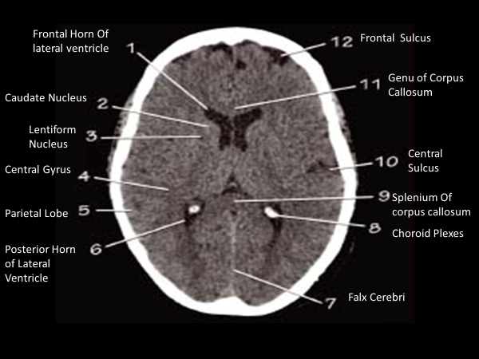

Slide 21
SYSTEMIC APPROACH TO CT INTERPRETATION
Symmetry: Compare left & right side
Midline: Look for midline shift
Cross sectional anatomy:
Brain matter (gray matter, white matter, any lesions
CSF & ventricles
Skull & soft tissues
Subdural windows: Blood & collections adjacent to bone
Bone windows: Skull, orbit, sinuses, air

Slide 22
MRI BRAIN

Slide 23
MRI (Magnetic Resonance Imaging)
An MRI scanner is actually a large, powerful magnet in which the patient lies.
MRI sensitization Body sensitized & magnetized body sends magnetic signals Received by MRI scanner Computer image formed from proton map

Slide 25
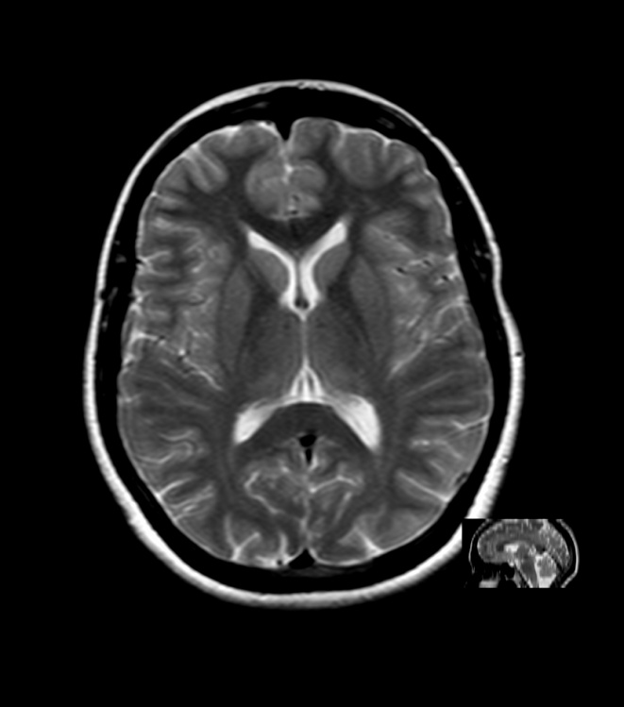
BRAIN NORMAL
T1W
T2W
FLAIR
PDW
MULTI SEQUENTIAL IMAGING

Slide 26
VERTICAL INTEGRATION- NORMAL ANATOMY

Slide 29
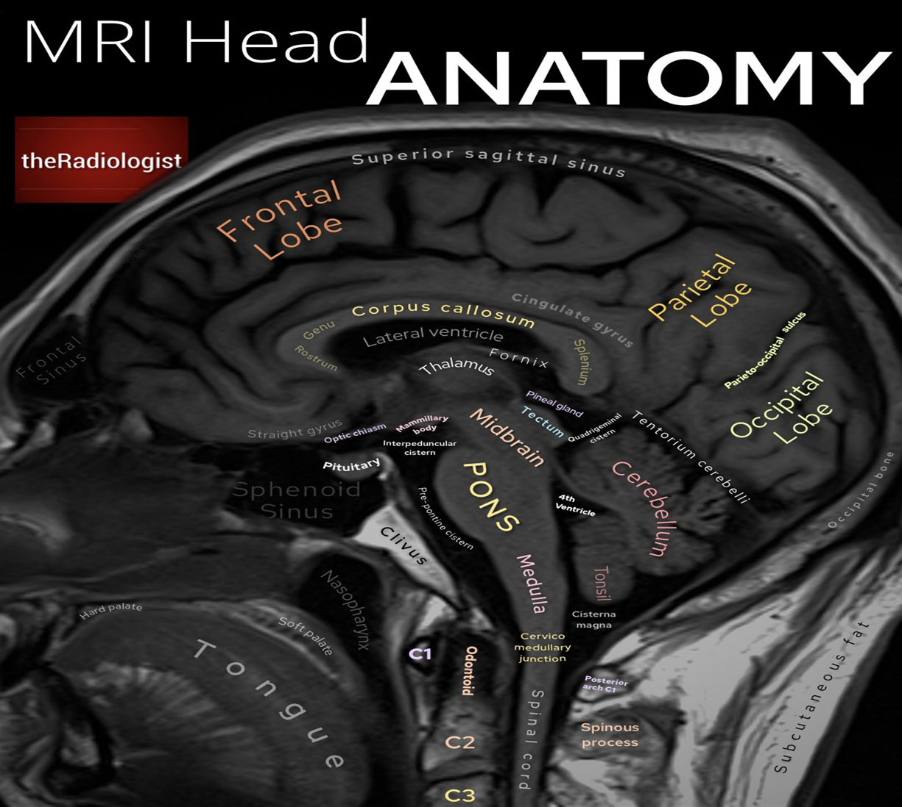
Sagittal view

Slide 33
CNS Pathologies
Horizontal integration

Slide 34
Congenital
Neoplastic
Infective
De/dysmyelinating
Vascular
Trauma

Slide 35
Hydrocephalus

Slide 36
Chiari Malformation

Slide 37
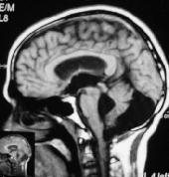
Dandy Walker Malformation
Plain C.T.
T1W Sagital MRI.

Slide 38
SPINA BIFIDA CT &MRI

Slide 39
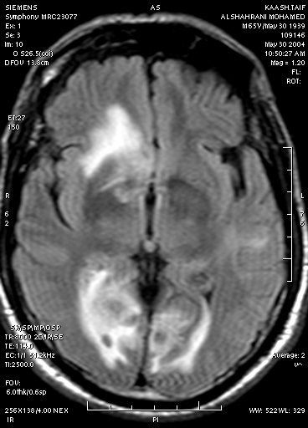
BRAIN TUMOURS
METASTASIS
BRAIN STEM GLIOMA
GLIOBLASTOMA MULTIFORME

Slide 40
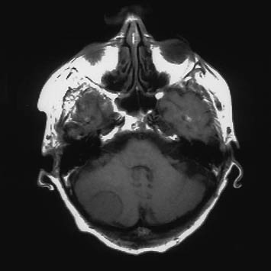
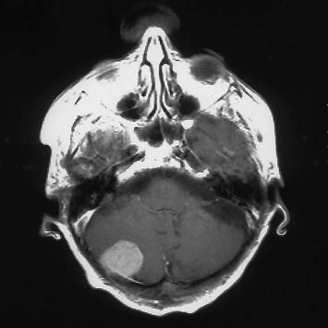
Meningioma
T1W Precontrast
T1W Postcontrast

Slide 41
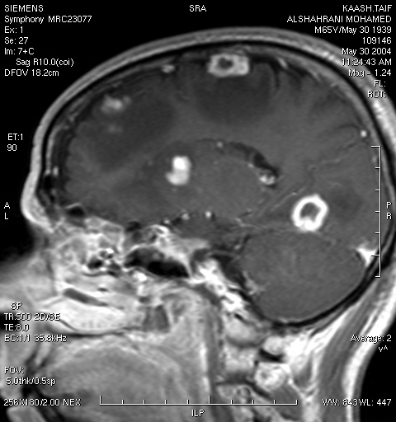
Metastasis

Slide 42
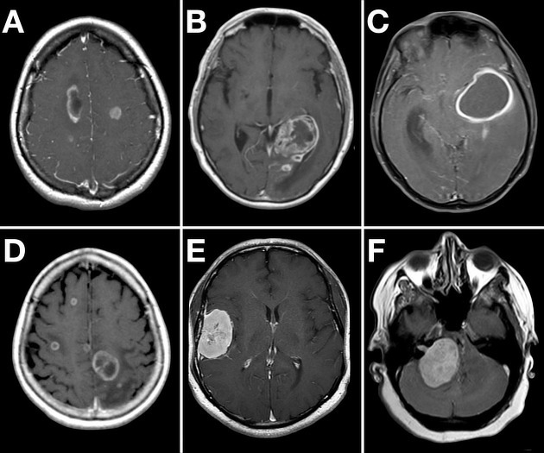

Slide 43
Trauma
Skull Fractures
S.A.H.
Haemorrhage
Extradural
Subdural
Subarachnoid
Intraparenchymal
Intraventricular

Slide 44
Haemorrhage
Extradural

Slide 45
Epidural /subdural hemorrhage
Usually traumatic in origin
Subdural (concavoconvex)
Venous bleed
Low pressure
Slow growth
Epidural (biconvex)
Arterial bleed
High pressure
Rapid growth
Both may be life-threatening from mass effect and herniation

Slide 46
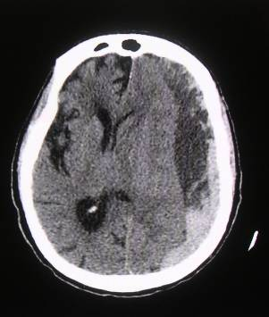

Slide 47
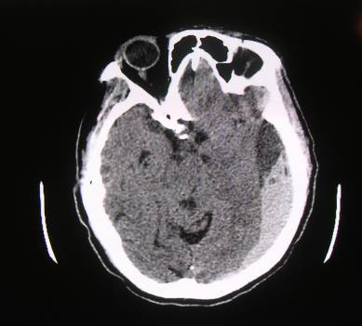
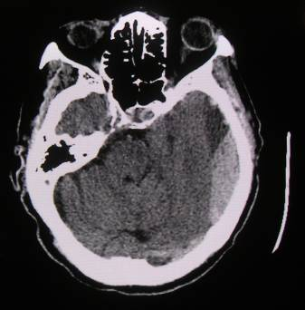
Haemorrhage
Subdural / Epidural
Basal cistern effaced-Early herniation
Midline shift

Slide 48
Subarachnoid bleed

Slide 50
VERTEBRAL FRACRURE

Slide 51
Haemorrhage
Intraparenchymal

Slide 52
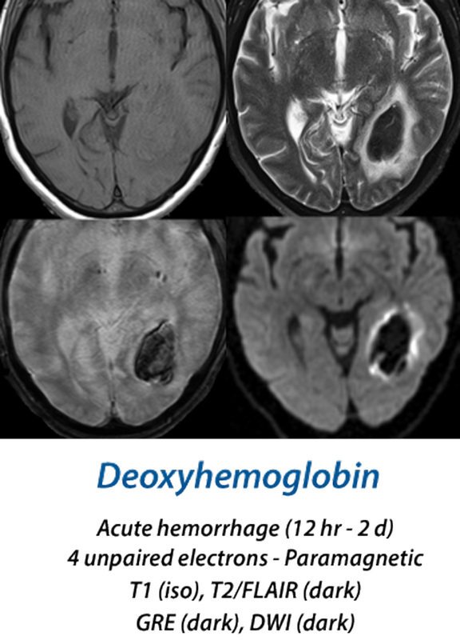

Slide 53
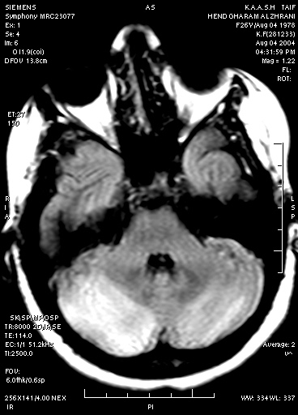
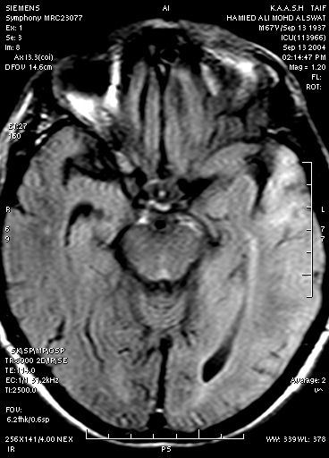
Meningitis / Encephalitis
HERPES ENCEPHALITIS

Slide 54
Abscess
Plain C.T.
Contrast Enhanced C.T.

Slide 55
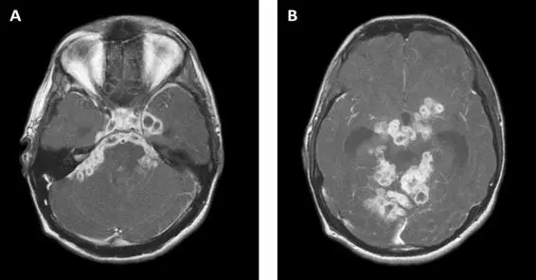
TUBERCULOSIS

Slide 56
Multiple Sclerosis

Slide 57
CEREBRAL ATROPHY

Slide 58
STROKE
Ischemia 80%
Embolic
Thrombotic
Hemorrhage 20%

Slide 60
As a rule for ischemic infarcts best modality of choice is MRI (DWI)
First and best modality of choice for hemorrhagic stroke is CT

Slide 61
Acute stroke Initial imaging
CT without IV contrast
Rapid
Reliable to exclude hemorrhage
High sensitivity for acute blood
Acute blood appears bright on CT relative to brain tissue.
IV contrast only if suspicion of another etiology, e.g. tumor or AVM

Slide 62
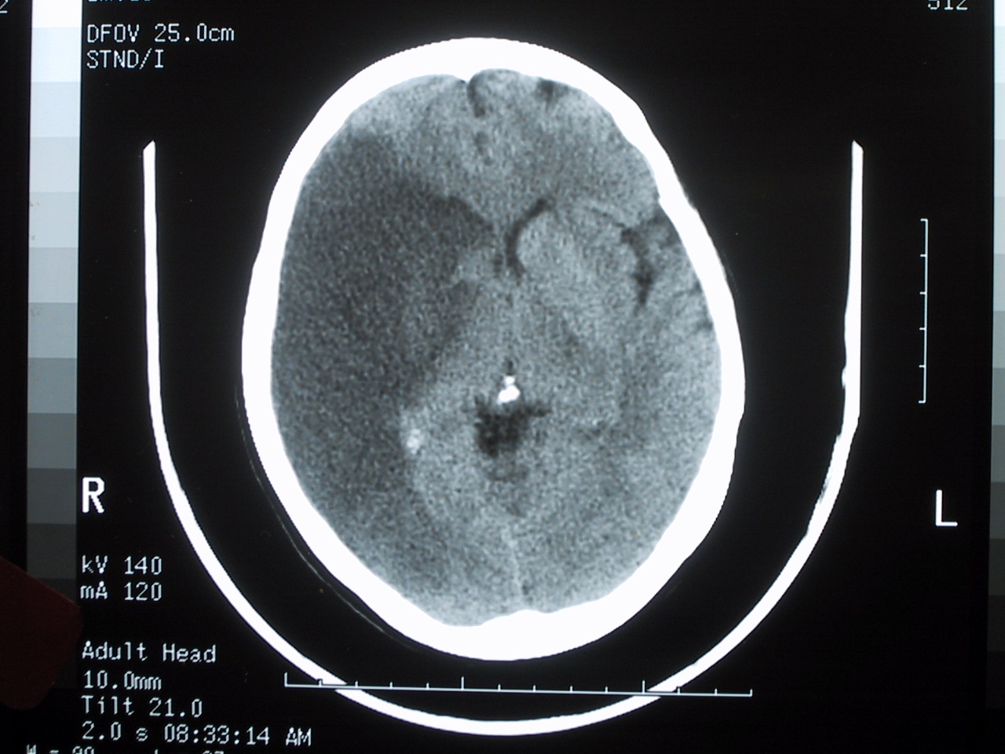
Acute Right MCA infarct CT
Minimal mass effect
Well circumscribed infarct
Cytotoxic edema pattern

Slide 63
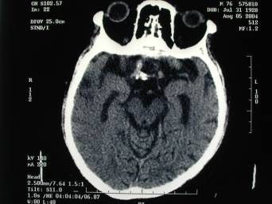
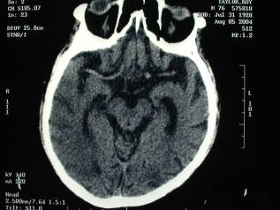
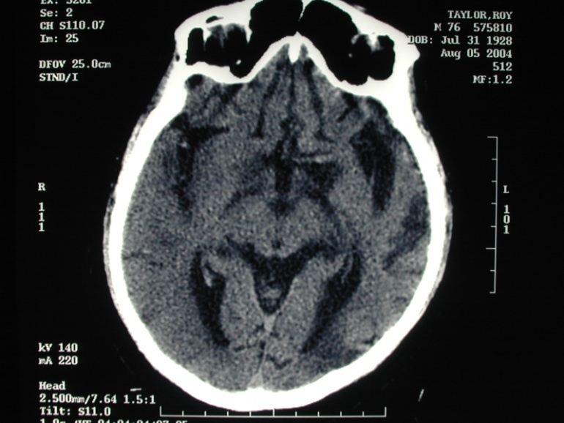
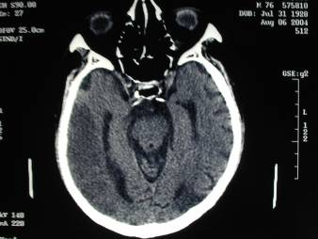
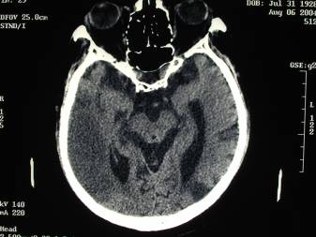
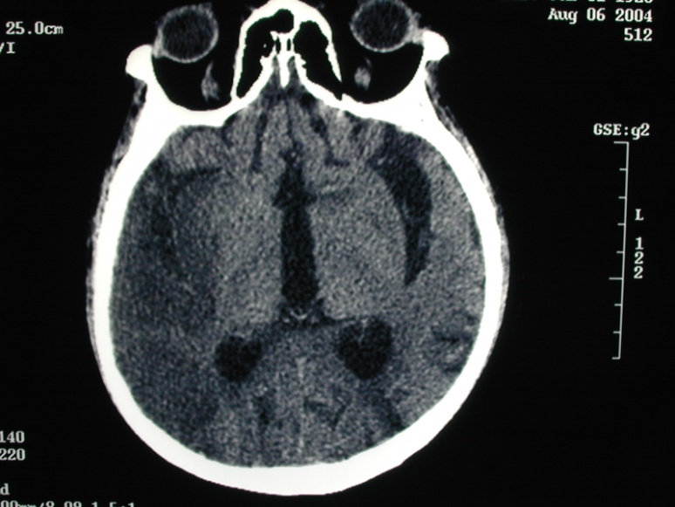
Acute right sided weakness
Initial Scans
24 hours later

Slide 64
ISCHEMIC STROKE MRI
Acute stroke appears as
Normal to low signal on T1WI
High signal on T2WI
High signal on FLAIR
High signal on DWI
FLAIR and DWI most sensitive

Slide 65
Ischemic Stroke MRI
Abnormal area becomes bright on DWI within 30 minutes of onset of ischemia
High signal visible on T2WI in about 8 hours
T1WI image becomes abnormal after ~16 hours

Slide 66
Ischemic Stroke Diffusion Weighted Imaging
T2WI
Signal intensity
DWI
Time
stroke
3-7 days

Slide 68
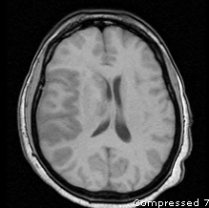
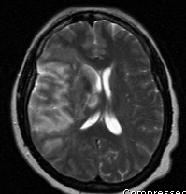
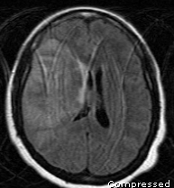
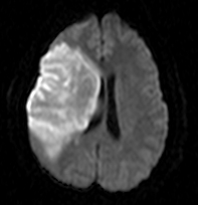
Subacute Infarct MRI
T1WI
T2WI
FLAIR
DWI
Dark on T1WI, bright on T2WI and FLAIR, very bright on DWI

Slide 69
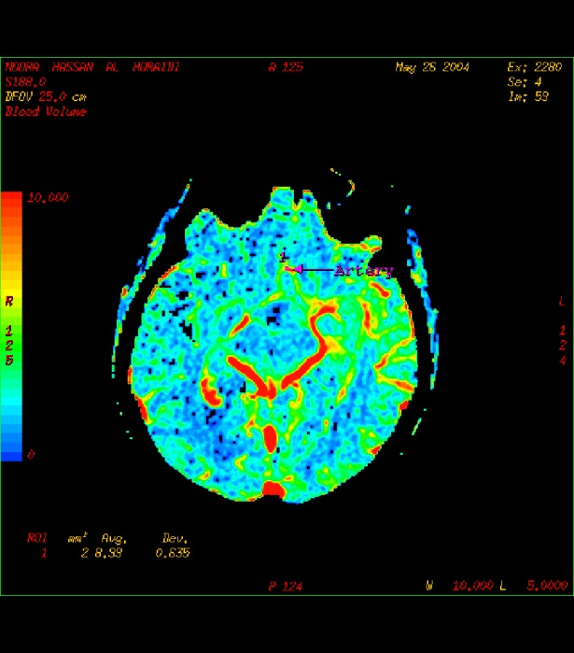
BRAIN IMAGING OF ACUTE STROKE
MRP
MR PERFUSION
DWI
CBF CBV MTT
CT PERFUSION

Slide 70
Clinical scenario and management (Horizontal integration

Slide 71
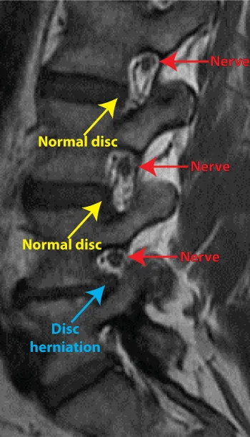
DEGENERATIVE DISEASE

Slide 72
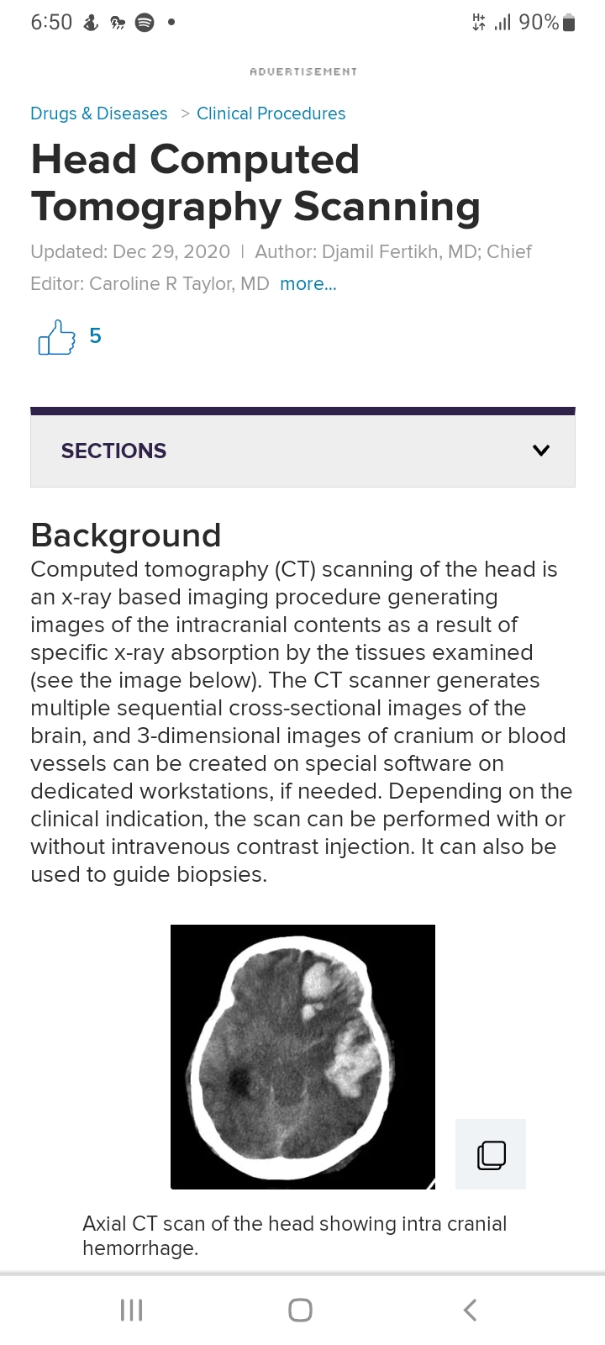
Research articles

Slide 73
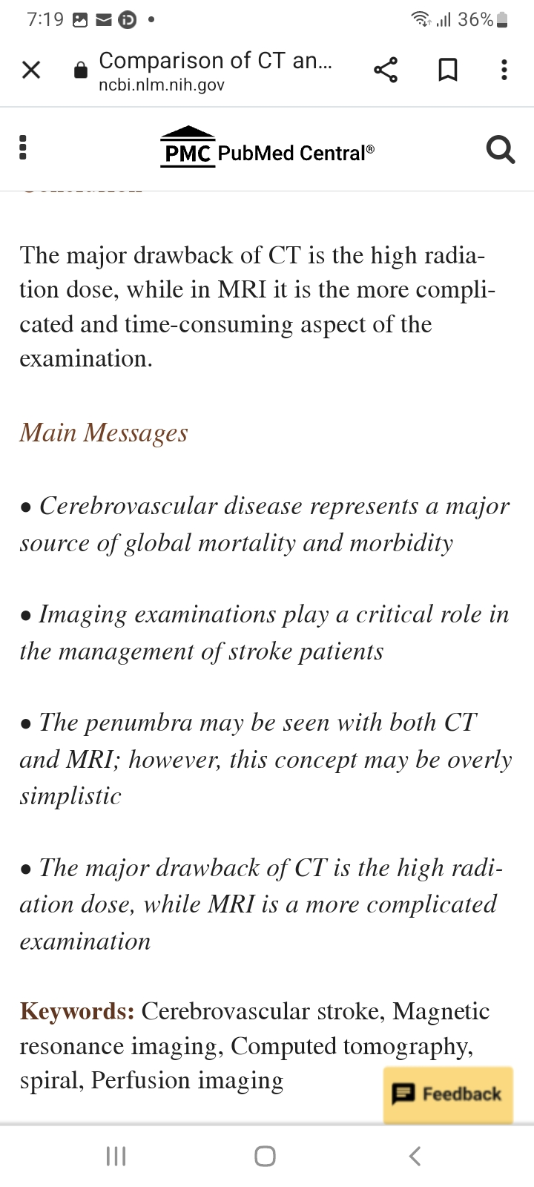

Slide 75
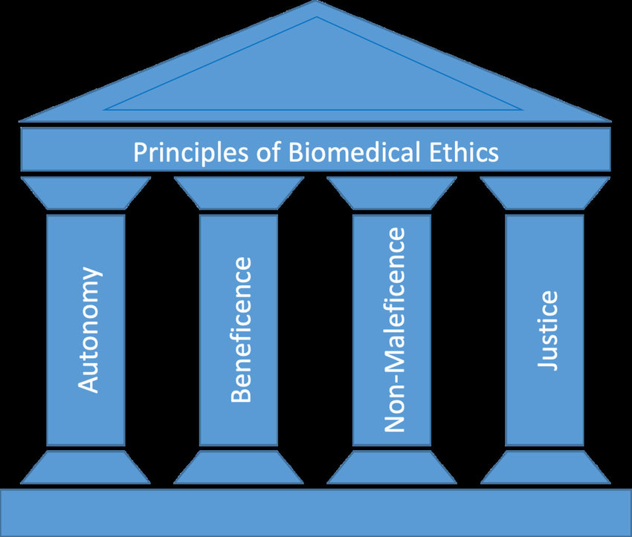
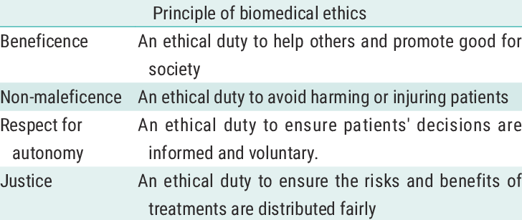

Slide 76
THANKYOU

