Slide 1


Slide 2


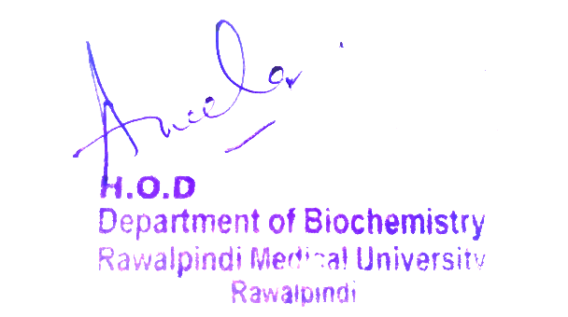
1st Year MBBS
Foundation Module
Case Based Learning (CBL)
Enzymes
Presenter: Dr. Uzma Zafar Date: 24-01-25
(Demonstrator)

Slide 3
Motto, Vision, Dream
To impart evidence based research oriented medical education
To provide best possible patient care
To inculcate the values of mutual respect and ethical practice of medicine
Wisdom
Truth
Service

Slide 4
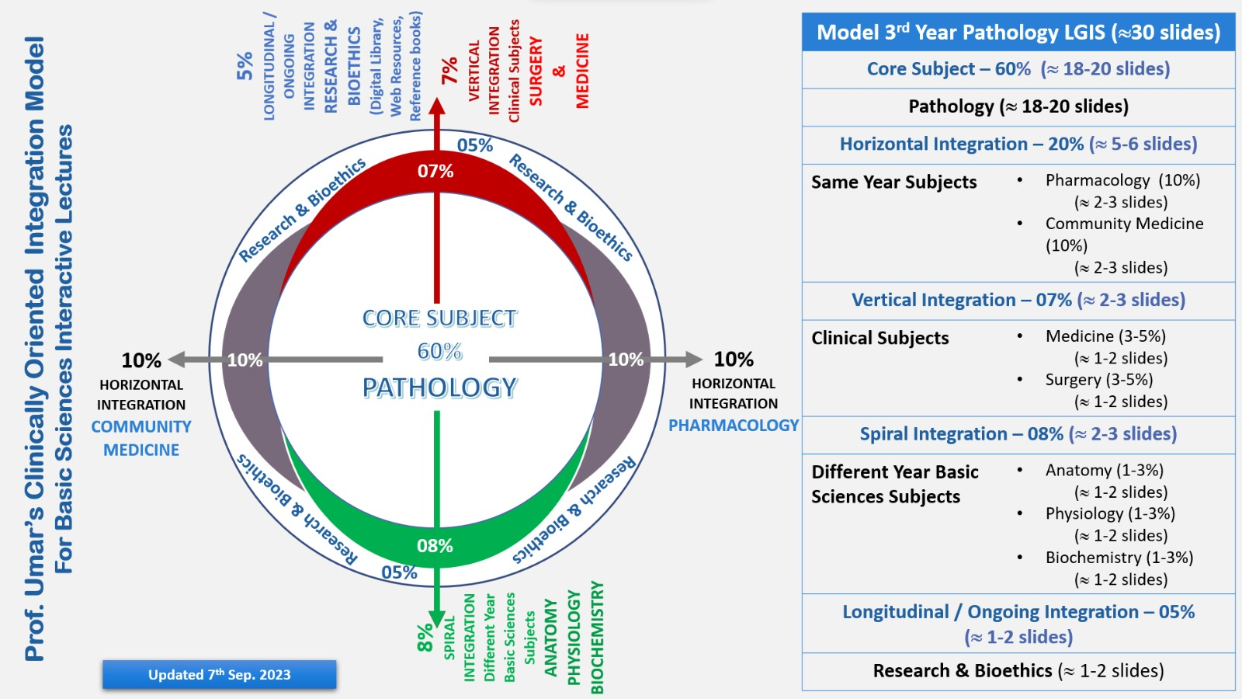
Professor Umar Model of Integrated Lecture

Slide 5
Learning Objectives
At the end of this session students should be able to
1. Define enzyme, coenzyme, cofactor and holoenzyme
2. Describe isoenzymes with suitable examples
3. Explain the clinical importance of enzymes
4. Describe the diagnostic role of enzymes in different disorders

Slide 6
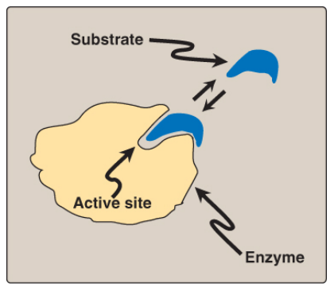
Enzyme
Core Knowledge
Enzymes are proteins that act as biological catalysts by accelerating chemical reactions, without being changed in the overall process.
An enzyme combines with the substrate at its active site and converts the substrate into product.
Schematic representation of an enzyme with one active site binding a substrate molecule.

Slide 7
Coenzyme, Cofactor and Holoenzyme
Core Knowledge
An apoenzyme is an inactive enzyme, activation of the enzyme occurs upon binding of an organic or inorganic cofactor.
If the nonprotein component is a metal ion, such as zinc (Zn²⁺) or iron (Fe²⁺), it is called a cofactor. If it is a small organic molecule, it is termed a coenzyme (NAD⁺, NADP⁺, FAD derived from vitamins)
The term holoenzyme refers to the protein component of the enzyme along with its nonprotein component. It is the enzyme's catalytically active form.
Holoenzyme = Apoenzyme + Cofactor

Slide 8
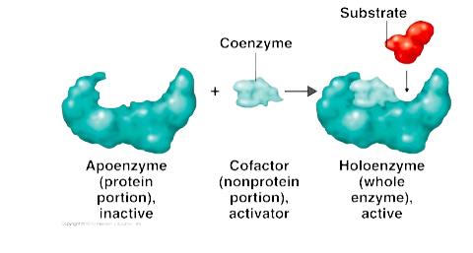
Coenzyme, Cofactor and Holoenzyme
Core Knowledge

Slide 9
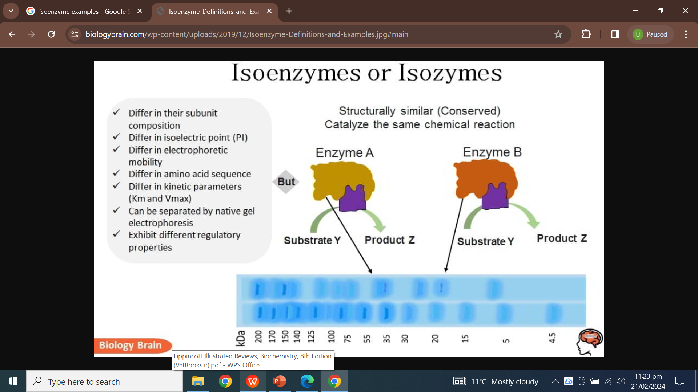
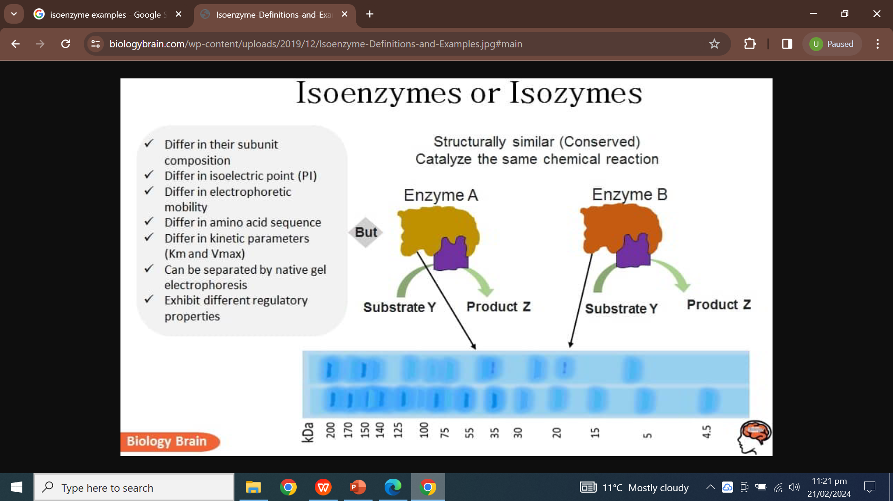
Isoenzymes
Core Knowledge
Isoenzymes are variant forms of the same enzyme that catalyze the same reaction but have slightly different physical properties because of genetically determined differences in amino acid sequence.

Slide 10
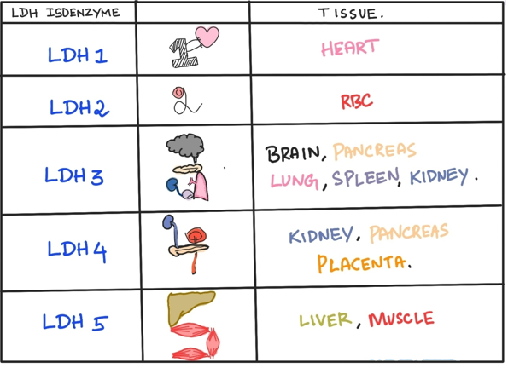
Lactate Dehydrogenase (LDH) Isoenzyme
Core Knowledge
Five isoenzyme forms of LDH exist in various body tissues.

Slide 11
Creatine Kinase (CK) Isoenzymes
Core Knowledge
CK occurs as three isoenzymes.
Each CK isoenzyme is a dimer composed of two polypeptide subunits (called B and M subunits for brain and skeletal muscle) associated in one of three combinations:
CK1 = BB (Brain)
CK2 = MB (Myocardium)
CK3 = MM (Skeletal muscle, cardiac muscle)
Each CK isoenzyme shows a characteristic electrophoretic mobility.

Slide 12
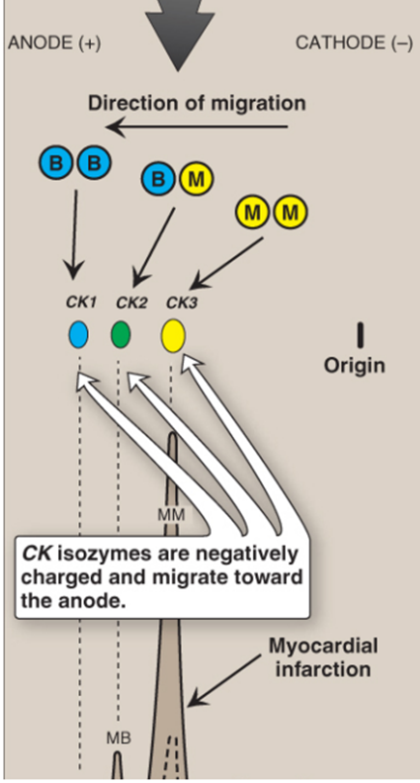
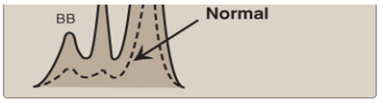
Clinical Importance of Isoenzymes
Core Knowledge
Different organs commonly contain particular proportions of different isoenzymes.
The pattern of isoenzymes found in the blood plasma can serve as a means of identifying the site of tissue damage.
The plasma levels of various isoenzyme forms of LDH and of creatine kinase (CK) vary under different disease states.
Subunit composition, electrophoretic mobility, and enzyme activity of
creatine kinase (CK) isoenzymes.

Slide 13
Plasma Enzymes as Diagnostic Tools
Core Knowledge
Some enzymes show relatively high activity in only one or a few tissues. The presence of increased levels of these enzymes in blood plasma reflects damage to the corresponding tissue.
For example, the enzyme alanine aminotransferase (ALT) is one of many enzymes that are abundant in the liver. The appearance of elevated levels of ALT in plasma signals possible damage to hepatic tissue.

Slide 14
Physiology of Enzymes
Enzymes provide support for many important processes within the body. For example, the digestive system enzymes, DNA replication enzymes, liver enzymes, etc.
Other activities in which enzymes help include:
Hormone production
Cell regulation
Creating movement to make the muscle contract
Transporting materials around a cell

Slide 15
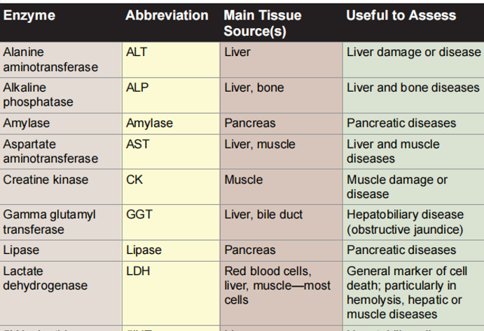

Slide 16
Family Medicine
Spiral Integration
Family Medicine plays important role in following manner:
Diagnosis should be made. Patients with mild Acute Pancreatitis disease should be managed at nearby family health clinics
Early aggressive fluid resuscitation with controlled fluid expansion should be given.
Vital signs should be monitored and stabilized
Early enteral nutrition should be planned
If no improvement, then refer the patient to the specialists

Slide 17
Ethical Consideration
Spiral Integration
Here are some ethical considerations related to Acute Pancreatitis (AP):
informed consent to participate after understanding the purposes, risks, and benefits of the treatment
Access to healthcare
Privacy of personal information needs to be addressed
Doctor-patient confidentiality

Slide 18
Role of AI in Managing
Spiral Integration
Artificial Intelligence plays role in following aspects:
Machine learning models have shown promise in improving diagnostic accuracy and predicting outcomes for Acute pancreatitis.
AI algorithms demonstrate significant promise in diagnosing and prognosticating Acute Pancreatitis, often surpassing traditional methods.

Slide 19
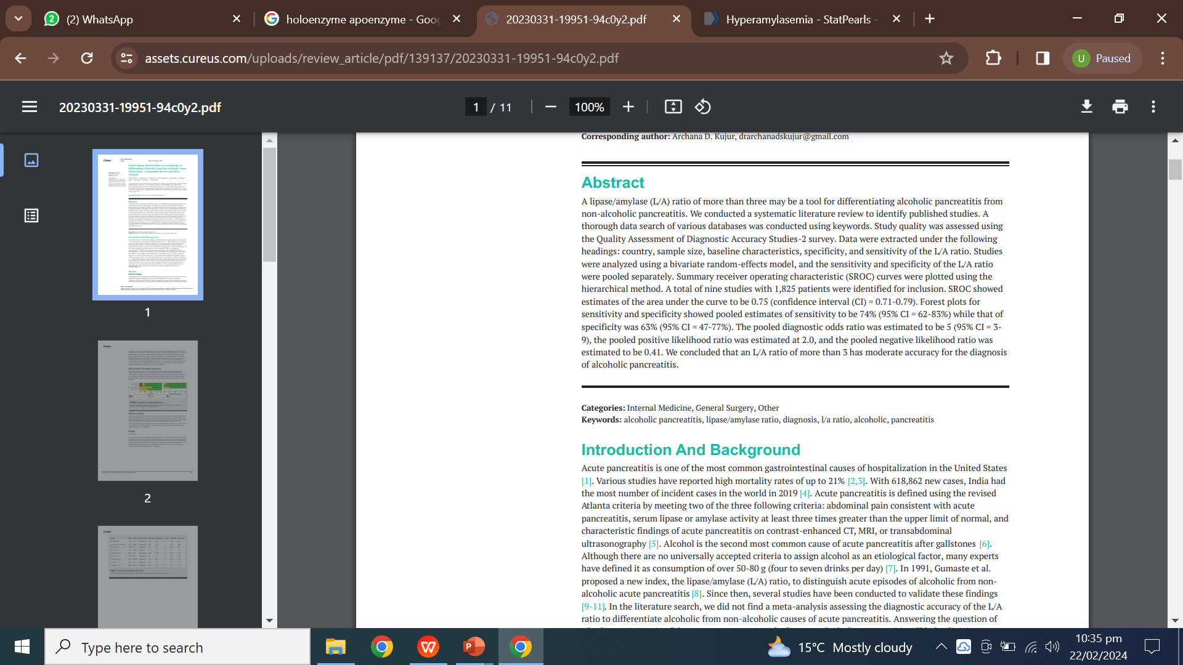
Suggested Research Article
Link: https://assets.cureus.com/uploads/review_article/pdf/139137/20230331-19951-94c0y2.pdf
Journal Name: CUREUS
Title: Serum Lipase Amylase Ratio as an Indicator to Differentiate Alcoholic From Non-alcoholic Acute Pancreatitis: A Systematic Review and Metanalysis
Author Name: Ekka et al.

Slide 20
How To Access Digital Library
Steps to Access HEC Digital Library
Go to the website of HEC National Digital Library.
On Home Page, click on the INSTITUTES.
A page will appear showing the universities from Public and Private Sector and other Institutes which have access to HEC National Digital Library HNDL.
Select your desired Institute.
A page will appear showing the resources of the institution
6. Journals and Researches will appear
7. You can find a Journal by clicking on JOURNALS AND DATABASE and enter a keyword to search for your desired journal.

Slide 21
Learning Resources
Textbook of Biochemistry, Lippincott 8th edition, chapter no. 5, page no. 136-167
Google Scholar
Google Images

Slide 22
THANK YOU

