Slide 2
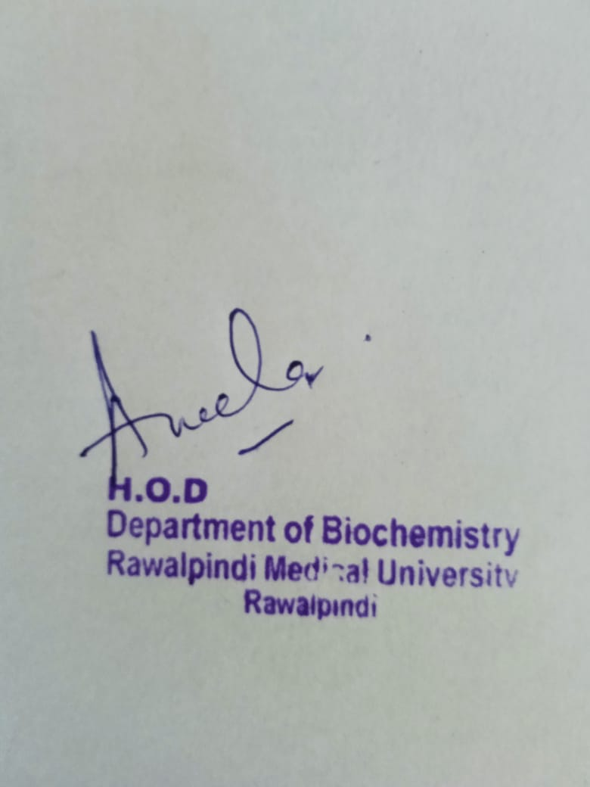
MSK-I MODULE BIOCHEMISTRY - CBL NIGHT BLINDNESS MSK-I MODULE BIOC
Presenter: Dr. Almas Ajaz

Slide 3
Motto, Vision, Dream
To impart evidence based research oriented medical education
To provide best possible patient care
To inculcate the values of mutual respect and ethical practice of medicine
Wisdom
Truth
Service

Slide 4
Professor Umar Model of Integrated Lecture
60%
CORE SUBJECT
20%
HORIZONTAL
INTEGRATION
Physiology
biochemistry
8%
VERTICAL INTEGRATION
Pathology
pharmacology
7%
VERTICAL INTEGRATION
Clinical integration
5%
VERTICAL INTEGRATION
Research, professionalism
Ethics
Digital library

Slide 5
Learning Objectives
At the end of this session students should be able to:
Describe the role of vitamin A in the body
Explain the deficiency manifestations of vitamin A
Discuss vitamin A toxicity.

Slide 6
Horizontal Integration

Slide 8
The Eyeball
Light enters through the cornea at the front of the eye.
The light then continues through the pupil which adjusts the amount of light which is allowed to enter the eye.
It travels through the lens where it is focused onto the retina.
The retina takes the light and through cells, converts light energy into electrical impulses for the brain.
A blind spot is located where the fovea attaches to the retina.

Slide 9
Rods & Cones of Retina

Slide 10
Chemical Changes in the Rods of the Retina

Slide 11
Visual phototransduction

Slide 12
Classification of Vitamins

Slide 13
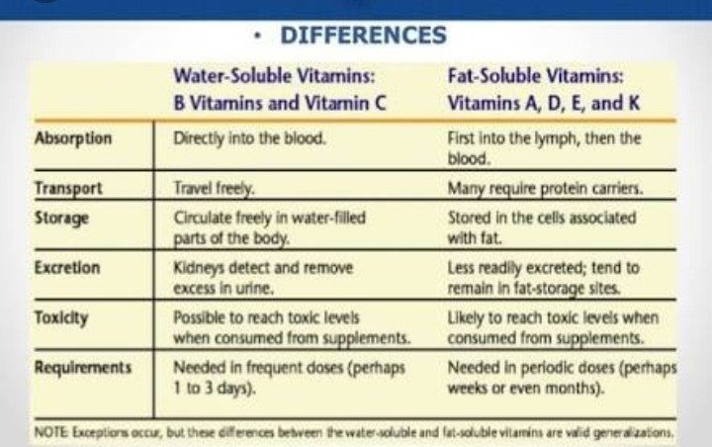
Difference between Fat Soluble and Water Soluble Vitamins

Slide 14
Vitamins A

Slide 15
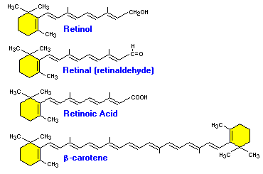
Vitamin A
Vitamin A is a complex alcohol & is represented by retinol.
It’s oxidative products retinaldehyde (also called retinal / retinene) is also active compound.
Retinoids also refers to retinol as well.
There are several isomers of vitamin A, the most important of these are 13-cis retinol found in many fish liver oils and 11-cis retinol which occurs in the retina.

Slide 16
Vitamin A

Slide 17
Vitamin A
Core Knowledge

Slide 18
Absorption, Transport & Storage of VIT A
Core Knowledge

Slide 19
Function of VIT A
Core Knowledge

Slide 20
Absorption of VIT A
Core Knowledge

Slide 21
Role of VIT A in the Eye
Core Knowledge

Slide 22
Role of Vitamin A in the Body
Core Knowledge
Vitamin-A is essential for vision, growth and reproduction and to maintain normal epithelial cells.
Role of vitamin A in vision: Vitamin A regulates visual cycle (Wald’s visual cycle):
Both dark, bright and color vision depends upon the activity of vitamin A.
Rods are responsible for dim light vision, where as cones are responsible for color and bright light vision.

Slide 23
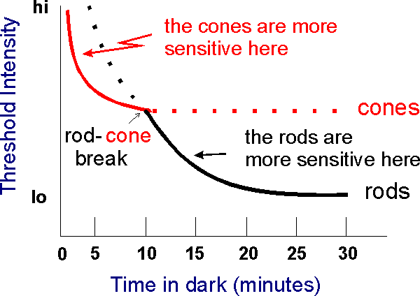
Role of Vitamin A in the Body
Core Knowledge
Dark adaptation time:
In the absence of vit-A the dark adaptation time is longer.
When an individual suddenly enters the dim light room rhodopsin are depleted.
The room appears dark until and unless rhodopsin is not regenerated.
For this reason, vit-A is required.
Color vision:
Cones are responsible for color vision such as Iodopsin (green), cyanopsin (blue) and porphyropsin (red).
These also form retinal complexes and upon bleaching release different colors, red, blue, and green which are transmitted as nerve impulse to central nervous system.

Slide 24
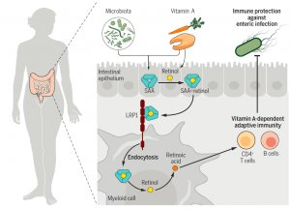
Role of Vitamins In the Body
Core Knowledge
2. Maintenance of healthy epithelial surfaces:
Retinol and retinoic acid regulate/control the keratin gene and therefore prevent the formation of keratinized (horny) surfaces.
Similarly, retinyl-phosphate are involved in the synthesis of mucus (mucopolysaccharide) as well as glycoprotein, which is required to keep the epithelial surfaces smooth and moist.

Slide 25
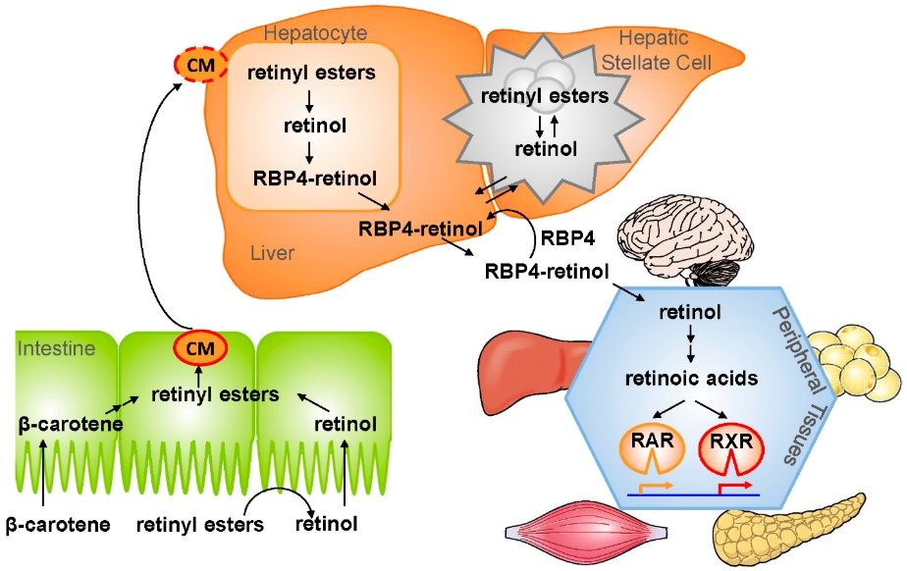
Role of Vitamins In the Body
Core Knowledge
3. Lipid metabolism:
Mevalonate is intermediate formed during cholesterol biosynthesis.
In the absence of vit-A, mevalonate is directed toward the synthesis of co-enzyme Q.
5. In the absence of vit-A, glucocorticoids synthesis is inhibited which in turn inhibit the process of gluconeogenesis.

Slide 26
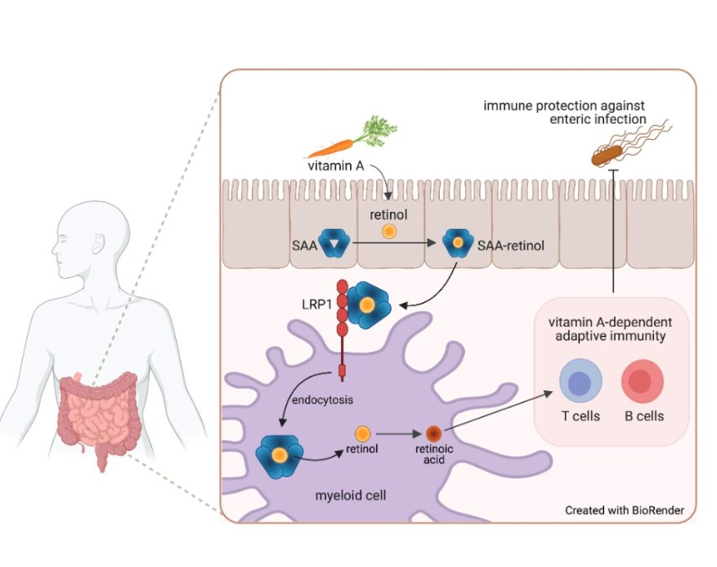
Role of Vitamins in the Body
Core Knowledge
4. Vit-A is also required for the proper functioning of immune system and for the formation of iron transfer protein transferrin.

Slide 27
Dietary Sources and RDA of Vitamin A
Core Knowledge
It is present in the food sources either in the form of Preformed Vitamin A which are fat soluble that are easily absorbed by the body or in the form of Provitamin carotenoids that get converted into active retinols and retinyl esters for better absorption by the body.
Recommended daily allowance (RDA) of Vitamin A:
For men, the RDA value is 1000
For female, it is 800
Vitamin A is abundantly present in the following food sources such as:
Healthy Leafy Greeneries:
Vegetables which have a high content of Vitamin A mostly in the form of carotenoids are:
Spinach, turnip, broccoli, lettuce, parsley, kale and other leafy green veggies.
Carrot, tomatoes, sweet potato, pumpkin, squash, zucchini, red pepper and other orange and yellow coloured vegetables.
Apart from the veggies, certain orange and yellow coloured fruits are also loaded with Vitamin A like mango, orange, papaya, cantaloupes, pink or red grapes, watermelon, apricot, guava
Rich Content of active Vitamin A is also found in various food obtained from animal sources such as:
Dairy products like milk, cheese and butter
Animal-based food items like egg, fish oils and lean meat

Slide 28
Vitamins A Deficiency
Deficiency Leads:
Degeneration of eyes and skin.
There may be Vit. A deficiency night blindness (nyctalopia).
When the deficiency is prolonged then the patient may have total blindness.
The patient may have Dry eyes (Xerophthalmia).
There is dryness of the conjunctiva (xerosis conjunctivae).
There are Bitot spots.
There are keratomalacia and ultimately blindness.
There are metaplastic changes in the epithelium of the lungs
Metaplasia is the urinary tract that leads to stone formation.
The patient develops an immune deficiency.

Slide 29
Clinical Scenario - Case
A 41 years old female presented in OPD of District Headquarter hospital with complaints of difficulty to drive at night. She had past history of frequent urinary tract infections. Her dietary history revealed she was intolerant to any fatty food. Her ocular examination was performed. Based on history and examination she was found to be suffering from vitamin A deficiency.

Slide 30
Deficiency Manifestations of Vitamin A

Slide 31
Vitamin A Toxicity

Slide 32
Night Blindness
If vitamin A is not available, synthesis of rhodopsin cannot take place and the person becomes unable to see in dim light, a condition called “Night Blindness”.
Night Blindness is the earliest symptom of Vitamin A deficiency followed by degenerative changes in the retina.
Not all cases of Night Blindness are due to lack of vitamin A.

Slide 33
Night Blindness

Slide 35
Family Medicine
Family Medicine plays important role in following manner:
Diagnosis
Education
Dietary Guidance
Monitoring
Referral to specialists

Slide 36
Artificial Intelligence
Artificial Intelligence plays the following role in case of lactose intolerance:
Personalized Nutrition
Diagnostic Tools
Food Recommendations
Drug Development

Slide 37
Biomedical Ethics
Privacy and Confidentiality
Access to Healthcare
Informed Consent

Slide 38
Suggested Research Article
Link: https://www.ncbi.nlm.nih.gov/books/NBK545246/
Journal Name : National Library of Medicine
Title: Night Blindness
Author: Divy Mehra
Abstract:
Nyctalopia refers to night blindness or difficulty of the eye in visualizing under dim light or at night. Daytime vision, however, is unimpaired. Nyctalopia is due to the eye's inability to adapt quickly from lightness to darkness. The principle cell-type associated with Nyctalopia is rod cells. Rods are a type of photoreceptor cell present in the retina that transmits low-light vision and is most responsible for the neural transmission of nighttime sight. Rods have a singular photopigment, rhodopsin, which utilizes the protein scotopsin and the Vitamin A-derived cofactor, retinol.[1] This cascade is essential for the body's ability to regulate the pupillary light reflex. The pupillary light reflex allows unilateral afferent detection of changes in light energy entering the eye, and efferent adjustments in the pupillary sphincter and dilator pupillae muscles to initiate consensual constriction and dilation of the eyes. Pupil dilation is an adaptive response to changes in lightness and darkness.[2] Night blindness is the physical manifestation of impaired functioning of these processes.

Slide 39
CBL --- Assessment
BicarbonateIn which form vitamin A is stored in the liver?
What are the dietary sources of vitamin A?
Enlist clinical features of vitamin A deficiency.
How is vitamin A transported in the blood?
Which fat soluble vitamin helps in vision?

Slide 40
Learning Resources
Lippincott Illustrated Reviews - BIOCHEMISTRY, Eighth Edition, chapter 28, pages 432 – 436
Google images
Google scholar

