Slide 2
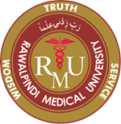
Foundation Module First Year MBBS
Down’s syndrome
Supervised by Prof. Samia Sarwar Chairperson Physiology Presenter :Dr. (FCPS PHY)
Dated : 00-00-2025
Physiology Department

Slide 3
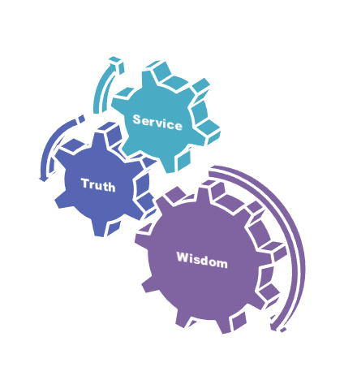
Motto, Vision, Dream
To impart evidence based research oriented medical education
To provide best possible patient care
To inculcate the values of mutual respect and ethical practice of medicine
Wisdom
Truth
Service

Slide 4
Professor Umar Model of Integrated Lecture

Slide 5
Learning Objectives
To Discuss the case of Down syndrome
To Discuss the clinical features and Association with other diseases
To corelate the Signs and Symptoms with the disease
To explain management plan of down syndrome

Slide 6
Interactive Session

Slide 7
Case-based learning (CBL)
Case-based learning (CBL) is a teaching method where students learn by analyzing real-life cases and applying their knowledge to solve problems or make decisions. CBL is often used in medical education, where students analyze patient cases to develop diagnostic and treatment skills.

Slide 8
Conducting CBL
Identify the learning objectives
Choose a case: Select a real-life case that is relevant to the learning objectives you have identified
Present the case
Analyze the case: Have students work in groups to analyze the case
Develop hypotheses

Slide 9
Conducting CBL (Cont.)
Test hypotheses: Have students test their hypotheses by using relevant diagnostic tests or other methods.
Discuss the results
Discuss the results
Evaluate learning: Evaluate student learning by assessing their ability to analyze the case, develop hypotheses, and apply their knowledge of medical physiology to diagnose and treat the patient.

Slide 10
Down’s Syndrome
Discuss and explain Down Syndrome in detail.
Horizontal integration:
Application of Principles of cell division and structure of chromosomes
Vertical integration:
Clinical Features of disease/presentation/diagnosis/complications & treatment.

Slide 11
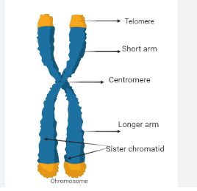
Structure of Chromosomes
Horizontal Integration/Biochemistry
Horizontal Integration with Biochemistry
Reference: https://www.labiotech.eu/trends-news/downs-syndrome-cause-switzlerland/

Slide 12
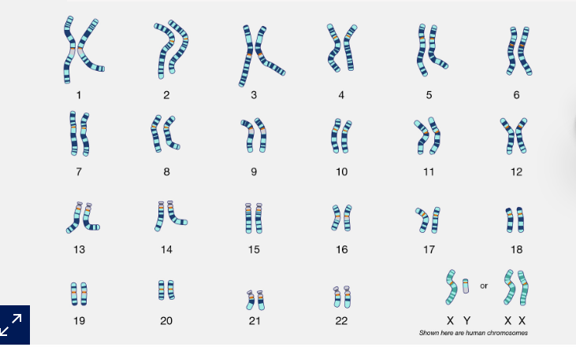
Structure of Chromosomes
Horizontal Integration with Biochemistry
Reference: https://www.labiotech.eu/trends-news/downs-syndrome-cause-switzlerland/

Slide 13
Case Scenario
Vertical Integration/ Medicine/ Genetics
Vertical Integration with Medicine & Genetics
Question: A 42 years old lady presented with her 2 months old baby boy in pediatric outpatient department of holy family department. During her antenatal visit, An ultrasound examination performed at 18 weeks' gestation revealed no abnormalities. Family history is significant for a 12-year old maternal first cousin with Down syndrome.
On General Physical Examination, Face is flattened, especially the bridge of the nose, Short neck and low set ears. Baby has difficulty during feeding and his mother gives history of Bluish discoloration of hands and feet while feeding. A single crease was found on his hands.
Chest examination was normal.
Neurological examination revealed decreased tone.
What is your likely diagnosis?

Slide 14
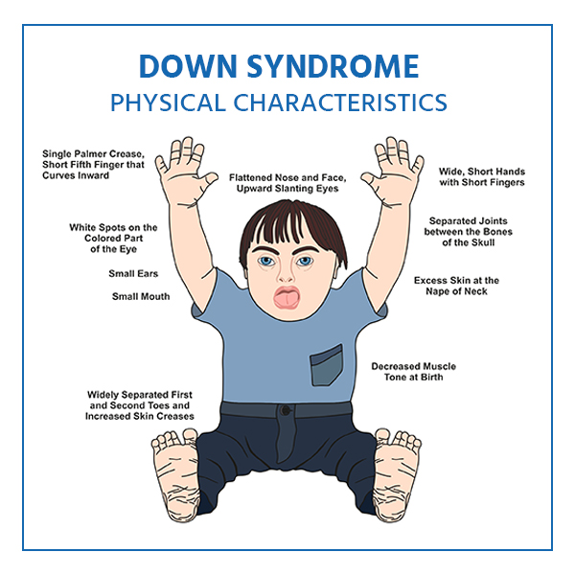
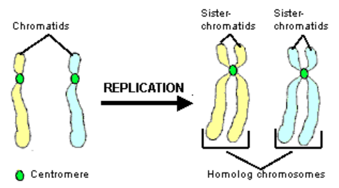
Replication of Chromosomes
Vertical Integration/ Medicine/ Genetics
Vertical Integration with Medicine & Genetics
Number of chromosomes in human cell is 46
Number of pairs is 23
Genes also exist in pairs
Replication occurs after few minutes of replication of DNA.
Reference: https://www.medicoverhospitals.in/diseases/down-syndrome/

Slide 15
Introduction
Vertical Integration/ Medicine/ Genetics
Vertical Integration with Medicine & Genetics
Down Syndrome (DS) is a genetic, chromosomal condition.
Chromosomes are structures found in every cell of the body that contain genetic material and are responsible for determining anything ranging from eye color to height.
Typically, each cell has 23 pairs of chromosomes.
However, in individuals with Down syndrome, there is a full or partial extra copy of chromosome 21 in some or all cells.

Slide 16
Types of Down’s Syndrome
Vertical Integration/ Medicine/ Genetics
Vertical Integration with Medicine & Genetics
There are three types of DS:
Trisomy 21 (95%)
Translocation (3%-4%)
Mosaicism (1%).
Whichever the type, persons with DS typically have poorer overall health at a young age and exhibit a greater loss of health, mobility, and increased secondary complications as they age compared to their non-DS counterparts.

Slide 17
Clinical Features
Vertical Integration/ Medicine/ Genetics
Vertical Integration with Medicine & Genetics
Growth failure
Hypotonia
Ligamentous laxity
Flat posterior aspect of the head
Broad flat face
Slanting eyes
Epicanthic eyefold
Short nose
Small and arched palate
Big wrinkled tongue
Dental anomalies

Slide 18
Clinical Features
Vertical Integration/ Medicine/ Genetics
Vertical Integration with Medicine & Genetics
12. Short and broad hands
13. Special skin ridge patterns
14. Unilateral/bilateral absence of one rib
15. Congenital heart disease
16. Intestinal blockage
17. Enlarged colon
18. Umbilical hernia
19. Pelvis anomalies
20. Diminished muscle tone
21. Big toes widely spread

Slide 19
Clinical Features
Vertical Integration/ Medicine/ Genetics
Vertical Integration with Medicine & Genetics
Reference: Google Images

Slide 20
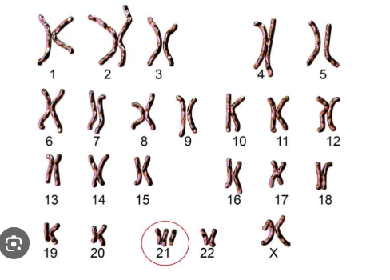
Trisomy 21
Vertical Integration/ Medicine/ Genetics
Vertical Integration with Medicine & Genetics
Reference: https://www.labiotech.eu/trends-news/downs-syndrome-cause-switzlerland/

Slide 21
Associations
Vertical Integration/ Medicine/ Genetics
Vertical Integration with Medicine & Genetics
Gastrointestinal Problems
Low bone density
Hearing and Vision loss
Thyroid dysfunction
Obesity
Diabetes
Alzheimer’s Disease

Slide 22
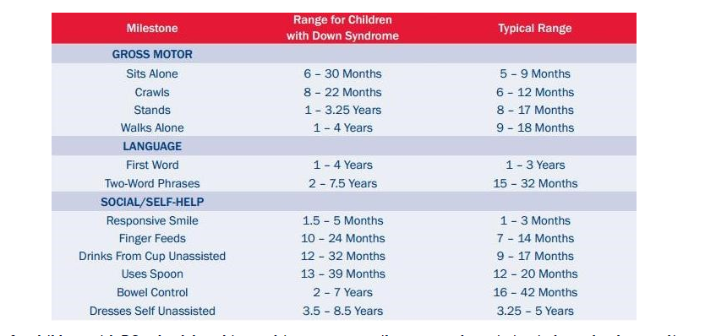
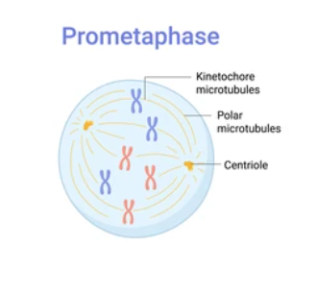
Developmental Milestones and Down Syndrome
Vertical Integration/ Medicine/ Genetics
Vertical Integration with Medicine & Genetics
Spindle microtubules extend into the central region
Reference: Davidson’s Book of Internal Medicine ,Page 349.

Slide 23
Diagnosis
Vertical Integration/ Medicine/ Genetics
Vertical Integration with Medicine & Genetics
Three primary procedures for diagnostic testing.
Amniocentesis.
Chorionic villus sampling (CVS)
Ultrasound
Amniocentesis is the test we most commonly use to identify chromosomal problems, such as Down syndrome.

Slide 24
Management
Vertical Integration/ Medicine/ Genetics
Vertical Integration with Medicine & Genetics
There is no cure for Down Syndrome, but treatment is available to help your child reach their full potential.
Treatment focuses on helping your child thrive physically and mentally.
Treatment options could include:
Physical or occupational therapy.
Speech therapy.
Participating in special education programs in school.
Treating any underlying medical conditions.
Wearing glasses for vision problems or assisted hearing devices for hearing loss.

Slide 25
Treatment
Vertical Integration with Medicine & Genetics
Interventions are based on the individual’s physical and intellectual needs, as well as his or her personal strengths and limitations.
Below are some examples of interventions for children with Down Syndrome:
Sensory integration therapy (SIT)
Perceptual-motor therapy (PMT)
Neurodevelopmental Treatment (NDT)
Two-wheeled bicycle training
Treadmill training
Physical Activity
Strength Training

Slide 26
Spiral Integration

Slide 27
Role of Family Physician
Spiral Integration/ Family Medicine
Spiral Integration with Family Medicine
What will be the role of family physician in this scenario?
Regular health check-ups are essential to monitor physical and developmental milestones in individuals with Down syndrome.
Addressing common health issues such as heart problems, respiratory infections, and thyroid dysfunction is a key aspect of family medicine management.
Collaborating with specialists like pediatricians, cardiologists, and therapists helps ensure a holistic approach to care.
Early intervention and supportive therapies are vital to optimize cognitive and motor development.

Slide 28
Counseling
Spiral Integration/ Family Medicine
Spiral Integration with Family Medicine
The goal of the counseling is to enable the individual to make critical decisions regarding alternative courses of actions without outside influence.
Example: A 2 months old baby boy known case of Down Syndrome presented in peadiatric outpatient department of holy family hospital with his parents.
How will you counsel his parents?

Slide 29
Counseling
Spiral Integration with Family Medicine
Emotional Support: Providing emotional support to the family is crucial. Counseling can help them navigate through these feelings and develop coping strategies.
Education: Offering information about Down syndrome, its characteristics, and potential challenges can empower families to better understand the condition.
Behavioral Strategies: Individuals with Down syndrome may exhibit specific behavioral challenges. Counseling can provide families with strategies to manage and address these behaviors effectively. This may include positive reinforcement, communication techniques, and setting realistic expectations.
Developmental Milestones: Helping families understand and celebrate developmental milestones is important. Individuals with Down syndrome may reach milestones at different rates.

Slide 30
Relevance of Topic with Biomedical Ethics
Spiral Integration with Biomedical Ethics
Ethics are important in counseling, as they are means to protect the welfare and benefit of the patient.
Doctor should discuss all the important information with the parents.

Slide 31
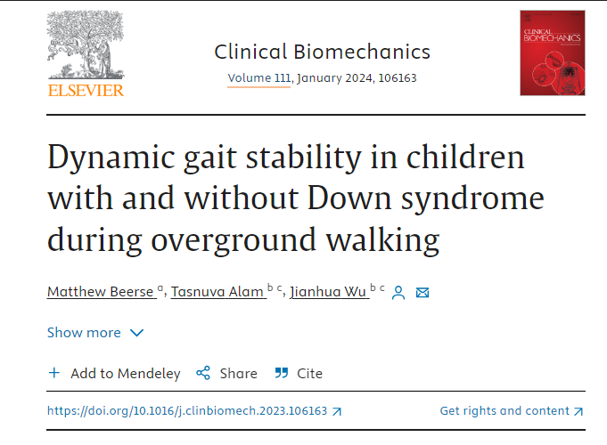
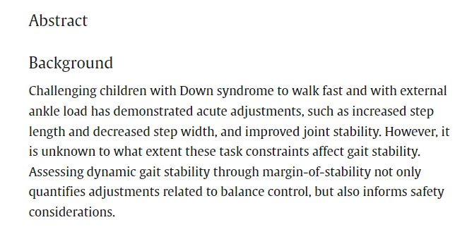
Suggested Research Article
Spiral Integration with Research
Dynamic gait stability in children with and without Down syndrome
during overground walking.
.

Slide 32
How To Access Digital Library
Promoting IT & Research Culture
Steps to Access HEC Digital Library
Go to the website of HEC National Digital Library.
On Home Page, click on the INSTITUTES.
A page will appear showing the universities from Public and Private Sector and other Institutes which have access to HEC National Digital Library HNDL.
Select your desired Institute.
5. A page will appear showing the resources of the institution
6. Journals and Researches will appear
7. You can find a Journal by clicking on JOURNALS AND DATABASE and enter a keyword to search for your desired journal. Link:https://www.topstudyworld.com/2020/05/access-hec-digital-library.html?m=1

Slide 33
References
References
Books:
Guyton And Hall textbook of Medical Physiology 14th Edition
Ganong’s Review of Medical Physiology 25th Edition
Sherwood, 9th edition.
Silverthorn Physiology,6th edition
Vander’s Human Physiology,14th edition
Research:
Dynamic gait stability in children with and without Down syndrome during overground walking
https://doi.org/10.1016/j.clinbiomech.2023.106163
YouTube/videolink:
https://youtu.be/ze_6VWwLtOE?si=VYcbQsvoUhawTPQs

Slide 34
Summary
Summary
Core knowledge:
Down Syndrome
Integration:
Biochemistry(Structure Of Chromosome) and Genetics.
Research:
Dynamic gait stability in children with and without Down syndrome during overground walking
Biomedical Ethics:
Counseling.
Family Medicine:
Role of family physician in the management of baby of Down syndrome

