Slide 2
Foundation Module First Year MBBS
Body Fluid Compartment, Cell Membrane & Cytoskeleton
Supervised by Prof. Samia Sarwar Chairperson Physiology Presenter :Dr. (FCPS PHY)
Dated : 00-00-2025
Physiology Department

Slide 3
Motto, Vision, Dream
To impart evidence based research oriented medical education
To provide best possible patient care
To inculcate the values of mutual respect and ethical practice of medicine
Wisdom
Truth
Service

Slide 4
Professor Umar Model of Integrated Lecture

Slide 5
Learning Objectives
To understand control of cell growth and cell reproduction
To explain replication of chromosomes and cell cycle
To understand programmed cell death/apoptosis

Slide 6
Interactive Session

Slide 7
Case-based learning (CBL)
Case-based learning (CBL) is a teaching method where students learn by analyzing real-life cases and applying their knowledge to solve problems or make decisions. CBL is often used in medical education, where students analyze patient cases to develop diagnostic and treatment skills.

Slide 8
Conducting CBL
Identify the learning objectives
Choose a case: Select a real-life case that is relevant to the learning objectives you have identified
Present the case
Analyze the case: Have students work in groups to analyze the case
Develop hypotheses

Slide 9
Conducting CBL (Cont.)
Test hypotheses: Have students test their hypotheses by using relevant diagnostic tests or other methods.
Discuss the results
Discuss the results
Evaluate learning: Evaluate student learning by assessing their ability to analyze the case, develop hypotheses, and apply their knowledge of medical physiology to diagnose and treat the patient.

Slide 10
Cystic Fibrosis
Core Concept
Cystic Fibrosis is characterized by the production of abnormally thick, sticky mucus. Most dramatically affected are the respiratory airways and the pancreas.

Slide 11
Cause
Core Concept
Genetic mutation in CFTR gene
CFTR gene mutation leads to flawed protein production.
Defective CFTR proteins fail to form chloride channels in the plasma membrane.
Result: Impaired chloride ion transport across cell membranes.

Slide 12
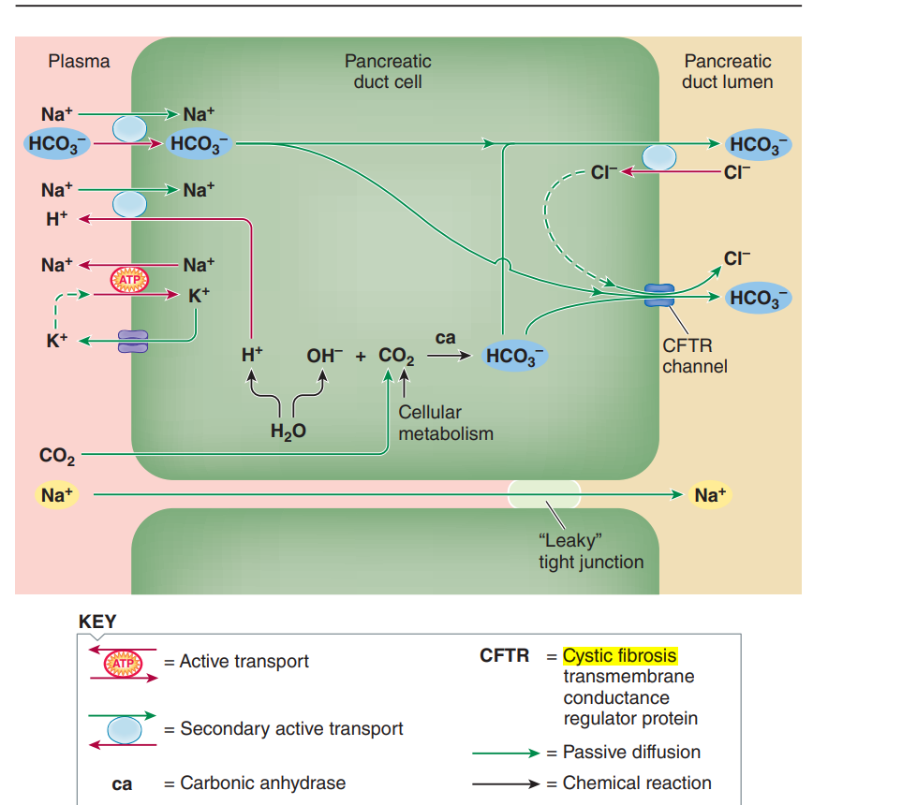
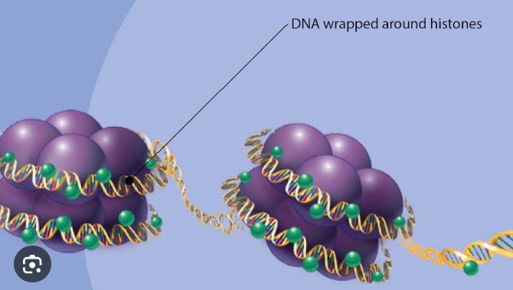
Functions of Histones
Core Concept
Regulates DNA activity.
Decondense by regulatory proteins.
Reference : Human Physiology by Sherwood 9th edition page 591

Slide 13
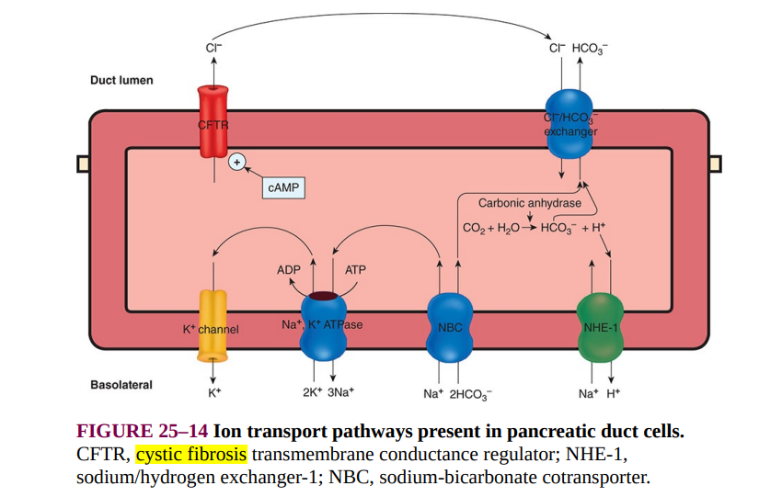
Cell Cycle
Core Concept
‘Cell cycle is the period of time between the birth of a cell and its own division to produce two daughter cells’
Reference : Ganong’s Review of Medical Physiology 26th edition page 1063

Slide 14
Characteristics
Core Concept
Sodium chloride accumulation in airway fluid due to impaired transport.
Salt-rich environment hinders the function of natural antibiotics.
Reduced effectiveness of white blood cells against infections.
Excessive production of thick, sticky mucus in the airways.

Slide 15
Respiratory Problems
Core Concept
Thick mucus in airways obstructs airflow.
Promotes bacterial growth, leading to recurrent infections.
Vulnerability to Pseudomonas aeruginosa.
Scarred lung tissue (fibrosis) complicates breathing.

Slide 16
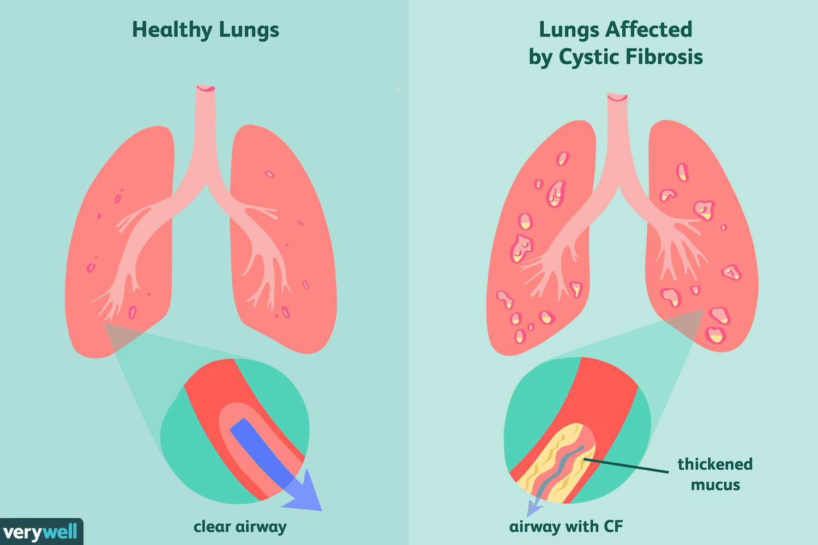
Core Concept
Image from google

Slide 17
Pancreatic Problems
Core Concept
Pancreatic duct blockage by mucus.
Impairs enzyme secretion and digestion.
Malnourishment and pancreatic tissue degeneration.
Formation of fluid-filled cysts in the pancreas.

Slide 18
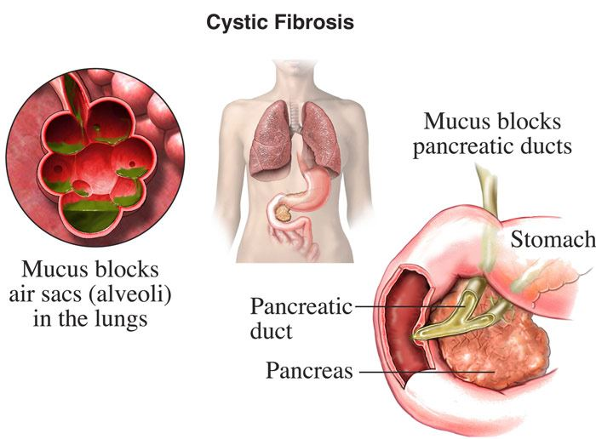
Prophase
Core Concept
Chromosomes becomes visible
Centriolar migration
Assembling of microtubules
Formation of asters
Image from google

Slide 19
Signs and Symptoms
Core Concept
Chronic cough with thick mucus.
Frequent lung infections.
Shortness of breath.
Poor weight gain despite good appetite.
Bulky, greasy stool
Salty taste of skin
Dehydration
Clubbing of hands

Slide 20
Investigations
Core Concept
Sweat Chloride Test:
Measures chloride levels in sweat (>60 mmol/L indicates CF).
Genetic Testing:
Identifies CFTR gene mutations.
Newborn Screening:
Detects elevated immunoreactive trypsinogen (IRT) levels.
Pulmonary Function Tests (PFTs):
Evaluates lung function.

Slide 21
Treatment
Core Concept
Physical therapy and mucus-thinning aerosols to clear airways.
Antibiotic therapy for respiratory infections.
Special diets and pancreatic enzyme supplements for nutrition.
Despite treatment, life expectancy limited, often not beyond late 30s.

Slide 22
Structure of the Cell Membrane
Core Concept
Basic structure is a lipid bilayer interspersed with large globular proteins
The basic lipid bilayer is composed of three main types of lipids—phospholipids, sphingolipids, and cholesterol.

Slide 23
Core Concept
The phosphate end of each phospholipid molecule is hydrophilic and soluble in water.
The fatty acid portion is hydrophobic and soluble only in fats

Slide 24
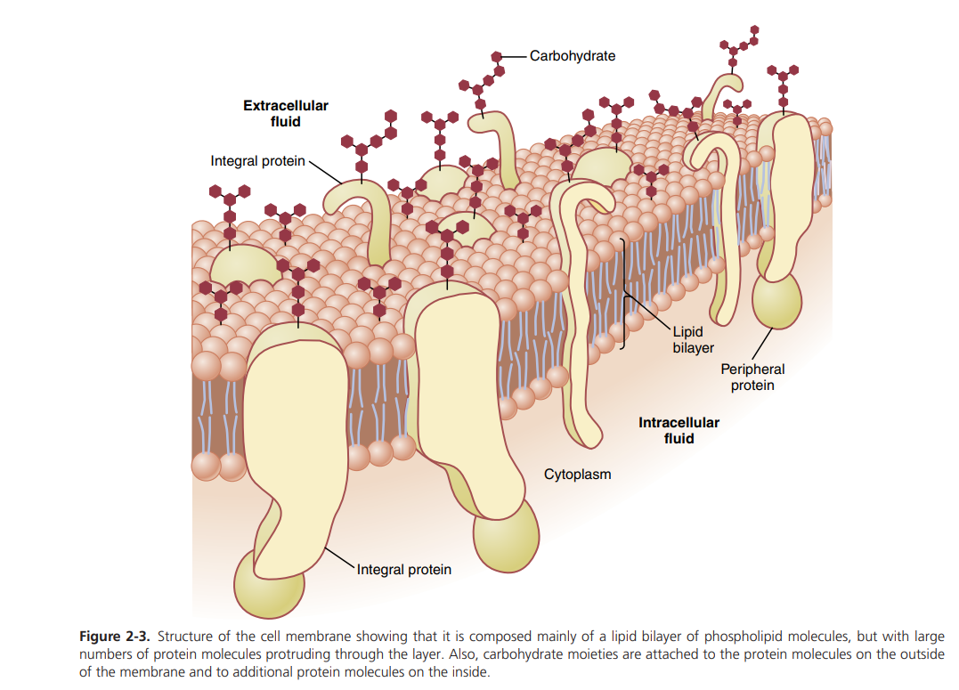
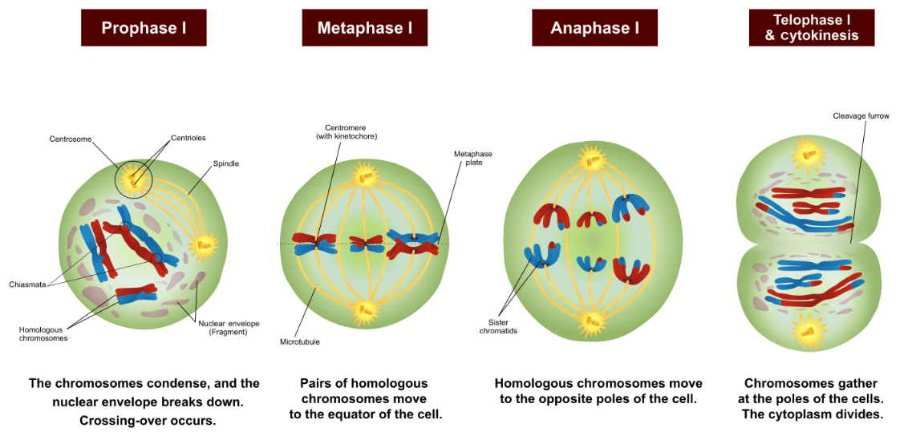
Phases of Meiosis I
Core Concept
Reference : Guyton and Hall Textbook of Physiology Fourteen edition page 15

Slide 25
Cell Membrane Proteins
Core Concept
Types of cell membrane proteins
integral proteins, which protrude all the way through the membrane
peripheral proteins, which are attached only to one surface of the membrane and do not penetrate all the way through

Slide 26
Core Concept
Integral proteins
Act as channels(pores), receptors, carrier proteins
Peripheral proteins
Attached to integral proteins act as enzymes and as controllers of transport of substances through cell membrane pores.

Slide 27
Body Fluid Compartments
Core Concept
Human body
50-70%fluid
(42L)
Extracellular fluid 1/3rd
(14L)
Plasma
Interstitial fluid
Intracellular fluid 2/3rd
^{(28L)}

Slide 28
Difference between Extracellular and Intracellular Fluid
Core Concept
Extracellular fluid Found outside the cells 1/3rd of total body fluid Major cation is sodium Major anion is chloride | Intracellular fluid Found inside the cells 2/3rd of total body fluid Major cation is potassium Major anion is phosphate

Slide 29
Amyotrophic lateral sclerosis (ALS)
Core Concept
Abnormal accumulation and disorganization of neurofilament (intermediate filaments )
Disorganized neurofilaments block the axonal transport of crucial materials along the microtubular highways, thus choking off vital supplies from the cell body to the axon terminal

Slide 30
Cell Cytoskeleton
Core Concept
It is a network of fibrillar proteins organized into filaments and tubules, dispersed throughout the cytosol that acts as the “bone and muscle” of the cell by supporting and organizing the cell components and controlling their movements
Types of cytoskeletal elements :
microtubules,
microfilaments
intermediate filaments

Slide 31
Core Concept
Reference : Sherwood 9th edition page 45

Slide 32
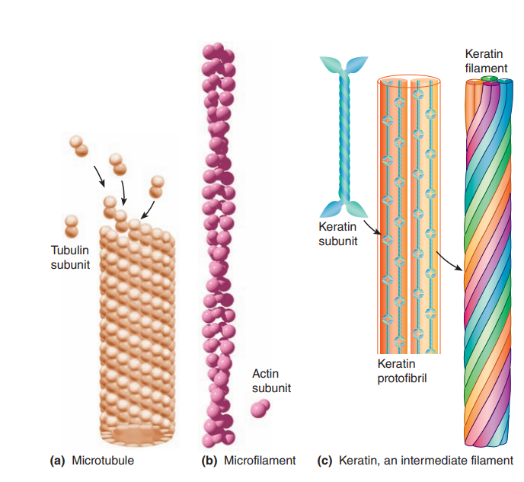
Prophase II
Core Concept
Disappearance of the nucleoli and the nuclear envelope
Shortening and thickening of the chromatids
Centrioles move to the polar regions and arrange spindle fibers for the second meiotic division
Reference : Sherwood 9th edition page 46

Slide 33
Brain Storming

Slide 34
Brainstorming
A 7-year-old male presented to OPD with his parents who were concerned about their son’s health and repeated chest infections. After history, examination and relevant investigations he is diagnosed with Cystic Fibrosis

Slide 35
Question
Brainstorming
Question 1 : . Which ion channel is defective in this disease

Slide 36
Brainstorming
Answer :
Chloride Channels

Slide 37
Brainstorming
Question 2 : What are the respiratory problems that could occur in a patient with Cystic Fibrosis

Slide 38
Answer
The presence of thick, sticky mucus in the respiratory airways makes it difficult to get adequate air in and out of the lungs.
bacteria thrive in the accumulated mucus, patients with CF experience repeated respiratory infections.
They are especially susceptible to Pseudomonas aeruginosa, an “opportunistic” bacterium that is often present in the environment but usually causes infection only when some underlying problem handicaps the body’s defenses.
Gradually, the involved lung tissue becomes scarred (fibrotic), making the lungs harder to inflate. This complication increases the work of breathing beyond the extra effort required to move air through the clogged airways

Slide 39
Brainstorming
Question 3 :What is the pathophysiology behind cystic fibrosis

Slide 40
Answer
Brainstorming
Genetic mutation in CFTR gene
CFTR gene mutation leads to flawed protein production.
Defective CFTR proteins fail to form chloride channels in the plasma membrane.
Result: Impaired chloride ion transport across cell membranes.
Sodium chloride accumulation in airway fluid due to impaired transport.
Salt-rich environment hinders the function of natural antibiotics.
Reduced effectiveness of white blood cells against infections.
Excessive production of thick, sticky mucus in the airways

Slide 41
Spiral Integration

Slide 42
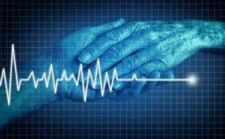
Euthanasia
Spiral Integration/Biomedical Ethics
The term “Euthanasia” is derived from Greek, literally meaning “good death”. taken in its common usage, however, euthanasia refers to the Termination of a person’s life, to end their suffering, usually from an incurable or terminal condition. it is for this reason that euthanasia was also coined the name “Mercy Killing”.

Slide 43
Spiral Integration/Biomedical Ethics

Slide 44
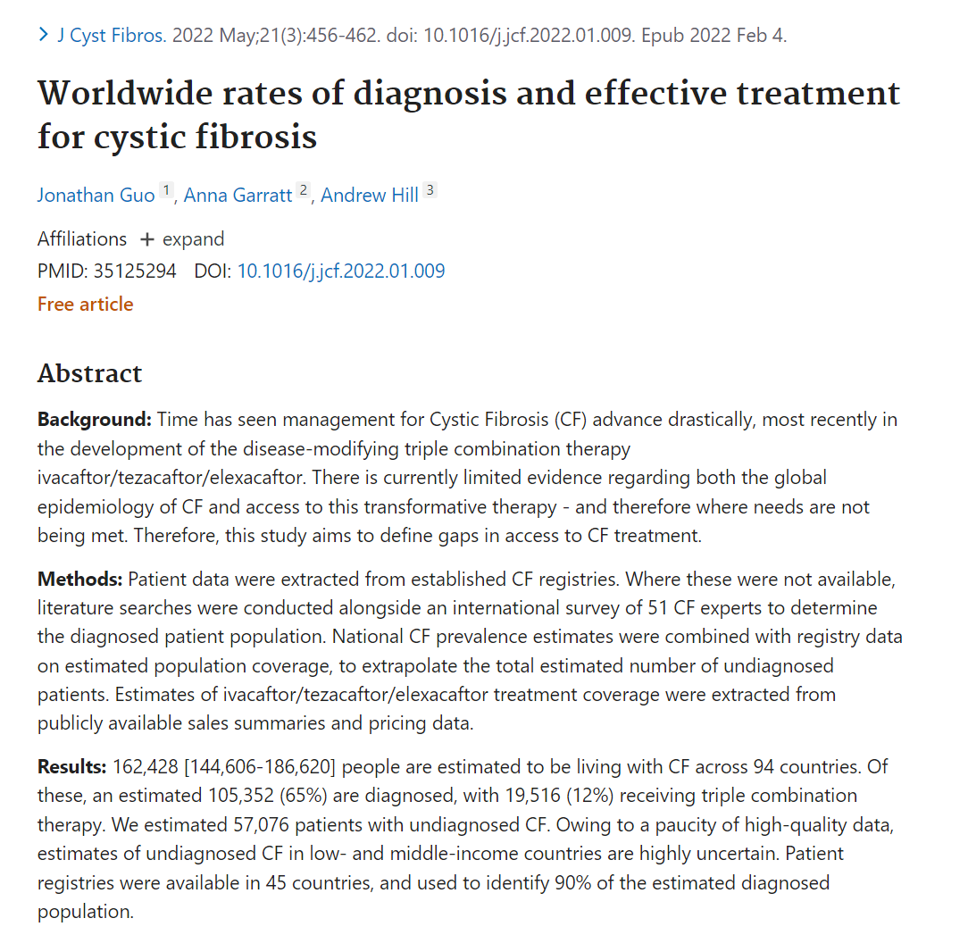
Suggested Research Article
Spiral Integration/Research
Reference: https://onlinelibrary.wiley.com/doi/abs/10.1111/and.14375

Slide 45
How To Access Digital Library
Promoting IT & Research Culture
Steps to Access HEC Digital Library
Go to the website of HEC National Digital Library.
On Home Page, click on the INSTITUTES.
A page will appear showing the universities from Public and Private Sector and other Institutes which have access to HEC National Digital Library HNDL.
Select your desired Institute.
5. A page will appear showing the resources of the institution
6. Journals and Researches will appear
7. You can find a Journal by clicking on JOURNALS AND DATABASE and enter a keyword to search for your desired journal. Link:https://www.topstudyworld.com/2020/05/access-hec-digital-library.html?m=1

Slide 46
References
References
Guyton And Hall textbook of Medical Physiology 14th Edition.
Davidson's Principles and Practice of Medicine - 24th Edition
Oxford Handbook of Clinical Medicine
Research Article Link
Worldwide rates of diagnosis and effective treatment for cystic fibrosis - PubMed (nih.gov)
/ pubmed.ncbi.nlm.nih.gov/35125294/

Slide 47
Summary
Summary
Define cystic fibrosis
Underlying channelopathy
Signs and symptoms related to respiratory and pancreatic system
Investigations and treatment for cystic fibrosis

