Slide 1
BREAST RECONSTRUCTION
Dr. Husnain Khan
Assistant Professor
Rawalian Burn & Reconstructive Surgery Department
RMU/HFH

Slide 2
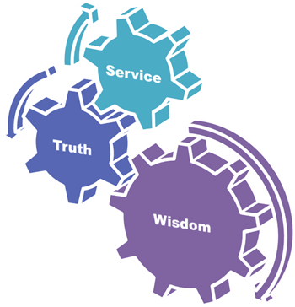
University Motto, Vision, Values & Goals
Mission Statement
To impart evidence-based research-oriented health professional education best possible patient care
Mutual respect, ethical practice of healthcare and social accountability.
Vision and Values
Highly recognized and accredited center of excellence in Medical Education, using evidence-based training techniques for development of highly competent health professionals, who are lifelong experiential learner and are socially accountable.
Goals
The Undergraduate Integrated Learning Program is geared to provide you with quality medical education in a healthy environment
2

Slide 3
SEQUENCE OF LGIS
Learning objectives
Reconstruction of Breast(core concept = 60%)
Related General surgery and Medicine (horizontal integration 20%)
Related clinical / Basic sciences (vertical integration – 15%)
Research article related to topic (3%)
Ethics (2%)

Slide 4
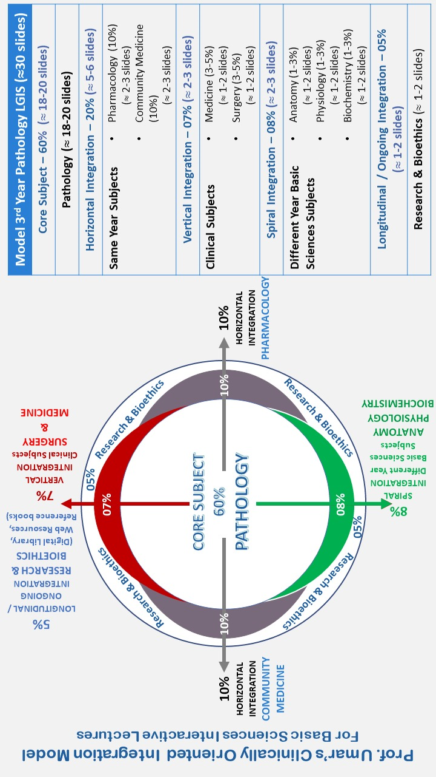
Plastic Surgery
General Medicine
General Surgery

Slide 5
Vision & Mission of RMU
Wisdom
Truth
Service
To impart evidence based research oriented medical education
To provide best possible patient care
To inculcate the values of mutual respect and ethical practice of medicine

Slide 6
LEARNING OBJECTIVES
Anatomy
Physiology
Types of mastectomies
Reconstruction
Pre-operative evaluation
Patient selection
Surgery timings
Nipples Areola Complex Reconstruction
Complications
Bioethics

Slide 7
Breast anatomy
Vertical Integration

Slide 8
Breast Physiology
Vertical Integration

Slide 9
SIGNIFICANCE of Breast
Important marker of female gender
Feeding importance
Self consciousness
Notes:
Breast cancer awareness month - OCTOBER

Slide 10
Loss of breast
No Feeding
Psychological effect
Social insecurity

Slide 11
Psychological distress and body image disturbances after modified radical mastectomy among breast cancer survivors: A cross-sectional study from A tertiary care center in north India, Monika Thakur
Research
Depression | 27.8%
Anxiety | 31.5%
Stress | 24.8%
Body image disturbance | 92%

Slide 12
Types of Mastectomies
Horizontal Integration
Skin sparing Mastectomies
Nipple Sparing Mastectomies
Modified Radical Mastectomies

Slide 13
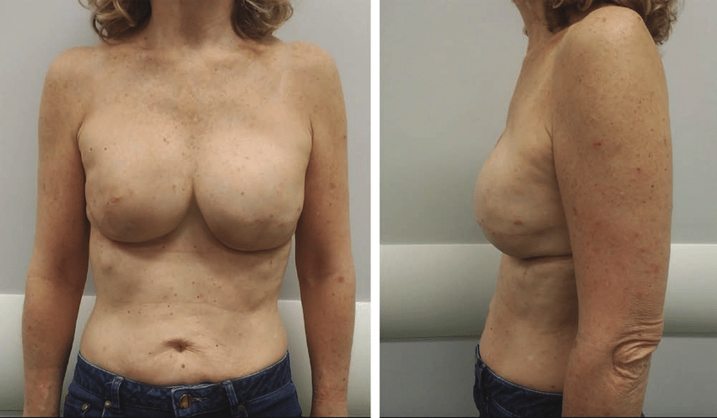
Skin Sparing mastectomy
Horizontal Integration
Preserves the inframammary fold and as much native skin as possible.
It is used when immediate breast reconstruction is planned.
For example: lumpectomy

Slide 14
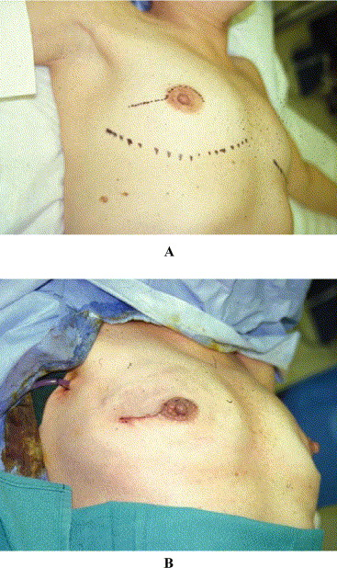
Nipple sparing mastectomy
Horizontal Integration
Preserves the entire breast skin envelope.
Used in women with small to moderate breast size and minimal breast ptosis
Done in small intra-lobular carcinoma

Slide 15
Modified radical mastectectomy(MRM)
Horizontal Integration
Whole skin, breast tissue removed
Large tumors

Slide 16
RECONSTRUCTION LADDER
Core Concepts
Breast Mound Reconstruction
Nipple/areola

Slide 17
Pre Operative Evaluation
Core Concepts
After detailed history and relevant examination, risk factors are ruled out
Smoking
Obesity (BMI >30)
Large breasts
Diabetes (Hgb A1C >6.5%)
Desired post operative breast volume is assessed.

Slide 18
Patient Selection
Core Concepts
Define patient’s goals and expectations
Autologous reconstruction is better in irradiated patients
Quit smoking 4 weeks prior to surgery
Avoid free flaps in history of hypercoagulable state

Slide 19
When to Operate?
Core Concepts
Immediate Reconstruction
Indications: Oncological safe patients
Advantages:
Easier Operation
Better aesthetic outcome
Avoids second operation
Avoids disfigurement

Slide 20
When to Operate?
Core Concepts
Delayed Reconstruction
In advanced staged patients
Decreased complications in comorbidities/radiation
Decreased mastectomy skin flap necrosis
Reference:
Impact of Immediate and Delayed Breast Reconstruction on Quality of Life of Breast Cancer Patients by Int J Environ Res Public Health. 2022 Jul 13; 19(14): 8546.

Slide 21
This 55 Year Lady underwent immediate bilateral breast reconstruction after stage four breast tumor. After radiation there was bilateral flap necrosis and wound infection. What was the possible mistake in planning for breast reconstruction ?
Stage 4 tumor, so delayed reconstruction should have been done

Slide 22
Recall
What is a Flap?
A flap is a unit of tissue that is transferred from one site (donor site) to another (recipient site) while maintaining its own blood supply

Slide 23
Types of Flaps
Core Concepts

Slide 24
BREAST RECONSTRUCTION
AUTOLOGOUS FLAP
PROSTHETIC
Core Concepts

Slide 25
AUTOLOGOUS TYPES
PEDICLE FLAPS
FREE FLAPS
LD FLAP
TRAM FLAP
ABDOMEN BASED FLAPS
GLUTEAL ARTERY PERFORATOR FLAP
THIGH FLAPS
LOCAL FLAPS
REGIONAL FLAPS
Core Concepts

Slide 26
Local flap

Slide 27
Transposition flap
Core Concepts

Slide 28
Thoraco-epigastric flap
Core Concepts

Slide 29
Pedicled Flaps

Slide 30
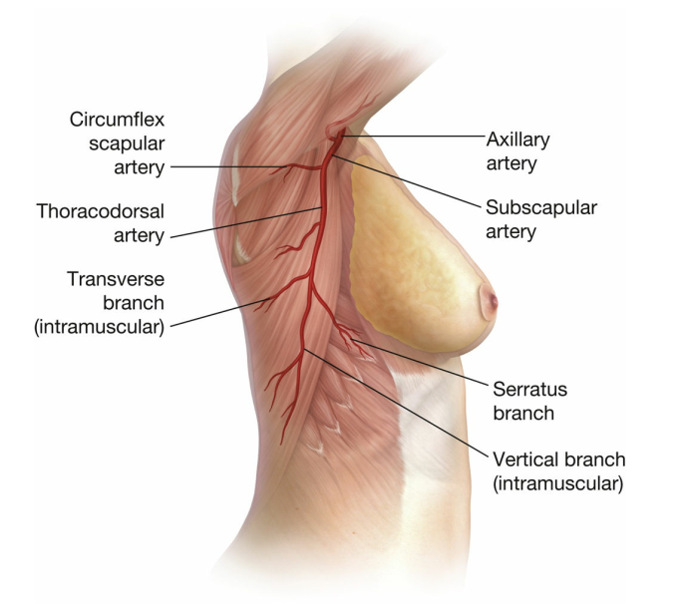
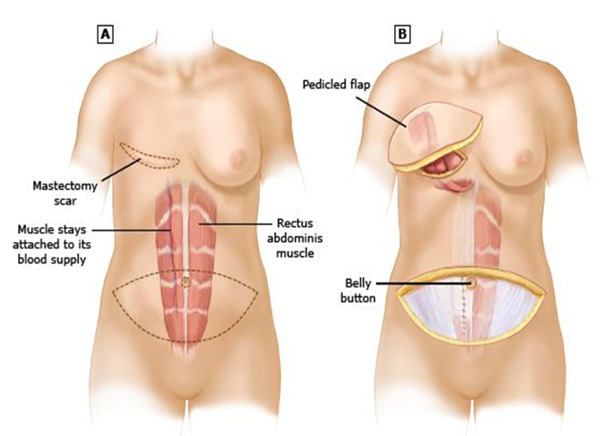
Pedicle LD Flap Pedicle tram Flap
Core Concepts
Based on the Thoracodorsal artery Based on Superior Epigastric Artery

Slide 31
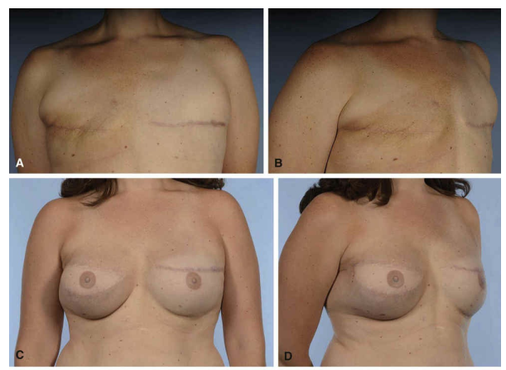
LD Flap Following Mastectomy
Core Concepts

Slide 32
Pedicle LD flap
Core Concepts
ADVANTAGES
DISADVANTAGES
Skin paddle does not provide sufficient volume
Often has to be used in combination with a prosthesis
Broad muscle, covers large surface area
Can be used with/without skin paddle
Can be used in salvage procedures

Slide 33
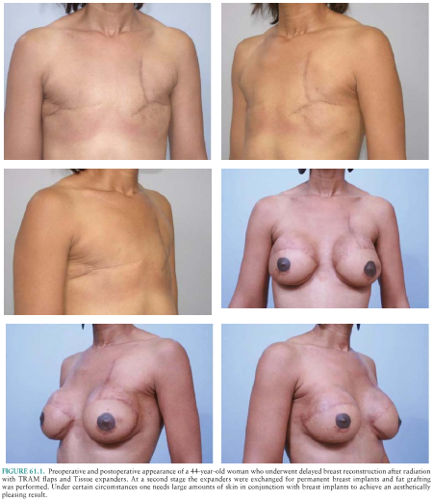
Transverse Rectus Abdominus Flap
Core Concepts

Slide 34
Pedicle TRAM flap
Core Concepts
ADVANTAGES
DISADVANTAGES
Good Tissue Adiposity
Short operation time
Weakens the Abdominal Wall
May cause Abdominal Wall Hernia

Slide 35
Free Flaps

Slide 36
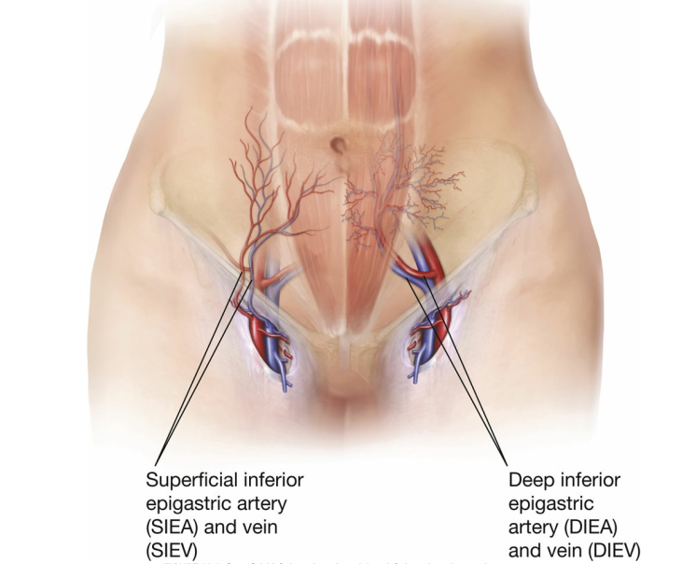
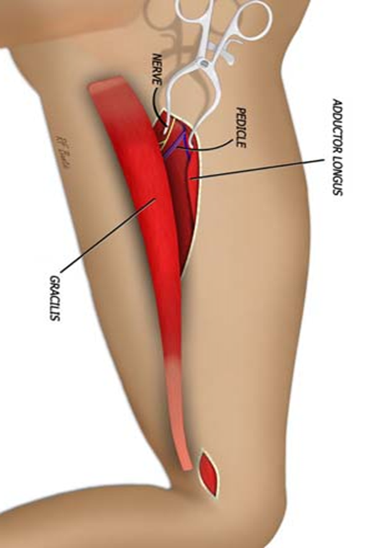
Abdominal (DIEP) medial Thigh gluteal artery
Core Concepts
DIEP Flap Medial circumflex femoral artery Sup/Inf gluteal artery

Slide 37
DIEP Flap
Core Concepts

Slide 38
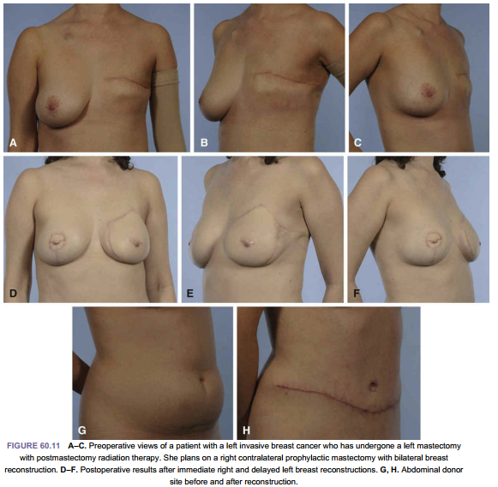
Core Concepts

Slide 39
Free Diep flap
Core Concepts
ADVANTAGES
DISADVANTAGES
Good Tissue Adiposity
Can be used in high risk patients
Weakens the Abdominal Wall
May cause Abdominal Wall Hernia
Longer surgery duration

Slide 40
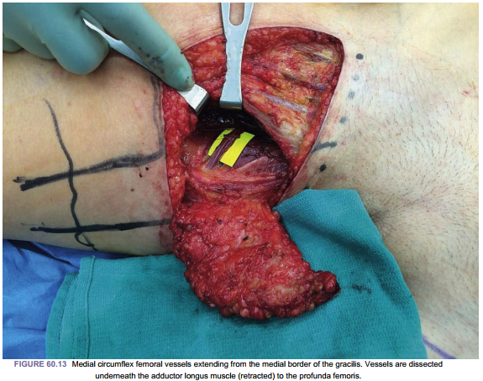
Medial Thigh Flap
Core Concepts

Slide 41
Medial Thigh flap
Core Concepts
ADVANTAGES
DISADVANTAGES
Can be used in abdominoplasty / abdominal flap patients
Incorporate gracilis muscle
Reliable skin paddle
Hidden scar
Tension in scar may cause labial spreading
Limited availability of soft tissue (250-350g)
Limited vascular pedicle length (7 cm)

Slide 42
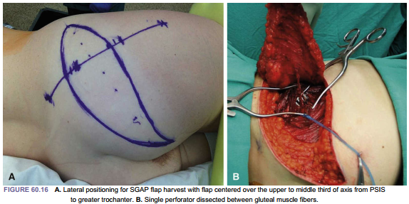
Core Concepts

Slide 43
Gluteal artery flaps
Core Concepts
ADVANTAGES
DISADVANTAGES
Can be done in abdominoplasty patients
Good amount of adipose tissue
Single perforator is sufficient to support the flap
Limited vascular pedicle length (5.6 cm)
Usually needs intra operative position change

Slide 44
Complications
Core Concepts
RECIPIENT SITE
DONOR SITE
Vascular Compromise
Fat Necrosis
Partial Flap Loss
Wound Dehiscence
Infection
Hematomas
Infection
Hematoma
Wound Dehiscence
Skin Flap Necrosis
Umbilical Necrosis
Abdominal Wall Hernias and Bulges
Medial thigh lymphatic leaks

Slide 45
Nipple Areola Reconstruction

Slide 46
Goals
Core Concepts
To create nipples that are appropriately located on the breast mound
Nipple is of appropriate size, shape, color, and texture.
Projection is another key aspect of nipple reconstruction

Slide 47
Local Flaps
Core Concepts
A central dermal fat pedicle is wrapped by full- or partial-thickness skin flaps Most commonly used nowadays
Include
Skate flap
Modified skate flap
Star flap
Cervical visor (CV) flap
Wrap flap
Fishtail flap

Slide 48
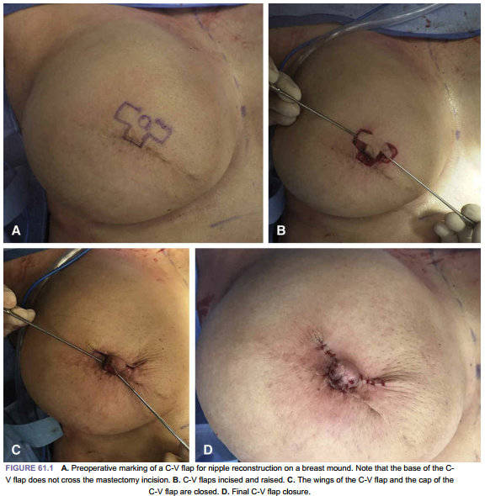
Core Concepts

Slide 49
Local flaps
Core Concepts
ADVANTAGES
DISADVANTAGES
Not suitable for thin/irradiated patients
Difficult in prosthetic reconstruction
Lose volume with time, hence they need 50-75% overcorrection
Reliable
Donor site can be usually closed primarily

Slide 50
Grafts
Core Concepts
Useful in prosthetic reconstruction due to limited soft tissue
Most common donor site is Contralateral composite nipple graft.
30-50% of the nipple can be taken
Excellent aesthetic results
Donor site can be closed primarily
May lead to loss of Donor site sensibility, erectile and ductile function.

Slide 51
Grafts
Core Concepts
Other donor sites include
Skin grafts from medial thigh skin
Placed over de-epithelialized circular donor site
Separate graft is placed in center to simulate the nipple
Tongue
Earlobe
Toe
Labia

Slide 52
Cartilage graft
Core Concepts
Important for nipple projection
Easy to perform
No donor site
Long lasting projection
Does have firm and unnatural feel.

Slide 53
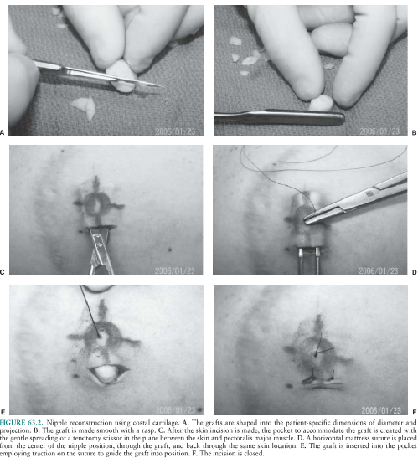
Core Concepts

Slide 54
Acellular dermal matrix
Core Concepts
A long cylindrical roll of ACM is taken
Sutured around itself to form a donut
Placed in front of the dermal fat pedicle of any local flap
It is then wrapped by the lateral skin flaps

Slide 55
Areola Tattooing
Core Concepts
Intra-dermal tattooing is very popular
Tattoo pigments are deposited into the dermis using a dermabrasion technique
Over correction is needed due to fading over time
Usually done 6 – 8 weeks after nipple reconstruction

Slide 57
PROSTHETIC TECHNIQUES

Slide 58
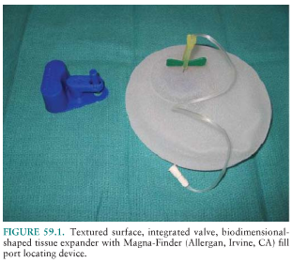
PROSTHETIC TECHNIQUES
Core Concepts
Use Tissue Expanders and Implants
Advantages
Shorter Operative Time
Shorter Hospital Stay
Shorter Recovery
No Donor Site or Recipient Vessel
Needed

Slide 59
PROSTHETIC TECHNIQUES
Disadvantages
Implant related Complications
Less natural Feel compared to autologous tissue
Difficult to achieve symmetry
Core Concepts

Slide 60
PROSTHETIC TECHNIQUES
Core Concepts
Single vs Two Stage Reconstruction
Single Stage: Direct Placement of a Permanent Implant
Two Stage: Placement of a tissue expander followed by Replacement by a Permanent Implant

Slide 61
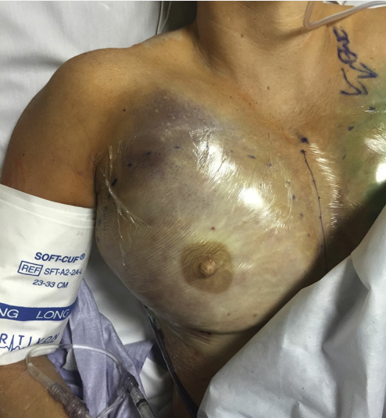
Complications
Core Concepts
Hematoma Formation
2-3%
Acute within 48 hours
If left untreated, can lead to flap necrosis

Slide 62
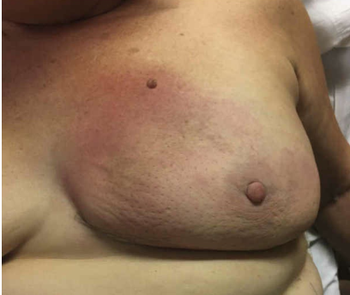
Complications
Core Concepts
Infection
Incidence is 7.6%
May need incision & drainage and implant removal

Slide 63
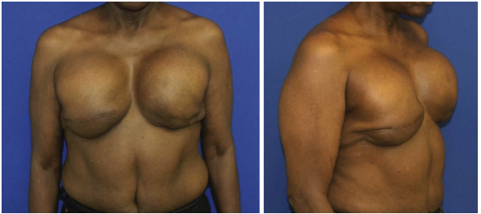
Complications
Core Concepts
Capsular Contracture
Incidence at 3 years – 13%

Slide 64
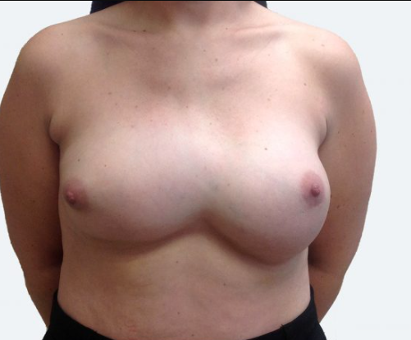
Complications
Core Concepts
Implant Malposition or Asymmetry

Slide 65
Prevention: The first consideration is the prevention of breast cancer. Preventive measures, such as regular mammograms and genetic testing, can help detect breast cancer early and reduce the need for breast reconstruction. There is also ongoing research into preventative therapies such as drugs and lifestyle changes that may reduce the risk of breast cancer
Protection: Protection of the patient's privacy and autonomy is critical in all medical procedures, including breast reconstruction. Patients should be fully informed of the risks and benefits of the procedure and have the right to refuse treatment if they do not want it. Additionally, patient confidentiality must be maintained at all times.
Diagnosis: The correct diagnosis of breast cancer is essential for appropriate treatment, including breast reconstruction. The use of accurate diagnostic tools such as mammography, ultrasound, and MRI is critical to ensure that patients receive the correct treatment
Treatment: Breast reconstruction is an elective surgical procedure, and as such, the patient's well-being and ability to make informed decisions must be the focus of the medical team. The treatment plan should be tailored to the patient's individual needs and preferences, taking into account factors such as age, general health, and lifestyle.
BIOETHICS

Slide 66
Latest Research in breast reconstruction

Slide 67
Recent advances
BRAVA
The Brava device is a bra with plastic cones that apply gentle pressure to the breast tissue. This pressure causes the skin to expand, making room for the fat graf
Fat grafting:
Surgeons can use harvested fat from other areas of the body to further refine the breast shape and achieve a more natural look after reconstruction.
Acellular dermal matrices (ADMs):
These patches can be used in prosthetic breast reconstruction to improve the fit and appearance of the prosthesis.
Minimally invasive techniques:
Overall, the trend is towards less invasive approaches to breast reconstruction with techniques like the SIEA flap which minimizes donor site morbidity.

Slide 68
Family medicine
Evaluating the family history of a person diagnosed with breast cancer is imp
To identify potential high-risk relatives who may need earlier breast cancer screening tests
Due to the possibility of inherited genetic mutations like BRCA1 or BRCA2, which significantly increase the risk of developing breast cancer.

Slide 69
LEARNING SOURCE
Grabb and Smith’s Plastic Surgery (8th Edition)
"Breast Reconstruction: Principles and Practice" by Peter C. Neligan

Slide 70
References
Grabb and Smith , 8th Edition
"Breast Reconstruction: Principles and Practice" by Peter C. Neligan

Slide 71
Thank You

