Slide 2
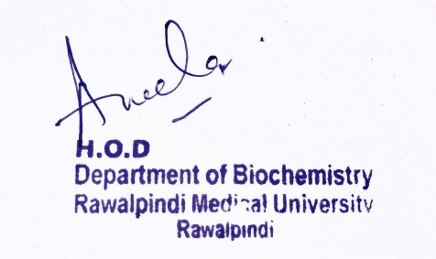
Blood and Immunology Module 1st Year MBBS (LGIS) Heme Synthesis and Porphyria
Presenter: Dr. Aneela Jamil Date: 27-01-25
(Assistant Professor)

Slide 3
Motto, Vision, Dream
To impart evidence based research oriented medical education
To provide best possible patient care
To inculcate the values of mutual respect and ethical practice of medicine
Wisdom
Truth
Service

Slide 4
Professor Umar Model of Integrated Lecture

Slide 5
Learning Objectives
At the end of this lecture students should be able to
Describe heme synthesis pathway
Explain defect, pathophysiology and clinical features of porphyria

Slide 6
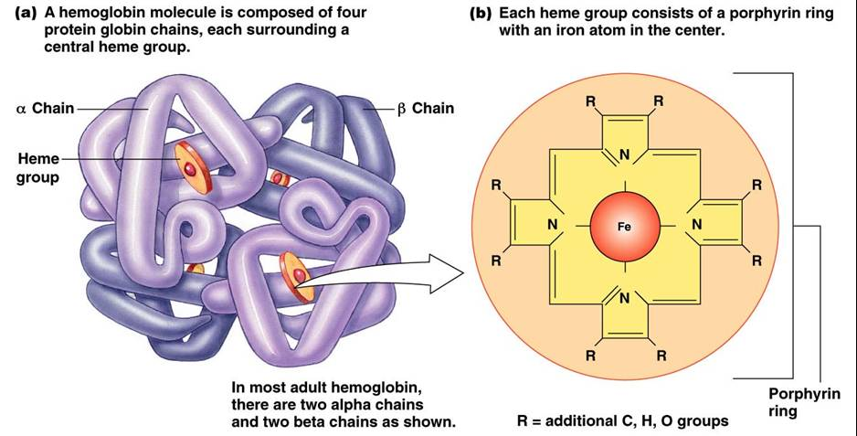
Core Knowledge

Slide 7
Heme Synthesis
Core Knowledge
Liver and bone marrow are major sites of heme synthesis
First and last 3 reactions take place in mitochondria
All others in cytoplasm
Mature red blood cells have no mitochondria so can’t make heme

Slide 8
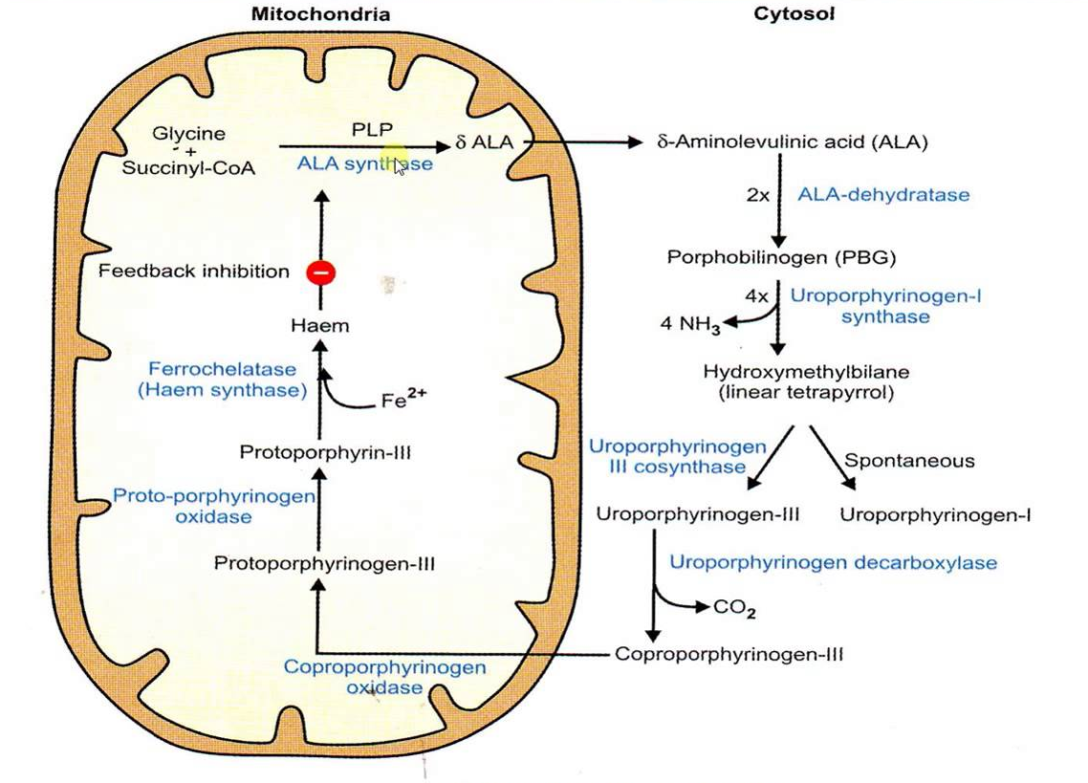

Slide 9
Core Knowledge
Effect of drugs on ALA synthase 1 activity
Drugs metabolized by cytochrome P450 monooxygenase system found in the liver → increase the synthesis of cytochrome P450 proteins leading to an enhanced consumption of heme
Decrease concentration of heme in liver cells leads to an increase in the synthesis of ALAS1 (derepression)

Slide 10
Porphyrias
Core Knowledge
"Group of inherited or acquired disorders caused by defects in heme synthesis leading to excessive accumulation of porphyrins or porphyrin precursors and their consequent excretion in urine"

Slide 11
Core Knowledge
Mutations in genes for enzymes of heme synthesis
Decrease heme synthesis
Increase ALAS activity
Accumulation of intermediates prior to block
Accumulation of ALA & Porphobilinogen
Accumulation of tetrapyrroles

Slide 12
Core Knowledge
Accumulation of ALA & Porphobilinogen
Neuropsychiatric signs & symptoms
Abdominal pain, nausea & vomiting
Accumulation of Tetrapyrroles
Photosensitivity

Slide 13
Core Knowledge
Porphyria Cutanea Tarda
Most common porphyria
Chronic hepatic porphyria
Defect: Uroporphyrinogen decarboxylase deficiency
Signs & symptoms:
Photosensitivity
Skin blisters
Onycholysis

Slide 14
Core Knowledge
Risk factors:
Alcohol abuse
Iron overload
Hepatitis B & C infection
Treatment:
Avoid exposure to sun-light
Use of sun screens
Avoid alcohol consumption

Slide 15
Core Knowledge
Acute Intermittent Porphyria
Acute hepatic porphyria
Defect: Porphobilinogen deaminase deficiency
Signs & symptoms:
Abdominal pain
Neuropsychiatric
Urine turns dark on exposure to air
No photosensitivity

Slide 16
Core Knowledge
Risk factors:
Estrogen
Drugs e.g barbiturates
Alcohol
Treatment:
Avoid precipitating agents
Opiates to treat pain
Hematin

Slide 17
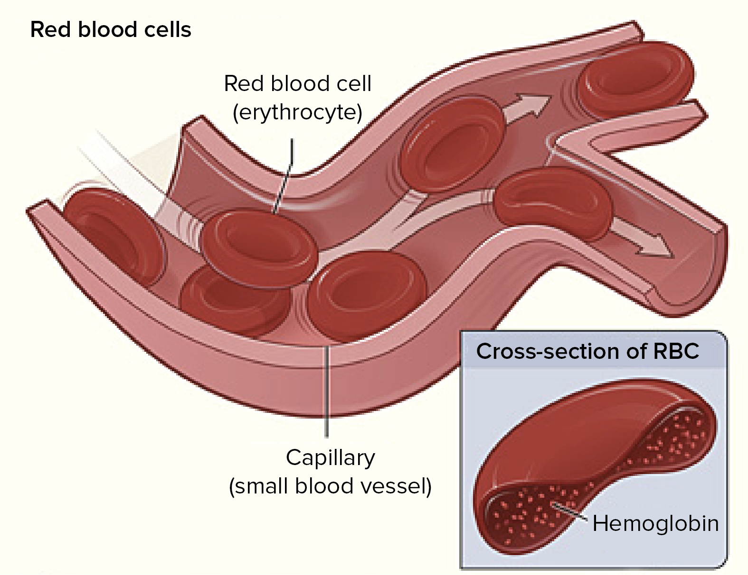
Anatomical & Physiological Aspects
Horizontal Integration

Slide 18
Anatomical & Physiological Aspects
Horizontal Integration
Heme is the prosthetic group in heme proteins
In hemoglobin it serves to transport oxygen
In cytochromes it is involved in electron transport chain

Slide 19
Vertical Integration
Porphyrias
Disorder | Defect | Type | Clinical features
Acute intermittent porphyria | Porphobilinogen deaminase | Acute hepatic | No photosensitivity Neuropsychiatric symptoms
Congenital erythropoietic porphyria | Uroporphyrinogen III synthase | Erythropoietic | Photosensitivity
Porphyria cutanea tarda | Uroporphyrinogen decarboxylase | Chronic hepatic | Photosensitivity
Hereditary coproporphyria | Coproporphyrinogen oxidase | Acute hepatic | Photosensitivity Neuropsychiatric symptoms
Variegate porphyria | Protoporphyrinogen oxidase | Acute hepatic | Photosensitivity Neuropsychiatric symptoms
Erythropoietic protoporphyria | Ferrochelatase | Erythropoietic | Photosensitivity

Slide 20
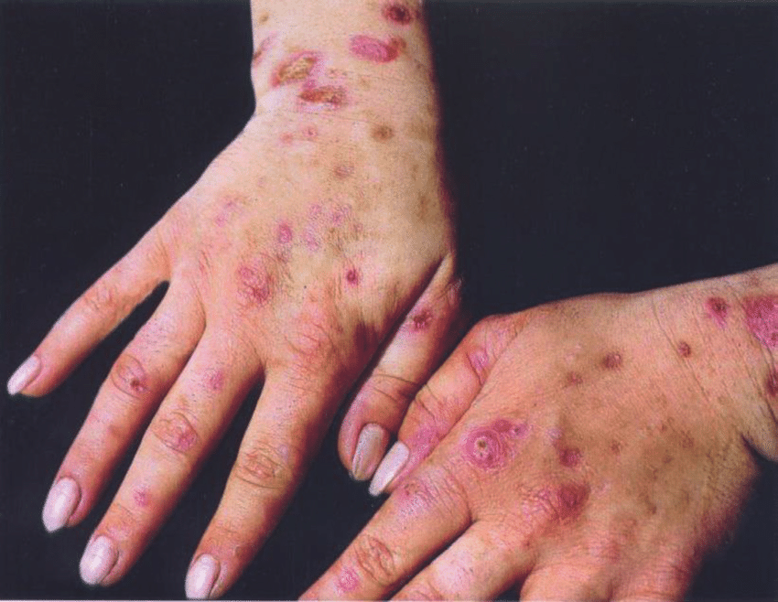
Vertical Integration

Slide 21
Family Medicine
Spiral Integration
Family Medicine plays important role in following manner:
Early Diagnosis
Education
Dietary Guidance
Monitoring
Refer to Specialists

Slide 22
Artificial Intelligence
Spiral Integration
Artificial Intelligence plays role in following aspects:
Decoding DNA sequences to
pinpoint genetic variations
identify genetic abnormalities
Utilizes extensive data from patient thereby enhancing prevention, diagnosis & treatment based on individual genetic profiles
Food Recommendations

Slide 23
Suggested Research Article
Spiral Integration
Link: https://www.ncbi.nlm.nih.gov/pmc/articles/PMC6340172/
Journal Name : Journal of Medical Case Report
Title: Porphyria cutanea tarda: a case report
Author Name: Hanife Usta Atmaca
Abstract
The porphyrias are a rare group of metabolic disorders that can either be inherited or acquired. Along the heme biosynthetic pathway, porphyrias can manifest with neurovisceral and/or cutaneous symptoms, depending on the defective enzyme. Porphyria cutanea tarda, the most common type of porphyria worldwide, is caused by a deficiency of uroporphyrinogen decarboxylase, a crucial enzyme in heme biosynthesis, which results in an accumulation of photosensitive byproducts, such as uroporphyrinogen, which leads to the fragility and blistering of sun-exposed skin.
Porphyria cutanea tarda is a condition that affects the liver and skin by reduction and inhibition of uroporphyrinogen decarboxylase enzyme in erythrocytes. Areas of skin that are exposed to the sun can generate blisters, hyperpigmentation, and, sometimes, lesions that heal leaving a scar or keratosis. Liver damage might present in a wide range of ways from liver function test abnormalities to hepatocellular carcinoma. The toxic effect of iron plays a role in liver damage pathogenesis.

Slide 24
Bioethics
Spiral Integration
Appropriate information
Explain to patient or his family the genetic aspects of the condition
Counselling

Slide 25
How To Access Digital Library
Steps to Access HEC Digital Library
Go to the website of HEC National Digital Library
On Home Page, click on the INSTITUTES
A page will appear showing the universities from Public and Private Sector and other Institutes which have access to HEC National Digital Library HNDL
Select your desired Institute
A page will appear showing the resources of the institution
Journals and Researches will appear
You can find a Journal by clicking on JOURNALS AND DATABASE and enter a keyword to search for your desired journal

Slide 26
Learning Resources
Lippincott Illustrated Review, Biochemistry (Eighth edition, chapter 21, Pages 309-313)
Google scholar
Google images

