Slide 1
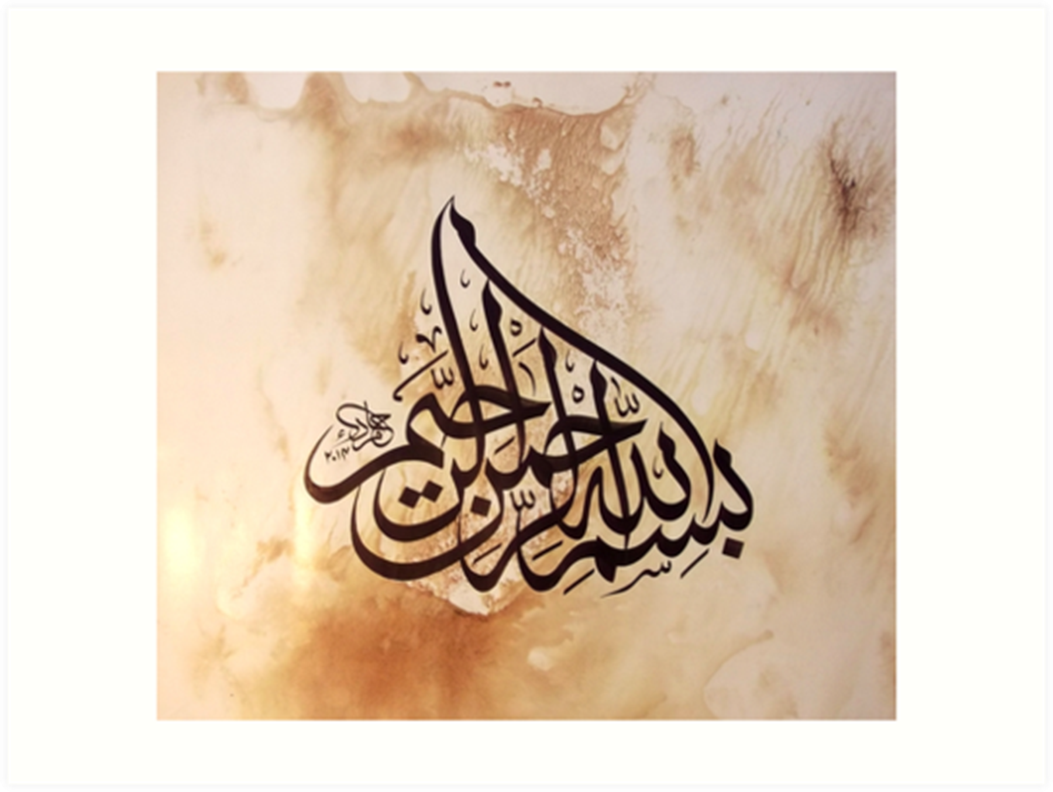

Slide 2
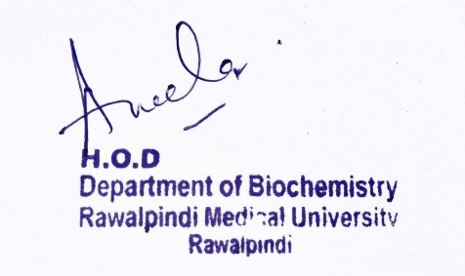
Blood and Immunology Module 1st Year MBBS (LGIS) Heme Degradation and Jaundice
Presenter: Dr. Aneela Jamil Date: 27-01-25
(Assistant Professor)

Slide 3
Motto, Vision, Dream
To impart evidence based research oriented medical education
To provide best possible patient care
To inculcate the values of mutual respect and ethical practice of medicine
Wisdom
Truth
Service

Slide 4
Professor Umar Model of Integrated Lecture

Slide 5
Learning Objectives
At the end of this lecture students should be able to
Describe heme degradation pathway
Explain types, pathophysiology and biochemical findings of jaundice

Slide 6
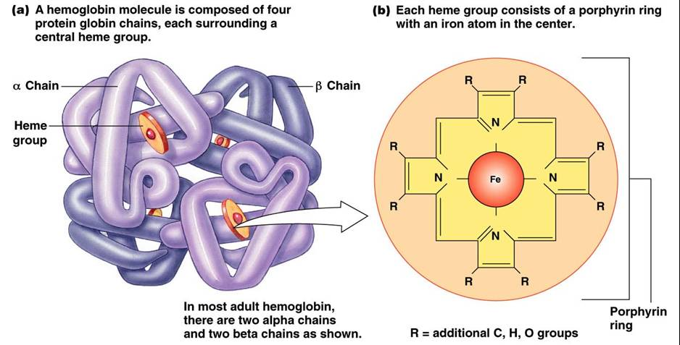
Core Knowledge

Slide 7
Core Knowledge
Hemoglobin is degraded in the body to produce Heme & Globin
globin is degraded to its constituent amino acids,
iron of heme enters the iron pool for reuse
iron-free porphyrin portion of heme is degraded, mainly in the reticuloendothelial cells of the liver, spleen and bone marrow

Slide 8
Heme Degradation
Core Knowledge
Steps
Formation of bilirubin
Uptake by liver
Conjugation in liver
Secretion into bile
Formation of urobilins in intestine

Slide 9
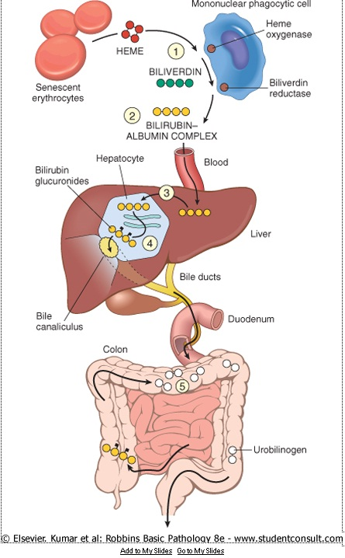
Core Knowledge

Slide 10
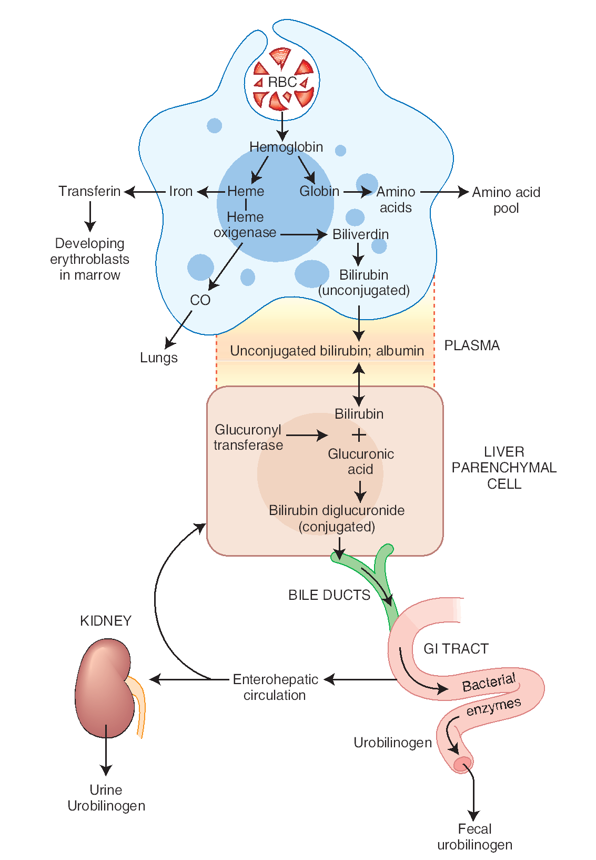

Slide 11
Core Knowledge
1. Formation of Bilirubin
Catalyzed by microsomal heme oxygenase system
Green pigment biliverdin is produced as ferric iron and CO are released
Biliverdin is reduced, forming bilirubin
Bilirubin and its derivatives are collectively termed bile pigments

Slide 12
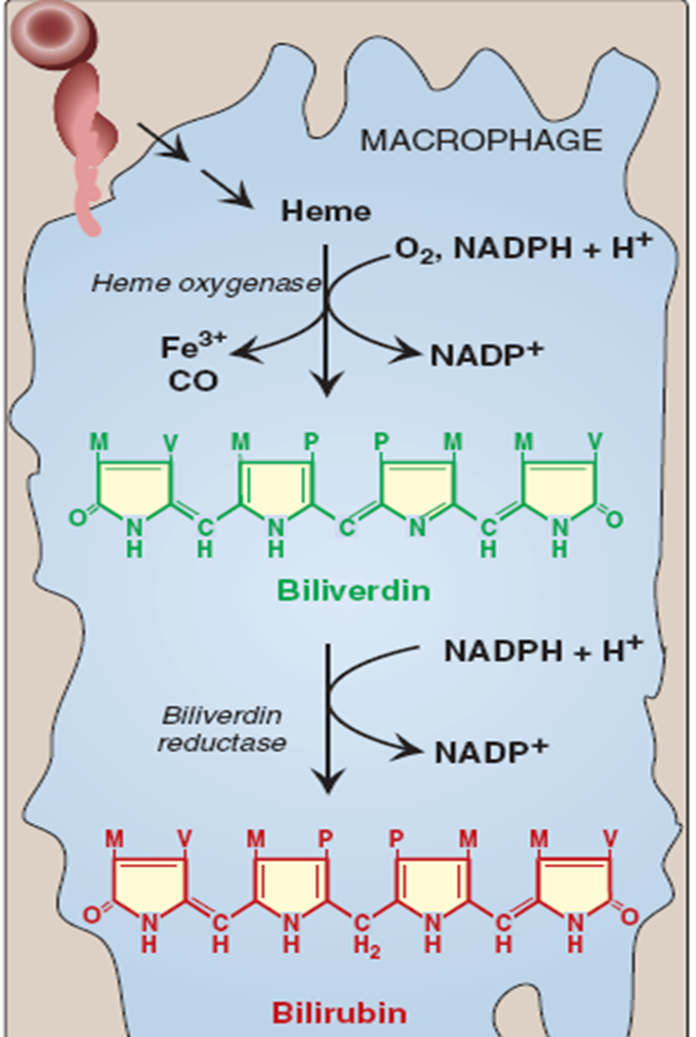
Core Knowledge

Slide 13
Core Knowledge
2. Uptake by Liver
Bilirubin is transported in blood by albumin
Dissociates from albumin and enters hepatocyte by facilitated diffusion

Slide 14
Core Knowledge
3. Conjugation in Liver
By bilirubin glucuronyl transferase
Bilirubin diglucuronide is water soluble
Most of the bilirubin excreted in the bile of mammals is in the form of bilirubin diglucuronide

Slide 15
Core Knowledge
4. Secretion into Bile
By active transport
5. Formation of Urobilins in Intestine
Urobilinogens are produced by intestinal bacteria
Most of it is converted to stercobilin and lost in feces
Some is absorbed in blood and is excreted in urine as urobilin

Slide 16
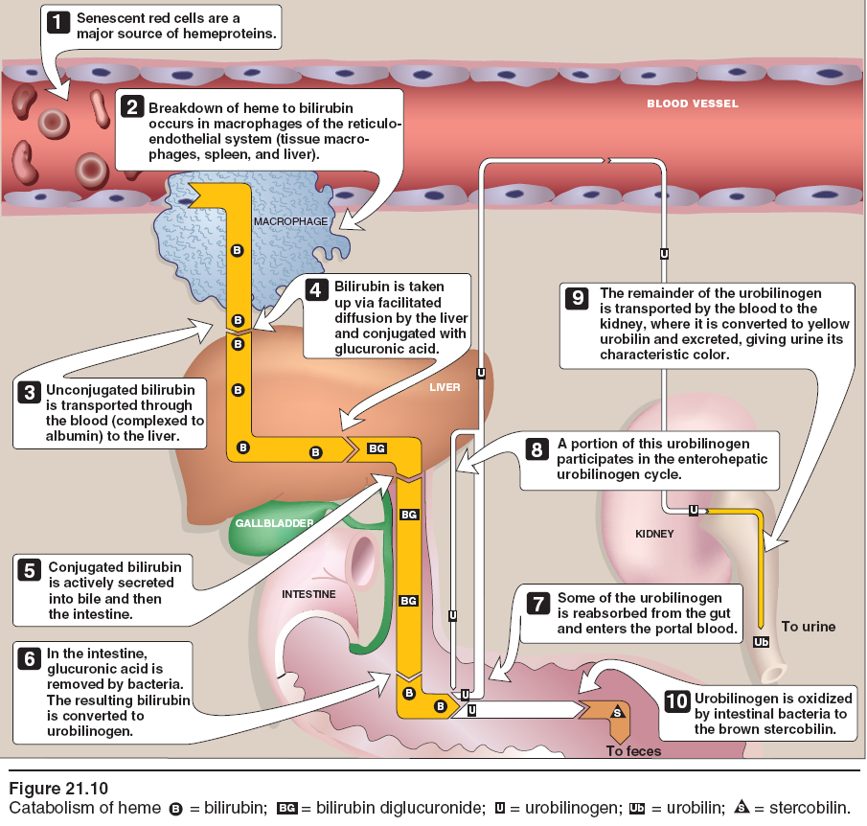

Slide 17
Core Knowledge
Hyperbilirubinemia → bilirubin in the blood exceeds 1 mg/dL (17.1μmol/L)
may be due to the production of more bilirubin than the normal liver can excrete, or
may result from the failure of a damaged liver to excrete bilirubin produced in normal amounts or
obstruction of the excretory ducts of the liver

Slide 18
Core Knowledge
When bilirubin reaches a certain concentration (approximately 2–2.5 mg/dL), it diffuses into the tissues, which then become yellow. This condition is called jaundice or icterus.

Slide 19
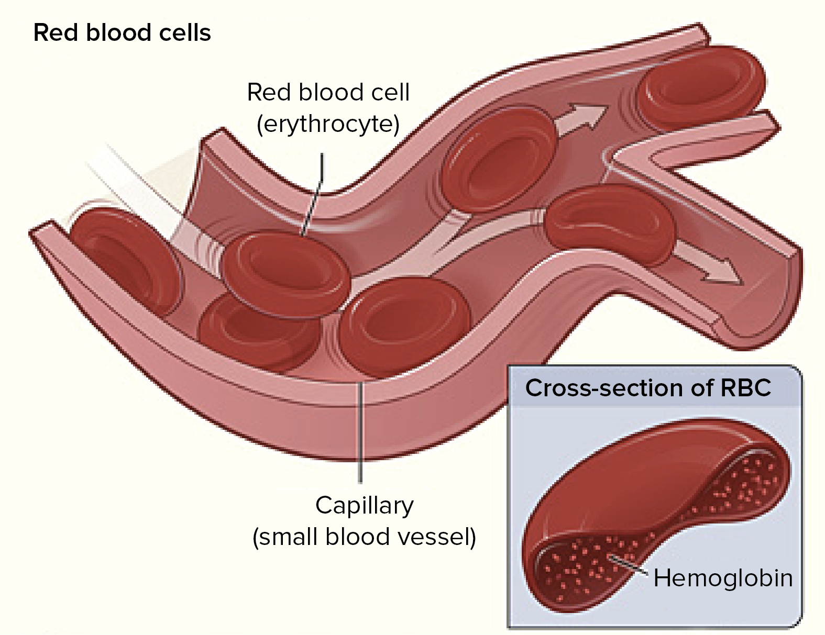
Anatomical & Physiological Aspects
Horizontal Integration

Slide 20
Anatomical & Physiological Aspects
Horizontal Integration
Heme is the prosthetic group in heme proteins
In hemoglobin it serves to transport oxygen
In cytochromes it is involved in electron transport chain

Slide 21
Vertical Integration
Jaundice
Type | Defect
Hemolytic jaundice Unconjugated hyperbilirubinemia | Bilirubin production exceeds its conjugation in the liver (hemolytic anemias) Raised plasma LDH
Hepatocellular jaundice Unconjugated/conjugated hyperbilirubinemia | Hepatocellular damage (due to hepatitis) Raised ALT & AST
Obstructive jaundice Conjugated hyperbilirubinemia | Extrahepatic cholestasis (gallstone) Raised ALP

Slide 22
Vertical Integration
 | Serum bilirubin | Urine bilirubin | Urinary urobilinogen
Hemolytic jaundice | Unconjugated | Absent | Increased
Hepatic jaundice | Both conjugated and unconjugated | Present in case of micro-obstruction | Decreased in case of micro-obstruction
Obstructive jaundice | Conjugated | Present | Absent

Slide 23
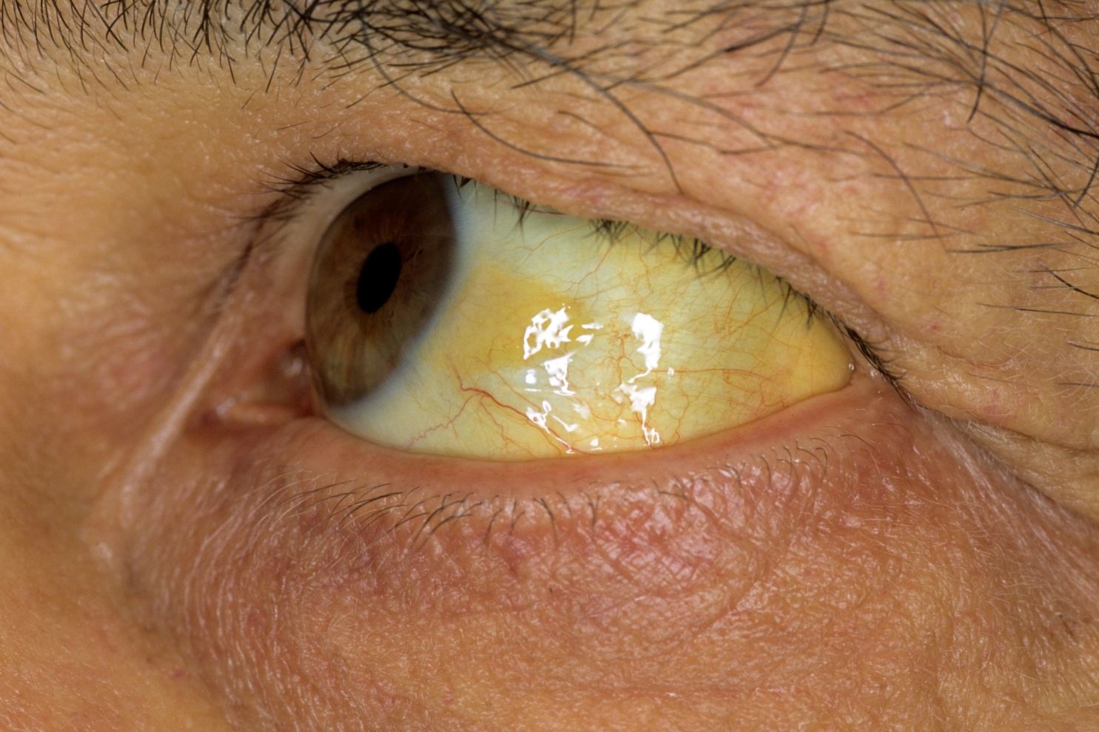
Vertical Integration

Slide 24
Family Medicine
Spiral Integration
Family Medicine plays important role in following manner:
Early Diagnosis
Education
Dietary Guidance
Monitoring
Refer to Specialists

Slide 25
Artificial Intelligence
Spiral Integration
Artificial Intelligence plays role in following aspects:
Utilizes extensive data from patient thereby enhancing prevention, diagnosis & treatment based on individual genetic profiles

Slide 26
Suggested Research Article
Spiral Integration
Link: https://www.academia.edu/download/64227366/Obstructive%20Jaundice.pdf
Journal Name : Surgery
Title: Obstructive jaundice: understanding the Pathophysiology
Author Name: Ketan Vagholkar
Abstract
Jaundice is one of the most prevalent symptom in hepatobiliary disorders. The nature of jaundice may vary from hepatocellular to obstructive pattern. In a few cases, it may be haemolytic in nature. Identifying and ascertaining the type is pivotal for further investigation. A combination of haematological and radiological investigations will not only provide information on the severity and the impact of obstructive jaundice on various organ systems of the body but also help in determining the prognosis. Endoscopy can also provide diagnostic as well as a therapeutic benefit in obstructive jaundice. The pathophysiology, clinical evaluation and investigations in a case of obstructive jaundice is discussed in this paper

Slide 27
Bioethics
Spiral Integration
Appropriate information
Explain to patient or his family the genetic aspects of the condition
Counselling

Slide 28
How To Access Digital Library
Steps to Access HEC Digital Library
Go to the website of HEC National Digital Library
On Home Page, click on the INSTITUTES
A page will appear showing the universities from Public and Private Sector and other Institutes which have access to HEC National Digital Library HNDL
Select your desired Institute
A page will appear showing the resources of the institution
Journals and Researches will appear
You can find a Journal by clicking on JOURNALS AND DATABASE and enter a keyword to search for your desired journal

Slide 29
Learning Resources
Lippincott Illustrated Review, Biochemistry (Eighth edition, chapter 21, Pages 313-315)
Google scholar
Google images

