Slide 1
Bacterial metabolism and growth
Microbe Module
3rd Year MBBS
Dr Kiran Fatima
Pathology Department
Rawalpindi Medical University

Slide 2


Motto of RMU

Slide 3


Vision of RMU The Dream/ Tomorrow
To impart evidence based research oriented medical education
To provide best possible patient care
To inculcate the values of mutual respect and ethical practice of medicine

Slide 4
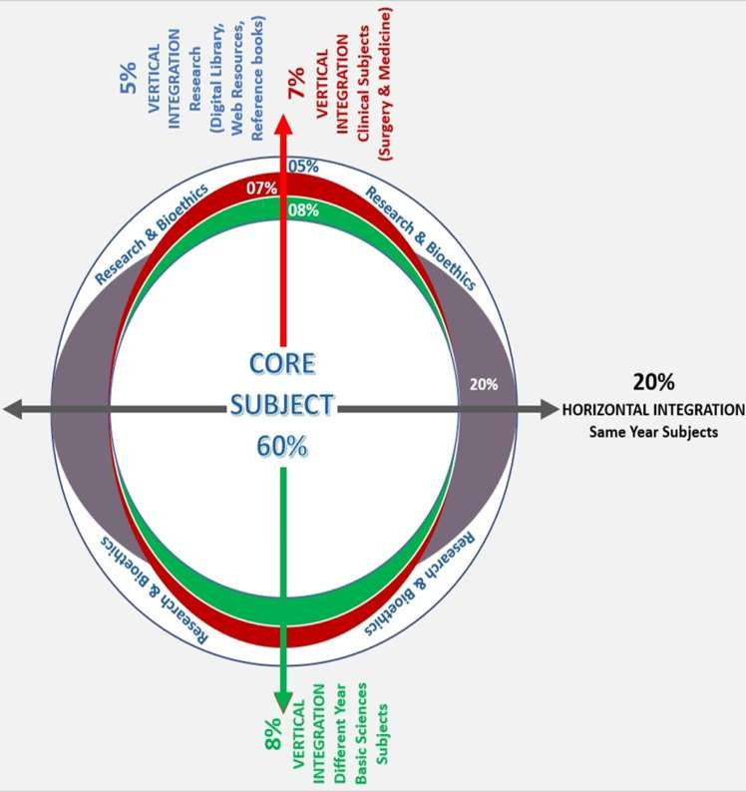
Prof Umar’s LGIS model

Slide 5
Learning objectives
Differentiate between aerobic and anaerobic growth
Explain fermentation of sugars
Discuss iron metabolism
Define each phase of growth cycle

Slide 6
Requirements for growth
Core Content
1-Chemical Requirments: Macro & Micro Elements Ca Fe Mg NaCl
2-Physical Requirements: It includes
Temperature
– psychrophiles (cold loving microbes ) .range 0 C - 20 C
-mesophiles (moderate temp. loving microbes .range20 C - 40 C
thermophiles
  range
(heat loving microbes) 40 C - 100 C

Slide 7
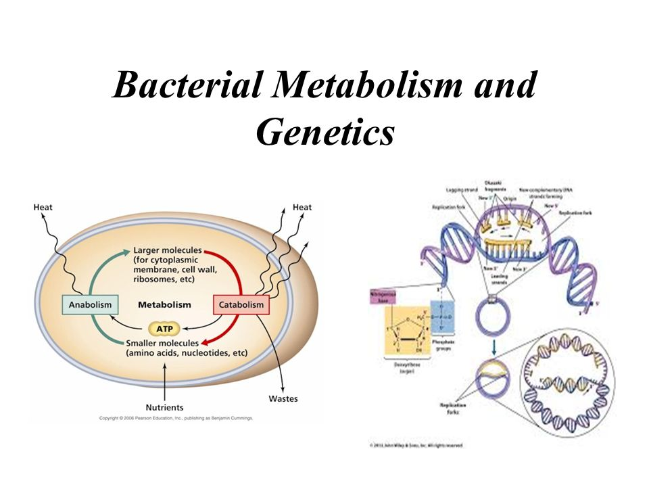
spiral

Slide 8
Requirements for Growth
Core Content
Bacterial Metabolism and Growth cont..
Most bacteria grow between pH 6.5 - pH 7.5
Very few can grow at below pH 4.0
  many foods, such as pickles, and cheeses are preserved
from spoilage by acids produced during fermentation
Microbes obtain almost all their nutrients in solution from
surrounding water
Tonicity
  isotonic
  hypertonic
  hypotonic

Slide 9
What is Aerobic and anaerobic Growth
Core Content
Adequate supply of oxygen enhances metabolism and growth in bacteria.
Oxygen acts as hydrogen acceptor in final steps of energy production catalyzed by cytochromes and flavoprotein.
Use of oxygen generates two toxic molecules hydrogen
peroxide(H2O2) and free radical superoxide.
Superoxide (steals electrons) and Hydrogen peroxide is toxic
to cells and it must be neutralized
Bacteria requires two enzymes to utilize oxygen
1-superoxide dismutase
2-Catalase

Slide 10
Superoxide dismutase
Core Content
O₂- + O₂- + 2 H⁺ -------> H₂O₂ + O₂
Catalase:
2 H₂O₂ --------> 2 H₂O + O₂
Obligate Anaerobes lack:
  Superoxide dismutase ( SOD )
  Catalase

Slide 11
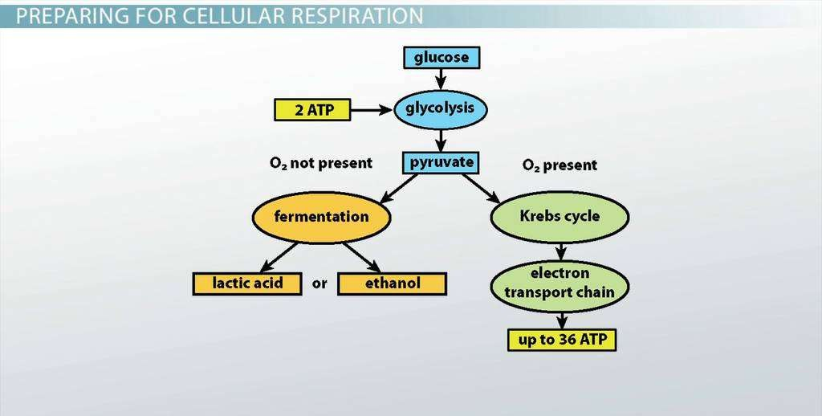
Horizontal
Biochemistrry
Aerobic and Anaerobic Growth of bacteria

Slide 12
Practical Significance of oxygen Response of bacteria
Vertical Integration
To classify bacteria
Incubation of bacterial samples obtained from patients in a proper atmosphere according to the oxygen requirements.

Slide 13
Core Content
Types of bacteria according to the oxygen Requirements

Slide 14

Core Content
1. Obligate Aerobes
An obligate aerobe is an aerobe that
requires oxygen for aerobic respiration.
Obligate aerobes need oxygen to oxidize substrates (for example sugars and fats) in order to obtain energy.
They use oxygen as the terminal electron acceptor during aerobic respiration. Examples:
Gram negative :
Pseudomonas aeruginosa, E.
coli, Klebsiella pneumonia.
Obligate Aerobic Gram (+ve)
bacteria are Bacillus, Nocardia, Micrococc
us spp.

Slide 15
Core Content
2- Facultative anaerobes
A facultative anaerobic organism is
an organism that makes ATP by aerobic respiration if oxygen is present, but is capable of switching to fermentation if oxygen is absent
Example: Staphylococcus spp., Escherichia coli, Salmonella, Listeria spp and Yersinia pestis.

Slide 16

Core Content
3. Obligate Anaerobes
organisms that can grow and survive only in the absence of oxygen.
In aerobic conditions they tend to die.
They are killed by normal atmospheric concentrations of oxygen (ie,20.95% O2)
Examples:
Actinomyces, Bacteroides, Clostridium, Fusobacterium, Peptostreptococcus, Porphyromonas, Prevotella, Propionibacterium, and Veillonella.

Slide 17

Core Content
4. Facultative Aerobes
These are bacteria that, under normal circumstances, breathe anaerobically. But can breathe aerobically when oxygen is available.
Example:Rhodopseudo monas is an example of facultative aerobes.

Slide 18

Core Content
5. Microaerophilic
A microaerophile is a
microorganism that requires environments containing lower levels of dioxygen than that are present in the atmosphere (i.e. < 21% O₂; typically 2–10% O₂) for optimal growth.
Example : Borrelia burgdorferi Helicobacter pylori,

Slide 19
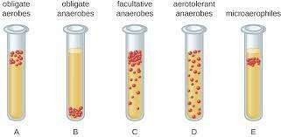
Core Content

Slide 20
Special Culture Techniques
Core Content
Microaerophilic Bacteria
  grow best under reduced O₂ levels and increased CO₂ levels
  Normal Atmosphere 21 % O₂

Slide 21
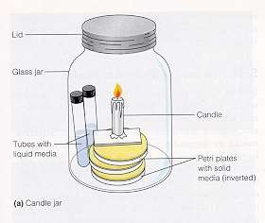
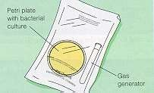
Core Content
Microaerophilic bacteria
A. Candle jar
Microaerophilic bacteria
:Co₂generating packet
16 % O₂
CO₂ 4 %

Slide 22
Horizontal integration
General concept of Energy Production
The cells of living things power their activities with the energy
carrying molecule ATP (adenosine triphosphate)
The cells of most living things make ATP from glucose in the
process of cellular respiration
This process occurs in three major stages, and one intermediate
stage:
glycolysis, oxidation of pyruvate,
the Krebs cycle, and electron transport (require oxygen)
There are also other ways of making ATP from glucose without oxygen, such as anaerobic respiration and fermentation of making ATP from glucose without oxygen.

Slide 23
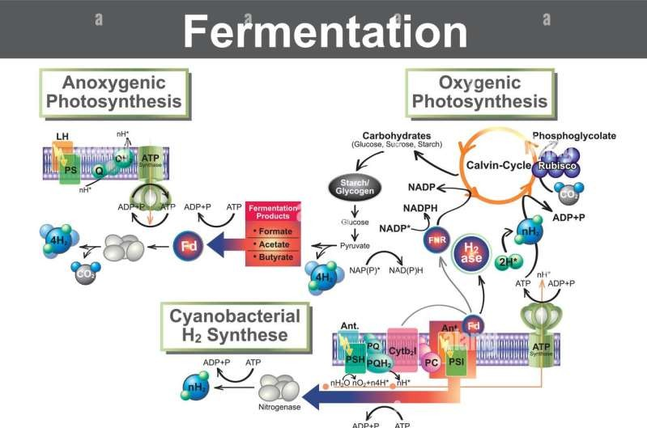
Horizontal integration

Slide 24
Fermentation of Sugar in Bacteria
Horizontal integration
Fermentation is a metabolic process that some microorganisms use to break down glucose and other sugars when O₂ is not available or could not be used by the microorganism.
Fermentation is a way bacteria can produce ATP to meet their energy needs (although fermentation produces significantly less ATP than aerobic respiration or anaerobic respiration).

Slide 25
Horizontal integration
Fermentation includes the metabolic pathway glycolysis (where a single molecule of glucose is broken down into 2 molecules of pyruvate), as well as additional fermentation reactions that produce a variety of end products (acids, alcohols, gases).

Slide 26
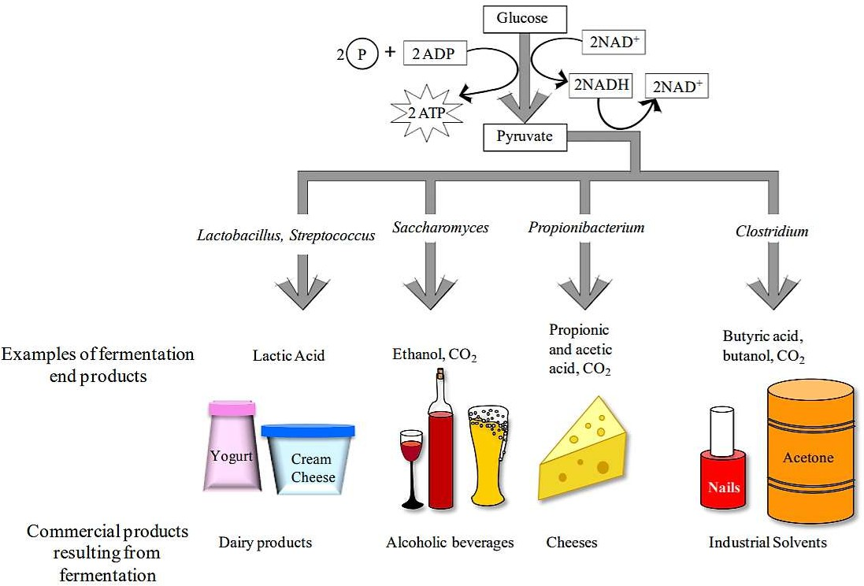
Horizontal integration

Slide 27
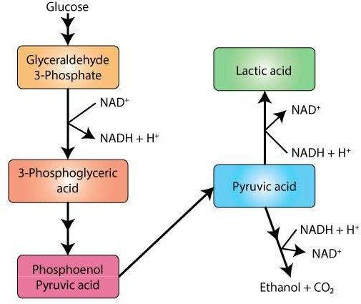
Horizontal integration

Slide 28
Horizontal integration
There are two types of fermentation, alcoholic and lactic acid. Fermentation follows glycolysis in the absence of oxygen.
Alcoholic fermentation produces ethanol, carbon dioxide, and NAD⁺.
Lactic acid fermentation produces lactic acid (lactate) and NAD⁺.

Slide 29
Horizontal integration
1. Alcoholic fermentation
In this pathway first glucose is converted into Pyruvate by glycolysis. And then alcohol dehydrogenase reduces the pyruvate into ethanol and CO2.
Metabolism of pyruvate to produce ethanol occurs in two steps.
1st step: pyruvate is first decarboxylated into Acetaldehyde and CO2. This reaction is catalyzed by the enzyme Pyruvate decarboxylase with Thymine pyrophosphate (TPP) as co- enzyme.
2nd step: Acetaldehyde is then reduced to ethanol by NADH2. This reaction is catalyzed by enzyme Alcohol dehydrogenase. NAD+ is regenerated in this step.

Slide 30
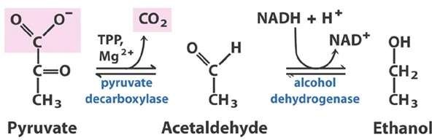
Horizontal integration

Slide 31
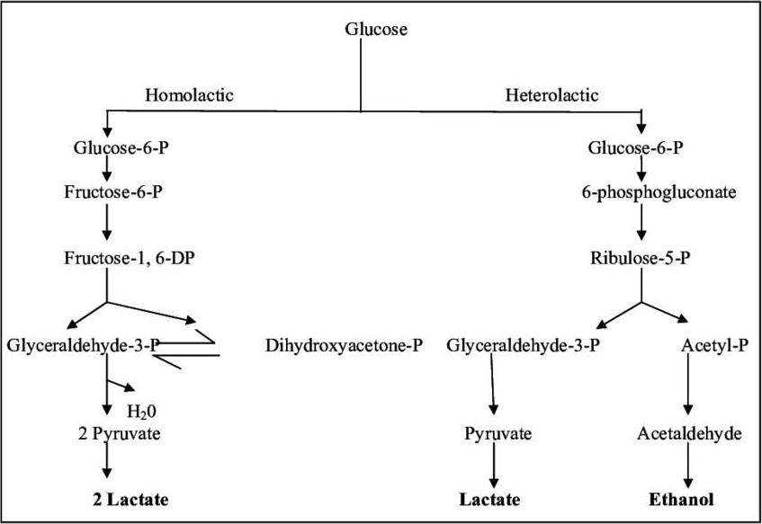
Horizontal integration
Lactic acid pathway

Slide 32
Uses of concept of sugar fermentation
Vertical integration
For identification of different bacteria on the basis of sugar fermentation in different clinical samples.
glucose (Nisseria g)
maltose (Nisseria meningitidis)
- lactose (Salmonella, shigella)

Slide 33
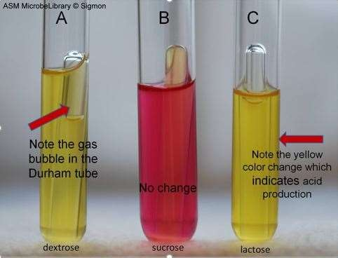
Core Content
Fermentation reactions produced by Escherichia coli in phenol red sugar broths containing dextrose, sucrose, and lactose.

Slide 34
Iron metabolism in bacteria
Core Content
Some invading bacteria respond by producing specific iron chelators-siderophores-that remove the iron from the host sources.
Other bacteria rely on direct contact with host iron proteins, either abstracting the iron at their surface or, as with heme, taking it up into the cytoplasm.

Slide 35
Core Content
Iron is essential for bacterial and fungal physiological processes such as DNA replication, transcription, metabolism, and energy generation via respiration. Hence, pathogenic bacteria and fungi have developed sophisticated strategies to gain access to iron from host sources.

Slide 36
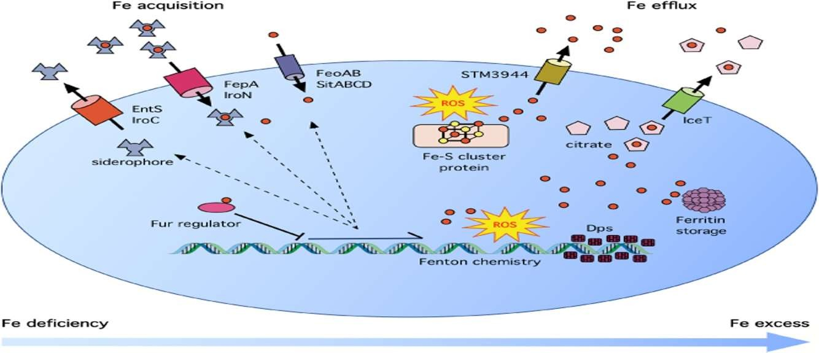
Core Content

Slide 37
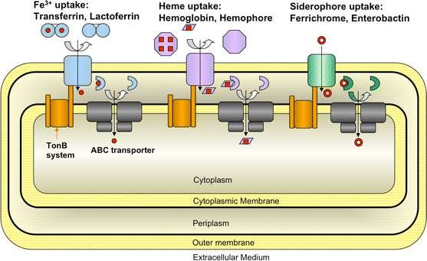
Core Content

Slide 38
Bacterial growth
Core Content
Binary fission
E. Coli - generation time : 20 min.
20 generations (about 7 hrs.)
  1 million cells
30 generations ( about 10 hrs.)
  1 billion cells
72 generations ( about 24 hrs.)
  1 x 10²¹
    1,000,000,000,000,000,000,000 cells
    Mycobacterium tuberculosis - 24 hrs.

Slide 39
Limiting factors in the environment
Core Content
Lack of food, water or nutrients
space
accumulation of metabolic wastes
lack of oxygen
changes in pH
temperature

Slide 40
Phases of Growth
Core Content
4 Phases
1. Lag Phase
2. Log Phase
3. Stationary Phase
4. Death Phase

Slide 41
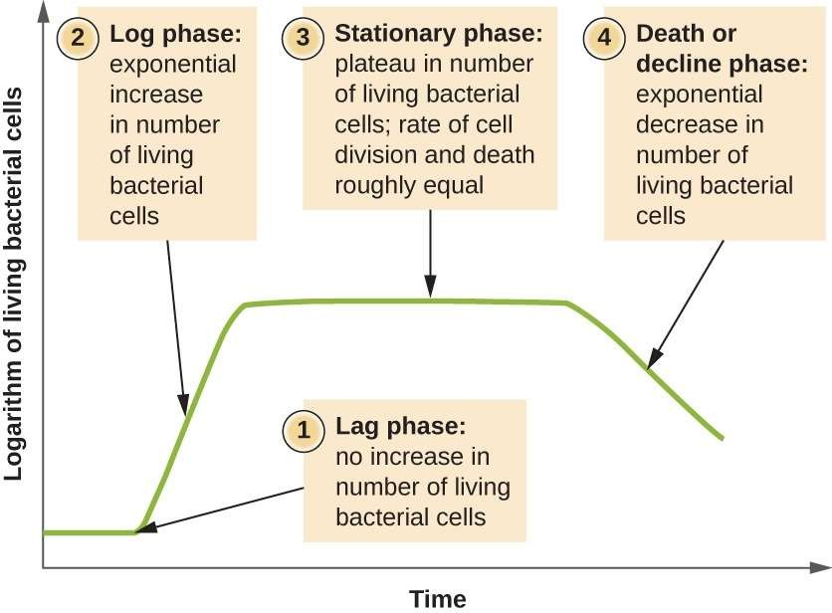
Core
Pathology
Core Content
Phases of Growth …cont

Slide 42
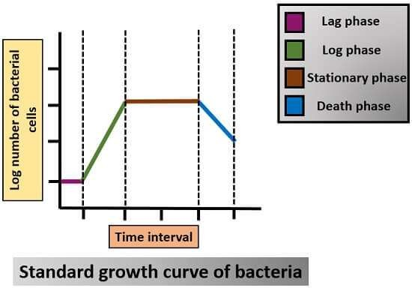
Core Content

Slide 43
Core Content
Phases of growth …cont
Lag Phase
  Bacteria are first introduced into an environment or media
  Bacteria are “checking out” their surroundings
  cells are very active metabolically
  # of cells changes very little
  1 hour to several days.
Log Phase:
  Rapid cell growth (exponential growth)
  population doubles every generation
  microbes are sensitive to adverse conditions
    antibiotics
    anti-microbial agents

Slide 44
Core Content
Core
Phases of growth …cont
Pathology
Stationary Phase
  Death rate = rate of reproduction
  cells begin to encounter environmental stress
    lack of nutrients
    lack of water
    not enough space
    metabolic wastes
    oxygen
    pH
4. Death Phase:
-Death rate > rate of reproduction
-Due to limiting factors in the environment

Slide 45
Horizontal integration Pharmacology
Phases of growth …cont
A chemostate is a bioreactor to which fresh medium is continuously added, while culture liquid containing left over nutrients, metabolic end products and microorganisms is continuously removed at the same rate to keep the culture volume constant. it is used for

Slide 46
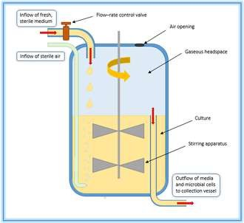
Horizontal integration Community Medicine
Core Content
Phases of growth …cont
Chemostats are also used as microcosms in ecology and evolutionary biology.
To study nutritional and physical need for bacterial growth.
To study biochemical and molecular pathways of bacteria.
To produce desired bacterial
products.
Industries need to grow
bacteria exponentially.

Slide 47
Family medicine
Primary care health providers and other child health professionals are most likely to encounter new mothers and infants during their well-child care visits. It is essential that primary care health providers be aware of the infectious pathophysiology and associated risk factors of dental caries in very young patients so that they may make appropriate decisions regarding timely and effective
intervention .
Reference:
Journal of the American Academy of Nurse Practitioners
Assessment, management, and prevention of early childhood caries
Lynette E. Kagihara DDS, MSED, Victoria P. Niederhauser DrPH, APRN, BC, PNP, Marialiana Stark DrPH, CPNP
First published: 05 January 2009 https://doi.org/10.1111/j.1745-
7599.2008.00367.xCitations: 80

Slide 48
Research
https://www.ncbi.nlm.nih.gov/books/NBK7919/
Chapter 4Bacterial Metabolism
Peter Jurtshuk, Jr.
Go to:
General Concepts
Heterotrophic Metabolism
Heterotrophic metabolism is the biologic oxidation of organic compounds, such as glucose, to yield ATP and simpler organic (or inorganic) compounds, which are needed by the bacterial cell for biosynthetic or assimilatory reactions.
Respiration
Respiration is a type of heterotrophic metabolism that uses oxygen and in which 38 moles of ATP are derived from the oxidation of 1 mole of glucose, yielding 380,000 cal. (An additional 308,000 cal is lost as heat.)
Fermentation
In fermentation, another type of heterotrophic metabolism, an organic compound rather than oxygen is the terminal electron (or hydrogen) acceptor. Less energy is generated from this incomplete form of glucose oxidation, but the process supports anaerobic growth.
Krebs Cycle
The Krebs cycle is the oxidative process in respiration by which pyruvate (via acetyl coenzyme A) is completely decarboxylated to CO₂. The pathway yields 15 moles of ATP (150,000 calories).
Glyoxylate Cycle
The glyoxylate cycle, which occurs in some bacteria, is a modification of the Krebs cycle. Acetyl coenzyme A is generated directly from oxidation of fatty acids or other lipid compounds.
Electron Transport and Oxidative Phosphorylation
In the final stage of respiration, ATP is formed through a series of electron transfer reactions within the cytoplasmic membrane that drive the oxidative phosphorylation of ADP to ATP. Bacteria use various flavins, cytochrome, and non-heme iron components as well as multiple cytochrome oxidases for this process.
Mitchell or Proton Extrusion Hypothesis

Slide 49
Biomedical ethics
Few people are in any doubt that microbes should be conserved for their direct uses to humans, for example, in food and drug production, and their indirect uses such as the crucial role they have in the health of ecosystems. Indeed, these motivations can be used to prioritize microbial conservation and protection efforts.
Refernce:
https://www.ncbi.nlm.nih.gov/pmc/articles/PMC3059913/

Slide 50
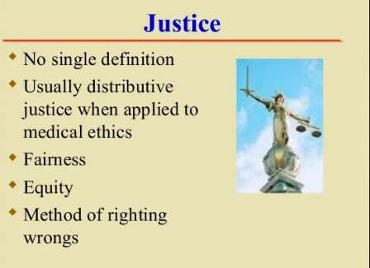
Biomedical ethics

Slide 51
Thank you

