Slide 1


Slide 2



MOTTO AND VISION
To impart evidence based research oriented medical education
To provide best possible patient care
To inculcate the values of mutual respect and ethical practice of medicine

Slide 3

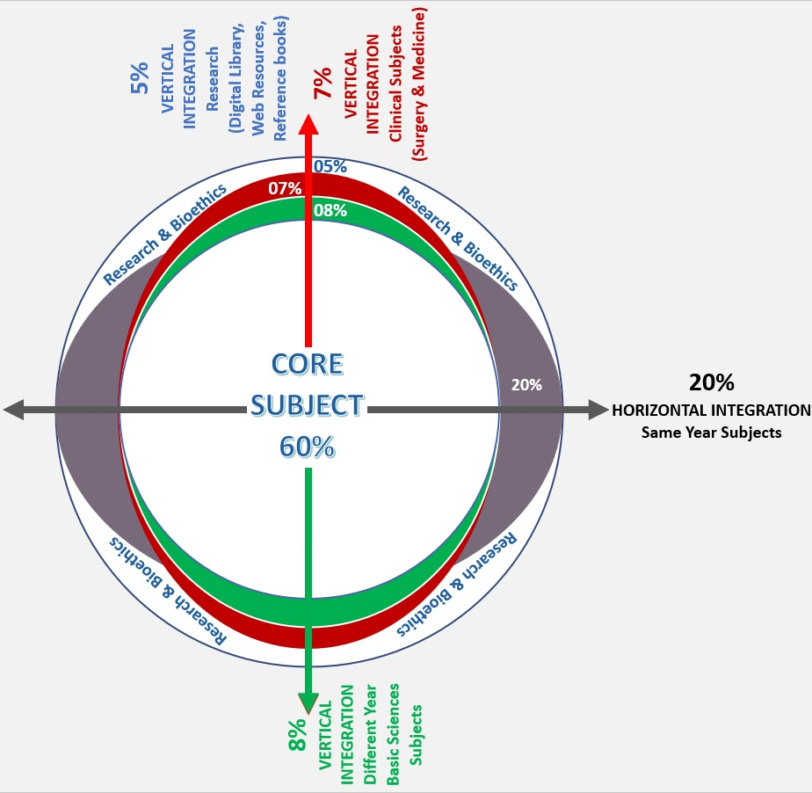
Professor Umar Model of Integrated Lecture
60%
CORE SUBJECT
20%
HORIZONTAL
INTEGRATION
Physiology
biochemistry
8%
VERTICAL INTEGRATION
Pathology
pharmacology
7%
VERTICAL INTEGRATION
Clinical integration
5%
VERTICAL INTEGRATION
Research, professionalism
Ethics
Digital library

Slide 4
FOUNDATION MODULE (I)
PRACTICAL
BIOSTATISTICS
Dr Uzma Umar (12th feb to 21st feb 2024)
Notes:
The term biostatistics is a combo of two words. Bio and statistics. Bio as u know is abbreviated from biological and statistics is derived from the latin word statis and in includs collection analysis interpretation presentation and dissemination of data. This application of statistics in biological experiments is called biostatistics. The experiments may involve human volunteers or experimental animals

Slide 5
LEARNING OBJECTIVES
By the end of practical you should be able to
Define biostatistics , sample, data , bias ,attribute , variable , placebo
Describe presentation of data
Define and calculate measures of central tendencies (including mean , median , mode )
Define and calculate measures of spread of dispersions (including range, variance, standard deviation)
Analyse and interpret data

Slide 6
STATISTICS
It is the scientific study of collection, organization,analysis and interpretation of data
Descriptive
Inferential
BIOSTATISTICS
It is the application of statistical principles for evaluation of biological studies or problems.
Human volunteers / experimental animals
  Organizing and summarizing data and making inferences about POPULATION from the SAMPLE observed
Notes:
The term biostatistics is a combo of two words. Bio and statistics. Bio as u know is abbreviated from biological and statistics is derived from the latin word statis and in includs collection analysis interpretation presentation and dissemination of data. This application of statistics in biological experiments is called biostatistics. The experiments may involve human volunteers or experimental animals

Slide 7
Descriptive Statistics
Merely describe, organize or summarize data
refers only to the actual data available
Inferential Statistics
Involves making inferences that go beyond the actual data

Slide 8
APPLICATIONS
Clinical Medicine
Biological Lab Research
Biological Field Research
Genetics
Ecology
Environmental Health
Health Services
Wildlife Biology
Agriculture
Fisheries
Epidemiological Studies

Slide 9
POPULATION AND SAMPLE
Target population :The collection of individuals about which the inference is about to be drawn. Population is an aggregate of creatures, things, cases and so on
Sample :The portion of the target population representing the whole population on which the experiment is to be performed

Slide 10
POPULATION AND SAMPLE
Random sample : Every element of the population has an equal and independent chance of being selected to minimize bias
Advantages:
    The chances of bias are reduced
    Probability can be worked out

Slide 11
BIAS
Error that leads to fallacies in statistical analysis and incorrect conclusion
Sampling/Data collection/Analysis/Interpretation of results
ATTRIBUTE
Character or a quality that a person may have
e.g tall/short
VARIABLE
Measured characteristic of a person, object or phenomenon in a study that can give different values in different subjects
Example – height in inches

Slide 12
PLACEBO:
  It is a dummy drug that is devoid of pharmacological activity but acts by psychological suggestions. It is an inert material with exactly same appearance, colour, consistency, etc. as the active dosage form under study
PLACEBO RESPONSE:
  The "placebo response" occurs when a person who is ill perceives an improvement or actually experiences an improvement in symptoms or overall health from the psychological effect of receiving treatment after receiving placebo.( 20% ---40%)

Slide 13
CLINICAL TRIAL
A controlled & ethically designed experiment on human beings with aim of answering some precisely framed questions or to investigate the efficacy of some medical treatment
METHODS
  Open trial
  Single blind trial
  Double blind trial
  Cross over trial

Slide 14
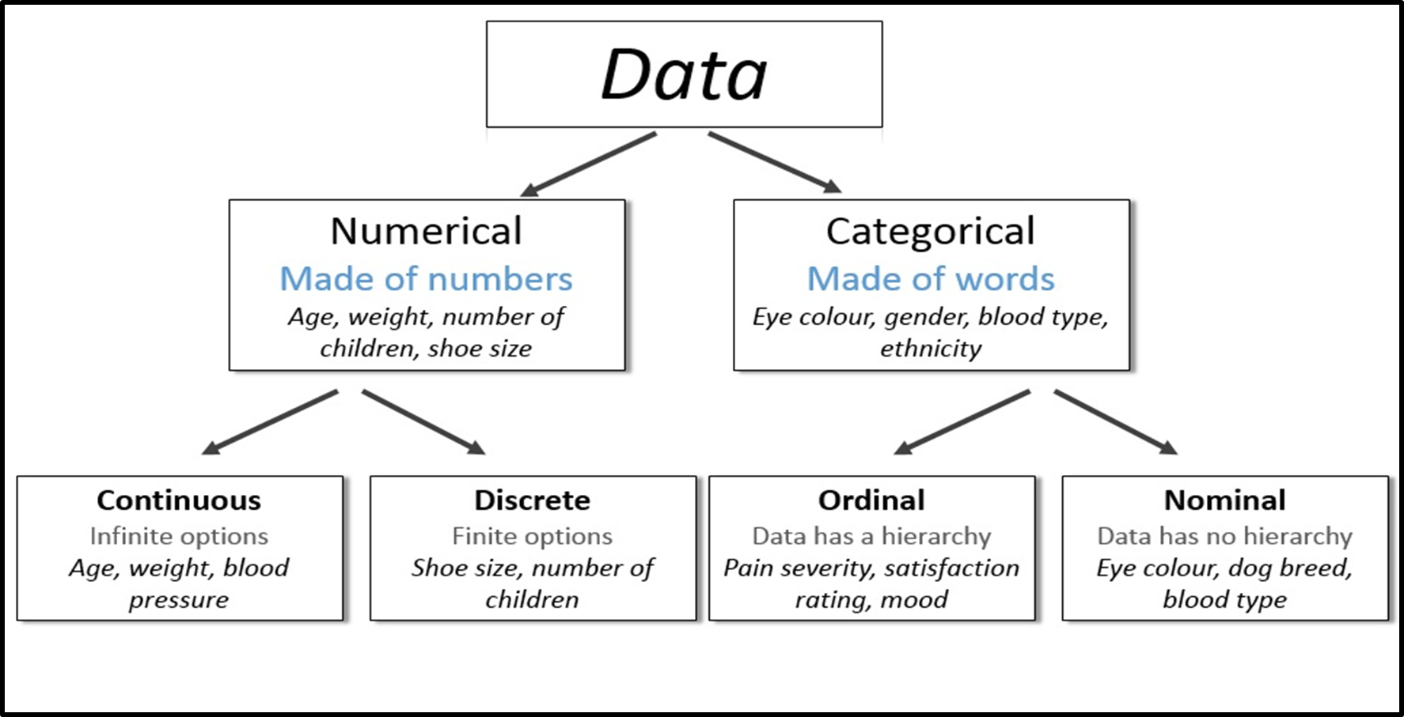
DATA
The set of numerical facts on which discussion is based
E.g measurement of blood pressure or counting of pulse

Slide 15
PRESENTATION OF DATA
Tables
Charts
Diagrams
Graphs
Pictures

Slide 16
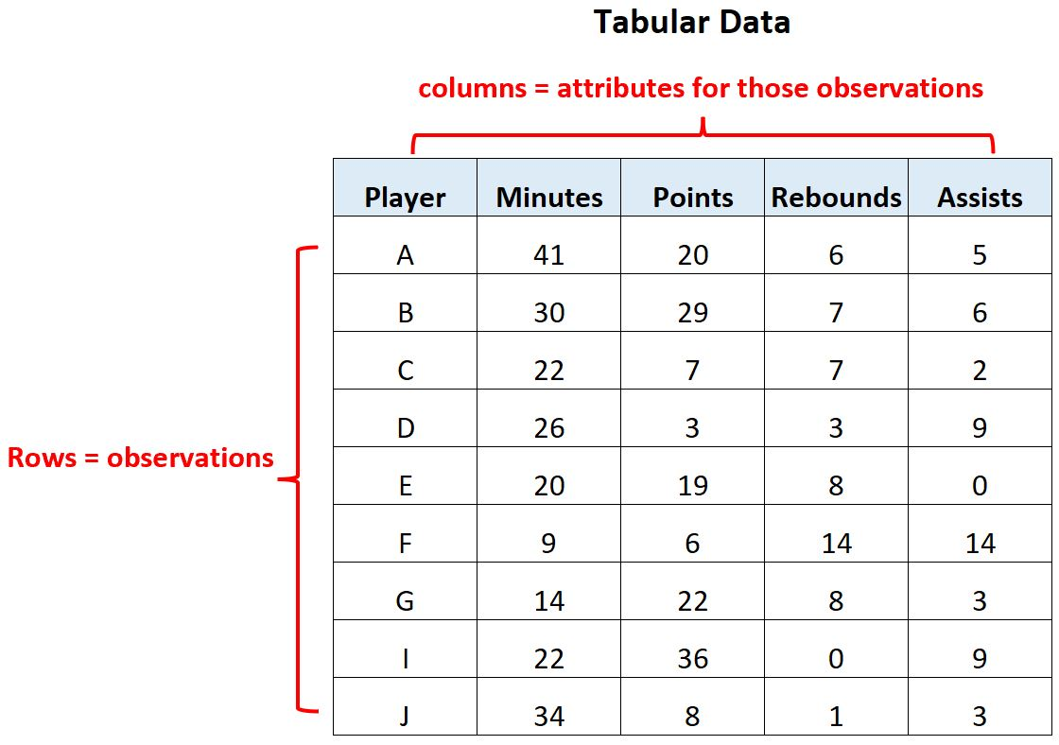

Slide 17
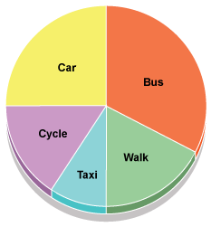
PIE CHART
Used to represent nominal or ordinal data

Slide 18
BAR CHART
Simple Bar
Chart
Multiple Bar
Chart
Component
Bar Chart

Slide 19
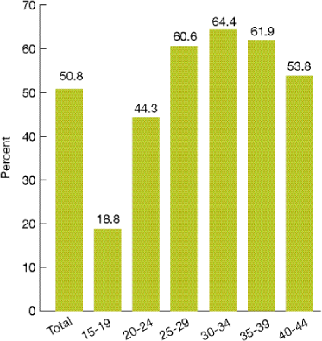
Simple Bar Chart
Bar charts are used for ordinal or nominal data

Slide 20
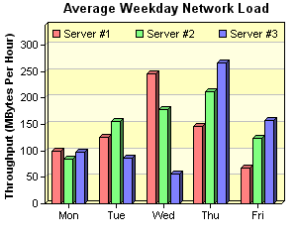
Multiple Bar Chart

Slide 21
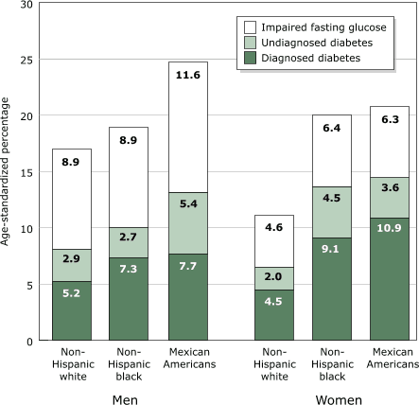
Component Bar Chart

Slide 22
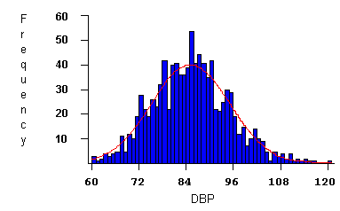
Histogram
Pictorial diagram of frequency distribution
Consists of series of blocks or bars
The area of each block is proportional to the frequency
Distribution
    Symmetrical
    Skewed

Slide 23
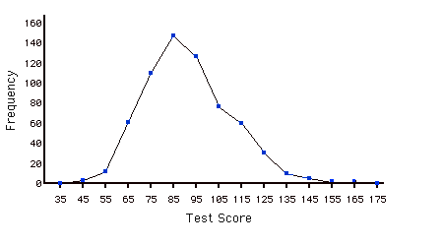
Frequency Polygon
Diagrammatic representation of a frequency distribution
Obtained by joining the mid points of bars in histogram

Slide 24
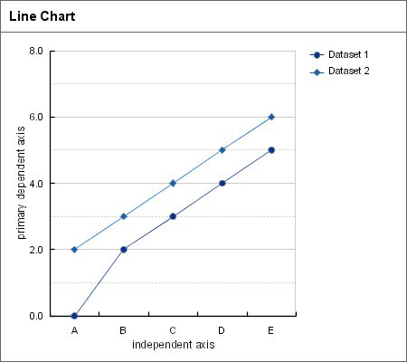
Line Chart / Diagram

Slide 25
Pictogram
Small pictures or symbols are used to present the data

Slide 26
Measurements : Biostatistics
Measures of central tendencies
Measures of spread of dispersions

Slide 27
CENTRAL TENDENCIES
Central tendency of a set of observations
MEAN
Arithmetic mean
Average of the group
Summing all the values for the subjects in the group and dividing by the number of subjects in the group.
Mean = Sum of all the values / n
X = Σ x / n
X=mean, x=individual value, n=no. of observations

Slide 28

FORMULA FOR MEAN

Slide 29
MEDIAN
Median is useful when some values are much bigger or smaller than the rest of values
The median is the middle value when observations are arranged in an order
The median represents the exact middle of a distribution that is half of the values are above that value and half are below that value
Odd / Even number of observations
Not influenced by extreme values
MODE
most frequently occurring data point

Slide 30
EXAMPLE:SOLUTION
Consider weight of 10 individuals
83, 75, 81, 79, 71, 95, 75, 77, 84, 90
Arrange data in ascending order
71, 75, 75, 77, 79, 81, 83, 84, 90, 95
Mean = 810 / 10 = 81
Median = 79 + 81 / 2 = 80
Mode = 75

Slide 31
MEASURES OF SPREAD / DISPERSION
Variation is the spread or dispersion of a set of observations around some central value
Measure of dispersion estimates the variability of a distribution around the center
Different Measures
  Range
  Variance
  Standard Deviation (SD)

Slide 32
RANGE
Difference between the lowest and highest value in the data set
More variable data – Larger range
Poor parameter – outliers
METHOD
Find the range of the following data:
29, 31, 24, 29,30, 25
Arrange the data from smallest to largest:
24, 25, 29, 29, 30, 31
Identify the minimum and maximum values:
Minimum = 24, Maximum = 31
Range = 31-24 = 7

Slide 33
RANGE , VARIANCE AND STANDARD DEVIATION
Range : It may give misleading impression of the true variability of the data if either or both the extremes fall wide apart. It is an inefficient measure of variation with large no of variations
Variance and standard deviation : It is a measure of average distance of the observations from their mean. It is a better indicator of the spread of all observations about the mean, especially if large no of observations is concerned

Slide 34
VARIANCE & STANDARD DEVIATION
Measure of average distance or position of observations in relation to the mean i-e to what extent the individual observations deviate from the mean
VARIANCE = Σ(x –x)²
n – 1
S.D = Variance
S.D = Σ(x – x)²
n – 1
LARGE S.D Means
Wide scatter of measured values around the mean
SMALL S.D Means
Individual values are concentrated around the mean with little variations among them

Slide 35
SD used for data normally distributed
Indicated as ± to the mean value
Mean ± 1SD = 68.2%
Mean ± 2SD = 95.4%
Mean ± 3SD = 99.7%
Significance tests – Theory of Probability

Slide 36
Steps for SD calculation
Calculate mean
Find difference of each observation from mean
Square the difference
Add the squared values to get the sum of squares
Divide the sum by the number of observations minus one (n – 1) to get mean-squared deviation or variance
Find the square root of variance to get root-mean squared deviation or SD

Slide 37
Calculation
X | X - X
1 | -3
2 | -2
3 | -1
4 | 0
5 | 1
6 | 2
7 | 3
Mean
x = 28 / 7
= 4

Slide 38
x = 28 / 7 = 4
Variance = Σ(x –x)²
n – 1
Variance = 28 / 6
= 4.67
SD = √4.67 = 2.16
X | X - X | (X - X)²
1 | -3 | 9
2 | -2 | 4
3 | -1 | 1
4 | 0 | 0
5 | 1 | 1
6 | 2 | 4
7 | 3 | 9

Slide 39
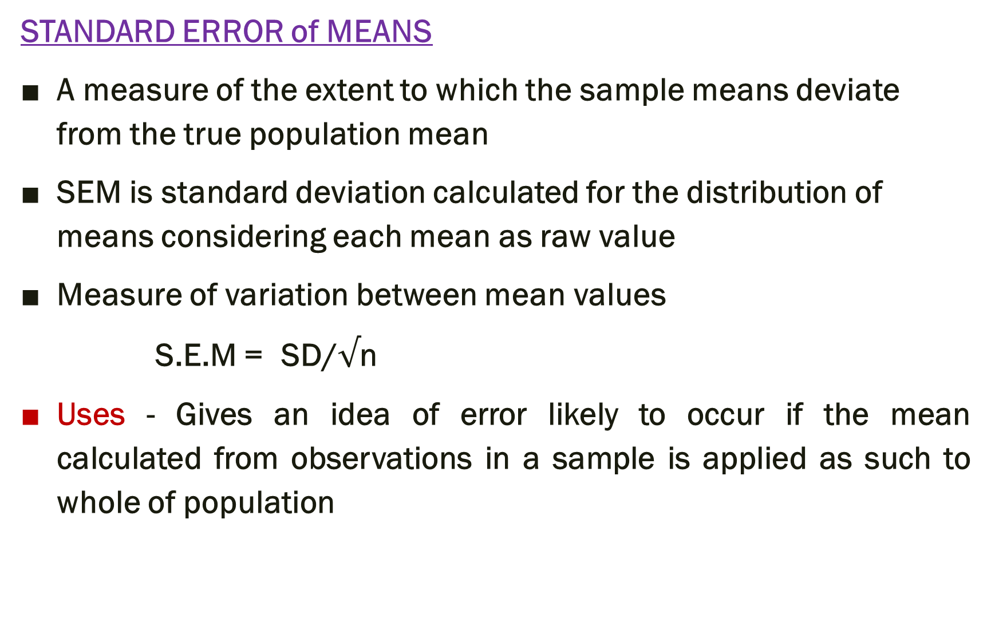
STANDARD ERROR of MEANS
A measure of the extent to which the sample means deviate from the true population mean
SEM is standard deviation calculated for the distribution of means considering each mean as raw value
Measure of variation between mean values
S.E.M = SD/$√$n
Uses - Gives an idea of error likely to occur if the mean calculated from observations in a sample is applied as such to whole of population

Slide 40
SIGNIFICANCE TESTS
Analysis & interpretation of results
Estimates the likelihood that an observed study result (e.g a difference between two data groups) could be due to chance
Example
Types
  Student’s t test
  Chi square test
  Z-test
  Analysis of variance (ANOVA)

Slide 41
Student’s t test
Analyze data of variables
Applied to find out significance of difference between two data groups / treatments
Steps
Null hypothesis
  A statement that there is no difference or superiority between two groups or results and corresponds to the “NO” answer. It implies that the difference is by chance
Alternate hypothesis
Calculate test statistic (t statistic)
  t = M_{A} – M_{B}
  (SEM_{A})² + (SEM_{B})²
M_{A}=Mean of group A
M_{B}= Mean of group B
S.E.M_{A}=Standard error of A
S.E.M_{B}= Standard error of B

Slide 42
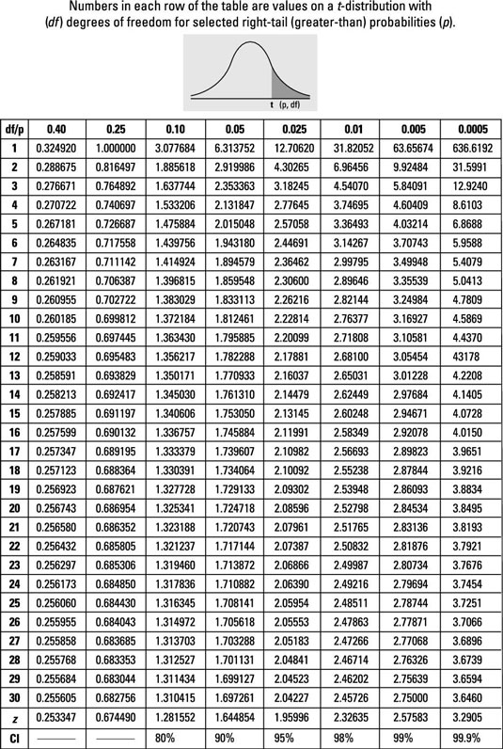

Slide 43
Find out the p-value
  Probability of the difference occurring by chance
  t-table
  1.96 = 95%
  Chance of error (α error) – 5%
  p – 0.05 (Level of significance)

Slide 44
Interpret the p-value
  p <0.05 – statistically significant (less probability of difference occurring by chance)
  Null hypothesis – rejected (difference is significant)
  Alternate hypothesis accepted
  p >0.05 – vice versa

Slide 45
EXAMPLE
Plasma levels of glucose (mg/dl) in control subjects Before and 2 wks after administration of drug A.
Null hypothesis - Plasma levels of glucose are not affected by administration of drug A.
Control No | Before drug | After drug
1 | 98 | 90
2 | 94.5 | 90
3 | 96 | 89
4 | 87 | 85.5
5 | 83.5 | 80
6 | 89 | 84
7 | 88 | 86
8 | 101 | 94
9 | 89 | 86
10 | 88 | 85

Slide 46
11 | 114.50 | 105
12 | 105 | 98
13 | 101 | 95
14 | 114 | 111
15 | 114 | 85
Mean | 97.59 | 90.92
S.D | ± 10.55 | ± 8.44
S.E. M | ± 2.72 | ± 2.18
Diff. of means = 97.59-90.92 = 6.67
t = 6.67
(2.72)² + (2.18)²
t = 1.91
P <0.05 (chance of error < 5%)

Slide 47
CALCULATION OF FREQUENCY
Absolute F. (v) – no. of observations that fall into each class
Relative F. = v / n
Percentage F.= v / n x 100 (RF x 100)
Cumulative F. =no. of absolute freq. cumulatively added until all are accounted for

Slide 48
TEST GROUP ( COFFEE)
S.No. | Pulse rate (0 min) | Pulse rate (60 min)
 | 85 | 86
2. | 80 | 82
3. | 72 | 78
4. | 74 | 76
5. | 76 | 76
6. | 80 | 84
7. | 73 | 80
8. | 74 | 76
9. | 76 | 78
10. | 80 | 84

Slide 49
Frequency table A1
For Test group at “0”Min
S. No. | Observation | Absolute Frequency | Relative Frequency | Percentage Frequency | Cumulative % Frequency
1. | 72 | 1 | 0.1 | 10% | 1=10%
2. | 73 | 1 | 0.1 | 10% | 2=20%
3. | 74 | 2 | 0.2 | 20% | 4=40%
4. | 76 | 2 | 0.2 | 20% | 6=60%
5. | 80 | 3 | 0.3 | 30% | 9=90%
6. | 85 | 1 | 0.1 | 10% | 10=100%

Slide 50
Bioethics
Whenever any topic for research is proposed it needs to be approved by ethical committee which reviews all possible ethical aspects of the repective research.
The ethical statistical practitioner does not misuse or condone the misuse of data. They protect and respect the rights and interests of human and animal subjects.
The ethical statistical practitioner understands that questions may arise concerning potential misconduct related to statistical, scientific, or professional practice. At times, a practitioner may accuse someone of misconduct or be accused by others. At other times, a practitioner may be involved in the investigation of others’ behavior. Allegations of misconduct may arise within different institutions with different standards and potentially different outcomes.

Slide 51
Research articles
Overview of biostatistics used in clinical research https://doi.org/10.2146/ajhp070006
Reinventing Biostatistics Education for Basic Scientists
https://doi.org/10.1371/journal.pbio.1002430

Slide 52
Artificial Intelligence(AI) & Biostatistics
By analyzing patient data, including genetics, medical history, and lifestyle factors, AI can help tailor treatments and interventions to individual patients.
AI models can be trained to predict disease outbreaks, assess population health trends, and recommend preventive measures. Biostatistics can provide the statistical framework for validating these predictions and assessing their accuracy.

Slide 53
PRACTICAL/ASSESSMENT
3rd yr MBBS practical batch comprises of both males and females. Select random sample of 10 from each. Find out systolic blood pressure of 2 samples .Calculate mean, median , mode , range ,variance , standard deviation, absolute frequency, relative frequency , percentage frequency and cumulative frequency of each set. Find out the statistical significance of the difference between systolic B.P in two samples

Slide 54
Reference
Handbook of applied pharmacolgy by dr muzammil hassan najmi and dr munir ahmad khan
Guidelines from associate professor dr asma (HOD pharmacolgy RMU rwp)
Google for bioethics

Slide 55
THANK YOU

