Slide 2
Obstructive Lung Disease- Asthma
Final Year MBBS- LGIS
PROF MUHAMMAD KHURRAM

Slide 3
University Motto, Vision, Values & Goals
Mission Statement
To impart evidence-based research-oriented health professional education
Best possible patient care
Mutual respect, ethical practice of healthcare and social accountability.
Vision and Values
Highly recognized and accredited centre of excellence in
Medical Education, using evidence-based training techniques for development of highly competent health
professionals, who are lifelong experiential learner and are socially accountable.
Goals
The Undergraduate Integrated Learning Program is geared to provide you with quality medical education in an environment designed to:

Slide 4
SEQUENCE OF LGIS
Learning objectives
What is Asthma and How to Diagnose it? (core concept = 70%)
Related pathology and pharmacology (horizontal integration 15%)
Related Obstetrics - Asthma and Pregnancy (vertical integration – 10%)
Research article related to topic (3%) Ethics (2%)

Slide 5
Learning Objectives
To know etiopathogenesis, and epidemiology of Asthma
Establish diagnosis of asthma through a focused history and physical exam
Assessment of asthma control
Know different medication categories
Propose management plan.
MDM/Future perspective.-Research
AI/Family Medicine
Resources/Articles to go through-MCQs

Slide 6
PROF UMER MODEL OF INTEGRATED LECTURE

Slide 7
Case Vignette
PRESENTATION
14 year old male
Presentation with
Cough
SOB
Diagnosis ----?
DETAILS OF PRESENTING COMPLAINTS
OTHER COMPONENTS OF HISTORY
WHAT TO DO NEXT?

Slide 8
Case Vignette
EXAMINATION
GPE
Chest Examination
WHAT TO DO NOW?
WORK UP
General and specific

Slide 11
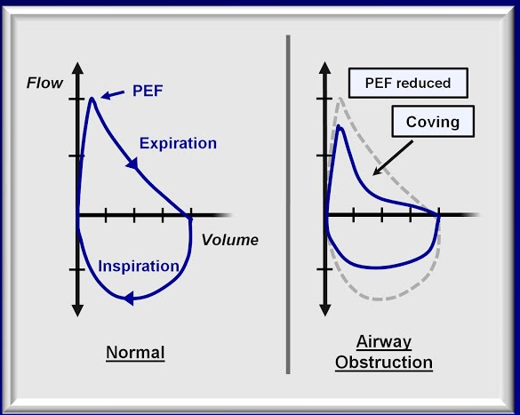

Slide 12
OBSTRUCTIVE
Asthma
COPD
RESTRICTIVE
ILD

Slide 13
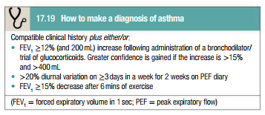
DIAGNOSIS
?
DEFININIG CRITERIA ASTHMA
AFL
Airway hyper- responsiveness
Bronchial inflammation

Slide 14
Horizontal Integration with Clinical Disciplines
- Community Medicine: Prevalence rates, urban vs. rural distribution.
- Pathology: Eosinophilic infiltration, subepithelial fibrosis.
- Family Medicine: Long-term asthma management, inhaler adherence, patient education.

Slide 15
Vertical Integration with Basic Sciences
- Anatomy/Physiology: Airway hyperresponsiveness, bronchial smooth muscle hypertrophy.
- Immunology: IgE-mediated inflammation, Th2 cytokines (IL-4, IL-5, IL-13).
- Pharmacology: Mechanisms of β2-agonists, corticosteroids, and biologics (e.g., omalizumab).

Slide 16
Prevalence
1 and 18% prevalence. More common in developed than developing countries. Rates are lower in Asia, Eastern Europe, and Africa.
Within developed countries it is more common among those who are economically disadvantaged while in contrast in developing countries it is more common amongst the affluent
About 250,000 people die per year from asthma-related causes. Low and middle income countries make up more than 80% of the mortality.
GINA report 2023
Notes:
15%

Slide 17
Pathophysiology
Atopy
Familial, skin prick test, allergen specific ab, IgE
Genetic
Environmental factors
Hygiene concept
Notes:
Atopy refers to the genetic tendency to develop allergic diseases such as allergic rhinitis, asthma and atopic dermatitis (eczema). Atopy is typically associated with heightened immune responses to common allergens, especially inhaled allergens and food allergens.
Atopy is an exaggerated IgE-mediated immune response; all atopic disorders are type I hypersensitivity disorders. Allergy is any exaggerated immune response to a foreign antigen regardless of mechanism.

Slide 18
Precipitation
Occupational
Icocynates- paints/sprays, colophony fumes- soldering/electrical industry= LMW- IgE unrelated
Allergens from animals/insects, Latex, Medications, Enzymes-W Powders= HMW- IgE related
Cold/Exercise
Pollution
Diet
Medications
Emotions?

Slide 19
Clinical features & diagnosis

Slide 20
Horizontal Integration with Clinical Disciplines
- Community Medicine: Prevalence rates, urban vs. rural distribution.
- Pathology: Eosinophilic infiltration, subepithelial fibrosis.
- Family Medicine: Long-term asthma management, inhaler adherence, patient education.
Notes:
15%

Slide 21
Vertical Integration with Basic Sciences
- Anatomy/Physiology: Airway hyperresponsiveness, bronchial smooth muscle hypertrophy.
- Immunology: IgE-mediated inflammation, Th2 cytokines (IL-4, IL-5, IL-13).
- Pharmacology: Mechanisms of β2-agonists, corticosteroids, and biologics (e.g., omalizumab).
Notes:
15%

Slide 22
Classification- Control Based
Components of Asthma Control | Classification based on Asthma Control
 | Well Controlled | Partly Controlled | Not Controlled
Daytime asthma symptoms > 2 ×/week Nighttime awakenings due to asthma Interference with normal activity due to asthma Reliever medication needed for asthma symptoms > 2 ×/week | None of these components within past 4 weeks | 1 or 2 of these components within past 4 weeks | 3 or 4 of these components within past 4 weeks

Slide 24
Medications available
Relievers
Controllers
B2 stimulants
Anticholinergics
Steroids
Leukotriene antagonists
Monoclonal antibodies

Slide 28
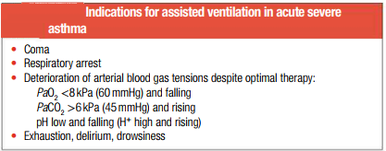

Slide 29
Desensitization
Allergen immunotherapy involves repeated administration of allergen extracts or products over several years
It may offer a more permanent solution to drugs that only treat symptoms and not the underlying cause.
It is offered to individuals who are atopic with IgE-mediated allergic rhinitis and/or allergic asthma due to inhaled allergens, such as pollens and house dust mites (HDMs), who have shown an inadequate response to anti-allergy drugs or who have experienced unacceptable drug side effects.
Nat Rev Immunol. 2022 Oct 17 : 1–12

Slide 30
MDM
Future perspective – Research
Family physicians: Providing primary care and coordination.
Pulmonologists: Specialists in respiratory diseases.
Allergologists/Immunologist: Specialists in allergies, which can be linked to asthma.
Other specialists: Depending on individual patient needs (e.g., Gynae, Surgery, cardiology
Nurses and patient educators: Providing support and education to patients.
New medications and therapies for improved asthma control.
Identifying asthma phenotypes and tailoring treatment accordingly.
Understanding the environmental and genetic factors contributing to asthma.
Notes:
In 2022 and beyond, the care of patients with asthma will likely be transformed by novel monoclonal antibodies targeting cytokines, new asthma guidelines emphasizing precision medicine, and real-world evidence on the efficacy of newer asthma drugs
Registry
Pattern
Pathophysiology
Research in Asthma Management:
Briefly address ongoing research in:
New medications and therapies for improved asthma control.
Identifying asthma phenotypes and tailoring treatment accordingly.
Understanding the environmental and genetic factors contributing to asthma.
5. Multidisciplinary Management:
Highlight the importance of collaboration between:
Family physicians: Providing primary care and coordination.
Pulmonologists: Specialists in respiratory diseases.
Allergologists: Specialists in allergies, which can be linked to asthma.
Other specialists: Depending on individual patient needs (e.g., cardiologist for heart concerns).
Nurses and patient educators: Providing support and education to patients.

Slide 31
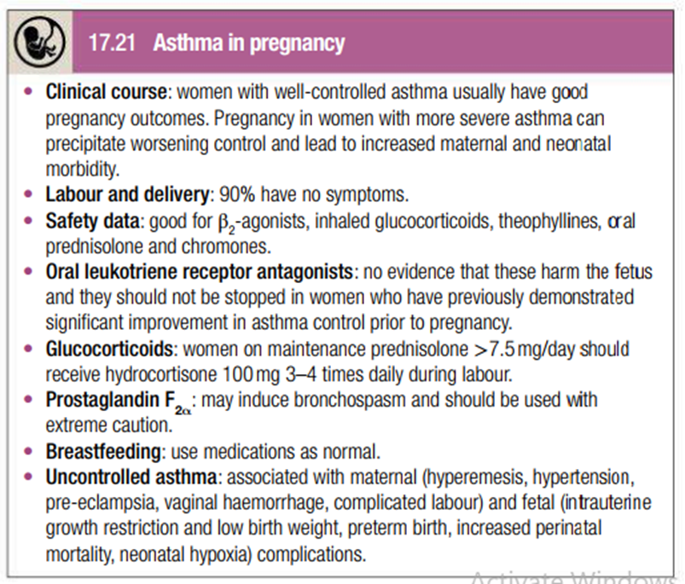

Slide 32
AI
Family Medicine
Diagnosis: Utilizing AI algorithms to analyze breathing patterns and medical data for improved initial diagnosis and differential diagnosis.
Management: AI-powered decision support systems suggesting personalized treatment plans based on individual patient factors.
Asthma symptom monitoring through wearable devices and AI-driven analysis for early intervention.
Prediction: Predicting exacerbations and hospital admissions to enable preventive measures.
Emphasize the crucial role of family physicians in:
Providing long-term, comprehensive asthma management.
Coordinating care with specialists if needed.
Educating patients and empowering them to manage their own asthma effectively.
Notes:
Artificial Intelligence (AI) in Asthma Management:
Diagnosis: Utilizing AI algorithms to analyze breathing patterns and medical data for improved initial diagnosis and differential diagnosis.
Management:
AI-powered decision support systems suggesting personalized treatment plans based on individual patient factors.
Asthma symptom monitoring through wearable devices and AI-driven analysis for early intervention.
Prediction: Predicting exacerbations and hospital admissions to enable preventive measures.
3. The Role of Family Medicine in Asthma Care:
Emphasize the crucial role of family physicians in:
Providing long-term, comprehensive asthma management.
Coordinating care with specialists if needed.
Educating patients and empowering them to manage their own asthma effectively.

Slide 33
Recent Advances in Asthma Management
- Biologics: Dupilumab (anti-IL-4/IL-13) for severe asthma.
- AI Applications: Predictive algorithms for exacerbations using wearable sensors.
- Immunotherapy: Sublingual tablets (e.g., grass pollen SLIT).

Slide 34
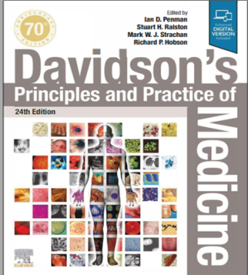
Resources/References
Article to go though/MCQs
RMU Portal
GINA Guidelines

Slide 35
