Slide 1
A BOY ABOUT 14 YEARS OF AGE REPORTS WITH RECCURENT ATTACKS OF PROFUSE NASAL BLEEDING AND NASAL OBSTRUCTION. THE BOY IS GROSSLY ANAEMIC. ON EXAMINATION NOSE you notice slight bulging of cheek and SMOOTH COMPRESSIBLE LOBULATED MASS IN RIGHT NASAL CAVITY & NASOPHARYNX.

Slide 2

ANGIOFIBROMA

Slide 3


Slide 4
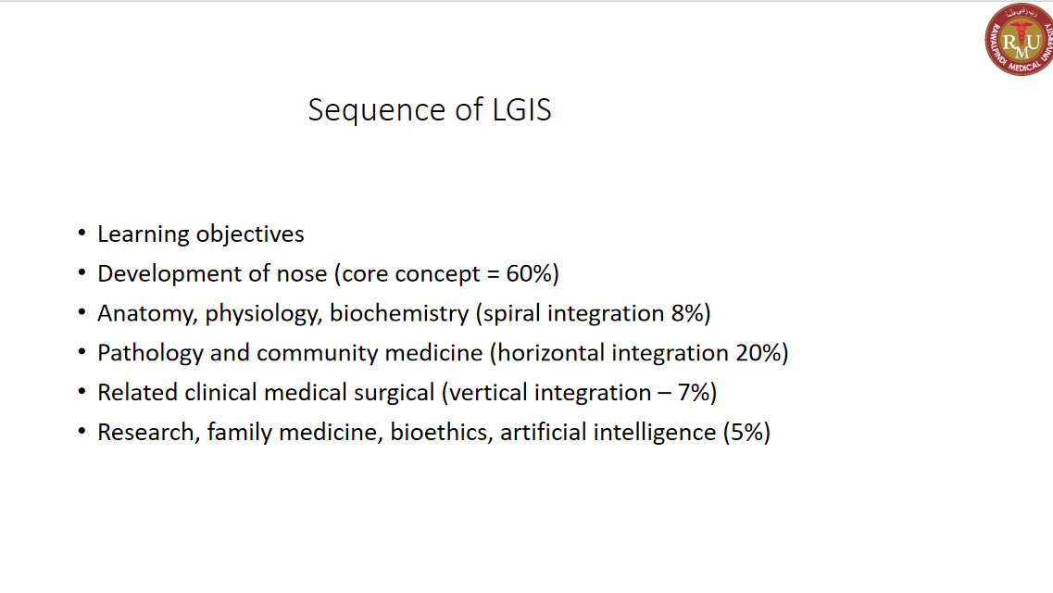

Slide 5
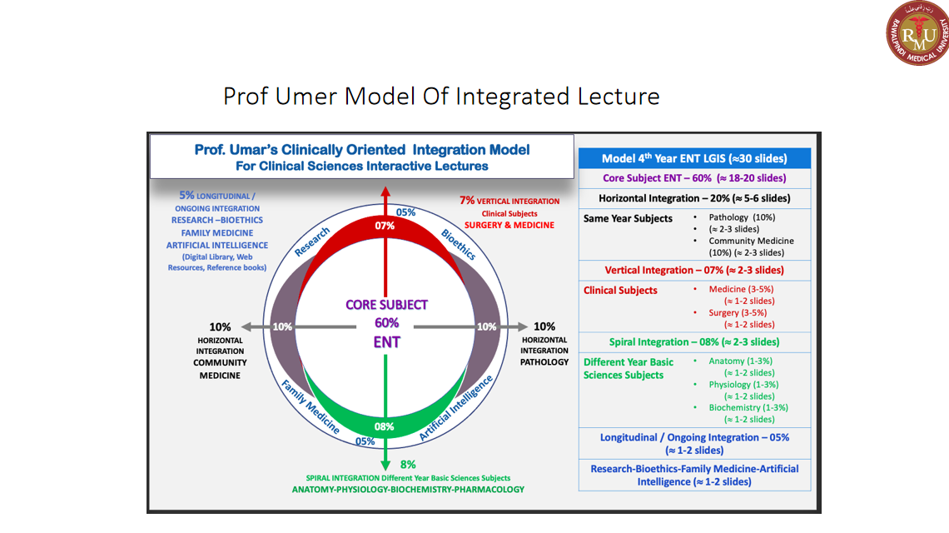

Slide 6
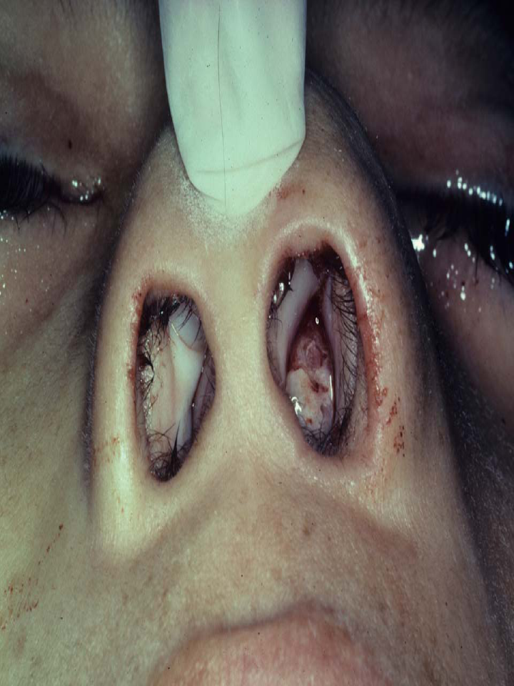

Slide 8
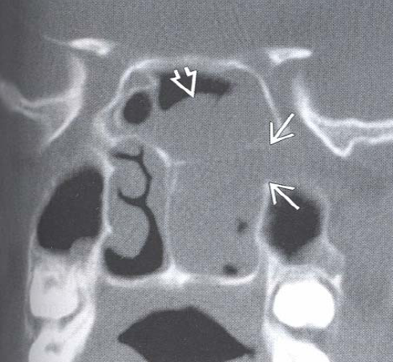
Coronal CT
Widening of left
sphenopalatine foramen
Lesion fills left choanae
Extends into sphenoid
sinus

Slide 9
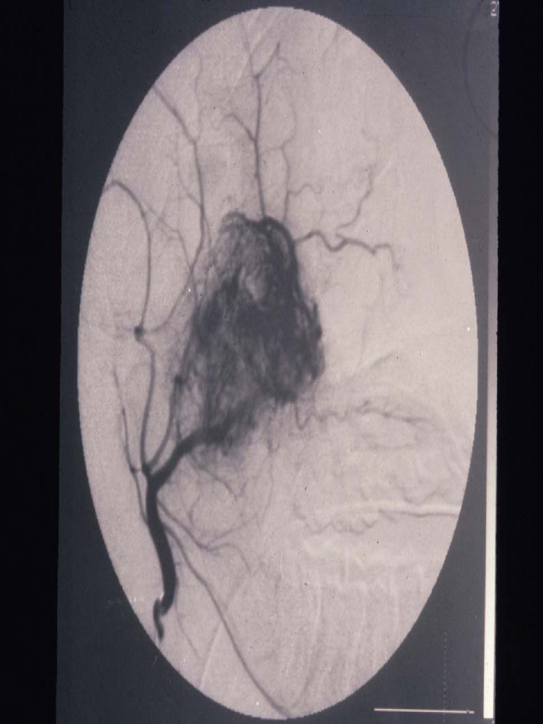
External Carotid Arteriogram

Slide 10
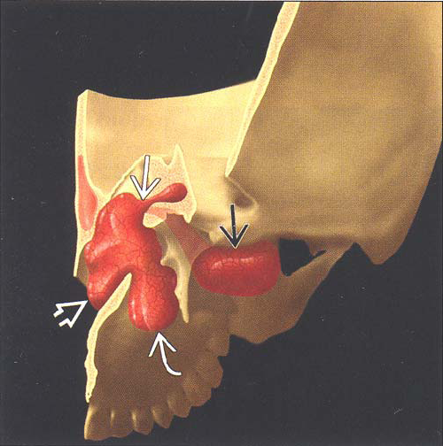
Juvenile Nasopharyngeal
Angiofibroma

Slide 11
JNA Facts and Statistics
Up to 0.5% of head and neck tumors
Occurring almost exclusively in males
Average age of onset = 15 years old
Intracranial Extension between 10-20%
Recurrence Rates as high as 50%

Slide 12
    Origin
spf
Sphenopalatine foramen

Slide 13
Routes of Spread
Medial growth
Nasal cavity
Nasopharynx
Lateral growth
Pterygopalatine fossa
Infratemporal fossa

Slide 14
Diagnosis
History
Physical Exam
Radiological study
CT Scan
MRI
Angiogram

Slide 15
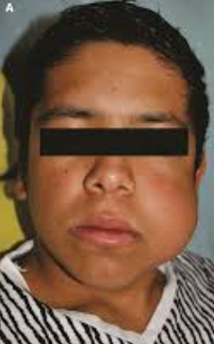
Characteristic Presentation
Teenage or young adult male
Recurrent epistaxis
Nasal obstruction

Slide 16
Additional Findings at Presentation
Conductive hearing loss
Rhinolalia
Hyposmia/Anosmia
Swelling of cheek
Dacrocystits
Deformity of hard and/or soft palate
Orbital proptosis

Slide 17
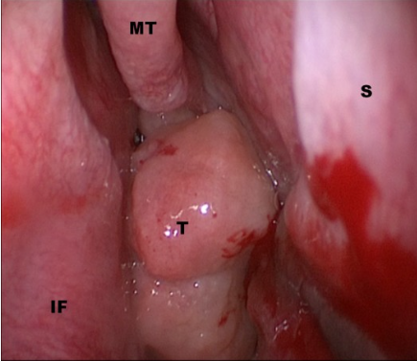
Appearance
Smooth lobulated mass in the nasopharynx or lateral nasal wall
Pale, purplish, red-gray, or beefy red
Compressible

Slide 18
Radiological Studies
CT Scan
Excellent for bone detail
Lesion enhances with contrast on CT
MRI
Differentiate tumor from other soft tissue structures
Angiogram
Evaluation of feeding blood vessels
Holman-Miller Sign
Characteristic anterior bowing of posterior maxillary wall

Slide 19
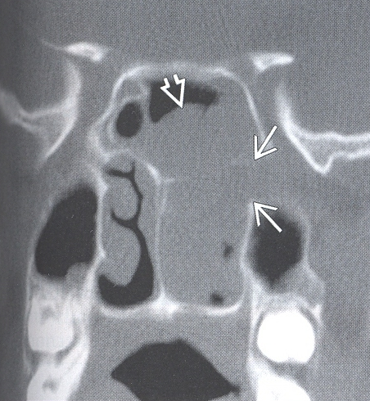
Coronal CT
Widening of left sphenopalatine foramen
Lesion fills left choanae

Slide 20
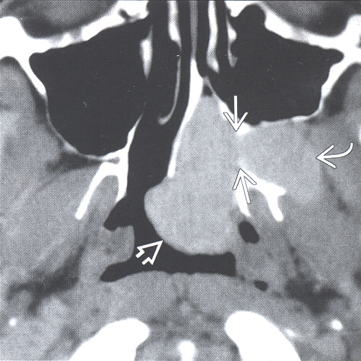
Axial CT
Widening of left sphenopalatine foramen
Extension into
Nasopharynx
Pterygopalatine fossa

Slide 21
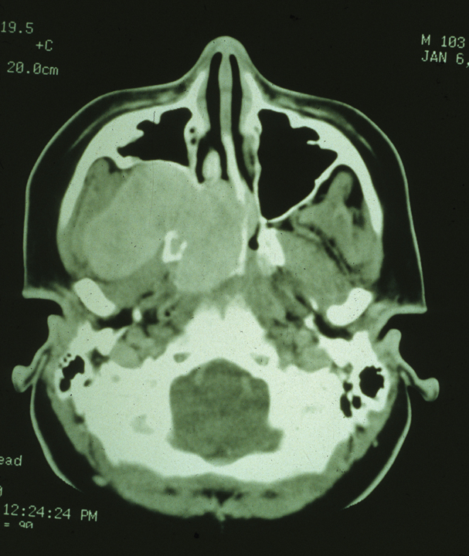
Axial CT
Widening of right sphenopalatine foramen
Extension into
Nasopharynx
Pterygopalatine fossa

Slide 22
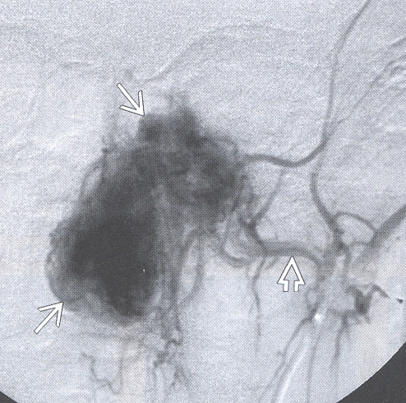
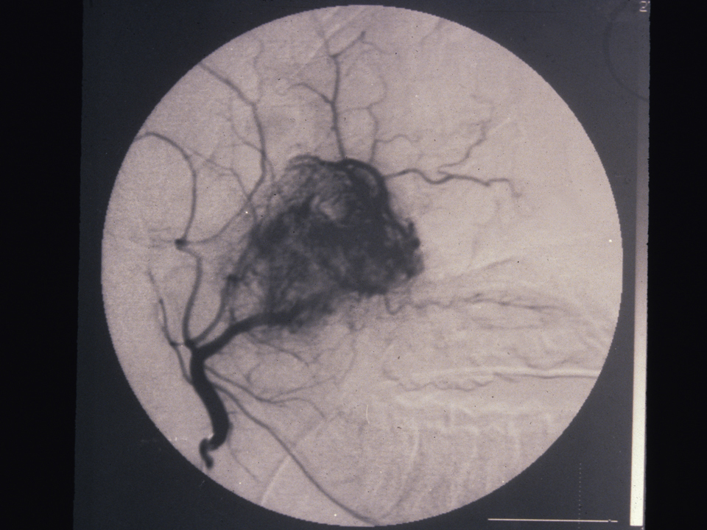
External Carotid Arteriogram
Feeding vessel = Internal Maxillary Artery

Slide 23
Biopsy?

Slide 24
Blood vessels lack a complete muscular layer

Slide 25
Preoperative Embolization
24 to 72 hours preoperatively
Gelfoam or polyvinyl alcohol foam
Complications
  Brain and ophthalmic artery embolization
  Facial nerve palsy
  Skin and soft tissue necrosis

Slide 26
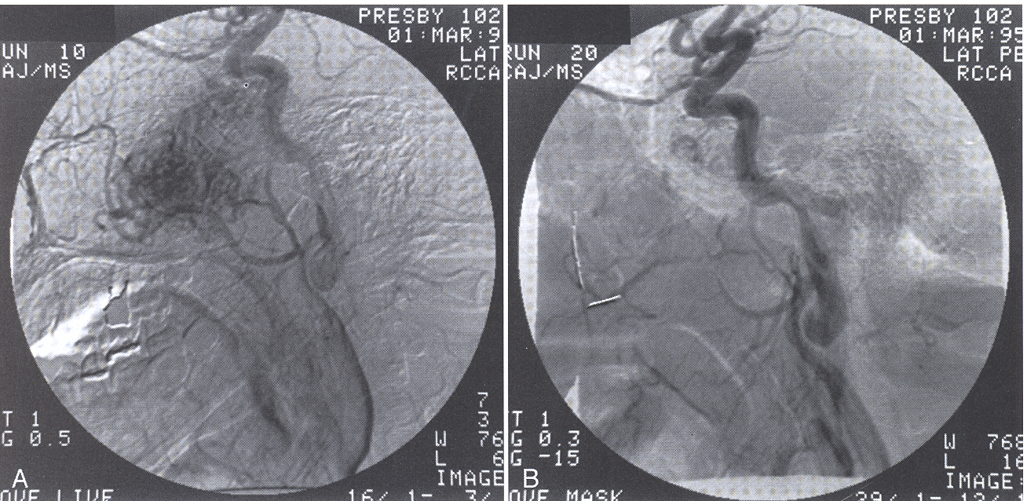
Embolization

Slide 27
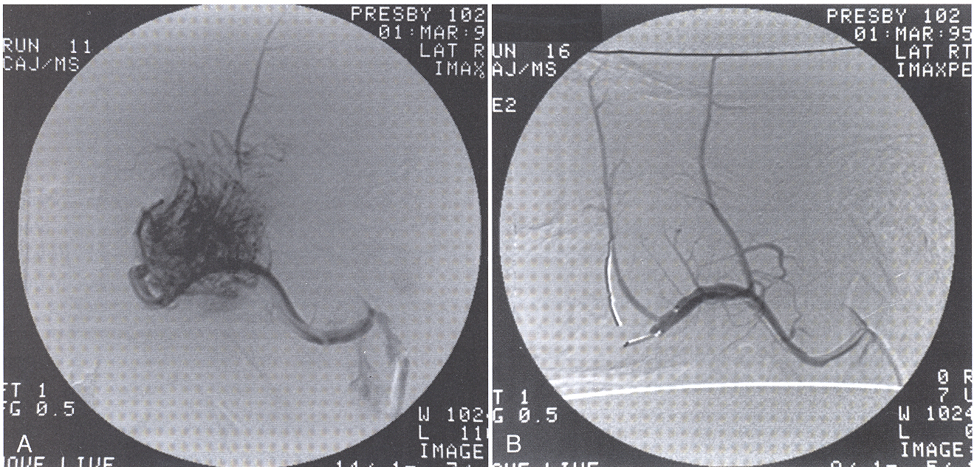
Embolization

Slide 28
Treatment Options
Surgery
Gold standard
Radiation therapy
Reserved for unresectable, life-threatening tumors
Chemotherapy
Recurrent tumors with previous surgery and radiation
Hormone therapy
Estrogens and antiandrogens used to decrease tumor size and vascularity

Slide 29
Surgical Approaches
Endoscopic transnasal
Transpalatal
Medial maxillectomy

Slide 30
Surgical Planning
Smaller tumors
Trans-nasal endoscopic
Transpalatal
Larger tumors
Lateral rhinotomy
Midfacial degloving

Slide 31
Endoscopic Transnasal

Slide 32
Transpalatal

Slide 33
Conclusions
1 Rare, benign, vascular tumor found almost exclusively in young males
2 Surgery is the gold standard with a trend towards endoscopic approaches
3 Frequent follow-up after treatment is necessary

Slide 34
THANK YOU

