Slide 1
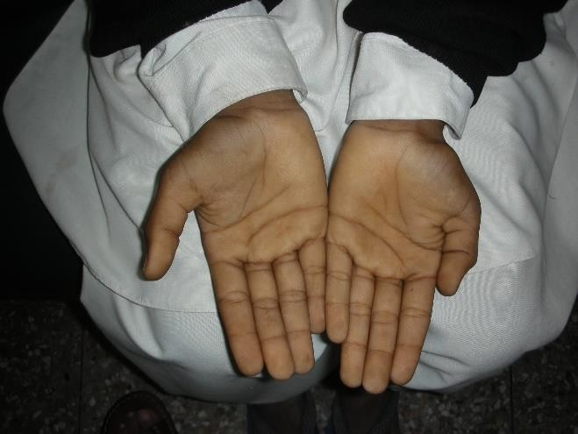
A Brief Review of
Anemia in Children
Epidemiology, Etiology, Clinical Features, Classification
Dr. Muhammad Hafeez
Assistant Professor
Rawalpindi Medical University, Rawalpindi

Slide 2

Motto Vision
To impart evidence based research oriented medical education
To provide best possible patient care
To inculcate the values of mutual respect and ethical practice of medicine
Wisdom
Truth
Service

Slide 3

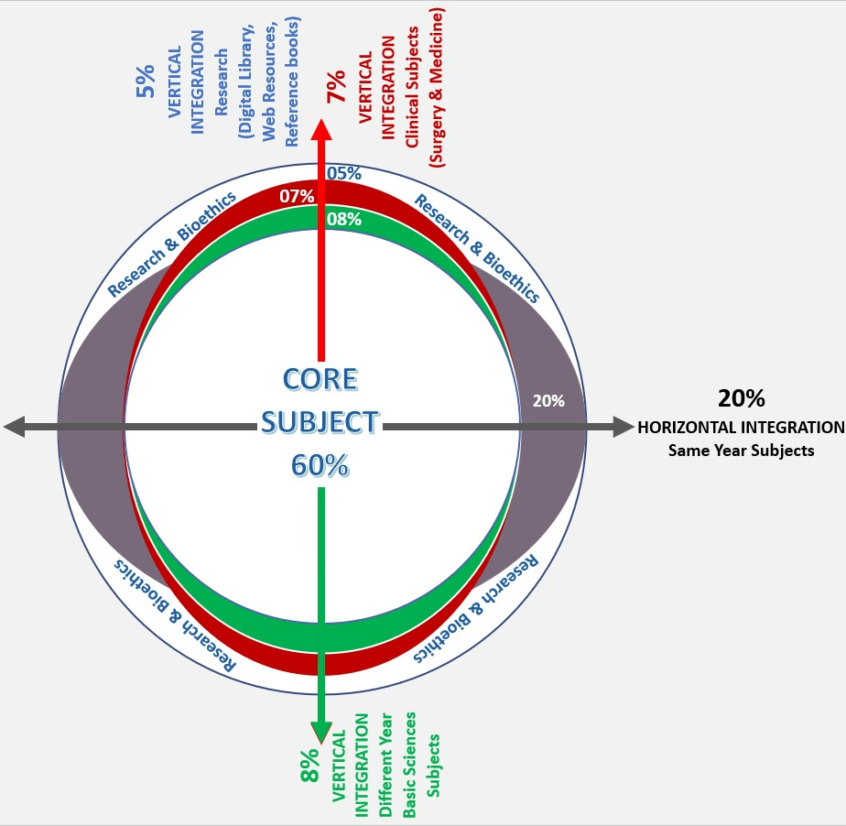
Professor Umar Model of Integrated Lecture

Slide 4
Learning Objectives
By the end of this session, students will be able to:
✅ Define anemia and classify its types.
✅ Explain the etiology and pathophysiology of iron deficiency anemia (IDA).
✅ Identify the clinical features, diagnostic approach, and laboratory findings of IDA.
✅ Discuss the management, including iron therapy and dietary modifications.
✅ Recognize complications and preventive strategies for IDA in children.

Slide 5
Vertical Integration
Anatomy
Physiology

Slide 6
Anatomy of Erythropoiesis
(RBC production)
In fetal life, erythropoiesis occurs in liver and spleen
After birth, RBCs are produced in Bone marrow
Active Bone marrow in small children is present in all skeleton
Active Bone marrow in adults is present in axial skeleton

Slide 7
Physiology of Erythropoiesis
(RBC production)
Anemia and other disorders produce cellular hypoxia
Hypoxia is a stimulus for production of erythropoietin
Erythropoietin produced in kidney stimulates Erythropoiesis
Thyroid hormones are needed for erythropoiesis
Adrenal cortical steroids are needed for erythropoiesis

Slide 8
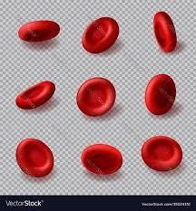
Anemia – Physiology
Average lifespan of RBCs is 120 days
About 1 % of the body's total red blood cells are produced and replaced per day
Anemia occurs when there is:
-- decreased production of RBCs
-- increased destruction / loss of RBCs
In the normal functioning Bone marrow, Anemia results in Erythroid Hyperplasia which can increase RBC production many times

Slide 9
Horizontal Integration
Community Medicine

Slide 10
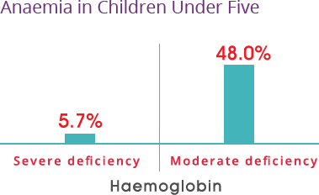
Anemia – Epidemiology
Anemia is one of the commonest disorders in children
Anemia is seen in 53.7 % of children in Pakistan (NNS 2018)

Slide 11
Iron Deficiency Anemia – Epidemiology
National Nutrition Survey – 2018
Iron deficiency is most common nutritional deficiency in the world seen in 30 % of the world's population
Nutritional Iron Deficiency Anemia is one of the commonest disorders in children of Pakistan
Anemia is seen in 53.7 % of children in Pakistan (NNS 2018)
Iron deficiency seen in 28.6 % of children in Pakistan (NNS 2018)
Impaired Iron utilization due to frequent infections is the cause of anemia in many other children

Slide 12
Core Subject

Slide 13
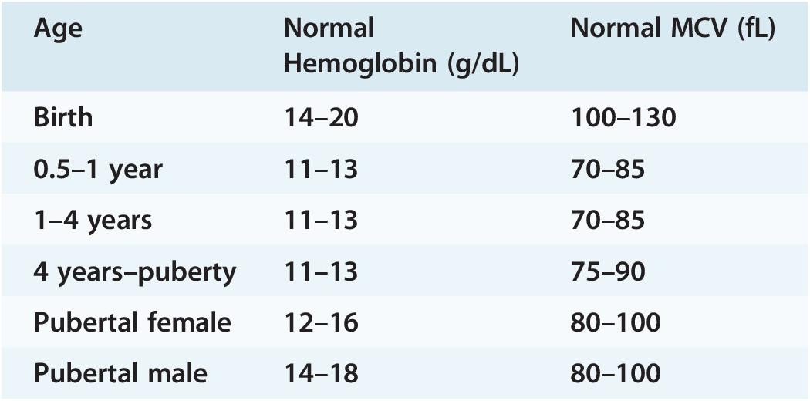
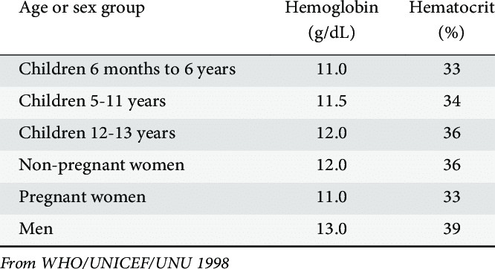
Anemia – Definition
Anemia is decrease in the
-- Hemoglobin
-- Hematocrit
-- RBC mass
below the reference range for age and sex

Slide 14
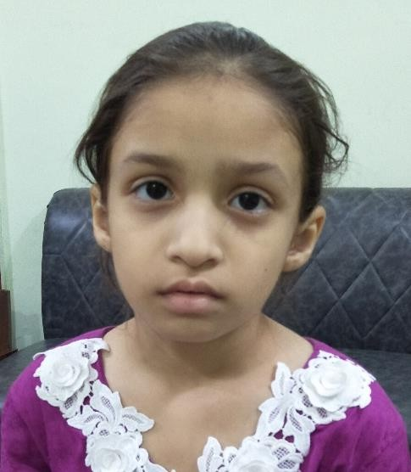
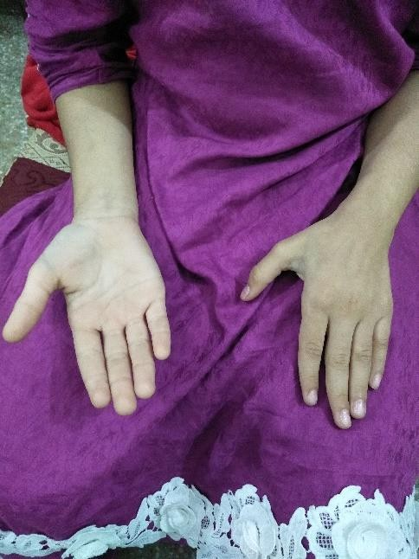
Anemia – Abnormal Symptoms
Pallor
Fatigue
Anorexia
Breathlessness
Palpitation
Breath – holding spells
Irritability
Poor sleep

Slide 15
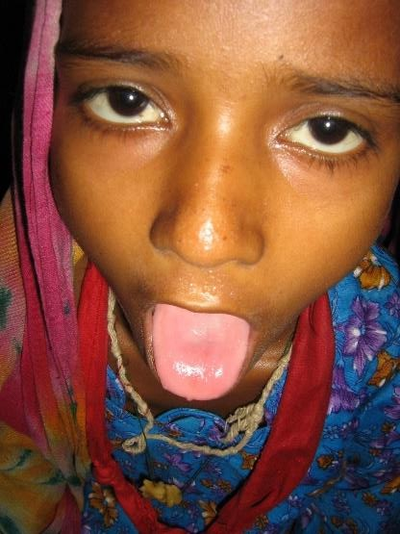
Anemia – Abnormal Signs
Pallor – palms, tongue, conjunctiva
Kilonychia
Tachycardia
Flow murmurs in heart
Cardiac Failure (Anemic Heart Failure)

Slide 16
Anemia – Etiology
Decreased production –
-- Nutritional substrate deficiency – Iron, Folic acid
-- Chronic diseases – CKD, JIA, Hypothyroid
Chronic Blood Loss – Worms, Visible chronic bleeds
Hypoplastic / Aplastic Anemia – Bone marrow Failure
Bone Marrow Replacement – Leukemia, lymphoma
Hemolytic Anemia – increased RBC breakdown
-- Genetic, congenital defects
-- Acquired disorders

Slide 17
Anemia – History
Age of onset
Duration
Birth Weight and Gestational age
Milk intake
Solid diet
Feeding problems
History of Blood loss or bruising
Blood Transfusions – indicate severity or chronicity
Any other symptoms – symptoms of chronic GI, liver or kidney disease

Slide 18
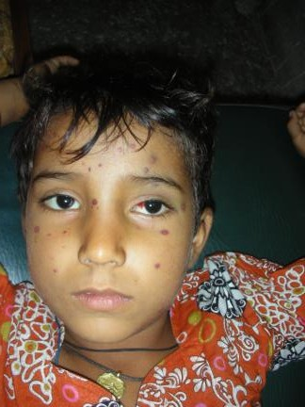
Anemia – Examination
Dysmorphic features – Congenital hypoplastic anemia,
-- Chronic hemolytic anemia
Jaundice - Hemolysis
Tongue (atrophy of papillae) – severe Iron deficiency
Purpura or bleeding - Thrombocytopenia
Kilonychia – severe Iron deficiency
Cardiac examination – Heart Failure
Lymphadenopathy – leukemia, lymphoma
Splenomegaly – Hemolysis, leukemia, lymphoma

Slide 19
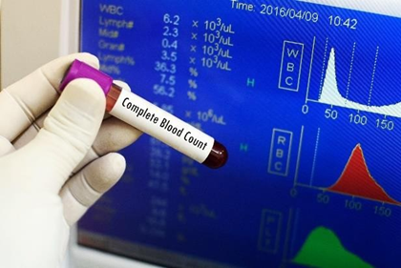
Anemia – Investigations
CBC (Hb, Hematocrit, MCV,MCH,MCHC, TLC, DLC, Platelets)
Peripheral Blood Film (microcytic, normocytic, macrocytic)
Reticulocyte count – high (hemolysis), Low (hypoplastic)
ESR, CRP (chronic disease, chronic inflammation)
Serum Ferritin, Serum Iron (Iron deficiency, chronic
inflammation)
Hemoglobin Electrophoresis (Hemoglobinopathies)
Bone Marrow Examination (hypoplasia, leukemia)

Slide 20
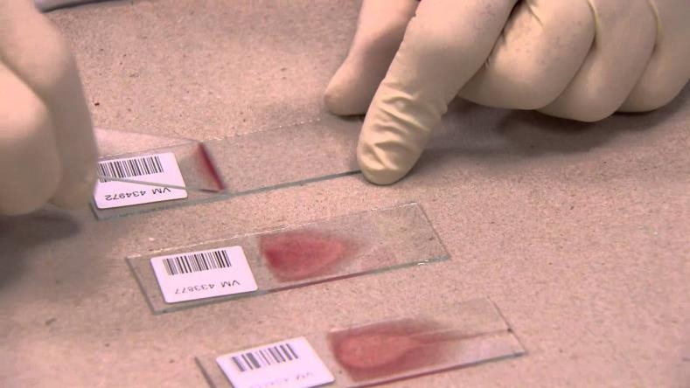
Anemia – RBC morphology
SIZE
Normocyte – normal size (MCV = 75 - 105 fl)
Microcyte – small cells (MCV < 75 fl)
Macrocye large cells (MCV > 105 fl)
SHAPES
Anisocytosis – variation in size
Poikilocytosis – variation in shapes
Spherocyte – small round cell

Slide 21
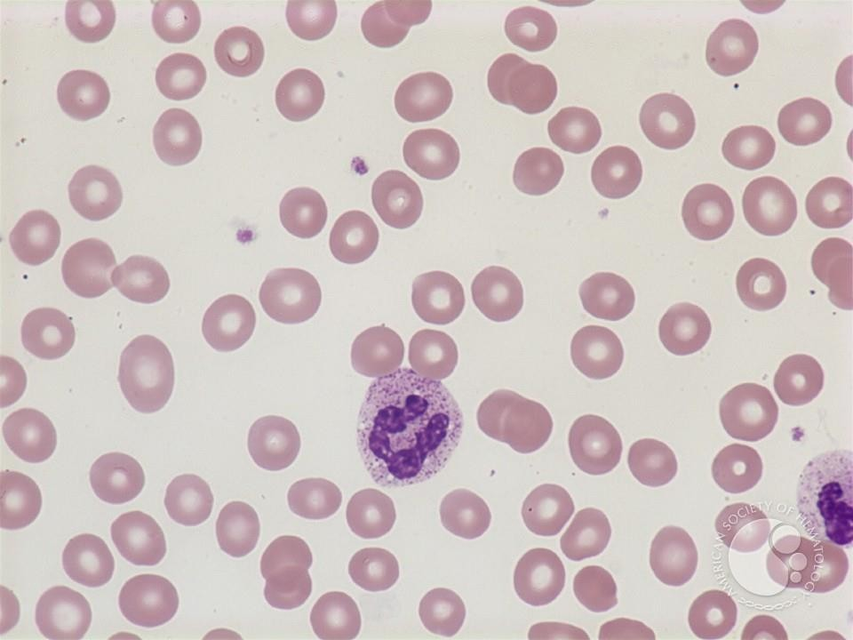
Normocytic Anemia (MCV = 75 - 105 fl)
Acute blood loss
Chronic diseases
Hypo-plastic Anemia – Decreased RBC production
Hemolytic Anemia – (G6-PD, AHA)

Slide 22
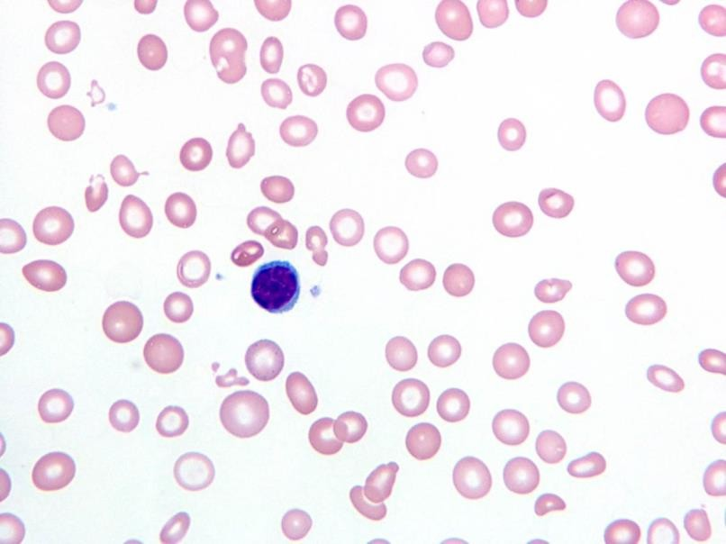
Microcytic Anemia (MCV < 75 fl)
Iron deficiency anemia
Hemolytic Anemia (Thalassemia, Hereditary Spherocytosis)
Chronic diseases

Slide 23
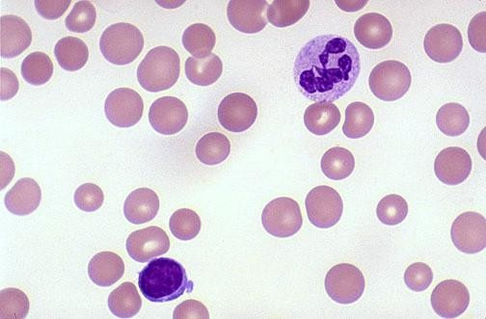
Macrocytic Anemia (MCV > 75 fl)
Hemolytic Anemia (chronic hemolysis)
Folic Acid Deficiency
Vitamin B12 deficiency

Slide 24
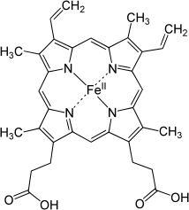
Iron in Human body
Adults: 3 - 5 gm
Children: 55 mg / kg
Hemoglobin = 70% (200 mg Iron in 500 ml blood)
Body stores = 26%
Myoglobin (muscles) = 3.9%

Slide 25
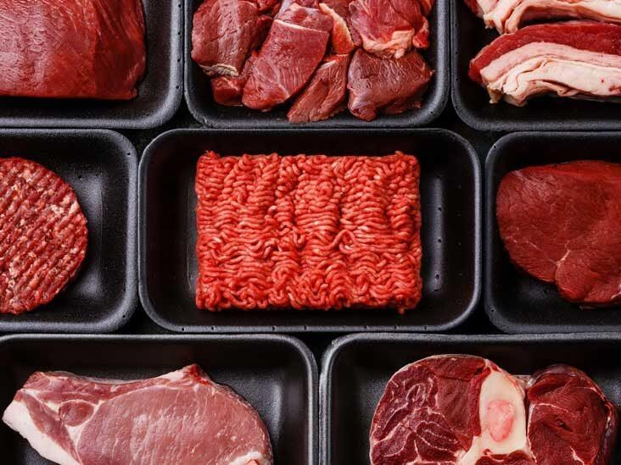
Sources of IRON
Liver
Red Meat
Green vegetables
Recommended Dietary Allowance (RDA)
IRON 10 mg/day
Only 10 % of ingested Iron is absorbed in body
Heme Iron is better absorbed than other forms

Slide 26
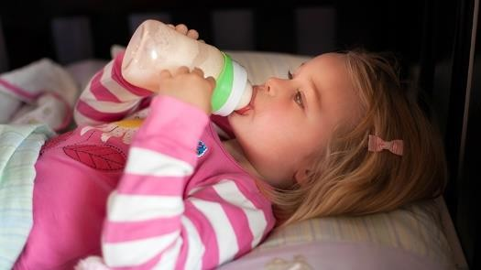
Iron Deficiency Anemia – common reasons
Newborns have sufficient Iron stores to last for six months – except when mother is anemic OR baby is preterm
Iron deficiency Anemia is likely to develop after six months of age if diet is not supplemented with Iron
Animal milk – a very poor source of Iron
Children less than three years of age, who take a large amount of animal milk daily, are deficient in Iron

Slide 27
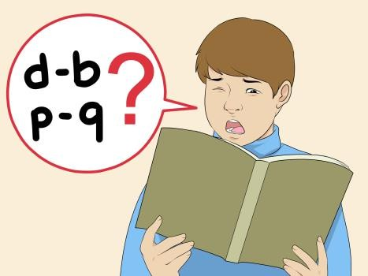

Iron deficiency Anemia – Complications
Low physical performance
Impaired cognitive functions / poor learning ability
Breath-holding spells in children
Increased risk of febrile seizures in children

Slide 28
Iron deficiency Anemia – Differential Diagnosis
Hypoplastic Anemia – Purpura, Leukopenia, Thrombocytopenia
Hemolytic Anemia – Splenomegaly, increased Reticulocytes
Chronic diseases (CKD, JIA, Hypothyroid) – Symptoms & Signs
Bone Marrow Replacement (Leukemia, lymphoma) – Purpura, Lymphadenopathy, Hepatosplenomegaly

Slide 29
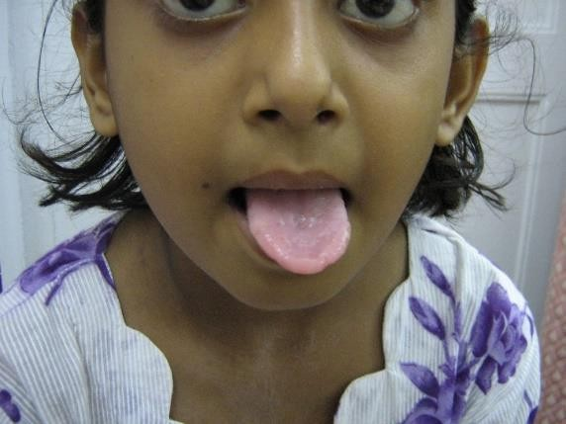
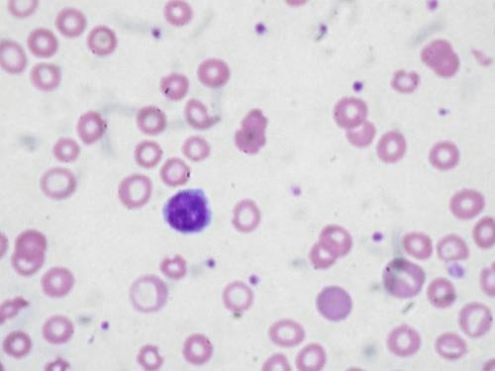
Diagnosis of IRON deficiency
Clinical Diagnosis (pallor and pica)
Spleen not enlarged
Lab Diagnosis
Hemoglobin low, TRBC count low
MCV, MCH, MCHC all are low, RDW is increased
Blood film – Microcytosis, Hypochromia, Anisocytosis
Platelets count increased
Serum Ferritin level < 10 ng/ml
Serum Iron level < 70 mcg/dl

Slide 30
Blood peripheral film in Iron deficiency anemia

Slide 31
Iron Deficiency Anemia – Treatment
Diet modification (less milk, more meat products)
Oral Iron therapy = 3 – 6 mg / kg / day
Intravenous Iron administration = 5 mg / kg / day IV slowly in 2-3 hours given for 1-3 doses
(given in severe anemia or oral iron intolerance)
Packed RBC transfusion (for rapid correction of severe anemia)

Slide 32
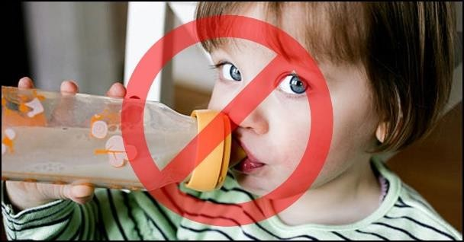
Iron Deficiency Anemia – Prevention
Animal Milk is the main nutrition for most of the infants and small children in Pakistan
Iron deficiency Anemia is likely to develop after six months of age if diet is not supplemented with Iron
After one year of age, milk not more than 1 litre.
After two years of age, milk once a day only
Liver and animal meat as part of diet
Iron supplementation = 1-2 mg / kg / day

Slide 33
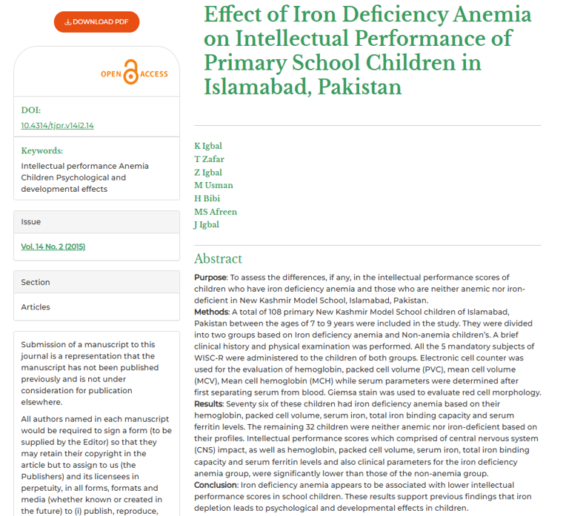
Research/ recent advances

Slide 34
REFERENCE BOOKS
BASIS OF PEDIATRICS by PERVAIZ AKBAR
(REVISED 10TH Edition)

Slide 35
Bio ethical aspects
1-informed consent from parents
2-early detection and treatment of anemia
3- socioeconomic status
4- Resource allocation
5- cultural sensitivity
6-Parental non adherence

