Slide 3
LADIES AND GENTLEMEN PLEASE RISE FOR THE NATIONAL ANTHEM

Slide 5
University Motto, Mission, Vision & Values
Mission Statement
To impart evidence-based research-oriented health
professional education, best possible patient care,
mutual respect, ethical practice of healthcare and social accountability.
Vision and Values
Highly recognized and accredited center of excellence in
Medical Education, using evidence-based training techniques for development of highly competent health professionals, who are lifelong experiential learner and are socially accountable.

Slide 6
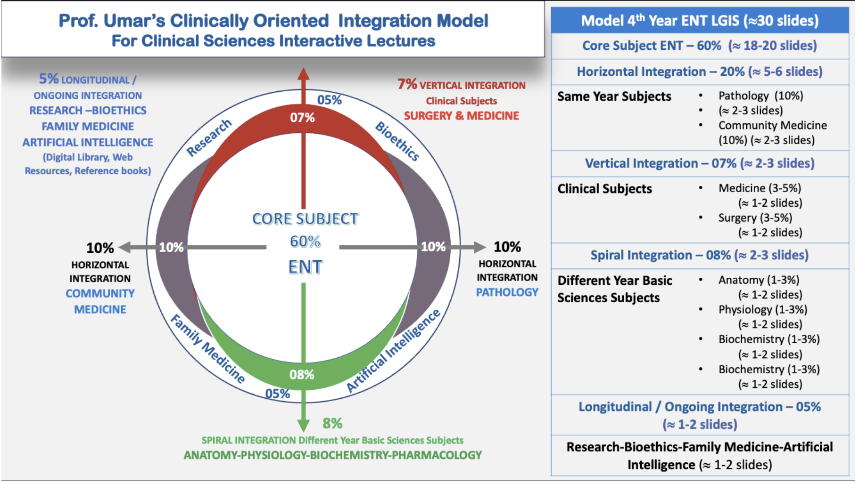
Prof Umar Model Of Integrated Lecture

Slide 7
Sequence Of LGIS
Learning objectives
Core concept of subject 60%
Anatomy, Biochemistry, Physiology (spiral integration 08%)
Surgery, Medicine (vertical integration – 07%)
Research article related to topic, Bioethics, A.I (05%)
Comm Med, Pathology (20%)

Slide 8
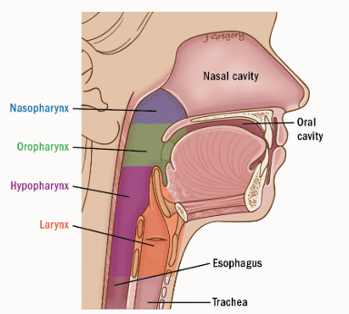
Anatomy & Investigation of Oral Cavity, Pharynx & Oesophagus

Slide 9
LEARNING OBJECTIVES:
At the end of this session you all would be able to:
Identify anatomical structure of oral cavity, pharynx and esophagus
Enlist arterial, venous, nerve supply and lymphatic drainage of these structures

Slide 10
ORAL CAVITY

Slide 11
Parts of Oral Cavity

Slide 12
Floor of mouth

Slide 13
Lymphatic drainage

Slide 14
Intrinsic tongue muscles

Slide 15
Extrinsic tongue muscles

Slide 16
Coronal section of tongue

Slide 17
Actions of tongue muscles
Inferior Longitudinal: moves tip up & down
Superior Longitudinal: moves tip up & down
Transverse: narrows & lengthens tongue
Vertical: flattens & depresses tongue
Genioglossus: Prevents tongue from falling back
Styloglossus: Pulls tongue up & back
Palatoglossus: Pulls tongue back
Hyoglossus: Depresses tongue

Slide 18
Nerve Supply of Tongue
 | Anterior 2/3 | Posterior 1/3
Sensory | Lingual | Glossopharyngeal
Motor | Hypoglossal ***
Taste | Chorda tympani | Glossopharyngeal
*** except palatoglossus which is supplied by pharyngeal plexus

Slide 19
Nerve
Supply
of
Tongue

Slide 20
Papillae in tongue

Slide 21
Papillae in tongue
Lingual taste buds sit on lateral borders of raised papillae. They are classified as:
Fungiform: at tip & sides of tongue
Circumvallate: just in front of terminal sulcus
Foliate: at posterior lateral margins of tongue
Filiform: centre of tongue, have no taste buds

Slide 22
Papillae in tongue

Slide 23
Tongue Map ?
Sweet = Sucrose
Salty = NaCl
Sour = HCl
Bitter = Quininn

Slide 24
Pharynx

Slide 25
Divisions

Slide 26
Divisions

Slide 27
Anterior Relations

Slide 28
Nasopharynx

Slide 29
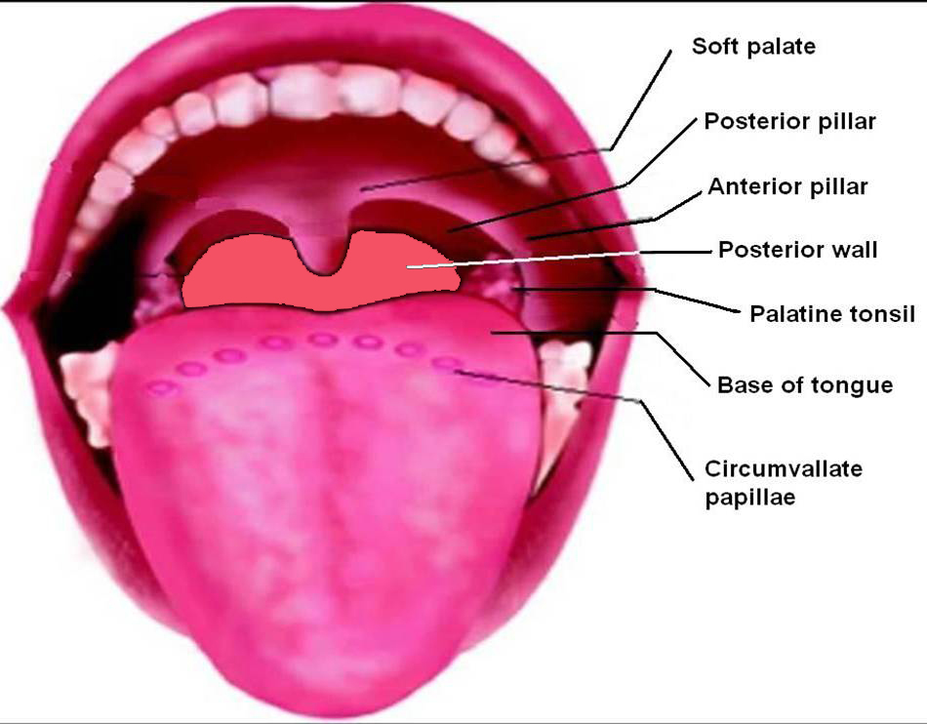
Oropharynx

Slide 30
Waldeyer’s Tonsillar Ring
Notes:
Vertically oriented, sub-epithelial lymphoid tissue ring located in pharynx, thought to function as a barrier to infection in first few years of life. Named after nineteenth century German anatomist Heinrich Wilhelm Gottfried von Waldeyer-Hartz

Slide 31
Hypopharynx

Slide 32
Coronal section of Pharynx

Slide 33
Layers of Pharyngeal Wall
Mucosa: ciliated columnar in nasopharynx & stratified squamous elsewhere
Pharyngo-basilar fascia
Longitudinal muscles: stylo-pharyngeus + salpingo-pharyngeus + palato-pharyngeus
Constrictor muscles: superior + middle + inferior
Bucco-pharyngeal fascia

Slide 34
Muscles

Slide 35
Structures Passing
Between Skull Base & Superior Constrictor (Sinus of Morgagni) | Eustachian tube + Levator palatini + Tensor palatini + Ascending palatine artery
Between Superior & Middle Constrictors | Glossopharyngeal nerve & Stylopharyngeus muscle
Between Middle & Inferior Constrictors | Internal Laryngeal nerve & Superior Laryngeal artery
Below Inferior Constrictor | Recurrent Laryngeal nerve & Inferior Laryngeal artery

Slide 36
Nerve Supply
Nasopharynx: pterygo-palatine ganglion (V2)
Oropharynx: glossopharyngeal & vagus nv
Hypopharynx: Superior & recurrent laryngeal nv
All muscles by pharyngeal nerve plexus (vagus nv carrying cranial part of accessory nv) except stylopharyngeus (glossopharyngeal nv) & cricopharyngeus (also by recurrent laryngeal)

Slide 37
Arterial Supply
Facial artery
Lingual artery
Ascending pharyngeal artery
Ascending palatine artery
Greater palatine artery
Artery of pterygoid canal
Superior laryngeal artery

Slide 38
Venous Drainage
Upper pharynx:
Pharyngeal venous plexus situated on middle constrictor → pterygoid venous plexus & internal jugular vein
Lower pharynx:
Inferior thyroid veins

Slide 39
Lymphatic Drainage
Nasopharynx: upper deep cervical + retro-
pharyngeal + parapharyngeal +
posterior triangle
Oropharynx: upper deep cervical + retro-
pharyngeal + parapharyngeal
Hypopharynx: deep cervical + parapharyngeal +
paratracheal + supraclavicular

Slide 40
Killian’s Dehiscence
Notes:
Triangular weak area between thyropharyngeus & cricopharyngeus part of inferior constrictor
Mucosa herniates through it to form hypo-pharyngeal pouch (Zenker’s diverticulum)
Perforation occurs here during forceful oesophagoscopy (gateway of tears)

Slide 41
Oesophagus

Slide 42
Introduction
Also called gullet
23 to 25 cm long
Extends from crico-pharyngeal sphincter (C6 vertebra) to cardiac orifice of stomach (T11 vertebra)

Slide 43
Anterior Curvature
Follows antero-
posterior curve of
vertebral column
through neck, thorax
(postr mediastinum)
& upper abdomen

Slide 44
Lateral curvatures
Starts in midline → deviates to left at C7 → returns to midline at T5 → deviates to left again at T7 to reach gastric cardia

Slide 45
Natural Constrictions

Slide 46
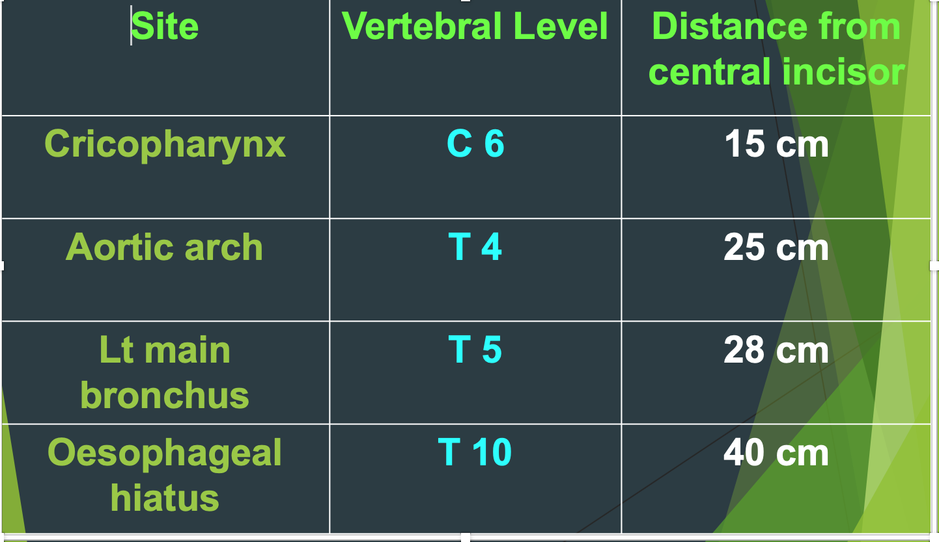

Slide 47
Importance of constrictions
Common sites for lodgement of oesophageal foreign bodies
Common sites for caustic stricture of oesophagus

Slide 48
Blood Supply
Part | Arterial | Venous
Cervical | Inferior thyroid | Inferior thyroid
Thoracic | Descending thoracic aorta, Bronchial | Azygos, Hemi-azygos
Abdominal | Left gastric, Inferior phrenic | Left gastric, Abdominal azygos

Slide 49
Oesophageal varices
Left gastric vein is a
site of portal-systemic
anastomosis. Portal
obstruction leads to
varicose veins in
lower oesophagus

Slide 50
Nerve Supply
Cervical: recurrent laryngeal nerve & cervical sympathetic trunk
Thoracic: vagal trunks, oesophageal plexus & thoracic sympathetic trunk
Abdominal: vagal trunks & thoracic sympathetic trunk
Esophageal pain mimics cardiac angina due to common nerve supply

Slide 51
Lymphatic Drainage
deep cervical + posterior mediastinal + left gastric lymph nodes
drain into coeliac lymph nodes
thoracic duct

Slide 52
Histology
Four coats from outside inwards: 1. Fibrous coat (adventitia) 2. Muscular coat (muscularis propria)
3. Submucous coat
4. Mucous coat

Slide 53
Barret’s esophagus

Slide 54
Investigations
X-ray post nasal space lateral view---Adenoids
X-ray neck lateral view soft tissue-Foreign body esophagus, retropharyngeal abscess
Barium Swallow- dysphagia
Flexible endoscopy
Ct scan neck
FNAC- neck node
Biopsy

Slide 55
Thank You

