Slide 1
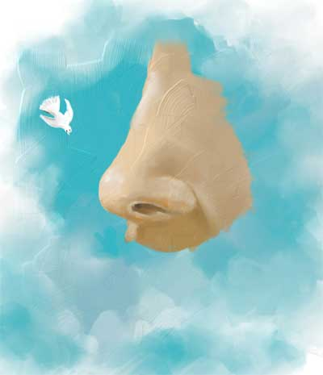
ANATOMY OF NOSE AND PARANASAL SINUSES

Slide 2
University Motto, Vision, Values & Goals
Mission Statement
To impart evidence-based research-oriented health professional education
Best possible patient care
Mutual respect, ethical practice of healthcare and social accountability
Vision and Values
Highly recognized and accredited centre of excellence in
Medical Education, using evidence-based training techniques for development of highly competent health professionals, who are lifelong experiential learner and and are socially accountable.
Goals
The Undergraduate Integrated Learning Program is geared to provide you with quality medical education in an environment designed to:

Slide 4
Sequence of LGIS
Learning objectives
Core concepts- Anatomy of nose and PNS(60%)
Spiral integration(8%)
Horizontal integrartion with pathology and community medicine(20%)
Vertical integration with Clinical,medical and surgical(7%)
Research,family medicine,bioethics,artificial intelligence(5%)

Slide 5
LEARNING OBJECTIVES
At the end of this lecture,students shall be able to learn:
Anatomy,blood supply, lymphatic drainage and physiology of external nose
Anatomy blood supply,lymphatic drainage and physiology of internal nose
Concept of Osteomeatal complex
Anatomy and physiology of paranasal sinuses

Slide 6
The Nose
The nose consists of the external nose and the nasal cavity,
Both are divided by a septum into right and left halves.

Slide 7
External Nose
The external nose has two elliptical orifices called the naris (nostrils), which are separated from each other by the nasal septum.
The lateral margin, the ala nasi, is rounded and mobile.

Slide 8
External Nose

Slide 9
External Nose
The framework of the external nose is made up above by the nasal bones, the frontal processes of the maxillae, and the nasal part of the frontal bone.
Below, the framework is formed of plates of hyaline cartilage

Slide 10
External Nose

Slide 11
Blood Supply of the External Nose
The skin of the external nose is supplied by branches of the ophthalmic and the maxillary arteries.
The skin of the ala and the lower part of the septum are supplied by branches from the facial artery.

Slide 12
Nerve Supply of the External Nose
The infratrochlear and external nasal branches of the ophthalmic nerve (CN V) and the infraorbital branch of the maxillary nerve (CN V).

Slide 13
Lymphatic Drainage
lymphatics from the external nose drain into submandibular lymph nodes

Slide 14
INTERNAL NOSE
It is divided into right and left nasal cavities by nasal septum.
Each nasal cavity consists of
a)Skin lined portion-vestibule
b)Mucosa lined portion-nasal cavity proper

Slide 15
Nasal Cavity
The nasal cavity has
a floor,
a roof,
a lateral wall,
a medial or septal wall.

Slide 16
The Floor of Nasal Cavity
Palatine process of maxilla(anterior 3/4th)
Horizontal part of palatine bone(posterior 1/4th)

Slide 17
The Roof of Nasal Cavity
Narrow
It is formed
anteriorly beneath the bridge of the nose by the nasal and frontal bones,
in the middle by the cribriform plate of the ethmoid,
located beneath the anterior cranial fossa,
posteriorly by the downward sloping body of the sphenoid

Slide 18
The Medial Wall of Nasal Cavity
The Nasal Septum
Divides the nasal cavity into right and left halves
It has osseous and cartilaginous parts
Nasal septum consists of the perpendicular plate of the ethmoid bone (superior), the vomer (inferior) and septal cartilage (anterior)
Perpendicular Plate (ethmoid)
Septal Cartilage
Vomer

Slide 19
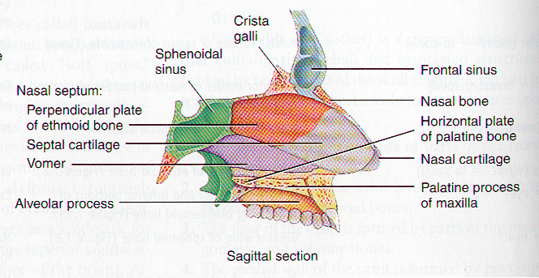
The Nasal Septum

Slide 20
The Lateral Walls of Nasal Cavity
Marked by 3 projections:
Superior concha
Middle concha
Inferior concha
The space below each concha is called a meatus.

Slide 21
The Lateral Walls of Nasal Cavity

Slide 22
The Lateral Walls of Nasal Cavity
Inferior meatus: nasolacrimal duct
Middle meatus:
Maxillary sinus
Frontal sinus
Anterior ethmoid sinuses
Superior meatus: posterior ethmoid sinuses
Sphenoethmoidal recess: sphenoid sinus

Slide 23
Openings Into the Nasal Cavity
Sphenoid sinus opens into sphenoethmoidal recess
Anterior & middle ethmoid air cells, maxillary and frontal sinuses open into middle meatus
Posterior ethmoidal air cells open into superior meatus
Nasolacrimal Canal drains into Inferior Meatus

Slide 24
Blood Supply to the Nasal Cavity
From branches of the maxillary artery, one of the terminal branches of the external carotid artery.
The most important branch is the sphenopalatine artery.
The sphenopalatine artery anastomoses with the septal branch of the superior labial branch of the facial artery in the region of the vestibule.
The submucous venous plexus is drained by veins that accompany the arteries.

Slide 25
Blood Supply to the Nasal Cavity
Sphenopalatine a.
Maxillary a.
Netter, Frank H., Atlas of Human Anatomy. Ciba-Geigy Corporation, Summit, N.J. 1993. Plate 35.

Slide 26
EPISTAXIS
LITTLE‘S AREA:
Situated in anteroinferior part of septum KIESSELBACH’S PLEXUS
Anterior ethmoidal artery
Septal branch of superior labial
Septal branch of sphenopalatine
Greater palatine

Slide 27
Nerve Supply of the Nasal Cavity
The olfactory nerves from the olfactory mucous membrane ascend through the cribriform plate of the ethmoid bone to the olfactory bulbs .
The nerves of ordinary sensation are branches of the ophthalmic division (V1) and the maxillary division (V2) of the trigeminal nerve.

Slide 28
AUTONOMIC NERVE SUPPLY
Sympathetic supply-superior cervical sympathetic ganglion->internal carotid plexus->vidian nerve->sphenopalatine ganglion.
Parasympathetic supply-facial nerve->greater superficial petrosal nerve->vidian nerve->sphenopalatine ganglion.

Slide 29
Nerve Supply of the Nasal Cavity
CN I – Olfactory Nerves (SVA)
Anterior ethmoidal branch of V₁
Posterior nasal branches of V₂
Cut nasopalatine branch of V₂ to septum

Slide 32
Lymph Drainage of the Nasal Cavity
The lymph vessels draining the vestibule end in the submandibular nodes.
The remainder of the nasal cavity is drained by vessels that pass to the upper deep cervical nodes.

Slide 33
PHYSIOLOGY OF NOSE
Functions of nose are classified as:
Respiration
Air conditioning of inspired air
Protection of lower airways
Vocal resonance
Olfaction

Slide 34
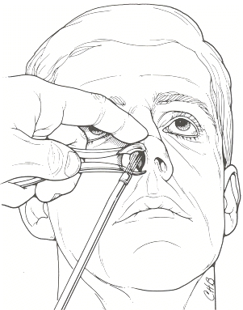
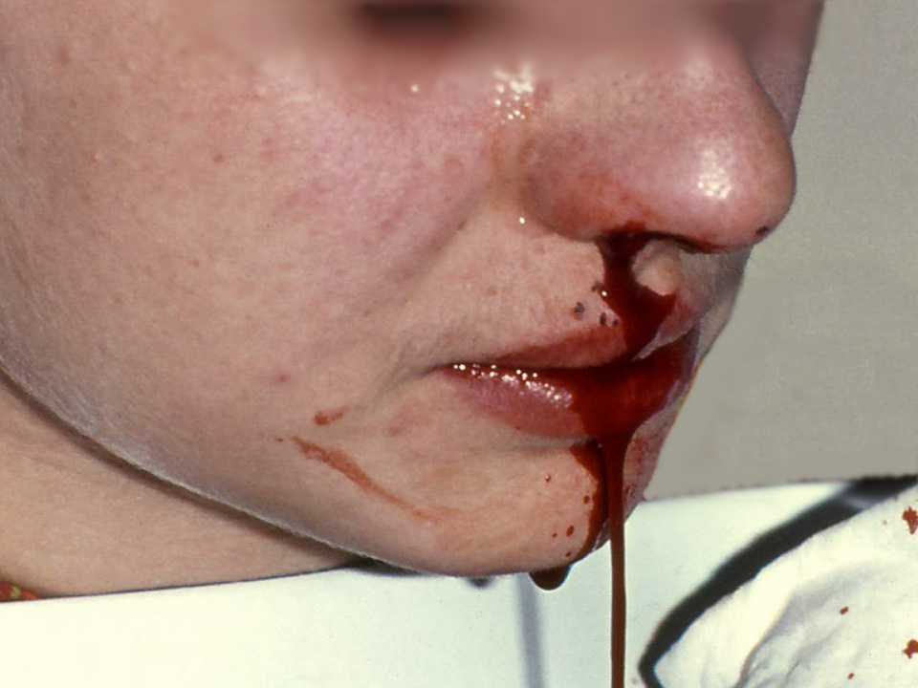
Clinical Notes
Examination of the Nasal Cavity
Trauma to the Nose
Infection of the Nasal Cavity
Foreign Bodies in the Nose
Nose Bleeding (Epistaxis)

Slide 35
OSTEOMEATAL COMPLEX

Slide 36
OSTEOMEATAL COMPLEX
The middle meatus is the space below and lateral to the middle turbinate and is often functionally referred to as the osteomeatal complex.It contains the drainage pathways for the anterior ethmoids,maxillary and frontal sinuses.
The middle meatus is the area that is most commonly involved in the pathophysiology of chronic rhinosinusitis.

Slide 37
OSTEOMEATAL COMPLEX-RELATED STRUCTURES
Bulla ethmoidalis-The ethmoid bulla is one of the most constant and largest of the anterior ethmoid air cells.It is located within the middle meatus directly posterior to the uncinate process and anterior to the basal lamella of the middle turbinate.
Hiatus semilunaris-hiatus semilunaris is a crescent shaped gap between the posterior free margin of the uncinate process and the anterior wall of the ethmoid bulla,through this passage the middle meatus communicates with the ethmoid infundibulum.

Slide 38
OSTEOMEATAL COMPLEX-RELATED STRUCTURES
Infundibulum-funnel shaped passage through which the secretions from various sinuses are channeled into the middle meatus.
Uncinate process-floor and medial wall of infundibulum is formed by the uncinate process of the ethmoid.
It is nearly sagitally oriented,nearly paralleling the ethmoid bulla.It is approximately 3 to 4 mm wide and 1.5 to 2 cm in length.

Slide 39
The Paranasal Sinuses

Slide 40
The Paranasal Sinuses
The paranasal sinuses are cavities found in the interior of the maxilla, frontal, sphenoid, and ethmoid bones .
They are lined with mucoperiosteum and filled with air.
They communicate with the nasal cavity through relatively small apertures.

Slide 41
Drainage of Mucus and Function of Paranasal Sinuses
The mucus produced by the mucous membrane is moved into the nose by ciliary action of the columnar cells.
Drainage of the mucus is also achieved by the siphon action created during the blowing of the nose.
Functions:
Resonators of the voice
They also reduce the skulls weight
Help warm and moisten inhaled air
Act as shock absorbers in trauma

Slide 42
Maxillary Sinus
Pyramidal in shape
Paired & symmetric
Located within the body of the maxilla behind the skin of the cheek.
The roof is formed by the floor of the orbit, and the floor is related to the roots of the 2nd premolars and 1st molar teeth.
The maxillary sinus opens into the middle meatus of the nose

Slide 43
Frontal Sinuses
Rarely symmetrical
Contained within the frontal bone .
Separated from each other by a bony septum.
Each sinus is roughly triangular
Extending upward above the medial end of the eyebrow and backward into the medial part of the roof of the orbit.
Opens into the middle meatus

Slide 44
Sphenoidal Sinuses
Lie within the body of the sphenoid bone
Below sella turcica
Extends between dorsum sellae and post clinoid processes
Opens into the sphenoethmoidal recess above the superior concha

Slide 45
Ethmoid Sinuses
They are anterior, middle, and posterior
They are contained within the ethmoid bone, between the nose and the orbit
Anterior & middle
Drains into middle nasal meatus
Posterior
Drain into superior nasal meatus
Separated from the orbit by a thin plate of bone so that infection can readily spread from the sinuses into the orbit

Slide 46
Sinus Drainage Schema

Slide 47
PHYSIOLOGY OF PARANASAL SINUSES
Air conditioning of inspired ear
To provide resonance to voice
To act as thermal insulators-protect delicate structures in the orbit and cranium from variations of intranasal temperature
To lighten the skull bones
Provide extended surface for olfaction
To act as buffers against trauma

Slide 49
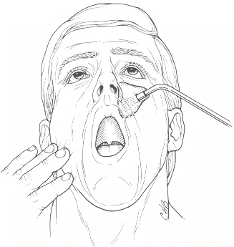
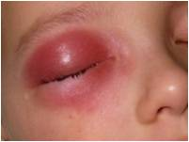
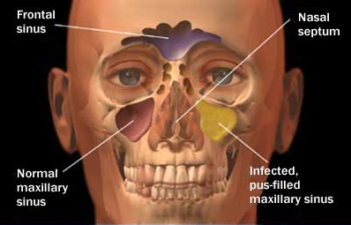
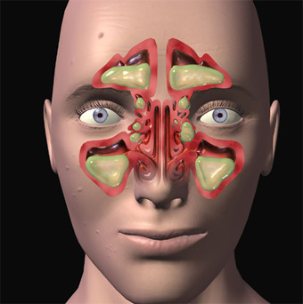
Clinical Notes
Examination of the Paranasal Sinuses
Sinusitis
Basal skull fracture

Slide 50
COMMUNITY MEDICINE
the physiology of the nose and paranasal sinuses is closely linked to community medicine through its implications for respiratory health, environmental factors, infectious disease control, occupational health, and chronic disease management.

Slide 51
FAMILY MEDICINE
Understanding the physiology of the nose and paranasal sinuses is integral to providing comprehensive care in family medicine.

Slide 52
RESEARCH
Some research has focused on genetic predispositions to nasal and sinus disorders, including studies on familial clustering of conditions like CRS and genetic variations associated with disease susceptibility.

Slide 53
ARTIFICIAL INTELLIGENCE
AI algorithms can analyze medical images such as CT scans, MRIs, and X-rays to detect abnormalities in the paranasal sinuses. By accurately identifying and localizing sinus pathologies like sinusitis, polyps, or tumors, AI can assist radiologists and clinicians in making faster and more accurate diagnoses.

Slide 54
THANK YOU

