Slide 1
Anatomy of Larynx, Tracheobronchial tree

Slide 2
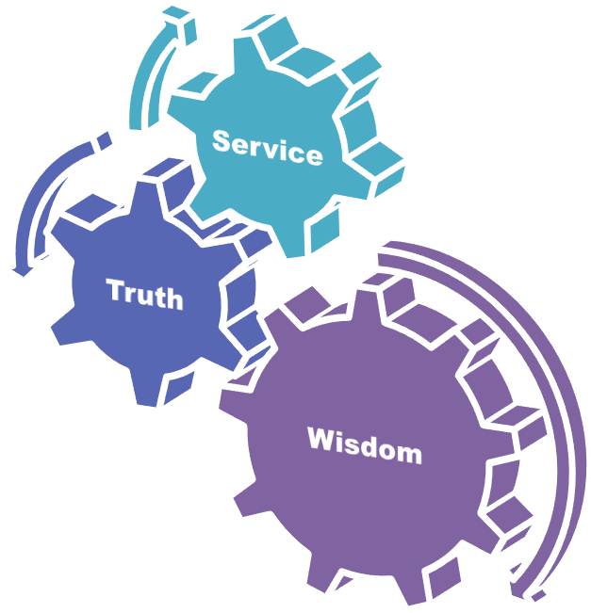
University Motto, Vision, Values & Goals
Mission Statement To impart evidence-based research-oriented health professional education Best possible patient care Mutual respect, ethical practice of healthcare and social accountability. Vision and Values Highly recognized and accredited centre of excellence in Medical Education, using evidence-based training techniques for development of highly competent health professionals, who are lifelong experiential learner and are socially accountable. Goals The Undergraduate Integrated Learning Program is geared to provide you with quality medical education in an environment designed to:

Slide 3
Sequence of LGIS
Learning objectives
Development of larynx (core concept = 60%)
Anatomy, physiology, biochemistry (spiral integration 8%)
Pathology and community medicine (horizontal integration 20%)
Related clinical medical surgical (vertical integration – 7%)
Research, family medicine, bioethics, artificial intelligence (5%)

Slide 4
Learning Objectives
At the end of this lecture students shall be able to learn:
Embryology of Larynx, Tracheobronchial tree
Anatomy of Larynx & tracheobronchial tree
Laryngeal cartilages, membranes and joints
Laryngeal Muscles
Blood supply and nerve supply of larynx and tracheobronchial tree

Slide 5
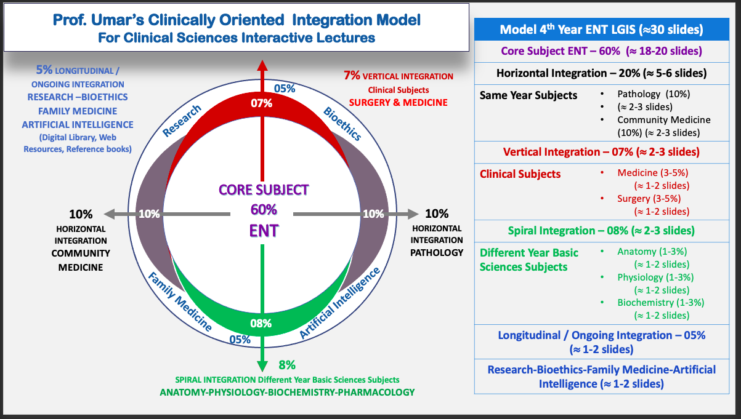
Prof Umer Model Of Integrated Lecture

Slide 7
Embryology
Larynx develops from tracheobronchial groove that is ventral to midline respiratory diverticulum of foregut
Epiglottis and thyroid cartilage develop from 4th branchial arch

Slide 8
Anatomical Location
Lies in front of hypopharynx
Opposite to C3 to C6 vertebra

Slide 9
Constitution of larynx
9 Cartilages:
-Connected by
Joints
Ligaments
Membrane
-Moved by
8 muscles (intrinsic Muscles)
-Cavity- Mucous membrane

Slide 11
Laryngeal Cartilages
Paired Cartilages
Arytenoid
Corniculate
Unpaired Cartilages
Thyroid
Cricoid
Cuneiform
Epiglottis

Slide 12
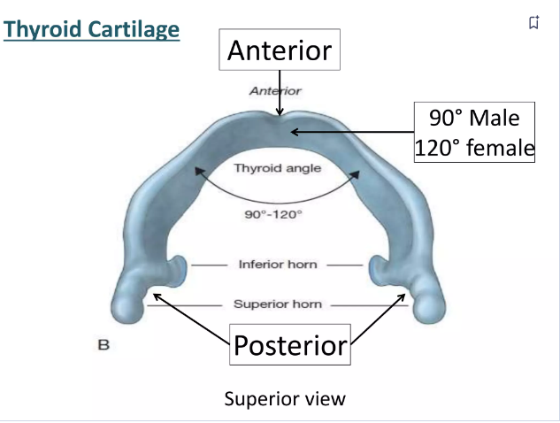
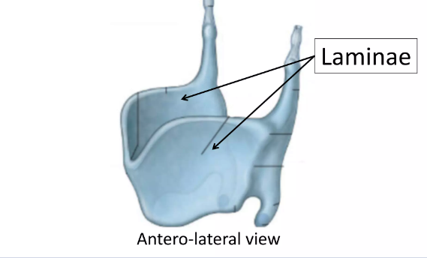
Thyroid Cartilage
Shield shaped, open posteriorly, angulated anteriorly
Largest cartilage
Provides an attachment to vocal cords

Slide 13
Cricoid Cartilage
Only cartilage forming a complete ring.
Its posterior part forms lamina
Anteriorly it is narrow & forms an arch

Slide 14
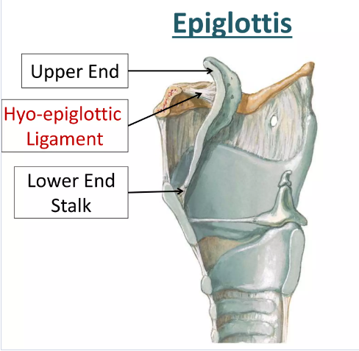
Epiglottis.
Leaf-like cartilage
It is divided by hyoepiglottic ligament into suprahyoid and infrahyoid epiglottis
Anterior surface of epiglottis has a potential space called the pre-epiglottic space.

Slide 15
Paired Cartilages
Arytenoid cartilages:
Pyramidal in shape.
It has a base ,a muscular process, a vocal process and an apex

Slide 16
Corniculate cartilages Each articulates with the apex of arytenoid cartilage
Cuneiform cartilages Each is situated in aryepiglottic fold in front of corniculate cartilage and provides passive support

Slide 17
Histology of Laryngeal Cartilages

Slide 18
Laryngeal Joints
Synovial Joints

Slide 19
Membranes & Ligaments of Larynx
Intrinsic
Cricovocal
Quadrangular
Cricothyroid
Thyroepiglottic
Extrinsic
Thyrohyoid
Cricotracheal
Hyoepiglottic

Slide 21
Extrinsic

Slide 22
Intrinsic Ligaments

Slide 23
Intrinsic membranes
Quadrangular membrane
Links arytenoid to epiglottis and forms vestibular ligament
Cricovocal membrane /cricothyroid ligament
Forms vocal ligament
Form conus elasticus with its fellow on opposite side

Slide 25
Intrinsic Muscles of Larynx
Abductors: Posterior cricoarytenoid
Adductors: Lateral cricoarytenoid, Interarytenoid ,Thyroarytenoid (external part)
• Tensors: Cricothyroid, Vocalis

Slide 26
Openers of laryngeal inlet: Thyroepiglottic (part of thyroarytenoid)
Closers of laryngeal inlet: Interarytenoid (oblique part).

Slide 28
Extrinsic Muscles
Elevators: Stylopharyngeus, salpingopharyngeus, palatopharyngeus and thyrohyoid.
Depressors: Sternohyoid, sternothyroid and omohyoid.

Slide 29
Cavity of Larynx
Vestibule
Ventricle (Sinus of Larynx). It is a deep elliptical space between vestibular and vocal folds
Subglottic Space : It extends from vocal cords to lower border of cricoid cartilage.
Vestibule
Ventricle
Subglottic space

Slide 30
Vestibular Folds : Fold of mucous membrane extending anteroposteriorly across the laryngeal cavity.
Vocal Folds : White sharp bands extending from the middle of thyroid angle to the vocal processes of arytenoids.

Slide 31
Glottis: Anterior 2/3rd of glottis is called phonatory glottis & posterior 1/3rd called respiratory glottis.

Slide 32
Spaces of Larynx

Slide 33
Reinke’s Space.
Potential space under epithelium of vocal cords with scanty subepithelial connective tissues.
Oedema of this space causes fusiform swelling of the membranous cords (Reinke’s oedema).

Slide 34
Blood supply of Larynx
Superior thyroid artery
Inferior thyroid artery
Cricothyroid artery

Slide 35
Nerve Supply of Larynx
Superior laryngeal nerve
Internal Branch: Sensory supply of larynx above vocal cord
External Branch: Cricothyroid muscle
Recurrent Laryngeal nerve
Sensory branch: Subglottis
Motor branch: All muscles except cricothyroid muscle

Slide 37
Paediatric Larynx
Soft and collapsed
Position: high in the neck opposite to C3 or C4
Thyroid cartilage in an infant is flat
Infant’s larynx is small and conical
Submucosal tissues are loose

Slide 38
Physiology of larynx
Protection of lower airways
Phonation
Respiration
Fixation of the chest

Slide 39
ANATOMY OF TRACHEA
Tube made up of cartilage and membrane measures approx. 10-11cm in adult
Extends from C6 to T5
16-20 incomplete cartilaginous rings.

Slide 41
Blood Supply
Inferior Thyroid artery

Slide 42
Nerve supply of Larynx
Vagus Nerve
Recurrent laryngeal nerve
Sympathetic trunk

Slide 43
Lymphatics
Pre tracheal and paratracheal lymph nodes

Slide 44
Functions of tracheobronchial tree
Respiration
Protection of lungs
Warming and moistening of inspired air
Phonation

