Slide 1
ANATOMY AND PHYSIOLOGY OF THE EAR AND VESTIBULAR SYSTEM

Slide 2
University Motto, Vision, Values & Goals
Mission Statement
To impart evidence-based research-oriented health professional education Best possible patient care Mutual respect, ethical practice of healthcare and social accountability.
Vision and Values
Highly recognized and accredited centre of excellence in Medical Education, using evidence-based training techniques for development of highly competent health professionals, who are lifelong experiential learner and are socially accountable.
Goals
The Undergraduate Integrated Learning Program is geared to provide you with quality medical education inan environment designed to

Slide 3
SEQUENCE OF LGIS
Learning objectives
Anatomy of Ear(core concept = 70%)
Related physiology (horizontal integration 15%)
Related clinical / congenital abnormalities (vertical integration – 10%)
Research article related to topic (3%)
Ethics (2%)

Slide 4
LEARNING OBJECTIVES
AT THE END OF THIS LECTURE STUDENTS SHALL BE ABLE TO Comprehend:
Anatomy of Outer Ear
Anatomy of Middle Ear
Anatomy of Inner Ear
Anatomy of vestibular system
Physiology of hearing
Physiology of Balance system.

Slide 5
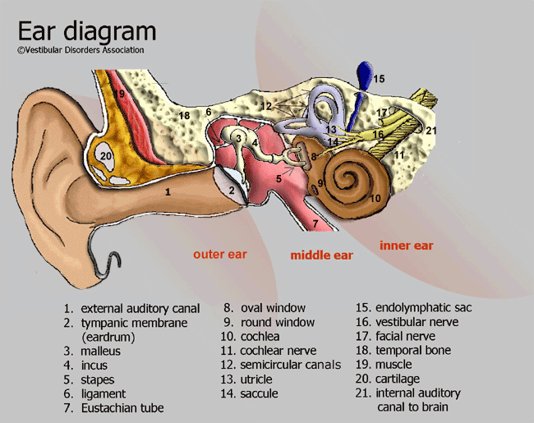

Slide 6
Main Components of the Hearing Mechanism:
Divided into 4 parts (by function):
Outer Ear
Middle Ear
Inner Ear
Central Auditory Nervous System

Slide 7
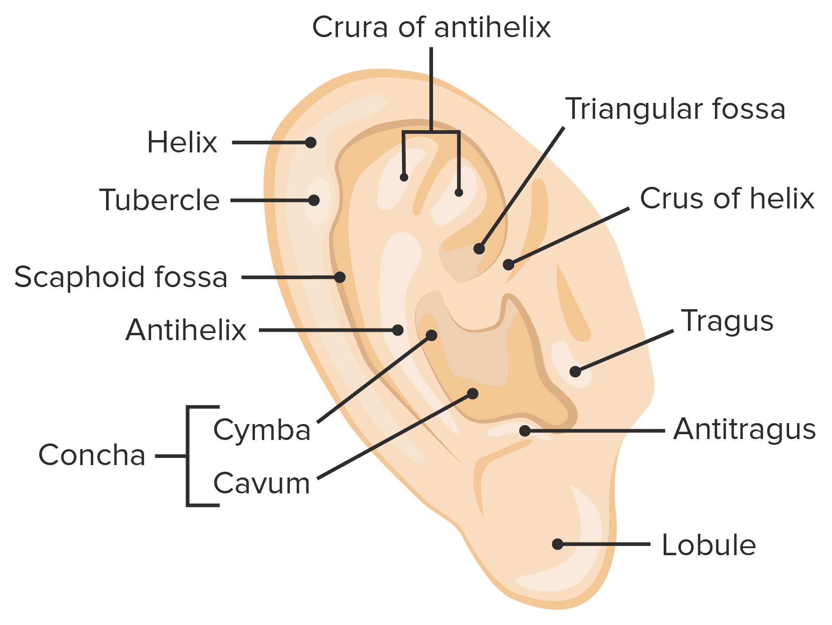
Structures of the Outer Ear
Auricle (Pinna)
Gathers sound waves
Aids in localization
Amplifies sound approx. 5-6 dB

Slide 8
External Auditory Canal
Outer 1/3 cartilaginous
Medially, Upward, Backward
Inner 2/3 : bony
Medially, Downwards, forward

Slide 9
External Auditory Canal:
24mm long
“S” shaped
Outer 1/3 surrounded by cartilage; inner 2/3 by mastoid bone
Allows air to warm before reaching TM
Isolates TM from physical damage
Cerumen glands moisten/soften skin
Presence of some cerumen is normal

Slide 10
Tympanic Membrane
Thin membrane
Forms boundary between outer and middle ear
Vibrates in response to sound waves
Changes acoustical energy into mechanical energy

Slide 11
Mastoid Process of Temporal Bone
Bony ridge behind the auricle
Hardest bone in body, protects cochlea and vestibular system
Provides support to the external ear and posterior wall of the middle ear cavity
Contains air cells.

Slide 12
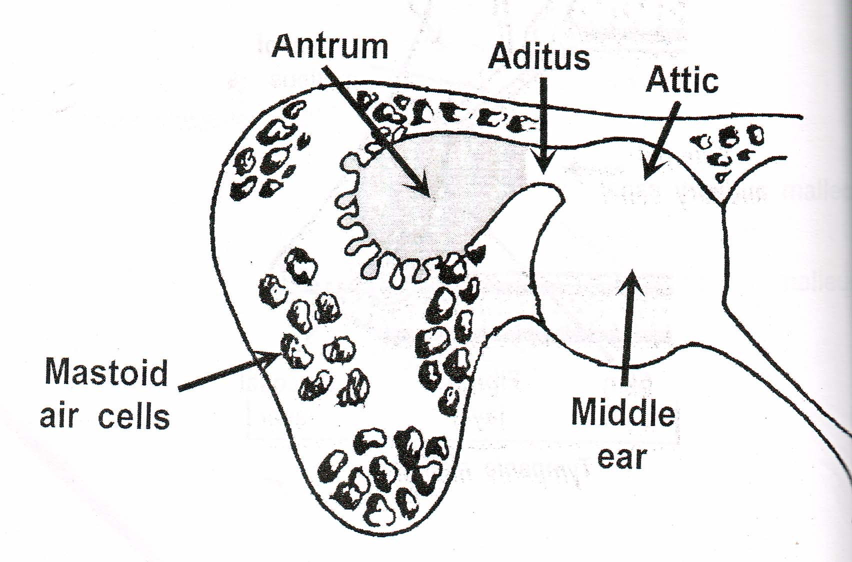
MIDDLE EAR CLEFT
Middle ear cavity
Additus
Antrum
Mastoid air cells
Eustachian tube

Slide 13
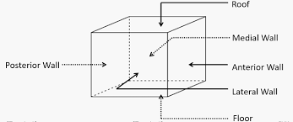
MIDDLE EAR CAVITY
6 sided box
Lateral wall
Medial wall
Anterior wall
Posterior wall
Roof
Floor

Slide 14
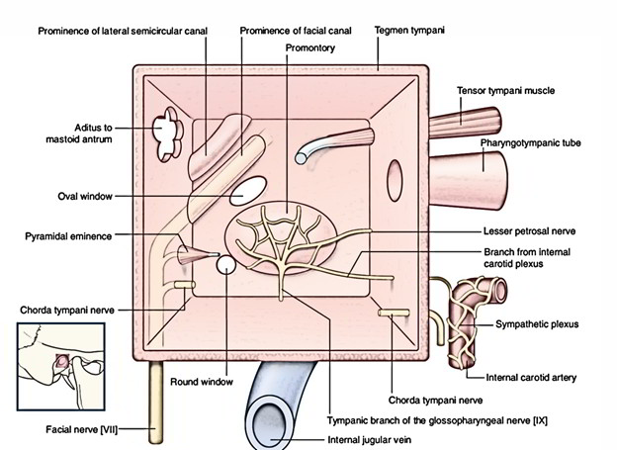
MEDIAL WALL

Slide 15
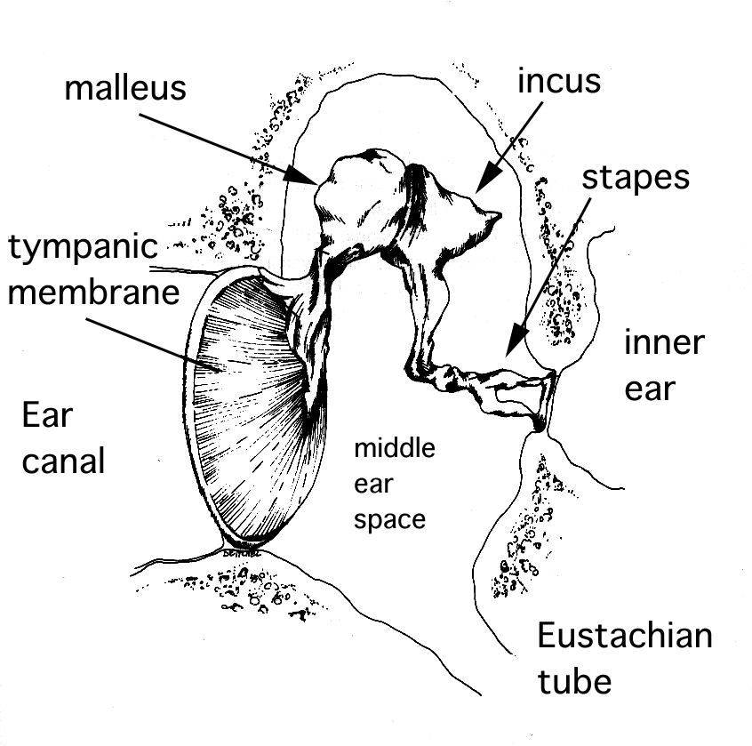
The Ossicles
Ossicular chain = malleus, incus & stapes
Malleus
TM attaches at Umbo
Incus
Connector function
Stapes
Smallest bone in the body
Footplate inserts in oval window on medial wall

Slide 16
Eustachian Tube (AKA: “The Equalizer”)
Mucous-lined, connects middle ear cavity to nasopharynx
“Equalizes” air pressure in middle ear
Normally closed, opens under certain conditions
May allow a pathway for infection
Children “grow out of” most middle ear problems as this tube lengthens and becomes more vertical

Slide 17
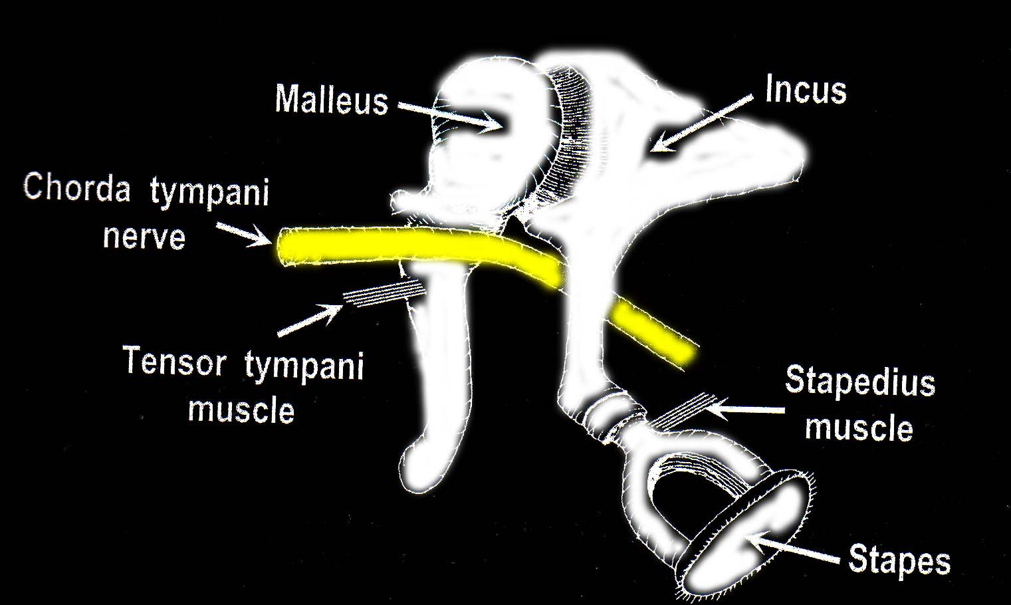
Middle Ear Contents
Air
Three ossicles
Two muscles
Two nerve

Slide 18
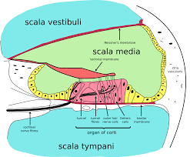
Structures of the Inner Ear: The Cochlea

Slide 19
Inner ear has three main parts:
cochlea
semi-circular canals (labyrinth)
vestibule.
Cochlea supports your hearing and vestibule and semi-circular canals support your balance

Slide 20
Cochlea Structure and Function:
The cochlea is a portion of the inner ear that looks like a snail shell (cochlea is Greek for snail). The cochlea receives sound in the form of vibrations, which cause the stereocilia to move. The stereocilia then convert these vibrations into nerve impulses which are taken up to the brain to be interpreted.

Slide 21
Semicircular Canal Structure and Function
The three semicircular canals of the bony labyrinth are designated according to their position: superior, horizontal, and posterior. The superior and posterior canals are in diagonal vertical planes that intersect at right angles. Each canal has an expanded end, the ampulla, which opens into the vestibule.

Slide 22
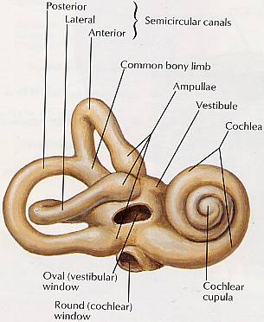

Slide 23
Vestibule Structure and Function
The vestibular system is a sensory system that is responsible for providing our brain with information about motion, head position, and spatial orientation; it also is involved with motor functions that allow us to keep our balance, stabilize our head and body during movement, and maintain posture.
The peripheral vestibular apparatus consists of the saccule, utricle, and semicircular canals

Slide 24
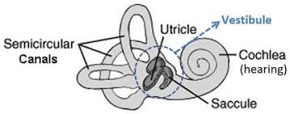
Vestibule Structure and Function

Slide 25
Physiology of Ear

Slide 26
Central Auditory System
VIIIth Cranial Nerve or “Auditory Nerve”
Bundle of nerve fibers (25-30K)
Travels from cochlea through internal auditory meatus to skull cavity and brain stem
Carry signals from cochlea to primary auditory cortex, with continuous processing along the way
Auditory Cortex
Wernicke’s Area within Temporal Lobe of the brain
Sounds interpreted based on experience/association

Slide 28
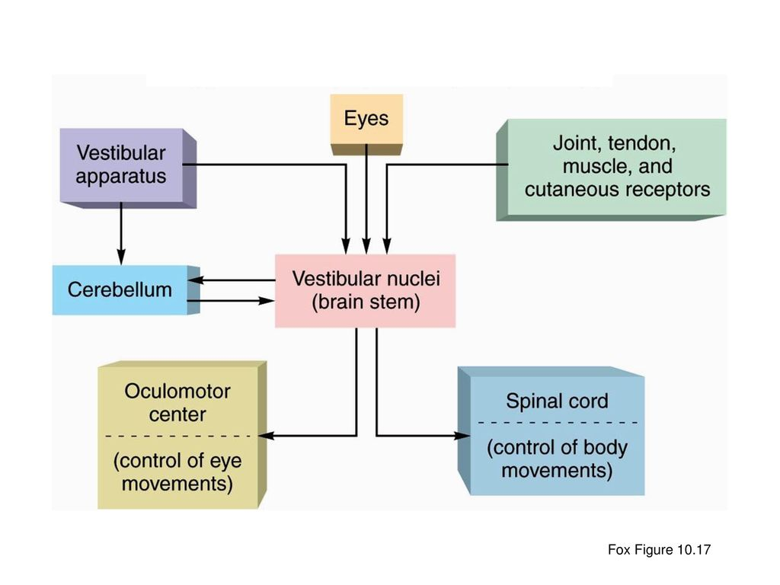
Balance Pathway

Slide 29
Summary: How Sound Travels Through The Ear
Acoustic energy, in the form of sound waves, is channeled into the ear canal by the pinna. Sound waves hit the tympanic membrane and cause it to vibrate, like a drum, changing it into mechanical energy. The malleus, which is attached to the tympanic membrane, starts the ossicles into motion. The stapes moves in and out of the oval window of the cochlea creating a fluid motion, or hydraulic energy. The fluid movement causes membranes in the Organ of Corti to shear against the hair cells. This creates an electrical signal which is sent up the Auditory Nerve to the brain. The brain interprets it as sound!

Slide 30
ARTIFICIAL INTELLIGENCE
1. Image Analysis: AI-powered algorithms can analyze medical images (e.g., CT, MRI) to identify abnormalities in the ear and vestibular system, such as tumors or structural defects.
2. Hearing Loss Diagnosis: AI can help diagnose hearing loss by analyzing audiograms and other hearing test results. Machine learning algorithms can identify patterns and predict the likelihood of hearing loss.
3. Vestibular Function Testing: AI can assist in analyzing vestibular function tests, such as electronystagmography (ENG) and videonystagmography (VNG), to diagnose vestibular disorders.

Slide 31
References:
Heine PA. Anatomy of the ear. Vet Clin North Am Small Anim Pract. 2004 Mar;34(2):379-95. doi: 10.1016/j.cvsm.2003.10.003. PMID: 15062614.
Scott Brown, Edition 8th

