Slide 1
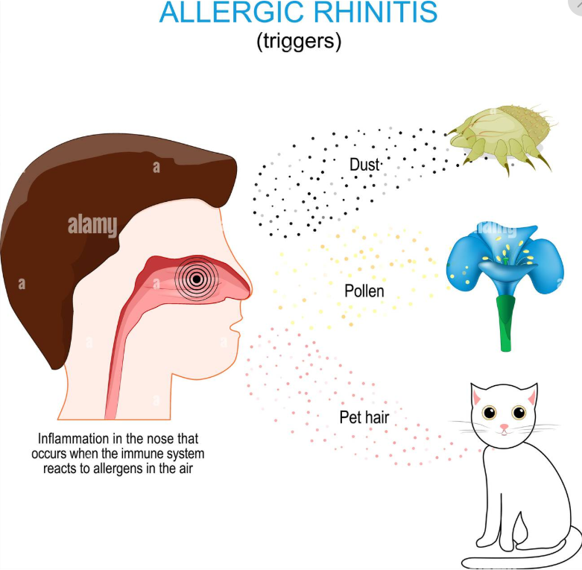
ALLERGIC RHINITIS + ATROPHC RHINITIS

Slide 2
University Motto, Vision, Values & Goals
Mission Statement
To impart evidence-based research-oriented health
professional education
Best possible patient care
Mutual respect, ethical practice of healthcare and social
accountability.
Vision and Values
Highly recognized and accredited centre of excellence in
Medical Education, using evidence-based training
techniques for development of highly competent health
professionals, who are lifelong experiential learner and are
socially accountable.
Goals
The Undergraduate Integrated Learning Program is geared to
provide you with quality medical education inan
environment designed to:

Slide 3
SEQUENCE OF LGIS
Learning Objectives
Related Physiology and biochemistry (horizontal integration 15%)
Related clinical/ congenital abnormalities (Vertical integration-10%)
Research article related to topics (3%)
Ethics (2%)

Slide 4
LEARNING OBJECTIVES
Definition
ARIA Classification
Etiology
Pathogenesis
Clinical features
Investigations
Management
Recent Advances

Slide 5
PROF UMER MODEL OF INTEGRATED LECTURE

Slide 6
DEFINITION
It is an Ig-E mediated response resulting in 2 or more of the following symptoms lasting for 2 or more consecutive days for more than one hour on most days
–anterior/ posterior rhinorrhea
-sneezing
-nasal blockage
-nasal itching

Slide 7
VERTICAL INTEGRATION WITH ANATOMY

Slide 8
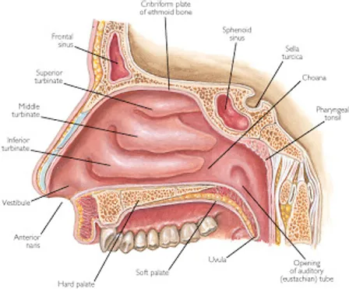
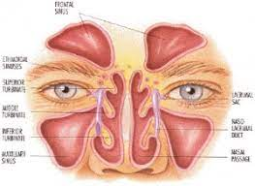
ANATOMY OF NOSE AND PARANASAL SINUSES

Slide 9
EPIDEMIOLOGY
Affects 0.8-39.7% of the world population
Prevalent in Western Europe (23%)
Steep rise in prevalence in recent years
Significant impact on sleep, work and study
Hygiene hypothesis

Slide 10
ETIOLOGY
CLINICAL TYPES | ALLERGENS
Seasonal | Pollens
Perennial | Molds Dust mites Cockroaches Dander
Genetic predisposition | Parental allergic diathesis

Slide 11
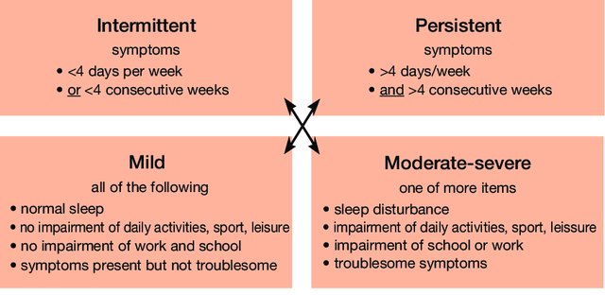
ARIA CLASSIFICATION

Slide 12
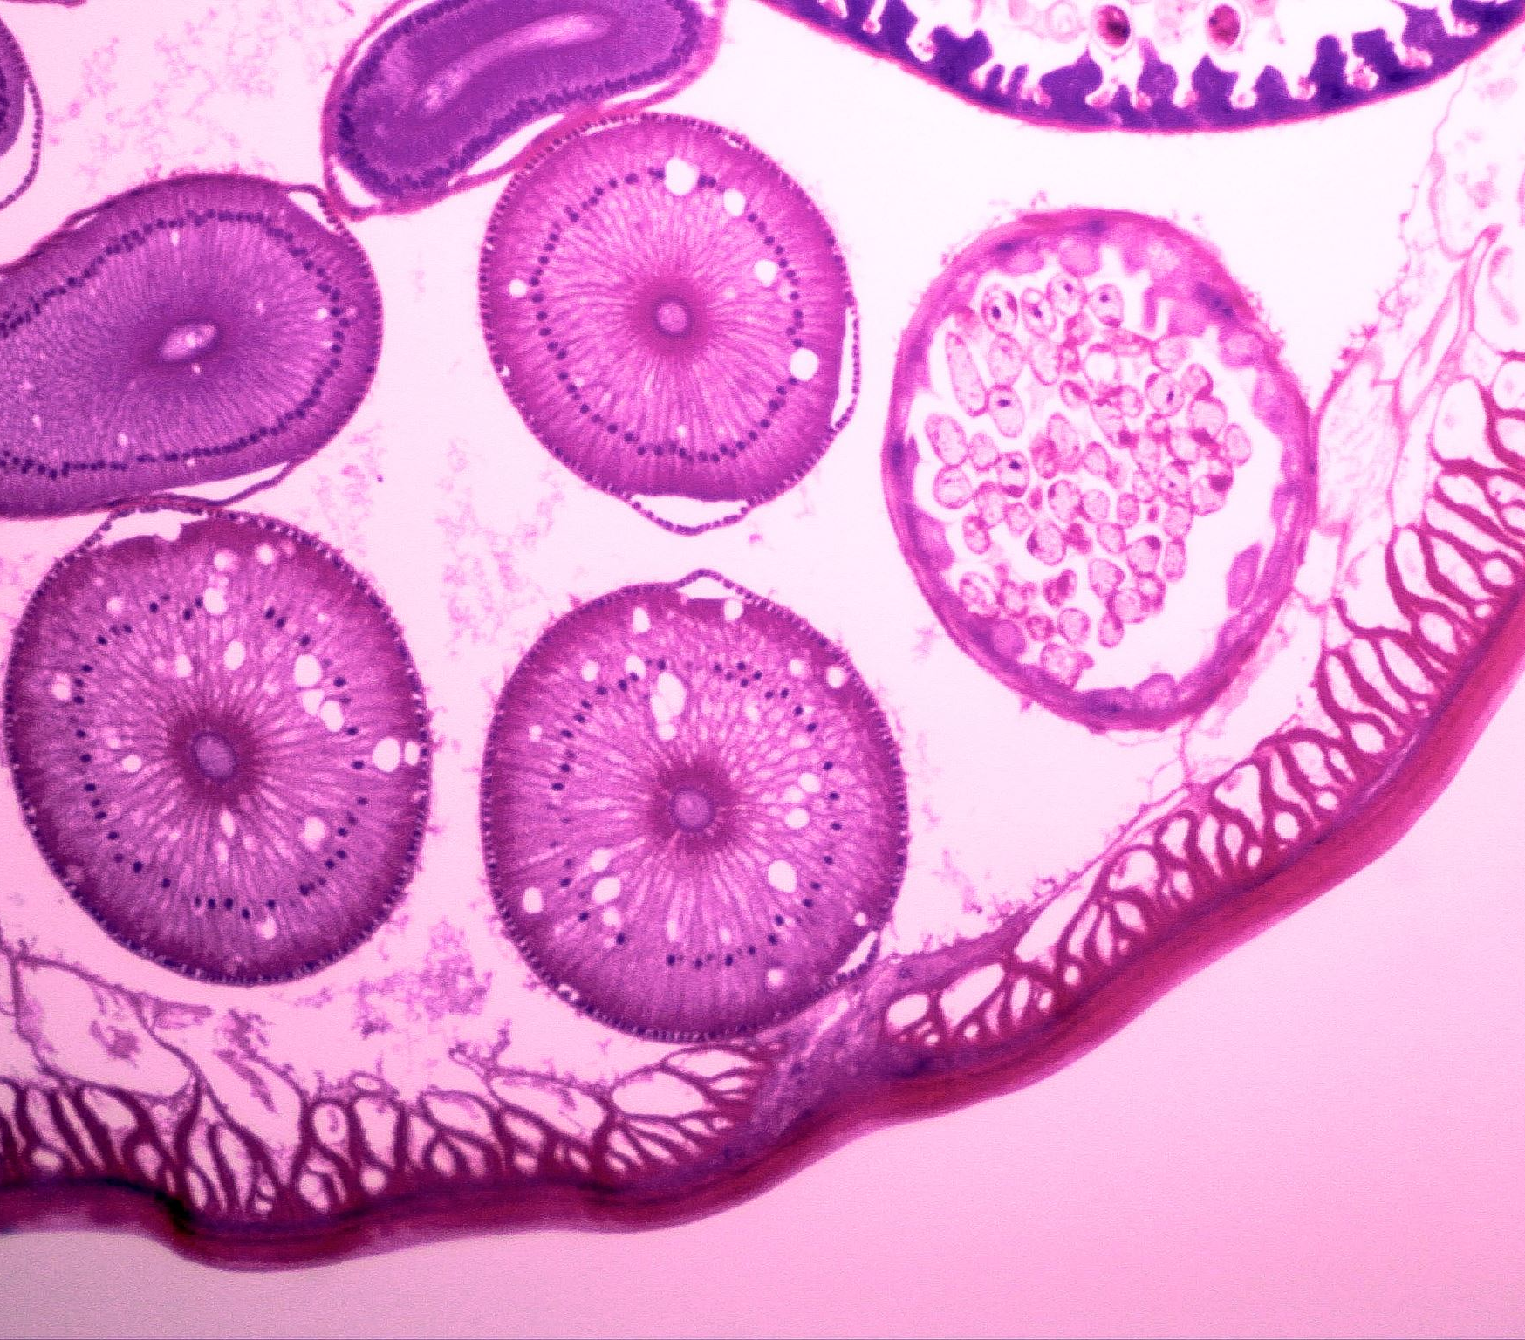
PATHOGENESIS
Allergic response occurs in 2 phases:
Acute/ Early phase (within 5-30 min of exposure) -> due to release of vasoactive amines i.e histamine
Late/ Delayed phase (2-8 hours post exposure) -> due to infiltration of inflammatory cells at site of antigen deposition

Slide 13
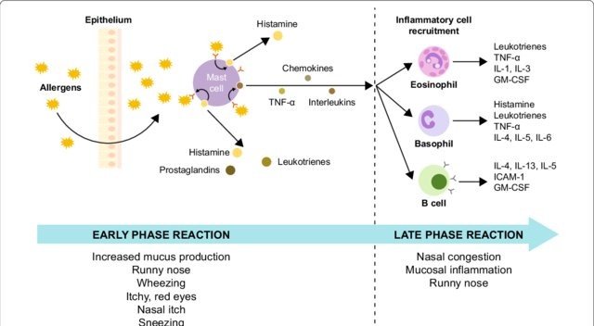
“
”
Richard Branson

Slide 15
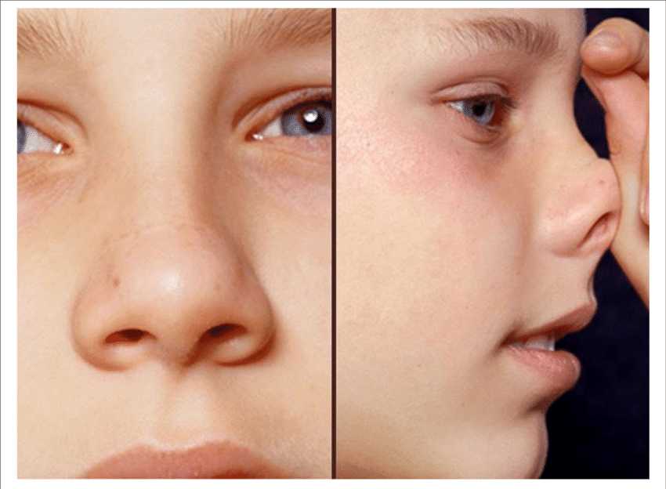
CLINICAL FEATURES
NASAL SIGNS:
Transverse nasal crease, Allergic salute
Hypertrophied turbinates
Pale and edematous nasal mucosa
Watery or mucoid discharge

Slide 16
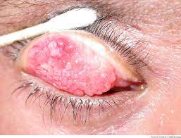
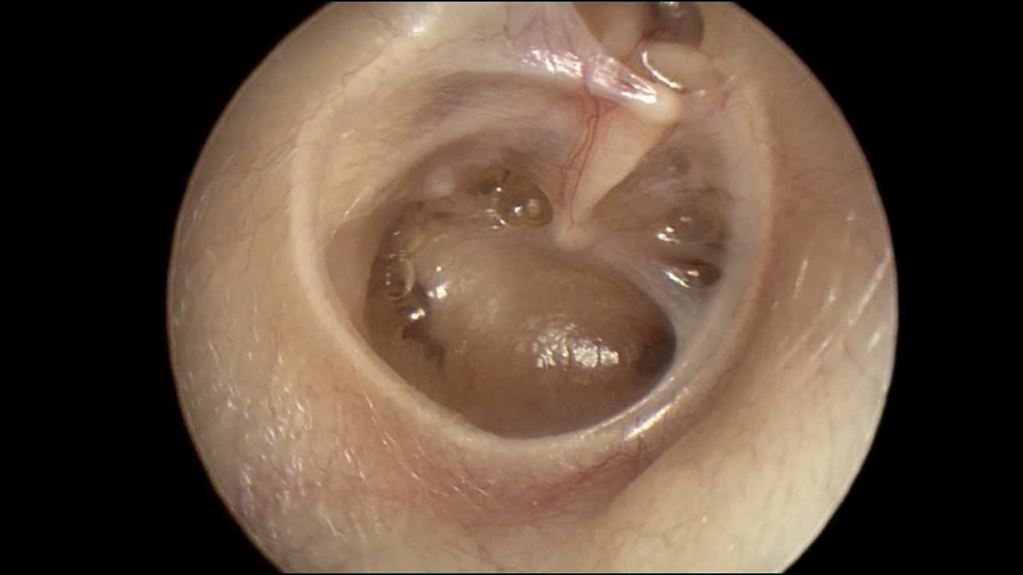
CONTD.
2. Ocular Signs :
- Lid edema
cobblestone appearance of conjunctiva
dark circles under eyes (Allergic shiner)
3. Otologic signs:
Retracted TM
- Serous Otitis Media

Slide 17
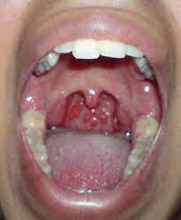
CONTD.
4. Pharyngeal Signs:
Granular Pharyngitis
Features of prolonged mouth breathing
5. Laryngeal Signs:
- Hoarseness (due to vocal cord edema)

Slide 18
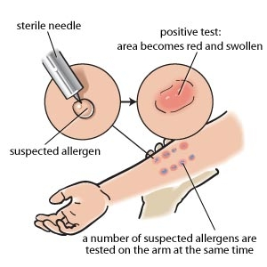
INVESTIGATIONS
TLC and DLC (peripheral eosinophilia)
Nasal smear( should be done during active disease)
Skin prick test***
positive reaction is manifested by formation of central wheal surrounded by flare within 10-15 mins
Radioallergosorbent test (RAST)

Slide 19
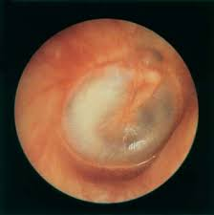
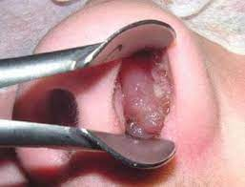
COMPLICATIONS
Recurrent sinusitis
Development of Nasal polypi
Serous Otitis Media
Orthodontic problems due to prolonged mouth breathing
Bronchial Asthma (4x more risk )

Slide 20
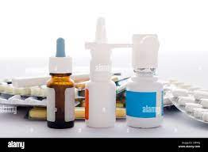
MANAGEMENT

Slide 21
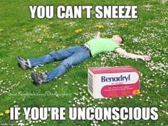
Avoidance of Allergens
Best when a single antigen is involved
Pharmacological Management
Antihistamines (A/E: drowsiness)
Sympathomimetic/ Alpha adrenergic drugs (constrict blood vessels, reduce congestion and edema, cause CNS stimulation, given in combination w/ Antihistamines)
Topical Anticholinergics
Corticosteroids
Sodium cromoglycate

Slide 22
Leukotriene receptor antagonists
Anti-IgE (Omalizumab, approved yet only for asthma in children >12 yrs)
Immunotherapy (Hyposensitization)
Allergen is given in gradually increasing doses till maintenance dose is achieved
Should be given for a year before improvement is observed
Discontinued if uninterrupted treatment for 3 years does not yield any improvement

Slide 23
Management Flowchart

Slide 24
A middle aged female presented in ENT Opd with c/o nasal obstruction bilaterally with h/o anosmia. O/E nasal cavities were filled with greenish dried crusts in nasal cavity. What will be your probable diagnosis?

Slide 25
Atrophic Rhinitis
Chronic inflammation of nose with progressive atrophy of nasal mucosa & turbinate bones
Formation of scanty viscid secretion & green crusts which emit a foul odour (ozaena)
Removal of crusts reveals roomy nasal cavity
Types: 1. Primary 2. Secondary

Slide 26
ETIOLOGY
HERNIA
• Hereditary
• Endocrine
• Racial
• Nutritional deficiency
• Infection
• Autoimmune • Autonomic Imbalance

Slide 27
SECONDARY CAUSES
Long-standing purulent sinusitis
Iatrogenic: Radical turbinectomy, maxillectomy, post-radiotherapy
Tuberculosis, Syphilis, Leprosy
Deviated nasal septum (atrophy in wider nasal cavity)

Slide 28
SYMPTOMS
Nasal obstruction
Greenish-yellow nasal discharge
Offensive smell (ozaena) due to anaerobic infection, experienced by relatives
Merciful anosmia present in the patient
Epistaxis on crust removal

Slide 29
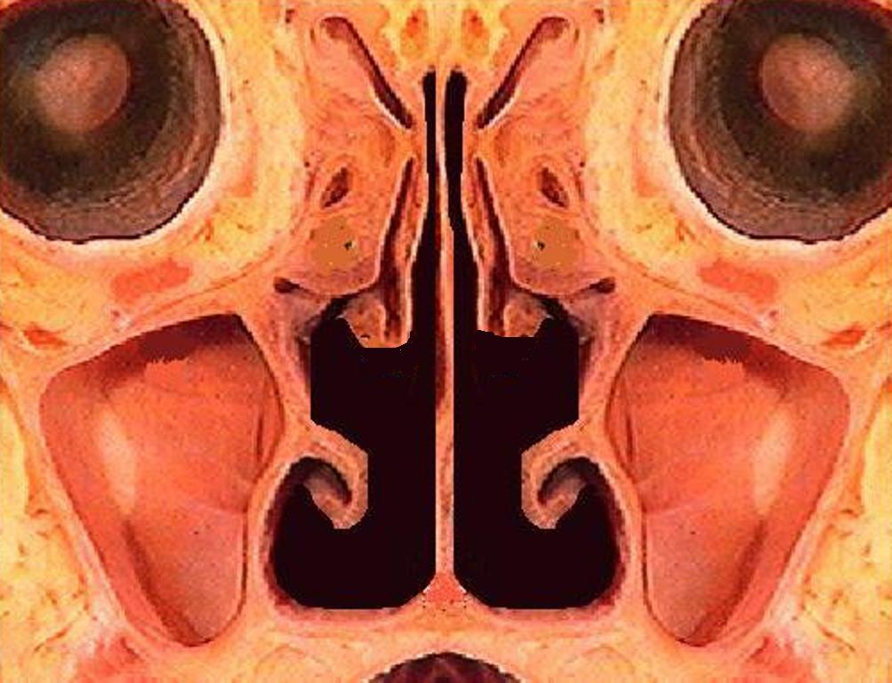
SIGNS
Roomy nasal cavity with atrophy of mucosa & turbinates
Greenish-yellow nasal discharge with crust formation (begins posteriorly)
Foul smell (foetor)
Nasal septum perforation
Nasal myiasis

Slide 30
CT SCAN
Mucoperiosteal thickening
Resorption of ethmoid bulla & uncinate process
Hypoplasia of maxillary sinuses
Roomy nasal cavities
Erosion & bowing of lateral nasal wall
Atrophy of turbinates

Slide 31
SPECIFIC INVESTIGATIONS
Chest X-ray: T.B., bronchiectasis, lung abscess
Serology for syphilis: V.D.R.L.,
Sputum for AFB, Mantoux test: T.B.
Nasal smear study: Leprosy

Slide 32
MEDICAL MANAGEMENT
Douching → alkaline nasal douche
Oestradiol nasal spray (1%)
Glucose (25%) in glycerin nasal drops
Streptomycin injection
Placental extract injection
Autogenous vaccines
Rifampicin
Kemicetine solution: Estrogen, Vit. D, Chloramphenicol
Mandl’s nasal paint (Potassium Iodide & oestradiol)
Potassium Iodide orally

Slide 33
SURGICAL MANAGEMENT
Young’s operation: Only 1 nostril closed
completely by raising 2 circumferential
flaps (inner mucosal & outer cutaneous) in nasal
vestibule & suturing them in midline.
Modified Young’s operation : done by similar
way but keeping a 3 mm opening on both sides.
Recannalisation done after 12-18 month with a
tri-radiate (Mercedes Benz) incision.

Slide 34
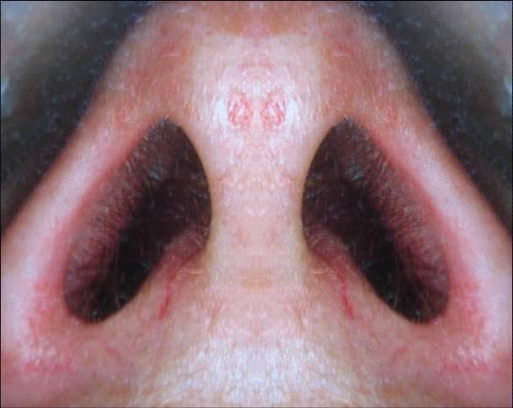
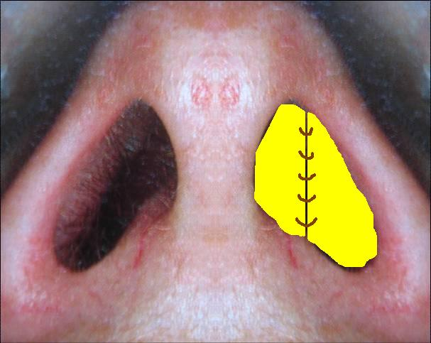
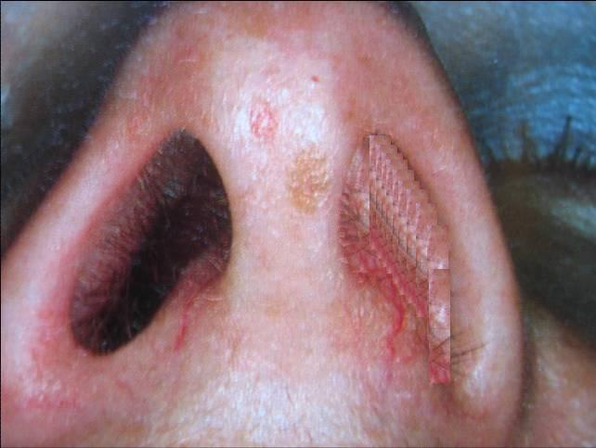

Slide 35
RESEARCH AND ETHICS
Liu P, Hu T, Kang C, Liu J, Zhang J, Ran H, Zeng X, Qiu S. Research Advances in the Treatment of Allergic Rhinitis by Probiotics. J Asthma Allergy. 2022;15:1413-1428
https://doi.org/10.2147/JAA.S382978
Conclusion: Probiotics have clear benefits for clinical AR patients and can represent an aspect of future management of AR therapy due to their excellent immunoregulatory effects.
Prognosis should be explained thoroughly to patients.
Advise regarding its complex and multifactorial nature

Slide 36
RECENT ADVANCES
Allergen specific immunotherapy use in patients with allergic rhinitis ?
Occupational allergen avoidance methods and their use

Slide 37
REFERENCES
SCOTT BROWN OTOLARYNGOLOGY 8TH edition
PL Dhingra 7th edition

