Slide 2
Air And Ventilation
Otorhinolaryngology MODULE-I
Block X
D Mehrish Saleem
Dr Maria Jabeen

Slide 3
Vision & Mission of RMU
Wisdom
Truth
Service
To impart evidence based research oriented medical education
To provide best possible patient care
To inculcate the values of mutual respect and ethical practice of medicine

Slide 4
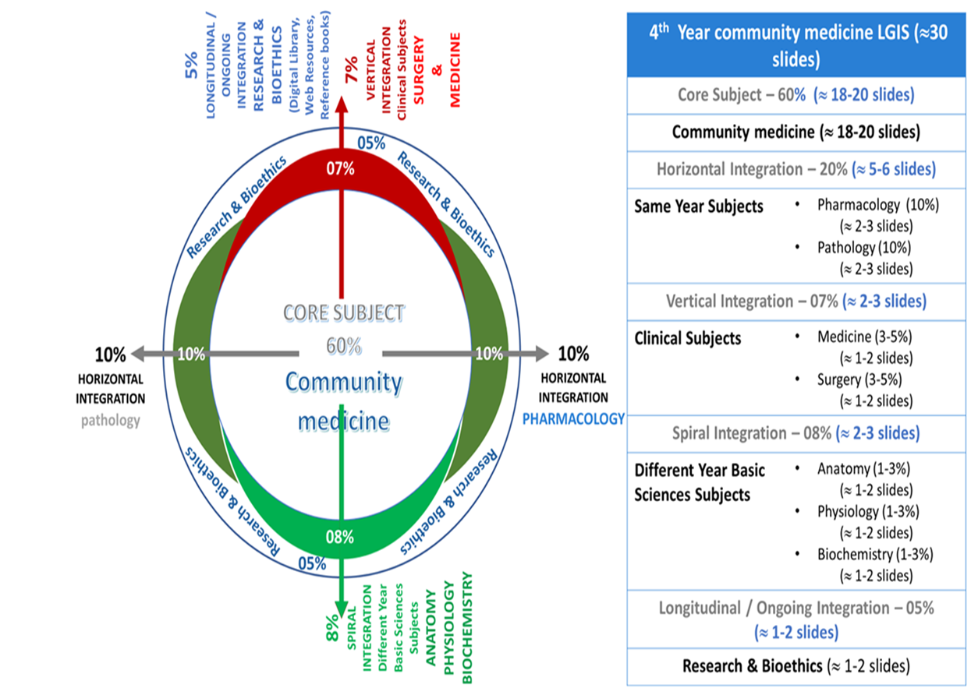
Prof Umar Model

Slide 5
Learning objectives
The student should be able to :
Enlist indices of thermal comfort Describe the factors responsible for vitiation of air Define air pollution Identify sources of air pollution and air pollutants Demonstrate selection of air sample for analysis
Enumerate the methods to prevent & control of air pollution
Describe standards and types of ventilation

Slide 6
Role Of Air In Human Health
Vital role: all forms of life
Supply of oxygen for living organisms
Supply CO2 to plants
Helps in smelling through air transmitted stimuli
Helps in hearing
Keeps body cool
Spread of disease
Human constant requirement of air :10-20 m³ /day
Vertical integration

Slide 7
Composition Of Air
Core Content

Slide 8
Air of occupied room (vitiated air)
Chemical changes:
- Contamination by CO₂ :
* CO₂ by human breathing-
0.6-0.7 cu ft/ hr at rest
2 cu ft /hour during exercise
Metabolic processes decrease oxygen content
Physical Changes:
-Rise in temperature: 400 Btu/hour by a human at rest
4000 Btu during exercise
1 Btu (British Thermal Unit) = Qty of heat required to heat 1 pound of water to 1 degree F
Vertical integration

Slide 9
Air of occupied room (vitiated air)
(Physical changes contd….)
- Increase of humidity: Perspiration and respiration
* 6% of water vapors in the expired air
* Decrease in air movement
Body odors: foul breath, perspiration, bad oral hygiene
Bacterial pollution: conversation, coughing, sneezing, loud talking
Vertical integration

Slide 10
Air of occupied room (vitiated air)
Effects of vitiated air( Oxygen depleted air):
Discomfort/ feeling of suffocation
Adverse effects on vital organs
Decrease in efficiency
Headache, drowsiness, inability to concentrate
Droplet infection
Lowered resistance to disease
Horizontal integration

Slide 11
Discomfort
Core Content
“A subjective sensation which people experience in ill-ventilated and crowded rooms.”
Not due to chemical changes but due to physical changes.
Temperature
Humidity
Air movement
Heat radiation
Cooling power of the air

Slide 12
Indices Of Thermal Comfort
1. Air temperature: not an adequate index
2. Air temperature and humidity: even this was not found to be an adequate index
3. Cooling power:
Air temperature, humidity and air movement to gather considered as the “ Cooling Power” of the air
Kata thermometer( HILL)- Used for measuring cooling power-Dry Kata reading of 6 and Wet Kata reading of 20 and above are considered as indices of thermal comfort
Core Content

Slide 13
Core Content
Indices Of Thermal Comfort
4. Effective temperature: Effect of temperature, humidity and movement of the internal air on the sensation of warmth or cold felt by human body
5. Corrected effective temperature:
6. McArdle’s Maximum allowable sweat rate:
- refers to the highest rate at which a person can sweat without experiencing significant dehydration or a decline in performance.
- "predicted four-hour sweat rate" (P4SR) - McArdle has put P4SR value of 3 as upper limit of comfort zone.

Slide 14
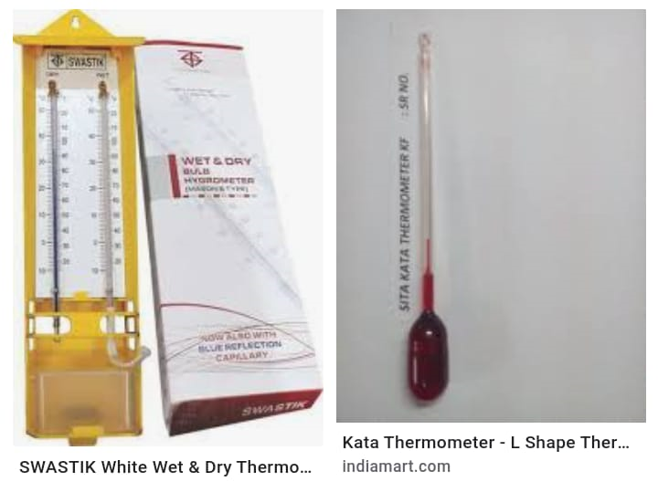

Slide 15
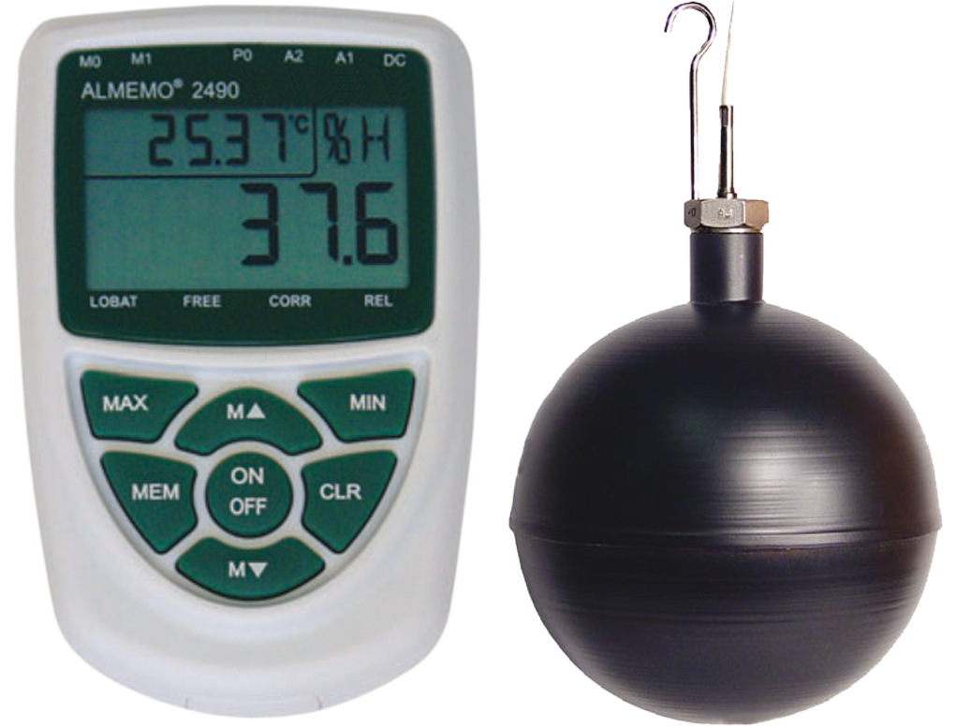

Slide 16
Comfort zones
Core Content
The range of effective temperature over which the majority of adults feel comfortable.
Comfort: a complex, subjective experience depending on:
Physical factors
Physiological factors
Psychological factors
Based on environmental factors
Comfortable thermal conditions are those under which a person can maintain normal balance between production and loss of heat, at normal body temperature and without sweating.”

Slide 17
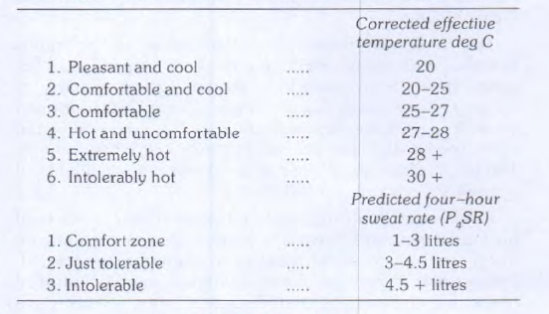
Comfort zones
Core Content

Slide 18
Air Pollution
Core Content
Introduction of chemicals, particulate matters, biological materials that cause harm or discomfort to humans or other living organisms or damages the nature into the atmosphere .
Air pollution either emitted into the atmosphere or formed within the atmosphere itself.

Slide 19
Basic Definitions
Core Content
Primary air pollutants
Emitted directly into the air from a source like factory chimney or an exhaust pipe or suspension of contaminated dusts by wind.
Particulate air pollutants
Solid or liquid suspended in air.
Secondary air pollutants
Gaseous air pollutant
formed by chemical reactions of primary pollutants with natural components of air e.g, ozone
e.g, sulphur dioxide, nitrogen dioxide and carbon mono oxide.

Slide 20
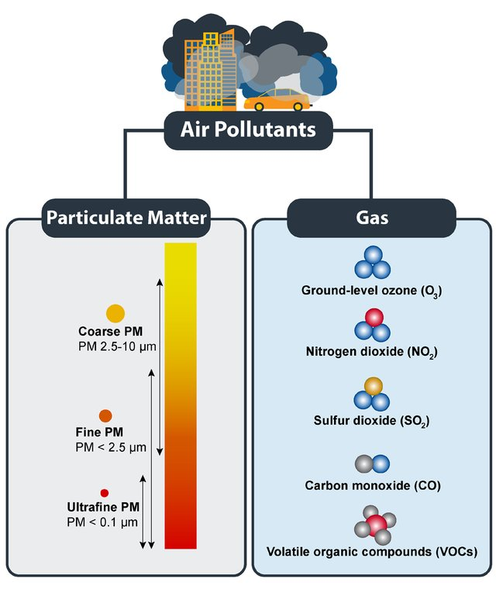
Core Content

Slide 21
Basic Definitions
Core Content
Local scale:
some pollutants by virtue of their source or having short atmospheric life are only encountered in appreciable concentration near source e.g, burning biomass fuel
Urban scale:
Nitrogen oxide, CO, generated by road traffic are present in high concentrations
Regional scale:
gas-phase pollutants such as ozone have atmospheric lifetime of days e.g, sulphates and ozone can travel thousands of kilometer as long-range transport
Global scale: pollutants associated with greenhouse effect have atmospheric lifetime of years and capable of distribution globally e.g CH₄. CO₂

Slide 22
Sources Of Air Pollution
Vertical +horizontal integration
Automobiles: Emit hydrocarbon, carbon monoxide, lead, nitrogen oxide, in sunlight many of these hydrocarbons and oxides of nitrogen get converted into photochemical pollutants
Industries: produce smoke, sulfur dioxide, nitrogen oxide and fly ash
Petrochemical industries generate hydrogen fluoride, hydrochloride.
Domestic sources: Domestic consumption of coal, wood or oil is a major source of smoke, dust,sulpher dioxide and nitrogen oxide
Miscellaneous : burning refuse, incinerators, pesticide spraying and nuclear energy programmes)

Slide 23
Sources Of Indoor Pollution
Horizontal integration
Efficient insulation
Bacteria
Molds
Viruses
animal dander and saliva
plants
house dust
Mites
pollen

Slide 24
Air pollutants
Core Content
More than 100 substances have been identified
Density depends on distance form the source, may be in the form of solids, liquids (vapours) or gases
Important pollutants include:
Carbon monoxide | Fluorine compounds
Carbon dioxide | Organic compounds (hydrocarbons, aldehydes, ketones, organic acids)
Hydrogen sulphide | Metallic contaminants (e.g., Arsenic, zinc)
Sulphur dioxide | Radio-active compounds
Sulphur trioxide | Photochemical oxidants (e.g., Ozone)
Nitrogen oxides

Slide 25
Major Air Pollutants
Core Content
More than 100 air pollutants identified ( solids, liquids-vapours and gases)
Carbon Monoxide and Carbon Dioxide
Sulfur Dioxide and Sulfur trioxide
Nitrogen oxides
Fluorine compounds
Organic Compounds (Hydrocarbons, Aldehydes, Ketones, organic acids etc)

Slide 26
Major Air Pollutants……
Core Content
Metallic contaminants ( Arsenic, Zinc, iron from smelting operations etc)
Photochemical oxidants eg. Ozone
Others: Mercury, Benzene, Lead, Radioactive radiations, Cadmium, Hydrogen sulphide, Particulate matter
Pollutants differ from place to place
Dependent upon the contamination source

Slide 27
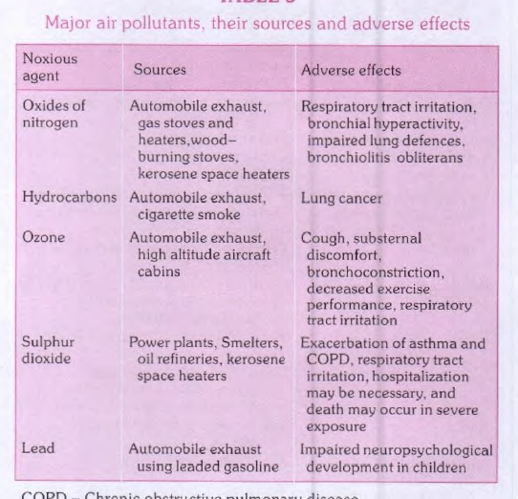
Vertical integration

Slide 28
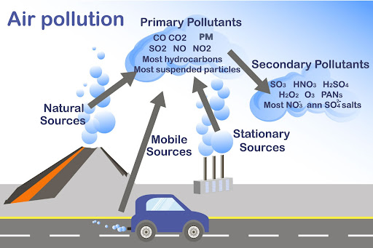
Core Content

Slide 29
Meterological Factors
Temperature Inversion
Smog

Slide 30
Collection Of Air Sample
Core Content
Wide mouth jar 3-4 L capacity
Thoroughly wash it and dry , fill it with water and close with a stopper
Take the jar to vitiated room and turn upside down near a basin
Allow to dry and close with a stopper so that no outside air could enter
Label it showing its capacity, barometric temperature and pressure, time of collection of air sample

Slide 31
Prevention and control of Air Pollution
Core Content
Containment
Prevention of escape of toxic substances into air by enclosure, ventilation and air cleaning
Arrestors are mostly used for removal of contaminants
Replacement
Use of natural gas and electricity has replaced smoke producing coal
Reduce lead level in petrol which is a cumulative poison

Slide 32
Prevention and control
Core Content
Dilution
Green belts, settlements of industries away from communities
Legislation
Height of chimneys, research and health education
International action
WHO has established an international network of laboratories for the monitoring and study of air pollution.

Slide 33
Disinfection Of Air
Core Content
Mechanical Ventilation : reduces vitiated air and bacterial density.
Ultraviolet Radiation : effective in operation theatres and infectious disease wards. Chemical Mists : Triethylene glucol vapours bactericides, particularly against droplet nuclei and dust.
Dust Control : The application of oil to floors of hospital wards reduces the bacterial content of the air.

Slide 34
Ventilation
Core Content
The modern concept of ventilation implies not only the replacement of vitiated air by a supply of fresh outdoor air but also control of the quality of incoming air with regard to its temperature, humidity and purity with a view to provide a thermal environment that is comfortable and free from risk of infection.

Slide 35
Standards of ventilation
Core Content
Cubic space
Minimal fresh air supply ranging from 300 to 3,000 c.Ft. Per hour per person
Air change
Living room there should be 2 or 3 air changes in one hour
Floor space
In work rooms and assemblies 4 to 6 air changes.
The optimum floor space requirements per person vary from 50 to 100 sq.ft

Slide 36
Types of ventilation
Core Content
Natural ventilation
Mechanical ventilation

Slide 37
Natural ventilation
Core Content
Wind
Perflation
Aspiration
cross-ventilation·
Diffusion Air passes through smallest spaces, slow process
Inequality of temperature :
These properties of air are utilized to best advantage by the proper location of windows, doors, ventilators and skylights.
The chief drawback of natural ventilation is that it is not possible to regulate the velocity of the incoming air nor to adjust its temperature or humidity

Slide 38
Mechanical ventilation
Core Content
Exhaust ventilation
Plenum ventilation fresh air is blown(through ducts) to create positive pressure and displace the vitiated air
Balanced ventilation combination of both systems
Air conditioning

Slide 39
Ethical issues in air pollution
Spiral integration
Public Health Impact
Harm to vulnerable populations
Right to clean air
Responsibility and Accountability
Corporate accountability for pollution
Governmental role in regulation
Informed Consent and Transparency
Lack of public information
Data manipulation concerns

Slide 40
Family Medicine
Spiral integration
Preventive Care
Health Education
Advocacy for Public Health
Managing Chronic Diseases
Long-term care for asthma, COPD, etc.
Research and Data Collection
Contribute to pollution-related health studies
Collaboration with Public Health
Implement air quality monitoring programs
Assist in air pollution emergency preparedness

Slide 41
Artificial intelligence
Spiral integration
https://www.cleanairfund.org/news-item/ai-wearables-innovative-tech/

Slide 42
Ventilation Strategies for Good Indoor Air Quality and Energy Efficiency
research
https://www.tandfonline.com/doi/abs/10.1080/14733315.2008.11683785
This indicates the importance of proper design and installation as well as qualified, well trained operational personnel, the indoor air quality can be maintained or improved while reducing energy consumption. Aspects include: proper target and design values of indoor air quality and climate, source control, the efficient removal of contaminants, proper location of fresh air intakes, cleaning of intake air, efficient air distribution in rooms by means of improved ventilation efficiency, heat recovery from exhaust air, control of ventilation rates by air quality, correct balancing of airflows, controlling of indoor climate locally and using ventilation for night cooling.

Slide 43
EOLA
Which pollutant is most commonly associated with industrial emissions and contributes significantly to respiratory problems?
A) Carbon Dioxide (CO₂) B) Sulfur Dioxide (SO₂) C) Methane (CH₄) D) Nitrous Oxide (N₂O) E) Ozone

Slide 44
Suggested reading
K. park chapter environment & health

