Slide 1
ADENOIDITIS

Slide 2
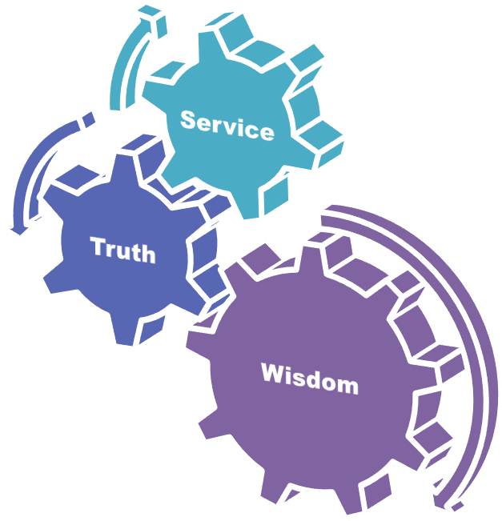
University Motto, Vision, Values & Goals
Mission Statement To impart evidence-based research-oriented health professional education Best possible patient care Mutual respect, ethical practice of healthcare and social accountability. Vision and Values Highly recognized and accredited centre of excellence in Medical Education, using evidence-based training techniques for development of highly competent health professionals, who are lifelong experiential learner and are socially accountable. Goals The Undergraduate Integrated Learning Program is geared to provide you with quality medical education in an environment designed to:

Slide 3
Sequence of LGIS
Learning objectives
Development of Adenoids(core concept = 6%)
Anatomy, physiology, biochemistry (spiral integration 8%)
Pathology and community medicine (horizontal integration 20%)
Related clinical medical surgical (vertical integration – 60%)
Research, family medicine, bioethics, artificial intelligence (5%)

Slide 4
Learning Objectives
At the end of this lecture students shall be able to learn:
Development of Adenoid
Anatomy of Adenoids
Signs and Symptoms
Examination
Investigations
Medical and Surgical Management
Recent Advances

Slide 5
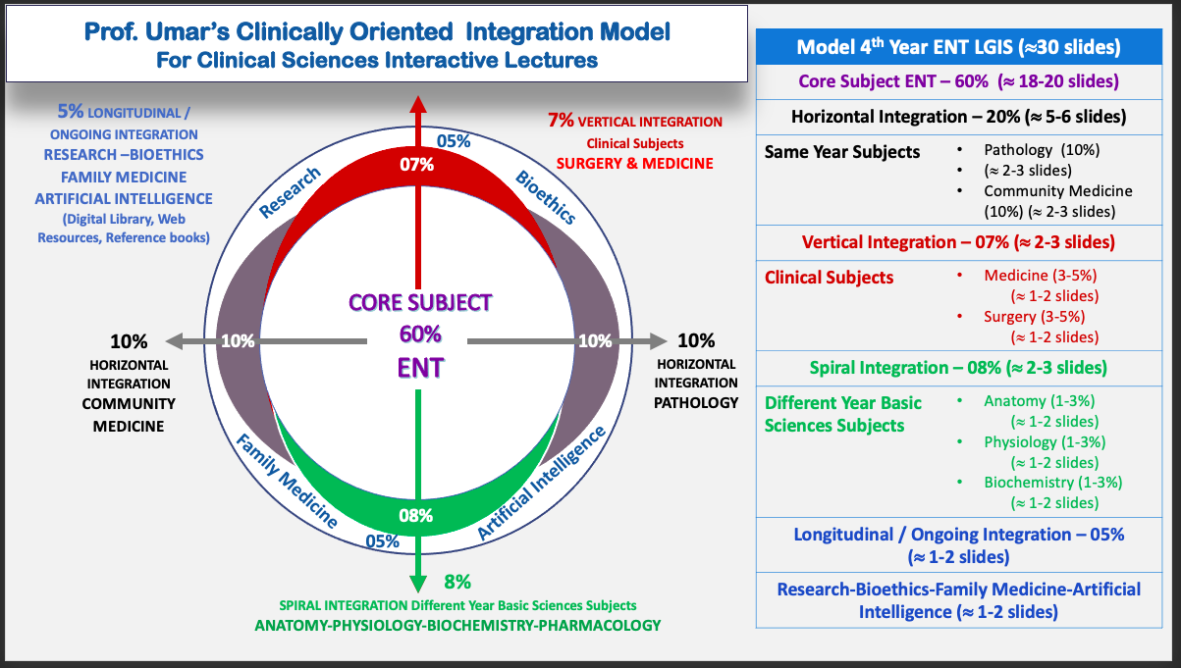
Prof Umer Model Of Integrated Lecture

Slide 6
Spiral Integration With Anatomy

Slide 7
Development of Adenoids
The formation of the adenoids begins in the
3rd month of fetal development.
In the 5th month sagittal folds are formed which are the beginnings of pharyngeal crypts.
By the 7th month of development the
adenoids are fully formed.

Slide 8
Anatomy Of Adenoid
Nasopharyngeal tonsil or Adenoid is a single mass of pyramidal tissue with its base on the posterior nasopharyngeal wall and it’s apex pointed toward the nasal septum.
Covering epithelium is of three types, ciliated pseudostratified columnar, stratified squamous and transitional.
Adenoid have no crypt and no capsule

Slide 9
Arterial Supply & Venous Drainage
Ascending palatine branch of the facial artery
Pharyngeal branch of the internal maxillary artery
Artery of the pterygoid canal
Ascending cervical branch of the thyrocervical trunk.
Pharyngeal plexus and the pterygoid plexus following ultimately into the facial and internal jugular veins.

Slide 10
Nerve supply & Lymphatics
Innervation is derived from the glossopharyngeal and vagus nerves.
Efferent lymphatics drain to the
retropharyngeal nodes and the
upper deep cervical nodes.

Slide 11
Horizontal Integration With Pathology And Histopathology

Slide 12
Pathological effects of Adenoid
Otitis media with effusion
Recurrent acute otitis media
Upper airway obstruction and sleep disorder breathing
Rhinusinusitis
Reduced Olfactory sensitivity
Neoplasia
Histology
Covering epithelium is of three types, ciliated pseudostratified columnar, stratified squamous and transitional.

Slide 13
Integration With Pathophysiology
Physiological enlargement in childhood
Recurrent attack of rhinitis, sinusitis or chronic tonsillitis
Allergy of upper respiratory tract
Horizontal integration

Slide 14
Clinical Features
CORE SUBJECT
Enlarged and infected adenoids may cause nasal,aural or general symptoms
Nasal obstruction
Nasal discharge
Epistaxis
Voice change
Sinusitis
Aural symptoms
Tubal obstruction
Recurrent attacks of acute otitis media
Otitis media with effusion

Slide 15
General Symptoms
It is the long, open-mouthed,face of children with adenoid hypertrophy
The mouth is always open because upper airway congestion has made patients obligatory mouth breathers
The most common presenting symptoms are chronic mouth breathing and snoring.
The most dangerous symptom is sleep apnea

Slide 16
Diagnosis
Core Subject
Detailed history of the patient
Detailed clinical examination which includes:
General Examination
Posterior Rhinoscopy
Investigations include:
Xray Soft Tissue Nasopharynx Lateral View
CT Scan Nose
Nasopharyngoscopy

Slide 17
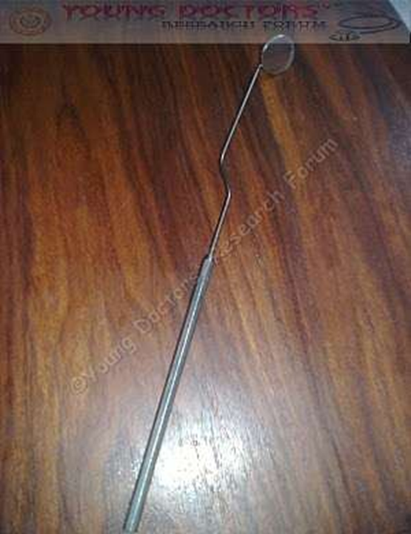
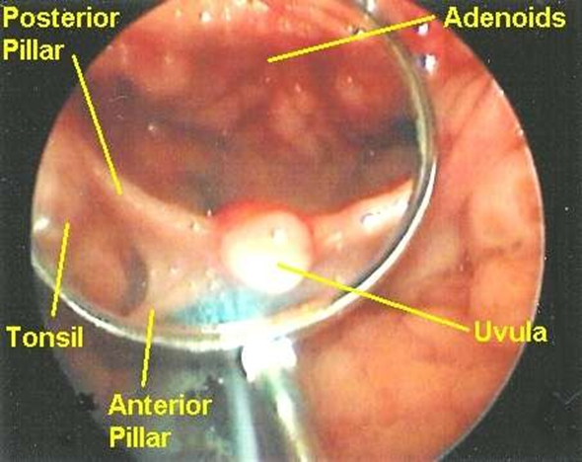
POSTERIOR RHINOSCOPY

Slide 18
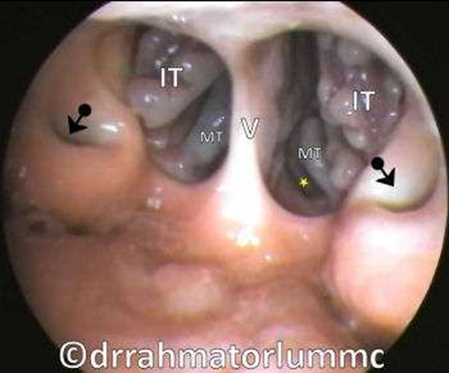
NASOPHARYGOSCOPY

Slide 19
Integration With Radiology
Spiral Integration
Xray soft tissue nasopharynx lateral view
CT scan Nose

Slide 20
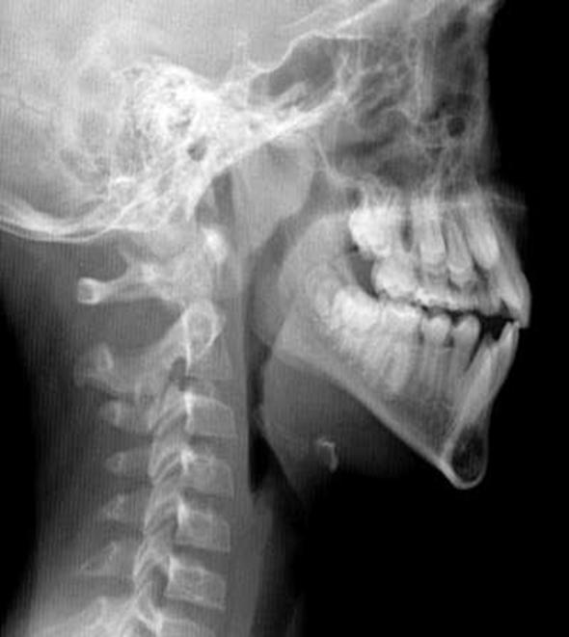
X-Ray soft tissue nasopharynx- lateral view

Slide 21
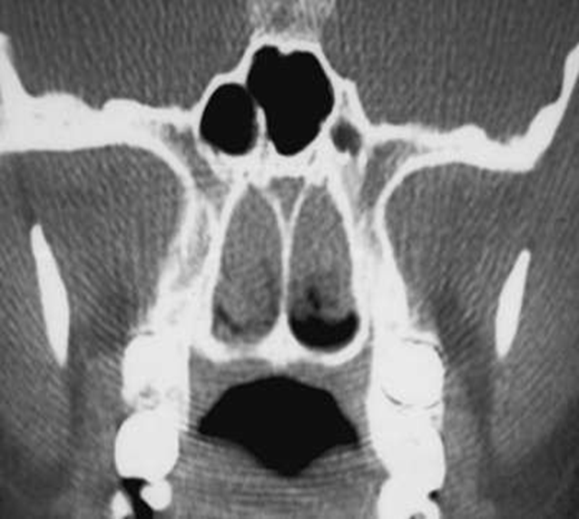
CT SCAN NOSE

Slide 22
Differential Diagnosis
Obstructive Sleep Apnea
Acute Nasopharyngitis
Chronic Nasopharyngitis
Thornwaldt’s Disease (Pharyngeal Bursitis)

Slide 23
Management/Treatment

Slide 24
Medical Treatment
Vertical Integration
Breathing Exercises
Nasal Decongestants
Steroidal Nasal Sprays
Anti Histamines

Slide 25
Surgical Treatment
Vertical Integration
ADENOIDECTOMY is the definite surgical treatment
INDICATIONS OF ADENOIDECTOMY:
Four or more episodes of recurrent purulent rhinorhea in a child <12years old.
Persisting symptoms of adenoiditis
Sleep disturbance with nasal airway persisting for three months.
Hyponasal or nasal speech
Otitis media with effusion >3 months or second set of tubes
Dental malocclusion or orofacial growth disturbance documented by orthodontist.
Cardiopulmonary complications including cor pulmonale, pulmonary hypertension, right ventricular hypertrophy associated with upper airway obstruction.
Otitis media with effusion over age 4.

Slide 26
CONTRAINDICATIONS OF ADENOIDECTOMY:
A submucous cleft palate which may lead to velopharyngeal insufficiency after surgery. If the adenoid obstruction is severe enough, then only superior half adenoidectomy is performed.
Avoid surgery in patients with hemoglobin less than 10.
Perform surgery at least 2 weeks after the last attack of acute tonsillitis.
Avoid surgery in patients with uncontrolled systemic diseases (ie. leukemia).

Slide 27
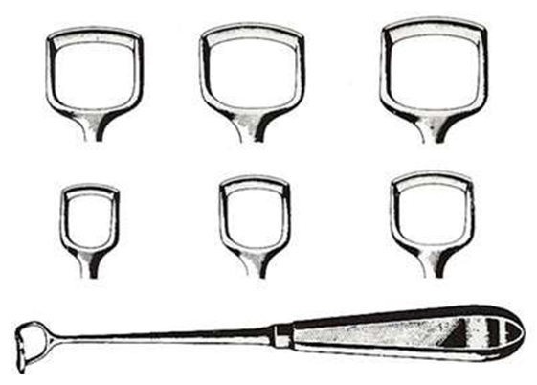
St. Claire Thomson Adenoid Curette

Slide 28
Position for Adenoidectomy

Slide 29
Complications
Vertical Integration
The incidence of mortality from adenotonsillar surgery ranges from 1 in16,000 to 1 in 35,000 cases.
Anesthetic complications and hemorrhage cause the majority of deaths.
The prevalence of hemorrhage ranges from 0.1% to 8.1%.
It is divided into primary bleeding, in the first 24 hours, and secondary bleeding, around 7-10 days post operatively.
Other risks include: Vomiting,Dehydration, Airway obstruction due to edema, Fever, velopharyngeal insufficiency, Dental injury Burns, Nasopharyngeal stenosis.

Slide 30
Contd.
Atlantoaxial subluxation can occur in patients with Down syndrome.
Atlantoaxial joint laxity because of Grisel’s syndrome.This is vertebral body decalcification and laxity of the anterior transverse ligament between the atlas and the axis from inflammation or infection in the nasopharynx.
Spontaneous subluxation occurs about 1 week post operatively with pain and torticollis.

Slide 31
Post Operative Care
Vertical Integration
Immediate general care:
a. Coma position
b. Watch for bleed
c. Vital monitoring
Soft diet
Oral Hygiene
Analgesia
Antibiotics

Slide 32
Research
Longitudinal Integration
https://emedicine.medscape.com/article/859760-overview
According to Batson (2021) it is a complex and progressive disease
It is affecting 360 million people worldwide

Slide 33
Biomedical Ethics
Longitudinal Integration
Before doing any medical and surgical treatment, informed consent must be taken
Prognosis should be explained to patients and attendants

Slide 34
Family Medicine
Longitudinal Integration
Any patient who presents with progressive hearing loss in middle age should be referred to ENT specialist and tested for audiological assessment

Slide 35
Artificial Intelligence
Longitudinal Integration
Improves pre-op planning by through 3-D image analysis
Helps in navigation of complex anatomical variations

Slide 36
REFERENCES
SCOTT BROWN OTOLARYNGOLOGY 8th edition
Disease of ENT Saleem Iqbal Bhutta
PL Dhingra, 7th edition

