Slide 1
ACYNOTIC HEART DISEASE PAEDIATRIC DEPARTMENT RMU

Slide 2
Motto Vision
Wisdom
Truth
Service
To impart evidence based research oriented medical education
To provide best possible patient care
To inculcate the values of mutual respect and ethical practice of medicine

Slide 3
Professor Umar Model of Integrated Lecture

Slide 4
Learning Objectives
Define Congenital Heart Disease
Describe Etiology and pathophysiology
Describe clinical features
Investigate a patient with Congenital Heart Disease
Know the management options available
Recent advances in CHD
Bioethical issues

Slide 5
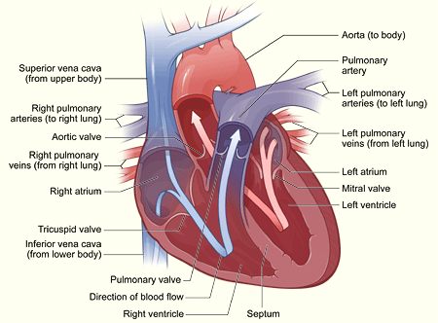
Congenital Heart Disease (CHD)
Vertical integration
Review anatomy
Review embryology
Review physiology
Review cardio mechanics

Slide 6
Circulatory changes at birth In fetus left atrial pressure is low, as little blood returns from the lungs Right atrial Pressure is higher than left, as it receives all the systemic venous return including blood from the placenta Blood flows across the foramen ovale into the left atrium, and then into the left ventricle, which in turn pumps it to the upper body

Slide 7
With the first breaths, resistance to pulmonary blood flow falls and the volume of blood flowing through the lungs increases six-fold Volume of blood returning to the left atrium increases resulting in rise in the left atrial pressure Meanwhile, the volume of blood returning to the right atrium falls as the placenta is excluded from the circulation Foramen ovale closes due to change in the pressure The ductus arteriosus closes within the first few hours or days

Slide 8
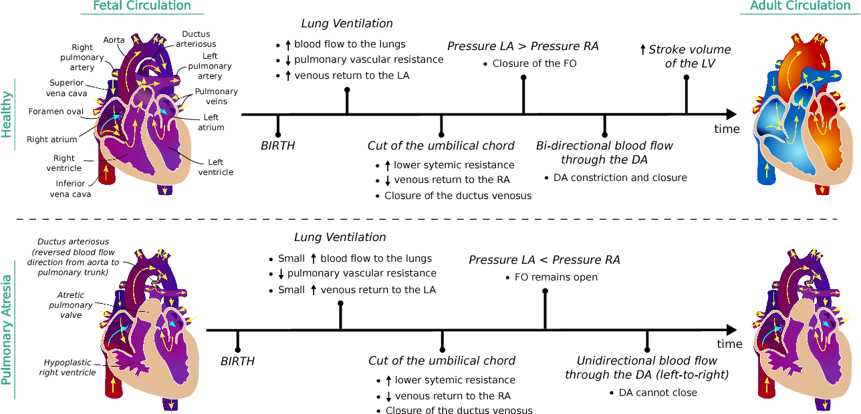

Slide 9
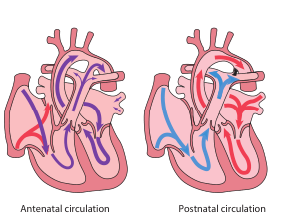

Slide 10
Clinical scenario…
A 9month old child present with a history of recurrent pneumonia present with respiratory distress ,physical examination shows wheezing,intercostal recession,hyperdynamic precodium and systolic murmer at left sternal border radiating at back in interscapular region.What is most likely diagnosis
a)ASD
b)VSD
c)PDA
d)Pulmonary stenosis
e)Aortic stenosis

Slide 11
Epidemiology of CHD Heart disease in children is mostly congenital Incidence : 8 per 1000 live born infants About 1 in 10 stillborn infants

Slide 12
Most common anomalies - 80% of all lesions 1• Ventricular septal defect 30 % 2• Persistent arterial duct 12 % 3• Atrial septal defect 07 % 4• Pulmonary stenosis 07 % 5• Tetralogy of Fallot 05 % 6• Transposition of the great arteries 05 % 7• Aortic stenosis 05 % 8• Coarctation of the aorta 05 %. 9• Atrioventricular septal defect (complete) 02 %

Slide 13
Etiology of congenital heart disease Maternal disorders Rubella, SLE, Diabetes mellitus Maternal drugs Warfarin therapy, Fetal alcohol syndrome Chromosomal abnormality Down syndrome Edwards syndrome

Slide 14
Etiology of congenital heart disease
Patau syndrome
Turner syndrome
Williams syndrome
Noonan syndrome

Slide 16
Presentation Congenital heart disease presents with: • Antenatal cardiac ultrasound diagnosis • Detection of a heart murmur • Heart failure • Shock • Cyanosis

Slide 17
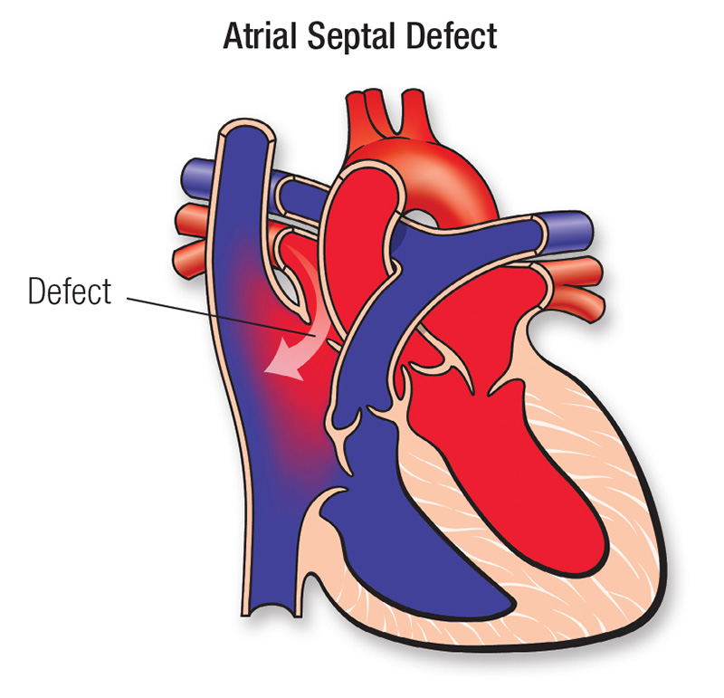
Atrial septal defect

Slide 18
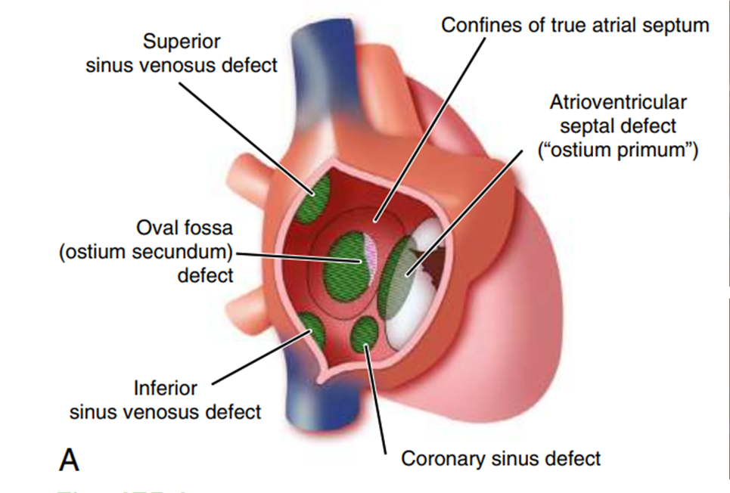
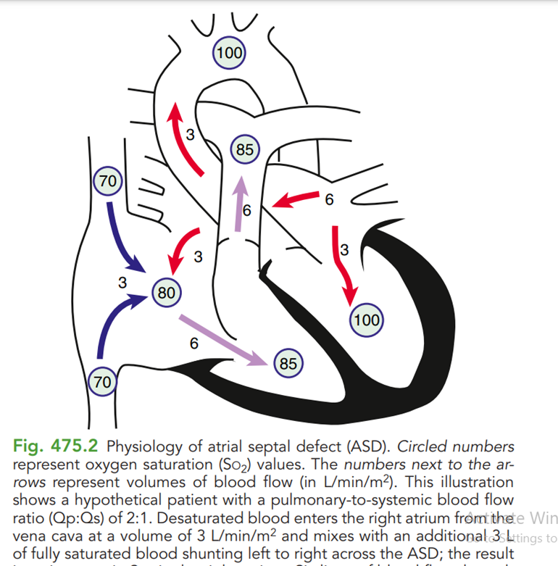
Pathophysiology

Slide 22
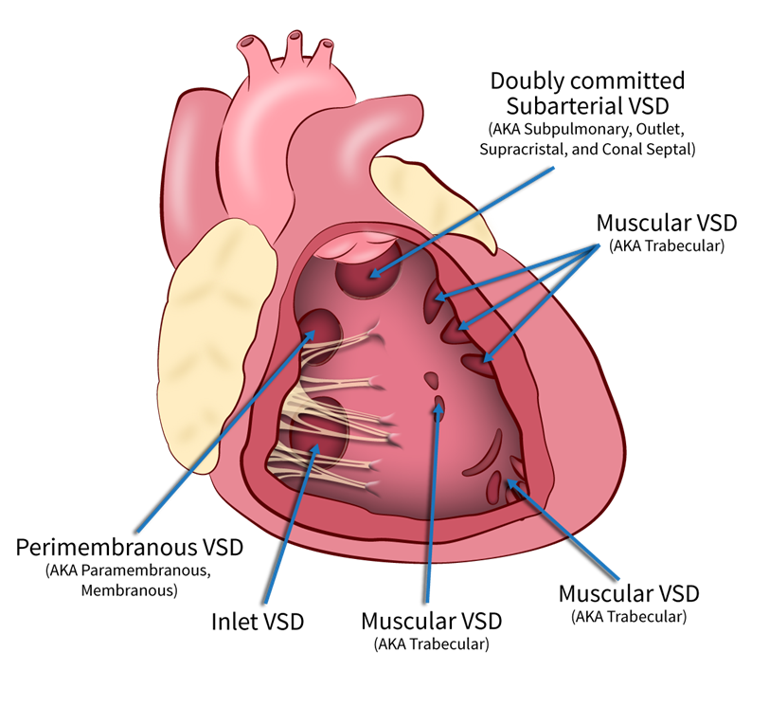
Ventricular septal defects VSDs are common - 30% of all cases of CHD There is a defect anywhere in the ventricular septum 1. Membranous 2. Muscular

Slide 23
Small VSDs - up to 3 mm Asymptomatic
Large VSDs - > 3mm Symptomatic
Heart failure with breathlessness
Faltering growth after 1 week old
Recurrent chest infections

Slide 24
PATHOPHYSIOLOGY

Slide 25
Clinical presentation

Slide 26
Clinical presentation

Slide 27
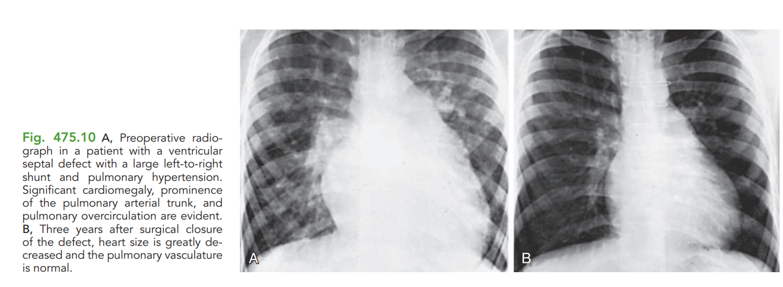
DIAGNOSIS

Slide 28
Management Medical- Heart failure - Diuretics, Captopril. Additional calorie input is required. Surgery - Performed at 3 months to 6 m of age in order to: • Manage heart failure and faltering growth • Prevent permanent lung damage from pulmonary hypertension and high blood flow.

Slide 30
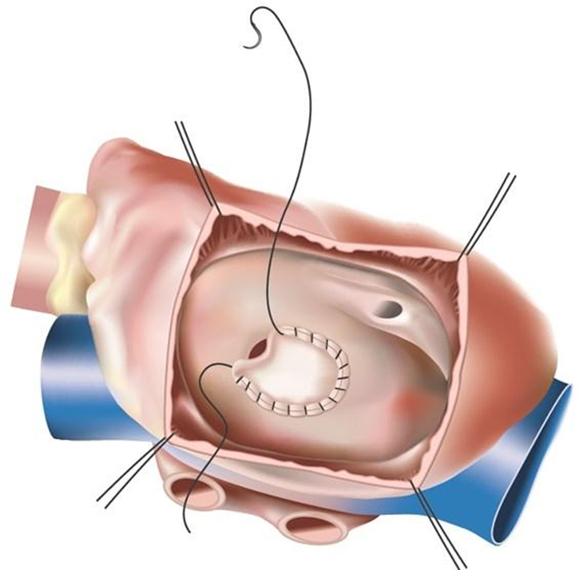
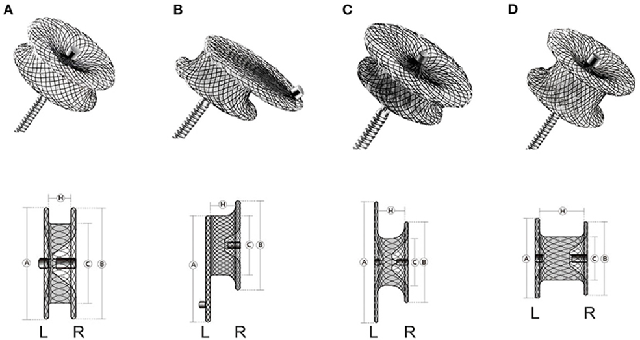
Device occlusion Surgery

Slide 31
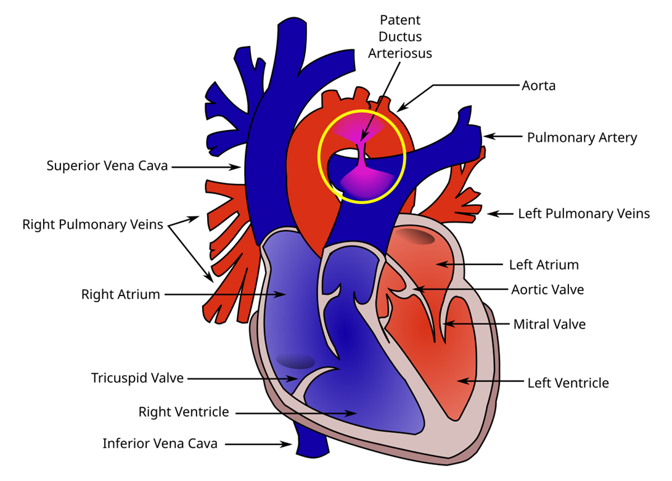
Persistent ductus arteriosus (PDA) Ductus arteriosus connects PA to descending aorta Normally closes shortly after birth In PDA it fails to close Flow of blood in PDA is from the aorta to the pulmonary artery

Slide 32
Clinical features Usually asymptomatic When the duct is large - Heart failure Pulmonary hypertension Bounding pulse Continuous machinery murmur beneath the left clavicle radiating at back between the two scapula

Slide 33
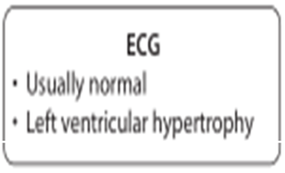
Investigations
CXR and ECG
Usually normal
But if the PDA is large and symptomatic
CXR and ECG are indistinguishable from those seen in a patient with a large VSD
Echocardiography
Duct is identified .

Slide 34
Management:
Closure is recommended to abolish the lifelong risk of
Bacterial endocarditis
Pulmonary vascular disease
Closure is with a coil or occlusion device
Occasionally surgical ligation is required

Slide 35
Advances in the Diagnosis and Management of Congenital Heart Disease in Children
P. Syamasundar Rao^{1,*} and Arpit Agarwal²
Author information Article notes Copyright and License information PMC Disclaimer
The last five decades have witnessed an inordinate number of advances in the diagnosis and management of congenital heart defects (CHDs), as reviewed elsewhere [1]. These advances include the
detection of CHDs using fetal echocardiography;
the identification of critical CHD via the pulse oximetry screening of neonates before discharge from the hospital in addition to conventional methods of CHD identification by routine history, physical gram; examination, and simple laboratory studies, such as chest X-ray and electrocardiograph

Slide 36
Bio ethical aspects
Bioethical aspects in pediatric patients with congenital heart disease (CHD) primarily navigating complex decisions regarding
Diagnosis
Treatment options
Quality of life considerations
Informed consent
Resource allocation
End-of-life care

Slide 37
REFERENCE BOOKS
BASIS OF PEDIATRICS by PERVAIZ AKBAR
( REVISED 10TH Edition)
Page no.300
Children (Basel). 2022 Jul; 9(7): 1056.
Published online 2022 Jul 15. doi: 10.3390/children9071056

Slide 38
THANK YOU

