Slide 1
Acute Renal Failure (ARF)
DR.ASMARA ASRAR
Assistant Professor of Nephrology
HOLY FAMILY HOSPITAL

Slide 2
MOTTO AND VISION
Mission Statement
To impart evidence-based research-oriented health
professional education
Best possible patient care
Mutual respect, ethical practice of healthcare and social
accountability.
Vision and Values
Highly recognized and accredited centre of excellence in
Medical Education, using evidence-based training
techniques for development of highly competent health
professionals, who are lifelong experiential learner and are
socially accountable.
Goals
The Undergraduate Integrated Learning Program is geared to
provide you with quality medical education in an
environment designed to:

Slide 3
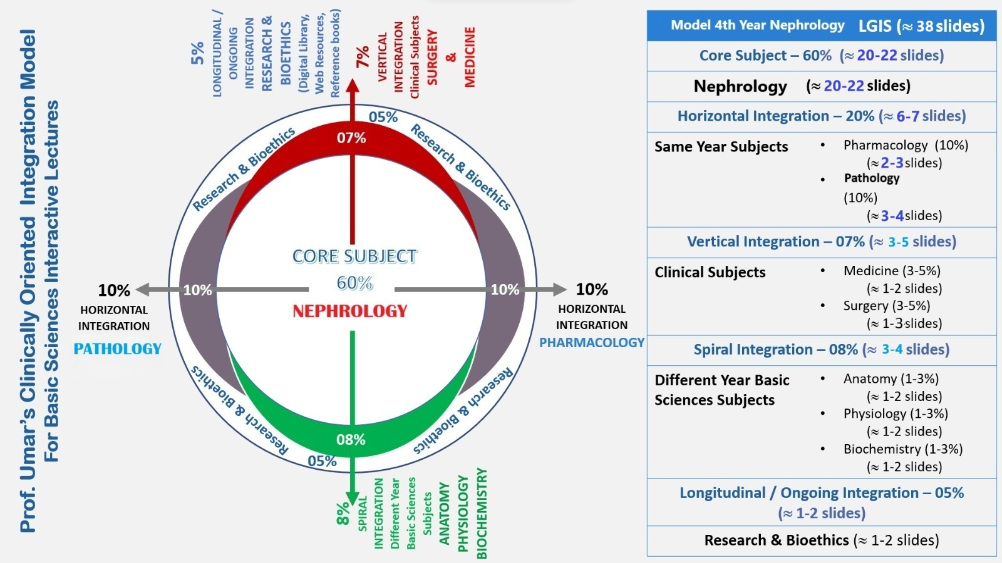

Slide 4
LEARNING OBJECTIVES
AT THE END OF THIS LECTURE STUDENTS SHALLBE ABLE TO LEARN:
ETIOLOGY OF AKI
SIGNS AND SYMPTOMS
EXAMINATION
INVESTIGATIONS
MEDICAL MANAGEMENT
RECENT ADVANCES

Slide 7
Diagnosis and management plan ?

Slide 8
ACUTE KIDNEY INJURY:
The KDIGO guidelines define AKI as follows:
●Increase in serum creatinine by ≥0.3 mg/dL (≥26.5 micromol/L) within 48 hours, or
●Increase in serum creatinine to ≥1.5 times baseline, which is known or presumed to have occurred within the prior seven days, or
●Urine volume <0.5 mL/kg/hour for six hours

Slide 12
Prerenal AKI
Volume depletion (profuse diarrhea, vomiting, over-diuresis with diuretics)
Shock of any etiology
Cardiorenal syndrome
Hepatorenal syndrome
Congestive nephropathy (systemic congestion impairs venous outflow)
Abdominal compartment syndrome
Hypertensive emergency

Slide 13
Intrinsic (renal)AKI Causes:
Tubular injury
Ischemic ATN: Ischemia due to severe prolonged hypoperfusion
Nephrotoxic ATN:
Endogenous toxins: Myoglobin (rhabdomyolysis), hemoglobin (hemolysis), intra-tubular obstruction from crystalluria (ethylene glycol, tumor lysis syndrome)
Exogenous toxins

Slide 14
Renal AKI
Tubulointerstitial injury
Acute interstitial nephritis: NSAIDs, PPIs,antibiotics
Infection: Viral, bacterial, and fungal infections
Acute glomerulonephritis
Glomerulonephritis may present as:
Nephrotic syndrome with peripheral edema, heavy proteinuria (protein excretion greater than 3.5 g/24h), hypoalbuminemia (<3g/dl), and hyperlipidemia and a bland urinary sediment.
Nephritic syndrome with acutely elevated creatinine, hematuria, proteinuria, red blood cell casts, hypertension and no obvious cause of pre-renal or post-renal cause.

Slide 15
Postrenal (obstructive) AKI Causes:
Nephrolithiasis
Prostate obstruction, e.g. BPH, carcinoma, infection.
Bladder neck obstruction
Occluded or mal-positioned Foley catheter
Functional: neurogenic bladder secondary to spinal cord injury, diabetes, multiple sclerosis, stroke, pharmacologic side effects of drugs (anticholinergics, antidepressants).
Urethral: posterior urethral valves, strictures, trauma.

Slide 18
LABORATORY INVESTIGATIONS:
Serum creatinine
The serum creatinine tends to rise progressively and usually at a daily rate of ~1mg/dl/d with complete cessation of renal function.
A higher rate of rise in serum creatinine (~>1.5-2 mg/dl per day) is highly suggestive for rhabdomyolysis.
A slower rate of rise with periodic downward fluctuation (due to variation in renal perfusion) is suggestive of prerenal disease.
Urinalysis.
Creatinine Kinase (CK). Consider to request for CK when:
Any one risk factor for rhabdomyolysis is present including trauma, compartment syndrome, crush injury, extreme exertion, hyperthermia, found down.
Presence of any one symptom of rhabdomyolysis such as muscle pain, muscle weakness, vomiting, dark urine.
Electrolytes.

Slide 20
Electrolyte disturbance
↑K
It is a common and potentially life-threatening complication of AKI.
The serum potassium level typically rises by 0.5 mmol/L/day in oligo-anuric patients; reflecting impaired excretion of potassium.
Hyperkalemia may be compounded by coexistent metabolic acidosis and/or hyperglycemia or other hyperosmolar states that promote potassium efflux from the cells.
Rapidly developing severe hyperkalemia at the time of diagnosis of AKI suggests massive tissue destruction, as might be seen with rhabdomyolysis, hemolysis, or tumor lysis syndrome.
Hyperuricemia
Uric acid is cleared from blood by glomerular filtration and secretion by proximal tubule cells.
Asymptomatic hyperuricemia (12−15 mg/dl) is typical in established AKI.
Higher levels suggest increased production of uric acid and may point to a diagnosis of acute urate nephropathy.

Slide 21
↑PO4
Mild to moderate hyperphosphatemia (5−10 mg/dl) is a common consequence of AKI.
Severe hyperphosphatemia (10−20 mg/dl) may be seen in highly catabolic patients or when AKI is associated with rapid cell death as in rhabdomyolysis, severe burns, hemolysis, or tumor lysis.
↓Ca
Factors that potentially contribute to hypocalcemia include skeletal resistance to the actions of parathyroid hormone, reduced levels of 1,25-dihydroxyvitamin D, Ca sequestration in injured tissues, such as muscle in the setting of rhabdomyolysis, and metastatic deposition of calcium phosphate salts in the setting of severe hyperphosphatemia.
Hypocalcemia is usually asymptomatic, possibly because of the counterbalancing effects of acidosis on neuromuscular excitability.
However, symptomatic hypocalcemia can occur in patients with rhabdomyolysis or acute pancreatitis or after treatment of acidosis with HCO3.

Slide 22
↑Mg
Mild asymptomatic hypermagnesemia is common in oliguric AKI and reflects the impaired excretion of ingested magnesium, dietary magnesium, magnesium-containing laxatives, or antacids.
More significant hypermagnesemia is usually the result of overzealous parenteral magnesium administration, as in the management of AKI associated with preeclampsia.
↓Mg
occasionally complicates nonoliguric ATN associated with cisplatin or amphotericin B and, as with hypokalemia, likely reflects injury to the thick ascending limb of loop of Henle, a principal site for Mg reabsorption

Slide 23
RADIOLOGICAL STUDIES:
Renal Ultrasonography: Most common modality to assess structural diseases, renal vascular status and post-renal obstructive causes.
Helical CT Scan: Preferred in patients with flank pain and suspected urolithiasis.
MRI
RENAL BIOPSY:
Usually considered among patients with suspected glomerulonephritis/ vasculitis/ unexplained acute or subacute kidney injury.

Slide 24
Pregnancy related AKI
Pre-renal
Renal
Post-renal

Slide 27
Schistocytes

Slide 28
Investigations
CBC (anemia and thrombocytopenia)
PT/APTT
Blood p.filmAQ
Retic count
LDH
haptoglobin
Indirect bilirubin
ADAMS 13 activity
RFTs

Slide 29
Management
According to cause
Plasma exchange
eculizumab

Slide 33
How to use HEC Digital Library
Steps to Access HEC Digital Library
Go to the website of HEC National Digital Library.
On Home Page, click on the INSTITUTES.
A page will appear showing the universities from Public and Private Sector and other Institutes which have access to HEC National Digital Library (HNDL).
Select your desired Institute.
A page will appear showing the resources of the institution
Journals and Researches will appear
You can find a Journal by clicking on JOURNALS AND DATABASE and enter a keyword to search for your desired journal.

Slide 34
QUESTIONS
MCQ 1
What is the primary criterion for diagnosing Acute Kidney Injury (AKI) according to the KDIGO guidelines?
A) Increase in serum creatinine by 0.5 mg/dL within 48 hours
B) Increase in serum creatinine by 50% within 7 days
C) Urine output less than 0.5 mL/kg/h for 12 hours
D) All of the above

Slide 35
MCQ 2
A 60-year-old patient is admitted to the ICU with severe sepsis and is found to have Acute Kidney Injury (AKI). Which of the following interventions is most appropriate for managing his AKI?
A) Administer diuretics to increase urine output
B) Initiate hemodialysis immediately
C) Fluid resuscitation with crystalloids to achieve euvolemia
D) Administer dopamine to increase renal perfusion

Slide 36
ANSWERS
MCQUE 1 ANSWER: D) All of the above
MCQUE 2 ANSWER: C) Fluid resuscitation with crystalloids to achieve euvolemia

Slide 37
REFRENCES
REFERENCES
1. Mehta RL, Kellum JA, Shah SV, et al. Acute Kidney Injury Network:
report of an initiative to improve outcomes in acute kidney injury. Crit
Care. 2007;11(2):R31.
2. Liano F, Pascual J. Epidemiology of acute renal failure: a prospective,
multicenter, community-based study. Madrid Acute Renal Failure Study
Group. Kidney Int. 1996;50(3):811–818.
3. Zuk A, Bonventre JV. Acute kidney injury. Annu Rev Med. 2016;67:293–
307.
4. Schley G, Klanke B, Schodel J, et al. Hypoxia-inducible transcription
factors stabilization in the thick ascending limb protects against ischemic
acute kidney injury. J Am Soc Nephrol. 2011;22(11):2004–2015

Slide 38
THANK YOU!

