Slide 1
ACUTE & CHRONIC RHINOSINUSITIS
DEPARTMENT OF OTORHINOLARYNGOLOGY
RAWALPINDI MEDICAL UNIVERSITY

Slide 2
University Motto, Vision, Values & Goals
Mission Statement To impart evidence-based research-oriented health professional education Best possible patient care Mutual respect, ethical practice of healthcare and social accountability. Vision and Values Highly recognized and accredited centre of excellence in Medical Education, using evidence-based training techniques for development of highly competent health professionals, who are lifelong experiential learner and are socially accountable. Goals The Undergraduate Integrated Learning Program is geared to provide you with quality medical education in an environment designed to:

Slide 3
Sequence of LGIS
Learning objectives
Development of nose (core concept = 60%)
Anatomy, physiology, biochemistry (spiral integration 8%)
Pathology and community medicine (horizontal integration 20%)
Related clinical medical surgical (vertical integration – 7%)
Research, family medicine, bioethics, artificial intelligence (5%)

Slide 4
Learning Objectives
At the end of this lecture students shall be able to:
Describe Anatomy of Paranasal sinus
Explain etiology, pathophysiology of Acute Sinusitis
Manage the cases of acute and chronic rhinosinusitis
Identify the clinical presentation of Complications of Sinusitis

Slide 5
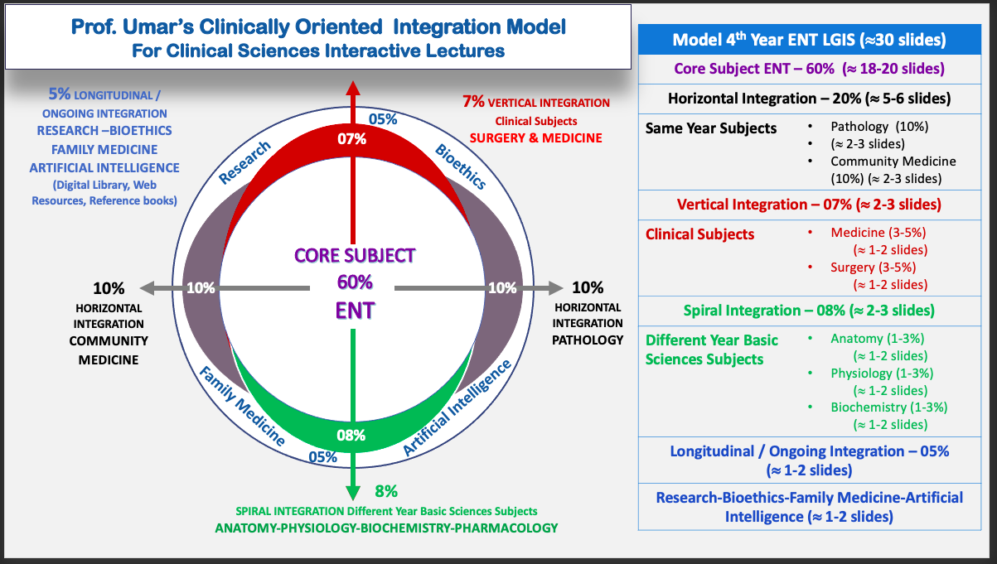
Prof Umer Model Of Integrated Lecture

Slide 7
SPIRAL INTEGRATION WITH ANATOMY

Slide 9
HORIZONTAL INTEGRATION WITH COMMUNITY MEDICINE

Slide 10
Etiology
Drainage obstruction
Stasis of Secretions
Environmental Factors
Poor Health
Nasal / Dental Infections
Swimming
Trauma

Slide 11
HORIZONTAL INTEGRATION WITH PATHOLOGY

Slide 12
Pathology
Viral/ Bacterial Invasion
Mucosal changes with fluid exudate and ↑ gland activity
Failure of drainage
Empyema of sinus and destruction of wall

Slide 14
Acute Maxillary Sinusitis
Symptoms
Constitutional Symptoms
Signs
Tenderness over anterior wall of antrum
Headache
Pain over upper jaw
Redness of Cheek
PND
Pus on middle meatus
Posterior rhinoscopy: PND
Investigations
CT nose and PNS

Slide 15
Management
Antibiotics
Nasal Decongestants
Steam Inhalation
Analgesics
Hot Fomentation
Antral Lavage

Slide 16
Acute Frontal Sinusitis
Symptoms
Frontal Headache
Signs
Tenderness over anterior sinus wall
Investigation
CT Nose and PNS
Swollen upper lid & photophobia
Nasal Discharge
Mucopus at middle meatus
Inflammed middle meatus

Slide 17
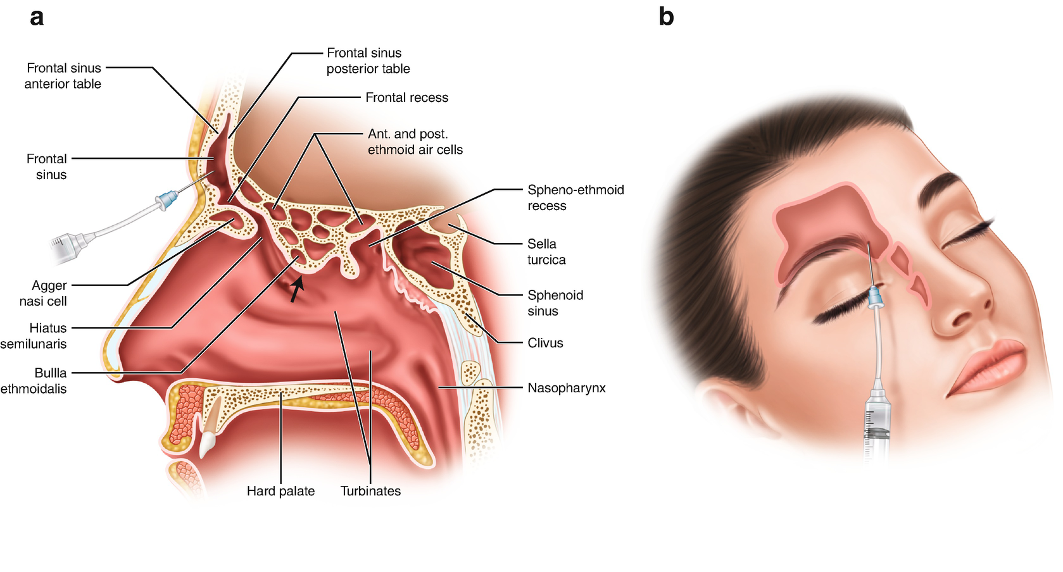
Management
Medical Management Same as Maxillary Sinusitis
Surgical Management : Trephination of frontal Sinus

Slide 18
Acute Ethmoid Sinusitis
Symptoms
Pain at bridge of nose/deep to eye
Signs
Pus at superior/middle meatus
Management
Medical : Same
Edema of lids
↑Lacrimation
Nasal Discharge
Swollen middle turbinate
Surgical : If visual deterioration drainage of ethmoid sinus

Slide 19
Acute Sphenoid Sinusitis
Isolated sphenoid sinusitis is rare
Presents as occipital / vertex headache with PND
Examination shows pus on roof or posterior wall of nasopharynx
Management same as above

Slide 20
Chronic Sinusitis
Sinus Infection lasting for months or years

Slide 22
Investigations
CT Nose and PNS
C/S of sinus discharge
Workup for nasal allergy

Slide 23
Management
Antibiotics
Decongestants
Antihistamines
Sinus Irrigation
Endoscopic Sinus Surgery

Slide 24
Surgery for Chronic Sinusitis
CHRONIC MAXILLARY SINUSITIS
Antral Puncture & Irrigation
Intranasal antrostomy
Caldwel Luc Procedure

Slide 25
Trephination of frontal sinus
External Frontoethmoidectomy
Osteoplastic flap operation
CHRONIC FRONTAL SINUSITIS

Slide 26
CHRONIC ETHMOID SINUSITIS
Intranasal Ethmoidectomy
External Ethmoidectomy

Slide 27
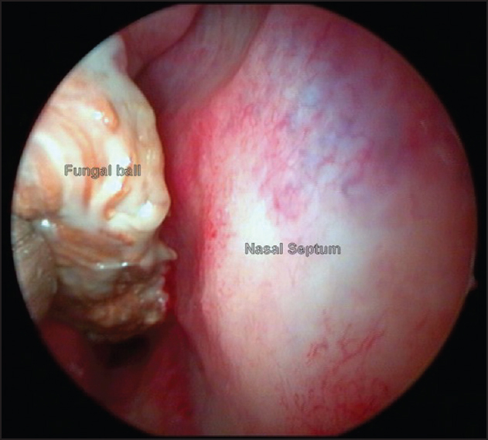
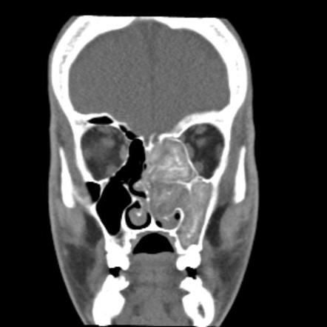
Fungal Ball
No Bony Erosion
Allergic Fungal Sinusitis
Allergic mucin(eosinophils, Charcot leyden crystals & Fungal Hyphae)
CT Hyperdensitis ±Bone erosion
Mostly in Maxillary sinus
Surgical Removal
ESS with pre and postop steroids

Slide 28
Chronic Invasive Sinusitis
Invasion of sinus mucosa and bone
CT scan Sinus opacification+ bone erosion ± intracranial or intraorbital invasion
Histopathology : Invasion of submucosa
Surgical removal of involved soft tissue/ bone with antifungals

Slide 29
Fulminant Fungal Sinusitis
Mucor: Rhinocerebral Disease
Invasion of blood vessels > Ischemic necrosis> black eschar
Surgical debridement and amphothericin B
Aspergillus cause tissue invasion and sinusitis
Antifungal Therapy and surgical Management

Slide 30
Complications of Sinusitis

Slide 31
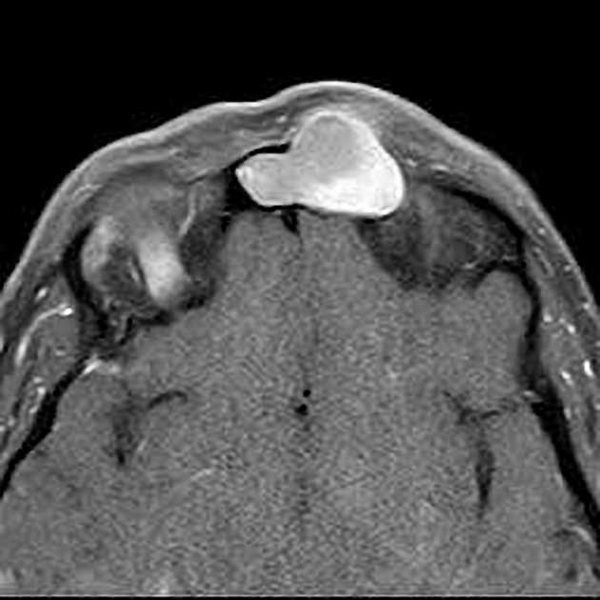
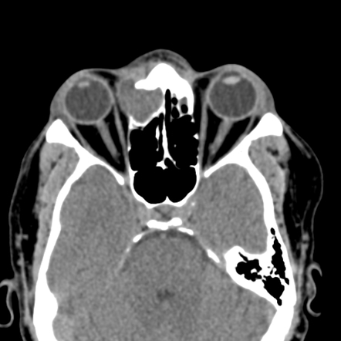
Mucocele
Frontal
Symptoms: headache, diplopia and proptosis
Ethmoidal
Expansion of the medial wall of the orbit, displacing the eyeball forward and laterally
Cystic swelling in superiomedial quadrant of orbit
Frontoethmoidectomy with free drainage of frontal sinus
Drained by an intranasal operation

Slide 32
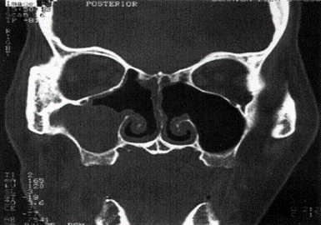
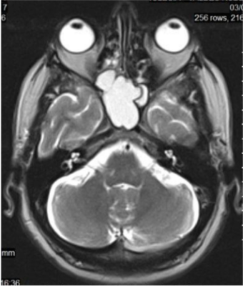
Maxillary
Complication of chronic sinus inflammation
Sphenoidal
Superior orbital fissure syndrome or orbital apex syndrome
Sinus fills with mucus and its bony walls get expanded
Treatment is external ethmoidectomy with sphenoidotomy

Slide 33
OSTEOMYELITIS
Osteomyelitis of maxilla
In infants and children
Infection in the dental sac > maxilla
Treatment : Antibiotics, drainage of abscess & removal of the sequestra.
Complications: damage to tooth-buds, maldevelopment of maxilla, oroantral fistula, persistently draining sinus or epiphora.

Slide 34
Osteomyelitis of frontal bone
In adults
After acute frontal sinus infection/ venous spread/ trauma
Pott’s puffy tumour / extradural abscess.
Treatment : antibiotics, drainage of abscess & frontal trephination & removal of necrotic bone.

Slide 35
ORBITAL COMPLICATIONS

Slide 36
Inflammatory oedema of lids: It involves only preseptal space. Presents with lid swelling
Subperiosteal abscess. Pus collects outside the bone under the periosteum.

Slide 37
Orbital abscess. Clinical picture > orbital cellulitis. Diagnosis CT scan or USG orbit. Treatment is i.v. antibiotics and drainage of the abscess and that of the sinus

Slide 38
Superior orbital fissure syndrome. If superior orbital fissure structures affected by sphenoid sinusitis. Symptoms consist of deep orbital pain, frontal headache and progressive paralysis of CN VI, III and IV
Orbital apex syndrome. Superior orbital fissure syndrome+ Optic nerve and V2 of trigeminal nerve involvement

Slide 39
Cavernous Sinus Thrombosis
Aetiology. Infection of paranasal sinuses(ethmoid and sphenoid) and orbital complications
Clinical Features Swollen eyelids with chemosis and proptosis of eyeball.
CN III, IV and VI are involved.
Pupil dilated and fixed.
↓ vision.
Sensation of V1 is ↓.

Slide 40
CT scan to differentiate from orbital cellulitis
Treatment IV antibiotics and drainage of infected ethmoid or sphenoid sinus.

Slide 41
Biomedical Ethics
Longitudinal Integration
Before doing any medical and surgical treatment, informed consent must be taken
Prognosis should be explained to patients and attendants

Slide 42
Family Medicine
Longitudinal Integration
Any patient with headaches, nasal discharge and postnasal drip should be evaluated for sinusitis
Eye/ face swelling in a patient with sinusitis should be evaluated by ENT Specialist for suspected complications.

