Slide 2
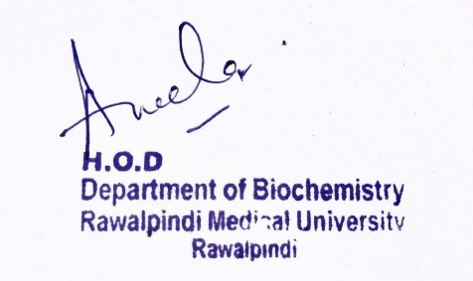
Renal Module 2nd Year MBBS (LGIS) Acid Base Imbalance II
Presenter: Dr. Aneela Jamil Date: 27-01-25
(Assistant Professor)

Slide 3
Motto, Vision, Dream
To impart evidence based research oriented medical education
To provide best possible patient care
To inculcate the values of mutual respect and ethical practice of medicine
Wisdom
Truth
Service

Slide 4
Professor Umar Model of Integrated Lecture

Slide 5
Learning Objectives
At the end of this lecture students should be able to
Explain the causes and compensation of Respiratory acidosis and alkalosis

Slide 6
Core Knowledge
Parameter | Normal Range
pH | 7.35-7.45
HCO₃ | 22-26 mmol/L
pCO₂ | 35-45 mmHg
HCO₃/H₂CO₃ | 20:1

Slide 7
Respiratory Acidosis
Core Knowledge
“Accumulation of H2CO3 within the body”
Primary increase in pCO2
Low pH (< 7.35)
Decrease ratio of HCO3: H2CO3

Slide 8
Core Knowledge
Causes
Hypoventilation
Depression of the respiratory center
Airway obstruction
Respiratory muscle weakness
Diseases of pleura and lung
Extreme obesity

Slide 9
Core Knowledge
Renal compensation
Increased excretion of acid
Conservation of bicarbonate
Ammonia excretion

Slide 10
Respiratory Alkalosis
Core Knowledge
“A condition primarily associated with decrease in the H2CO3”
Primary decrease in arterial blood pCO2
Increase plasma pH (> 7.45)
Increase ratio of HCO3: H2CO3

Slide 11
Causes
Core Knowledge
Hyperventilation
Hypoxia
Respiratory center stimulation
Anxiety, tension
Injury to central nervous system
Septicemia
Salicylate poisoning
Excessive mechanical ventilation

Slide 12
Core Knowledge
Renal compensation
Conservation of hydrogen ions
Loss of bicarbonate

Slide 13
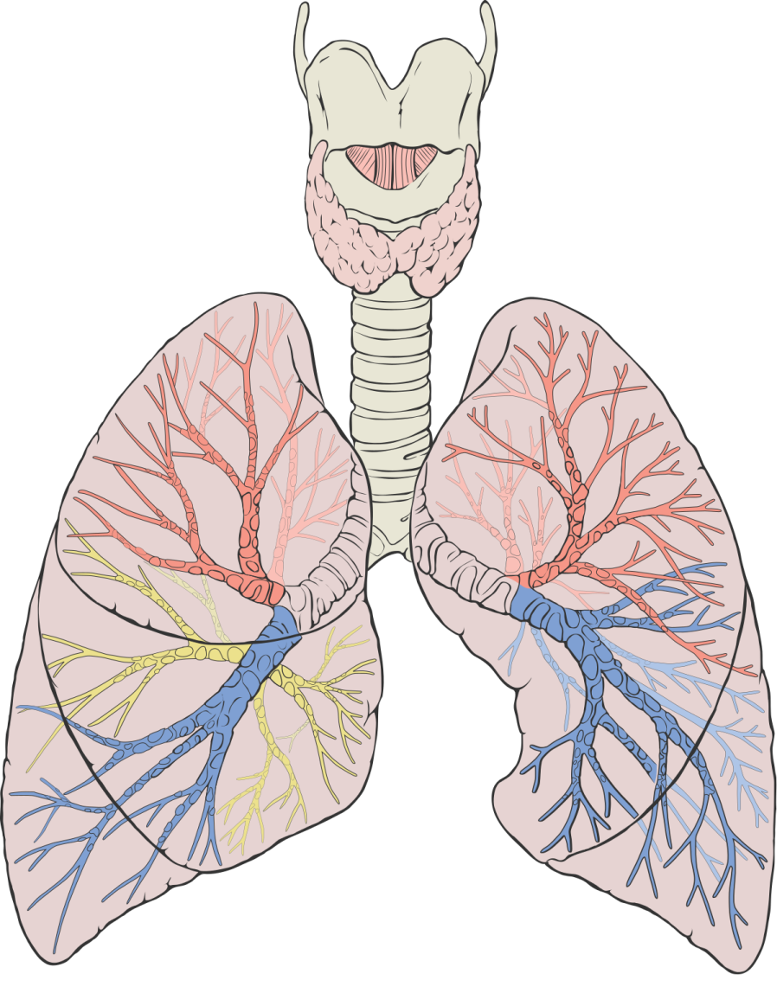
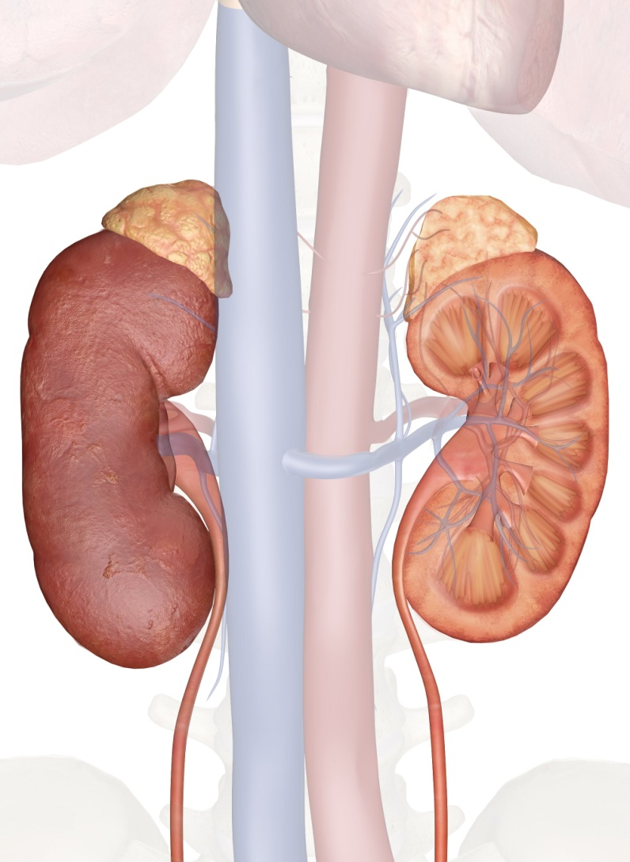
Anatomical & Physiological Aspects
Horizontal Integration

Slide 14
Horizontal Integration
Physiological aspects of Lungs & Kidneys
Regulation of acid-base equilibrium
Control of partial pressure of carbon dioxide and bicarbonate concentration
Control of blood pressure and fluid homeostasis

Slide 15
RESPIRATORY ACIDOSIS
pH | HCO₃⁻ | PCO₂ | Status
Vertical Integration
↓ | N | ↑↑
Uncompensated
↓ | ↓ | ↑↑
Partially compensated
N | ↓ | ↑↑
Fully Compensated
RESPIRATORY ALKALOSIS
pH | HCO₃⁻ | PCO₂ | Status
↑ | N | ↓↓
Uncompensated
↑ | ↑ ↑ | ↓↓
Partially compensated
N |  | ↓↓
Fully Compensated

Slide 16
Family Medicine
Spiral Integration
Family Medicine plays important role in following manner:
Early Diagnosis
Education
Dietary Guidance
Monitoring
Refer to Specialists

Slide 17
Artificial Intelligence
Spiral Integration
Artificial Intelligence plays role in following aspects:
Utilizes extensive data from patient thereby enhancing prevention, diagnosis & treatment based on individual genetic profile

Slide 18
Suggested Research Article
Spiral Integration
Link: https://www.sciencedirect.com/science/article/pii/S2590059521000194
Journal Name : Kidney Medicine
Title: Metabolic Acidosis in CKD: A Review of Recent Finding
Author Name: Michal L. Melamed
Introduction
Metabolic acidosis is fairly common in patients with chronic kidney disease (CKD). The prevalence of metabolic acidosis increases with worsening kidney function and is observed in ∼40% of those with stage 4 CKD. For the past 2 decades, clinical practice guidelines have suggested treatment of metabolic acidosis to counterbalance adverse effects of metabolic acidosis on bone and muscle. Studies in animal models of CKD also demonstrated that metabolic acidosis causes kidney fibrosis. During the past decade, results from observational studies identified associations between metabolic acidosis and adverse kidney outcomes, and results from interventional studies support the hypothesis that treating metabolic acidosis with sodium bicarbonate preserves kidney function.

Slide 19
Bioethics
Spiral Integration
Appropriate information
Explain to patient or his family the genetic aspects of the condition
Counselling

Slide 20
How To Access Digital Library
Steps to Access HEC Digital Library
Go to the website of HEC National Digital Library
On Home Page, click on the INSTITUTES
A page will appear showing the universities from Public and Private Sector and other Institutes which have access to HEC National Digital Library HNDL
Select your desired Institute
A page will appear showing the resources of the institution
Journals and Researches will appear
You can find a Journal by clicking on JOURNALS AND DATABASE and enter a keyword to search for your desired journal

Slide 21
Learning Resources
Textbook of Biochemistry, Mushtaq
Google scholar
Google images

