Slide 3
LADIES AND GENTLEMEN PLEASE RISE FOR THE NATIONAL ANTHEM

Slide 5
University Motto, Mission, Vision & Values
Mission Statement
To impart evidence-based research-oriented health
professional education, best possible patient care,
mutual respect, ethical practice of healthcare and social accountability.
Vision and Values
Highly recognized and accredited center of excellence in
Medical Education, using evidence-based training techniques for development of highly competent health professionals, who are lifelong experiential learner and are socially accountable.

Slide 6
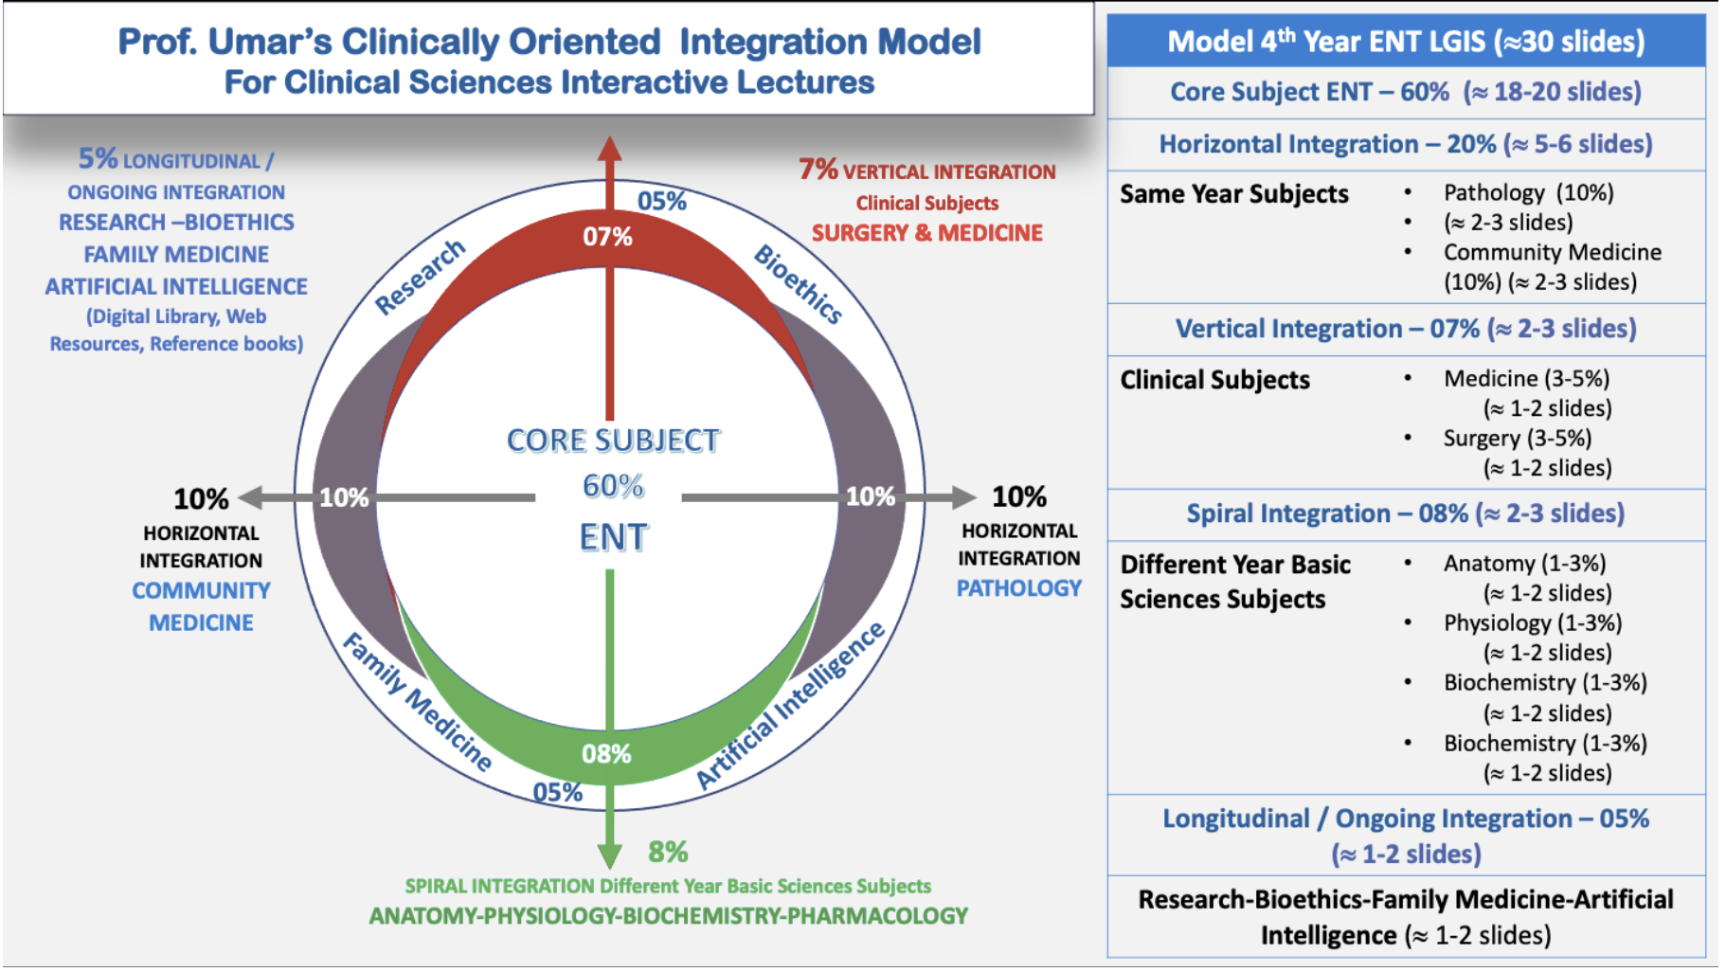
Prof Umar Model Of Integrated Lecture

Slide 7
SEQUENCE OF LGIS
Learning Objectives
Related Physiology and biochemistry (horizontal integration 15%)
Related clinical/ congenital abnormalities (Vertical integration-10%)
Research article related to topics (3%)
Ethics (2%)

Slide 8
A 5-year-old boy presented in ENT Department with high-grade fever, sore throat and neck pain. On examination his oral cavity examination reveled inflamed tonsils. His neck examination is positive for palpable jugulodigastric lymph nodes.
What will be your probable diagnosis?

Slide 9
ACUTE TONSILLITIS

Slide 10
LEARNING OBJECTIVES
At the end of this lecture students of 4th year will be able to:
Define acute tonsillitis
Manage the patients of acute tonsillitis
Differentiate between different deep neck spaces infections
Explain etiological factors leading to deep neck space infections
Manage deep neck space infections

Slide 11
VERTICAL INTEGRATION WITH ANATOMY

Slide 13
Paired aggregates of lymphoid tissue, situated in the lateral wall of the oropharynx, between the palatoglossus and palatopharyngeus muscles.
With the adenoids and diffuse aggregates of pharyngeal submucosal lymphoid tissue, they form the Waldeyer’s Ring.
Medial surface --- crypta magna.
Lateral surface --- well defined fibrous capsule

Slide 14
Tonsillar bed: is formed by superior constrictor and styloglossus muscle. Tonsil is related laterally to loose areolar tissue containing paratonsillar vein, superior constrictor and styloglossus muscle, glossopharyngeal nerve, facial artery, medial pterygoid muscle, angle of mandible, submandibular salivary gland, pharyngobasilar fascia and buccopharyngeal fascia.

Slide 15
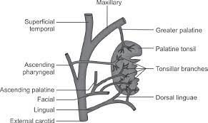
BLOOD SUPPLY
Tonsillar branch of facial artery
Ascending pharyngeal artery from external carotid
Ascending palatine, branch of facial artery
Dorsal lingual branches
Descending palatine, branch of maxillary artery

Slide 16
VENOUS DRAINAGE
Paratonsillar vein which joins the common facial vein and pharyngeal venous plexus

Slide 17
LYMPHATIC DRAINAGE
Upper deep cervical lymph nodes esp. Juglodigastric lymph node.

Slide 18
Grade of palatine tonsil enlargement

Slide 19
NORMAL FLORA
The organism most commonly identified from the surface of tonsil in disease is Group A Beta Hemolytic Streptococcus (GABHS).
Less common organisms include hemophilus, staph aureus, alpha hemolytic streptococci, branhamella sp, mycoplasma, chlamydia

Slide 20
ACUTE TONSILLITIS
Mostly the causative organism is GABS.
Different types of tonsillitis are:
Acute catarrhal or superficial tonsillitis: occurs as a part of generalized pharyngitis and is mostly viral in origin.
Acute follicular tonsillitis: crypts are filled with purulent material.
Acute parenchymatous tonsillitis: tonsil is uniformly enlarged and red.
Acute membranous tonsillitis: membrane on the tonsil surface

Slide 22
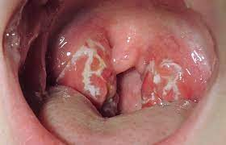
SIGNS AND SYMPTOMS
Sore throat with painful swallowing
Fever
Pharyngeal erythema with or without tonsillar exudates
Painful cervical lymphadenopathy
Earache
Foetid breath, coated tongue

Slide 23
MANAGEMENT
Primary management: principally supportive with the use of analgesics (paracetamol, NSAIDS) and adequate hydration.
Specific treatment: in patients in whom illness shows no improvement within 48-72hrs or in whom symptoms are very severe, antibiotic therapy is started and drug of choice is Benzylpenicillin.

Slide 24
Chronic tonsillitis
.
An infection of the tonsils—the two pieces of tissue at the back of your throat—that lasts longer than two weeks.

Slide 25
CHRONIC TONSILLITIS
Chronic follicular tonsillitis: Tonsillar crypts are full of infected cheesy material which shows on the surface as yellowish spots.
Chronic parenchymatous tonsillitis: Hyperplasia of lymphoid tissue. Tonsils are very much enlarged and may interfere with speech, deglutition and respiration. Attacks of sleep apnoea may occur. Long-standing cases develop features of cor pulmonale.
Chronic fibroid tonsillitis. Tonsils are small but infected, with history of repeated sore throats.

Slide 26
COMPLICATIONS
Chronic tonsillitis: chronic low grade symptoms affecting quality of life, throat discomfort and ill-health.
Peritonsillar abscess: collection of pus in potential space between the tonsil and its bed. Characterized by severe pharyngitis, marked lymphadenopathy and severe trismus. Treated by I & D and antibiotic therapy (high dose penicillin or cephalosporin).
Retropharyngeal abscess: rare but serious complication. Occurs in infants and children less than 5yrs. Plain x-ray of the neck, USG, CT scan are the investigations

Slide 27
TONSILLECTOMY

Slide 28
Peritonsillar abscess (Quinsy)
It is a collection of pus in the peritonsillar space between the capsule of the tonsil & the superior constrictor muscle.
Etiology:
It usually follows acute tonsillitis.
Abscess formation begins 2 to 8 days after onset of symptoms, following an episode of acute tonsillitis.
Most common organisms are group A hemolytic streptococci, Staphylococcus aureus, Haemophilus influenzae, and various anaerobes including Peptostreptococcus and Fusobacterium. Polymicrobial infections are also common.
Greatest frequency from November to December and from April to May.

Slide 30
Clinical features
Severe pain in throat.
Pyrexia, upto 104 F.
Malaise.
Headache.
Rigors.
Trismus is common,making examination difficult.
Ear ache due to referred otalgia.
Thickened speech.
Foetor oris.
Cervical adenitis with tenderness.
Marked hypermia & edema of the tonsillar & palatal region on the same side.

Slide 31
Diagnosis
Usually made after clinical examination of the throat.
Full blood count which shows raised leucocytes.
Radiological investigations maybe required to exclude complications.

Slide 32
TREATMENT

Slide 34
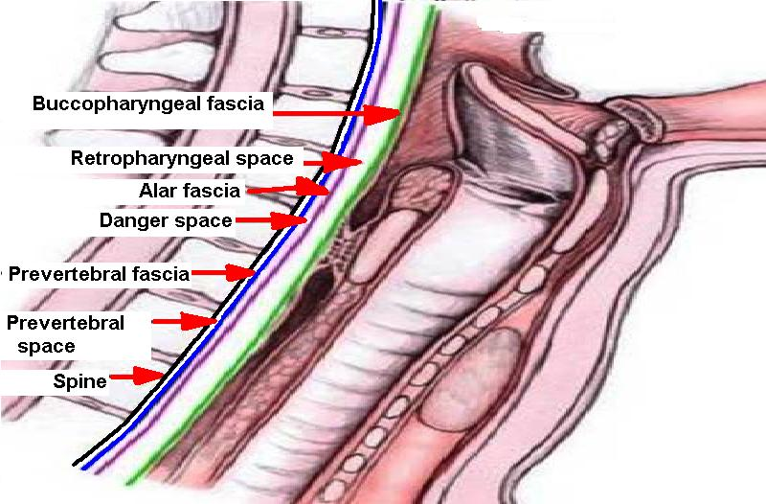
Retropharyngeal abscess
The abscess lies in the potential space between the buccopharyngeal & prevertebral fasciae.
Acute retropharyngeal abscess:
Etiology:
Is caused by suppuration in the retropharyngeal lymph nodes (Nodes of Rouviere)
Commonly seen in children below 3 years of age.
Commonest organism is streptococcus pneumoniae.
Infection spreads from nasopharynx, oropharynx, para nasal sinuses & rarely from supporative otitis media.
In adults it may result from penetrating injury from posterior pharyngeal wall or cervical esophagus.

Slide 35
Clinical features:
Difficulty in breathing is the prominent features.
Croupy cough is common.
Nasal obstruction maybe present with highly placed abscess.
Neck stiffness or torticollis.
Pyrexia & toxemia.
Lateral swelling of the posterior pharyngeal wall maybe seen & maybe fluctuant.
Oedema of the larynx may develop.
Spontaneous rupture of the abscess may occur occasionally & can cause sudden death.

Slide 36
Diagnosis:
On clinical examination.
Xray neck soft tissues lateral view will show widening of the prevertebral shadow with gas bubbles sometimes.
Treatment:
Incision & drainage of the abscess.
No anesthetic is used in infants.
Vertical incision is given while the infant is in supine position with head lower down & suction should be done.
Systemic antibiotics.
Tracheostomy may become necessary when there is threatened laryngeal obstruction by edema of the larynx.

Slide 38
b) Chronic retropharyngeal abscess:
Etiology:
The abscess is caused by tuberculous infection of the cervical vertebrae or tuberculous infection of the retropharyngeal lymph nodes.
Clinical features:
It is seen in older children or adults.
The signs & symptoms are slow in onset & maybe minimal.
Dysphagia is slight.
Sore throat or discomfort in throat maybe complained of.
Posterior pharyngeal wall will show a fluctuant swelling which is centrally placed.
Enlarged painless lymph nodes maybe present in the deep cervical group in patients without caries spine.

Slide 39
Diagnosis:
Radiography reveals vertebral disease (erosion) or calcification in tuberculous lymph nodes of the neck.

Slide 42
Treatment
Incision of the abscess is made through the neck & never through the mouth.
Incision is given in front of the sternocleidomastoid muscle.
The abscess is approached in the plane between the carotid sheath & the cervical compartment of the neck.
In highly placed abscess the approach is through an incision behind the sternomastoid.
Caries spine is treated appropriately with anti tuberculous drugs.

Slide 43
Parapharyngeal abscess
It is suppurative infection of the parapharyngeal space.
Etiology:
Tonsillitis & peritonsillar abscess.
Penetrating foreign body.
Lower wisdom tooth infection.
May occur at any age but common in adults.
Bezold’s abscess from the tip of mastoid bone.

Slide 44
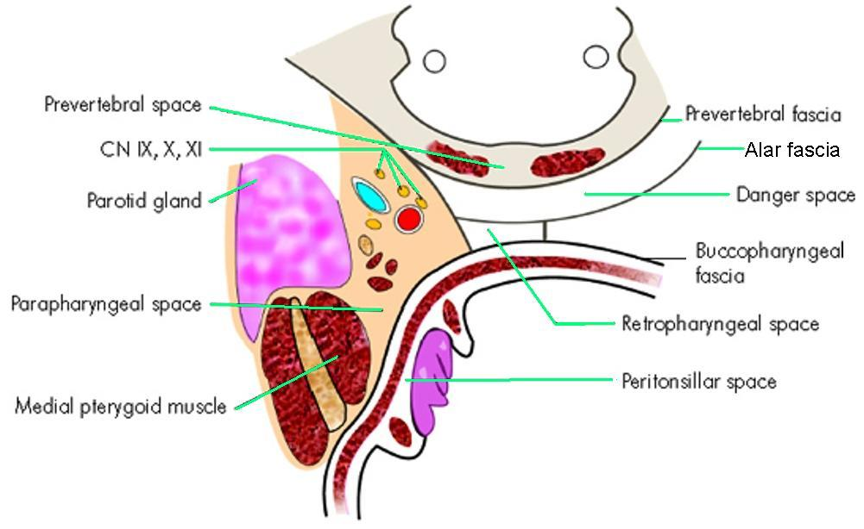
Parapharyngeal space

Slide 46
Clinical features
Painful throat
Trismus due to spasm of medial pterygoid muscle.
Pyrexia between 101-102 F.
Swelling of the neck which is tender.
Pharyngeal wall & tonsil are pushed medially.
Complications:
Acute edema of the larynx.
Thrombophlebitis of internal jugular vein.
Spread of infection to other spaces of the neck & mediastinum.
Erosion of carotid artery.

Slide 48
Diagnosis
History.
Clinical examination.
Radiological examination.
Full blood count.

Slide 51
Treatment
I/V systemic antibiotics to cover aerobes & anaerobes.
Drainage of abscess.
External incision under GA.
Incase of trismus pre operative tracheostomy is mandatory.
Transoral drainage should never be attempted due to possible injury to the great vessels.

Slide 52
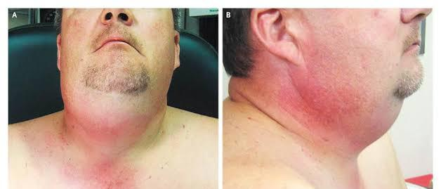
LUDWIGS ANGINA
An acute spreading potentially life threatening form of cellulitis in the submandibular space, causing severe swelling and tenderness with pain, and fever
Dysphagia / odynophagia
Associated withdifficulty in opening the mouth ( Trismus)

Slide 53
ETIOLOGY
Dental infection
They account for 80% of cases . Premolars Sublingual space infection Molar Submaxillary space infection.
Submandibular Sialadenitis
Injuries of oral mucosa
fractures of Mandible

Slide 54
EXAMINATION
Patient presented mostly with a history of swelling in front of neck, with odynophagia and drooling .
On oral Examination:
Swelling on floor of mouth with elevation of
Tongue
Swelling of the anterior soft tissues of neck above Hyoid bone leads to characteristics “Bull’s neck” appearance
On palpation it imparts a woody hard feel with no fluctuance
Laryngeal edema may appear.

Slide 55
MANAGEMENT
Immediate admission to hospital
Treat the cause
Start systemic antibiotics
Symptomatic treatment

Slide 56
If airway is endangered ___ Tracheostomy
No need of surgical intervention for ludwig angina until an abcess develops
If abcess develops we perform
Incision and drainage of the abcess
Intraoral ___ if infection localized to sublingual space.
External ___ if infection involves submaxillary space

Slide 57
INCISION AND DRAINAGE

Slide 58
Research
Kekre M, Chakravarty S, Agarwal R. Foreign Bodies in Ear, Nose, Throat and Maxillofacial Region: A Study on Their Clinical Profile and Complications. Indian J Otolaryngol Head Neck Surg. 2022 Dec;74(Suppl 3):4483-4494. doi: 10.1007/s12070-020-02233-w. Epub 2020 Oct 23. PMID: 36742524; PMCID: PMC9895506.
Loperfido A, Mammarella F, Giorgione C, Celebrini A, Acquaviva G, Bellocchi G. Management of Foreign Bodies in the Ear, Nose and Throat in Pediatric Patients: Real-Life Experience in a Large Tertiary Hospital. Cureus. 2022 Oct 26;14(10):e30739. doi: 10.7759/cureus.30739. PMID: 36457611; PMCID: PMC9705068.

Slide 59
Artificial Intelligence
Artificial intelligence can play a role in Head and neck space infections by aiding in medical imaging analysis, early detection, and predictive modeling. AI algorithms can assist in interpreting radiological images, such as CT scans, to identify signs of Ludwig’s angina and assess its severity. Additionally, machine learning models may help healthcare professionals predict patient outcomes and optimize treatment plans based on historical data.

Slide 60
FAMILY MEDICINE
Any patient who presents with a painful swelling in front of neck with odynophagia and trismus should be referred to ENT specialist and tested for submandibular space infections

Slide 61
Biomedical Ethics
Before doing any medical and surgical treatment, informed consent must be taken
Prognosis should be explained to patients and attendants

Slide 62
References
Scott and brown 7th edition
Diseases of Ear, Nose and Throat, Dhingra, 7th Edition

