Slide 1
Anorectal Malformation
Dr Ameena Shahwar
Paeds Surgery
RMU Holy Family Hospital

Slide 2
Scenario
- Patient XYZ , healthy male baby , 2 days of life presented in SER with complaint of vomiting after feeding, abdominal distension and failure to pass meconium.
He was delivered through SVD at term and it was uneventful. Antenatal history was unremarkable.
On examination :
Abd was mildly distended and soft
On perineal examination following findings were noted :

Slide 3
Findings ?

Slide 4
Learning objectives
Definition
Embryology
Epidemiology
Classification
Diagnosis
Management

Slide 5
Introduction
Anorectal malformations comprise a wide spectrum of diseases
Involve the distal anus and rectum as well as the urinary and genital tracts

Slide 6
Embryology

Slide 7
Epidemiology and Etiology
Anorectal malformations occur in approximately 1 newborn per 5000 live births.
- The most common defect in female is rectovestibular fistula
- The most common defect in males is recto uretheral fistula
- The etiology of such malformations remains unclear and is likely multifactorial.
- There are however reasons to believe there is a genetic component.

Slide 8
Classifications
Wingspread classification
Pena’s classification
Krickenbeck classification

Slide 10
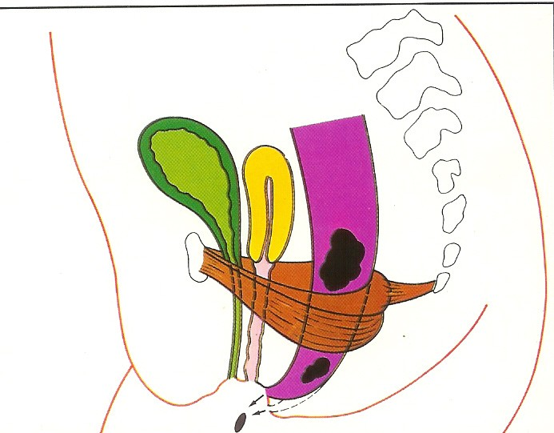
Low abnormality

Slide 11
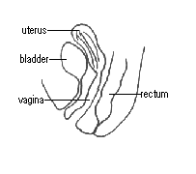
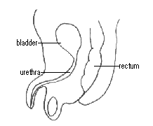
Low abnormalities

Slide 12
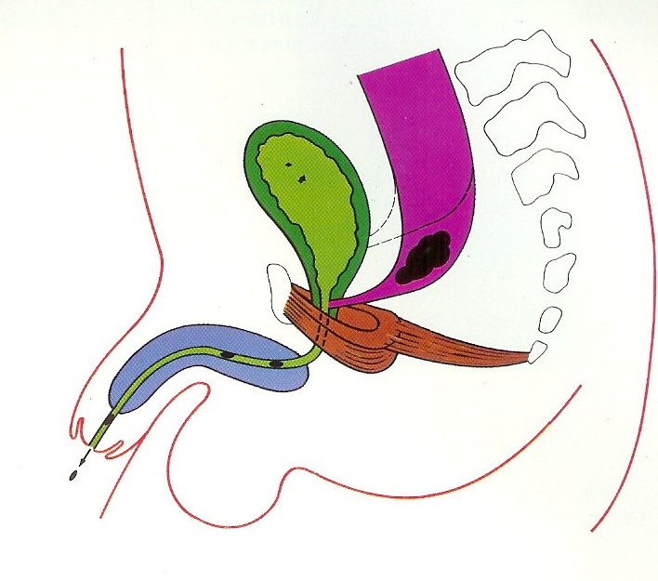
High abnormalities

Slide 14
1-Perineal fistula 2-Vestibular fistula 3- Cloaca

Slide 16
Approach to a case of ARM
▪ History of neonate
▪ Clinical examination
▪ Investigation

Slide 17
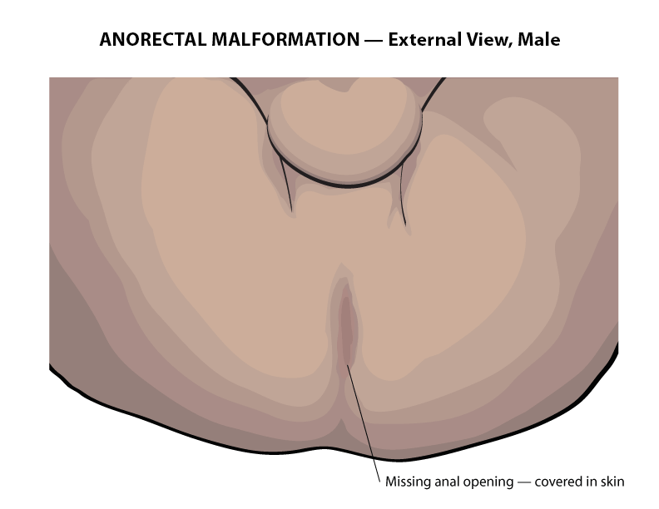
Examination
Pelvic floor
• Absence or presence of anal opening
• Bulge in perineum on crying or straining

Slide 18
Exclude other anomalies!!
Anal atresia may occur as a part of the VACTERL group of anomalies
V Vertebral body segmentation defect
A Anal atresia
C Cardiovascular (PDA, VSD)
TE Tracheo esophagial fistula
R unilateral Renal agenesis
L Limb anomaly (radial ray hypoplasia)
So, very careful examination of the baby must be made to exclude these anomalies

Slide 19
INVESTIGATIONS
Imaging studies
X-rays (Invertogram/Cross table lateral view)
Ultrasound (sacral spine and KUB)
Echo
CT / MRI (for complex anomalies)

Slide 20
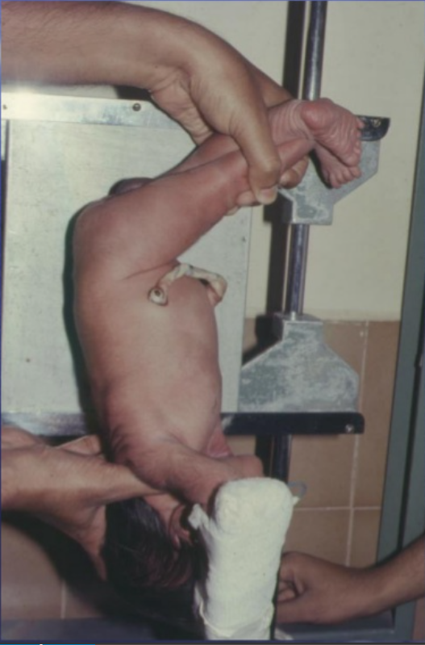
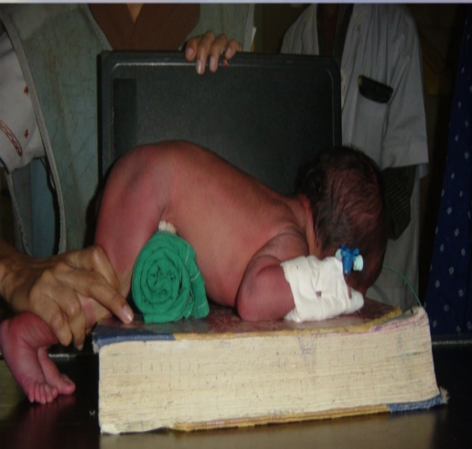
To determine the type of anomaly

Slide 21
To determine the high or low anomaly

Slide 22
Pre-operative management:
During first 24 hours
NPO
IV fluids
Antibiotics
Nasogastric decompression

Slide 23
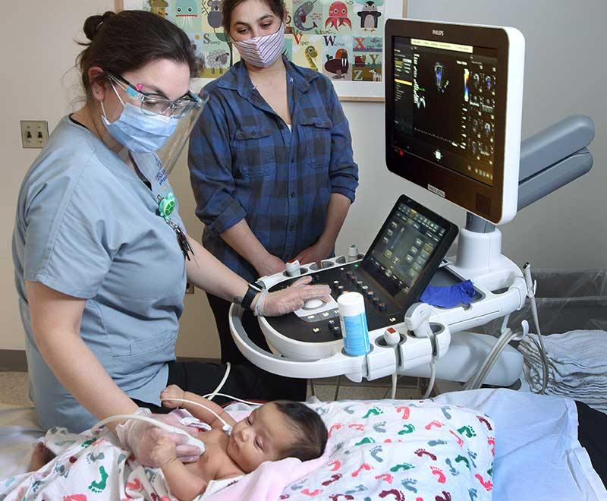
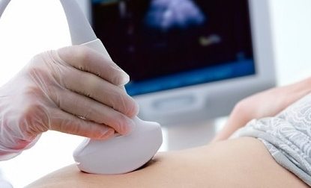
Rule Out VACTERL Anomalies
Ecohcardiogram
Check for esophageal atresia
Radiograph of sacral spine
Spinal ultrasound
USG KUB

Slide 24
Tracheoesophageal fistula
Curling of NG can be seen in the upper esophageal pouch
Gas shadows in abdomen confirm presence of fistula between trachea and esophagus

Slide 25
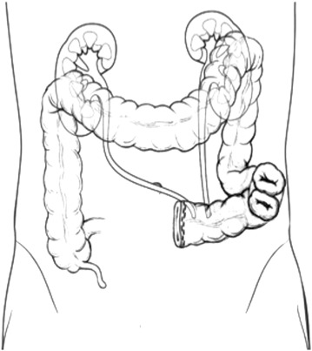
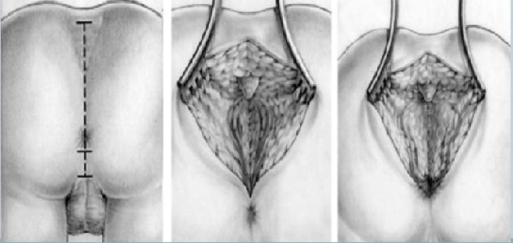
Operative Procedures
• Colostomy
• Posterior Sagittal Anorectoplasty
• Pull through procedures
• Laparoscopic assisted procedures

Slide 26
Thank You

