Slide 1


Slide 2


Slide 3
LADIES AND GENTLEMEN PLEASE RISE FOR THE NATIONAL ANTHEM

Slide 4


Slide 5

University Motto, Mission, Vision & Values
Mission Statement
To impart evidence-based research-oriented health
professional education, best possible patient care,
mutual respect, ethical practice of healthcare and social accountability.
Vision and Values
Highly recognized and accredited center of excellence in
Medical Education, using evidence-based training techniques for development of highly competent health professionals, who are lifelong experiential learner and are socially accountable.

Slide 6
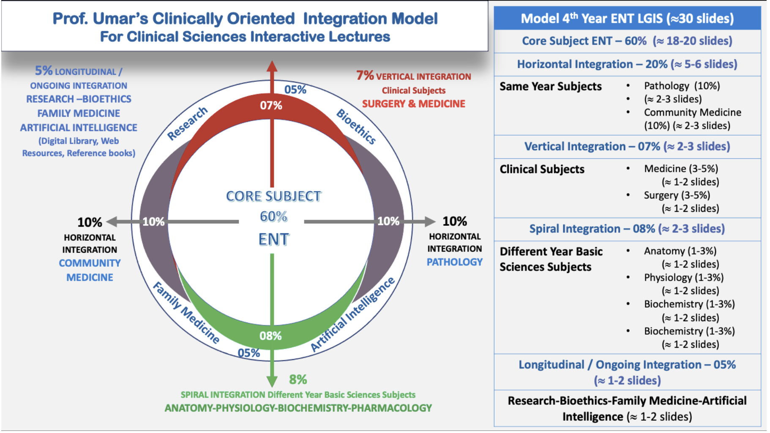
Prof Umar Model Of Integrated Lecture

Slide 7
Sequence Of LGIS
Learning objectives
Core concept of subject 60%
Anatomy, Biochemistry, Physiology (spiral integration 08%)
Surgery, Medicine (vertical integration – 07%)
Research article related to topic, Bioethics, A.I (05%)
Comm Med, Pathology (20%)

Slide 8

A mother brings her child complaining of excessive crying at night, irritability, poor feeding, ear pulling and clumsiness.

Slide 9
Learning Objectives
At the end of this lecture you all will be able to:
Define acute otitis media
Explain its pathophysiology and bacteriology
Describe the stages of acute otitis media
Manage patient of acute otitis media.
Manage patients of Glue Ear

Slide 10


Slide 11
Acute Suppurative Otitis Media
Prof Dr Sadia Chaudhry
sadiaaatif@yahoo.com

Slide 12
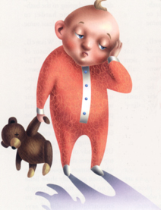
Acute Otitis Media
AOM
One of the commonest illness of the child hood

Slide 13
Definition
Pyogenic infection of middle ear cleft lasting for < 3 weeks.
Routes for infection:
Via Eustachian tube
Via Tympanic membrane perforation
Haematogenous (rare)

Slide 14
Bacteriology
Haemophilus influenzae
Streptococcus pneumoniae
Staphylococcus aureus
Moraxella catarrhalis
β - Hemolytic streptococci (causes acute necrotizing otitis media)

Slide 15
Predisposing Factors
1. Breast feeding in supine position
2. Recurrent upper respiratory tract infection
3. Nasal allergy
4. Chronic rhinitis & sinusitis
5. Tumours of nose & nasopharynx
6. Exposure to cigarette smoke
7. Cleft palate

Slide 16
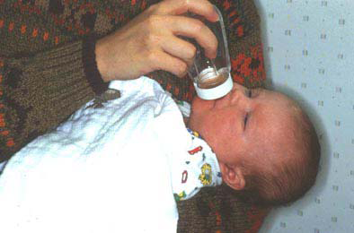
NEVER bottle-feed an infant on it’s back like this!

Slide 17
Pathophysiology
Eustachian tube obstruction
  Length: shorter in children
  Angle: 10º children vs. 45º adult
Follows upper respiratory infection (URI)
  Peak incidence 2 - 4 days

Slide 18
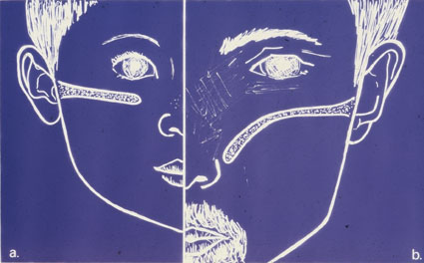
Ventilation tube child vs adult

Slide 19
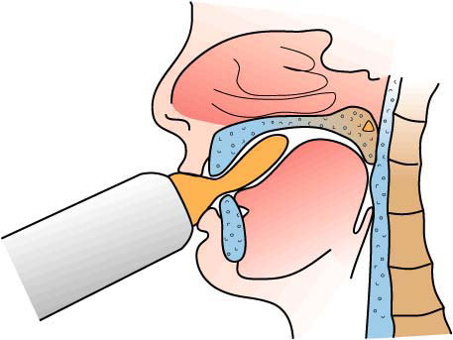
Bottle-feeding forces tongue back. This elevates tongue at back, which in turn can block off Eustachian tubes.

Slide 20
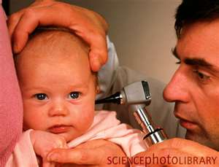

Slide 21
Stages of A.S.O.M.

Slide 22
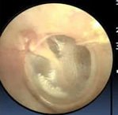
Stage of Tubal Occlusion
Oedema and hyperaemia of nasopharyngeal end of eustachian tube
Retraction of tympanic membrane with some degree of effusion in the middle ear but fluid may not be clinically appreciable
Deafness and earache not much
Tympanic membrane is retracted with handle of malleus assuming a more horizontal position, prominence of lateral process of malleus and loss of light reflex.

Slide 23
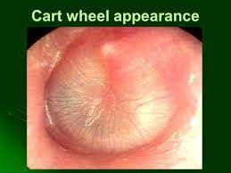
Stage of Pre-suppuration
Synonym: Stage of tubal occlusion
Mild earache
T.M. retracted in early stage
T.M. congested later stage
Cartwheel appearance: radiating blood vessels from handle of malleus

Slide 24
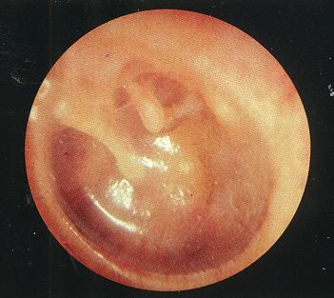
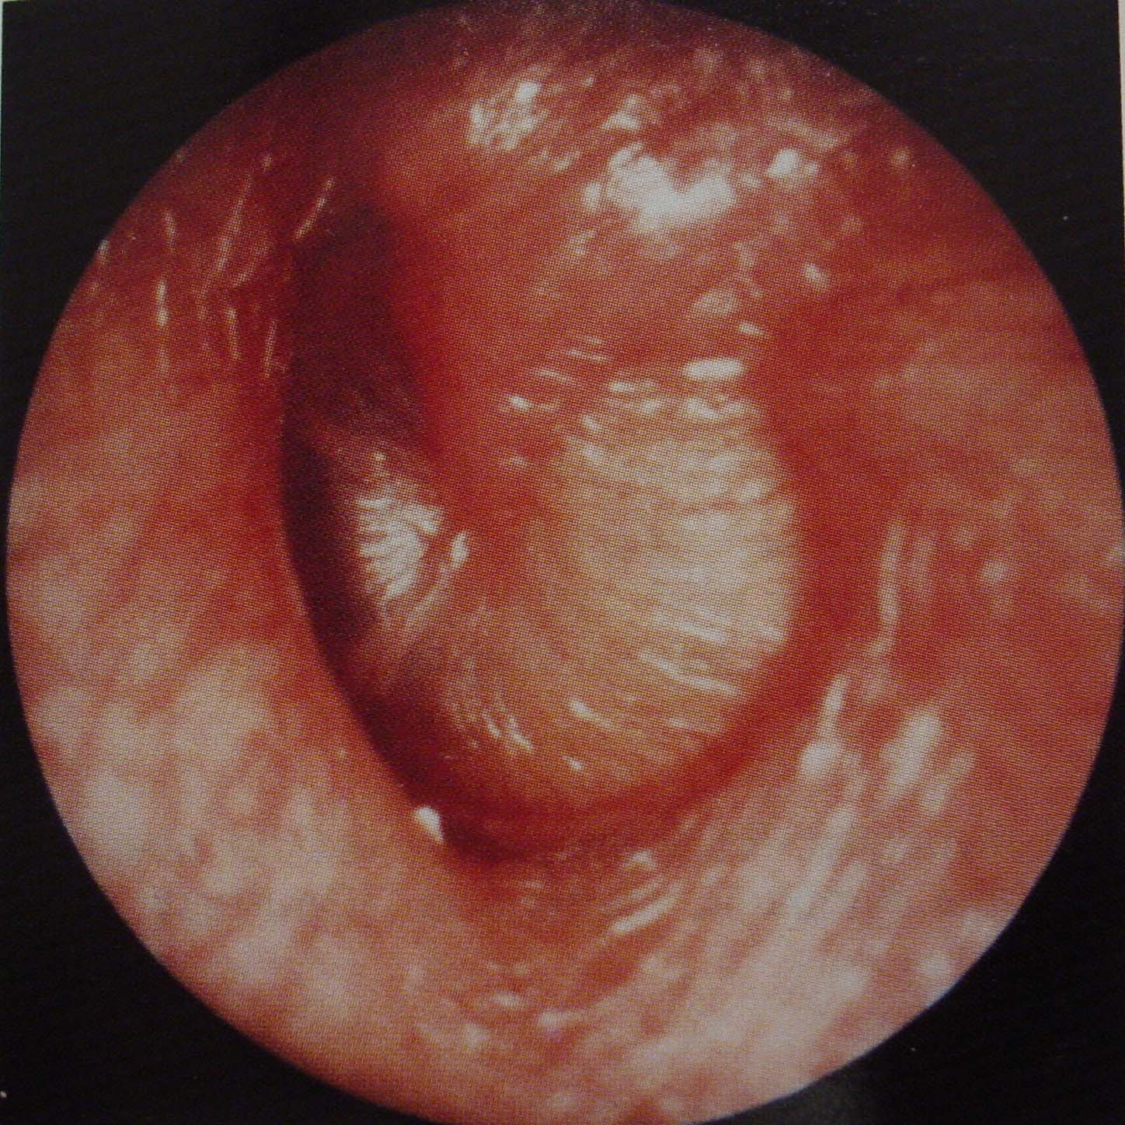

Slide 25
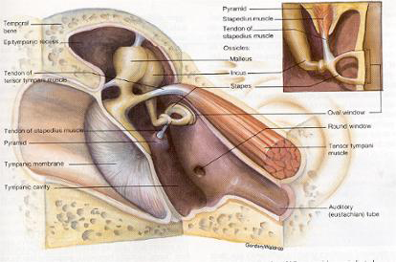

Slide 26
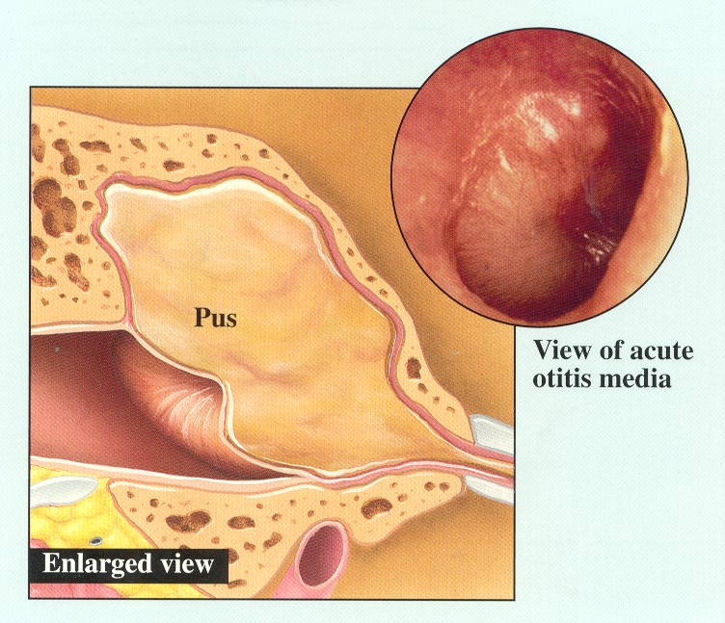

Slide 27
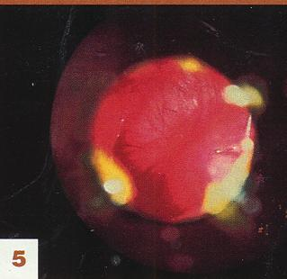

Slide 28
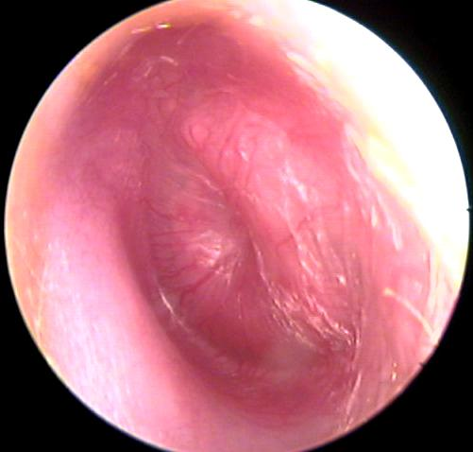
Stage of Suppuration
High fever
Severe earache
Deafness
Marked congestion + bulging of T.M.
Mastoid tenderness
P.T.A.: high frequency conductive deafness due to mass effect of pus

Slide 29
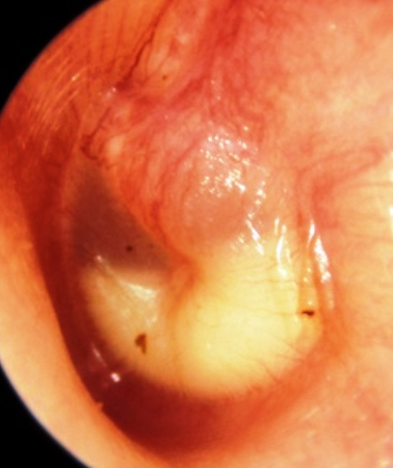
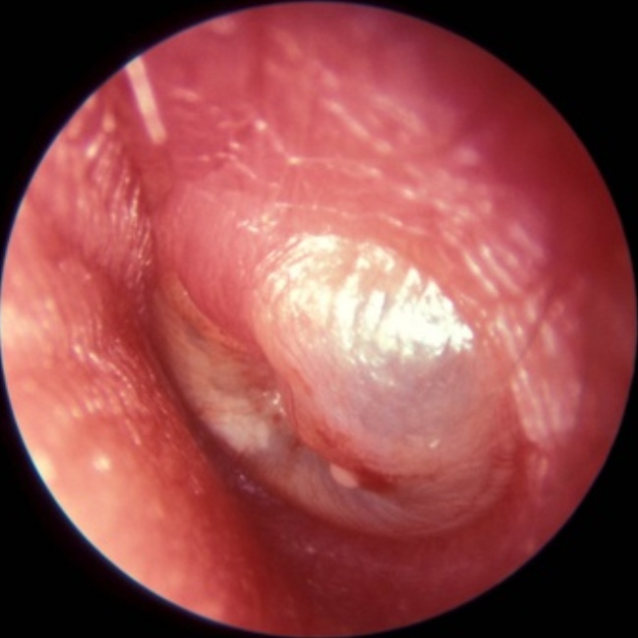
Stage of suppuration

Slide 30
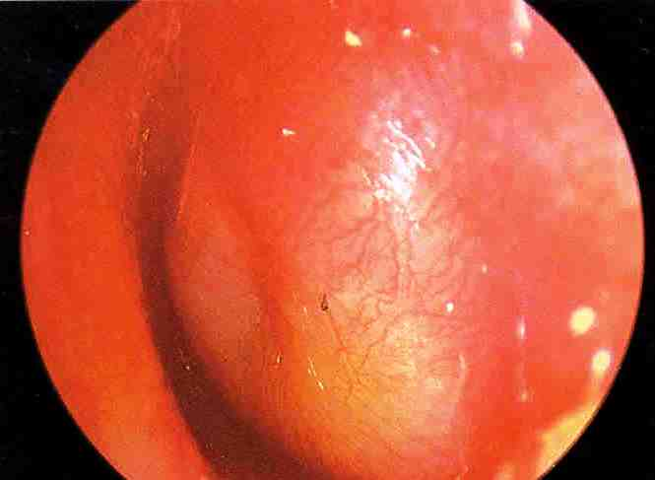
Stage of Suppuration

Slide 31
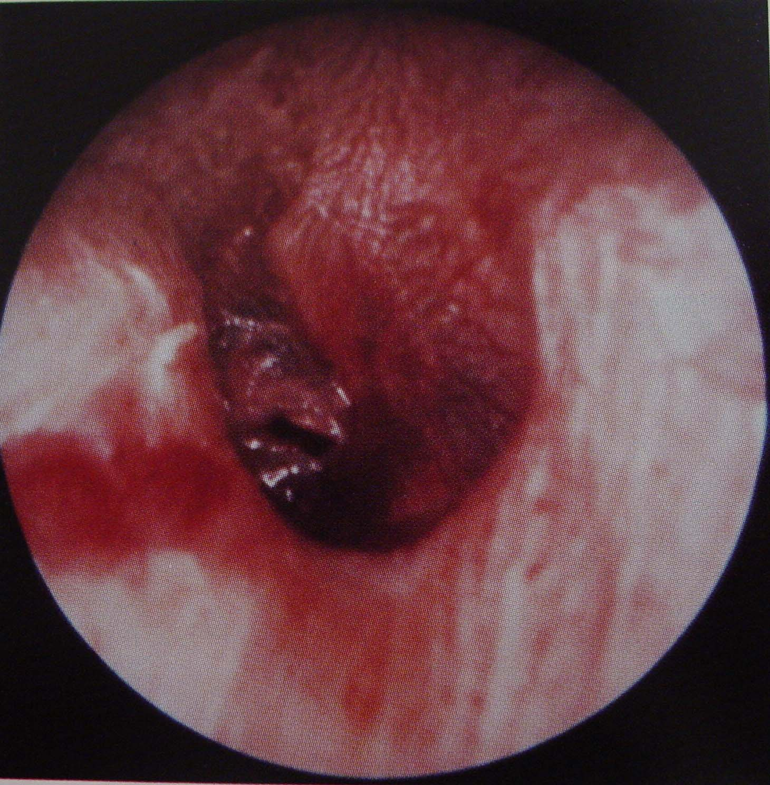
Rupture of TM

Slide 32
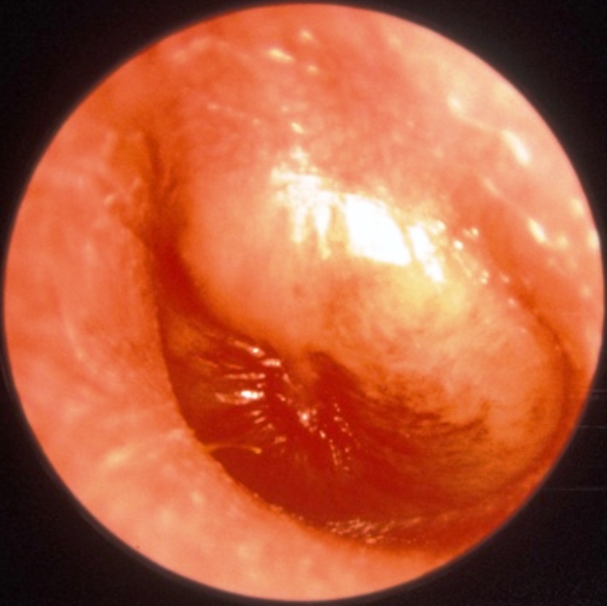
Blood stained otorrhoea

Slide 33
Signs & Investigations
Pinhole perforation + otorrhoea
Light house sign: intermittent reflection of light
Decreased mastoid tenderness
Conductive deafness
Clouding of air cells in mastoid X-ray

Slide 34
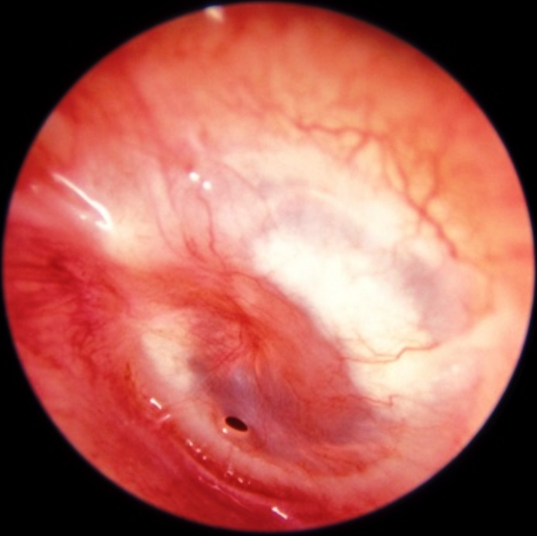
Pinhole perforation

Slide 35
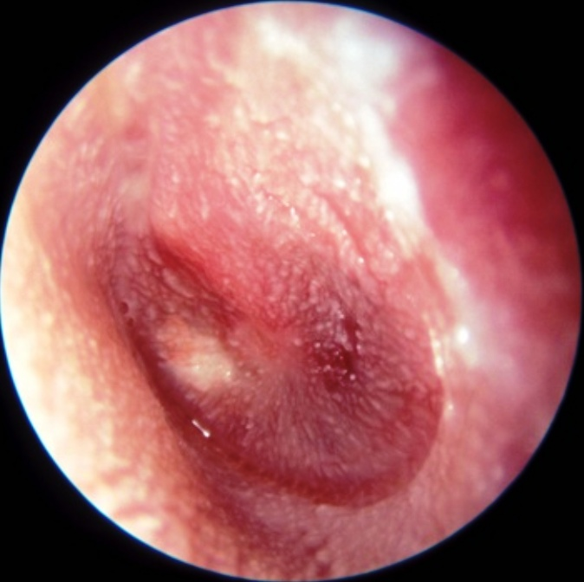
Stage of Resolution
Otorrhoea stops
Normal hearing
Healed perforation

Slide 36
Diagnosis
Accurate diagnosis is important to avoid unnecessary treatment
Physical examination
History

Slide 37

Treatment
Antibiotics increase cure rate to 94 percent, and decrease duration of symptoms and risk of complications

Slide 38
Management
Antibiotic therapy
Ampicillin
Ephedrine nasal drops(1% - 0.5%)
Xylometazolin (Otrivin) spray
Nasal decongestants:
Amoxicillin
Oral Decongestants
Antipyretics and analgesics
Myringotomy

Slide 39
Stage of complication
Acute mastoiditis: before the advent of antibiotics
TM perforation
Chronic suppurative OM
Facial nerve paralysis

Slide 40
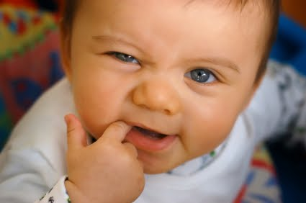
DIFFERENTIAL DIAGNOSIS

Slide 41
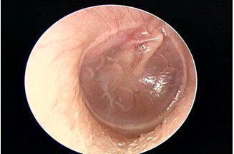
Otitis media with effusion
Also known as glue ear, serous otitis media secretory otitis media
characterized by accumulation of non-purulent effusion in the middle ear cleft

Slide 42
PATHOGENESIS
1. Malfunctioning of eustachian tube.
Fails to aerate the middle ear and is also unable to drain the fluid.
2. Increased secretory activity of middle ear mucosa.

Slide 43
Aetiology
Malfunctioning of eustachian tube
Allergy
Unresolved otitis media
Viral infections

Slide 44
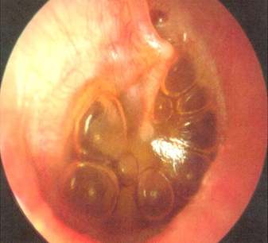
Clinical Features
Symptoms
Hearing loss
Delayed speech
Mild ear ache
Otoscopic findings
Tympanic membrane is often dull with loss of light reflex.
Fluid level and air bubbles may be seen when fluid is thin and tympanic membrane transparent

Slide 45
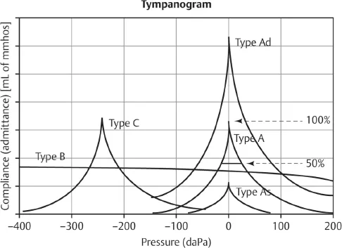
Investigations
Tuning fork test
Audiometry
Impedance audiometry

Slide 46
Treatment
Medical
Decongestants
Antiallergies
Surgical
Myringotomy with grommet insertion

Slide 47
Biomedical Ethics
The biomedical ethics surrounding acute otitis media primarily focus on the appropriate use of antibiotics due to its prevalence in children, concerns about over-prescription, potential for antibiotic resistance, and the need to balance aggressive treatment with watchful waiting depending on the severity of symptoms and patient age, while ensuring proper pain management and timely referral for complications.

Slide 48
Family Medicine
Acute otitis media (AOM) is a middle ear infection that is a common bacterial infection in children. It is the second most common reason for a visit to a family physician.

Slide 49
Research
https://jamanetwork.com/journals/jamapediatrics/fullarticle/2759422
https://thejas.com.pk/index.php/pjhs/article/view/605

Slide 50
Artificial Intelligence
The use of AI technology, particularly machine learning algorithms, to analyze medical images like otoscope videos of the tympanic membrane (eardrum) to diagnose acute otitis media (ear infection) with higher accuracy, potentially assisting healthcare professionals in making quicker and more precise treatment decisions, especially in identifying subtle signs of infection that might be missed by the human eye; this could lead to reduced unnecessary antibiotic use and improved patient care.

Slide 51
References
Meherali S, Campbell A, Hartling L, Scott S. Understanding Parents' Experiences and Information Needs on Pediatric Acute Otitis Media: A Qualitative Study. J Patient Exp. 2019 Mar;6(1):53-61
Ubukata K, Morozumi M, Sakuma M, Takata M, Mokuno E, Tajima T, Iwata S., AOM Surveillance Study Group. Etiology of Acute Otitis Media and Characterization of Pneumococcal Isolates After Introduction of 13-Valent Pneumococcal Conjugate Vaccine in Japanese Children. Pediatr Infect Dis J. 2018 Jun;37(6):598-604.
Emmett SD, Kokesh J, Kaylie D. Chronic Ear Disease. Med Clin North Am. 2018 Nov;102(6):1063-1079.

Slide 52


