Slide 1
PAIN EPIGASTRIUM RADIATING TO BACK
DR. Usman Qureshi
M.B.B.S F.C.P.S F.A.C.S
ASSISTANT PROFESSOR OF SURGERY
SURGERY UNIT–II, BBH
RAWALPINDI MEDICAL UNIVERSITY

Slide 2
CLINICAL SCENARIO
45 yr old gentleman known case of cholelithiasis since 3 years presents in the ER with severe pain in the epigastrium radiating to back associated with multiple episodes of vomiting.
Pain is acute in onset, stabbing in character and not relieved by oral analgesics.
He is also a known diabetic which is controlled on oral medications.

Slide 3
EXAMINATION
Middle-aged man, well oriented in time place and person with vitals of
BP: 110/70 mmHg
PULSE: 115/min
RR: 25/min
TEMP: 98.6 F
SPO2: 94% at RA
ABDOMINAL EXAMINATION:
Tender Epigastrium with guarding and mild distension
No palpable mass

Slide 4
DIFFERENTIAL DIAGNOSIS
Peptic ulcer disease
Perforated duodenal ulcer
Acute Gastritis
Acute pancreatitis
Biliary Colic
Inferior wall MI
Aortic Dissection
Lower lobar pneumonia

Slide 5
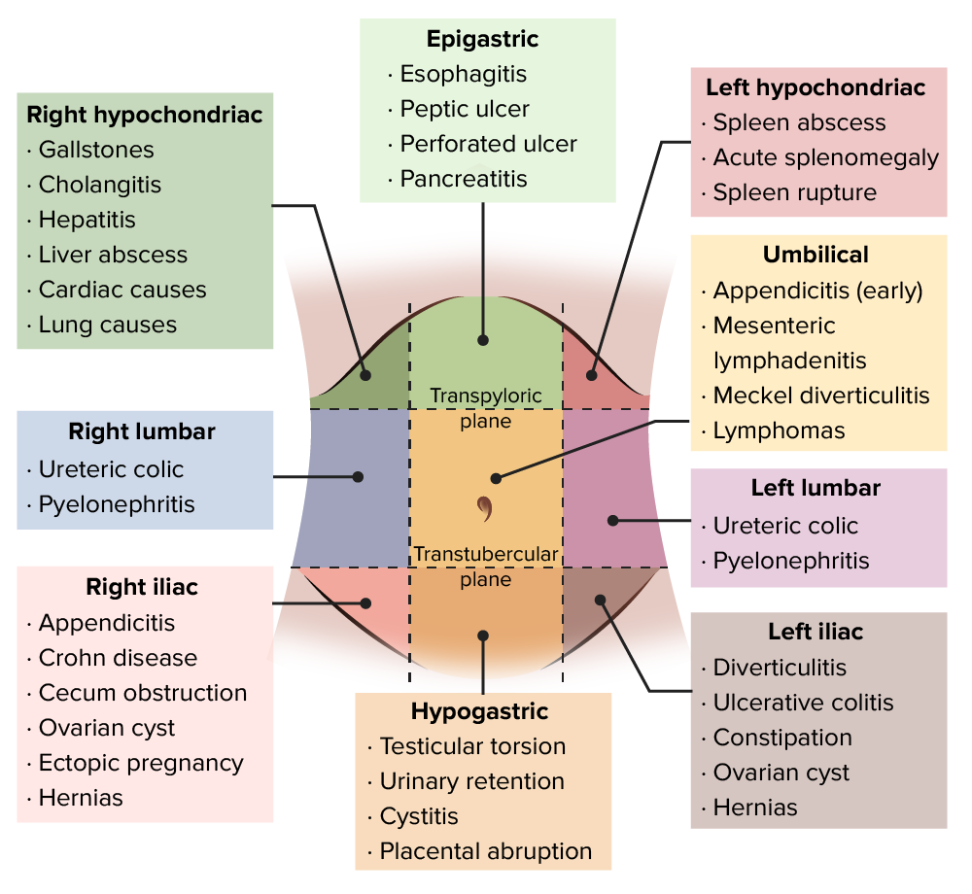
DIFFERENTIAL DIAGNOSIS

Slide 6
ACUTE PANCREATITIS
Acute inflammatory process of the pancreas associated with raised pancreatic enzyme level in the blood and/or urine.

Slide 7
ETIOLOGY OF ACUTE PANCREATITIS

Slide 8
PATHOPHYSIOLOGY

Slide 9
CLINICAL FEATURES
Severe Abdominal pain radiating to back
Retching , Nausea , Hiccups
Bluish discoloration of flanks due to subfascial bleeding (grey turner sign) or it can occur around the umbilicus( Collens’s sign)
Pleural Effusion occurs in 10-20% of cases
Abdominal distension and ileus

Slide 11
INVESTIGATIONS
Serum amylase and lipase
It increases immediately and remains elevated for 3-5 days. Mild elevation of the amylase is also seen in duodenal ulcer perforation and other acute abdominal conditions but ina cute pancreatitis it increases upto 4 fold. Serum lipase is elevated for a longer time than amaylase. A normal amylase doesnot exclude pancreatitis

Slide 12
INVESTIGATIONS
USG Abdomen
Due to bowel air and distension it doesnot provide satisfactory information but must be performed with in 24hrs to detect gall stones as a potential cause, to rule out acute cholecystitis and to determine whether common bile duct is dilated.
CT Scan
Gold Standard investigation of acute pancreatitis. Not used routinely . It is indicated only if
Diagnosis is uncertain
Suspicion of local complications and necrotizing pancreatitis

Slide 13
ASSESSMENT OF SEVERITY
Atlanta score
Ranson criteria
APACHE II
Glasgow scale
C reactive protein
CT severity index

Slide 16
CT SEVERITY INDEX

Slide 17
NORMAL CT SCAN

Slide 19
COMPLICATIONS OF ACUTE PANCREATITIS

Slide 20
PANCREATIC FLUID COLLECTIONS

Slide 21
MANAGEMENT
For Mild pancreatitis:
IV fluids
Monitoring
Analgesia
Anti-emetics
Antibiotics are not indicated unless evidence of infection
Mostly recover in 72hrs

Slide 22
FOR SEVERE ACUTE PANCREATITIS
Ideally required ICU care
Replace fluids and electrolytes
Oxygenation
Analgesia
Monitor vitals , Input /output, and ABGs
Nasogastric Aspiration
Biochemical Monitoring
Antibiotic prophylaxis

Slide 23
Contd…
Get a CT scan if patient develops organ failure or signs of sepsis
If cause is gall stones or there are signs of cholangitis then ERCP should be planned.
Nutritional Support (Early)
Systemic Support:
CVS: Ionotropic support
Renal Failure: Dialysis
Respiratory : Ventilation

Slide 24
RADIOLOGICAL INTERVENTIONS
CT guided drainage of collections

Slide 25
SURGICAL INTERVENTIONS
Necrosectomy
Early vs late
Open vs Laparoscopic
Continuous Drainage

Slide 26
THANK YOU !
Any questions?

