Slide 2
Millennium Development Goals (MDGs) and Sustainable Development Goals (SDGs)
Module: ll -Special Senses-ll
Ophthalmology (EYE)

Slide 3
Vision & Mission of RMU
Wisdom
Truth
Service
Vision
Highly recognized and accredited center of excellence in Medical Education, using evidence-based training techniques for development of highly competent health professionals, who are lifelong experiential learner and are socially accountable.
Mission Statement
To impart evidence-based research-oriented health professional education in order to provide best possible patient care and inculcate the values of mutual respect, ethical practice of healthcare and social accountability.

Slide 4
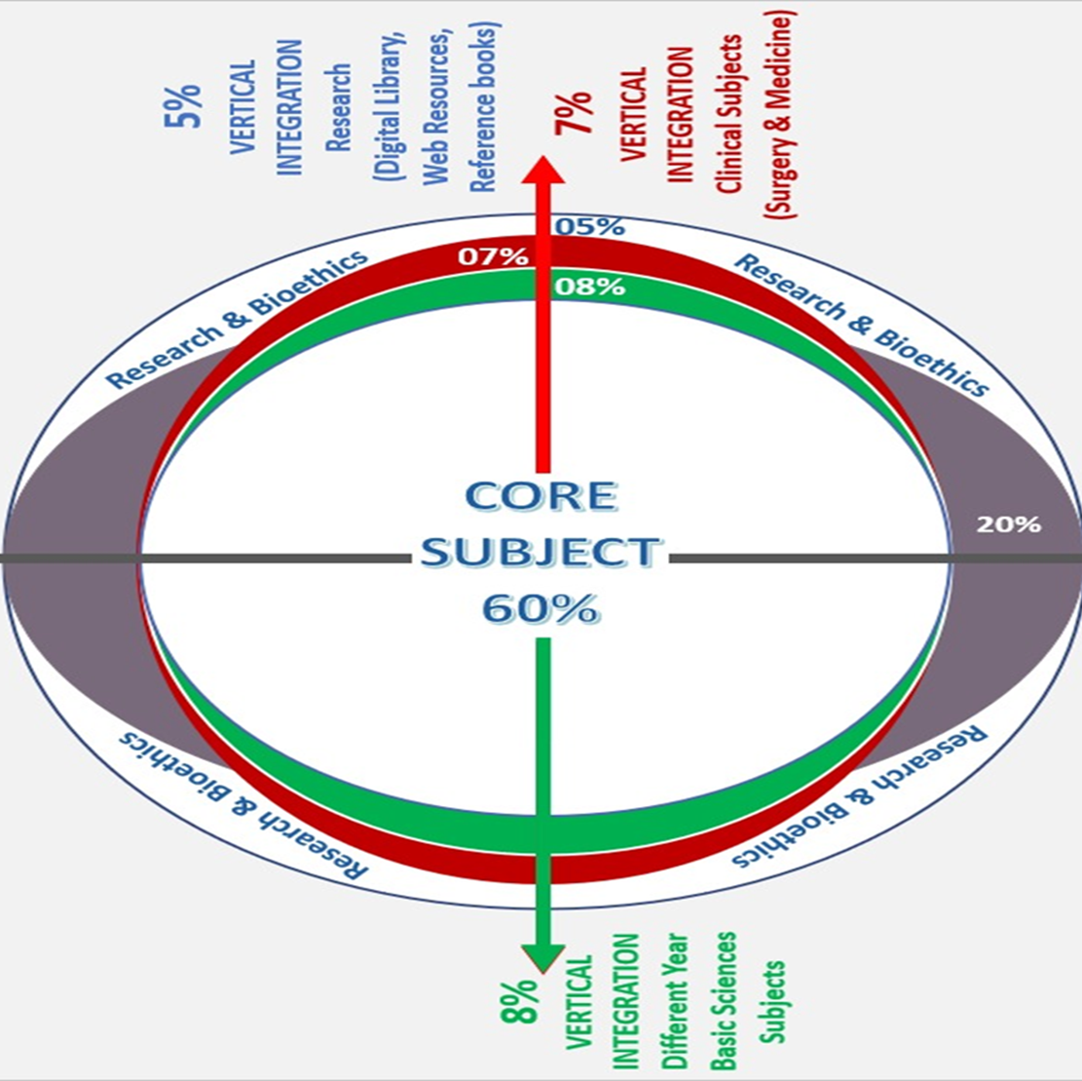
Prof Umar’s Model

Slide 5
Sequence Of Lecture
Learning objectives (1 slide)
Core Subject (35 slides)
End of lecture assessment (2 slides)
Research and online digital learning - resources (1 slide)
Ethics /Professionalism (1 slide)

Slide 6
LEARNING OBJECTIVES
1- Explain the millennium development goals(MDGs)
2- Appraise sustainable development goals(SDGs) and their origins
3- Difference between MDGs and SDGs
4- Comprehend how SDGs might affect overall health as global priority in future
5- Understanding universal health coverage (UHC)

Slide 7
Origin of MDGs
Core Content

Slide 8
IMPORTANCE OF HEALTH IN MDGS
Core Content
In MDGs 3 out of 8 goals are directly related to HEALTH and rest 5 goals have important indirect effects on health;,
8 of 18 targets, 18 of 48 indicators of progress, are also health-related and rest are indirectly related

Slide 11
Millennium development goals and eye health
Horizontal integration
In September 2000, world leaders made a commitment to build a more equitable, prosperous and safer world by 2015 and launched the Millennium Development Goals (MDGs).
In the previous year, the World Health Organization and the International Agency for the Prevention of Blindness in partnership launched the global initiative to eliminate avoidable blindness by the year 2020–VISION 2020 the Right to Sight
Faal HB. Millennium development goals and eye health. Indian J Ophthalmol. 2012 Sep-Oct;60(5):411-5. doi: 10.4103/0301-4738.100538. PMID: 22944751; PMCID: PMC3491267.

Slide 12
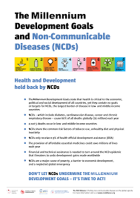
Millennium development goals and NCDs
Vertical integration
Many low- and middle-income countries are faced with a rising burden of NCDs while working to improve health outcomes to meet health-related MDGs.
LMIC face challenges in addressing both infectious and non-communicable diseases, which highlight the need of integrated interventions in addressing this double burden of disease
Reference: Setting the Stage to Address the Dual Challenge of MDGs and NCDs

Slide 13
Key MDG achievements
More than 1 billion people have been lifted out of extreme poverty (since 1990)
Child mortality dropped by more than half (since 1990)
The number of out-of-school children has dropped by almost more than half (since 1990)
HIV/AIDS infections fell by almost 40 percent (since 2000)

Slide 15
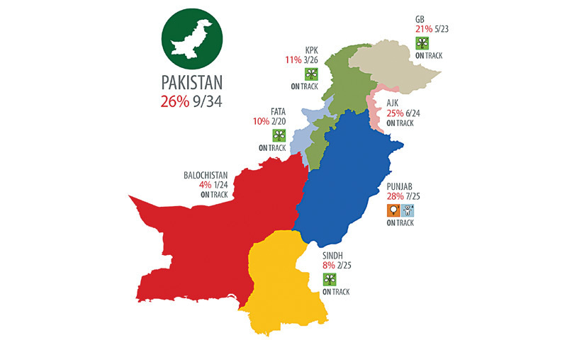
Status of Millennium Development Goals
Pakistan 2015
Pakistan has adopted 16 targets and 41 indicators against which progress towards achieving the Eight Goals of the MDG’s is measured

Slide 16
Introducing Sustainable Development Goals (SDGs)
The legacy and achievements of the MDGs provide us with valuable lessons and experience to begin work on the new goals for unfinished job
We need to go the last mile on ending hunger, achieving full gender equality, improving health services and getting every child into school beyond primary
The SDGs are also an urgent call to shift the world onto a more sustainable path
The SDGs are a bold commitment to finish what we started, and tackle some of the more pressing challenges facing the world today. All 17 Goals interconnect, meaning success in one affects success for others

Slide 17
Sustainable Development Summit 2015
Notes:
In September 2015, more than 150 world leaders attended the UN Sustainable Development Summit held at UN Headquarters in New York to formally adopt an ambitious new sustainable development agenda.
The seventeen Sustainable Development Goals are our shared vision of humanity and a social contract between the world's leaders and the people.

Slide 20
What is new and different about the 17 SDGs?
First, and most important, these Goals apply to every nation and every sector. Cities, businesses, schools, organizations, all are challenged to act. This is called
Universality

Slide 21
Second, it is recognized that the Goals are all inter-connected, in a system. We cannot aim to achieve just one Goal. We must achieve them all. This is called
Integration

Slide 22
And finally, it is widely recognized that achieving these Goals involves making very big, fundamental changes in how we live on Earth. This is called
Transformation

Slide 23
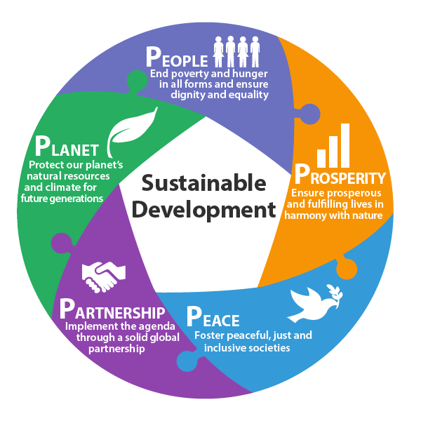
The 2030 Sustainable Development Goals
The main goals focus on the 5 Ps
People: the wellbeing of all people
Planet: protection of the earth’s ecosystems
Prosperity: continued economic & technological growth
Peace: securing peace
Partnership: improving international cooperation

Slide 24
Difference between MDGs and SDGs

Slide 25
CURRENT STATUS OF MDGs & SDGs
https://www.sdgpakistan.pk/uploads/pub/Pak_SDGs_Status_Report_2021.pdf

Slide 33
Another comparison

Slide 34
Impact of SDGs on overall health as global priority in future
The SDGs are a bold commitment to finish what we started, and end poverty in all forms and dimensions by 2030. This involves
targeting the most vulnerable,
increasing basic resources and services
supporting communities affected by conflict
climate-related disasters

Slide 35
In future SDGs stimulate the discovery of ways to confront today’s major challenges to health, including
ageing and disabilities,
non-communicable diseases,
antimicrobial resistance,
epidemics
health security
climate change,
sustainable financing, health inequities, migration, urbanization and rural poverty
4.

Slide 36
Universal Health Coverage
Universal Health Coverage (UHC) is a principle that aims to ensure that all people, particularly those in need, have access to essential health services when and where they need, without any financial hardship.
This UHC concept was globally reaffirmed in 1978 through the Declaration of Alma-Ata International Conference on Primary Health Care, where PHC was identified as the key to the achievement of Health for All by 2000.
WHO’s recommendation is to reorient health systems to primary health care (PHC). Most (90%) of essential UHC interventions can be delivered through PHC and 75% of projected health gains from the SDGs could be achieved through PHC.

Slide 37
World Health Organization emphasized on three dimensions of UHC:
Maximum population coverage (the range of health according to need)
Health service coverage (coverage for the entire population)
Financial protection (the level of financial protection)
The UHC service coverage index (SDG indicator 3.8.1) increased from 45 in 2000 to 67 in 2019
Almost 2 billion people are facing catastrophic or impoverishing health spending (SDG indicator 3.8.2).
Sehat Sahulat Program is a milestone towards social welfare reforms and health coverage; ensuring that the identified under-privileged citizens across the country

Slide 38
EOLA (End of lecture assessment
Which of the following Millennium Development Goals is about ensuring environmental sustainability?
Goal 1
Goal 3
Goal 5
Goal 7
Goal 8
Key : d

Slide 39
Research and online digital Learning resources
https://www.mdgmonitor.org/millennium-development-goals/
https://ourworldindata.org/millennium-development-goals
http://www.aserpakistan.org/document/learning_resources/2014/Post_2015_Agenda/MDGs%20&%20EFA%20Goals.pdf
https://unstats.un.org/sdgs/indicators/Global%20Indicator%20Framework%20after%20refinement_Eng.pdf
https://www.pmhealthprogram.gov.pk/
https://www.who.int/news-room/fact-sheets/detail/universal-health-coverage-(uhc)

Slide 40
Ethical issues
They are underlain by fundamental ethical concerns such as inequality, discrepancy against children and women, social injustice, poverty, human rights, freedom, and choice, which have been and remain at the center of real life, philosophical discourse, and development ethics (Gasper, 2012; Marangos et al., 2019)
https://reliefweb.int/report/world/can-mdgs-provide-pathway-social-justice-challenge-intersecting-inequalities

Slide 41
Thank you

