Slide 1
Medico-Legal Certificates
Dr Urooj Shah
Dr Roheena Saeed
Forensic Medicine & Toxicology

Slide 3
Motto of RMU
Service
Wisdom

Slide 4
Vision of RMU The Dream/ Tomorrow
To impart evidence based research oriented medical education
To provide best possible patient care
To inculcate the values of mutual respect and ethical practice of medicine

Slide 5
Learning outcomes
Students will be able to:
State the privileges of a registered medical practitioner.
Define Professional misconduct.
Enlist ,Identify and write different formats of medical certificates.
Write and fill the medico-legal Performa (Reports/Certificate).

Slide 6
Privileges Of A Registered Medical Practitioner
According to the PMDC ,there are certain privileges of a registered medical practitioner, and one of the most important privilege is to issue a medical certificate
Medical certificates may be:
Simple Medical certificates
Medico legal certificates
Post-mortem certificates
Dying declaration and dying deposition.

Slide 7
Types of Certificates
Sickness certificate
Death certificate
Fitness certificate
Vaccination certificate
Compensation certificate
Driving license certificate

Slide 8
Professional Misconduct
Remember: Issuing a false certificate is a PROFESSIONAL MISCONDUCT.
A medical certificate must contain:
All the relevant facts/information.
Exact –date and time of examination, and issuing of certificate.
Two marks of identification of examinee.
Signature / thumb impression of the examinee (Left for males and Right for females).

Slide 9
Simple sickness (Illness) Certificate:
Exact nature of the illness / sickness (s/s of disease, its provisional diagnosis, treatment and rest advised with effect from (w.e.f) ………… to ………. date.
At the end, the Dr. must sign, put his/her PMDC Reg No and stamp (The stamp must contain name, designation, and address).

Slide 11
Death Certificate
If the Doctor is convinced that the death is due to any natural cause.
No any delay
No fees
The certificate must state the exact cause of death.

Slide 12
Precautions:
Must inspect the whole dead body from head to toe (to rule out any violence/ injuries/ torture).
The cause must be natural.
Actually dead or in a state of suspended animation.
Properly mentioning time and date of examination and issuing of certificate.

Slide 14
Fitness certificate
Complete physical examination, i.e. Pulse, BP, Temp, Resp. Rate, Locomotor system, ENT and vision.
Final Opinion:
The examinee is in state of physical mental and social wellbeing. Thus he is declared medically fit to resume his/her duties etc.

Slide 16
Disability Certificate/ Compensation Certificate
Complete examination along with the exact nature of disability.
(This certificate is now given the constituted district disability board).

Slide 18
Vaccination Certificate
The certificate must state:
Nature of vaccination
Exact date of vaccination

Slide 20
Driving License Certificate
This is usually given in a prescribed Performa.

Slide 21
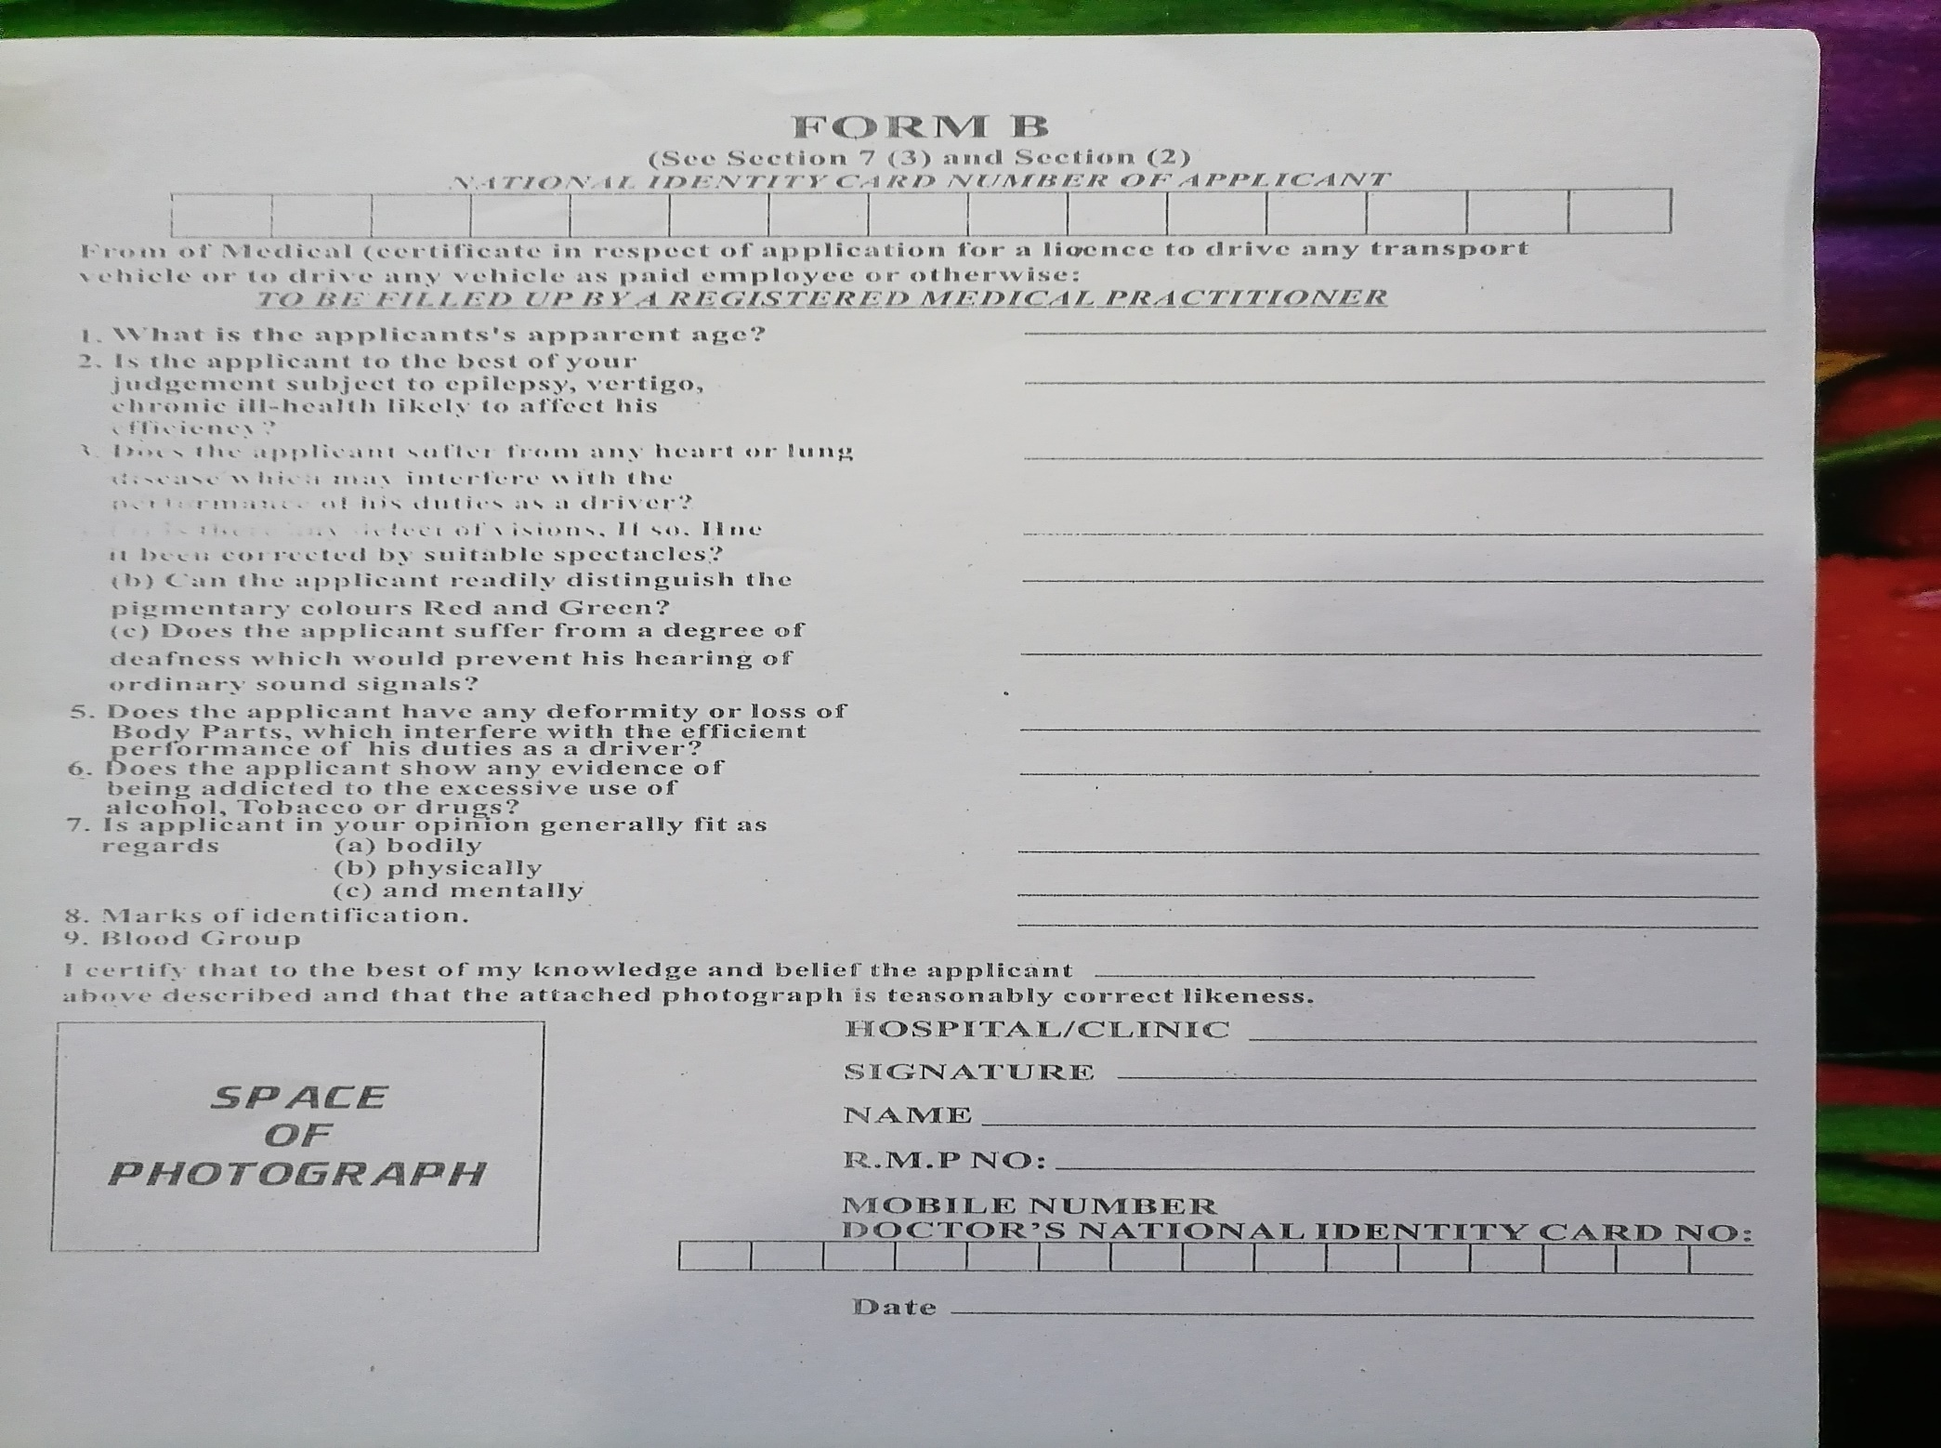

Slide 22
Medico-legal Certificates
Medico-legal certificates are generally of two types
Medico legal certificates (For living persons).
Post-mortem reports/ certificates (For dead persons).

Slide 23
Medico-legal certificates are usually given in cases of:
Assaults i.e. Injured persons (Injuries/ Fire arms/ accident)
Burns
Age- certificates
General features (child, adult. And old age)
Sec. Sex characters
Teeth’s
Radiology (ossification of bones)
Drunken –Persons (persons under the influence of alcohol)
Sexual offences i.e. Victim of rape and Sodomy and offender of rape and sodomy.
In a case of poisoning
Mental illness
Dying declaration

Slide 24
Post mortem (reports) certificates
(In case of deaths due to homicide, suicide and accidental means)
Today we will discuss the proforma (prescribes forms on which the medico-legal certificate is issued)

Slide 27
The medico-legal certificate proforma consists of:
The front-page
Left side of the proforma
Right side of the proforma
The back page
For diagrammatic representation of injuries.

Slide 32
Back page contains
Six different diagram showing various views of the body for representing various injuries on the body
At the end, total no of injuries, on the body, signature and stamp of the M/L officer.
Any exhibits, e.g. clothes or weapons etc. sent for medical examination should be described in detail with appropriate diagram/sketches whenever applicable then these articles should be properly sealed, labeled and returned to the investigating off

Slide 34
The medico legal certificate contains two parts
Description of injuries (Physical findings in case of drunken person, examination of victim of rape and sodomy, case of burn, mental illness, sign and symptoms of poisoning and age estimation).
Opinion drawn
Immediately
K.U.O

Slide 35
Research
https://www.researchgate.net/publication/270016452_A_study_on_legal_problems_concerning_issuance_of_false_medical_certificates/download
https://www.ncbi.nlm.nih.gov/pmc/articles/PMC1372274/
https://bmcprimcare.biomedcentral.com/articles/10.1186/s12875-017-0627-z
https://www.linkedin.com/pulse/answer-rising-problem-fake-medical-certificates-vicente-md

Slide 36
Biomedical Ethics
Section 197 of PPC says that:
“Whoever issues or signs any certificate required by law to be given or signed, or relating to any fact of which such certificate is by law admissible in evidence, knowing or believing that such certificate is false in any material point, shall be punished in the same manner as if he gave false evidence.”
Section 193 of PPC deals with giving false evidence.
“ Whoever intentionally gives false evidence in any of a judicial proceeding, or fabricates false evidence for the purpose of being used in any stage of a judicial proceeding, shall be punished with imprisonment of either description for a term which may extend to seven years, and shall also be liable to fine. And whoever intentionally gives or fabricates false evidence in any other case, shall be punished with imprisonment of either description for a term which may extend to three years, and shall also be liable to fine. ”

Slide 37
Family Medicine
What to do first when you suspect that a sick note is a fake:
First thing you need to do is to contact the medical practitioner and verify the authenticity of the certificates and possibly the
diagnosis.
What is a medical practitioner allowed to tell you?
If you contacted an employee's medical practitioner to establish the nature of the illness that forced the time off work, the
practitioner would be able to confirm:
If he/she had examined the employee, On what date he/she had examined the employee, and If he/she had issued a medical
certificate stating that he/she had examined the employee and had found the employee to be unfit for duty.
Verify the medical practice's address and registration number
If, during your investigations, you find that the practice number is not registered with PMDC, you are entitled to reject the
certificate

Slide 38
How To Access Digital Library
1. Go to the website of HEC National Digital Library.
2. On Home Page, click on the INSTITUTES.
3. A page will appear showing the universities from Public and Private Sector and other Institutes which have access to HEC National Digital Library HNDL.
4. Select your desired Institute.
5. A page will appear showing the resources of the institution
6. Journals and Researches will appear
7. You can find a Journal by clicking on JOURNALS AND DATABASE and enter a keyword to search for your desired journal.

Slide 39
THANK YOU

